Slide 1
Collection Assessment Meets the Web-scale World
Kathryn Silberger
Automation Resources Librarian
Marist College, Poughkeepsie, NY
-----------------------------------------
Mark Tullos
Sr Product Manager, ProQuest

Slide 2


About Us
Kathryn Silberger (Marist College, Poughkeepsie, NY) is the Automation Resources Librarian and one of six development partners for Intota™
Mark Tullos is the product champion for Intota Assessment, a module of Intota Web-scale management, currently in development

Slide 3

Why We’re Here
We have been working to better understand print and eResource analysis and assessment
We’ve analyzed current flows and problems and achieved automation and improvement
We will share our findings and next steps with you in this session

Slide 4
Current Situation at Marist
    Multiple systems = multiple interfaces
      Very different workflows and procedures
    Procedures learned for one system don’t transfer to others
    Electronic and print statistics are in separate workflows
    Data cannot be easily merged or exchanged between systems

Slide 5
Project COUNTER
Taking Counter data from an Excel spreadsheet to the mainframe
      Make multi-year comparisons; observe trends
      Add in cost data
      Ability to merge reports from different providers
      Valuable analysis with great surprises
      Option to download to spreadsheet available for additional manipulation

Slide 6
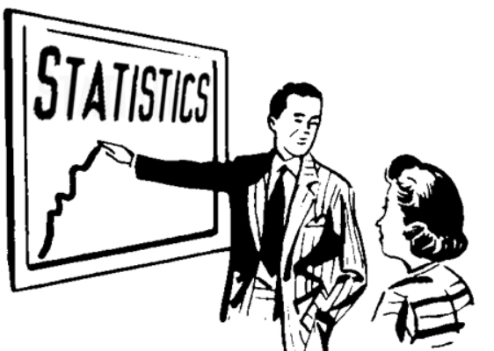
Click-Through Analysis
Stats for products not providing stats
    Open Access Resources
    Referrer reports
      Google
      Measuring impact of Resources and Services
        Summon Referrer report showing usage of widgets in LibGuides

Slide 7
Circulation Reports
  “The ILS vendor has not made any significant upgrades to the reports we can run from our IOLS in over a decade.”
  “Most of the prepackaged reports are designed around print collection routines.”
  “Our programmer pulls reports using SQL. It takes some time, so we don’t ask for things out of curiosity.”

Slide 8
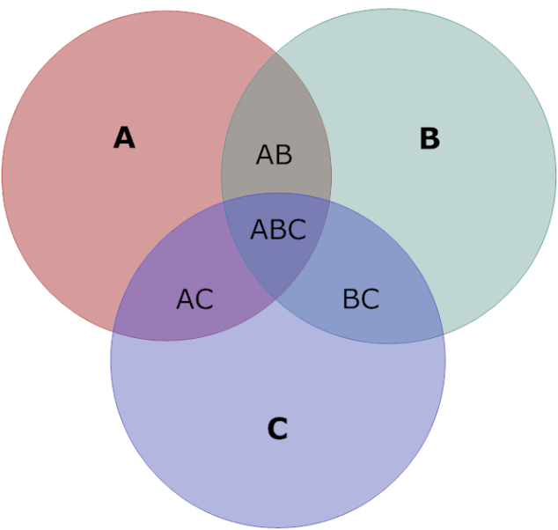
Overlap Analysis
First step in database evaluation
Most telling is the list of unique titles

Slide 9
Renewal Time
Renewal decision: Cost per Article use
  When journals are acquired, cost information is integrated into the Counter Statistics
  Report: cost per use over past 3 years, sorted descending order by expense.

Slide 10
Book selection
OBSERVATION:
ePublishing and electronic analytics have changed the pace of Collection Development; moves more quickly

Slide 11
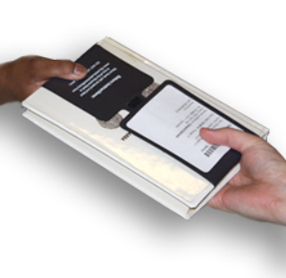
Inter-Library Loan Statistics
Telling indicator of gaps in collection based on usage
As with other analytics, difficult to blend with others and extrapolate next steps

Slide 12
DIY Statistics on the Web
Use a Google form and spreadsheet for reference question analysis
  Define reference question by content - not physical location
  Add phone calls, emails we receive in our offices
Collection Development Librarians watch the log from their desks

Slide 13
Discovery Log from the Summon® service
Collection Development Librarians watch for…
Book and journal requests
Subjects of searches

Slide 14

But How to Combine?
Print statistics
E-Stats
Multi-format
DIY
Discovery

Slide 15
Intota Assessment Includes
Base collection assessment for book and serial analysis
COUNTER data for e-resources – cost per use
Print usage
Overlap analysis
Recommendations based on transactions (orders, checkouts, ILL, etc.)
= Total picture of holdings, usage and overlap across all formats

Slide 16
A Unique Solution and a Part of Intota
Unified, intelligent workflows
Interoperable
Knowledgebase
Assessment
Developed and supported by Serials Solutions
Notes:
Certainly Intota is not the only new model system being offered to libraries. Others are, in fact, ahead of us in development. But we really feel that Intota is a unique offering, one that is worth watching. There are many unique aspects of Intota, but the combination of 4 elements especially create a superior solution:
1. A linked data model. Because we are building Intota and its accompanying knowledgebase from the ground up, we are able to employ the very latest thinking in its data architecture. We store a master system record in the KB and you link to it via Intota. No more loading and unloading of your records. You can make local modifications and keep them in Intota. Or you can opt to load them into the KB. You have flexibility with lower costs for resource description.
2. Inherent interoperability means more current data and less duplicate data entry. We are building in support for real time transfer of data from suppliers, from student systems and from financial systems, so that you can work more efficiently and less in redundant batch mode.
This same interoperability extends to Summon, linking discovery and management is a real-time way, reflecting your collections to your users more efficiently.
3. Lower TCO: Intota displaces your ILS and allows you to free up hardware and software maintenance costs and personnel. Our Software-as-a-Service platform means that you do not need to budget for hardware. Because it is a unified system that manages all types of collections, it also displaces separate systems for ERM, archives and special collections. The knowledgebase offers a source of bibliographic and authority records at lower costs. Inherent resource sharing cuts your ILL costs.
Lower TCO is a big goal for Serials Solutions. We know that you need to rein in the costs of old model systems and redeploy your resources. By offering a unified system as a subscription, Intota will save the library money.
4. Built and delivered by Serials Solutions: History of providing innovative solutions and delivering industry firsts, such as Summon, Serials Solutions has earned your trust. We understand e-resources, and we have experienced people on our team who have indepth knowledge of print resources, too. Combined with our proven platforms, we are very well positioned to deliver the best system for your library.

Slide 17

Next Steps
Data ingest – holdings, circ, ILL, COUNTER
Beta testing on Intota Assessment
Develop new use cases/test cases
Recommend best practices
Report findings and recommend reports/dashboards
Share with other development partners
Share with peers

Slide 18
Q&A

