Slide 1
The Social Economy of Open Access
Anthony Davis Jr.
Copyright & Policy Librarian
California State University, Fullerton

Slide 2
Social Economy of Open Access
Social Economy
Scholarly Publishing
Open Access
Recommendations
Questions

Slide 3
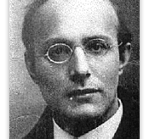
Karl Polanyi
1886-1964

Slide 4
Categories of Exchange
Market (Private Sector, Trade)
Hierarchy (Public Sector, Redistribution)
Social Economy (Community, Reciprocity)

Slide 5
Categories of Exchange
Market
Exchanges for Consideration or Utility
Firms that Maximize Shareholder Value
Hierarchy
Taxes
National Defense
Social Economy
Non-Profit
Commons

Slide 6
Categories of Exchange
Society tends to organize activities through the method of exchange that works the best.

Slide 7
Social Economy
Common Values & Beliefs
Gift Exchange
Obligation to Reciprocate
Uncertainty in the Nature of the Return Gift
Trust & Reputation Effects
Benefits of Continuous Cooperation

Slide 8
Social Economy
Weakness
Potentially Oppressive
Self-Interest

Slide 9
Scholarly Publishing as Social Economy

Slide 10
Scholarly Publishing as Social Economy
Articles are Donated
Gift Exchange
Peer Review
Inclusion in the Community
Shared Values
Scholarly Sharing
Between Scholars
Between Scholars and Students

Slide 11
Scholarly Publishing as Social Economy
Subscriptions (Market Distribution)
Print Journal
Electronic Journal
Open Access (Social Economy Distribution)
Electronic Articles
Green
Gold

Slide 12
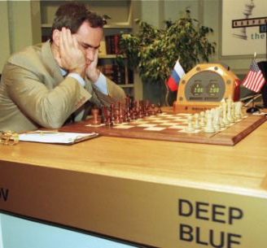
Social Economy vs. Market

Slide 13
Social Economy vs. Market
Market Victory
The Social Economy serves to maximize shareholder value
Social Economy Victory
Market serves to enable universal access & use
Society Chooses the Better Method of Exchange

Slide 14
Competition
Peer-review
Transaction Costs
Hierarchy (Policy Environment)
Mandates

Slide 15
Social Economy vs. Market
Green OA
Cooperative Strategy
Gold OA
Competitive Strategy

Slide 16
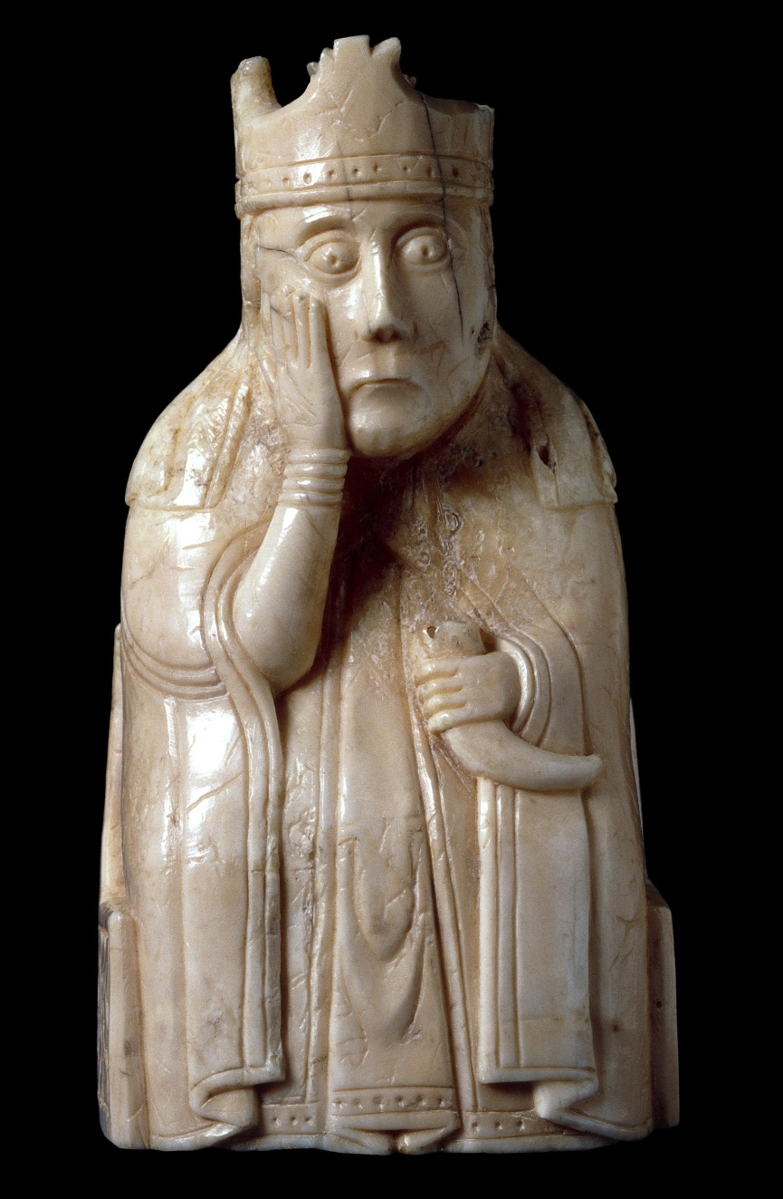
The Social Economy of Open Access is both Nascent and Fragmented

Slide 17
Dr. Marguerite Mendell Concordia University, Quebec, Canada
“The Three Pillars of the Social Economy. The Quebec Experience (1996-2007)” in A. Amin. Social Economy: Alternative Ways of Thinking about Capitalism and Welfare. London: Zed Press 2009.

Slide 18
Three Pillars of Social Economy
Leadership
Social Enterprise
Favorable Policy Environment

Slide 19
Chantier de l'économie sociale
http://www.chantier.qc.ca/

Slide 20
Chantier de l'économie sociale
Cooperatives
Non-profits
Community Economic Development Organizations
Social movements

Slide 21
“The risk that the social economy may also add up to numerous fragmented initiatives at the margins”

Slide 22
Open Access
Activists
Faculty
Libraries
Universities
Publishers
Associations
Technologists
Funders
Governments

Slide 23
What’s missing?
“Integrated Systemic Approach”
“Network of Networks”
“Negotiating Capacity”
“Institutional Innovation”

Slide 24
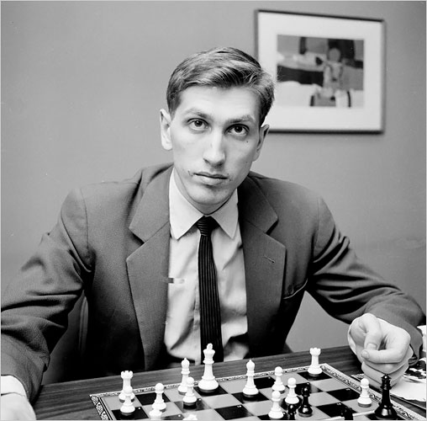
Recommendations
Unprecedented Social Coordination & Innovation
A New Non-Governmental Organization

Slide 25
Recommendations
Faculty Self-Interest
Prestige

Slide 26
Recommendations
Evolve Librarianship

Slide 27
Scholarship is a Social Economy. It should be led and managed like one.

Slide 28
Social Economy of OA
Social Economy
Scholarly Publishing
Open Access
Recommendations

Slide 29
anthonydavis@fullerton.edu

