Slide 1
Journey from fragmentation to Resilience renew, rejuvenate, reactivate
Dr. Celina Belmarce Pina, Psy.D
5 keys to emotional Oneness, the emotional detox system

Slide 2
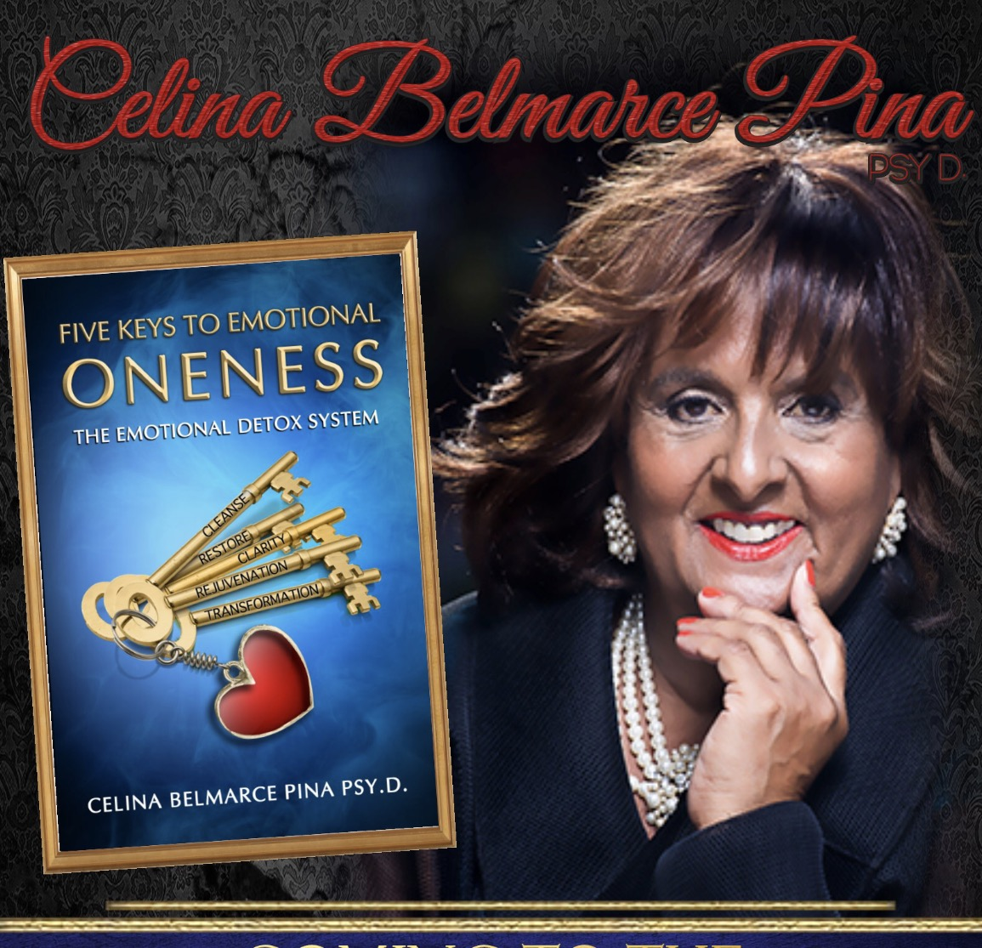
SHIFTING PERCEPTION
Looking Through the Trauma Lens
Presented by:
Celina Belmarce Pina, Psy.D.
VGI Mental Health

Slide 3
Dr. Celina pina
Introduction
Fragmentations
Resiliency through Traumatic Events
Internal Growth in Complicated Times
Bridging Pain with Passions

Slide 4
Heartmath
Learn to access your heart’s intuition to become the best version of yourself more often

Slide 5
Thread of life
Process
Compilations
Fragmentations
Unconsciousness

Slide 6
Trauma, Culture and Life Experience
Belief system: Cultural Stigma, Shame survival denial
Belief System and Cultural Values
Religious Belief System

Slide 7
Trauma, Culture and Life Experience
Neurobiology
Cultural Shapes and Patterns

Slide 8
RELATIONAL
TRAUMA
Dr. Judith Herman calls relational trauma; “trauma, particularly trauma inflicted on one person by another, constitutes relational trauma and is characterized by a “violation of human connection.” (Herman, 1992).” Dr. Barbara Steffens, leading partner trauma specialist states “Relational trauma, often called attachment injuries, occurs when one person betrays, abandons, or refuses to provide support for another person with whom he or she has developed an attachment bond.”

Slide 9
POLYVICTIMIZATION
refers to having experienced multiple victimizations such as sexual abuse, physical abuse, bullying, and exposure to family violence. The definition emphasizes experiencing different kinds of victimization, rather than. multiple episodes of the same kind of victimization.

Slide 10
STOCKHOLM
SYNDROME
is a condition that causes hostages to develop a psychological alliance with their captors as a survival strategy during captivity.^{[1]} These feelings, resulting from a bond formed between captor and captives during intimate time spent together, are generally considered irrational in light of the danger or risk endured by the victims. Generally speaking, Stockholm syndrome consists of "strong emotional ties that develop between two persons where one person intermittently harasses, beats, threatens, abuses, or intimidates the other."

Slide 11
CONVERSION
DISORDER
is a mental illness characterized by the loss or alteration of physical functioning without any physiological reason. These physical symptoms are the result of emotional conflicts or needs. The symptoms usually appear suddenly and at times of extreme psychological stress

Slide 12
Internal Conduit for resiliency
DNA
Love
Consistency
Exposures
Pain
Purpose

Slide 13
External complications for resiliency
Pain
Environmental
Violence
Global Unconsciousness
Emotional Imbalances

Slide 14
Trauma Perceptions
Group Discussion
What is an operational definition of trauma from your discipline’s perspective?
What are your thoughts on survivors who has experienced various forms of trauma.
How does trauma present differently based on culture and life experiences?

Slide 15
Renew, rejuvenate and reward resilience in oneness
Discussion of “Five Keys to Emotional Oneness”
Reading of “A Symphony in the Key of Oneness”
Creating Your Oneness Affirmation, Poem, Song

Slide 16
Trauma
“Five Keys to Emotional Oneness”
Trauma is an emotional response to a horrendous, unconceivable and unpredictable traumatic event. It is imposed by a disruptive event that affects us physically, mentally and emotional. These events are impactful and create variations of emotional imbalances. Trauma presents in many forms, in many forums and holds no boundaries. The impact of trauma is significate and has a chronic attachment to its victim. The presentation, whether minor or severe, holds a deep penetration in the victim’s psychological temperament. Each individual absorbs the event respectfully, however, traumatic events will always leave internal scars. Our unconscious tends to repress these traumatic experiences until which time the victim is resilient enough to manage these memories. Victims who live with traumatic responses are privy to the intrusive thoughts and feelings that have a way of surfacing to create a conduit for emotional destruction. In many cases, the victim is not aware of the responses and has great difficulty with self-dysregulation and emotional control.

Slide 17
Trauma
“Five Keys to Emotional Oneness”
Through traumatic events, victims; whether they have witnessed, been exposed to or are an unwilling participate of, are deeply impacted with life changing emotional and mental health complications. The impact of complex trauma, which is chronic exposure to trauma beginning in childhood, is horrific, consuming and sometime life threatening. These complications take the shape of: attachment and relationship issues, changes in behavior and emotional flow, dissociative and cognitive interruptions, health complications, and major mental health diagnoses. Trauma is a life changing occurrence that has life-long influxes unless clinically addressed and embraced by significant support systems.

Slide 18
CARE PLAN
Making a Trauma-Informed Self-Care Plan The Pennsylvania Child Welfare Resource Center 313: Managing the Impact of Traumatic Stress on the Child Welfare Professional (example plan)

Slide 19
References/Resources
50 Shades of Grief on VoiceAmerica.com
American Psychological Association Disaster Response Network, www.apa.org
Association of Traumatic Stress Specialists, www.atss-hq.com
Ott, C.H., Lueger, R.J., Kelber, S.T., Prigerson, H.G. (2007). Spousal bereavement in older adults: common, resilient and chronic grief with defining characteristics. J Nerv Ment Dis, 195(4): 332-341.
Prigerson, H.G., Bierhals, A.J., Kasi, S.V., Reynolds, C.F., Shear, M.K., Newsom, J.T. & Jacobs, S. (1996). Complicated grief as a disorder distinct from bereavement-related depression and anxiety: A replication study. Am J Psychiat, 153(11): 1484-1486.
Prigerson, H.G., Horowitz, M.J., Jacobs, S.C., Parkes, C.M., Aslan, M., Goodkin, K., Raphael, B. & Marwit, S.J. (2009). Prolonged Grief Disorder: Psychometric validation of criteria proposed for DSM-V and ICD-11. PLoS Medicine, 6(8): e100121.

