Slide 1
Trauma Informed Care
Jennifer Groebe, LCSW –
IAM4US 2019 Conference
Santa Clara University, Santa Clara, CA

Slide 2
Objectives- Learners will be able to:
Describe what the term Trauma Informed Care means
Describe the Adverse Childhood Experience study and it’s basic findings
Learn how to safely discuss ACE
Identify the impact of trauma stewardship and the need for self care

Slide 3
What is Trauma
Any experience that causes unbearable psychic pain or anxiety, overwhelming the usual defensive measures. It is the protective shield against stimuli.
Individual trauma results from an event, series of events, or set of circumstances experienced by an individual as physically or emotionally harmful or life-threatening with lasting adverse effects on the individual’s functioning and mental, physical, social, emotional, or spiritual well-being.
Interrupts or changes someone’s world view

Slide 4
Markers of Trauma-
Behaviors Correlated with Having Experienced Trauma
Being Reactive
Easily Triggered, angered, offended
Withdrawn
Dissociated

Slide 5
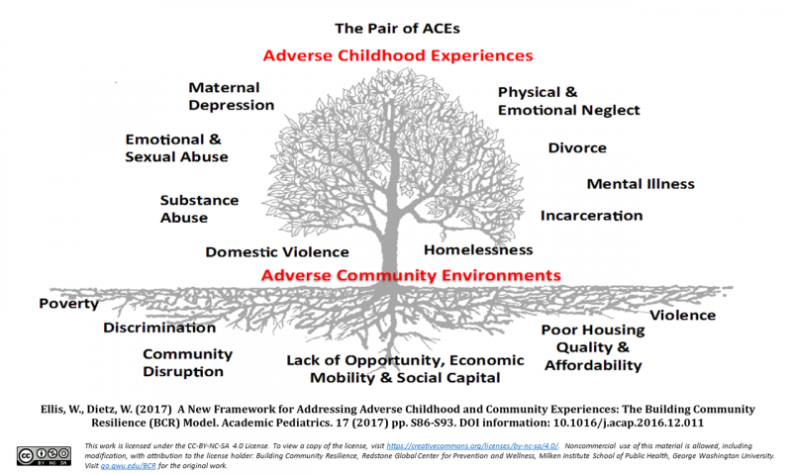
The Pair of Aces

Slide 6
ACE Findings-
ACE in childhood correlates with adult disease
Positive for 4+ ACEs have :
twice the rate of lung and liver disease
three times the rate of depression
three times the rate of alcoholism
eleven time the rate of IV drug use
fourteen times the rate of attempted suicide

Slide 7
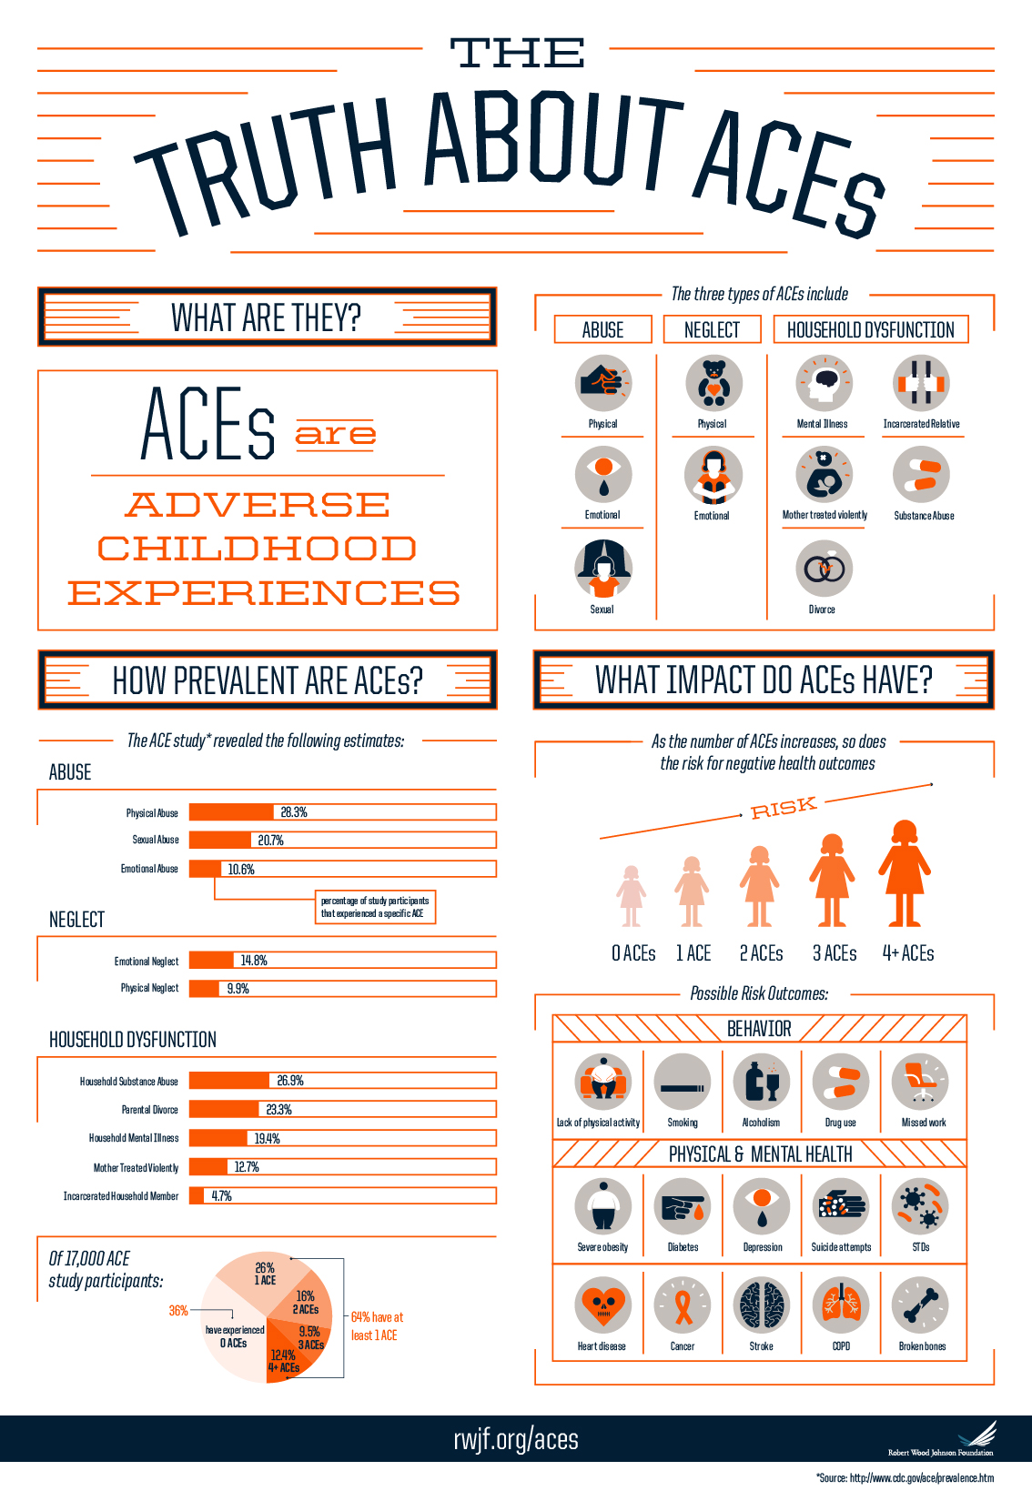

Slide 8
What is Trauma Informed Care?
Sees person/client/patient beyond their disease
Is aware that childhood and adult trauma are beneath and a cause of serious physical and psychosocial illnesses
Is data driven
Can be integrated into health care settings
Involves community partners
Looks for markers of trauma- highly correlated conditions
  Heart, lung, liver disease, obesity substance abuse, depression, PTSD, anxiety

Slide 9
What is Trauma Informed Care?
Acknowledges patient’s courage to discuss difficult experiences with statements of empathy
Is dependent upon practice, providers, expertise, resources
A trauma lens assumes that assumes medical conditions and coping behaviors are a result of difficult life experiences
Screens for the markers
Uses open ended questions
Uses a validated tool and allows for discussion of the responses with privacy

Slide 10

Where Do We Go From Here?

Slide 11
More Refined Lenses
Going humbly back to our service
Increased self understanding
Increased awareness of others
    Team Members
    Patients
    Medical Center Staff

Slide 12
Trauma Informed Approach
OLD WAY GENERAL WAY Be mindful to determine rather than assume NEW WAY Assume with humility
Be very observant, refrain from judgement
Engage in candid, respectful communication
Cultural generalization (opens up questions) vs stereotype (assumes answers)

Slide 13
Sample Script
“ Difficult life experiences, like growing up in a family where you were hurt, or where there was mental illness of drug/alcohol issues, or witnessing violence, can affect our health. Do you feel like any of your past experiences affect your physical or emotional health?”
Edward Machtinger, MD Professor of Medicine UCSF
www.capc.org/blog/palliative-pulse-thepalliative-pulse-October-2018-an-interview-with

Slide 14
Types of Trauma Informed Care-Communication
Psycho Educational flyers that include information about a support circle
Agreement to receive a follow up call for trauma counseling. Client/pt leaves with a phone number to call.
Candid, simple questions like “How is life at work and home these days?” Or “are you experiencing more stress than you can manage?”, may open things up for some clients/pts.

Slide 15
Types of Trauma Informed Care Communication
Transactional
  Focus on information exchange (“please follow up with our ….., who can talk with you more.”)
Transactional including social talk
  Mostly information exchange with some social talk (e.g. joking, comment on weather, upcoming health fair, recent holiday)
Interactional
  Focus on rapport-building and interpersonal relationship integrated with the information exchange ( “How was your meeting with …? “ , “At first this seems hard to talk about. I hope it is getting better for you. I hope you are more comfortable talking about these things.”)

Slide 16
Healing Strategies
Acknowledge emotional pain with kindness
Validate the feelings with simple statements you are comfortable using
Explore coping skills and social support
Support efforts to release tension and stress
Acknowledge small improvements and healing
YOUR UNIQUE HEALING STRATEGY
`

Slide 17
Building Community Resilience
The BCR approach aims to provide a seamless continuum of cross-sector cooperation and services to build the ‘social scaffolding’ that will support children and families and contribute to community resilience.
The work of BCR is to build networks that foster resilience against the stressors that can become toxic to a child’s development and long-term health: Adverse Childhood Experiences occurring in Adverse Community Environments – the “Pair of ACEs.”
Policy and system driven inequities
Trauma Equity Resilience

Slide 18
The Building Community Resilience Collaborative
Connects community organizations (through a church health ministry or trusted food pantry, for example) with larger systems (including those in health care, education, business, law enforcement) can begin to build a durable network to improve community wellbeing.
test sites are in Cincinnati, OH, Dallas, TX, the State of Oregon, Washington, DC and the Alive and Well Communities in Missouri and Kansas.

Slide 19
The Other Side of Trauma
Factors Contributing to Vicarious Truma
Contributing Factors to Vicarious Loss
Society
Burnout
Trauma
PTSD
Culture
Personal Loss
Burden

Slide 20
The Other Side of Trauma-
Factors Contributing to Resilient Stewardship
Humor
Your Factor
Gratitude
Self Care
Time Off
Movement
Community
Culture

Slide 21
References and Resources
Ellis, W., & Dietz, W. (2017). A New Framework for Addressing Adverse Childhood and Community
Experiences: The Building Community Resilience Model.. Academic Pediatrics, 17 (7S).http://dx.doi.org/10.1016/j.acap.2016.12.011
R. Anda, V. Felitti, W. Giles, et al.The enduring effects of abuse and related adverse experiences in childhood - a convergence of evidence from neurobiology and epidemiology
Eur Arch Psychiatry Clin Neurosci, 256 (2006), pp. 174-186
R. Anda, V. Felitti, W. Giles, et al.The enduring effects of abuse and related adverse experiences in childhood - a convergence of evidence from neurobiology and epidemiology
Eur Arch Psychiatry Clin Neurosci, 256 (2006), pp. 174-186
United States, Baltimore, MD. Available at: http://www.aecf.org/resources/the-2014-kids-count-data-book. Accessed February 19, 2015.Google Scholar 8
http://www.ncjfcj.org/sites/default/files/Finding%20Your%20ACE%20Score.pdf ACE Questionnaire

Slide 22
C. Pretty, D. O'Leary, J. Cairney, et al.Adverse childhood experiences and the cardiovascular health of children: a
cross-sectional study
BMC Pediatrics, 13 (2013), p. 208
  A. Danese, T. Moffitt, A. Caspi, et al.Adverse childhood experiences and adult risk factors for age-related disease:
  depression, inflammation, and clustering of metabolic risk markers
  Arch Pediatr Adolesc Med, 163 (2009), pp. 1135-1143
  D. Williamson, T. Thompson, R. Anda, et al.Body weight and obesity in adults and self-reported abuse in childhood
  Int J Obes Relat Metab Disord, 26 (2002), pp. 1075-1082
The Annie E. Casey Foundation. The 2014 KIDS COUNT Data Book: an annual report on how children are
faring in the United States, Baltimore, MD. Available at: http://www.aecf.org/resources/the-2014-kids-count-data-book.
Accessed February 19, 2015.
Google Scholar
8
  B. Dreyer, P. Chung, P. Szilagyi, et al.Child poverty in the United States today: inoduction and executive summary
  Acad Pediatr, 16 (3 suppl) (2016), pp. S1-S5
  Chaudry, C. WimerPoverty is not just an indicator: the relationship between income, poverty, and child well-being
  Acad Pediatr, 16 (3 suppl) (2016), pp. S23-S29

