Slide 1
Using the Hope Visit to promote resilience for ourselves and our patients
Practicing Whole Person, Patient-Centered Care
Elena Rosenbaum, MD Andrea Gordon, MD
Wayne Jonas MD Cortney Crespo, MD

Slide 2
OBJECTIVES
On completion of this session the participants will be able to
Describe the components of the HOPE note and explain why all are important components of well-being.
Use the HOPE note and Personalized Health Inventory to enhance care.
Experience the healing qualities of feeling heard by practitioner.

Slide 3

Are we just trying to keep moving forward

Slide 4

How can we understand the real issue?

Slide 5

Does frustration = not enough information?
Angela is a 35 year old cisgender woman who comes to you with about 10 years of abdominal pain.
She reports:
- pain most days, not related in time to eating
- sometimes has diarrhea, esp when stressed
- occasional constipation
- has had normal EGD and colonoscopy last year
- no relief with PPI, Gas-x or fiber
She has been told she has IBS but does not find this helpful since she still feels sick - she wants you to “fix” her

Slide 6



How do you approach IBS in your practice?
Fiber
Antidepressant
Probiotics
Stool softeners
Therapy
How well does this work?

Slide 7
How do we usually structure our visits?
The SOAP note
Making the medical diagnosis and treatment plan
Asking
“What’s the matter?”
Subjective – what the patient describes
Objective – what you observe and test
Assessment – the diagnosis and CPT code
Plan – your treatment and its access
Notes:
I did something with Sally to open the lens of options with an approach I call the HOPE Note – which are a set of questions to help patients see how their healing works and document an integrative health visit.
Sally had been continually asked in her SOAP visits about “what is the matter.” My goal in HOPE visit was to find out “what mattered” to Sally
I emphasize this because it provides the most direct way to change the conversation with patients – which is essential if we are to reform healthcare itself.
HOPE asks questions about the patients personal determinants of health and then builds an action plan for the patient based on what is meaningful for them.
It explores the core domains of healing that impact most chronic disease. These are the external, behavioral, social and spiritual dimensions of a patients life.
The physician brings evidence and expertise, but the patient is a partner in the exercise and at the center of the planning and plan.
It is a tool for whole patient and patient centered care in the truest sense.
___________________________________________
Additional NOTES BELOW:
The questions cover four key parts of the whole person, - involving the body, behavior, and the social and spiritual dimensions of healing.
It brings into focus the key determinants of health.
__
The first set of questions are about the external space patients spend time in.
Work by Esther Sternberg - who was at NIH for 30-year and now runs the Center for Place and Wellbeing at University of Arizona - has demonstrated that the hippocampus and amygdala are constantly monitoring the physical space your body is in, comparing it to memories of safety or stress, and preparing to alert (and coopt) you if your safety might be comprised. Most of this occurs unconsciously.
Sometimes the easiest thing for a patient who is not ready or able to make behavior change is to help them change their physical environment.
Recently, I had a patient that was about to undergo intensive chemo and surgery. She was not a fan of lifestyle change but changed her bedroom to become more conformable and improve her rest and sleep after treatments.
There she could also listen to music and imagery and induce a deep relaxation response – the kind of response that science shows builds resilience – exactly what she needed.
___
Health behaviors contribute to and cause 60-70% of chronic disease – and lifestyle can be used to treat as well as prevent these diseases.
So I ask patients how they live their day?
Five core behaviors – chemicals exposure (tobacco/alcohol/drugs), movement, food, sleep and stress management, make up most of healthy behavior.
However, less than 5% of the population actually do these – 2% of men and whopping 4% of women! No wonder women live longer than men!
For those that need to change, - they usually know it. The HOPE visit seeks to find what motivates them to change - what is meaningful for them.
For example, a simple and rapid way to both assess and educate about a healthy diet is to simply ask patients what they ate the day before and count the fruit and vegetable servings they had. Let’s try that now.
Most patients don’t understand the power of beliefs and mind-sets on their health. In a HOPE visit I take some time to explain the fundamental biology of these behaviors.
It is amazing what patients can do when they understand the why – both the why of the biology; and the why of their meaning.
__
Social support is a key salutogenic factor – so I ask them about theirs.
Do they have family, friends, fun? How often? Is there someone that will look out for their house when they go away? Will take them to the airport?
Loneliness is as powerful a risk factor as smoking for CVD and death post-MI, for patients like Joe.
If appropriate, I ask them to tell me about any major past traumas – such as ACEs. Simply talking about past traumas in a safe environment improves pain, function and physiology.
Once I had a patient who, after several visits for depression (that I treated with medications) and sleep problems (that I treated with sleep hygiene and CPAP), I stepped back and asked when her difficulties had all started. She said they came on a few months after she retired from a 30-year steady hotel job. It turned out that she was lonely and needed to see others every morning. Her sleep and mood improved when she found a part-time job – this time for just a few hours each day.
__
People contantly need, seek out and try to create meaning in life. So after asking them what’s the matter, I also ask them, what matters?”
In the SOAP Note we routinely ask patents “what’s the matter?” In the HOPE Note, I ask “What matters to them?” Parallel questions might be - Why are you here in life? What brings you joy? What enhances your wellbeing?
Research shows that people live better and longer if they have a purpose.
I recall one patient with chronic pain who had tried multiple treatments and was on several different drugs. When I asked him what was the primary thing he wanted to do in life he said it was to get down on the floor and play with his grandchildren.
So, instead of giving him more pain treatments we focused on a set of core muscle exercises that allowed him to get up and down off the floor.
He was pleased with that and after a few months he also reported less pain.
__
For some people, the very place or group they were born into - along with its history - prevents healing from happening.
The social, educational and economic environments in which people are born account for 40% of health.
Zip code often trumps genetic code for how healthy you are and how long you will live.
In those populations, the lens must be widened still further to address issues like:
Safety, walkability, food access, housing, educational and economic assets and social capacity – these all impinge on healing capacity.
Environmental toxins and adverse childhood experiences may have already shaped the brain to further undermine their healing capacity.
Sometimes, it is the faith community that holds the lifeline – “Do you go to church?” may be a key question for survival.
See https://www.aamc.org/download/442878/data/chahandout1.pdf

Slide 8
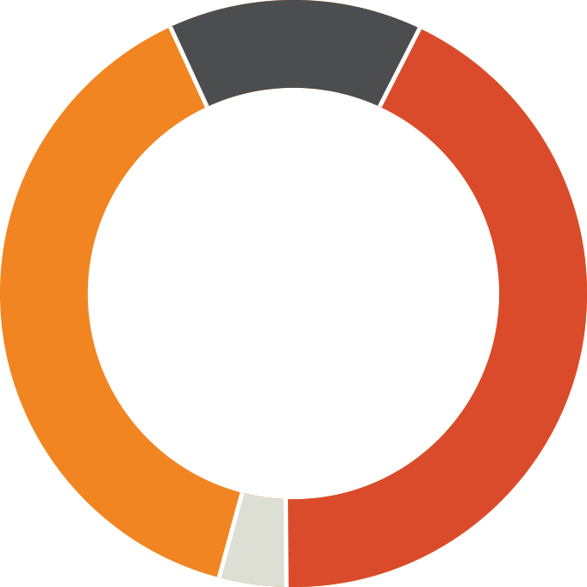
But what really influences health?
15–20%
Behavior & Lifestyle Impacts
Medical treatment
Social &
Economic Impacts
Environment
Source: McGinnis JM, Williams-Russo P, Knickman JR. The Case For More Active Policy Attention To Health Promotion. Health Aff (Millwood). 2002 Mar-Apr;21(2):78-93. doi: 10.1377/ hlthaff.21.2.78
Notes:
Can see how the SOAP note misses so much
Where IS the VALUE in healthcare? Well, we actually know.
We know that 80 percent of what causes chronic disease lies outside of the office and hospital. Medical care produces at most 20 percent of health.
The rest is from social, economic, behavior and lifestyle factors.
If we want health - we need to widen our lens to address these determinates of health, not only on the population level, but in our day to day encounters between providers and patients.
We need to integrate these determinates into conventional medical delivery.

Slide 9
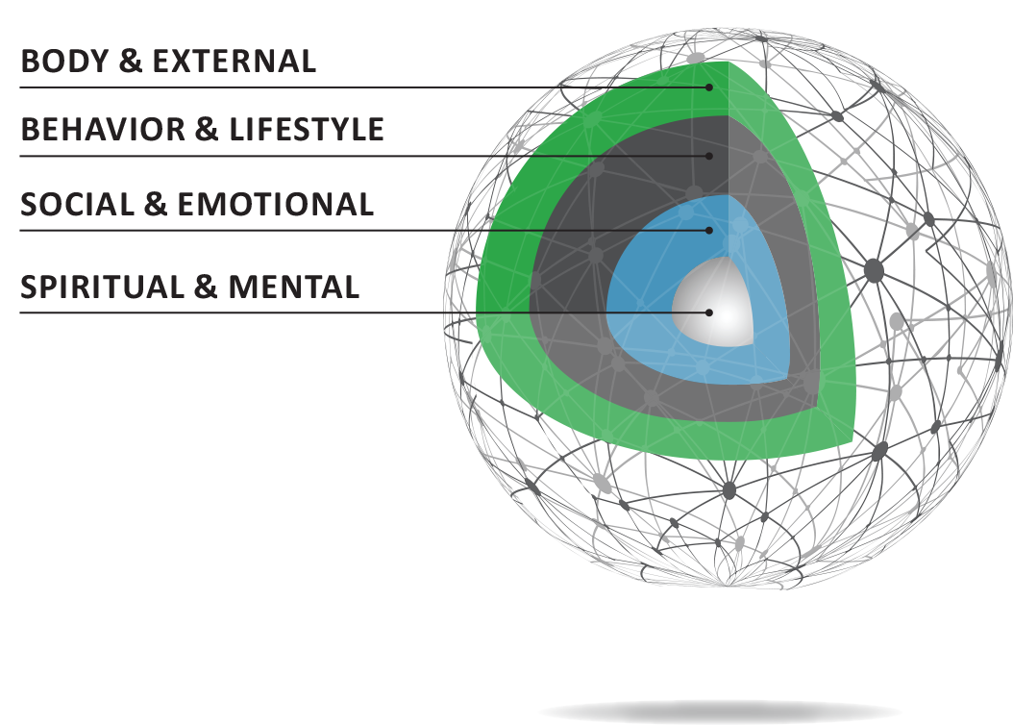
From SOAP to HOPE:
HEALING ORIENTED PRACTICES AND ENVIRONMENTS
Asking “What Matters”
Exploring a patient’s personal
determinants of health
Notes:
I developed the HOPE note because as a primary care provider, I’ve found that the SOAP note is too narrow to effectively grasp the causes of and approaches needed for many of the conditions I see – conditions like chronic pain, obesity, diabetes and hypertension.
The HOPE note is a tool for physicians that can be used to improve a patient’s health and well-being, particularly those with chronic conditions. The goal of the HOPE note is to reframe the patient experience from one of disease treatment to one that emphasizes self-healing and integrates evidence-based complementary approaches into conventional medical care.
I did something with Sally to open the lens of options with an approach I call the HOPE Note – which are a set of questions to help patients see how their healing works and document an integrative health visit.
Sally had been continually asked in her SOAP visits about “what is the matter.” My goal in HOPE visit was to find out “what mattered” to Sally
I emphasize this because it provides the most direct way to change the conversation with patients – which is essential if we are to reform healthcare itself.
HOPE asks questions about the patients personal determinants of health and then builds an action plan for the patient based on what is meaningful for them.
It explores the core domains of healing that impact most chronic disease. These are the external, behavioral, social and spiritual dimensions of a patients life.
The physician brings evidence and expertise, but the patient is a partner in the exercise and at the center of the planning and plan.
It is a tool for whole patient and patient centered care in the truest sense.
___________________________________________
Additional NOTES BELOW:
The questions cover four key parts of the whole person, - involving the body, behavior, and the social and spiritual dimensions of healing.
It brings into focus the key determinants of health.
__
The first set of questions are about the external space patients spend time in.
Work by Esther Sternberg - who was at NIH for 30-year and now runs the Center for Place and Wellbeing at University of Arizona - has demonstrated that the hippocampus and amygdala are constantly monitoring the physical space your body is in, comparing it to memories of safety or stress, and preparing to alert (and coopt) you if your safety might be comprised. Most of this occurs unconsciously.
Sometimes the easiest thing for a patient who is not ready or able to make behavior change is to help them change their physical environment.
Recently, I had a patient that was about to undergo intensive chemo and surgery. She was not a fan of lifestyle change but changed her bedroom to become more conformable and improve her rest and sleep after treatments.
There she could also listen to music and imagery and induce a deep relaxation response – the kind of response that science shows builds resilience – exactly what she needed.
___
Health behaviors contribute to and cause 60-70% of chronic disease – and lifestyle can be used to treat as well as prevent these diseases.
So I ask patients how they live their day?
Five core behaviors – chemicals exposure (tobacco/alcohol/drugs), movement, food, sleep and stress management, make up most of healthy behavior.
However, less than 5% of the population actually do these – 2% of men and whopping 4% of women! No wonder women live longer than men!
For those that need to change, - they usually know it. The HOPE visit seeks to find what motivates them to change - what is meaningful for them.
For example, a simple and rapid way to both assess and educate about a healthy diet is to simply ask patients what they ate the day before and count the fruit and vegetable servings they had. Let’s try that now.
Most patients don’t understand the power of beliefs and mind-sets on their health. In a HOPE visit I take some time to explain the fundamental biology of these behaviors.
It is amazing what patients can do when they understand the why – both the why of the biology; and the why of their meaning.
__
Social support is a key salutogenic factor – so I ask them about theirs.
Do they have family, friends, fun? How often? Is there someone that will look out for their house when they go away? Will take them to the airport?
Loneliness is as powerful a risk factor as smoking for CVD and death post-MI, for patients like Joe.
If appropriate, I ask them to tell me about any major past traumas – such as ACEs. Simply talking about past traumas in a safe environment improves pain, function and physiology.
Once I had a patient who, after several visits for depression (that I treated with medications) and sleep problems (that I treated with sleep hygiene and CPAP), I stepped back and asked when her difficulties had all started. She said they came on a few months after she retired from a 30-year steady hotel job. It turned out that she was lonely and needed to see others every morning. Her sleep and mood improved when she found a part-time job – this time for just a few hours each day.
__
People contantly need, seek out and try to create meaning in life. So after asking them what’s the matter, I also ask them, what matters?”
In the SOAP Note we routinely ask patents “what’s the matter?” In the HOPE Note, I ask “What matters to them?” Parallel questions might be - Why are you here in life? What brings you joy? What enhances your wellbeing?
Research shows that people live better and longer if they have a purpose.
I recall one patient with chronic pain who had tried multiple treatments and was on several different drugs. When I asked him what was the primary thing he wanted to do in life he said it was to get down on the floor and play with his grandchildren.
So, instead of giving him more pain treatments we focused on a set of core muscle exercises that allowed him to get up and down off the floor.
He was pleased with that and after a few months he also reported less pain.
__
For some people, the very place or group they were born into - along with its history - prevents healing from happening.
The social, educational and economic environments in which people are born account for 40% of health.
Zip code often trumps genetic code for how healthy you are and how long you will live.
In those populations, the lens must be widened still further to address issues like:
Safety, walkability, food access, housing, educational and economic assets and social capacity – these all impinge on healing capacity.
Environmental toxins and adverse childhood experiences may have already shaped the brain to further undermine their healing capacity.
Sometimes, it is the faith community that holds the lifeline – “Do you go to church?” may be a key question for survival.
See https://www.aamc.org/download/442878/data/chahandout1.pdf

Slide 10
How do we delve deeper?
DO A Personal Health Inventory
ASK the HOPE questions – keep fluid, it is not a checklist
PRIORITIZE the action items – “patient is in the driver’s seat”
  Ask-tell-ask: “reflect back and listen”
  Action plan -creating at Personalized Health Plan
  Closing the loop with “teach back”
4. When possible Hand off to health coach or medical assistant and/or group visit.
  Use other specialists such as nutritionists or acupuncturists as part of the team.

Slide 11
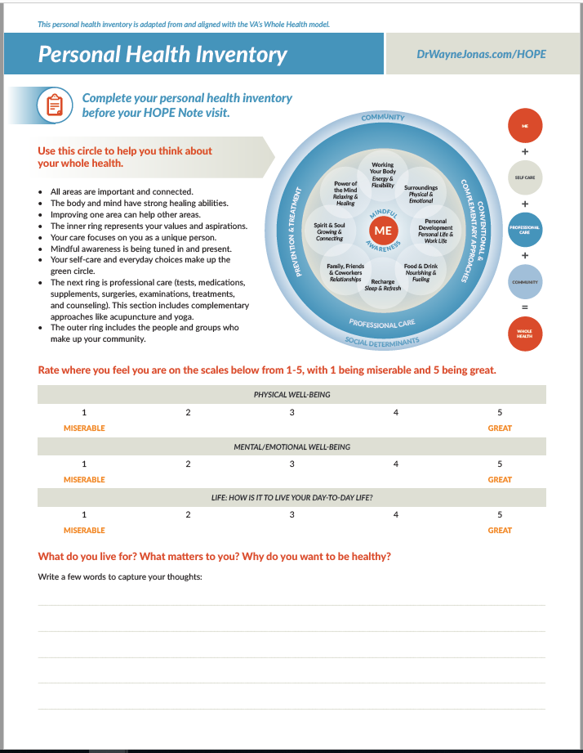
PERSONAL HEALTH INVENTORY
Helps patient think about why they want to be healthy – linking life purpose and health goals
Reviews current self-health assessment
Reviews current personal determinants of healing
Assesses readiness for change or action
Basis for provider-patient HOPE discussion

Slide 12
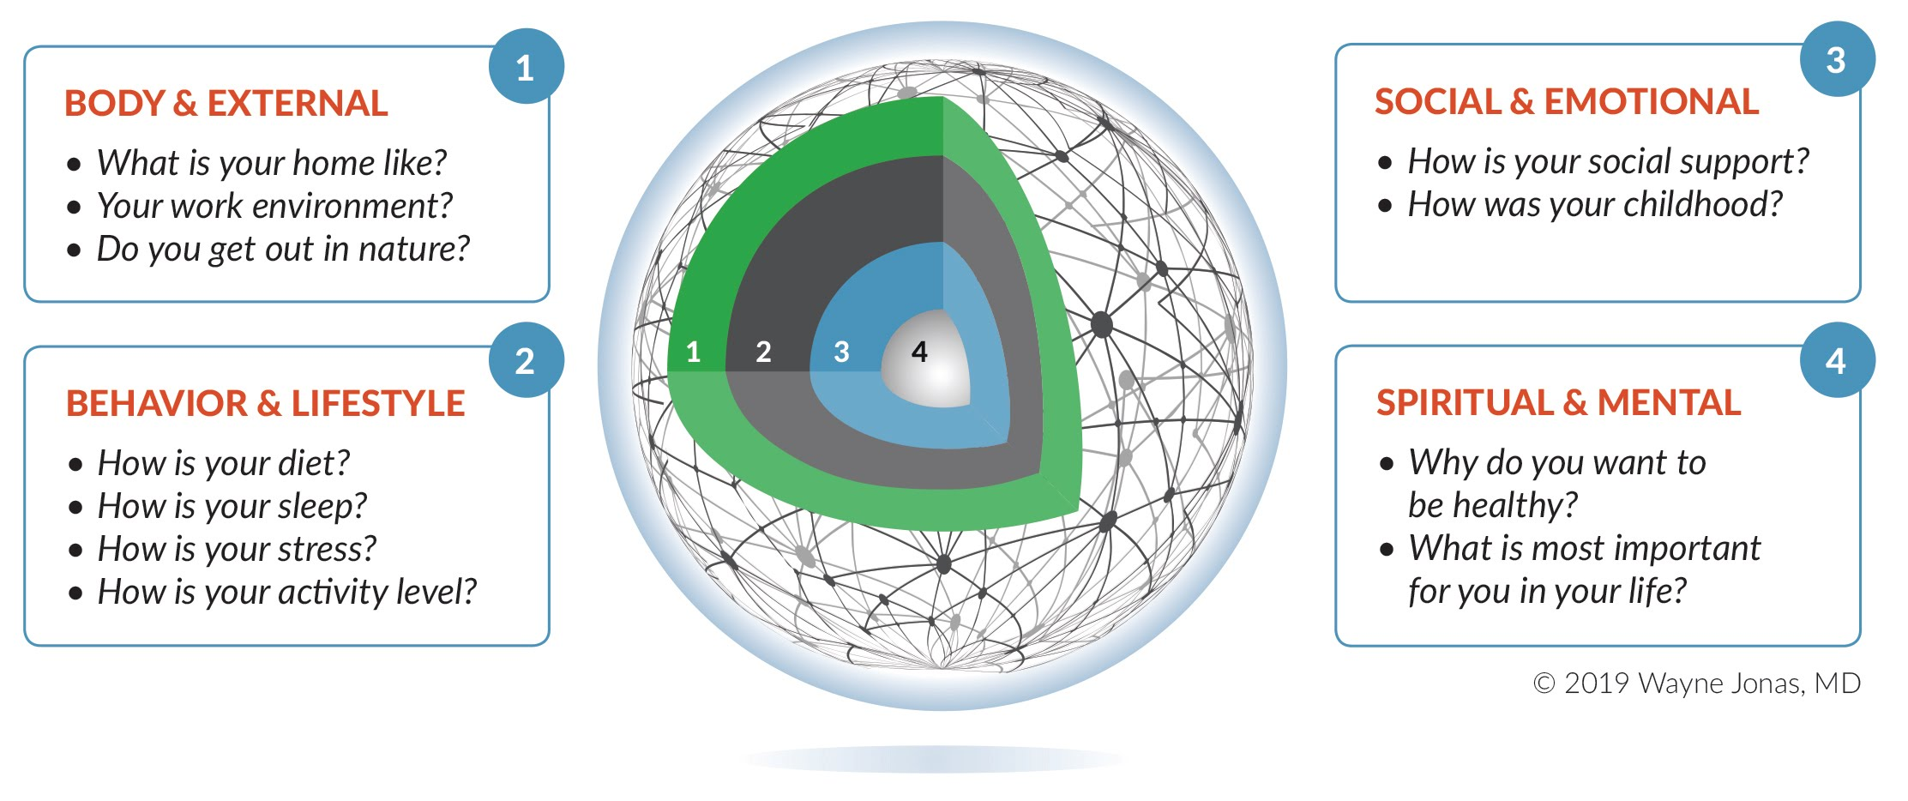
THE HOPE NOTE QUESTIONS
Notes:
Now we are talking about the person, not the illness

Slide 13



SPIRITUAL & MENTAL
Why do you want to be healthy?
What is most important for you in your life?
Address a person’s inner life
  desires, beliefs and needs
  why they get up in the morning
  their purpose and meaning in life
“What matters” rather than “what’s the matter”

Slide 14

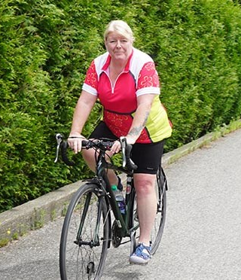
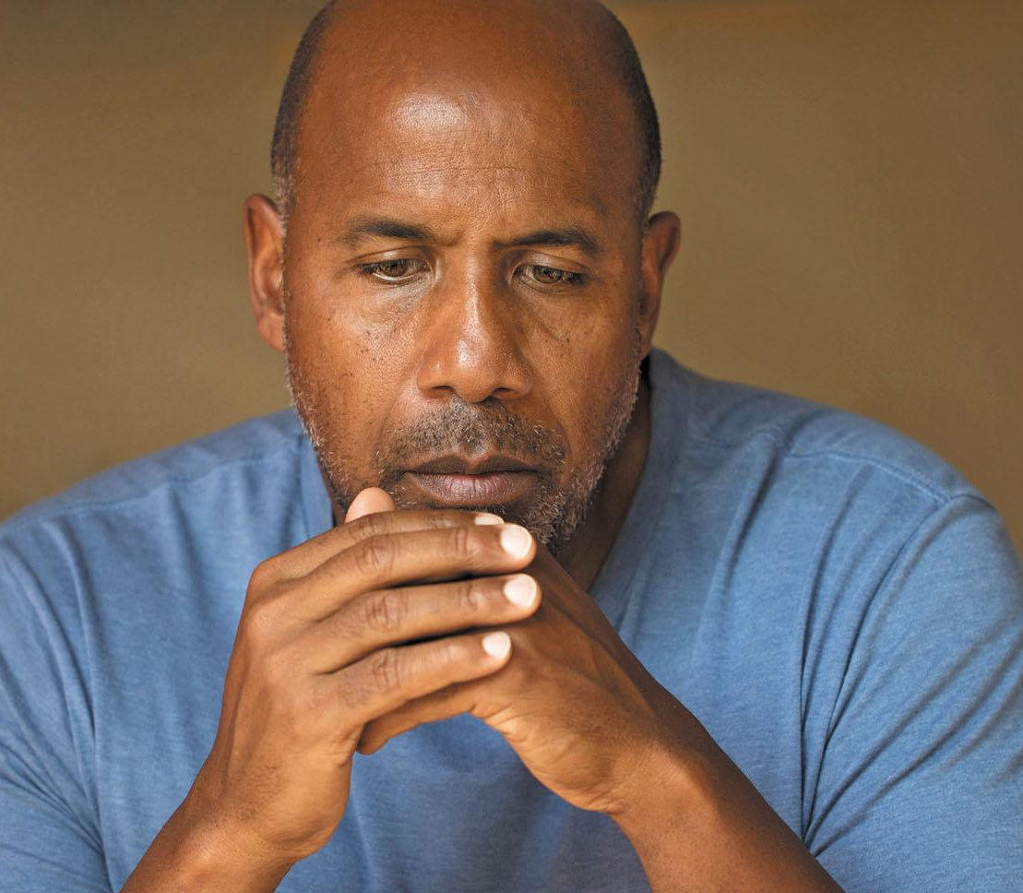
BEHAVIOR & LIFESTYLE
How is your:
- Diet?
- Sleep?
- Stress?
What do you do for
stress management?
- Activity level?
Do you think what you are doing is helping?
Notes:
ow is your diet? – listen to their global assessment, count the F&V
How is your sleep? – global assessment, determine pattern, rested?
How is your stress? – What do you do for stress management? – explain M/B
How is your activity level? – assess level and intensity of movement
Remember:
Behavior change must connect with what a person finds meaninguful or it won’t be sustained

Slide 15

SOCIAL & EMOTIONAL
How is your social support?
How was your childhood?
Loneliness is epidemic
  A risk factor for disease and death
  Impacts recovery, resilence and return visits and readmission
So often the reason and process for healing has to do with relationships
  Depth (quality) of the relationship more important than number (quantity)
Notes:
How is your social support? – family, friends, frequency, fullness
How was your childhood? – explain that ACE can influence healing
Loneliness is epidemic
A risk factor for disease and death
Impacts recovery, resilence and return visits and readmission

Slide 16




PHYSICAL ENVIRONMENT
What is your home like?
Your work environment?
Do you get out in nature?
Zip code vs genetic code
Notes:
What is your home like? – do you have a place and time for yourself?
Your work environment? – gauge the level of stress, control and privacy
Do you get out in nature? – most people underestimate its importance
Community, work site, school and home environments shape:
what a person is able to do
what happens to a person
how safe or stressed they feel
how well a person flourishes and functions
how long a person lives

Slide 17



SOCIAL DETERMINANTS
The largest influences on health are social
and economic factors:
Education
Employment
Housing Insecurity
Financial Strain
Food Insecurity
Transportation issues
Exposure to Violence
All impact a person’s ability to engage in healthy behavoirs and choices
Notes:
The largest influences on health are social and economic factors.
Education – level (HS, College) and type (professional, vocational)
Employment – Salaried, contract, temporary, homemaker, self-employed, retired, unemployed
Financial Strain Problems - yes, no; or Paying for Basics - very hard, somewhat hard, not hard at all
Housing Insecurity – homeless, housing quality, number of times moved in the year
Food Insecurity - always, sometimes, not often
Transportation issues - never, sometimes, often, always
Exposure to Violence - yes, no; specifics of situation; or Concerned about Child: yes, no, N/A

Slide 18

Please complete your own PHI

Slide 19


Choose a domain to discuss with a partner
Partner 1: Speak for 2 minutes - uninterrupted
Partner 2: (Listening partner )- just listen for 2 minutes, then respond by reflecting back opportunities and feelings you have heard.
Then switch and repeat both parts

Slide 20
What did we find out about Angela?
Her main concern is being healthy enough to travel to see family
- She grew up in a home with food insecurity, but no violence
- Her current job is very stressful and unsatisfying, but she is worried about finances if she quits
- The stress and time pressure influence her food choices and her worries interfere with going to sleep so she surfs on her phone for hours
- Exercise helps if/ when she makes time for it but that doesn’t seem possible right now
Notes:
She currently worried about having diarrhea or pain when traveling and feeling trapped/ embarassed

Slide 21
Summary of HOPE visit for Angela-1
She would like to try acupuncture - make referral to qualified acupuncturist for therapeutic trial.
2. Sleep improvement is a major issue. RR or Imagery could help. Consider natural supplement to help in meantime. Work with any medication prescribers to coordinate therapies
3. Consider 4-6 therapeutic yoga sessions. Previous yoga helped. Need to understand why that was stopped and explore if and how those sessions might be implemented.
* We will address transportation issues that might affect access to resources
Notes:
This discussion results in a patient action plan. The plan is mutually agreed upon and goals are set and tracked.

Slide 22
Summary of HOPE visit for Angela- 2
4. Diet feels difficult for her to address but she does feel she can:
-stock up on frozen fruits and vegetables
- prepare 2-3 healthy meals ahead of time
She is open to more education on how to create an affordable healthy diet and wants to see a nutritionist
5. Note that planning for mission related job that pays in new location next year will be helpful.
6. She will send me a note on her top areas for change and work with health coach on above.
7. Follow Up with health coach this week and with me in 4-6 weeks.

Slide 23
Creating a Personalized Health Plan
Summarize, prioritize and agree on a plan
Keep the patient in the driver’s seat (IOM, 2001)
  Ask-tell-ask
  Action plan
  Closing the loop
See UCSF’s Dr. Thomas Bodenheimer’s Health Coaching Model https://www.stepsforward.org/modules/health-coaching
Notes:
This discussion results in a patient action plan. The plan is mutually agreed upon and goals are set and tracked.

Slide 24

Creating a Personalized Health Plan
Consider how you might do this with your partner based on what you have learned.

Slide 25
How do I pay for this? - Physician time
2018 CPT CODES AND DESCRIPTIONS
Prolonged evaluation and management with direct patient contact, in the office or other outpatient setting.
  99354—add on code - use for first 30 minutes above times associated with main code used for visit
Use this code in conjunction with 90837, 99201-99215, 99241-99245, 99324-99337, 99341-99350.
  99355—add on code; each additional 30 minutes; use in conjunction with 99354
Prolonged evaluation and management with no direct patient contact. Before and/or after direct care.
  99358—first hour
  99359—each additional 30 minutes

Slide 26
How do I pay for this? Team time
Medical Team Conference, Direct Face to Face Contact with Patient and/or Family; 30 minutes or more; participation by non-physician qualified healthcare professional.
  99366
Medical Team Conference, without direct face to face contact with patient and/or family, 30 minutes or more.
  99367—Participation by physician.
  99368—participation by non-physician qualified healthcare professional.
  More information available: http://drwaynejonas.com/wp-content/uploads/2018/10/CodingThumbnail.png

Slide 27

Would using this format change:
-How you gather information?
- Your approach to patients with IBS?
- Your feelings about working with patients with chronic disease?
- What seems helpful and what may not?

Slide 28
Q & A

Slide 29
CONTACT US
More tools are available at
www.drwaynejonas.com/resources
Contact us if you would like to further use
and spread integrative health
Elena Rosenbaum erosenbaum@communitycare.com
Andrea Gordon agordon@challiance.org
Wayne Jonas healing@drwaynejonas.com
Cortney Crespo ccrespo@challiance.org

Slide 30
HOPE:
HEALING ORIENTED PRACTICES AND ENVIRONMENTS
Asking “What Matters”
Exploring a patient’s personal
determinants of health
Notes:
I developed the HOPE note because as a primary care provider, I’ve found that the SOAP note is too narrow to effectively grasp the causes of and approaches needed for many of the conditions I see – conditions like chronic pain, obesity, diabetes and hypertension.
The HOPE note is a tool for physicians that can be used to improve a patient’s health and well-being, particularly those with chronic conditions. The goal of the HOPE note is to reframe the patient experience from one of disease treatment to one that emphasizes self-healing and integrates evidence-based complementary approaches into conventional medical care.
I did something with Sally to open the lens of options with an approach I call the HOPE Note – which are a set of questions to help patients see how their healing works and document an integrative health visit.
Sally had been continually asked in her SOAP visits about “what is the matter.” My goal in HOPE visit was to find out “what mattered” to Sally
I emphasize this because it provides the most direct way to change the conversation with patients – which is essential if we are to reform healthcare itself.
HOPE asks questions about the patients personal determinants of health and then builds an action plan for the patient based on what is meaningful for them.
It explores the core domains of healing that impact most chronic disease. These are the external, behavioral, social and spiritual dimensions of a patients life.
The physician brings evidence and expertise, but the patient is a partner in the exercise and at the center of the planning and plan.
It is a tool for whole patient and patient centered care in the truest sense.
___________________________________________
Additional NOTES BELOW:
The questions cover four key parts of the whole person, - involving the body, behavior, and the social and spiritual dimensions of healing.
It brings into focus the key determinants of health.
__
The first set of questions are about the external space patients spend time in.
Work by Esther Sternberg - who was at NIH for 30-year and now runs the Center for Place and Wellbeing at University of Arizona - has demonstrated that the hippocampus and amygdala are constantly monitoring the physical space your body is in, comparing it to memories of safety or stress, and preparing to alert (and coopt) you if your safety might be comprised. Most of this occurs unconsciously.
Sometimes the easiest thing for a patient who is not ready or able to make behavior change is to help them change their physical environment.
Recently, I had a patient that was about to undergo intensive chemo and surgery. She was not a fan of lifestyle change but changed her bedroom to become more conformable and improve her rest and sleep after treatments.
There she could also listen to music and imagery and induce a deep relaxation response – the kind of response that science shows builds resilience – exactly what she needed.
___
Health behaviors contribute to and cause 60-70% of chronic disease – and lifestyle can be used to treat as well as prevent these diseases.
So I ask patients how they live their day?
Five core behaviors – chemicals exposure (tobacco/alcohol/drugs), movement, food, sleep and stress management, make up most of healthy behavior.
However, less than 5% of the population actually do these – 2% of men and whopping 4% of women! No wonder women live longer than men!
For those that need to change, - they usually know it. The HOPE visit seeks to find what motivates them to change - what is meaningful for them.
For example, a simple and rapid way to both assess and educate about a healthy diet is to simply ask patients what they ate the day before and count the fruit and vegetable servings they had. Let’s try that now.
Most patients don’t understand the power of beliefs and mind-sets on their health. In a HOPE visit I take some time to explain the fundamental biology of these behaviors.
It is amazing what patients can do when they understand the why – both the why of the biology; and the why of their meaning.
__
Social support is a key salutogenic factor – so I ask them about theirs.
Do they have family, friends, fun? How often? Is there someone that will look out for their house when they go away? Will take them to the airport?
Loneliness is as powerful a risk factor as smoking for CVD and death post-MI, for patients like Joe.
If appropriate, I ask them to tell me about any major past traumas – such as ACEs. Simply talking about past traumas in a safe environment improves pain, function and physiology.
Once I had a patient who, after several visits for depression (that I treated with medications) and sleep problems (that I treated with sleep hygiene and CPAP), I stepped back and asked when her difficulties had all started. She said they came on a few months after she retired from a 30-year steady hotel job. It turned out that she was lonely and needed to see others every morning. Her sleep and mood improved when she found a part-time job – this time for just a few hours each day.
__
People contantly need, seek out and try to create meaning in life. So after asking them what’s the matter, I also ask them, what matters?”
In the SOAP Note we routinely ask patents “what’s the matter?” In the HOPE Note, I ask “What matters to them?” Parallel questions might be - Why are you here in life? What brings you joy? What enhances your wellbeing?
Research shows that people live better and longer if they have a purpose.
I recall one patient with chronic pain who had tried multiple treatments and was on several different drugs. When I asked him what was the primary thing he wanted to do in life he said it was to get down on the floor and play with his grandchildren.
So, instead of giving him more pain treatments we focused on a set of core muscle exercises that allowed him to get up and down off the floor.
He was pleased with that and after a few months he also reported less pain.
__
For some people, the very place or group they were born into - along with its history - prevents healing from happening.
The social, educational and economic environments in which people are born account for 40% of health.
Zip code often trumps genetic code for how healthy you are and how long you will live.
In those populations, the lens must be widened still further to address issues like:
Safety, walkability, food access, housing, educational and economic assets and social capacity – these all impinge on healing capacity.
Environmental toxins and adverse childhood experiences may have already shaped the brain to further undermine their healing capacity.
Sometimes, it is the faith community that holds the lifeline – “Do you go to church?” may be a key question for survival.
See https://www.aamc.org/download/442878/data/chahandout1.pdf

