Slide 1
Against Instinct
Electronic Resources & Libraries 2013
Choosing Discovery & Making it Work
Liane Taylor, Continuing Resources Librarian
Arlene Salazar, Reference/Instruction Librarian
Lisa Ancelet, Head, Reference & Instructional Services
Albert B. Alkek Library
Texas State University – San Marcos
March 18, 2013
Notes:
LISA
Welcome and Introductions

Slide 2
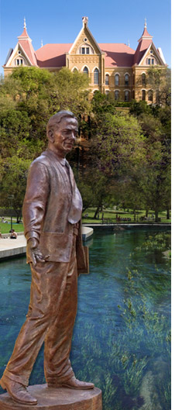

About Us:
Texas State University-San Marcos
5th Largest University in Texas
(…but you’ve never heard of us.)
34,000 FTE
  High Undergraduate (~30k FTE)
  18 Master’s Programs (~3600 FTE)
  11 Doctoral Programs (~400 FTE)
Main Library + Music Library + Satellite Campus Library
http://www.txstate.edu/about/history-traditions.html
Notes:
LISA
We are a high-undergraduate institution, with growing graduate population. Awarded Emerging Research Institution status in 2012. Main library has around 34 professional staff, Music Library has 1 professional staff, satellite library has 1.5 professional staff.

Slide 3
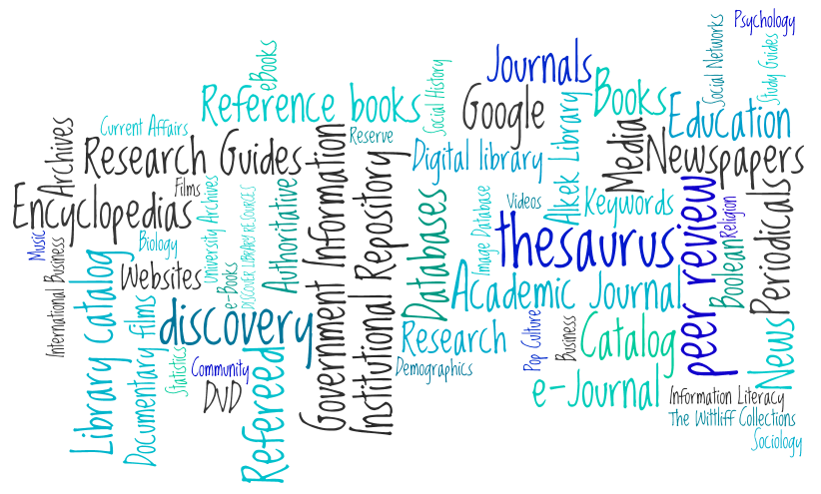
The Search for the Perfect search tool that will solve all of our problems forever
July 2009 - August 2011
Notes:
LISA
In July 2009, we started the search for the perfect search tool that will solve all of our problems forever. Students were having trouble getting started with research – which database to start with? We wanted to help. Little did we know what we were in for…

Slide 4

The team:
Transformation & Composition
Federated Discovery
Search Search
Team Team
The Perfect Mix
(Balance is key)
Reference/Instruction + Acquisitions/Cataloging
For “One-Search” + Against “One-Search”
BFFs
Met weekly for two years (some more than 2 yrs)
http://www.flickr.com/photos/1000photosofnewyorkcity/6018490089/
Notes:
LISA
A team was formed to look at federated search tools, which were big at the time (and had been for a while). The team was composed of professional staff from public services and technical services, and, most importantly, also contained folks FOR a “one-search” tool and folks AGAINST a “one-search” tool. The team basically met weekly until the end of the project…which wound up taking 2 years. By the end of 2009, what started as a federated search team became a discovery tool search team.

Slide 5
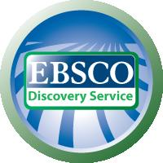


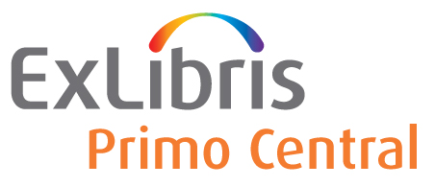
Wherefore EBSCO Discovery Service?
We considered comparing EBSCO Discovery Service vs Summon, however…
EBSCO Link Resolver
EBSCOHost-centric (75% of databases)
Clear Gateway to Subject-Specific Databases
December 2009: EBSCO Discovery Service Beta Test Site
Notes:
LISA
We quickly narrowed our search down to 2: EBSCO Discovery Service and Serials Solutions Summon. We attended a variety of presentations, etc., and these two struck us as working the best in terms of combining a variety of resources. However, we were offered an opportunity to become a beta test site for EBSCO Discovery Service. The team discussed whether we should continue to evaluate both Summon and EDS. In the end, we decided to focus on EDS solely, at least for a few months.
For us, EDS had several advantages over Summon: We used the EBSCO Link Resolver, we are an EBSCOHost-centric library with around 75% of our databases being hosted by EBSCO, and we felt the EBSCO interface offered a clearer gateway to subject-specific databases, which was important for our instruction goals. We wanted to use discovery as a way to discover not only results, but to discover SUBJECT-SPECIFIC DATABASES. We became an EDS Beta Test site in December 2009.

Slide 6

EDS vs EBSCO PowerSearch: Would Students Even Notice the Difference?
PowerSearch is FREE, EDS is NOT.
What does EDS give us that we don’t already have?
NOTE: Image not to scale
PowerSearch combines most of our databases
  Transferred most db to EBSCO, except for several where native interfaces were clearly stronger (i.e., EngVillage)
…but PowerSearch does not include Catalog, IR, other vendors
Notes:
LISA
However, we did decide to compare EDS to something: EBSCO PowerSearch, aka the combined search of all of our EBSCO databases. We had been toying around with the idea of putting a powersearch tool on the homepage, if we did not go with a federated/discovery tool, and had been using the powersearch in a variety of ways. What if powersearch was good enough? If we just wanted a starting point for research, how much did it really need in it? How important or valuable was it to students to find catalog and IR results along with article results? Was it worth the money for that functionality? We decided to compare EDS with EBSCO PowerSearch. To prepare, we reviewed all the databases that could be moved over to the EBSCOhost platform and moved as many over as we could. Some really needed to remain in their native interfaces, like those in EngineeringVillage.

Slide 7
What does success look like?
(Original Goals vs Value Test)
Original Goals
EDS Value Test
Provide enhancements to the library’s catalog such as facets and tags (discovery tools)
Provide the option for patrons to search multiple resources simultaneously (federated search)
Improve patron awareness of the many and varied electronic resources to which the library provides access
Provide customized search options for various disciplines or academic departments
?
EDS is valuable if a searcher can consistently type an unsophisticated, non-boolean search query, and as a default, with no sophisticated strategy, retrieve non-EBSCO results, including books from the Catalog (if not an article-only search), within the top 50 results.
Notes:
(LT) I’m going to discuss our testing of EDS and PowerSearch. When the team started, we had developed a list of goals – what we wanted to improve. For instance, we knew we wanted an improved display and we wanted students to search multiple databases at once. But these original goals were not enough as we entered beta testing – they didn’t help us determine if EDS was a “good value”. In one particularly difficult meeting that our Director attended, she asked us a tough but important question: What does success look like? We recommend that groups ask themselves this question, and make it explicit – what is your internal measure of value? For us, this was most of the time an implicit statement, though I used this “value test” throughout the entire testing period, and it was the foundation of our final report and recommendation. You can read the statement on the slide, but basically: EDS was valuable if a searcher could type a basic, unsophisticated search and retrieve results on the first page from different providers, including the catalog. We felt strongly that we could not really test EDS with PowerSearch until we started to see third-party results and catalog results on the first page. This took a while – because it took a while (until April 2011!) for the other vendors to GIVE EBSCO the data (at least enough so that we could see it). For our part, we contacted vendors that EBSCO had contracted with and asked them to give the data ASAP.
As a side note: Review of searches from the desk shows 3rd party results + catalog results consistently showing up on the first page, which is a feat considering 105 of our 440 databases, or 23.8%, are EBSCO databases, and of 146 collections activated in EDS, 95, or 46%, are EBSCO-hosted databases.

Slide 8


The Long and
Winding Road
Customizing, Testing, Tweaking
  Search Mode Parameters
  Facets
  Relevancy Ranking Tweaks
Waiting, waiting (Dec 2009-April 2011)
Listservs + Webinar
Notes:
(LT) During this waiting period, we did a lot of customization. It was clear to us that EDS, and our testing, wouldn’t work out-of-the-box. We had to do a lot of work. We spent time in the EBSCO Admin Module, trying out the different search mode parameter options and discussed whether we should use the same or different search mode parameters in PowerSearch and EDS (we chose the same; September 2010). We realized that when we made the search mode parameters the same, the results were the same! That’s how we knew the third-party content wasn’t loaded yet, and that our IR and catalog results needed higher relevancy ranking. We worked with EBSCO to increase the relevancy ranking for those and reloaded catalog data. **Search Mode Parameters Chosen: NOT Boolean, but if Boolean is chosen, then a NEAR proximity operator w/in 5 (NEAR = regardless of order); Find all search terms (AND) as default; no find any (OR); no “SmartText” searching; turned off “search within fulltext”.
We also worked hard to make the two interfaces as similar as possible. We also wanted the facets to work for searches, not against searches. For instance, we removed certain subject heading facets that would unnecessarily limit results because not all databases use discipline-specific subject headings like MeSh. EDS also has an “integrated search” option, where providers whose content is not part of the main index can be “federated” in – providers like ProQuest, Gale, etc. We tested the integrated search connectors to find which database worked the best, which included most unique content & results.
We also did a lot of our own searching, using search queries developed from our Ask-A-Librarian email questions and questions from the Reference desk – we tried both sophisticated search strategies using parentheses and boolean, and unsophisticated search strategies. We participated on the listserv and attended webinars, and EDS continued to develop. By April 2011, we felt it was ready for prime time, or at least, testing.

Slide 9
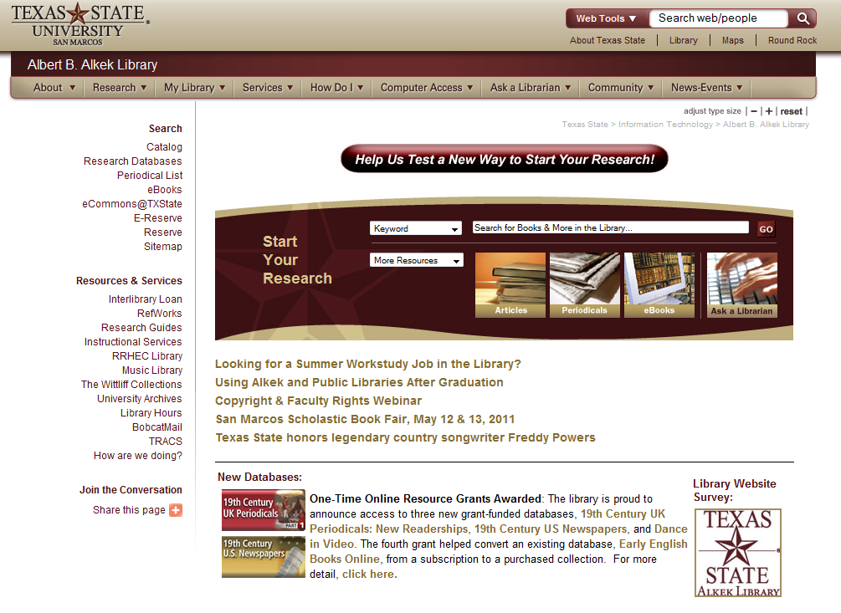
Notes:
By April 2011, we started to see more third-party results in EDS and decided it was time to rollout testing to users. We chose to do feedback via the website and focus groups.
First, feedback via the website. On June 1, 2011, we included a new button on the homepage – Help Us Test a New Way to Start Your Reserach.

Slide 10
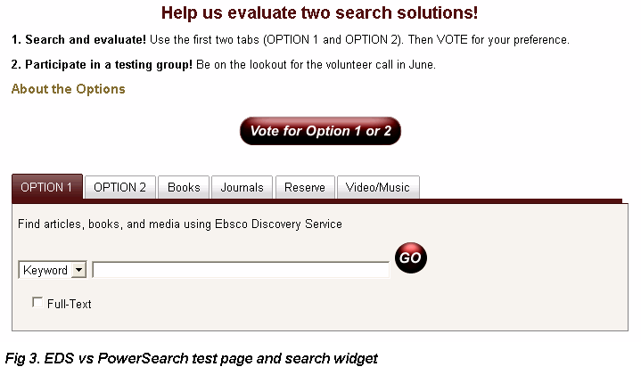
Notes:
When users clicked on the button, they were led to a page with a search widget and vote options. Users could choose to search Option 1 (EDS) or Option 2 (PowerSearch). The “About the Options” did briefly explain the difference between the options. The widget seen was a “first draft” of a search widget we were developing for the web page. When you clicked on Vote for Option 1 or 2, you would see a short feedback form that asked a couple of questions – what did you try, what did you prefer, why.

Slide 11
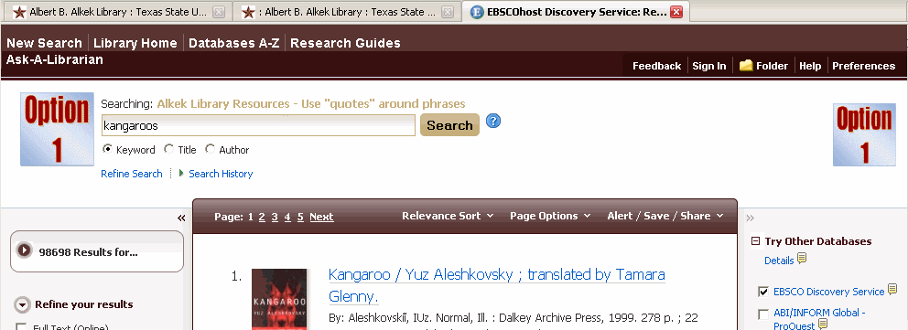
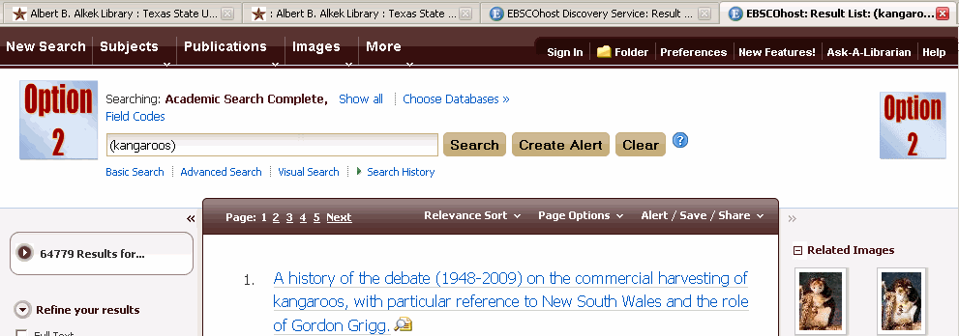
Notes:
We had to work hard to make the interfaces look as similar as possible. We changed the graphics so that each was clearly labeled OPTION 1 or OPTION 2. We found out right away that the smallest differences could “tip” someone over. The differences included: Option 1 had the ability to also search by author and title in the search widget but Option 2 didn’t; the large number of databases visible in the federated search in Option 1 pushed down the Ask a Librarian box and result images whereas in Option 2 they were close to the top. Option 1 had material format icons, Option 2 did not. These differences were fixed in the Admin interface in both EDS and Powersearch and by advocating to EBSCO. By making both interfaces as alike as possible, the team felt the comments would be more focused on the results rather than the inconsistencies of the interface.

Slide 12

THE WINNER: OPTION 1 (EDS)
137 Respondents
  37 faculty members (27%)
    26 preferred Option 1 (EDS)
  67 students (undergrad + grad) (48.9%)
    46 preferred EDS
  PROBLEM: Most were relying on number of hits or differences in the interface of one over the other.
Why Option 1?
  After taking out interface differences that could be fixed, results that include books from the catalog and journals articles.
Given the feedback comments, it was clear that either of the options were better than the existing search option.
Notes:
We had 137 respondents. 48.9% were students, 27% were faculty, 24% were library staff. This feedback was challenging to review, because much of the feedback strongly indicated that folks were looking at only the NUMBER OF RESULTS as the primary preference factor (not, for instance, relevance or quality) or minor interface differences. However, even when we accounted for that, we could see a not-statistically-verified but clear-to-us preference for EDS because it included books + journals. Either way, consistent comment such as “either of these are an improvement over what we have currently” indicated to us that either PowerSearch or EDS should go on the homepage.

Slide 13
Focus Groups
13 Participants (mix of undergrad, grad, fac)
Led group through 5 searches total, comparing:
  EDS to PowerSearch
  EDS to Catalog
Post-Search Feedback Questions, examples:
  Hard was this to do?
    If “Hard” or “Very Hard” – Why?
  Were the results same -> very different?
  Which do you prefer?
Notes:
The second phase of testing was focus groups. We held focus groups in July 2011 where we led students through a series of 5 searches. We asked for participants via the website and via a university-wide email. We asked participants to try the searches in both EDS and PowerSearch, as well as EDS and the Catalog, and then answer questions about difficulty, differences, and preferences. We gave 4 sample searches and in the last question, let them choose their own search topic. One problem we ran into, and could not correct for, was that we had participants search EDS first for each question. That meant that it was automatically harder – because they hadn’t tried that search yet. When they repeated the search in PowerSearch, it was “easier” --- but because they had already worked out some of the difficulties! Also, we found that similar to the website test, participants looked mostly at NUMBER of results, rather than QUALITY or RELEVANCE.

Slide 14

As Clear as…
For most of the questions, all interfaces were rated “About the Same” in terms of preference & performance
BUT!
“Overall, which option did you prefer
when searching for articles?”
5=The Same 5=EDS 2=Neither 1=PowerSearch*
(*likely mistake!)
Notes:
Participants generally rated EDS and PowerSearch the same, or PowerSearch/Catalog better, in each of the questions. For instance, in the first question, 9 of 13 felt both were the same, 3 preferred PowerSearch, and only 1 preferred EDS. The only question for which EDS rated higher than PowerSearch was #5, where students searched for their topic of choice, but it only “won” by 1 vote (4=EDS; 3=PowerSearch); furthermore, the highest number of votes, 6, was for both were about the same. In fact, in the comments throughout, participants often stated both were about the same. For instance, in questions #1, #4, and #5, the highest vote was “both were about the same”.
So one would expect that in the final feedback question, “Overall, which option did you prefer when searching for articles?” we would see either both are about the same, or some equivalency between EDS and PowerSearch. What we see instead is 5 of 13 stating both are about the same and 5 of 13 voting for EDS. Only 1 voted for PowerSearch and it appears to have been a mistake (their comments indicate their preference was EDS).
It is hard to draw conclusions from this. Which do we pay more attention to: the feedback and comments for each question or the “overall” feedback questions? Why are we seeing this difference between the two? We can only guess. It may be that in the beginning, PowerSearch was easier to use because it was the second option to evaluate for each question, so participants had already figured out how to do the steps in EDS. Or, it may also be that it wasn’t until the later questions that participants started to realize that book results were included in EDS and not in PowerSearch, and that option carried a lot of weight and trickled over to the article question. It may also be that participants paid more attention when it came to searching for their own topic, which they did in the last question – even still, with that question, we saw a close match between EDS and PowerSearch.

Slide 15
Reading (Projecting?) the Fine Print
“I was impressed with option 1 and its one stop for everything”;
“Option 1 is more connected with the library catalog which helps especially if you want one place to find everything.”
“I like being able to immediately see the cover of whatever book im looking at. Both had equally relevant articles, but I prefer books to PDF's”;
“When looking for books, option 1 was better because it had the book plus reviews on the book when it came up”.
Notes:
Whatever it may be, in the end, when we looked at the open-ended comments, we saw many statements clearly in favor of EDS, such as: “I was impressed with option 1 and its one stop for everything”; “Option 1 is more connected with the library catalog which helps especially if you want one place to find everything.”; “I like being able to immediately see the cover of whatever book im looking at. Both had equally relevant articles, but I prefer books to PDF's”; and “when looking for books, option 1 was better because it had the book plus reviews on the book when it came up”. That being said, participants actually preferred the catalog (8 to 5) when comparing it with EDS in a book search.
So we can perhaps only conclude the following:
1) In many cases, participants did not see much of a difference between EDS and PowerSearch
2) Participants prefer to see book results along with article results
We decided to move forward with EDS, given the preference for searching books and articles in one search, and given the fact that we were seeing more 3rd party results, including catalog results, on the first page of results. We wrote a recommendation and moved forward on a new tabbed search widget for the homepage, with EDS as a default search. However, due to problems at the time with known-item searching in EDS for books, and because students in the focus group seemed to prefer the catalog interface to EDS for books (8 to 5), the book tab in the widget goes to the catalog, not EDS.
Arlene will now talk about EDS implementation and the search widget.

Slide 16

Where do we put it?
Development of new homepage search widget
If your site has a tabbed search widget, we looked at it.
Notes:
During the final stages of testing, we were also developing a new search widget for the library homepage. The library website was set to undergo a major update, and we were trying to have the Discovery search box ready in time for the Spring 2012. This would give us time to have an all-in-one search option on the library homepage as a place holder over the duration of the Spring and summer semesters so that we could confidently implement it as part of the library redesign in the Fall 2012. Building the code for the search box required programming help from Ebsco and Texas State IT/TR. The code was formatted so that it worked off of EDS but if we did not choose EDS we could use the same search box to search off of PowerSearch as the default.
This is the first of two search widgets. This initial widget displayed prominently on the new library homepage in Spring 2012. Like others, we played around with the idea of a big contest to name and brand the tool. But in the end, we decided against this. We wanted to emphasize this tool was a place to start research, not an end-all-be-all search tool for everyone and everything. We chose to keep it simple and label it Start Your Research. We attempted to highlight the name of the search tool by putting it bolded in the default tab as well as in the text to the right.

Slide 17

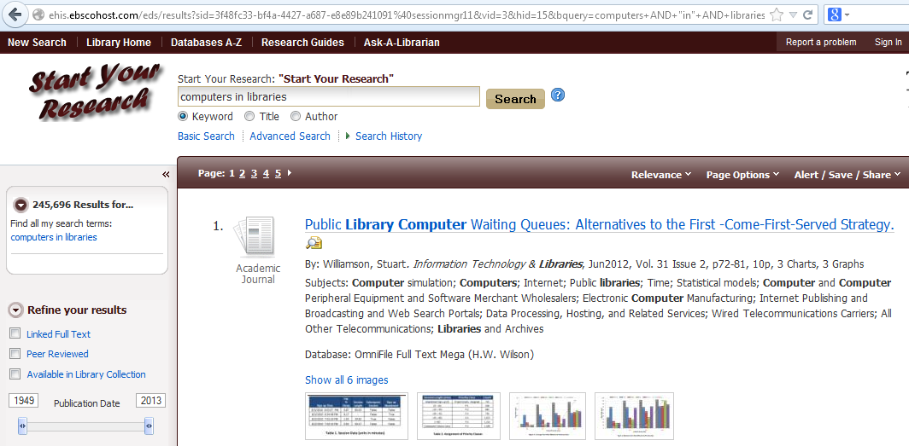
What do we call it?
Notes:
The problem that developed was that when patrons were searching it, they didn’t know what to call it. Reference Desk staff often asked patrons where they were searching and since EDS was an Ebsco product the only point of reference the patron had was an Ebsco logo or the url, so they’d tell us they were searching Ebsco. Librarians did not know if they were in an Ebsco database or EDS We then put a test-based logo at the top left: Start Your Research, and put it on the databases page, too, as Start Your Research. So now it’s referred to as Start Your Research. We went through two iterations of the search widget in a short amount of time.

Slide 18
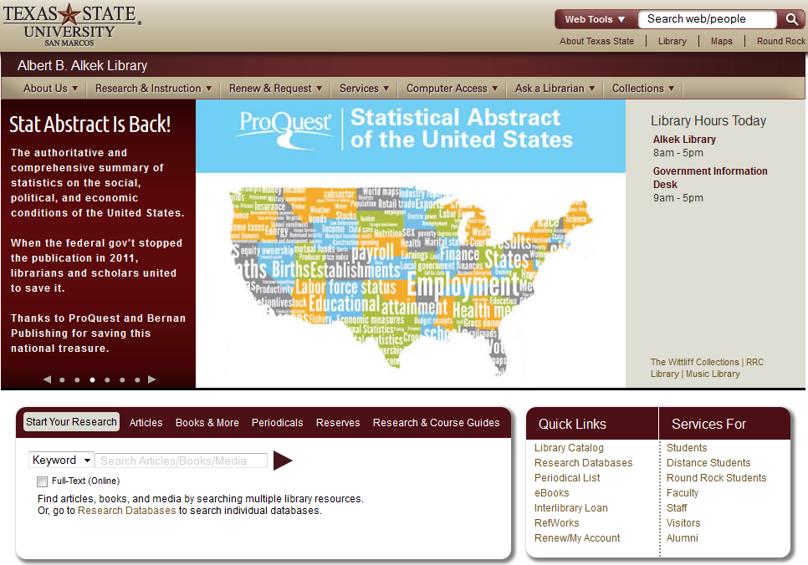
“Final” search box
Notes:
One major component of Implementation was marketing the search tool. The EDS search box was ready in time for the launch of the new library website and currently displays in a simple, clean search box with “Start Your Research” highlighted in beige as the default search tab. This go round we added

Slide 19
It ain’t over ‘til…well, ever.
Implementation & Promotion
Advisory Group
Continued Customization
Notes:
The initial EDS team regrouped into members of an Implementation Team, including more of the instruction team and individuals who wanted to help with marketing/promotion.

Slide 20
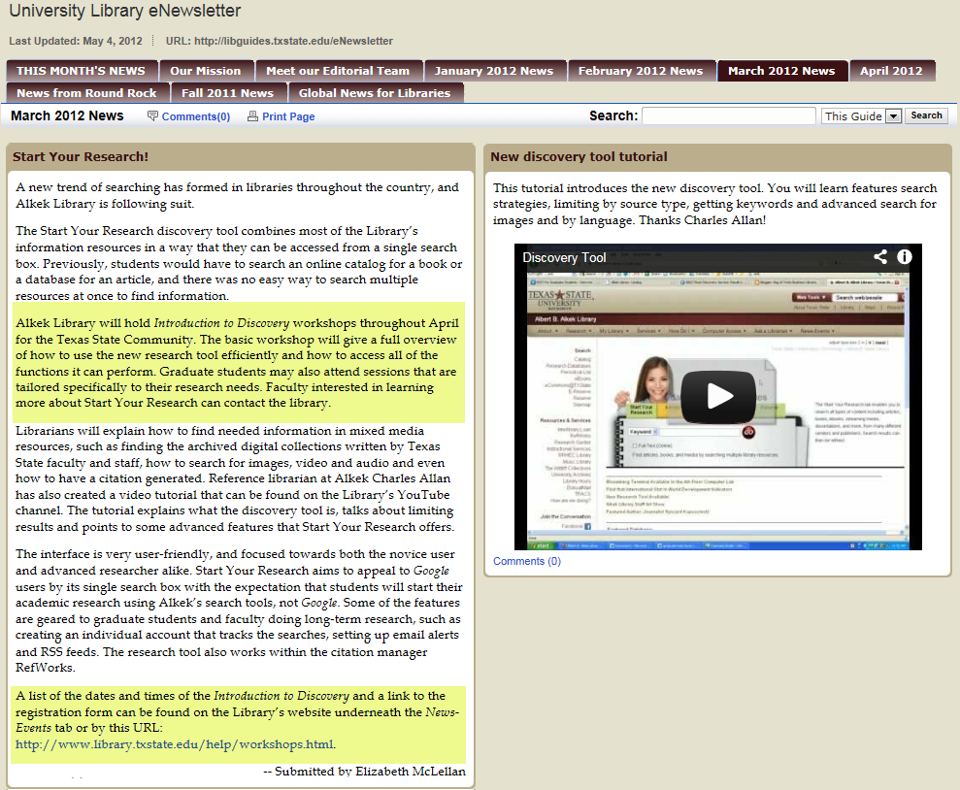
Notes:
The soft rollout began at the beginning of the Spring 2012 semester so instruction librarians could begin teaching EDS in undergraduate classes.
It also gave us a chance to work on class and workshop instruction material and tutorials. The official announcement went out in March 2012 via a column in the University newspaper and the Alkek Library newsletter http://libguides.txstate.edu/eNewsletter

Slide 21
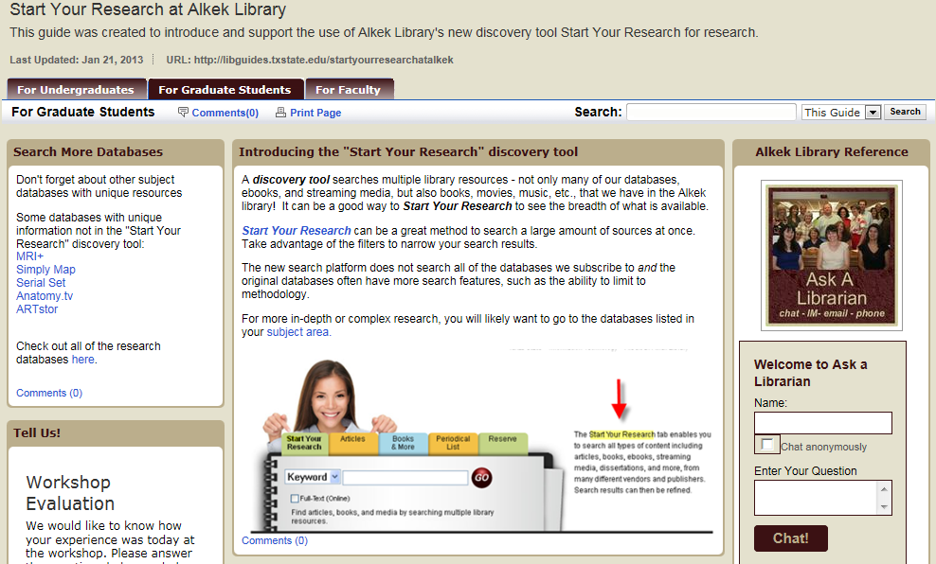
Implementation | Instruction
http://libguides.txstate.edu/startyourresearchatalkek
Notes:
The instruction team also worked on drop-in workshops to introduce patrons to EDS. We worked on a guide targeted at three groups we wanted to focus on: undergraduates, graduate students and faculty. http://libguides.txstate.edu/startyourresearchatalkek
We did a number of 45 minute workshops; undergraduate sessions were better attended than graduate workshops . Our Faculty Outreach librarian provided information on the For Faculty libguide tab, linked a pdf flyer introducing faculty to EDS and briefly presented EDS at a Faculty Advancement session.

Slide 22
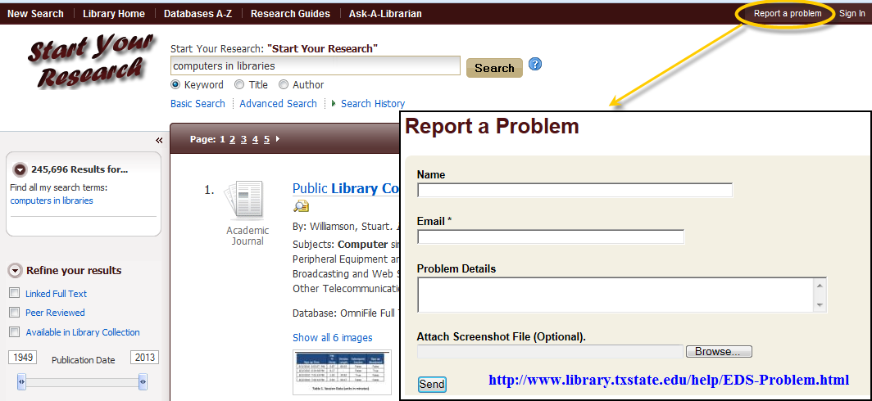
Advisory group
Members for an advisory group were brought together to continue to shape EDS.
Notes:
EDS is like a living organism. The final component was the Advisory Group, made up of reference librarians and Electronic resources and Acquisitions librarians. We receive Ebsco is constantly making changes, additions, and various alterations to Discovery. Some changes work for us, others do not.
As Ebsco added new collections that could be searched in EDS, it would sometimes cause problems in search results if a citation was leading to a source we did not subscribe to or that just didn’t work with our community. We opted to create a mirror Admin profile so that as Ebsco made changes to our main Admin account we could go in via our mirror Admin profile and either adopt additions or opt not to, without messing up setting we already decided already work for us.
We have a link to Report a Problem within the Start your Research search results screen so that patrons, and library staff, can immediately report any problems. There is an option to attach screenshots, but some of us simply use the Search Permalink under the Alert/Save/Share option so that those of us who receive the form can easily regenerate the search to see what the person is seeing and reporting. Off to the right, we also display the Ask a Librarian chat available for patrons to discuss issues with Start your Research with a librarian. Often this will prompt reference desk staff to submit a Problem Report so we can look into the issue and/or report it to Ebsco.

Slide 23
Against instinct, making it work
Our guts tell us two things: IT MUST BE PERFECT. IT MUST BE COMPLETE.
Your discovery tool is neither.
Manage Expectations!
  It’s a STARTING POINT, not an END-ALL, BE-ALL, SEARCH TOOL FOREVERYONE
It can’t have everything in it!
  Many databases aren’t well-suited to be included!
Notes:
Making it Work: One issue that we recently used as a means of tweaking EDS was one brought to us by the History department. They felt that the quality of the resources their students were using for assignments showed an obvious decline and attributed it to EDS. They reported an increased use of non-scholarly/academic resources and instead saw more citing of newspaper resources. As we looked into the issue and tested some topics, we too noticed that results from newspaper resources like NewsBank’s America’s Newpapers were coming up first and in disproportionate numbers in comparison to journal literature. We decided to turn this resource off to help highlight academic resources and that has seemed to help.
In the end, we are making EDS work, but we have to go against instinct. Like most librarians, our guts tell us two things: IT MUST BE PERFECT. IT MUST BE COMPLETE. But the fact is, your discovery tool, and ours, is neither of these. Embracing discovery means managing expectations and accepting that discovery is a starting point, mostly for undergraduates. It is what it is. It can’t contain everything – when it does, the results don’t always work. It’s not perfect – it pulls up results differently than the native interfaces. But that’s OK, because it’s a GATEWAY, and it’s a good place to just Start your Research.

