Slide 1

Breaking Up
Is Hard to Do
Carolyn DeLuca
Electronic Resources Librarian
University of St. Thomas Libraries (MN)
Dani Roach
Head of Serials & Electronic Resource Acquisitions
University of St. Thomas Libraries (MN)
2013 ER&L Conference

Slide 2

Who we are
University of St. Thomas (Minnesota)
Largest private, liberal arts higher ed institution in Minnesota
Approximately 9,000 FTE (70.3% undergrad)
Two campuses (Minneapolis and Saint Paul)
4 libraries (Law Library is separate)
$1.96 million annual materials budget

Slide 3

Agenda
Background
Break down break ups
Players
Types
Tools
Aftermath
Tips and takeaways
Q & A

Slide 4

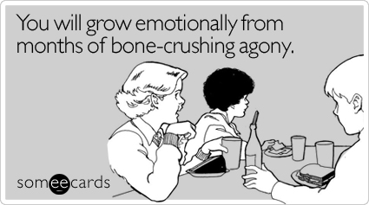
Why this topic?

Slide 5
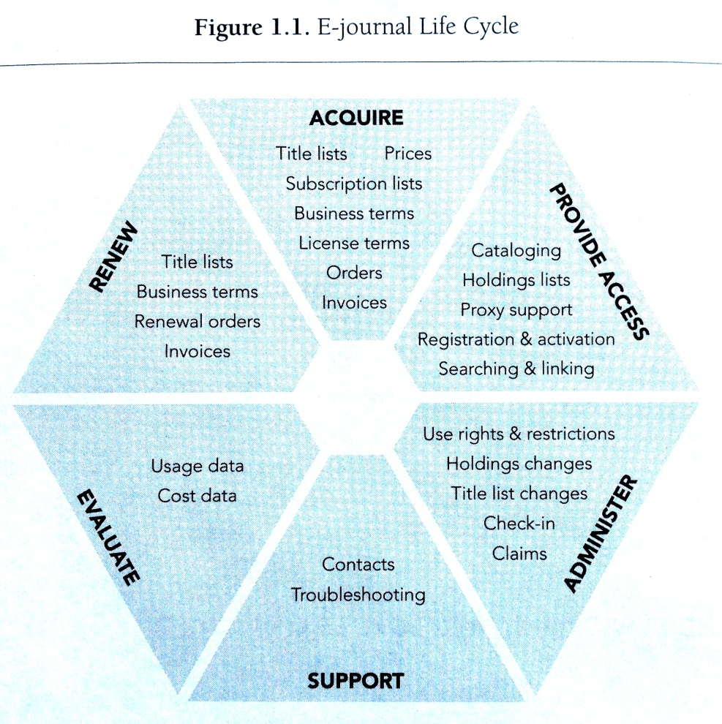
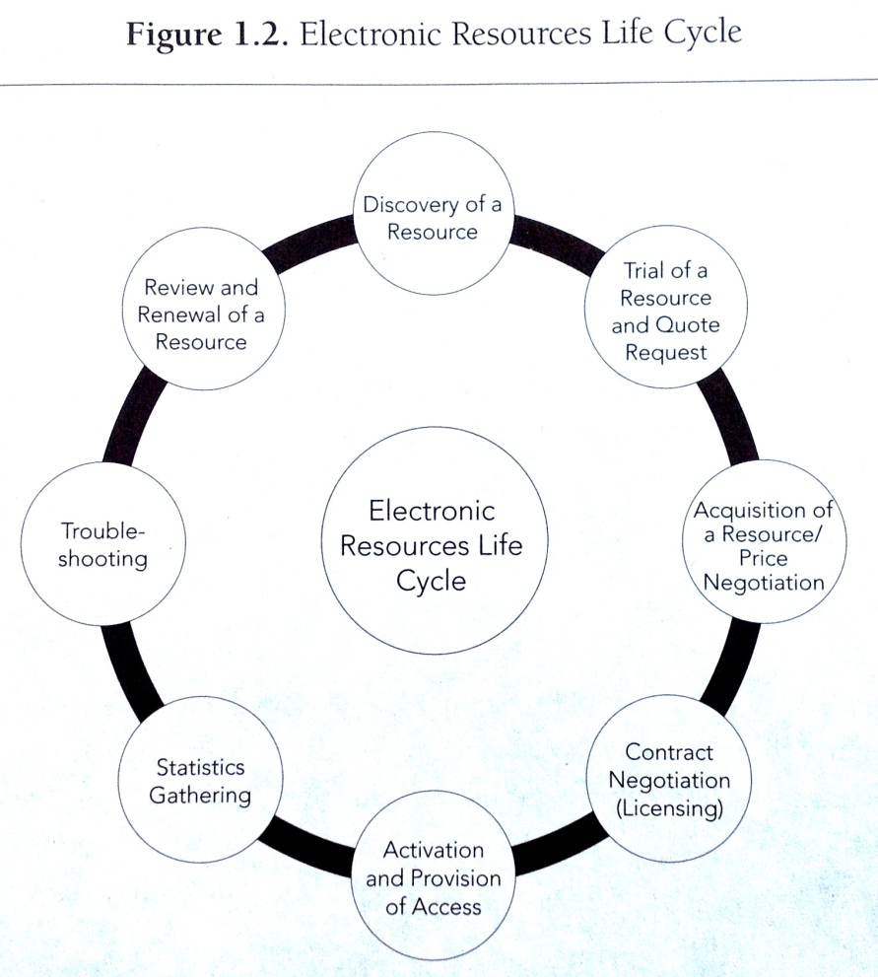
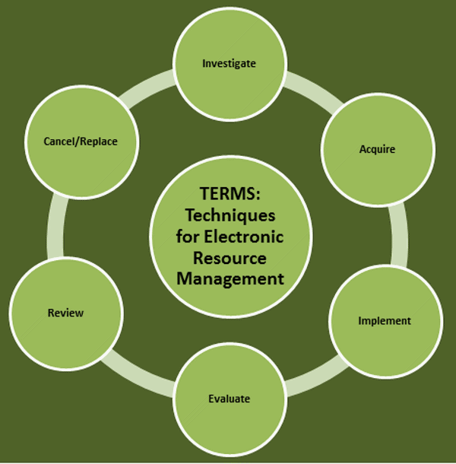
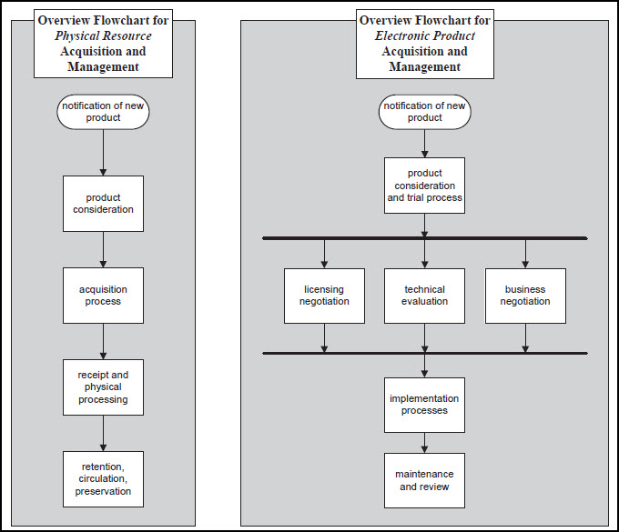
What’s missing

Slide 6
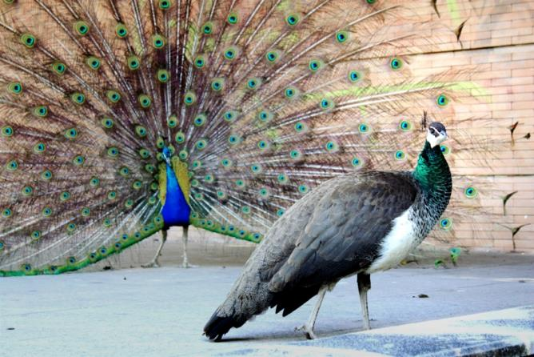

Courtship styles
Friends first
Arranged marriage
Long engagement

Slide 7
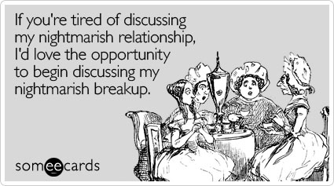
Breaking down the break up
Who
What
Why
Where
When

Slide 8
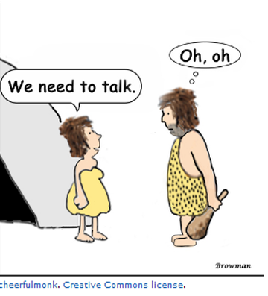
Trouble in paradise
http://cheerfulmonk.com/2010/02/15/we-need-to-talk-really/

Slide 9

Who broke it off?
Internal players:
  Liaison
  ERMS staff
External players:
  Publisher
  Provider
  Broker
  Consortium
  Vendor

Slide 10

What happened here?
Cancelled, ceased, or migrated
Affected in the fallout:
  Status
  Holdings
  Platform
  Product
  Provider

Slide 11


Why? Why? Why?
  In our control:
    User preferences
    Budget decisions
  Outside our control:
    Company merger
    Publisher changes
    Platform migration
    Available through free web

Slide 12

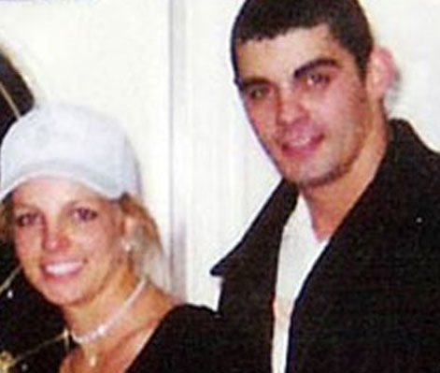
Cancelled
Examples in our control:
Low use/high cost
Redundant
No longer supports curriculum
Management decisions
Annulled

Slide 13
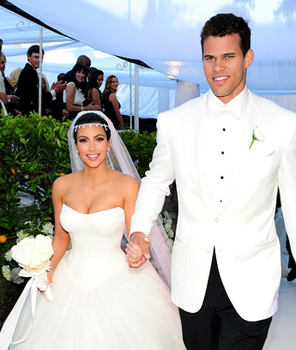
Cancelled
Examples outside our control:
State/consortial contracts change
Terms of access change
Non-library money source dries up
ERMS/KB change
Divorced

Slide 14

Ceased
How it dies may matter
  Needs immediate attention
  Advanced planning
E-journal titles change, cease, and publishers fold
Happy Widows

Slide 15
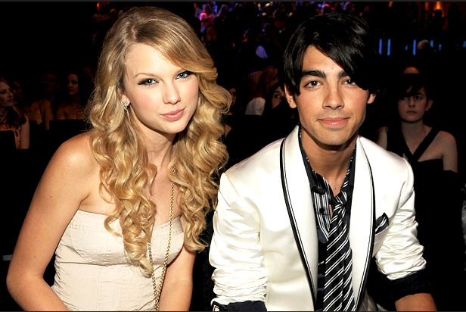

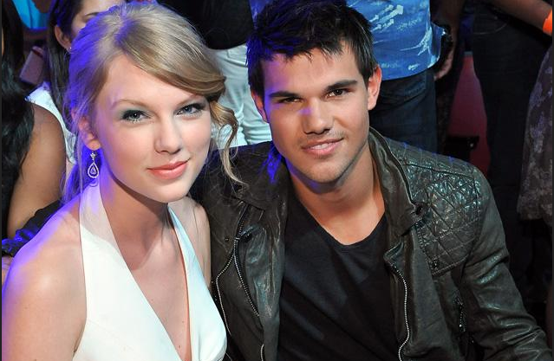
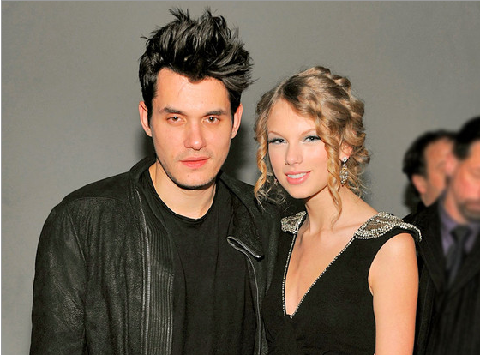
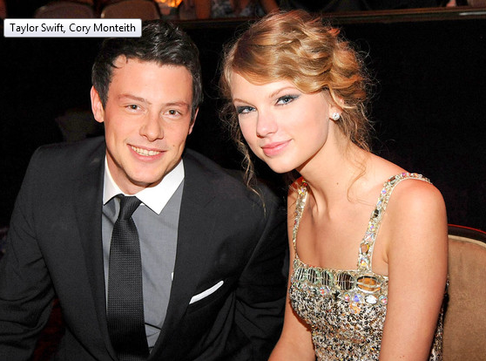
Migrated
Examples in our control:
  CSA to APA
Examples outside our control:
  CSA to ProQuest
  Wilson to EBSCO
  NetLibrary to EBSCO eBooks

Slide 16


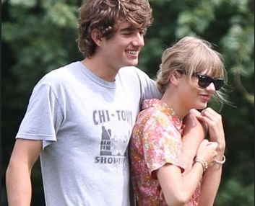


Migrated
E-Journal Publisher changes:
  Association to publisher
  Publisher to publisher
E-Journal platform changes:
  Hosted to publisher
  Publisher to hosted
  Out of (and sometimes back to) aggregators

Slide 17

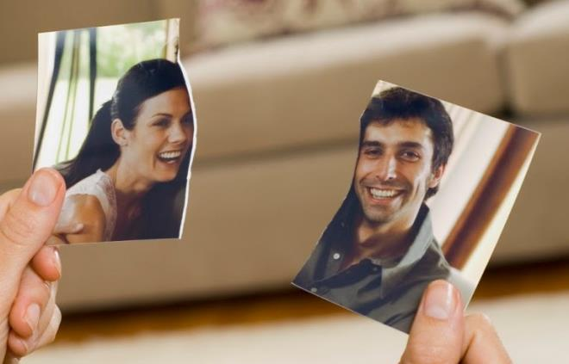
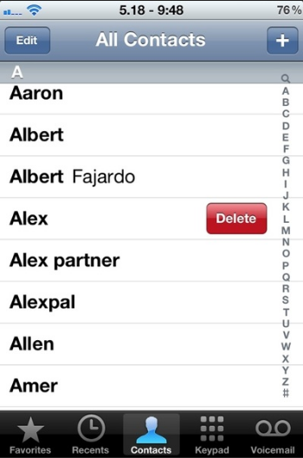
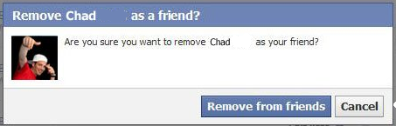
Where?
From where does the resource need to be removed?
Where do you communicate that?

Slide 18

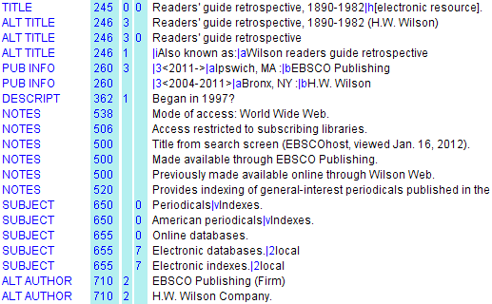


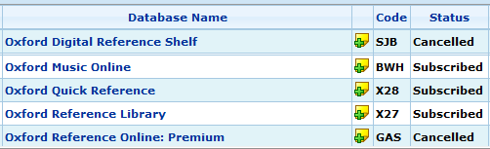
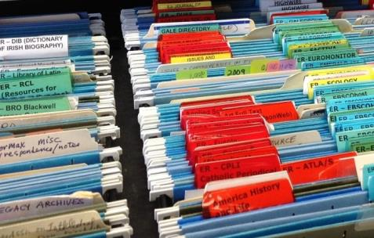
Where?
Catalog
ERM
Course management
Files

Slide 19
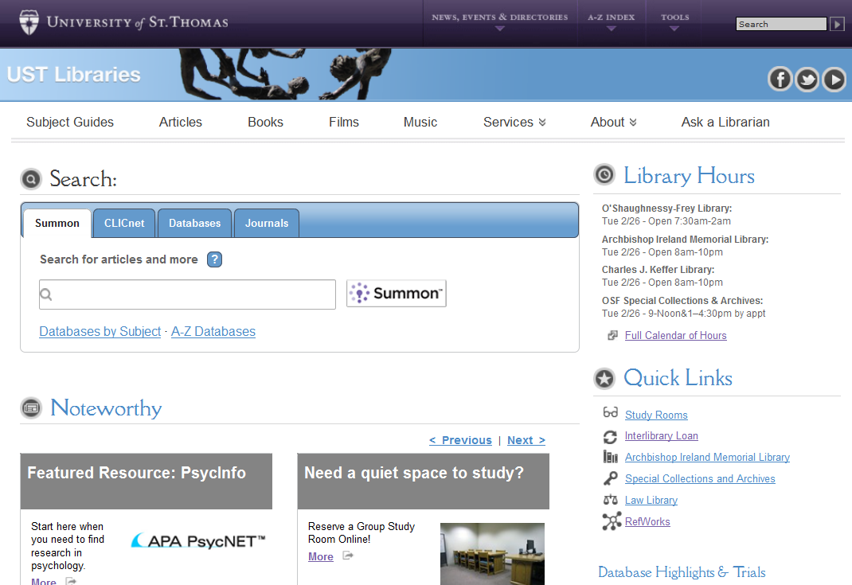
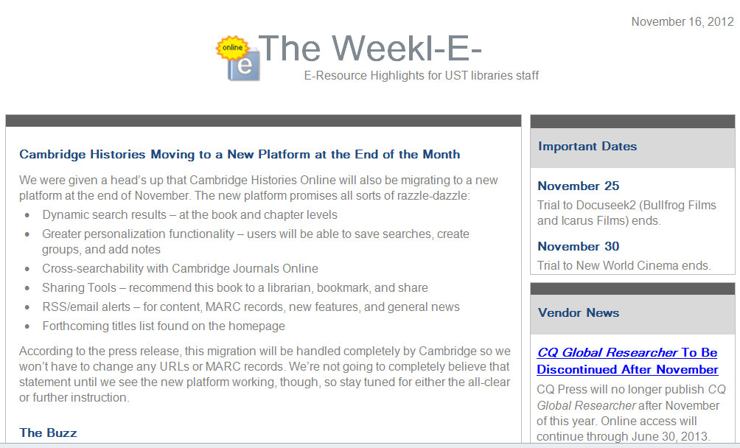
Where?
Subject Guides
Website
Refworks

Slide 20



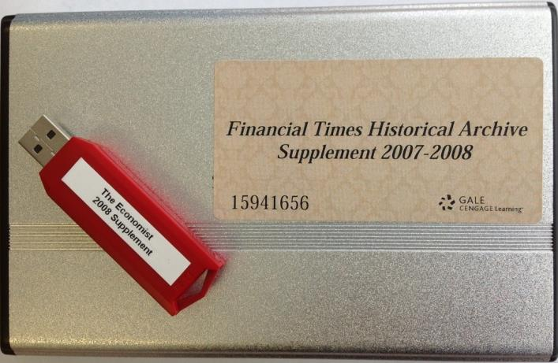

Where?
Proxy config
Local tools
Customized holdings
Archives

Slide 21
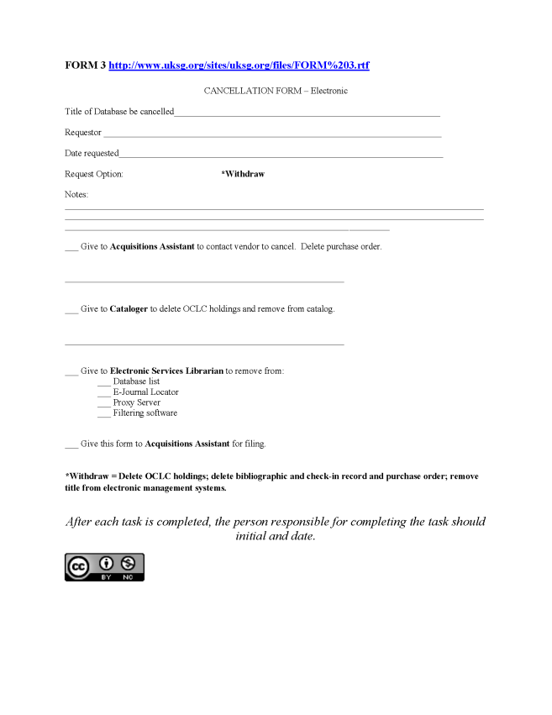
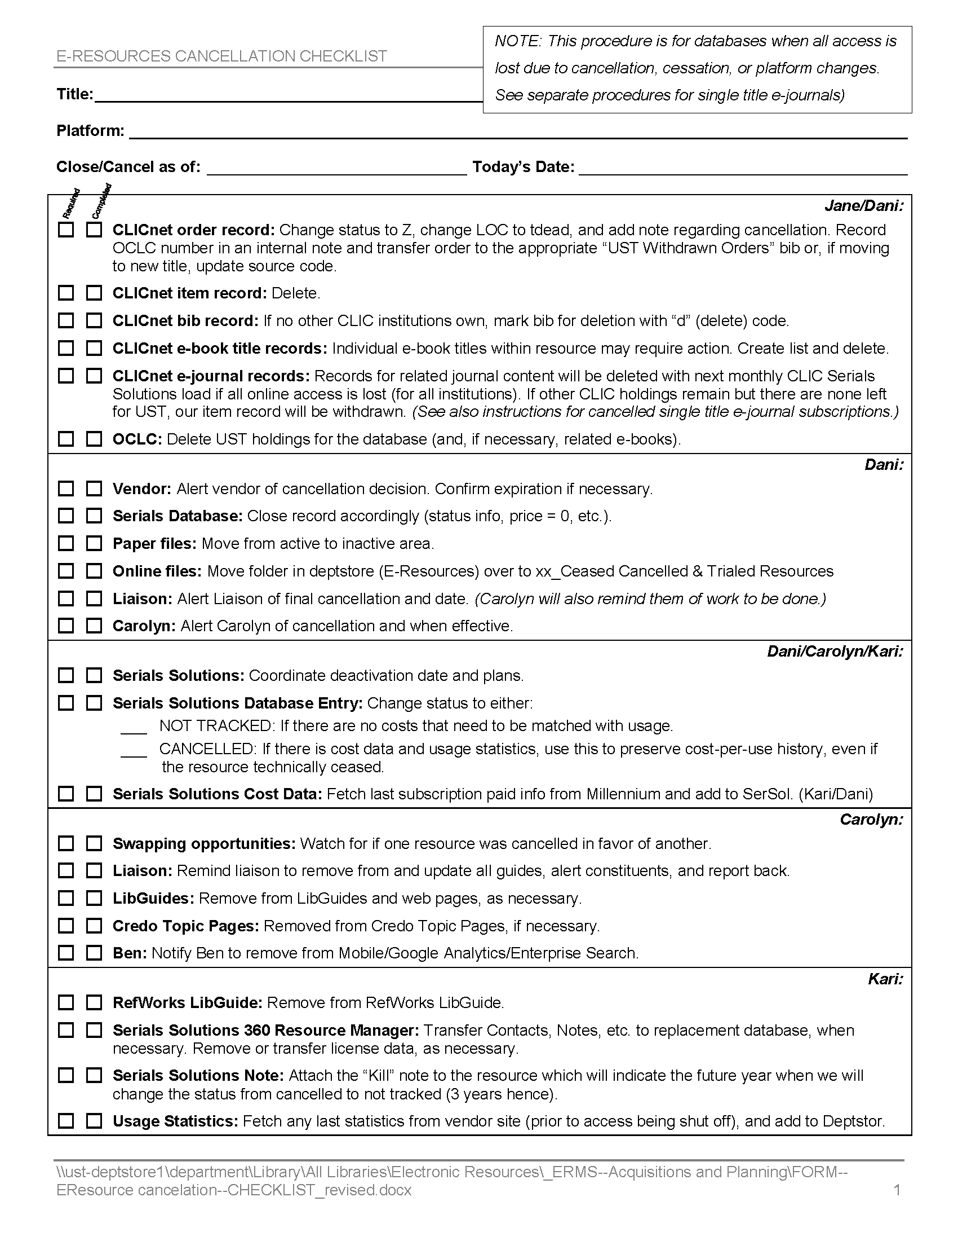
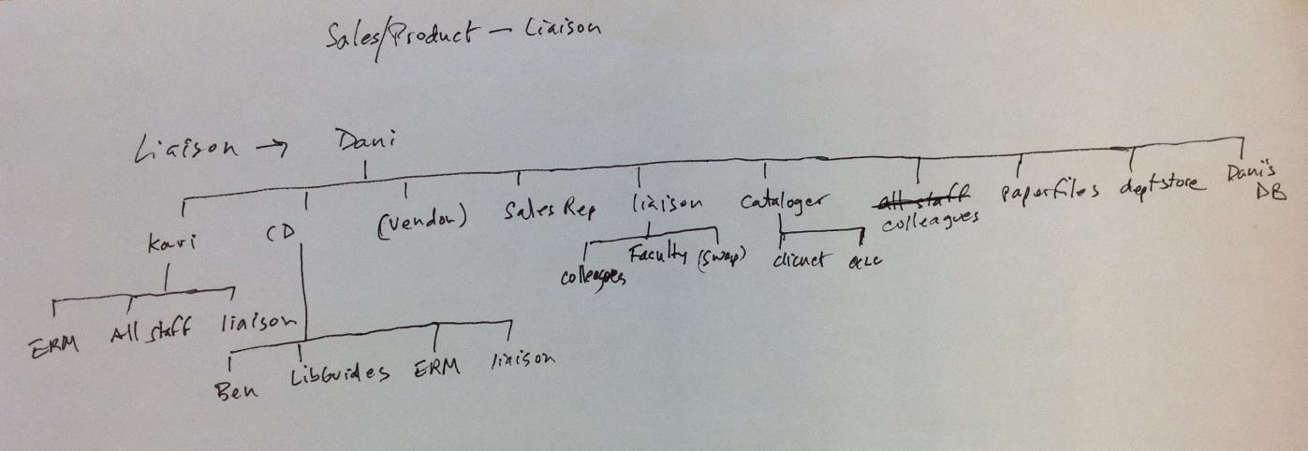
Tracking tools

Slide 22

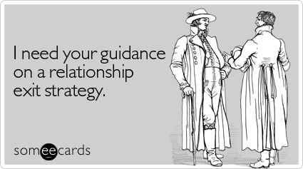
Vendor’s role

Slide 23
Break up tips
  From the vendor’s perspective:
  Know who signed the license
  Confirm post-cancellation rights
  Do not count on a refund
  Plan cancellations and migrations well in advance of renewal
  Know what you want; if replacing a product do your research

Slide 24



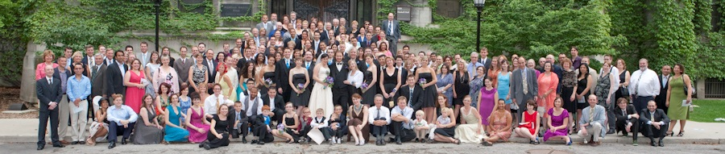
Publisher/Content providers

Slide 25
Break up considerations
From the publisher/content provider’s perspective:
Ownership transfers
Licensing
Grace periods
Overlap periods
Personal relationships

Slide 26
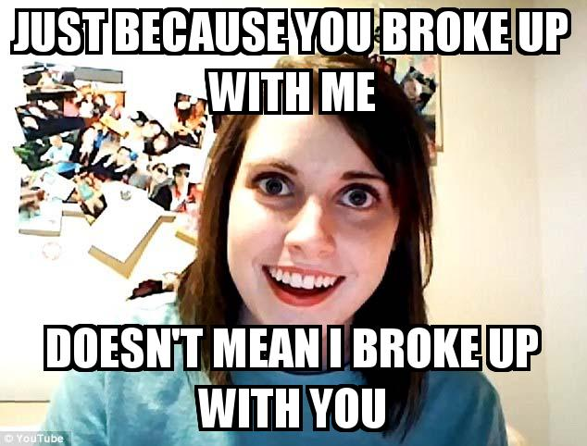
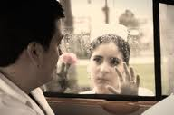
When?
After warning in
advance
Immediately
End of semester
After probation
Bitter end
(at expiration or death)

Slide 27


What’s left?
If cancelled
If deleting or weeding
If migrating

Slide 28


The ending

Slide 29
Thanks to…
Emery, Jill, and Graham Stone. "TERMS: Techniques for electronic resource management.“ Web. http://6terms.tumblr.com
Jewell, T. D., et al. "Electronic Resource Management. The Report of the DLF Initiative." 2004. Web. http://diglib.org/pubs/dlf102/
Holloway, Trina. “Cancellation workflow.” E-Resources Management Handbook. Ed. By Graham Stone. Oxon: UKSG, 2010. Web. http://uksg.metapress.com/content/w109um4113147240/?p=daa85037cbb24e108042c716fc5a6a27&pi=4
Crosetto, Alice. “Weeding E-books.” No Shelf Required 2. Ed. By Sue Polanka. Chicago: American Library Association, 2012. Print.
Weir, Ryan O. Managing Electronic Resources: A LITA Guide. Chicago: ALA TECHSOURCE, 2011. Print.
Special thanks to our colleague, Kari Petryszyn!

Slide 30


Parting shots
Links to our tools: http://libguides.stthomas.edu/content.php?pid=441445
  Copy of this presentation
  All purpose checklist for a journal
  Cancellation checklist for a database
  ERM roles at UST
Carolyn DeLuca
cjdeluca@stthomas.edu
Dani Roach
dlroach@stthomas.edu

