Slide 1
Integrative Cancer Care
Donald I. Abrams, M.D. UCSF, Division of Oncology,
Osher Center, Zuckerberg San Francisco General Hospital
Stephanie Cheng, M.D.
UCSF, Division of Palliative Medicine
Mikhail Kogan, M.D.
GWU, GW Center for Integrative Medicine
AIM Health Institute

Slide 2
What is Integrative Oncology?
Integrative oncology is an evidence-based medical sub-specialty that uses complementary therapies (CTs) in concert with conventional medical treatment to enhance efficacy, improve symptom control, alleviate patient distress, and reduce suffering.
Integrative oncology advocates that cancer is a metabolic diseases, and hence not just cancer but also whole body needs to be treated to optimize it’s normal cancer defense mechanisms
Tools – both disease modifying and constitutional support
Diet
Exercise
Mind-Body methods: meditation, yoga, tai chi
Supplements/Vitamins – Oral or Intravenous
Integrative Modalities: acupuncture, massage

Slide 3
Good News?

Slide 4
More Good News?

Slide 5
Not so Good News
Approximately 39.6 percent of men and women will be diagnosed with cancer at some point during their lifetimes.*
US incidence of cancer is 7th highest in the world
National expenditures for cancer in the United States totaled nearly $125 billion in 2010 and could reach $156 billion in 2020. *
The number of new cases is expected to rise by about 70% over the next 2 decades. **
Tobacco use is the most important risk factor for cancer causing around 20% of global cancer deaths and around 70% of global lung cancer deaths.**
* 2010-2012 NCI data
** 2015 WHO data

Slide 6
Cancer Disparities
The NCI defines "cancer health disparities" as "differences in the incidence, prevalence, mortality, and burden of cancer and related adverse health conditions that exist among specific populations groups in the United States."
From NCI Website
Notes:
Cancer disparities exist not only in the US, but around the world.

Slide 7
The anatomy of disparity
Death from Preventable cancers
Death from late-stage cancers otherwise detectable
Sub-standard treatment and care for minority groups
Death from curable cancers
Absence of pain control, other palliative care for cancers that do not have cure
From NCI Website
Notes:
Avoiding death from preventable cancers is very important, as many lives can be saved by easy to implement programs, such as smoking cessation.
While you may argue that implementation of smoking cessation is not easy, it is still easier than trying to find cure for Stage 4 lung cancer.

Slide 8
Overall Cancer Incidence and Death Rates
 | All Sites
Racial/Ethnic Group | Incidence | Death
All | 470.1 | 192.7
African American/Black | 504.1 | 238.8
Asian/Pacific Islander | 314.9 | 115.5
Hispanic/Latino | 356.0 | 129.1
American Indian/Alaska Native | 297.6 | 160.4
White | 477.5 | 190.7
http://www.cancer.gov/cancertopics/factsheet/cancer-health-disparities#1
Notes:
From
http://www.cancer.gov/cancertopics/factsheet/cancer-health-disparities#1
Please note that African American/Black minorities in the US have a heavy burden of both, cancer incidence and cancer mortality. More research is needed as to why this is happening.
Statistics are for 2000-2004, age-adjusted to the 2000 U.S. standard million population, and represent the number of new cases of invasive cancer and deaths per year per 100,000 men and women.

Slide 9
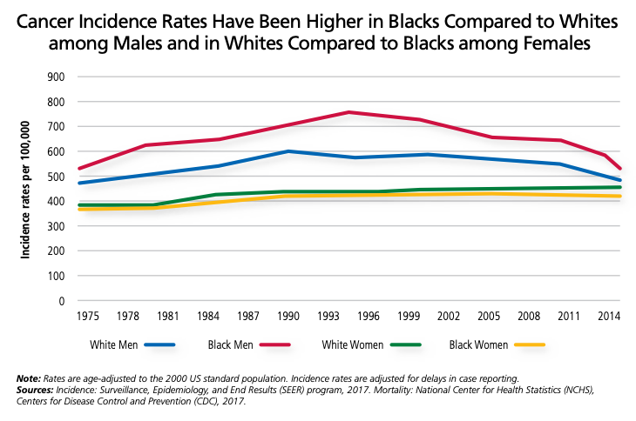

Slide 10
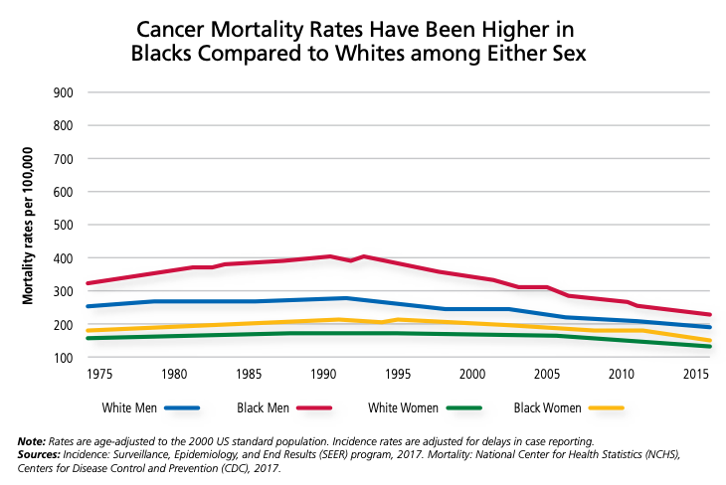

Slide 11
Obesity and Common Cancers
Women
Endometrial, ovarian, colon, breast (post-menopausal), renal cell
Men
Colon, prostate
Possible Mechanisms:
Hyperinsulinemia (especially central adiposity) associated with cell growth & proliferation
Adipose tissue is primary source of estrogens, which has been linked to carcinogenesis
Notes:
If obesity is a contributing factor for many cancers, programs that target obesity prevention are needed to address this issue. Bariatric surgery may provide alternative last option solution for people who cannot lose weight through traditional means.

Slide 12
Dietary components and risk of common cancers
Cancer | Increase Risk | Decrease Risk
Breast | Alcohol, excess energy intake, weight gain | Vegetables, monounsaturated fats
Colon | Red meat | Fruit/vegetable fiber, Alcohol
Lung |  | Vegetables, especially green/yellow
Prostate | Meat | Lycopene (tomatoes)
GI | Alcohol, Sodium | Fruit/vegetables
Notes:
While there are many different publications out there about the link between diet and cancer, it is important to point out that the exact dietary intake is very difficult to measure. The field of nutritional epidemiology is moving towards objective tests of dietary consumption (such as urine test), which can potentially give more information than traditional dietary surveys or diaries.

Slide 13
Physical Activity and risk of common cancers
Cancer | Cancer risk
Breast | inconsistent association—time period may be critical
Colon | 30-40% decreased risk among active men & women (Rectal—no association)
Prostate | findings inconclusive
Possible mechanisms:
1. Decreased GI transit time which decreases carcinogen exposure)
2. Enhanced immune function with moderate PA
3. Lowered levels of reproductive hormones
Notes:
Physical activity for cancer prevention receives quite a bit of attention, however more research is needed to explore the exact link.

Slide 14
Life style Summary Anti-inflammatory, Metabolism Optimizing Diet and Life style
Keep normal BMI
Avoid smoking
7+ servings of vegetables day, including dark green leafy veggies and cruciferous
Avoid processed sugar and synthetic sweeteners
Minimized simple carbs
Regular Consumption of high anti-oxidant foods: berries, turmeric, ginger, green tea
Limit Alcohol, Red Meat, Dairy
Sensible sun exposure (avoid burns but get regular sun exposure – vitamin D) – 30min/day before 10AM
Regular Exercise
Combat stress with
Mind-Body practices
Social Interactions
Body work (massage, etc)
Exercise

Slide 15
Integrative Oncology
Supporting conventional care (surgery, chemo, radiation, hormonal treatments, small molecule treatments, immunotherapy)
Providing support for the body’s terrain
Digestion
Immune system
Detoxification
Hormonal balance and elimination
Adjunctive natural anti-tumor agents

Slide 16
Supporting Conventional Care
Surgery
Eliminating any supplements that may interfere with anesthesia or affect clotting/bleeding (eg St. John’s Wort, high dose fish oil or garlic or vitamin C)
Supporting body’s healing capacity – protein, bromelain, zinc, probiotics, multivitamin
Radiation
Supportive care for side effects – fatigue (American ginseng), anorexia, burns (aloe), cardiomyopathy (CoQ10, L-carnitine)
Making sure evidence indicates safety for concurrent use of supplement recommendations during radiation

Slide 17
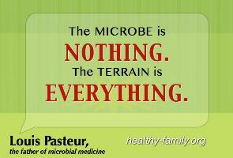
Optimizing the Terrain
Providing support for the body’s terrain
Diet
Digestion
Detoxification
Elimination
Immune system
Hormonal balance and elimination

Slide 18
Terrain Digestion
L-glutamine
Digestive enzymes, HCl, bile salts
Probiotics
Stress reduction (suppresses digestive fxn)
Water

Slide 19
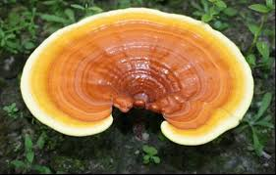
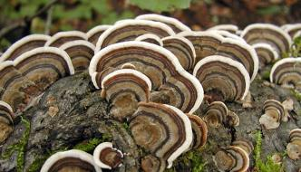
Terrain Immune System
Mushrooms
Reishi
Maitake
Trametes (aka Coriouls, turkey tail)
Others
Vitamin D3
Probiotics
Others?

Slide 20
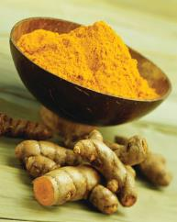
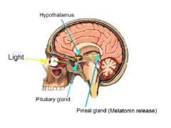

Adjunctive Natural Anti-Tumor Agents
Curcumin
EGCG
Mushrooms – Reishi, Maitake, Trametes (aka Coriouls, turkey tail)
Vitamins C, D3, K
Melatonin

Slide 21
References
.
Natural products and complementary therapies for chemotherapy-induced peripheral neuropathy: A systematic review. Brami C, Bao T, Deng G. Crit Rev Oncol Hematol. 2016 Feb;98:325-34.
Beijers AJ, Jongen JL, Vreugdenhil G. Chemotherapy-induced neurotoxicity: the value of neuroprotective strategies. Neth J Med. 2012 Jan;70(1):18-25. Review. PubMed PMID: 22271810.
National Cancer Institute-supported chemotherapy-induced peripheral neuropathy trials: outcomes and lessons. Majithia N., Temkin S.M., Ruddy K.J., Beutler A.S., Hershman D.L., Loprinzi C.L. Supportive Care in Cancer 2016 24:3 (1439-1447)
Cos S, Sanchez-Barcelo EJ. Differences between pulsatile or continuous exposure to melatonin on MCF-7 human breast cancer cell proliferation. Cancer Lett 1994;85:105-109
Melatonin. Monograph. Altern Med Rev. 2005 Dec;10(4):326-36. Review. PubMed PMID: 16366741
Blask DE, Cos S, Hill SM, et al. Melatonin action and oncogenesis. In: Franchini F, Reiter RJ, eds. Role of Melatonin and Pineal Peptides in Neuroimmunomodulation. New York, NY: Plenum Press; 1991;233-240.
Kostoglou-Athanassiou I. Therapeutic applications of melatonin. Ther Adv Endocrinol Metab. 2013 Feb;4(1):13-24. doi: 10.1177/2042018813476084. PubMed PMID: 23515203; PubMed Central PMCID: PMC3593297
Extended Exposure to Dietary Melatonin Reduces Tumor Number and Size in Aged Male Mice, Sharman, Sharman & Bondy, Exp. Gerontol. 2010 Sep 14
Curcumin Inhibits Prosurvival Pathways in Chronic Lymphocytic Leukemia B Cells and May Overcome Their Stromal Protection in Combination with EGCG, Ghosh, Kay, Secreto & Shanafelt, Clin. Cancer Res. 2009; 15 (4): 1250-1258.
McKenna DJ, Hughes K, Jones K. Green tea monograph. Altern Ther Health Med. 2000 May;6(3):61-8, 70-2, 74 passim. Review. PubMed PMID: 10802908
Yiannakopoulou EC. Interaction of green tea catechins with breast cancer endocrine treatment: a systematic review. Pharmacology. 2014;94(5-6):245-8. doi: 10.1159/000369170. Epub 2014 Nov 28. Review. PubMed PMID: 25471334.
Dietary Intakes of Mushrooms and Green Tea Combine to Reduce the Risk of Breast Cancer in Chinese Women, Zhng, Huang, Xie & Holman, Int. J. Cancer 2009; 1246: 1404-1408
Ganoderma lucidum (Reishi Mushroom) for Cancer Treatment (Review), Jin, Beguerie, Sze & Chan, Cochrane Collaboration 2012 ; 6: 1-38
.

Slide 22
Thank you Q & A

