Slide 1


Rx Self-Care:
Giving Yourself (and Patients) Permission for Self-Care
IM4US 2019 Conference
"Solidarity & Self-Care - Supporting Social Justice and Balance in Integrative Health"
August 22-24, 2019 | Santa Clara University in Northern California
Beth Rosenthal, MPH, MBA, PhD
Heather Carrie, MAS

Slide 2
Disclosure Statement
Beth Rosenthal
I am an author and presenter on topics related to subject matter of this conference presentation.

Slide 3
Disclosure Statement
Heather Carrie
I have no relevant relationships with commercial interests to disclose.

Slide 4
Learning Objectives
At the end of this session participants will be able to:
  Describe at least five ways in which provider self-care impacts patient care.
  Demonstrate at least five self-care activities.
  Discuss strategies to address challenges of engaging in daily self-care practices.

Slide 5
Welcome & Overview (10 min)
Importance of healing the healer (15 min)
Evidence-Based Self-Care Practices (20 min)
RX for Self Care: Writing your own prescription (5 min)
Conclusion / Discussion of link between Self-Care & Social Justice / Q&A (10 min)

Slide 6
Welcome & Overview (10 min)
Integrative Health and Medicine practitioners delivering care to the underserved experience high levels of stress that may lead to burnout, depression, substance abuse, and suboptimal patient care.
Due to these very real pressures it may feel impossible and/or inappropriate to take time for self-care. In this session we look at different ways of thinking about self-care and the link between self-care and social justice and equity: self-care is for everyone, not just the privileged.

Slide 7
We begin by discussing why provider self-care is so important, and ways in which provider self-care impacts patient care.
We'll demonstrate self-care practices and discuss strategies you can use to take care of yourself, and you'll have the opportunity to write yourself a prescription for self-care that you can take with you. We’ll engage in discussion about how you might make these prescriptions culturally relevant for underserved populations.

Slide 8

Importance of healing the healer (15 min)

Slide 9
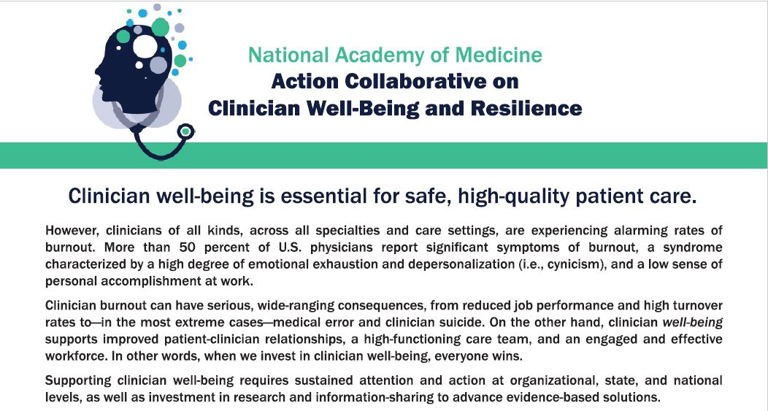
Notes:
https://nam.edu/initiatives/clinician-resilience-and-well-being/?utm_source=National+Academy+of+Medicine&utm_campaign=ade1e10759-CR+July+meeting+registration_COPY_01&utm_medium=email&utm_term=0_b8ba6f1aa1-ade1e10759-150975785
NAM Global Forum on Innovation in Health Professional Education
Stress and burnout of the workforce affect patient outcomes and patient experiences. Well-being affects workforce turnover, which can affect quality of care. Finally, health professional well-being affects the financial bottom line of health systems; these effects are important to acknowledge as they “often drive change,” concluded Talib. National Academies of Sciences, Engineering, and Medicine. 2019. A Design Thinking, Systems Approach to Well-Being Within Education and Practice: Proceedings of a Workshop. Washington, DC: The National Academies Press. doi: 10.17226/25151

Slide 10
How does practitioner self-care
impact patient care?
Notes:
Discussion: How do you think provider self-care impacts patient care?
[LO: Describe at least five ways in which provider self-care impacts patient care.]
many reasons why practitioner self-care is so important:
1) Integrative Health and Medicine practitioners experience high levels of stress that may lead to burnout, depression, substance abuse, and suboptimal patient care;
2) Healers are role models for patients; and
3) Collaboration and team care are enhanced when practitioners are able to respond rather than react, which can increase provider satisfaction as well as patient outcomes.

Slide 11
Evidence-Based Self-Care Practices (15 min)

Slide 12

National Academy of Medicine Global Forum on Innovation in Health Professional Education
Initiatives to improve the well-being of health professionals have largely focused on supporting individuals ... Initiatives that focus on changing the system are much less common, but they have the potential to be more effective … quote by Mark Greenawald: “You can teach physicians mindfulness and meditation techniques, but if you throw them back to the war zone it’s not going to work” (U.S. News & World Report, 2016).
National Academies of Sciences, Engineering, and Medicine. 2019. A Design Thinking, Systems Approach to Well-Being Within Education and Practice: Proceedings of a Workshop. Washington, DC: The National Academies Press. https://doi.org/10.17226/25151.
Notes:
Systems / Individuals: Rather than either/or, think both. we are providing suggestions for addressing self-care, but not implying that the "problem" is with the individual. Self-care is essential but not sufficient. Changes need to be made to the system, and taking good care of ourselves may help in bringing about change, and contributing to system improvement, starting with how we treat ourselves and those we interact with...
https://www.nap.edu/read/25151/chapter/1
From A Design Thinking, Systems Approach to Well-Being." National Academies of Sciences, Engineering, and Medicine. 2019. A Design Thinking, Systems Approach to Well-Being Within Education and Practice: Proceedings of a Workshop. Washington, DC: The National Academies Press. doi: 10.17226/25151

Slide 13
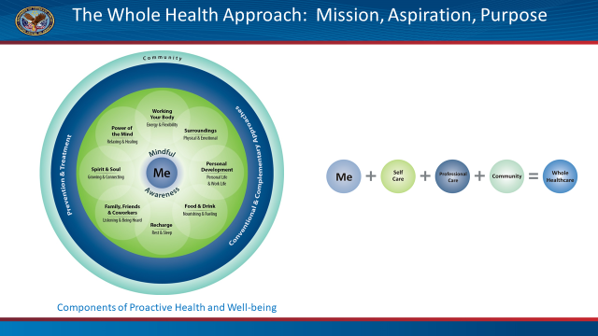
Notes:
While self-care is undeniably important, it may feel impossible and/or inappropriate to take time for self-care. In this session the case is made that the need for self-care is absolutely essential, for our own well-being, as well as for those we care for and about. Self-care is for everyone, not just the privileged. Self-Care is an important component of the VA Whole Health Approach.

Slide 14
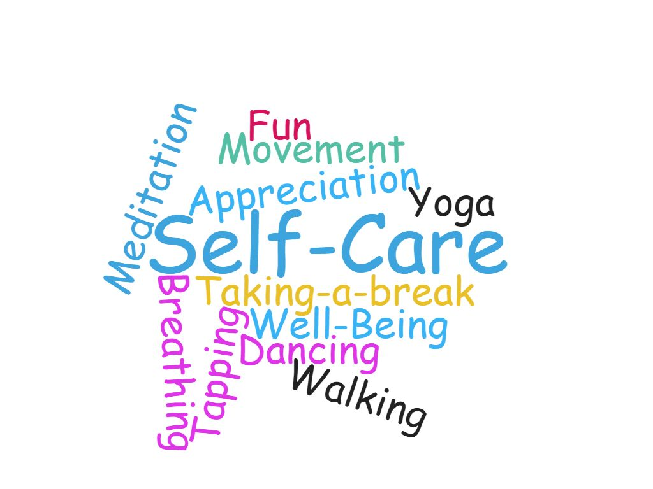
Experience Self-Care Practices &
Discuss Strategies to Implement
Notes:
Handout with practices. Demonstrate several evidence based self-care practices. 1-minute adaptations.
What variations might work best for you?
Discuss strategies for practitioner self-care.

Slide 15
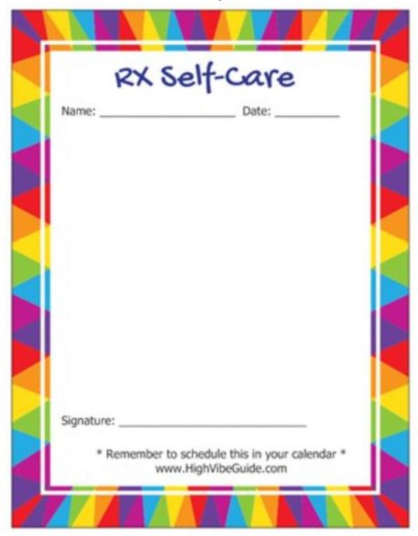
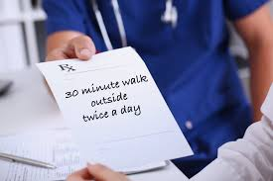
RX for Self Care: Writing your own prescription
(5 min)
Notes:
Participants are invited to write prescriptions for their own self-care. These self-care prescriptions are also tools that can be used with patients.
Engage in discussion: how might you make this RX culturally relevant for the populations you serve?

Slide 16
Conclusion
Discussion of link between Self-Care & Social Justice Q&A
(10 min)
Notes:
What is the link between self-care and social activism, social justice and equity?
* When we take care of ourselves we are in a better position to be of greater service to others.
* Encouraging others to take care of themselves makes self-care more equitable, and not just for the wealthy.
* Other ideas?

Slide 17
References
The National Academies of Sciences, Engineering, Medicine Proceedings of a Workshop: A Design Thinking, Systems Approach to Well-Being within Education and Practice. (2018) https://www.nap.edu/read/25151/chapter/1
Replenish: A Life Enhancing Activity Book. Beth Rosenthal (2018) https://smile.amazon.com/Replenish-life-enhancing-activity-book/dp/1981738479/ref=sr_1_1?ie=UTF8&qid=1529870749&sr=8-1&keywords=replenish+rosenthal
Science of the Heart: Exploring the Role of the Heart in Human Performance (An Overview of Research Conducted by the HeartMath Institute) https://www.heartmath.org/research/science-of-the-heart/
The National Academies of Sciences, Engineering, Medicine
Action Collaborative on Clinician Well-Being and Resilience
https://nam.edu/clinicianwellbeing/

Slide 18
Thank you!
Comments / Questions?
Beth: highvibeguide@gmail.com
Heather: hcarrie@aihm.org

