Slide 1
The Integrative Pain management program: implementing a multi-modal care program for chronic pain in a safety net setting
Joseph L. Pace, MD
Director of Primary Care Homeless Services
Medical Director, Tom Waddell Urban Health
San Francisco Department of Public Health
August 23, 2019

Slide 2
Disclosure
I have no significant relevant financial interests or other relationships with manufacturers of any pharmaceutical product or medical device.

Slide 3
Objectives
Background and Motivation
Design and implementation of the Integrative Pain Management Program (IPMP)
Discuss results, lessons learned
Sustainability and next steps

Slide 4
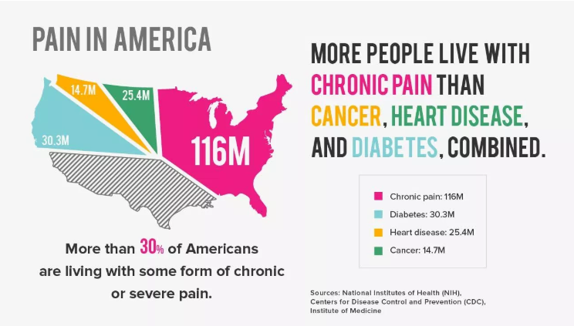
Notes:
This is not news to attendees of this conference. One in three Americans suffers from chronic pain – which is defined as any pain that lasts longer than 3 months. It affects over 100mil Americans -- more than cancer, diabetes, and heart disease combined.

Slide 5
Chronic PAIN & Primary CARE
More than one-third of primary care visits are for chronic pain
Primary Care Providers (PCPs) have low confidence and poor satisfaction with chronic pain management
About ½ of opioid prescriptions are written by PCPs
Prescription opioids have been the mainstay of treatment in many settings
IOM Relieving Pain in America: A Blueprint for Transforming Prevention, Care, Education, and Research. Washington, DC: National Academies Pres.; 2011.
Chou R, Fanciullo GJ, Fine PG, et al. Clinical guidelines for the use of chronic opioid therapy in chronic noncancer pain. J Pain 2009;10:113–130.
Notes:
Reasons why opioids have been the mainstay: 1- Concern in late 1990’s about undertreatment of pain, 2- Misleading marketing by pharma about high benefits, low risks of chronic opioid therapy, 3- lack of awareness/acceptance of and no visit models or reimbursement strategies for integrative treatments in the incredibly shrinking visit; Myth: Patients wouldn’t embrace it

Slide 6
Chronic Pain & The Safety net
Socioeconomic Disadvantage (SED)* a risk factor for having chronic pain
Is lower socioeconomic status truly a risk factor for pain or is it a consequence of experiencing chronic pain?
Evidence not clear, but interplay between SED and pain well-described
Poleshuck EL, Green CR. Socioeconomic disadvantage and pain. Pain. 2008;136(3):235–238.
Green CR, Anderson KO, Baker TA, et al. The unequal burden of pain: Confronting racial and ethnic disparities in pain. Pain Med 2003;4:277–294.
Notes:
SED, composite variable often incorporating markers for income, education, occupational status. Risk factor for many chronic diseases including reporting chronic pain.

Slide 7
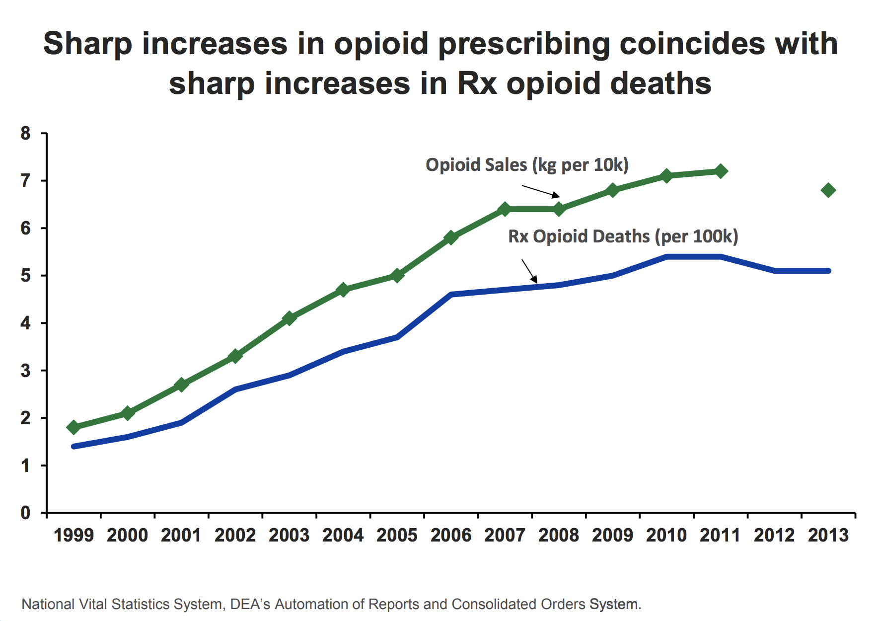

Slide 8
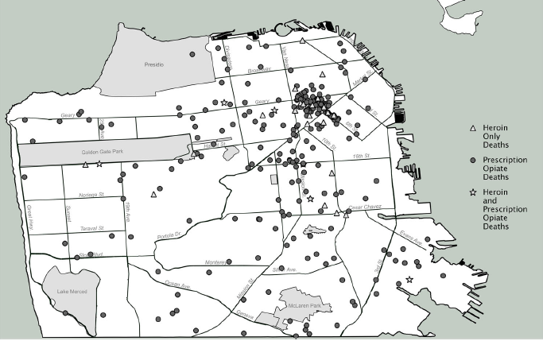
Source: Visconti et al. 2015 J Urban Health
Notes:
In San Francisco, we are witnessing a parallel phenomena. Prescription opioid related deaths – represented by the gray circles –happening throughout the city, with 35 of 37 neighborhoods recording at least one opioid overdose death. 45% of opioid-related deaths occurred in these two neighborhoods.
Based on these data, the leadership at SFDPH decided to target the hardest hit neighborhoods… and championed alternative approaches to pain management within these communities.
You’ll notice a cluster in the Tenderloin/Civic Center and South of Market neighborhoods where there’s a high proportion of residents living in poverty, single room occupancy hotels, and opioid-related drug arrests.

Slide 9
The CHALLENGE
Problem: Primary Care Systems (especially those in the safety net) have limited access to multimodal pain management that does not rely on prescription opioids
Vision: Every primary care patient in the San Francisco Department of Public Health (SFDPH) would be able to access non-medication based treatments for chronic pain
Goal: Develop a multimodal pain management program delivered within a primary care clinic located in a neighborhood particularly impacted by the opioid overdose epidemic
Notes:
This was the setting where the IPMP program was conceived.

Slide 10
Design principles
Evidence based
Patient centered
Responsive to staff needs
Robust evaluation
Notes:
This was a rare chance to start something from scratch! While we were reacting to public health crisis we wanted to be thoughtful about and responsive to the needs of the those we were trying to help. We also wanted to study this not only to help refine the intervention but to be able to disseminate our experience.

Slide 11
DESIGN process
Steering Committee
Patients
Staff
  March 2015
  20 Inter-professional members
  Brainstormed program structure, services, staffing, funding
  Spring 2015
  Interviews & focus groups with patients
  Formed a Patient Advisory Board:
  Treatments and Format
  Fall 2015
  Focus groups with providers and staff
  Referrals, communication, education
Notes:
We formed a steering Committee comprised of pain management specialists, SFHN leadership, experts on the local opioid overdose epidemic, behavioral health specialists, and health care providers with expertise in rehabilitation and integrative medicine. Committee met monthly during planning and implementation.
We also conducted 24 one-on-one interviews and asked potential participants about their goals for pain management, pain treatments they had tried, experiences with group settings, potential barriers to participation, and services that they were interested in trying or felt would be effective. We recorded and transcribed interviews. We identified a set of themes and coded qualitative responses according to repeating consistent themes. A qualitative researcher provided expertise on creating and tallying relevant codes, which were reviewed by the implementation team.
2016: Pilot, cohorts 1-3
2017: Expansion, cohorts 4-7

Slide 12
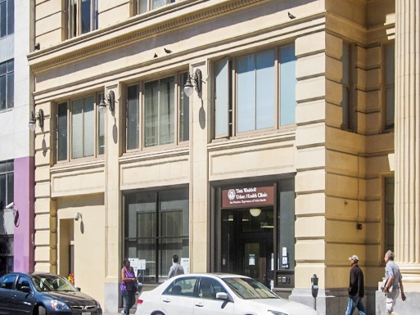
Program Setting
Tom Waddell Urban Health Clinic (TWUHC)
Flagship Health Care for the Homeless Site of the San Francisco DPH (SFDPH)
Serve adults who are experiencing homelessness, marginally housed, vulnerable/at- risk (transgender, HIV+, day laborers, high trauma burden)
  Multidisciplinary, integrated primary care and behavioral health services including chronic diseases management, medication adherence support, case management, psychiatry, urgent care, substance use treatment (MAT), podiatry, dental and nutrition services
Compared to the overall SFDPH, 4x as many TWUHC patients prescribed opioids for pain (12% vs. 3%, respectively)
Notes:
The TWUHC is located in the Tenderloin Civic Center neighborhood which is the site of the spike in opioid overdoses you saw on a previous slide. Above us are nearly 200 units of permanent supportive housing for formerly homeless adults.

Slide 13
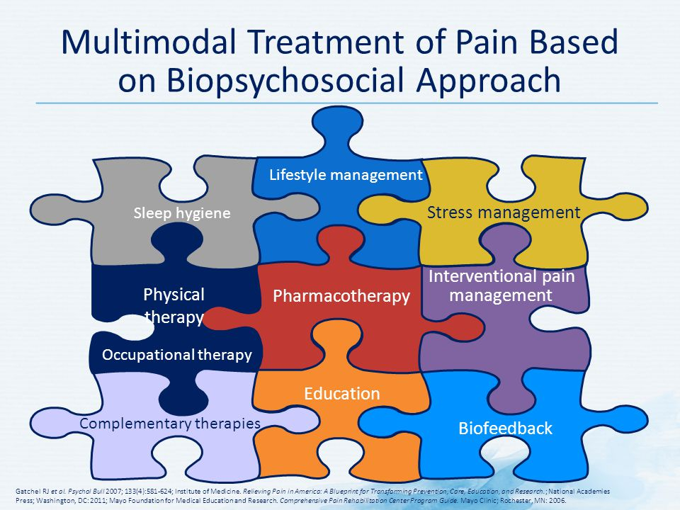
Program philosophy
Biopsychosocial approach
Notes:
We designed the components of IPMP using a biopsychosocial model of pain, which considers the biologic, psychologic, and social factors affecting patient function and prognosis.
This approach is thought to allow for patient-centered pain care that may have better results in improving function and quality of life.
As mentioned, during planning phases our steering committee and program leadership discussed the approaches currently available and then what would be part of an ideal chronic pain toolkit. These are some of the components that were discussed and incorporated into the IPMP program.
A multimodal approach to chronic pain management is now the standard of care. A multimodal approach includes medications, procedures, behavioral and physical treatments, and integrative modalities. This program offers the latter three treatments (among which there is overlap), with the primary care provider and team managing the first two. The program also provides education on the neuroscience of pain and pain treatments in addition to topics such as managing thoughts, sleep hygiene, and pacing.
I want to draw attention to one medication in particular – naloxone. While the program prescribed no medications (we left medication management to the primary care provider), we did conduct naloxone teaching with all IPMP participants. Naloxone is an opioid antagonist used to reverse the respiratory suppression seen in opioid overdose. We felt this educational topic was important to incorporate into the progam given the patients in the initial cohorts were all using opioids chronically and many had risk factors for misuse and unintentional overdose.

Slide 14
Program Structure
WEDNESDAYS
HOME GROUP 1-3 pm
Group-Based
ACUPUNCTURE MASSAGE MOVEMENT
3-4:30 pm
Graduation!
Invitation to Graduates Group
MONDAYS
One-on-One
ACUPUNCTURE
MASSAGE
1-5pm
OTHER
PHARMACIST
Meetings
HEALTH COACHING
12 wks
Notes:
Group-based care has been proposed as an effective and efficient way to deliver multimodal pain treatments. Home group sessions started with a ‘‘check-in’’ where participants could share their emotions, thoughts, hopes, and fears related to their health and provide updates since the last session. Group sessions, led by a health educator with years of experience as a group facilitator and a coordinator who had worked as a mental health case manager, involved principles of CBT and fostered peer support. Following the group ‘‘check-in,’’ an invited guest (e.g., pharmacist and mindfulness expert) provided information on an educational topic. Topics included ‘‘the neurobiology of pain,’’ ‘‘medication safety,’’ and ‘‘connections between mood and pain.

Slide 15
Educational topics
Notes:
We chose a different educational topic for each week. Participants also received handouts on these topics which were compiled in a binder that they were able to keep at the end of the program.

Slide 16
Program Evaluation
  Program Development and Refinement
    Patient and provider focus groups and surveys
  Quasi-experimental study: IPMP participants vs. ‘waitlist’ comparison group
    Used validated metrics for pain, functional status, and pain related quality of life
    Metrics assessed at baseline and 3 month follow up for everyone
    Additional 6 month follow up for IPMP participants
Notes:
Some of the waitlist participants joined the program eventually, but not all.

Slide 17
Program Evaluation
Participant Demographics
47% Female
Mean age = 55 years
97% Household income < $35k
47% Education - HS or less
27% African American
2% Asian American
14% Latinx
21% Multiple races
31% White
Notes:
We had a diverse participant population that is representative of the patient population receiving care at TWUHC. Latinx underrepresented because English language group. Later added Spanish language group.

Slide 18
Program Evaluation
Additional Participant Characteristics
13% Unstable or transitional housing
72% Living with a disability
Self-reported problematic substance use
15% Alcohol
21% Opioids
36% Cocaine
Differences between IPMP participants & comparison (waitlist) group
Mental health condition 83% vs 50%
Average daily opioid dose 140 MME vs. 313 MME
Notes:
MME: morphine milligram equivalents/day
95% had chronic pain for over a year
90% musculoskeletal, 46% neuropathic pain

Slide 19
Impact on pain experience
NIH PROMIS measures | Comparison Group Baseline to 3-mo | IPMP Participants Baseline to 3-mo | IPMP Participants Baseline to 6-mo
Pain interference* | -1.0 (-4.4, 2.5) | -2.6 (-4.5, -0.6) | -3.8 (-5.9, -1.7)
Social satisfaction | 0.6 (-3.9, 5.1) | 3.1 (0.5, 5.6) | 3.6 (0.8, 6.3)
Global mental health | 0.3 (-3.6, 4.3) | 2.8 (0.6, 4.9) | 3.6 (1.3, 6.0)
Global physical health | -0.6 (-3.7, 2.5) | 2.0 (0.3, 3.7) | 1.4 (-0.5, 3.2)
Other pain measures
Pain self-efficacy | -2.1 (-9.1, 4.9) | 5.2 (1.3, 9.0) | 7.4 (3.2, 11.5)
Average pain intensity* | -0.01 (-0.9, 0.9) | -0.8 (-1.3, -0.3) | -1.0 (-1.5, -0.5)
*Lower score is more optimal. Bolded results are significant at p<0.05 level
Source: Chao, Hurstak, Leonoudakis-Watts, et al. 2019. J Gen Intern Med
Notes:
We collected NIH PROMIS measures which are scored 0-100 with a change of 3 points indicating a clinically relevant difference. Our main outcome of interest was to reduce pain interference, which decreased by 2.6 points. Pain interference is the degree to which the pain hinders engagement with social, cognitive, emotional, physical, and recreational activities
Participants’ sense of social support and pain self-efficacy – their belief in one’s own ability to manage pain – were also notable improvements that were sustained at the 6 mo follow up.
There were no significant changes in the comparison group on any of these measures.

Slide 20
Impact on pain experience
NIH PROMIS measures | Comparison Group Baseline to 3-mo | IPMP Participants Baseline to 3-mo | IPMP Participants Baseline to 6-mo
Pain interference* | -1.0 (-4.4, 2.5) | -2.6 (-4.5, -0.6) | -3.8 (-5.9, -1.7)
Social satisfaction | 0.6 (-3.9, 5.1) | 3.1 (0.5, 5.6) | 3.6 (0.8, 6.3)
Global mental health | 0.3 (-3.6, 4.3) | 2.8 (0.6, 4.9) | 3.6 (1.3, 6.0)
Global physical health | -0.6 (-3.7, 2.5) | 2.0 (0.3, 3.7) | 1.4 (-0.5, 3.2)
Other pain measures
Pain self-efficacy | -2.1 (-9.1, 4.9) | 5.2 (1.3, 9.0) | 7.4 (3.2, 11.5)
Average pain intensity* | -0.01 (-0.9, 0.9) | -0.8 (-1.3, -0.3) | -1.0 (-1.5, -0.5)
*Lower score is more optimal. Bolded results are significant at p<0.05 level
Source: Chao, Hurstak, Leonoudakis-Watts, et al. 2019. J Gen Intern Med
Notes:
We collected NIH PROMIS measures which are scored 0-100 with a change of 3 points indicating a clinically relevant difference. Our main outcome of interest was to reduce pain interference, which decreased by 2.6 points.
Participants’ sense of social support and pain self-efficacy – their belief in one’s own ability to manage pain – were also notable improvements that were sustained at the 6 mo follow up.
There were no significant changes in the comparison group on any of these measures.

Slide 21
Impact on pain experience
*Lower score is more optimal. Bolded results are significant at p<0.05 level
Notes:
There were no other significant findings. Although we saw improvements in overall scores for symptoms of anxiety, depression, they did not achieve statistical significance
Physical functioning remained essentially constant.

Slide 22
Participant Satisfaction
Notes:
We noted very high rates of self-reported satisfaction. 100% of participants said they would recommend the program to another person living with pain.

Slide 23
Participant Experience: In their own words
“For the first time I’ve had real hope that I can manage the pain. I’ve had moments of real happiness and contentment, which I hadn’t had in years. I’m less stressed thinking about dealing with the pain, I’m less stressed about self-worth…
Making changes with daily routine of stretching, exercising, meditation, that’s really helped a lot with my outlook… my depression has gone down.
That’s the biggest [part], where it’s really helped me a lot - is all the anxiety and physical stress surrounding pain like holding my muscles, clenching them.”
Notes:
This is the same person who was interviewed after 12 weeks of the program.
You can see improvements in self efficacy around living with chronic pain.

Slide 24
Staff Satisfaction
Statistically significant improvement in provider:
  Satisfaction with available options for pain treatment
  Confidence that IPMP could reduce reliance on opioids in therapy
Providers described IPMP as “effective” in improving functioning of patients
No significant changes found in staff reported stress, frustration, or burnout level related to caring for patients with chronic pain
Notes:
I am not going to go into great detail here but we had less impressive impacts on provider experience in relation to managing chronic pain, which is an interesting topic for discussion. What impacts provider experience the most related to caring for patients with chronic pain?
These were assessed using likert scale style questions.

Slide 25
Program Evolution & Expansion
Expansion in Eligibility
  Eliminated opioid therapy requirement
  Expanded to include patients of three additional clinics
  Added Spanish language group
  Future: possible expansion to Zuckerberg San Francisco General Hospital
Expansion in Program Components
Cognitive Behavioral Therapy (CBT)
Creation of a Graduate Group
Sustainability
Combination of SFDPH General Funds + Incentive Funds supports program
  Continue to analyze data from ongoing cohorts in order to improve and refine program

Slide 26
Program Dissemination
Publications
  Chao, Hurstak, Leonadakis-Watts, Pace, Hammer, Wismer. 2019, J Gen Intern Med
  Hurstak, Chao, Pace, Walcer, Wismer. 2019, J Altern Complement Med
  Bruns, Befus, Wismer, Knight, Adler, Leonoudakis-Watts, Thompson-Lastad, Chao MT.2019 J Altern Complement Med
Toolkit – developed for other systems and clinics
Documentary Film: Together Transformed
Notes:
I can share this with you – information on breathing and mindfulness exercises, patient education around pain, group facilitation approaches

Slide 27


Slide 28
IPMP: Lessons Learned
An integrative, multi-modal, pain program delivered within a safety-net primary care setting:
Was feasible and acceptable to patients and staff
Produced high rates of participation & satisfaction
Achieved improvements in pain & psychosocial outcomes
Is sustainable without ongoing outside funds or grants
Notes:
Future Questions: How do we improve patient functioning to a greater degree? How do we improve provider/staff experience? Experience in different subgroups? Impact on opioid dose? “Dose response”

Slide 29
Acknowledgments
Participants of the IPMP steering committee, TWUHC staff, and patient participants;
Dr. Barbara Wismer
Kristina Leonoudakis-Watts,
Dr. Hali Hammer
Dr. Maria Chao
Dr. Emily Hurstak (for generously sharing her slides)
Jimmy He
Trilcee Santana
Frank Sidders

Slide 30
Thank you!
Feel free to contact me: joseph.pace@sfdph.org

