Slide 1



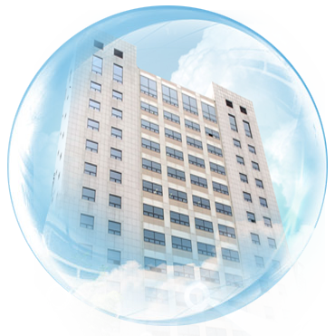

Current Status of Green Labeling and Consumer Information Policies in Korea
BAE, SOON-YOUNG(Research Fellow)
KWAK,YOON YOUNG(Researcher)
Korea Consumer Agency
Department of Consumer Policy Research
sarang2u@kca.go.kr,
yoonyoungkwak@kca.go.kr

Slide 2

1. Korea Consumer Agency
2. Korea’s Consumer Policy
3. Overview
Table of Contents
4. Greenwashing and Consumer issues in Korea
5. Problem & Solutions
6. Q & A

Slide 3
1. Korea Consumer Agency
2. Korea’s Consumer Policy
3. Overview
Table of Contents
4. Greenwashing and Consumer issues in Korea
5. Problem & Solutions
6. Q & A

Slide 4
1. Korea Consumer Agency
2
Green related Korean national guidelines
Established in July, 1987.
Major activities are Consumer redress,  Dispute resolution,  Policy/ System research, Consumer education,  Testing & Inspection, etc
Post-redress Measures
Precautionary Measures
Complaint handling (counseling)
Policy research, transaction improvement
Consumer empowerment
Consumer Redress
Consumer safety, Test & Analysis
Dispute settlement
Consumer education
Legal support
Consumer information provision

Slide 5

1. Korea Consumer Agency
* Departmet of Policy Research
ㆍPolicy development, research on relevant legislation and system,
and improvement proposal to consumer authorities
ㆍLeading national consumer policy
1989~
Research on Product Liability Act
1989~
Research on Door-to-door sales Act and System
Research on e-commerce system
2004
Framework Act on Consumer (draft)
2006
Direction of legislation policy for consumer protection
Impact of the US-Korea FTA on consumer welfare
2011
Survey on national consumer behavior

Slide 6
1. Korea Consumer Agency
2. Korea’s Consumer Policy
3. Overview
Table of Contents
4. Greenwashing and Consumer issues in Korea
5. Problem & Solutions
6. Q & A

Slide 7

2. Korea’s Consumer Policy
1
Global regulations on Green claims
International Standard : ISO 14000 Series
ISO 14021 Type II, Environmental Labels and Declarations : Self-declared Environmental Claims
Most relevant national guidelines in some countries
Commonly requires ‘Truthfulness(of green claims), properness of environmental claims and substantiation .’
 | Australia | U.S. | U.K. | Korea
Guidelines | Green Marketing Guidance | Green Guides | Green Claims Guidance | Guideline for screening Environmental Labeling and Advertising

Slide 8
2. Korea’s Consumer Policy
2
Green related Korean national guidelines
Guideline for screening Environmental Labeling and Advertising
Enforced in June.1999, Revised in Dec. 2010.
Purpose : suggesting detailed standard for handling
unfair labeling/advertising related to environment
General Principles : ① Truthfulness ②Counseling ③Substantiation
④ Considering life-cycle of product
■ Distinction standards □Comparison Advertising
environmental effect

Slide 9
1. Korea Consumer Agency
2. Korea’s Consumer Policy
3. Overview
Table of Contents
4. Greenwashing and Consumer issues in Korea
5. Problem & Solutions
6. Q & A

Slide 10
3. Overview
1
Green product are growing in the market
Consumer demand for greener products is changing the world.
Competing for consumers’ attention and for profit, companies are using environmental claims on their products.
Korean consumers are also in a rush for green product.
% of Consumers buying green product increased 20% during 5 yrs(KCA,2011)
In the same period, legitimate eco-labeled product increased about 60%

Slide 11
3. Overview
2
Greenwashing is on the rise
With green markets growing, ‘Greenwashing’ become blatant.
U.S., 95% of green claims were found to be ‘Greenwashing’ in 2010 (Terrachoice)
Korea, exaggerated/misleading green claims were over 50% in 2010 (Korea Consumer Agency)

Slide 12
1. Overview
3
Global trendss on Green claims
U.S., U.K., Austrailia, Korea
rearranged & progressed‘Futtera Sustainability Communications(2011)’
 |  | Australia | U.S. | U.K. | Korea
Truthfulness(4) | Mislead Consumers | V | V | V
 | Deceive Consumers |  | V | V
 | Make claims that cannot be verified |  | V | V
 | Use environmental images capable of making a sweeping claim of environmental benefit | V |  | V
Properness of Environmental Claims(6) | Be vague | V | V | V
 | Use exaggerating language |  | V | V
 | Be technically or narrowly correct, without looking at the bigger picture |  |  | V
 | Give the impression the product has qualities other than is actually the case | V |  | V
 | Overstate the environmental benefit either expressly or by implication | V | V | V
 | Make claims indicating and environmental benefit that while literally true, is unlikely to happen in practice |  |  | V
Substantiation(2) | Make Claims that are unsubstantiated | V | V | V
 | Present claims as universally accepted when the scientific basis is under dispute or inconclusive | V |  | V

Slide 13
1. Korea Consumer Agency
2. Korea’s Consumer Policy
3. Overview
Table of Contents
4. Greenwashing and Consumer issues in Korea
5. Problem & Solutions
6. Q & A

Slide 14
4. Greenwashing and consumer issues in Korea
1
Greenwashing Survey
Subject: Print advertisings and Product Displays
Evaluations: False/Exaggerated expressions (words, color, image, certifications), information omissions
Data Collection:
Period : 2012.3.12~3.17
Stores: 4 Wholesale marts
 | 2010 | 2012
Sample Categories | 6 ① House Cleaning Products (e.g. detergents..) ② Body-washing Products (e.g. soap. shampoo..) ③ Paper Products (e.g. tissue paper, diaper..) Processed Food (e.g. tofu, ham..) Dairy Products (e.g. milk, Cheese..) Agricultural Products (e.g. egg, vegetable..) | 7 ① House Cleaning Products (e.g. detergents..) ② Body-washing Products (e.g. soap. shampoo..) ③ Paper Products (e.g. tissue paper, diaper..) Processed Food (e.g. tofu, ham..) Dairy Products (e.g. milk, Cheese..) Agricultural Products (e.g. egg, vegetable..) Cosmetics

Slide 15
Product Display,
621Samples
Product Display,
702 Samples
Advertising
(10 Korean Print newspaper&magazine),
61 Samples
Advertising
(10 Korean Print newspaper&magazine),
103 Samples
Fact-Finding Survey in 2010
Fact-Finding Survey in 2012
Korea’s Greenwashing Trends

Slide 16
4. Greenwashing and consumer issues in Korea
2
National Trends from 2010 to 2012
Generally, Green Claims progressed in 2 yrs.
Product Display, a slight decrease of 3.8%
Advertising(10 printed newspapers and magazines), skyrocketing 40.7%

Slide 17
4. Greenwashing and consumer issues in Korea
2
National Trends from 2010 to 2012
Most Frequent types of Greenwashing is 'False Green Claims’; without supporting information such as ingredients, portions, etc
<Product Displays>
<Advertisings>

Slide 18
4. Greenwashing and Consumer issues in Korea
3
Korean Consumer Issues
In 2010,‘Little confidence on Green claims' was one of three big impediments for buying green products (Korea Consumer Agency )
Others were ‘higher price’ and ‘little confidence on qualities’
In 2012, Korean consumers were having difficulties in understanding ‘Greenwashing’ and availability of information
Korean consumers concerns mostly on used words and certifications
However, there are also problems: too little letters and fake certifications
lots of consumers don’t pay much attention the legitimacy of the certifications

Slide 19
4. Greenwashing and Consumer issues in Korea
4
Product Displays
Proper claims, 3.8% improved
2010 49.8%(309/621) → 2012 53.6%(376/702)
Trends in used Colors, Images, Certification, words are..
Green
Color
7.9%
DOWN
Company-made
→ Official
Tree,Forest,Leaf
Certifications
6.2%
Image
-13.1%
Up
Words
-0.1%
Eco → ‘No~’
Notes:
Color: 2012년 702개 중 588개(83.7%) ‘녹색(28.7%)’, ‘황토/갈색/베이지’(19.1%)’ ‘노란색(9.5%)
2010년 621개 상품 중 471개(75.8%), 녹색(35.2 )-노란색(21.0)-황토갈색 베이지(15.5)’
이미지: 2012년 286개(40.7%), 2010년 621개 상품 중 334개(53.8%), 공통적으로 나 무/숲/나뭇잎’이 10년 127(38.0) 12년 87개 25.6%로 가장 많음
인증마크: 2012년 353개(50.3%), 2010년 총 621개 상품 중 274개(44.1%), 기업자가마크 142(51.9) 에서 법정마크로 245(69.4) 급증
단어: 2012 702개 중 460개 65.4%, 2010 621개 중 406개 65.5%

Slide 20
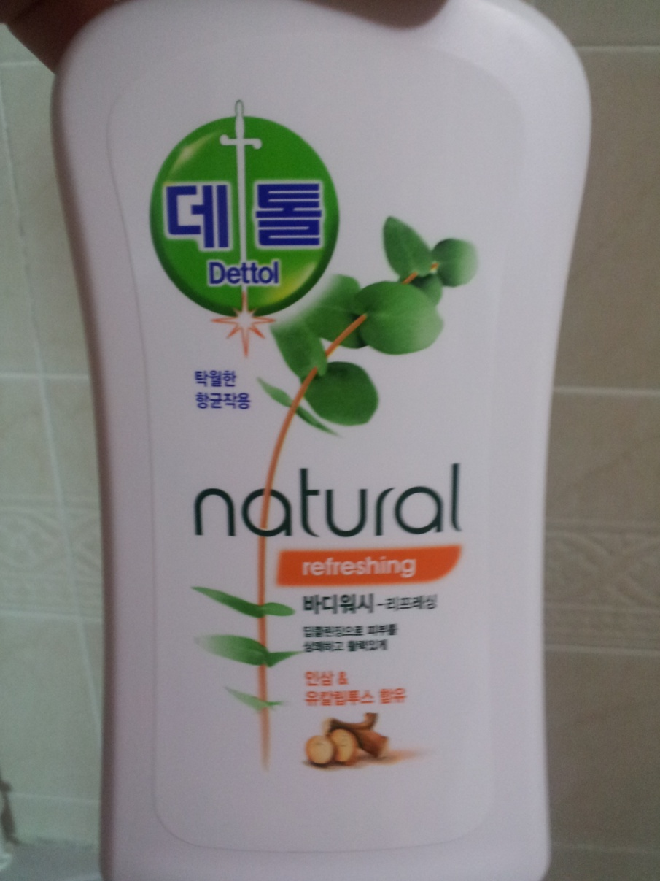
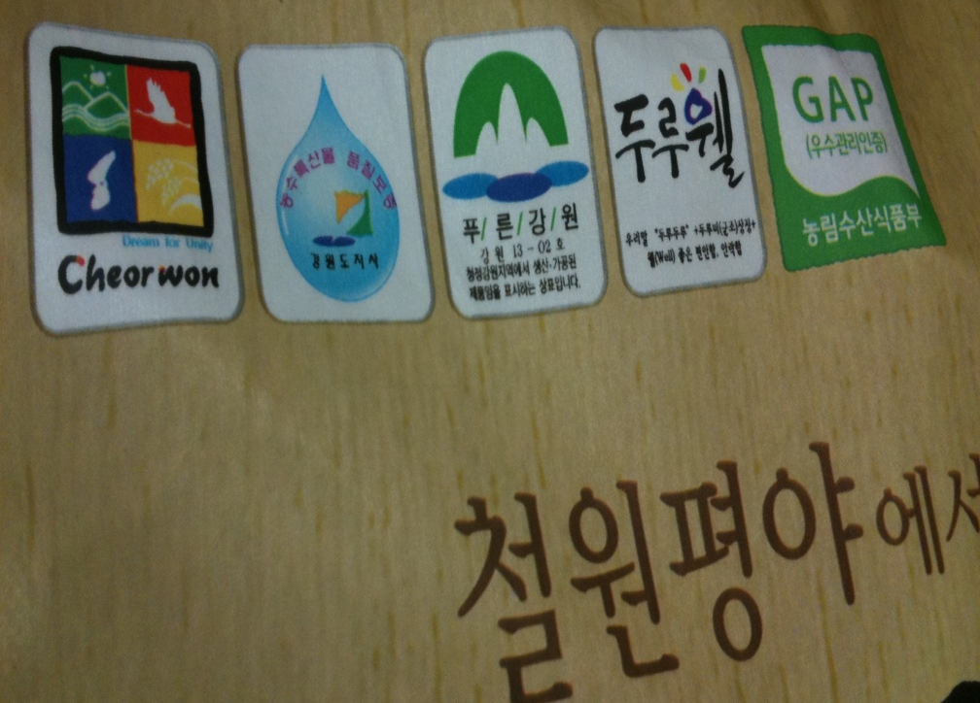


Slide 21
4. Greenwashing and Consumer issues in Korea
4
Advertisings(Print newspapers, Magazines)
Advertisings(Print newspapers, Magazines), 40.7% improved
2010 28.2% (29out of 61) → 2012 68.9% (42 out of 103)
Trends in used Colors, Images, Certification, words are..
Green
Color
25.2%
Tree, Forest,Leaf
Up
14.6%
Certifications
Company-made
Image
20.4%
Eco
Words
19.9%
Notes:
Color: 2012년 61개 중 58개(85%) ‘녹색, 2010년 103개 중 71개(59.8%)녹색
이미지: 2012년 61개 중 37(60.6%), 2010년 103개 중 42개(40.2%) 공통적으로 나 무/숲/나뭇잎’
인증마크: 2012년 61개 중 19(31.1%) 2010년 103개 중 17개(16.5%) 기업자가마크
단어: 61개 중 59 96.7%, 2010년 103개 중 80 76.8% 공통적으로 친환경

Slide 22
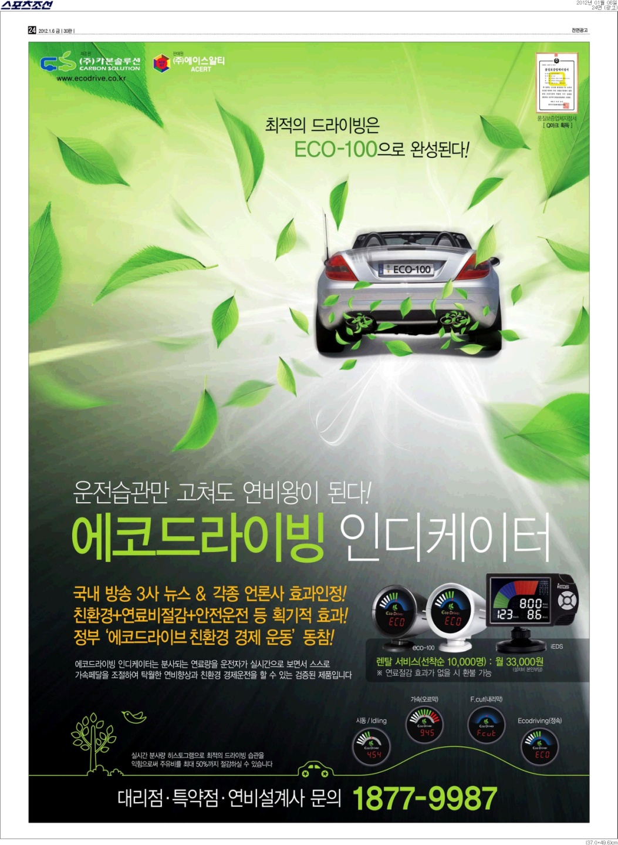
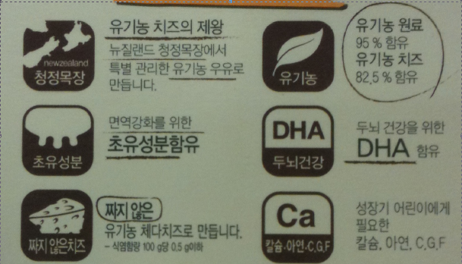
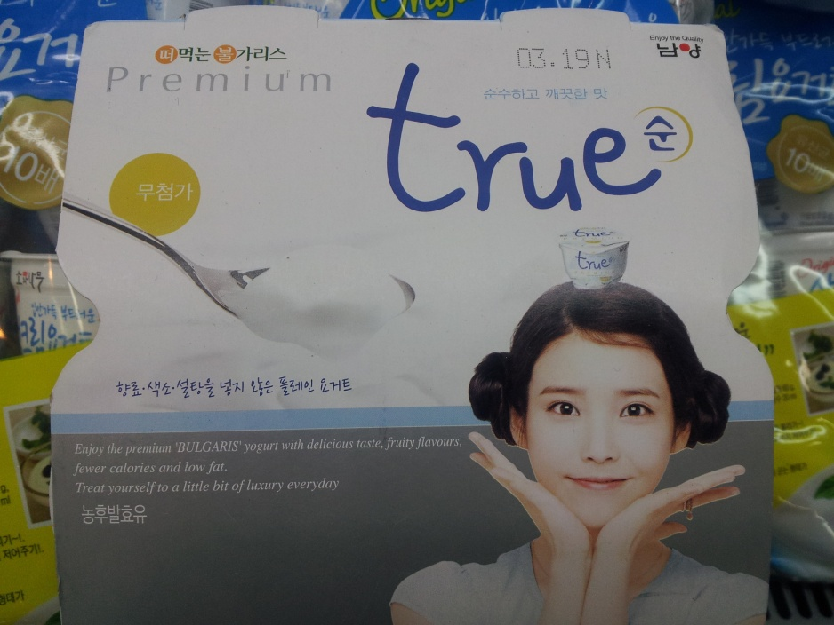

Slide 23
1. Korea Consumer Agency
2. Korea’s Consumer Policy
3. Overview
Table of Contents
4. Greenwashing and Consumer issues in Korea
5. Problem & Solutions
6. Q & A

Slide 24


5. Problems & Solutions
Problems
Greenwashing is declining
Greenwashing is still a significant problem.
Special Attention to usage of certification
Consumers with little information

Slide 25
5. Problems & Solutions
Solutions = Consumer Empowerment
Education &
Information
Law, Regulation,
Policies

Slide 26
1. Korea Consumer Agency
2. Korea’s Consumer Policy
3. Overview
Table of Contents
4. Greenwashing and Consumer issues in Korea
5. Problem & Solutions
6. Q & A

Slide 27
Thank you
www.kca.go.kr

