Slide 1
What would Google Do?
Data mining, discovery and search suggestions:
Proactively improving search relevance and the user experience
Tracy Gilmore, Virginia Tech
Lesley Moyo, Virginia Tech
Elizabeth German, University of Houston
Andrew Nagy, Serials Solutions

Slide 2
Summon discovery service at Virginia Tech
Evaluating user behaviors and experiences
By
Lesley Moyo & Tracy Gilmore

Slide 3
Study background
Plan for continuous assessment
A triangulation mixed-methods study – spring 2012
    Online survey of faculty and students
    Interviews and focus groups
    Task analysis
Current 2013 study - Multimethods

Slide 4
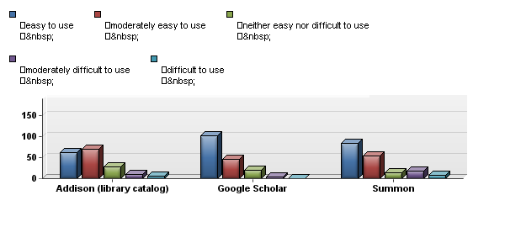
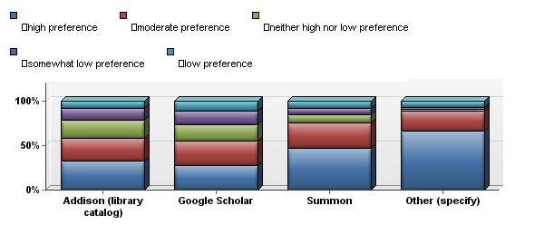
Online survey results
Ease of Use
Usability Findings:
Ease of use key factor in satisfaction with Summon
Preference for Summon stronger than Google Scholar
Preference for Summon
Easy to use Moderately easy to use Neither easy nor difficult Moderately difficult use Difficult to use
High preference Moderate preference Neither high nor low preference Somewhat low preference Low preference

Slide 5
Predictors of satisfaction
Ease of use & Satisfaction
Overall I am very satisfied with Summon
229.90
16
0.00
Facets use & Satisfaction
Overall I am very satisfied with Summon
41.40
16
0.00
My rating of Ease-of-use of Summon
Chi Square
Degrees of freedom
P-value
I always use the facets in Summon to improve my search strategy
Chi Square
Degrees of freedom
P-value
Overall I am very satisfied with Summon
246.68
16
0.00
Top ranked journals & Satisfaction
I can find articles from top ranked journals in my field
Chi Square
Degrees of freedom
P-value

Slide 6
Interviews and focus groups
Comments
Summon is easy to use
Facets are a great tool
Too many results!
Boolean operators please
Training would be nice
Suggestions
Provide direct linking to articles
Provide more instruction on how to use Summon
  Using facets
  Using Subject Terms

Slide 7
Open-ended feedback
“Summon is great if I know the article I’m looking for.”
AND
“I like that I only have to search in one place.”
BUT
“I need more skill at searching so that I don’t end up with a large list of sources.”
BECAUSE
“I get so many hits that are not useful.” “I feel overwhelmed by the results.”

Slide 8
Task analysis
Strengths
Challenges
Good results achieved with advanced search
Some participants able to effectively use facets
Effective use of quotations for known items
Page navigation
Evidence of lack of familiarity with Summon features
Large result sets still an issue
GetVtext (360 resolver)
Mixed success rates in task performance

Slide 9
Spring 2013 study
Repeat of 2012 survey for longitudinal data
Survey of VT Libraries faculty and staff
  Summon impact on work flows
  Summon impact on instruction and reference
Survey of librarians at other institutions
  Experiences with local instance of Summon

Slide 10
Contact information
Lesley Moyo
Director for Research & Instructional Services
University Libraries
Virginia Tech 560 Drillfield Drive
Blacksburg, VA 24061
Tel: 540-231-2708
Mobile: 814-777-7565
E-mail: moyo@vt.edu
Library Web: www.lib.vt.edu
Tracy Gilmore
Collections Assessment Librarian
University Libraries
Virginia Tech 560 Drillfield Drive
Blacksburg, VA 24061
Tel: 540-231-4956
Mobile: 540-239-4384
E-mail: tgilmore@vt.edu
Library Web: www.lib.vt.edu

Slide 11
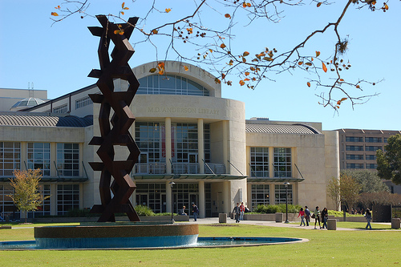
University of Houston Libraries
ARL member
201 library staff
51 librarians
3 branches (plus law)
ILS shared with UH System

Slide 12
UH Libraries and Summon
Implemented April-August 2010
Indexed 90% of subscribed sources
Already invested in SerialsSolution suite of services, easy of integration
Relatively painless turnkey implementation
Market in 2010 much different than market today

Slide 13
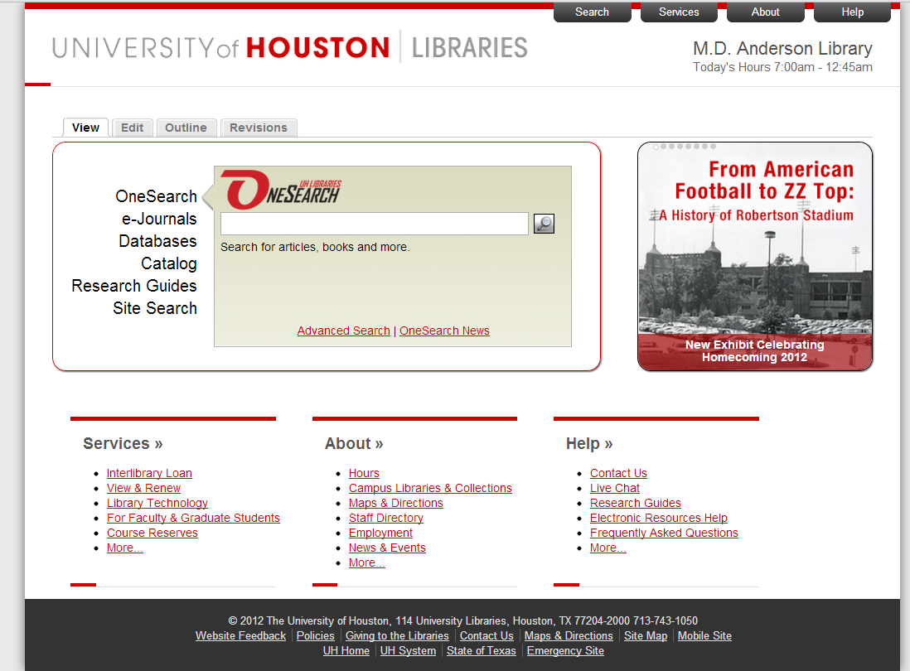
Summon Implementation: OneSearch

Slide 14
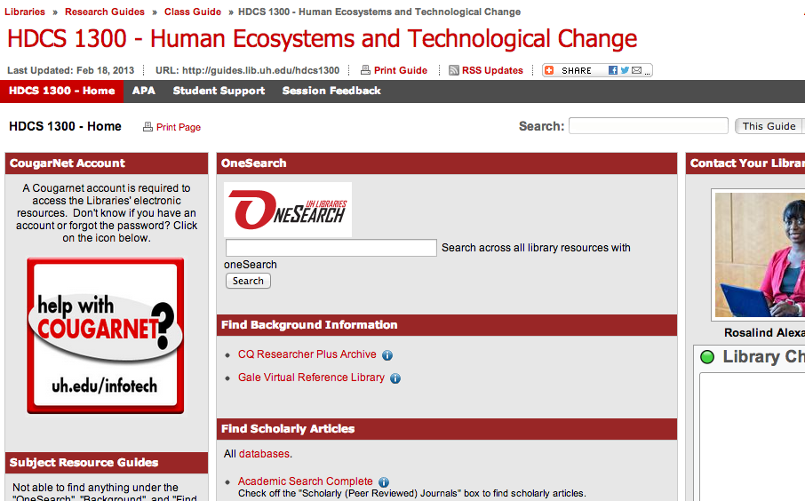
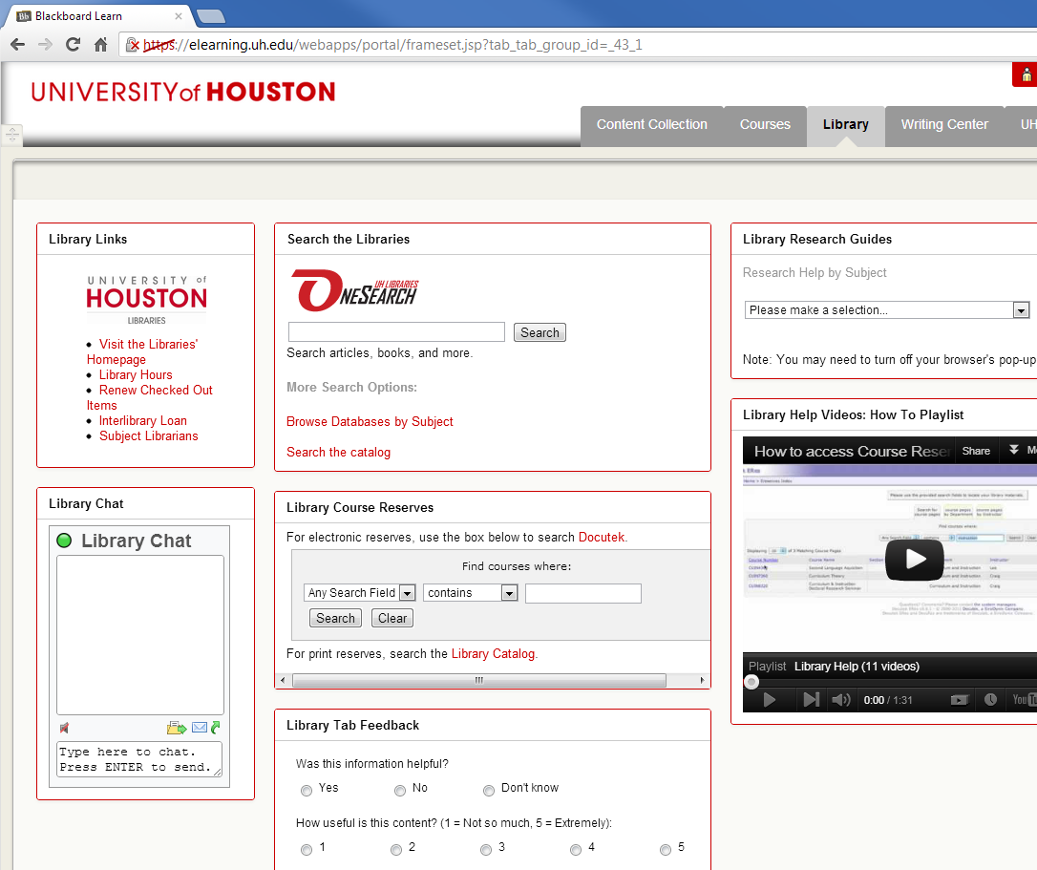
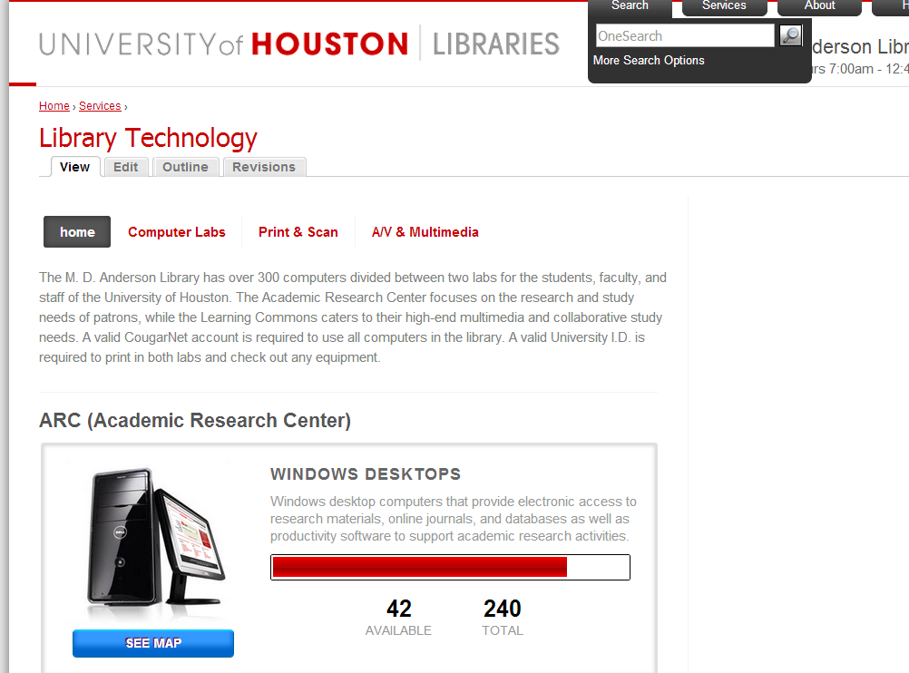
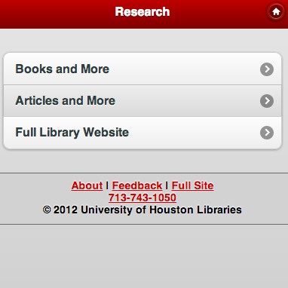
Summon Implementation: Integration

Slide 15
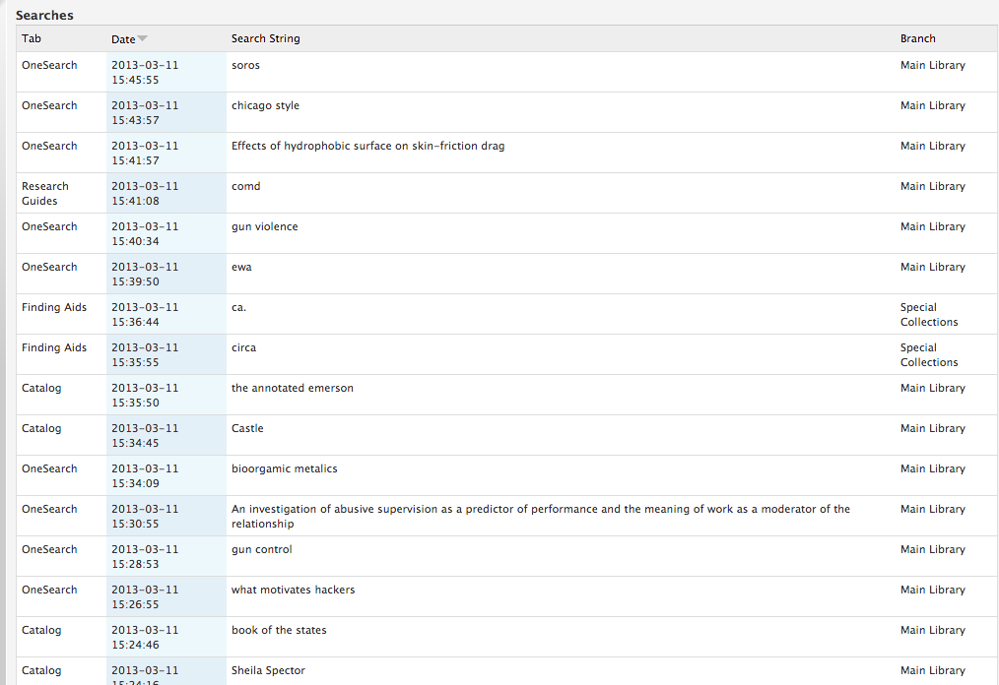
Transaction Log

Slide 16
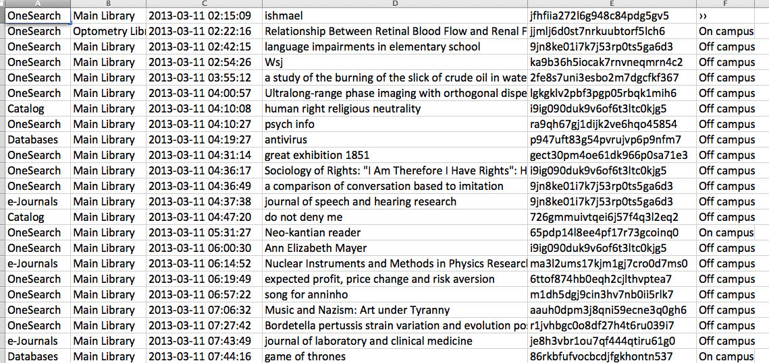
Transaction Log

Slide 17
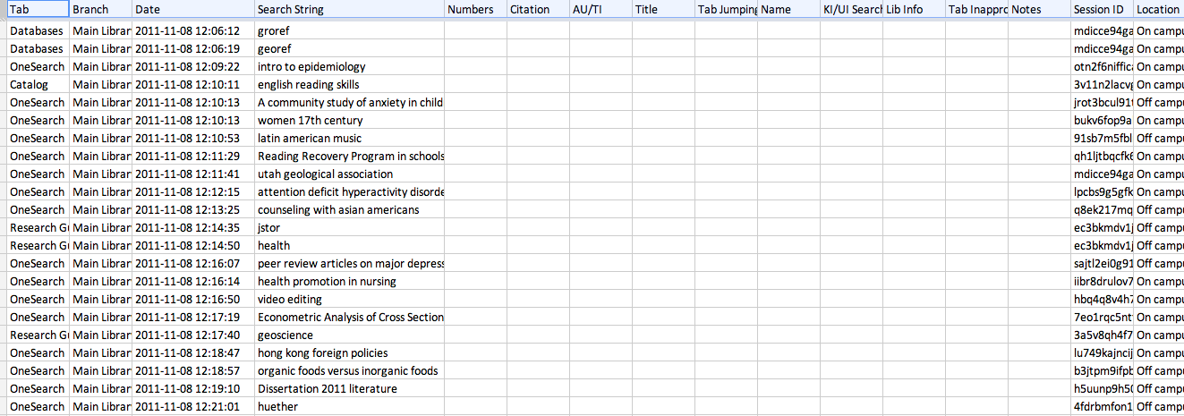
Coding

Slide 18
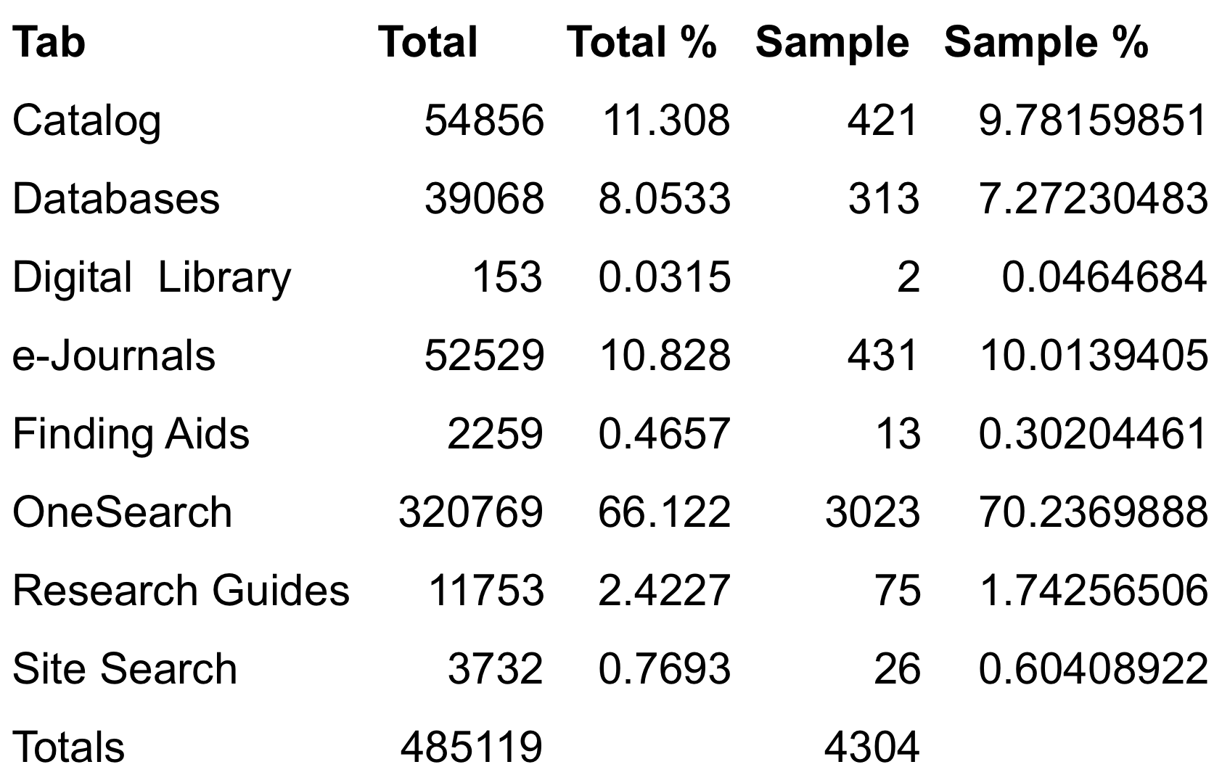
User Behavior

Slide 19
User Behavior
Known versus Unknown
  Known items - 1858 (43%)
  Unknown items - 2446 (57%)
Sessions
  2508 - Sessions
  1.72 - Searches per session
  1680 (67%) - Sessions only have one Search
Inappropriate tab use
  7% of all searches
  24% of non OneSearch searches are in an inappropriate tab

Slide 20
In-House Benefits
Better instruction and liaison services
Talking with vendors
Physical Services Decision making
  Open up the catalog computers
Reference services training

Slide 21
User Experience Directions
Search Assistance:
  Help Page
  FAQ
  Videos
  walk through coming soon
Search Interfaces:
  Research Guides: might take out
  Blackboard: Transaction log coming soon
  Homepage: Content Audit / More data (soon!)

Slide 22
ANDREW NAGY
Sr. Product Manager
Serials Solutions

Slide 23
Number of terms per query
Notes:
Here you can see the behaviors of users. We can easily group them into two main areas:
The broad topical queries
The known item queries

Slide 24
Number of terms per query
45% of Searches
3 words or less
Notes:
Lets put this chart into perspective using a logarithmic scale so you can see.
Majority of searches are 1, 2, and 3 word queries.

Slide 25
Top search terms
Jstor
Pubmed
Leadership
Global warming
Diabetes
Marketing
Obesity
Psychology
Depression
Austism

Slide 26
Long tail search terms
Branding in the Digital Age: You’re Spending Your Money in All the Wrong Places
Towards an Ethnographic Approach to Art Therapy Research: People with Psychiatric Disability as Collaborators
A method for bias-reduction of sample-based MLE of the autologistic model
group therapy native american women effectivness
endocrinology prolactin
childhood obesity organic baby food
Notes:
You will see here that there are lots of known item queries and also lots of subject terms grouped together.

Slide 27
Abandonment Rate: Words per Query
Notes:
Its clear that the more terms a user has in the query, the better chance they will find something valuable

Slide 28
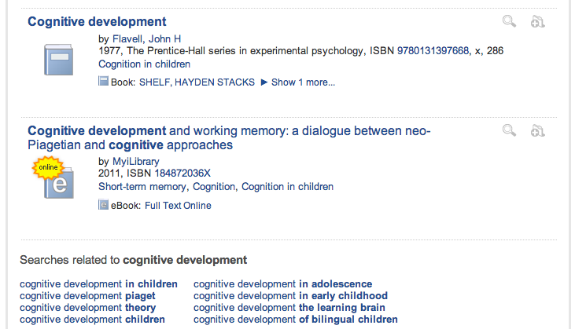
Improved User Experience

Slide 29
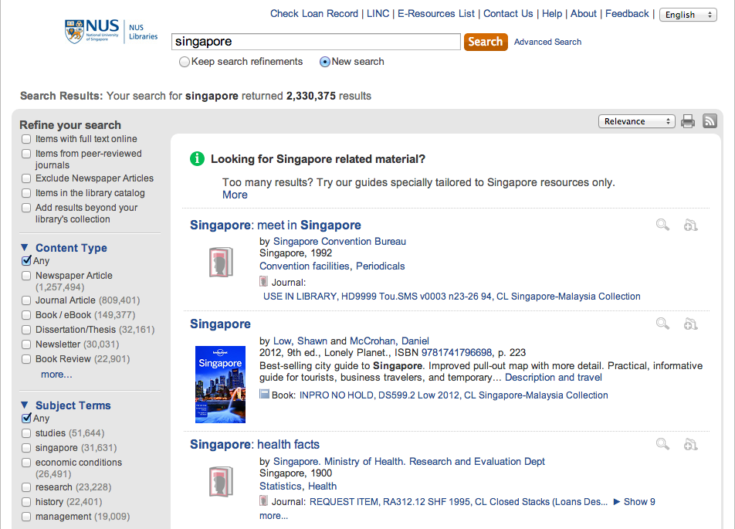
Improved User Experience

Slide 30
Number of Queries in a Session
Notes:
Here you can see the number of queries in a session. This shows great success. Its not sharp like the last graph – we have a large amount of users who are using the system and working with it – staying in the environment running lots of queries.

Slide 31
Filters per query in sequence

Slide 32
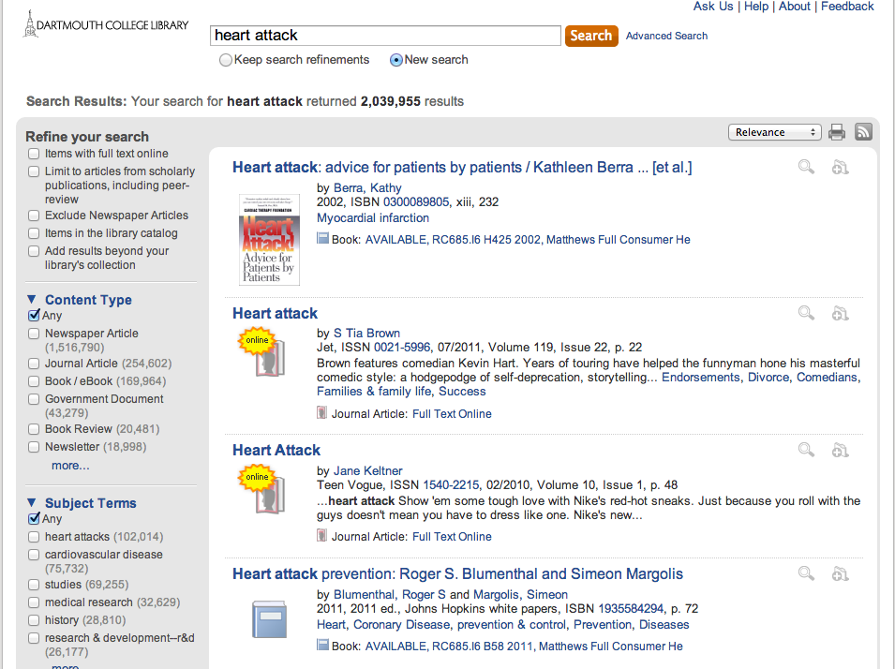

Slide 33
