Slide 1
Community Wellness Asset Mapping in solidarity for health equity
A strength-based approach for addressing the social determinants of Health
Elena Rosenbaum, MD, Marva Richards, MPH
Albany Medical College, New York
Notes:
Introductions
Background of Presenters
Why did you select this session.
What would you like to get from this session.
Why do we need to address SODH?
Why do we need to use a strength based approach?

Slide 2
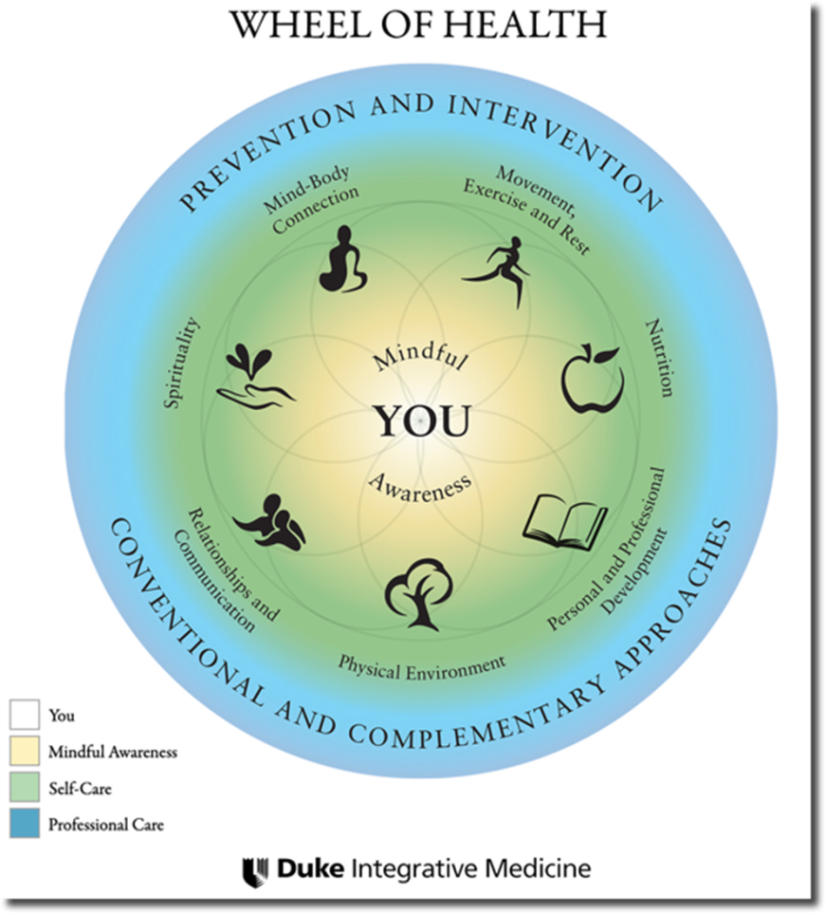
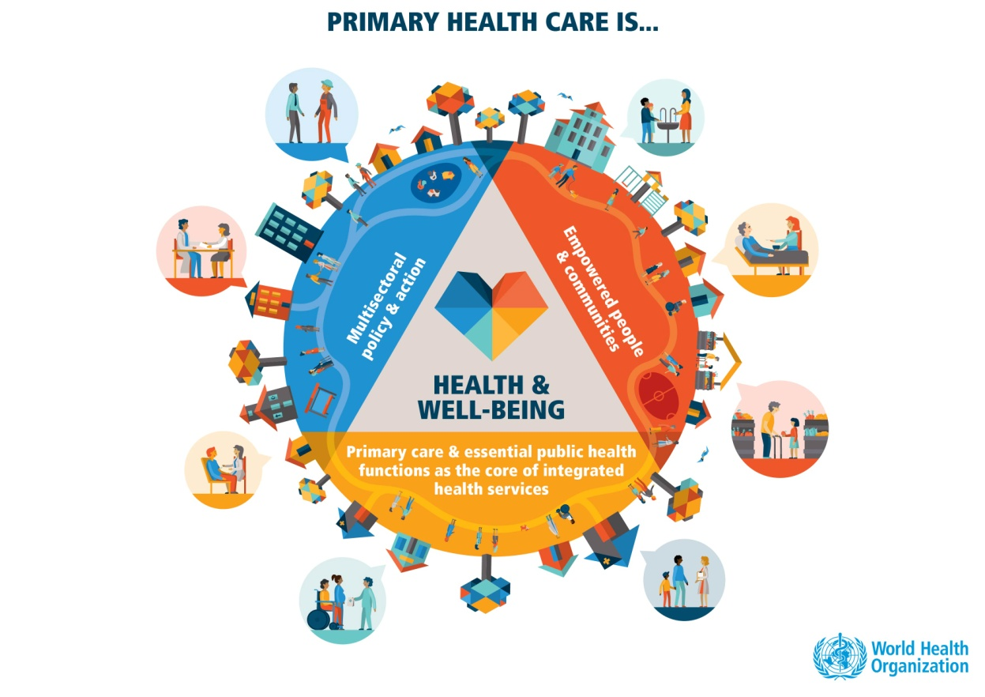
Aligning with the World Health Organization
Notes:
The principles of IM connect with the Public Health and WHO perspective on the question of “How to define Health?” Health is a state of complete physical, mental and social well-being and not merely the absence of disease or infirmity.
The enjoyment of the highest attainable standard of health is one of the fundamental rights of every human being without distinction of race, religion, political belief, economic or social condition.
The current WHO definition of health, formulated in 1948, describes health as "a state of complete physical, mental and social well-being and not merely the absence of disease or infirmity."

Slide 3

SOLIDARITY- Navigation and advocacy for the most vulnerable
Developing a Plan together for Identifying Local Needs and Resources.
Notes:
The first people to be impacted as a group by any cracks or failures in the system are those that are already oppressed, marginalized, or stigmatized –These are the most vulnerable.
Economic recession
Punitive laws
Loosening regulations
Lax oversight
Climate Change
Why is it important to include community members – whether it be patient/client, or neighbors, or fellow providers in the identifying and location of resources or assets to build the map? Self-empowerment!!

Slide 4
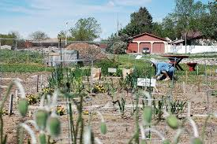
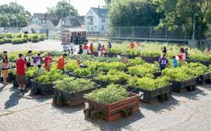
What is an Asset?
A positive place or program that makes the community a safe, healthy and good place to live
Notes:
What resources would you think about in an underserved area?

Slide 5
What is Asset Mapping?
Community Asset mapping – sometimes called resource mapping – sometimes called environmental scanning has been in use for many years in varying forms.
Asset or resource mapping is best understood as a system-building process used by many different groups at many different stages in order to align resources and policies in relation to specific system goals, strategies, and expected outcomes.
Notes:
At its most basic – it is looking around and identifying what assets are available in the community being studied, and geo-locating these assets on a list or map, paying attention to possible barriers and potential for increased access and usage by clients/patients/community.
The tool is used mostly by community development, community planning, or strategic planning project organizers to build capacity and stimulate development in communities.
Use of the tool in this form is similar, but aimed more directly at self-care, self-advocacy, and self-empowerment of your clients/patients AND YOURSELF to address identified social determinants of health.

Slide 6

Social Determinants of Health. What’s the buzz?
“…conditions in which people are born, grow, work, live, and age, and the wider set of forces and systems shaping the conditions of daily life.”
World Health Organization
Notes:
The places and circumstances under which people live, work, and grow old have a huge impact on their well-being.
Currently, there is a great deal of buzz about the SDOH. But public health scientists have long researched the effect of these circumstances on the lives of people, and how much of their physical, mental and emotional health is determined by social conditions over which they have little or no control.
The best known of these studies is the famous Whitehall studies in London – the first one in the 1960s by Marmot which found a strong association between grade levels of civil servant employment and mortality rates from a range of causes: the lower the grade, the higher the mortality rate. Men in the lowest grade (messengers, doorkeepers, etc.) had a mortality rate three times higher than that of men in the highest grade (administrators). This effect has since been observed in other studies and named the "status syndrome".
Discussion – What social determinant(s) would have been indirectly impacting the health of these civil servants?

Slide 7
Levels of Social Determinants
STRUCTURAL - Examples:
Income;
education;
gender;
social class;
occupation;
race/ethnicity;
culture or cultural norms and societal values.
AND INTERMEDIARY – Examples:
  Material circumstances (housing etc.);
  psychosocial circumstances;
  behavior;
  biology;
  and the health system itself.

Slide 8
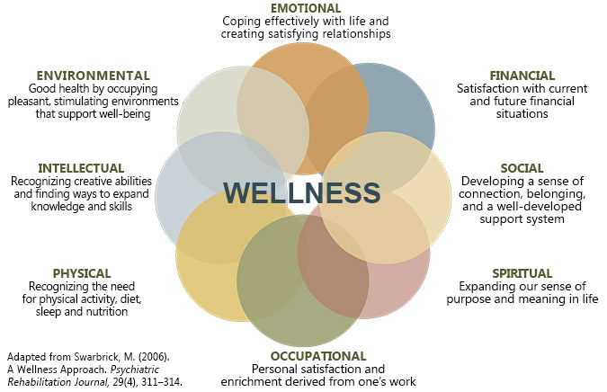
Wellness determinants
Notes:
Using a strength-based approach to identify wellness determinants for Asset Maps.

Slide 9
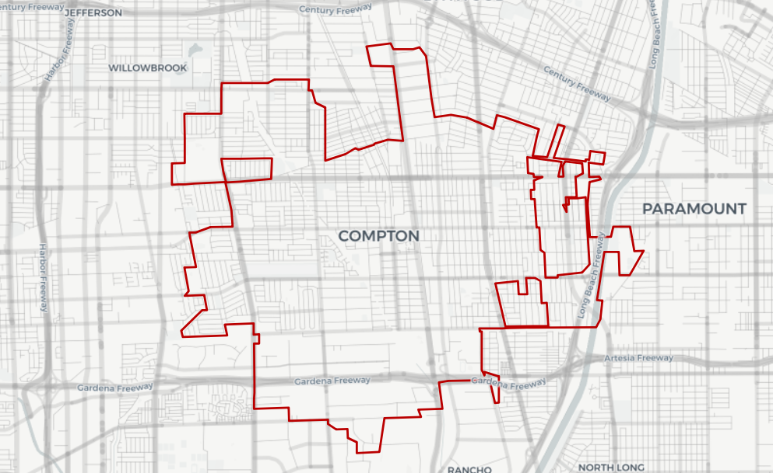
Notes:
Discussion:
What may be some social determinants affecting the health of the communities here?
What groups in the population may be most vulnerable here?
What may be some assets here to address the SODH identified?
What may be some barriers to accessing these assets?
What may be some strengthening resources to remove those barriers?
Other thoughts about producing a Wellness Asset Map?

Slide 10
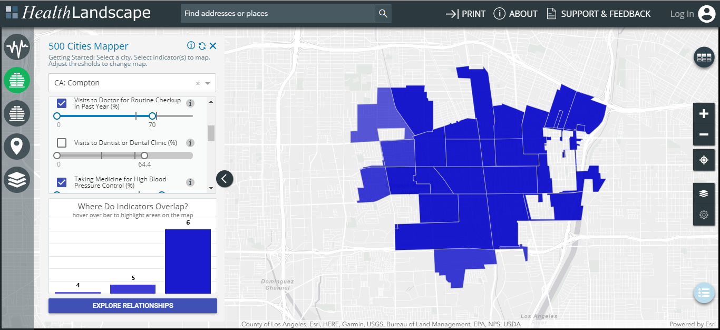
Examples of existing mapping sites
Health Landscapes (Graham Center)

Slide 11
How to plan, and produce a Wellness Asset Map
Decide what health issue to focus on
Include Clients, Policy Makers, neighbors, fellow providers
What resources in the neighborhood or city help alleviate symptoms or health outcomes?
What are the most pressing health issues arising from social determinants in your area?
How do these health issues affect other social determinants?
What are the resources available to address a particular area of wellness?
There are four steps to the community resource mapping process:
1) pre-mapping;
2) mapping;
3) taking action; and
4) maintaining, sustaining, and evaluating mapping efforts.
Notes:
Discussion.
Steps 1 and 2 are the beginning steps – engaging people, planning, identifying and then constructing some kind of product.
What are the practical uses of such a project?
What are some creative ways that you can think about to design a map?
How would the steps 3 and 4 enhance your services? What would these entail?
3) taking action; and
4) maintaining, sustaining, and evaluating mapping efforts.

Slide 12
Tools to use. Resources to jumpstart the process:
BRFSS: https://chronicdata.cdc.gov/browse?category=Behavioral+Risk+Factors
Neighborhood navigator: https://www.aafp.org/patient-care/social-determinants-of-health/everyone-project/neighborhood-navigator.html
CDC 500 Cities Data: https://www.cdc.gov/500cities/index.htm
Aunt Bertha: https://www.auntbertha.com/
Notes:
What do we need to bring?
Post it poster pad
Markers
Sharpies
Dots:
(Green: Parks, green spaces- Red: hazards)

Slide 13


Tools to use. Local, county and state
Notes:
What do we need to bring?
Post it poster pad
Markers
Sharpies
Dots:
(Green: Parks, green spaces- Red: hazards)

Slide 14
Wellness mapping activity- 1
Choose a neighborhood in your area.
Think about a patient or someone you know who has at least one health issue and social need.
What resources in your community may be available to address the social need(s).
What resources may be available to address wellness need(s).
Notes:
Split half the class into an affluent neighborhood, half the class will choose an underserved neighborhood).

Slide 15
Wellness mapping activity -2
Use your phones, computers, knowledge of your community to map out the resources.
You can physically create a map or a list of resources
Be creative about what you might consider wellness assets in your community
Green dots = healthy
Red dots = hazards
Yellow dots = potential healthy spaces
Notes:
What do we need to bring?
Post it poster pad
Markers
Sharpies
Dots:
(Green: Parks, green spaces- Red: hazards)

Slide 16
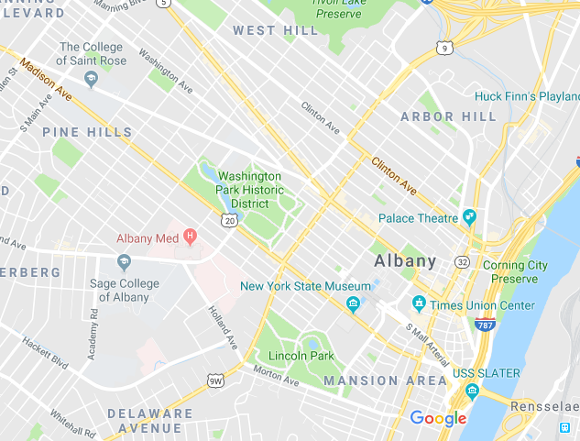
Discussion
Notes:
Post the posters to look at the differences
What did you discover?
What did you learn adding the additional layer of wellness web?
How was it for participants to use this strength based approach?
Have you found assets that you can share based on your maps?
Have you identified assets that you might use in the future for your own self care?
What community needs have you identified as a result of the community asset mapping activity?
Compare and contrast different community strengths and deficiencies.
How do you compare the maps developed on the two sides of the room?
What resources or solutions are available to address these identified needs
Suggestions from participants and from presenters on how to proceed with policy and advocacy
Creative ideas. Potential spaces for use as future assets.

Slide 17
GV mapping resources to bring home
Healthy City Participatory asset mapping toolkit
https://hc-v6-static.s3.amazonaws.com/media/resources/tmp/Participatory_Asset_Mapping.pdf
Notes:
What do we need to bring?
Post it poster pad
Markers
Sharpies
Dots:
(Green: Parks, green spaces- Red: hazards)

Slide 18
Conclusions
Community Asset Mapping is a tool that can be used to engage community members in identifying strengths that address social needs.
Tool can also be tailored to map out wellness assets that help mediate the adverse effects of stress caused by being part of a marginalized community, racial bias, discrimination, poverty and other unmet social needs.
Notes:
Post the posters to look at the differences
What did you discover?
What did you learn adding the additional layer of wellness web?
How was it for participants to use this strength based approach?
Have you found assets that you can share based on your maps?
Have you identified assets that you might use in the future for your own self care?
What community needs have you identified as a result of the community asset mapping activity?
Compare and contrast different community strengths and deficiencies.
What resources or solutions are available to address these identified needs
Suggestions from participants and from presenters on how to proceed with policy and advocacy
Creative ideas. Potential spaces for use as future assets.

Slide 19
Q & A
Marva Richards, MPH
richarm3@amc.edu
Elena Rosenbaum, MD
erosenbaum@communitycare.com

