Slide 1
FIGHTING THE GOOD FIGHT FOR ALL STUDENTS
DR. CEDRIC COOKS, LPC, NCC, NCSC
PROFESSIONAL SCHOOL COUNSELOR
GWINNETT COUNTY PUBLIC SCHOOLS

Slide 2
Objectives In this session participants will:
define advocacy and how it relates to the role of school counselors.
review data that clearly shows the achievement disparities that exist between students of color and their counterparts.
find ways to infuse advocacy into their work and training so as to decrease the achievement gap.

Slide 3
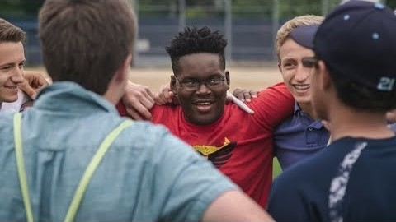

Slide 4

An Advocate is…
one who supports or promotes the interests of a cause or group (Merriam-Webster Dictionary).
not always popular or praised for the advocacy work.
subject to push-back or backlash.
sometimes viewed as a problem.
subject to losing it all for the fight in systemic change.

Slide 5
Advocating for Equity of ALL Students
The ASCA Ethical Standards for School Counselors (2016) states that all students have the right to a school counselor who:
acts as a social-justice advocate
supports students from all backgrounds and circumstances
consults when the school counselor’s competence level requires additional support.

Slide 6
Inequities in Education
Historically, underrepresented populations have faced barriers to participating in a rigorous curriculum and higher-level classes (Vazquex & Altshuler, 2017). School counselors, teachers, administrators and other school staff can be involuntary gatekeepers of access to these classrooms.

Slide 7
Fair Treatment of ALL Students
When students feel that they are treated in a biased or negative manner
When students feel that they are treated fairly
Self-destructive behaviors
Truancy
Withdrawal
Acting out
Non-participation in class activities
More likely to be engaged in schools
Talk about pressing issues
Participate in class activities

Slide 8
SC Promote Equitable Treatment of ALL Students:
Using data to identify gaps in achievement, opportunity and attainment
Advocating for rigorous course and higher education for underrepresented groups
Informing school staff of changes regarding different groups within the community
Promoting the development of school policies leading to equitable treatment of all students and opposing school policies hindering equitable treatment of any student

Slide 9
SC Promote Equitable Treatment of ALL Students:
Promoting access to rigorous standards-based curriculum, academic courses and learning paths for college and career for all students
Developing plans to address over- or underrepresentation of specific groups in programs such as special education, honors, Advanced Placement and International Baccalaureate
Creating an environment that encourages any student or group to feel comfortable to come forward with problems

Slide 10
Belief Gap
The Belief Gap is the gap between what students can achieve and what others believe they can achieve.

Slide 11
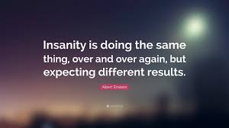

Slide 12
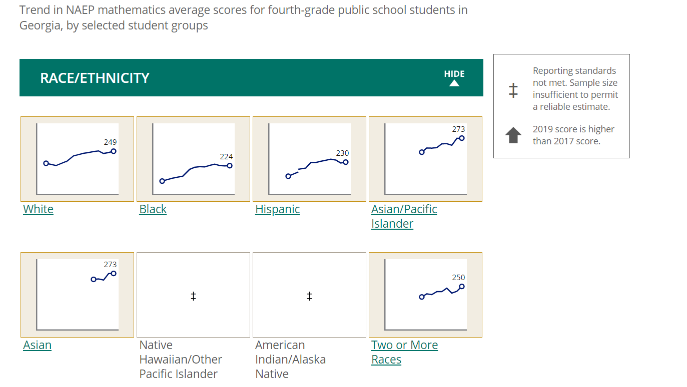

Slide 13
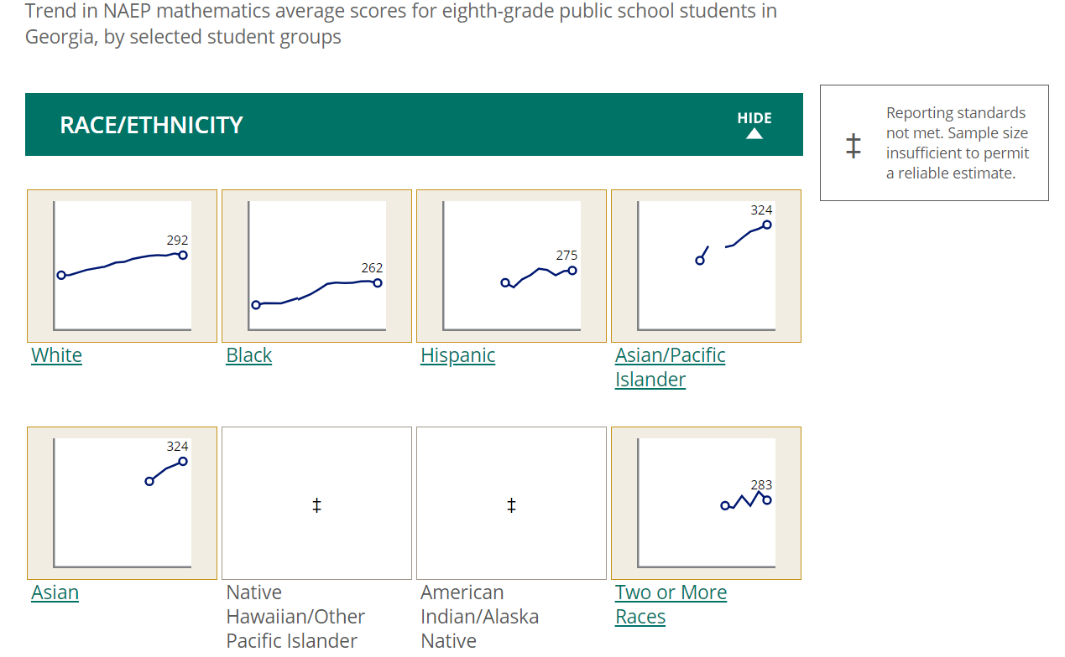

Slide 14
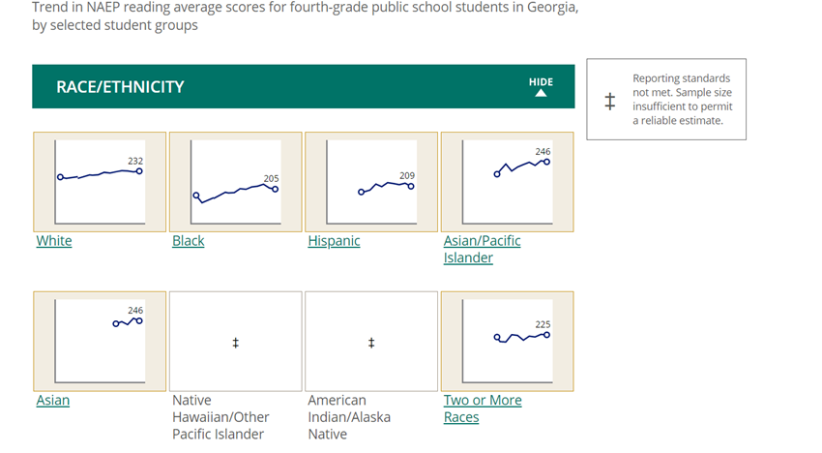

Slide 15
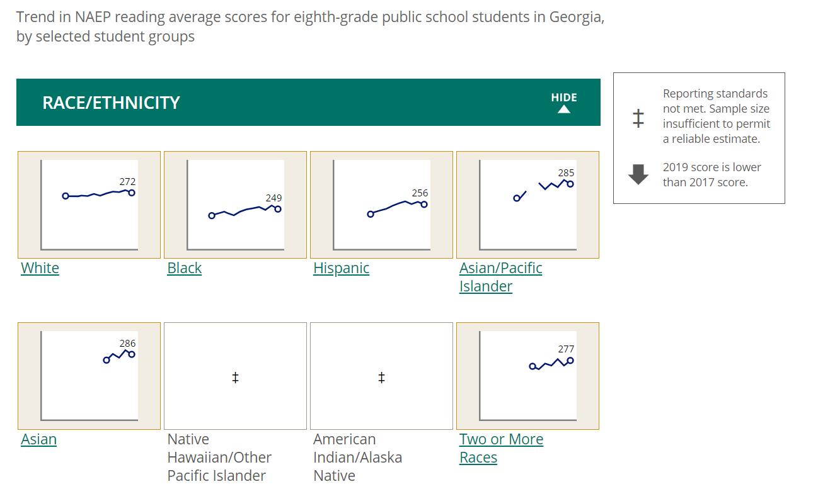

Slide 16
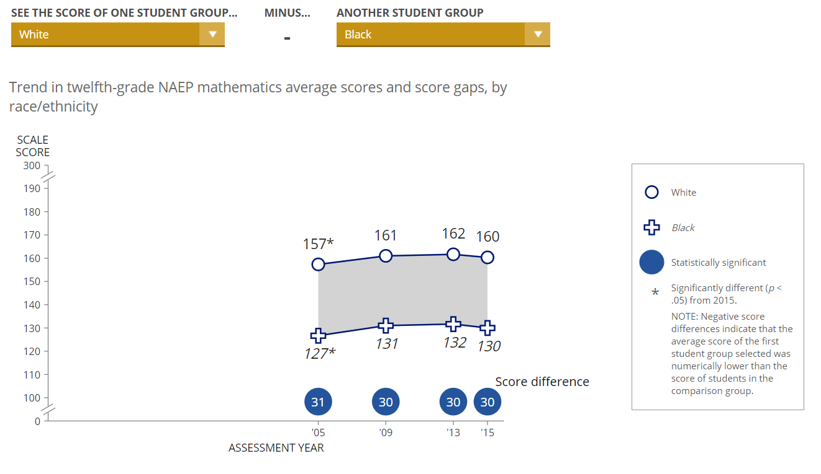

Slide 17
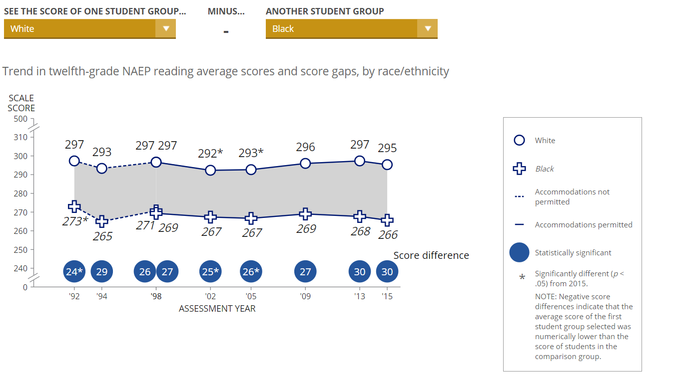

Slide 18
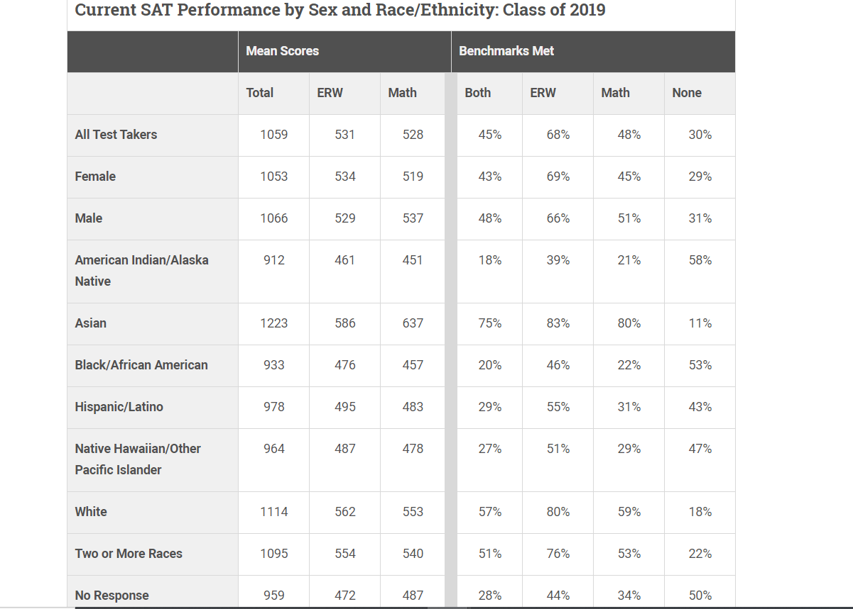
SAT. The college and career readiness benchmarks are 480 for Evidence-Based Reading and Writing and 530 for Math.

Slide 19
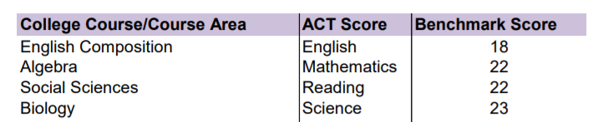
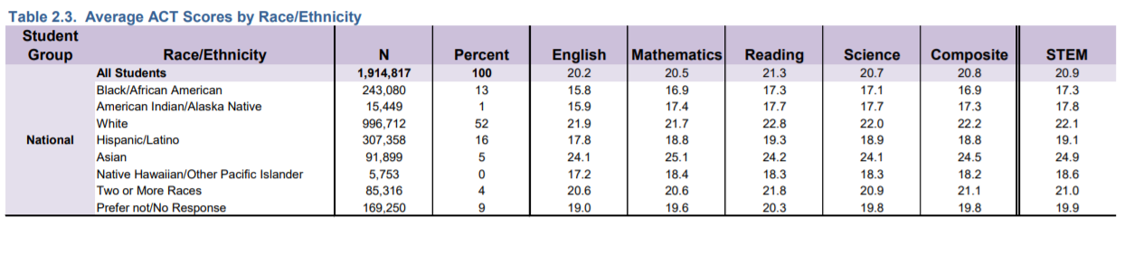

Slide 20

Who is in our public schools?
Students
Teachers
23.7 million White students
13.9 million Hispanic students
7.7 million Black students
2.7 million Asian students
2.1 million students of Two or more races
0.5 million American Indian/Alaska Native students
0.2 million Pacific Islander students
80 percent White
9 percent Hispanic
7 percent Black

Slide 21
Systemic Change
Serve on leadership committees or boards (administrative team, PTSA, advisory councils)
Provide in-service opportunities to teachers (face-to-face, webinars, podcasts)
Counseling Education and Teacher Education Programs redesigning programs that are culturally responsive nature.

Slide 22
A SUCCESSFUL ADVOCATE:
A good Advocate has a willingness to share knowledge, and expertise
A good Advocate demonstrates a positive attitude and acts as a positive role model.
A good Advocate takes a personal interest in the mentoring relationship
A good Advocate motivates others to want to advocate by setting a good example

Slide 23
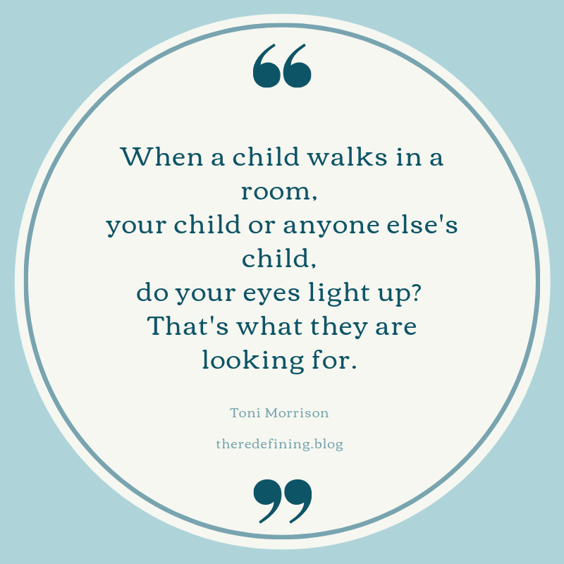

Slide 24
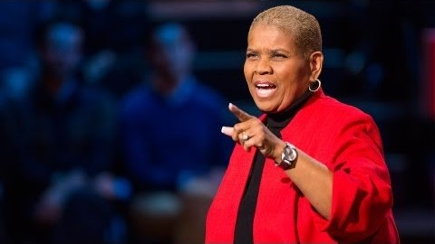

Slide 25
