Slide 1
Issues in assessment of ELL Students with disabilities
Karey Brau Curley
Brockton public schools
kareyacurley@bpsma.org

Slide 2
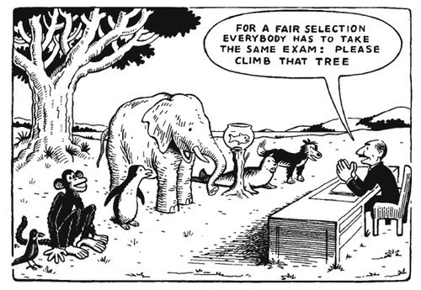

Slide 3
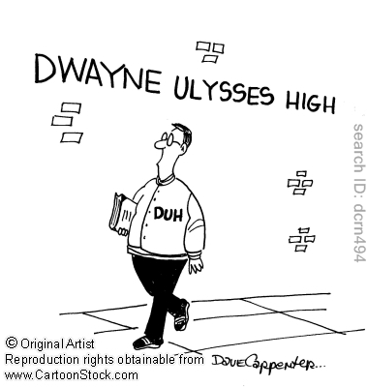
Possibly new ACRONYMS
RTI – Response to Intervention
CLD – Culturally and Linguistically Diverse
LD – Learning Disability (Disabled)
MSN – Moderate Special Needs

Slide 4

Manthala George Jr. Elementary School
K-5 SEI Program
K-5 ISEI (with ESL pull-out)
K-5 Dual Language Program
      60% L1/40% L2 in Kindergarten/1st grade
      50/50 split in grades 2-5
Bilingual Specialists
      School Adjustment Counselor
      Speech Language Pathologist
      Moderate Special Needs Teacher (MSN)
Additional programs: Gen. Ed., Inclusion, Self-Contained SPED

Slide 5
Role of Spanish Bilingual MSN
Within the George School setting:
        Service provider for ELLSWD in bilingual (SEI/DL) programs
        Member of Instructional Support Team (IST)
          aka Teacher Assistance Team (TAT)
        Interventionist at Tier 3 level
        Diagnostician for IST screening and TEAM evaluations
Within Brockton Public Schools:
        Member of Bilingual Task Force (Bilingual and SPED)
        Citywide Spanish Diagnostician for TEAM evaluations

Slide 6
Addressing issues in assessment of ELLSWD
Our district-wide Bilingual Task Force has addressed many ELLSWD issues and made improvements to current practice, including but not limited to:
        Creation of a BICS/CALP checklist to assist teachers in assessing language development
        Addendum to RTI and pre-referral documents to address specific questions related to ELL’s
        Establishment of a protocol for identifying SWD as ELL
This presentation presents an overview of the continued work of the BTF at the George School in identifying additional ELLSWD issues, specifically those surrounding assessment of L1 and L2, RTI, and identification of learning disabilities.

Slide 7
Guiding Questions
What are the challenges that professionals face when assessing ELL students for language proficiency, academic achievement, and/or learning disabilities?
How can we improve our assessment of ELL students in order to accurately assess language proficiency and academic achievement, provide meaningful interventions, and make appropriate diagnostic decisions?

Slide 8
Current issues in assessment
1. Consistent and thorough assessment of language development in L1 and L2
2. Consideration of language learning and development when providing interventions and assessing progress of CLD students
3. Culturally and linguistically relevant assessment for CLD students in determining disabilities

Slide 9
Current issues in assessment
1. Consistent and thorough assessment of language development
in L1 and L2
Current Practice:
BPS currently assesses native language proficiency upon entering school (Pre-LAS, IPT, WiDA APT)
Yearly assessment of ELD (WiDA Model, formerly used MEPA/MELA-O)
Yearly evaluation of ELD by Language Assessment Team
Quarterly ELD Report Card
Language Proficiency testing as requested by IST or TEAM (Bilingual Syntax Measure, IPT, TACL-3, BVAT)

Slide 10
What are we missing?
Assessment of Spanish
Progress monitoring
Beyond K (or entry), we do not have a protocol to assess Spanish language skills
Limited resources (rubrics, informal/formal assessments)
We progress monitor academic skills… why not language skills?
We discuss results in the Spring. How can we provide carryover to Fall?

Slide 11
Action plan
Assessment of Spanish
Progress monitoring
Set-up subcommittee of Bilingual Task Force to address language proficiency
WiDA SALSA and PODER – Spanish Standards and Assessment
Develop bilingual language assessments using Brigance – include BICS and CALP
Encourage teachers to consider ELD in:
    instruction (language objectives)
    classwork (what language skills are
    necessary to complete work?)
    assessments (does the assessment
    match the ELD level of the student?)
Find and develop additional resources to monitor progress in ELD (ex. BICS/CALP Checklist)

Slide 12
Current issues in assessment
2. Consideration of language learning and development when providing interventions and assessing progress of CLD students
Current Practice at George School:
Interventions are based on academic needs
ELD data is reported as scores (MEPA level, ACCESS)
ELD/SLD goals are not often established as part of RTI
Academic interventions are not available to all students due to scheduling (ESL pull-out) or staffing (lack of trained interventionists)

Slide 13
What are we missing?
Consideration of language
Interventions
We do not consider whether a student’s academic skills match his/her ELD level.
Many of our academic assessments are based on the expectation of proficient language.
We develop, address, and monitor academic goals but not language-specific goals.
We do not utilize all ESL-trained staff in IST or RTI process and interventions

Slide 14
Action plan
consideration of language
interventions
Collect specific language data (include “Can do” descriptors, expectations at student’s language level)
Consider and modify language when assessing academic skills (e.g. REACH assessments are leveled)
Conduct item analysis of assessments to identify specific language skills that need to be addressed
Use RTI model to establish current baseline data and develop language-based goals
Include classroom teachers, ESL teachers, bilingual staff in intervention plans and tiered services

Slide 15
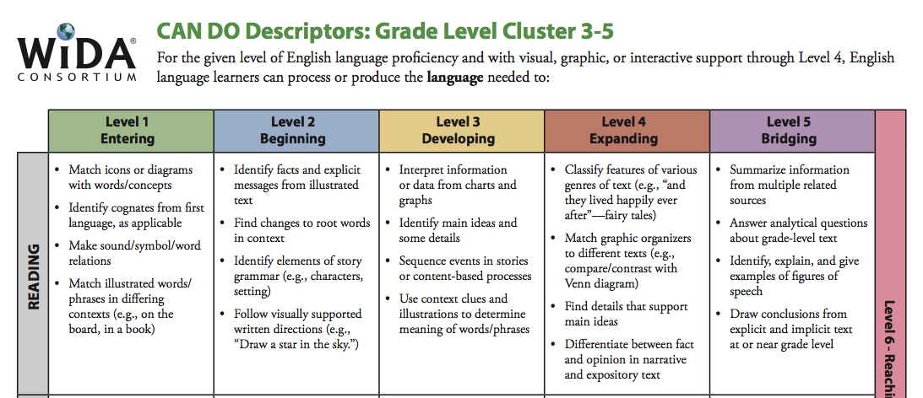
What are “Can Do” Descriptors?

Slide 16
Current issues in assessment
3. Culturally and linguistically relevant assessment for CLD students in determining learning disabilities
Current Practice:
Bilingual Special Educators and Specialists
      1 Spanish Speech-Language Pathologist
      1 Spanish MSN, 2 CV Creole MSN’s, 2 Haitian Creole MSN’s
Woodcock-Muñoz Batería III used as Spanish Achievement test
Monolingual School Psychologists are using Nonverbal measures of intelligence
BVAT and KABC Nonverbal Index provide supplemental ability data
Parental Rights, SPED documents are translated and sent home in language of families

Slide 17
What are we missing?
Fair & equitable assessments
Reducing bias
Batería III last normed in 2007; BPS has moved from WJ-III to WIAT/KTEA (no longer corresponds)
Ability and achievement tests are not normed on CLD population
We are not including enough descriptive, qualitative data
Parents should be included at pre-referral level, not just at TEAM

Slide 18
Action plan
Reducing bias
Fair & equitable assessments
Look into alternative Spanish assessments
Use Alternative Classification Scheme (Ortiz)
Improve pre-referral data collection - include observations by a variety of staff in different language settings
Institute parent interview process at IST and pre-referral levels to gather cultural/linguistic/social/medical data

Slide 19
Spanish-Language Assessments
Aprenda – comparable to Stanford 10, normed in U.S. and P.R.
      intended to be given mid-year to demonstrate progress
Logramos – comparable to ITBS, which we give in 3rd grade
      norm-referenced, used to assess student progress
Spanish Assessment of Basic Education
      multiple-choice, norms based on Hispanic students’ performance on similar English assessment
SUPERA – comparable to Terra Nova
      group administered, intended to guide instruction, comparison to English TerraNova
      *Data from Center for Applied Linguistics, July 2007

Slide 20
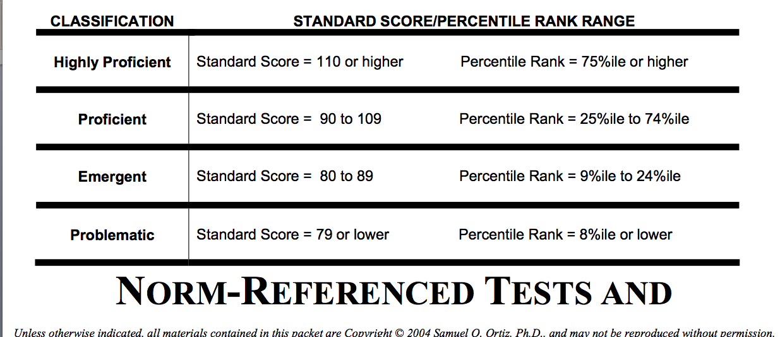
Alternative classification scheme

Slide 21
Considerations for pre-referral data
Focus on the key indicators of LD, as they relate to the definition:
      Persistence of a learning problem,
      Over time
      In the face of “normal” competent instruction*
      Identify strengths and weaknesses
      Compare to other students with similar cultural and linguistic backgrounds - Is the student’s progress in acquiring English significantly different from that of peers who started at about the same level of English proficiency and have had comparable instruction?
      LD and the English Language Learner
      Robin L. Schwartz, M.Sp.Ed.-LD
      Lesley University, 2002.

Slide 22
Considerations for pre-referral data
Team Approach to collecting data – asking the right questions
    Have other adults working with the child noticed similar difficulties?
    Does the problem exist across contexts (classroom, home, social)?
    Are the problems evident in L1?
    Are there other variables (cultural, social, economic, linguistic) that
    could explain the difficulties or contribute to them?
    Can problematic behaviors be caused or explained by bias during
    assessments?
    English Language Learners with Special Education Needs
    Alfredo J. Artiles and Alba A. Ortiz (2002)
    Published by the Center for Applied Linguistics

Slide 23
Parent interview
    Detailed parent interviews should provide information about the cultural and linguistic environment of the home, including:
      An understanding of language use, development, and preference (of student and family members)
      Level of proficiency in L1
      Communication/literacy in the home
      Developmental and medical history
      Social and emotional functioning
    English Language Learners with Special Education Needs
    Alfredo J. Artiles and Alba A. Ortiz (2002)
    Published by the Center for Applied Linguistics

Slide 24
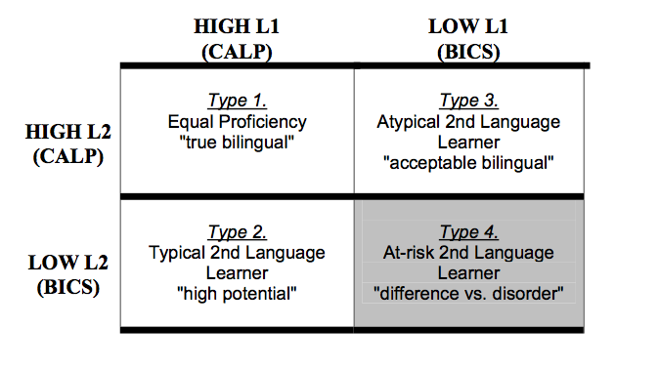
BICS/CALP and “difference vs. disorder”
Copyright © 2004 Samuel O. Ortiz, Ph.D.

Slide 25
Distinguishing language differences from learning disabilities
A TEAM must consider…
If the student has been assessed in L1 and L2 to the fullest extent possible
If the disorder is present in the student’s native language and English
If formal and informal assessments have been used to gather data
If a student’s language has been assessed in a variety of speaking contexts and by various professionals
If error patterns in language usage have been established and analyzed
If lack of academic progress is primarily the result of Limited English Proficiency
      See “Considerations for Pre-referral Data” – How does the student compare to his/her peers from similar CLD backgrounds? Do his/her learning behaviors fit within the context of the definition of a “learning disability”?

Slide 26

Key questions for developing a school-based action plan

Slide 27
Questions we asked ourselves
How are we evaluating language proficiency? How often? For what purpose?
Are we basing instructional decisions on the language level of our students?
How can we develop linguistically and culturally relevant interventions? Goals?
How can we better include parents and families in the intervention process?
How do we evaluate language, ability, and achievement in a way that is reliable, valid, and reduces bias?
How do we show that Limited English Proficiency is or is not an exclusionary factor when discussing possible LD?

Slide 28
How can we improve our assessment?
Accurately determine current language proficiency in L1 and L2
If a student is not developing CALP in either or both languages, we must ask why and address specific language needs
Rule out factors of:
      Instruction (direct, targeted instruction and interventions)
      Culture/environment (e.g. experience, norms/mores)
      Language learning (e.g. code switching, language loss)
Consider biases in assessment
Gather descriptive data and dynamic assessment to support unbiased results
Include parents/families in all aspects of the process

Slide 29

Thoughts? Questions?

