Slide 1
Making the common core accessible for ells
Cathy Fox, NBCT
Margaret Schembre, NBCT

Slide 2

English Learners and the Common Core Standards
Tesol Brief, March 2013

Slide 3
Content Objective
Participants will incorporate language supports and differentiation strategies when planning a thematic unit making the Common Core State Standards accessible to English Learners of various ELD levels.
Participants will be able to apply a variety of writing routines to a thematic unit to support English Learners of various ELD levels (generative writing, power writing, dictation, and writing recipes).

Slide 4
Language Objective
Participants will explain the language supports and differentiation strategies that help the English learner access the CCSS.
Participants will create prompts for two writing routines. (generative writing, power writing, dictation, and writing recipes).

Slide 5
Starting the Process
Background: FOSS is a researched-based science curriculum for grades K-8. It was developed with the belief that “the best way for students to appreciate the scientific enterprise, learn important scientific concepts, and develop the ability to think critically is to actively construct ideas through their own inquiries, investigations, and analyses.”(FOSS)

Slide 6
Background (cont’d)
Our Teachers need to have the knowledge of the content area to be taught:
Big Idea: Insects have unique structures, behaviors and basic needs such as food, water, air and waste removal. Insects are all related to each other, yet exhibit variations and complex life cycles.
Content Goals for Unit: (These goals do not align with The Next Generation Science Standards for Grade 2 at the present time, but do align with the Grade 1 NGSS)
1. Students will state what insects need to survive.
Students will be able to identify and label the body structures and describe the behaviors of these insects (mealworms, wax worms, milkweed bugs, silkworms, and butterflies) at each stage.
Students will explain how each insect grows to adulthood.
Students will compare and contrast mealworms and wax worms.
Vocabulary: Identify essential vocabulary.

Slide 7
Comprehensible Input
Vocabulary Cards for Essential Vocabulary
Academic Language: Vocabulary that spans content: 1-2-3
Expanding on the Lewiston Scientist Notebook to include differentiation for the ELD levels.

Slide 8
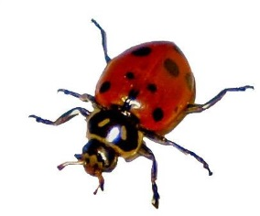
Strategies
Routines to improve English learners’ ability to communicate in writing.
Dictation: Practice writing sentences using grade appropriate conventions and reinforce content and vocabulary.
The red spotted ladybug has six legs.

Slide 9
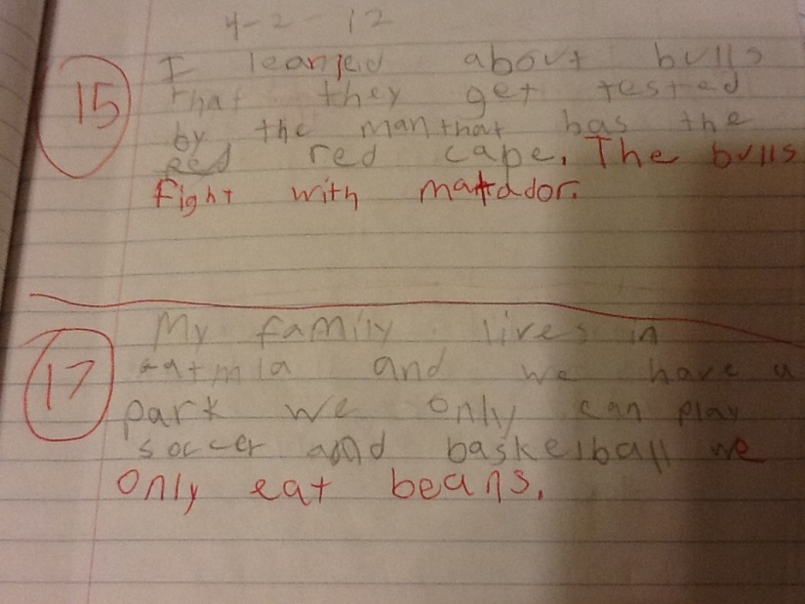
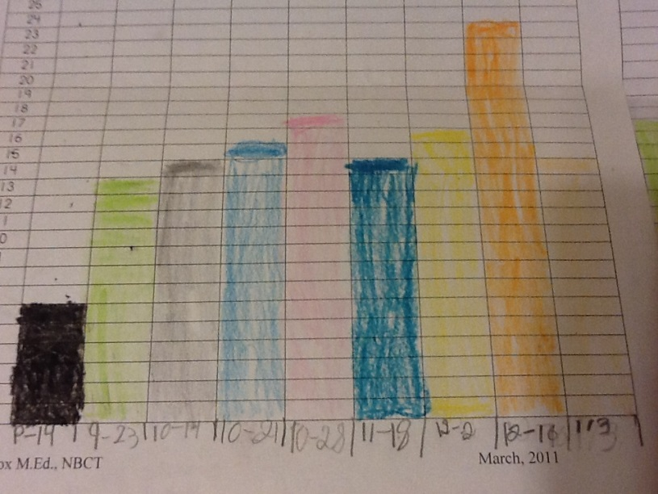
Strategies cont’d
Power Writing is: Writing as much as you can, as well as you can, and as fast as you can for one minute about a given topic. The purpose of this activity is to build writing fluency. (Fisher & Frey, 2007) The effectiveness of power writing is dependent on adequate background knowledge.

Slide 10
Let’s Try It!
Power Writing!
What did we learn?
How can I use this on Monday?

Slide 11
Strategies cont’d
Generative Writing:
Prompts for Generative Writing: from Fisher Frey, Scaffolded Writing Instruction: Teaching with a Gradual Release Framework, 2007
Let’s Try It!
Try this one on Tuesday!

Slide 12
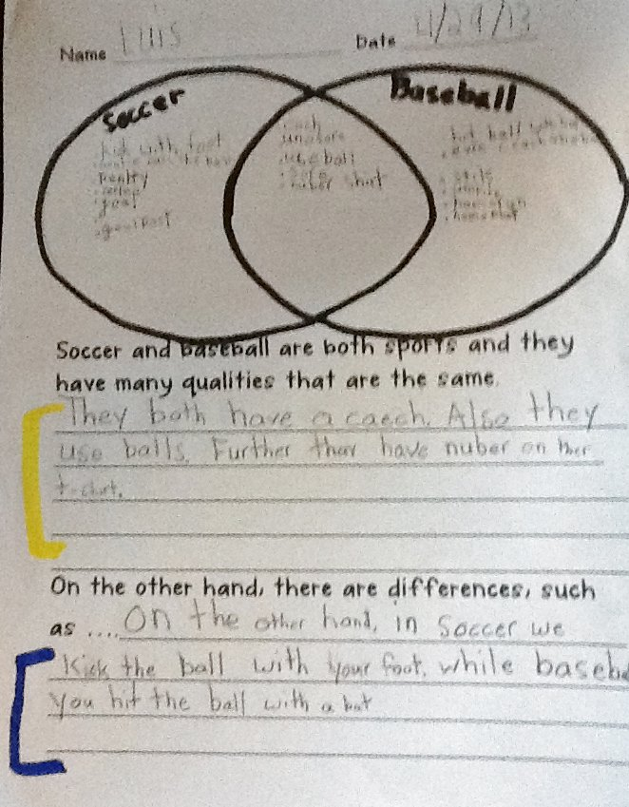
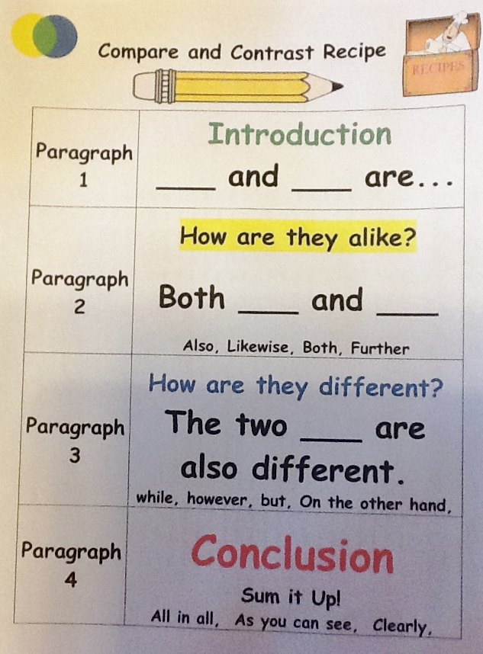
Strategies cont’d
Quick Write Recipes

Slide 13
Interactions
CCSS address speaking and listening in the ELA standards.
21st Century Skills address students ability to collaborate, be creative, use critical thinking and communicate with each other.
WIDA performance definitions for expressive language
All students benefit from using speaking to rehearse for their writing, but it is essential for our ELs.

Slide 14
Practice and Application
Effective Practice
Be focused on an acquiring skill
Provide multiple opportunities to practice
Actively engages the students.
Aligned with your assessment.
Provides immediate feedback to the student.

Slide 15
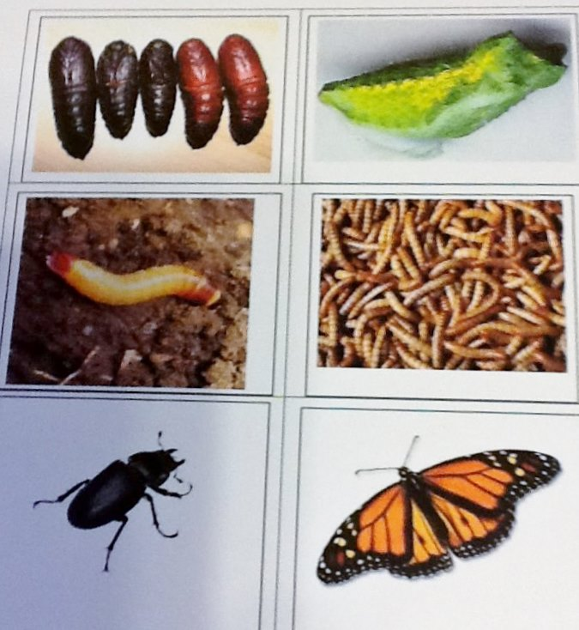
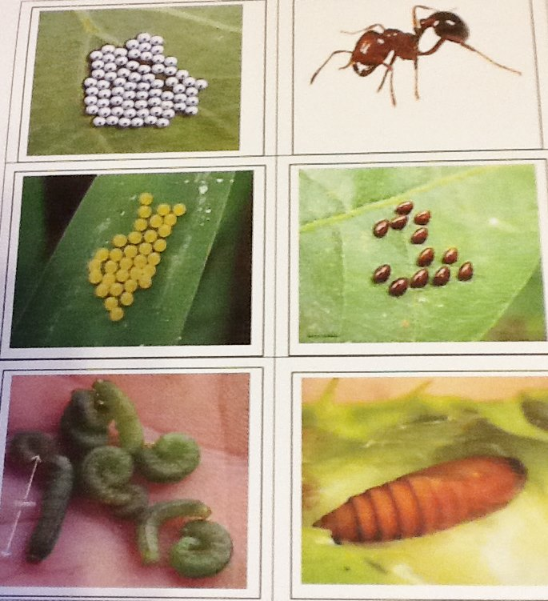
Practice and Application
Sorting Life Cycle to foster generalization

Slide 16
Lesson Delivery
Content Objectives
Language Objective
Student Engagement: Students should be engaged 90-100% of the period
Pacing

Slide 17

Review and Assessment
Formative Assessment

Slide 18
Sample Lesson Plan
This lesson plan is for the second of two introductory lessons for the Insect unit. The first lesson used the short video clip from www.wonderville.ca explaining the career of the entomologist. This is an awesome website for teachers and students.

Slide 19
Content Objective
Participants will incorporate language supports and differentiation strategies when planning a thematic unit making the Common Core State Standards accessible to English Learners of various ELD levels.
Participants will be able to apply a variety of writing routines to a thematic unit to support English Learners of various ELD levels (generative writing, power writing, dictation, and writing recipes).

Slide 20
Language Objective
Participants will explain the language supports and differentiation strategies that help the English learner access the CCSS.
Participants will create prompts for two writing routines. (generative writing, power writing, dictation, and writing recipes).

Slide 21
Thank you
Feel free to contact us with any questions:
Cathy Fox cathyfox10@gmail.com
Livebinder page: Writing with ELLs
Peg Schembre pegs2@cox.net

