Slide 1
Online Professional Development Strategies that Engage Teachers
MATSOL 2013
Mary-Margaret Almonte, B.F.A., MAT ESL
ELL Curriculum Specialist
Carley Ferren-Gardner, B.S., MATESL
ELL Teacher
Malden Public Schools
Notes:
Carley & I introduce ourselves, and distribute handouts

Slide 2
Online Professional Development Strategies that Engage Teachers
Objective:
To show ways to use technology to support teachers’ professional development
Featuring: Edmodo online WIDA discussion
Notes:
MM shares objectives, and talks about ELL coaching in the district, and using technology to reach as many teachers as possible.

Slide 3
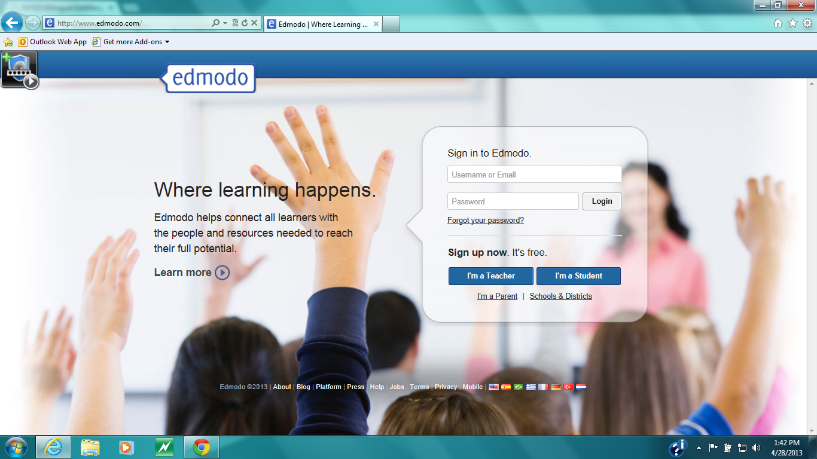
2012.2013 Malden Public Schools
EDMODO WIDA DISCUSSION
Approx. 42 K-12 teachers or administrators participants
Nov.-June Read & Respond
PDF articles, WIDA website, surveys & application discussions
Notes:
MM talk candidly about facilitating MPS WIDA discussion

Slide 4
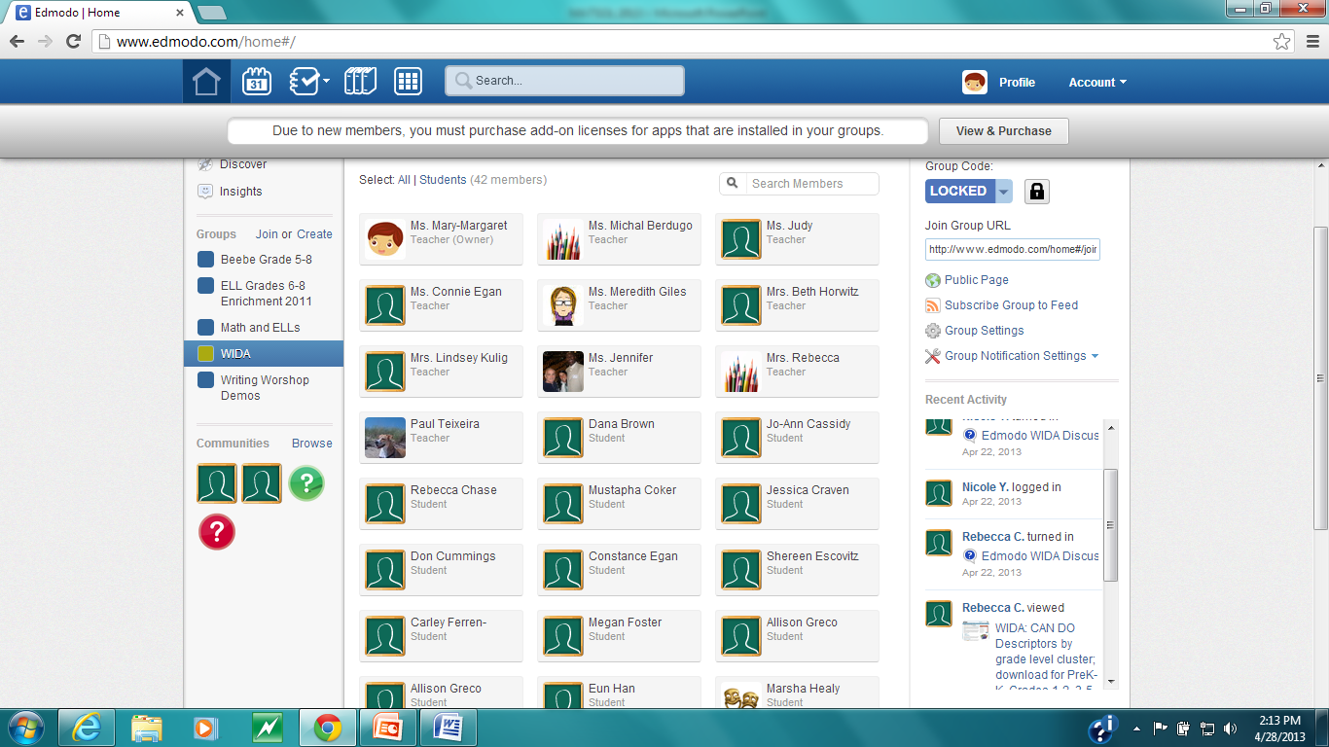

Slide 5
Easy Steps to begin an edmodo online discussion
www.edmodo.com
As the facilitator:
Click on “I’m a Teacher”
Create a title for your PD
Get Group Code:
Share code and outline for discussion

Slide 6
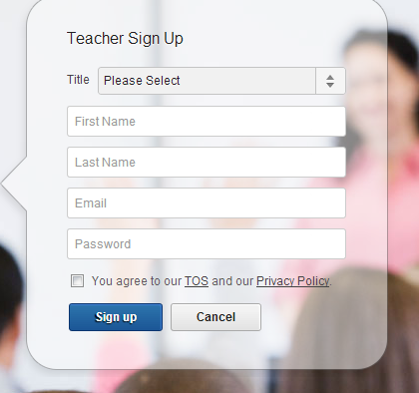

Slide 7
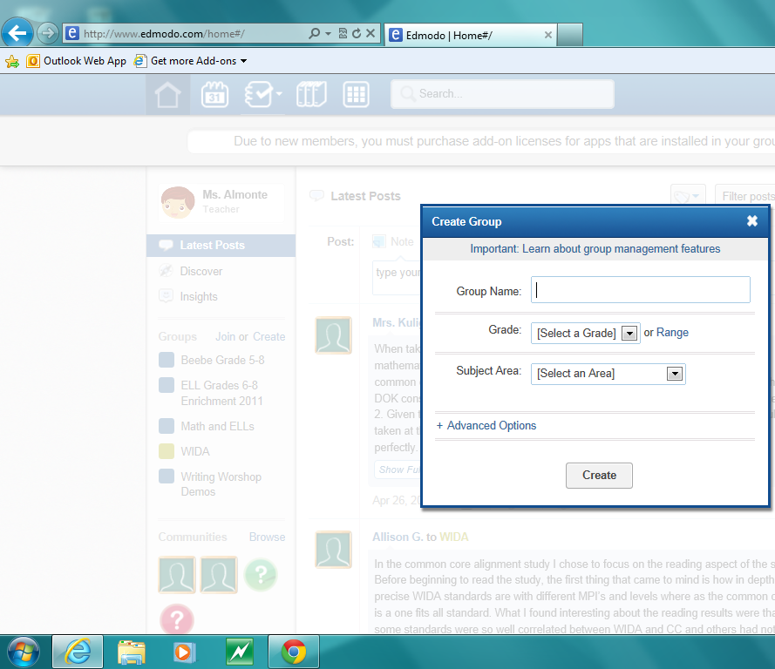

Slide 8
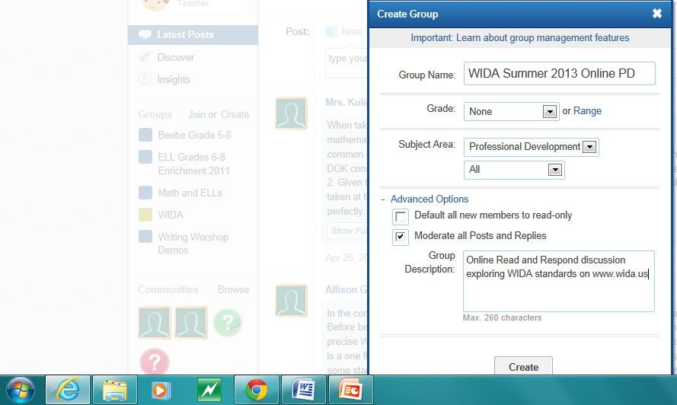

Slide 9
A Group Code is given to you.
At this point, you promote your online discussion!
I Sent out A promo letter district wide
When a cohort was formed, I sent out the outline and instructions for participants to join the edmodo discussion group
I Began the discussion with my initial post

Slide 10
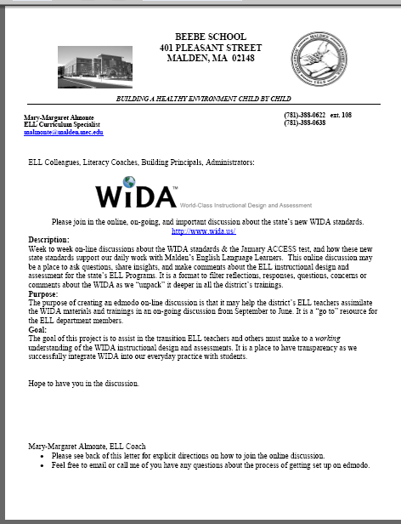

Slide 11
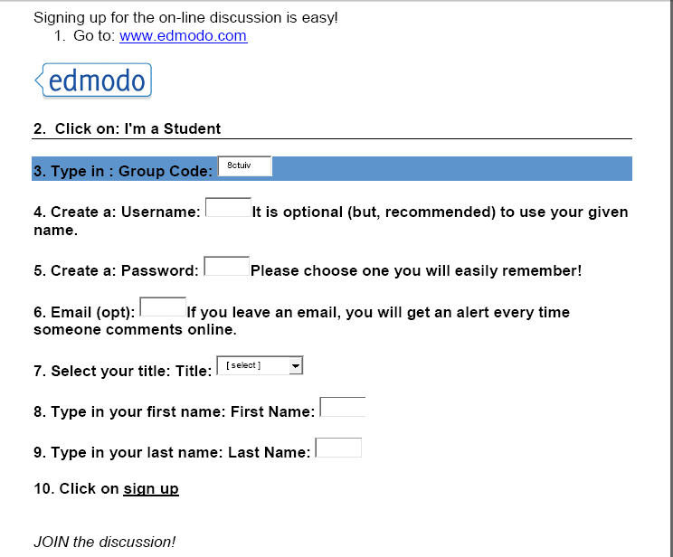

Slide 12
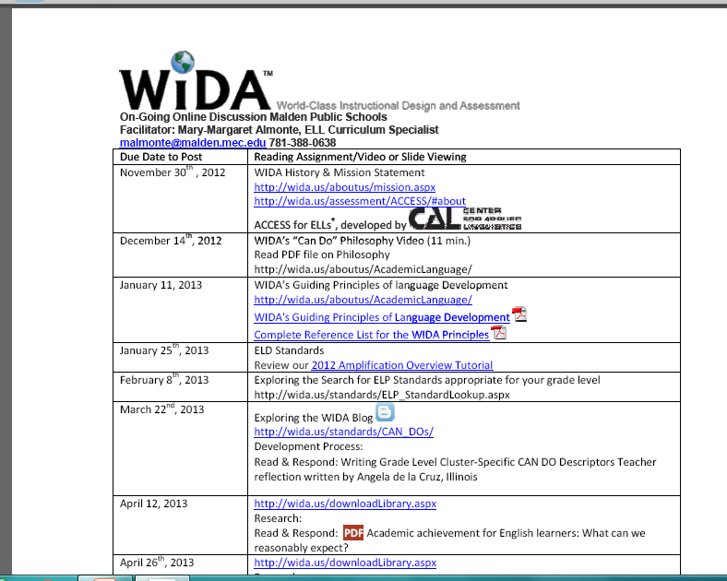

Slide 13
See example of WIDA Online Discussion Handout at the back of handout notes
It is important that you remind teachers to sign on as
“I’m a student”
To join the discussion.

Slide 14
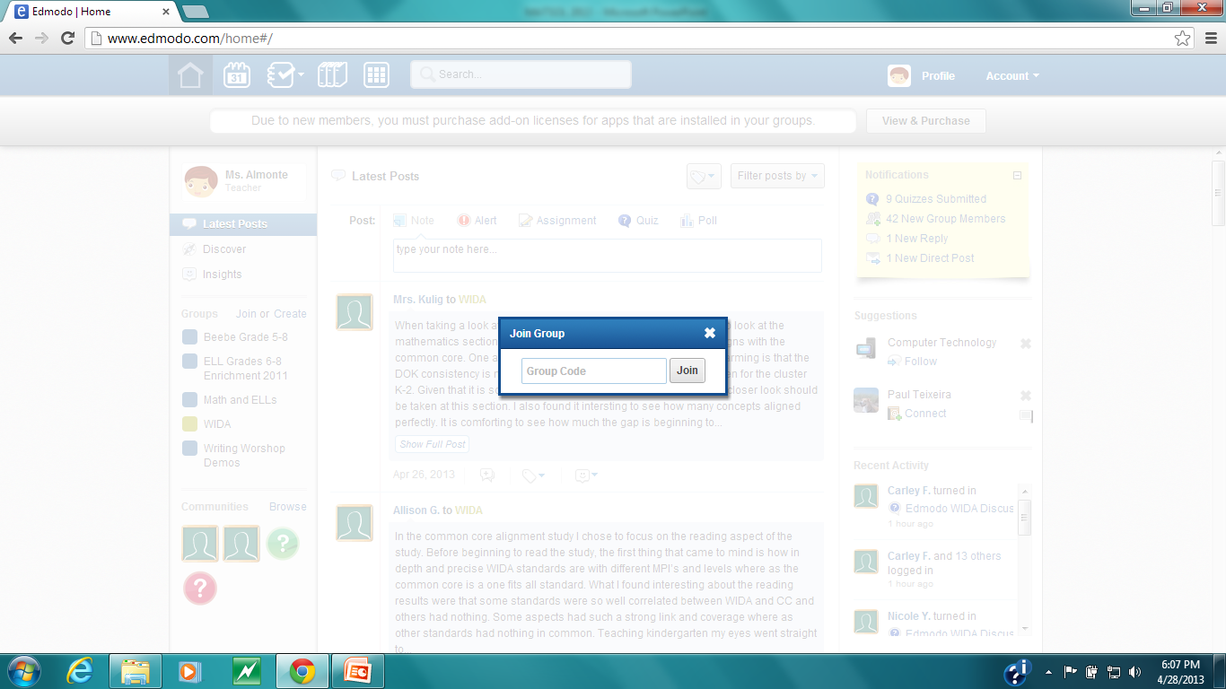

Slide 15
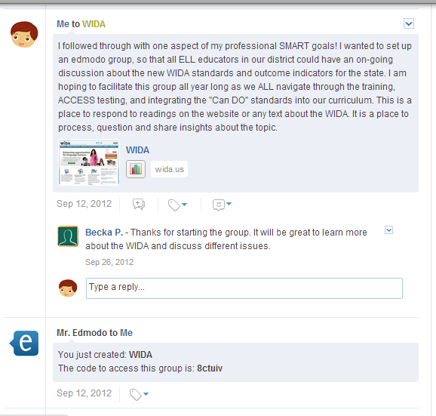

Slide 16
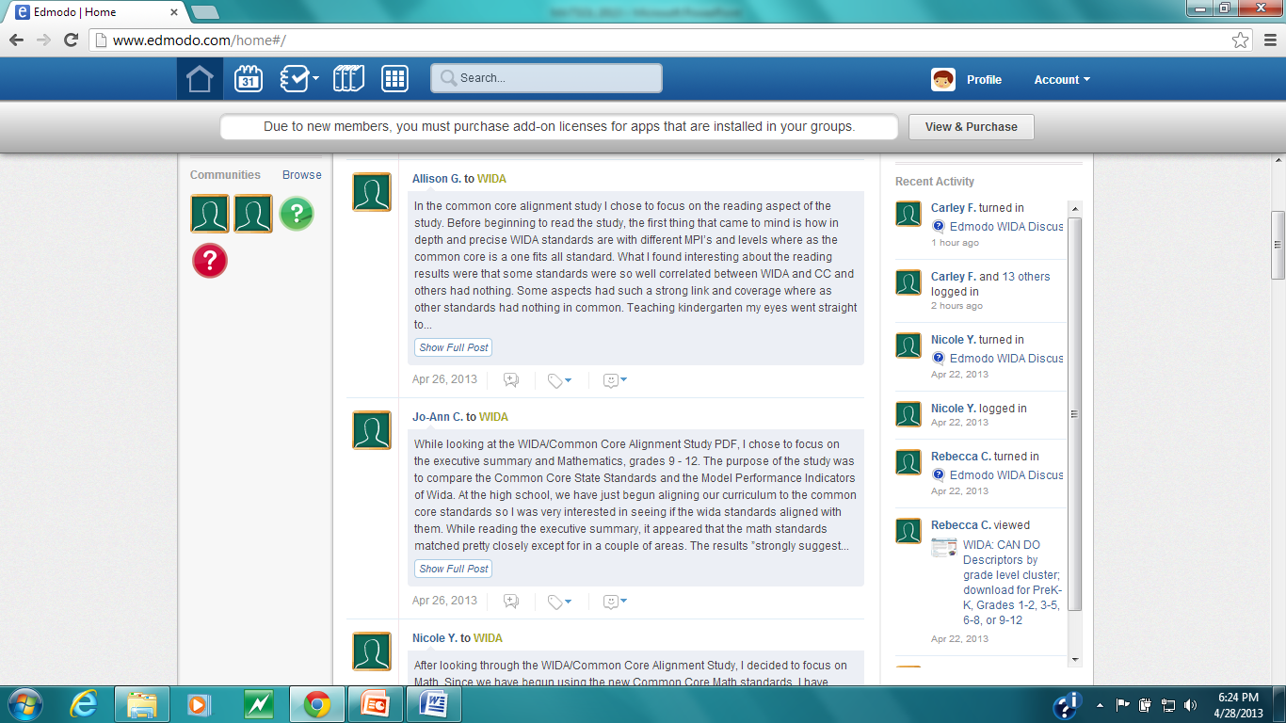

Slide 17
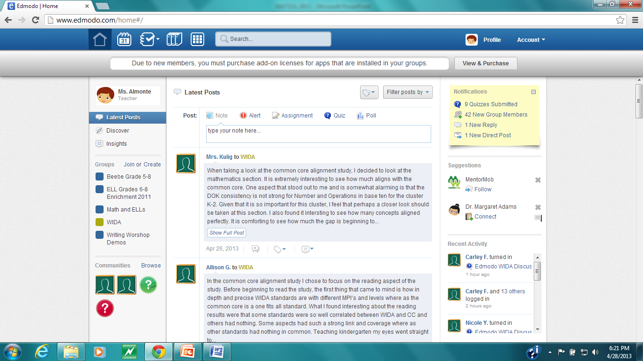

Slide 18
Participant Examples
SEI1 1 Teacher
As I focused on Grade 1, I discovered that
a majority of the WIDA MPIs did align
well with the Math Common Core according to
the 6 panelists who reviewed the two. In first
grade, Numbers and Algebraic Thinking, Base
Ten Operations, and Geometry all satisfied the
depth of knowledge required for ELP students,
however, Measurement and Data did not. Also,
Operations and Algebraic Thinking as well as
Geometry has strong coverage in the WIDA
MPIs, while Base Ten Operations and
Measurement and Data had limited coverage.
The document also stated that "these
findings strongly suggest there is substantial
correspondence between the Common Core
Mathematics standards and the WIDA ELP
standards in Mathematics" (p. 35).
SEI1Grade 6 Teacher
I have just read “Academic Achievement for
English Learners: What can we reasonably
expect?” The article greatly emphases the great
need to focus on academic English rather than social
English. One of the goals of using WIDA also focuses on
that. The students need to be held accountable for both
types of English. The students need to understand the
different ways that information can be presented. The
information in Science is presented differently than the
information in Reading.
Teachers need to understand the difference between
classroom language and playground. Classroom has
complex grammar and playground uses slang or idioms.
An interesting fact that I learned from this article is that
according to federal law ELLs do not need to be
proficient in academic language but need to be proficient
in academic content. They need to have the ability to
learn the content. unfortunately, ELLs are constantly
performing below content areas on accountability tests.

Slide 19
Participant Examples
MHS ESL Teacher
The "Academic achievement for English
Learners: What can we reasonably
expect?" article was an eye opening read.
It was interesting to have numbers to back
up what we are already seeing in the
classroom. "Over 5 million students are
learning English in America's public
schools...more than 10% of the K-12
population." The teaching of ESL has also
really changed. "American schools have
shifted emphasis from supporting social
English to emphasizing more academic
English." The shift is supported by the
academic testing of WIDA. It will force the
ESL classroom to be more focused on
English through the content based
materials.
ELL Teacher
March 22 Assignment
I really enjoyed reading the reflection written by Angela de la Cruz. From her description it sounds like the WIDA CAN DO Descriptor session was quite thought-provoking. I can imagine that identifying what ELLs can do at each proficiency level in all four strands was quite a tricky task. Reading this reflection made me remember the portion of our ACCESS training that dealt with the Speaking portion of the test. During this part of the training we engaged in various discussions regarding what score we would give to a given sound sample and why. I found this to be very stimulating because it made me really consider what qualities we were looking for in an answer and how to identify them. As many others have mentioned, it is always to our benefit to be able to collaborate and share our thoughts with other teachers!

Slide 20
What are some take aways you will use in your everyday practice with ELL students?
I have a better understanding of the time line for learning and the differences between social and academic language.
I plan to incorporate the CAN DO descriptors
I plan to visit the WIDA website more often so I can see what's new.
I took away how to create an objective using the WIDA formula. I also took away what to expect from my students depending on where there skill level is at. I will also be using the WIDA CAN Do philosophy everyday with my ELL students.
I took away the can do descriptors and writing proper WIDA objectives for each subject that I teach.
I have found some great resources on the website that have been helpful and useful in the classroom.

Slide 21
About her experience as a participant from
Carley Ferren-Gardner
A “reluctant” writer, but completely engaged in the discussion.

Slide 22
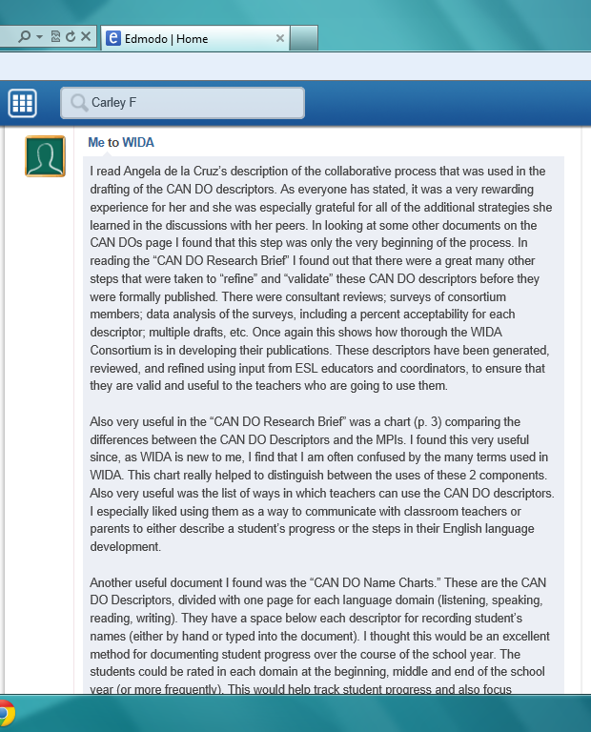

Slide 23
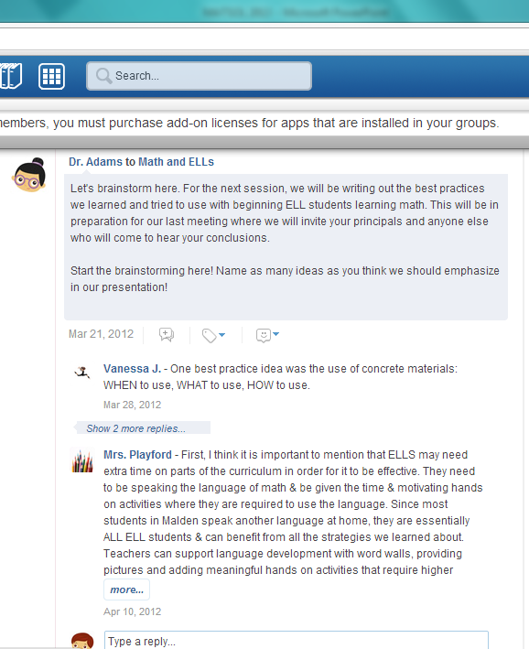
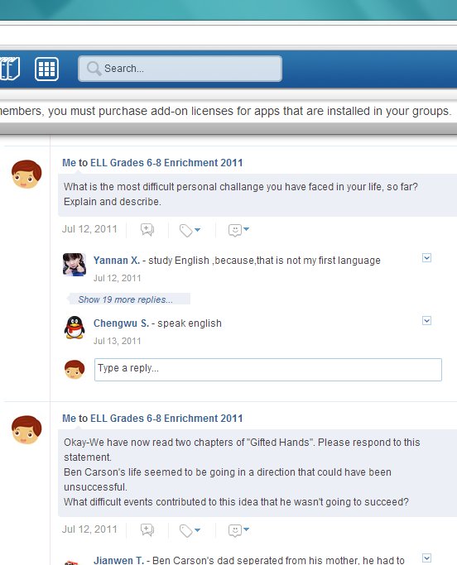
Other uses for edmodo
Collegiate Book Discussions
Student Book Discussions
Example: Math & ELLs
Example: Gr. 5-8 ELL

Slide 24
Thank you for attending.
Please do the quick survey before you exit.

Slide 25
malmonte@malden.mec.edu
We hope you will take this back to your district and facilitate a WIDA discussion
Feel free to contact me if you have any questions about doing an online discussion on edmodo.

