Slide 1
Collaborative Learning in THE ESL Classroom
Brian Conlon May 2013
Salem State University

Slide 2

Experimental Research Study
Will introducing small group learning bring about better content and language outcomes for my ESL students?
Notes:
Why??? Reached a new low in the classroom. Grade 10 test – half the students failed. Some students just put their head down on the desk.
Same students kept raising their hand to answer question – not engaging the class
Language outcome also poor. Some students not speaking in class. No chance to practice English,. Students unable to “talk” about math
Some students, particulary those w/ low English proficiency seemed to be stressing out

Slide 3
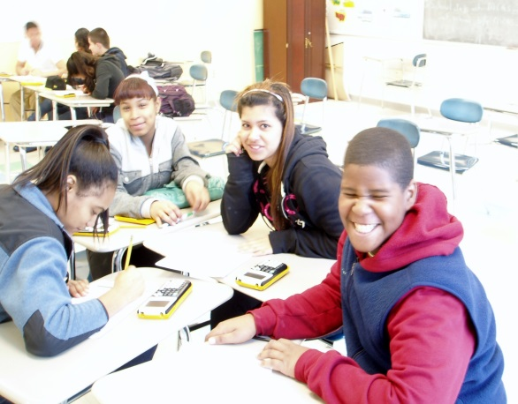
ESL students and Group instruction
There appears to be a natural cohesiveness among ESL students at LVTI
They look out for each other
Students share a core group of courses with small class sizes – develop relationships and bonds
Students were already doing “group work” on their own initiative
  Explaining concepts and vocabulary
  Translating teacher instruction to lower English proficiency students
Notes:
I reflected on what is working in my classroom. My ESL students were supporting each other every day and in many ways.
I wanted to see if I could leverage this process into a formalized process

Slide 4


Why did I pick this Topic?
Sometimes I had great success with group lessons
Students were engaged and on track. Learning goals and objectives were met
Notes:
So I tested out small group cooperative learning in the classroom.
You could hear the energetic interactions among the students. They were excited when they achieved their goal and their smiles lit up the classroom.
You could feel the focus and energy in the classroom.

Slide 5



Other times, my efforts were less than successful!!
Notes:
These were the days that I was glad I was not being evaluated!!
It was a like the last day of school – just after the bell rang. Lots of noise, chaos and aimless shouting.
These were the days I said – never again!

Slide 6
This raised a lot of ??????
Was group instruction an effective method to improve content and language learning for ESL students?
If collaborative instruction works:
  Why were some of my group instructional attempts successful?
  Why were some failures?
What techniques should a teacher use to make collaborative learning a success?
Notes:
Would this work in an ESL class
What factors caused success> What factors caused failure>
How can in implement group instruction to improve the content and language learning of my students?

Slide 7



I Started with a review of Available research and literature
There was a lot of it!!!!
I did not know where to begin
I tried to organize the data using some
of the techniques we learned from Teacher Action
Research
Notes:
There is a lot of information out there. The hard part was selecting what data to research as part of the literature review. I played around with some of the query parameters to look for both recent and older studies.
I looked at research in the US and abroad
I narrowed things down and used only peer reviewed articles.

Slide 8
Literature Review matrix
Author | Year | Location | Method | Sample Size | Focus on 2nd Language Learners | Benefits of Group | Teacher Role | Use of Different Group Methods | Notes
Allison | 2007 | Florida, US | Quantitative |  | Minority sample group | Yes | No | Yes | Teachers were used as subjects of study
Lavasani | 2011 | Iran | Experimental Quantitative Control group | 40 | No | Yes | Yes | No | Girls only
Morgan | 2010 | USA | Qualitative | 80 | Yes |  |  | Yes | Hispanic students
Nair | 2012 | Malaysia | Exploratory Quantitative Qualitative | 70 | Yes | Yes | Yes | No | Student self-evaluation
Özsoy | 2004 | Turkey | Experimental Quantitative Control group | 70 | No | Yes | No | Yes | Math based
Phuong-Mai | 2009 | Vietnam | Quantitative reversed treatment with posttest & control group | 181 | Yes | Yes |  | Yes | Incorporate cultural norms
Schumacher | 2011 | Rhode Island, US | Experimental Quantitative | 49 | No | Yes | Yes | Yes | Math – student centered
Notes:
This was my attempt to organize the data so I could learn from it and integrate the information into my research
I looked at the year, the country the research was conducted in, type of research’,
Whether the study was exclusively on ESL students.

Slide 9


Ideas
I got a lot of good ideas and suggestions
But how could I measure the success of these techniques?
Focused on 3 areas – triangulation of data:
  Student Input
  Actual Content Proficiency
  Teacher Evaluations
Notes:
Everything sounded great. I was very excited and anxious to start
But, how would I know if my experimental research was working? I needed some type of metrics and standards so I could objectively evaluate this process
Thinking that the more points of reference I could use, the more objective and useful would be the assessment process

Slide 10
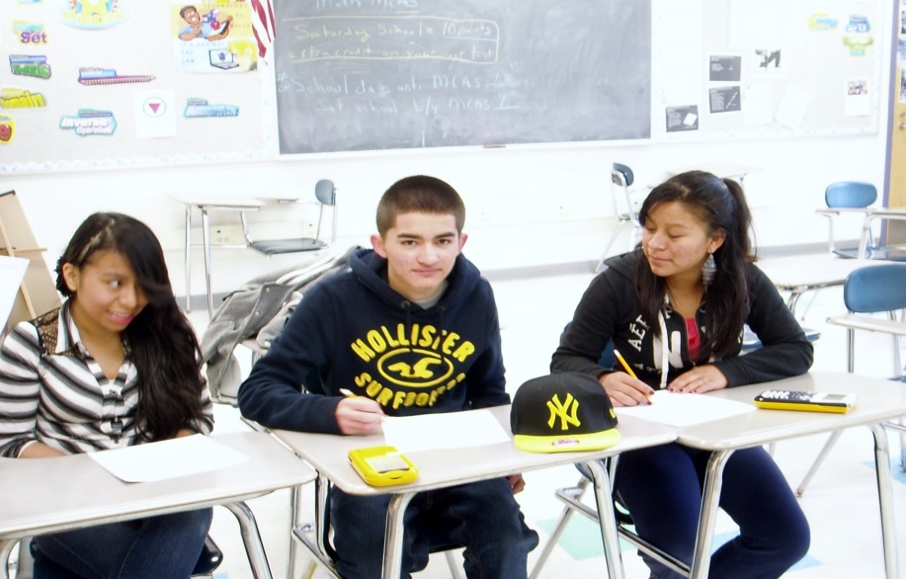
Student Perspective
Direct from the students
Quantitative and Qualitative
Assessed students perspective on achieving content knowledge/objective
Evaluated Group Experience from the ESL student’s point of view
  Theory – if students enjoy their lesson, they will be more motivated to work toward the learning goal
First attempted to gather data using a show of hands - unsuccessful
Notes:
I had been trying to engage my students in the learning process. I wanted them to invest in themselves. To become active learners and not passive.
I thought the best thing to do would be to make them a part of the process. Ask them what they thought about both the content learning and the group experience
Raising hands a disaster. Some students voted 2 or three times, others not at all
This is why Action Research is so powerful – you try something out, you get the results, you reflect and then you reimplement. The cycle is continuous

Slide 11
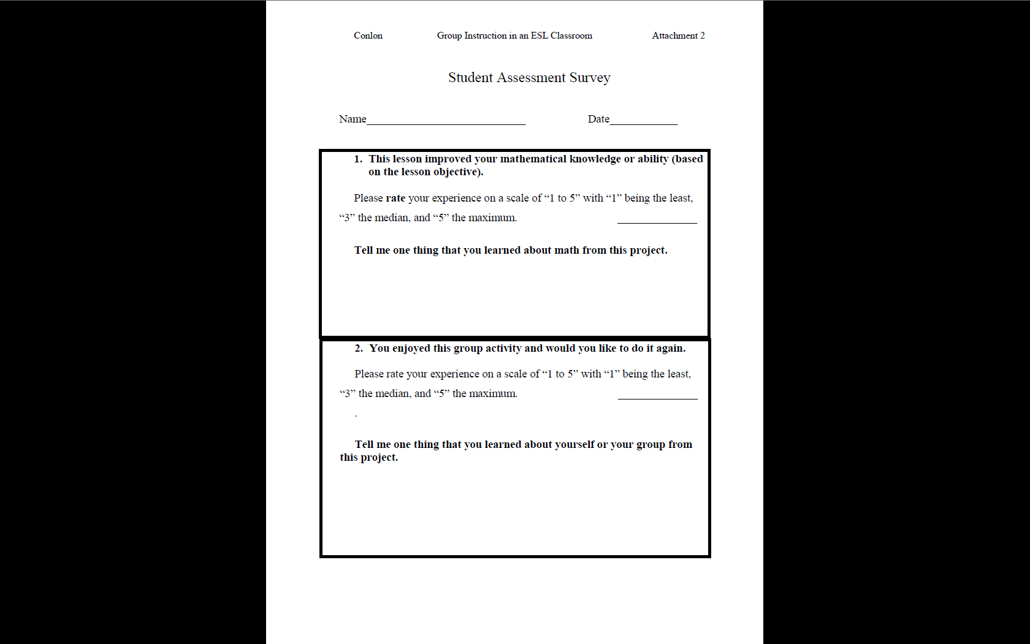


Notes:
Went back and forth on making anonymous vs student names. Decided to go with names to make comments more valid. Also used a way to gather information as part of a “ticket to leave”

Slide 12
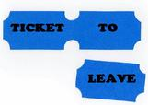


Assessing Content Knowledge
Experimenting with varying formats of assessment:
  Ticket to leave
  Completing the assignment successfully
  Grades on a test or quiz
Notes:
The next assessment area was the subject matter – Did the students achieve their objective?
SWBAT

Slide 13



Teacher Assessment
Did I feel that the group technique was effective?
Were all the students involved and participating?
Did the students demonstrate understanding of the lesson?
Notes:
This was the last area of rtriangulation – and the most important. No body knows your students like you do.
Looked at three areas

Slide 14
 | Technique | a | b | c | d | e | f | Total
 |  | Did this process improve your mathematical knowledge | Did you enjoy this group activity and would you like to do it again? | Based on the assessment, was the group instruction technique successful in building understanding with the students? | Did I feel that the group technique was effective? | Were all the students involved and participating? | Did the students demonstrate understanding of the lesson? | Total Number of Points
 | Indicator
1 | Establish a group goal | 3.0 | 4.5 | 4.0 | 5.0 | 5.0 | 4.0 | 25.5
2 | Teacher assigns students randomly to a pair group | 4.3 | 4.5 | 4.0 | 5.0 | 5.0 | 4.0 | 26.8
3 | Establish that students clear on their roles | 5.0 | 5.0 | 1.0 | 2.0 | 2.0 | 2.5 | 17.5
4 | Assessing student individual contribution | 4.3 | 4.7 | 4.0 | 5.0 | 5.0 | 4.0 | 27.0
5 | Group students homogeneously (math proficiency). | 4.1. | 4.1 | 4.5 | 5.0 | 5.0 | 4.0 | 26.7
Notes:
Put them all togehter

Slide 15
What I Learned
You need to teach and explain what collaborative learning should look like in the classroom. You cannot just group students and let things happen.
Group work is a great way to make students feel more relaxed and lower their affective filter – especially in high anxiety subjects such as math.
Collaborative work can cause some relationships to be intensified –be aware of the mix of students that are grouped together.
Collaborative techniques that work in one class, may not work in another – due to class dynamics.
Sometimes you have to go with your instinct and ignore the “facts”
  Student approval ranking
  Experiment 3 – Students clear on the goals
Notes:
Cooperative learning does not come about naturally. You need to set the expectations and rules of behavior. There maybe cultural bias, gender issues, personality conflicte, language proficiency gaps or content problems, You know your student and content the best, Lots of upfront planning
Students feel less stress, Teacher takes a background role. Have to resist the urge to jump in. Let the group handle the process. Defer to the group. “is this right” ask your partner
Put some thought into the students you place together. Can have a major impact. Boy-girl issues, bullying, friends, enemies,
There is not a one size fits all approach. Taking candy out of the bag for group assignments. Some students took more than one piece. Then picked the group their friends were in
Students give low grades when you correct them. Or as you push their comfort zones and give them more work
Homework copying problems with #3

Slide 16
Start gradually with collaborative learning and “plan”
how to incorporate it into the curriculum. Cumulative effect
Once you have used and tested a technique, going forward it does not have to be an “either/or” choice of only 1 method at a time. Instead you can layer different techniques together for synergy.
Students always rated the group process higher than they did the content portion.
You don’t have to grade and assess every group activity.
Some students do not like collaborative learning. Be sensitive to cultural values.
Potential downside –?? increase in “sharing” of homework & tests??
Notes:
Once you begin with cooperative learning, you need to change your mindset. Think- how does this situation lend itself to cooperative learning. Vary the routine in your classroom
Can add in several techniques – random groups, ticket to leave, individual contribution, common goal, etc
Take the student rating with a little bit of skepticism. They rate the group part higher, the more you push, the lower the student scale – This sucks
One of my top students did not want to join in. She was frustrated with her classmates.
Students pressuring others to do the work for them

Slide 17

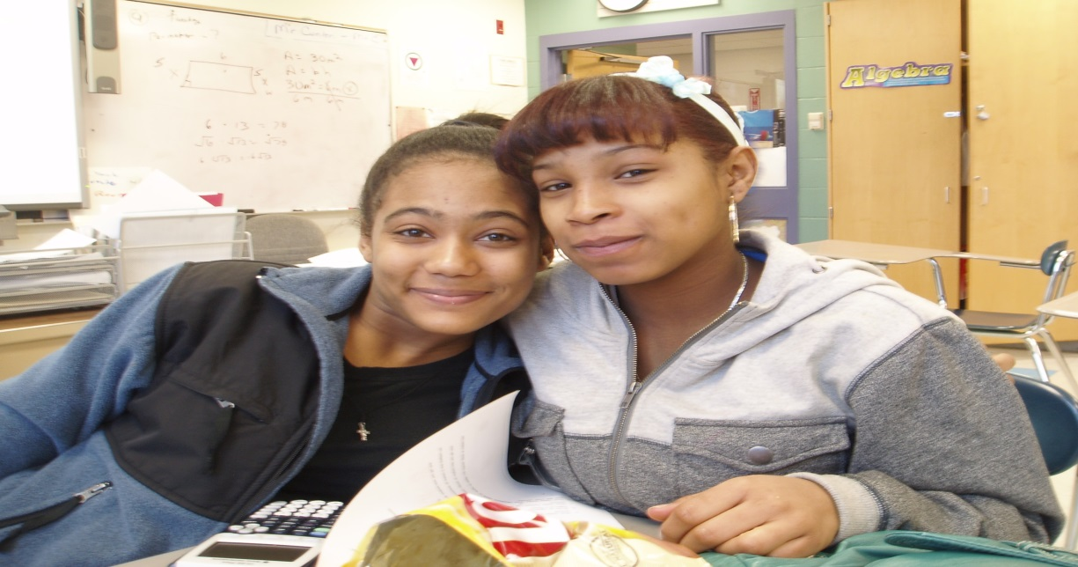
Evaluating Experimental research
Evaluating teaching techniques requires more than just quantitative scores and assessments
Qualitative data is also needed
Notes:
It is very easy to get into the metrics mode and quantify everything.
As and ex finance guy – I had to avoid this.
Just evaluating the numbers may not give us the full story and can be misleading.
We need to remember that We teach for our students

Slide 18


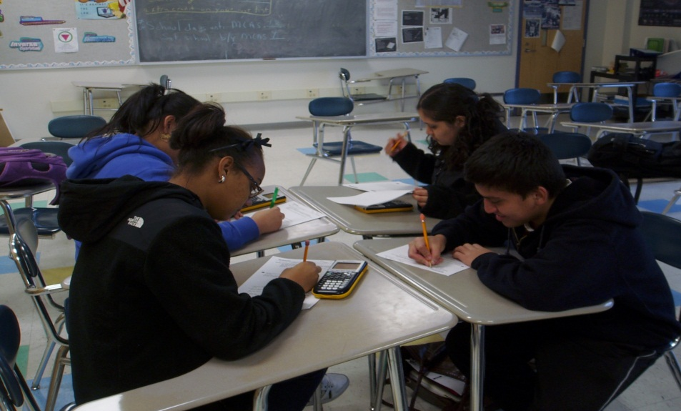


Slide 19
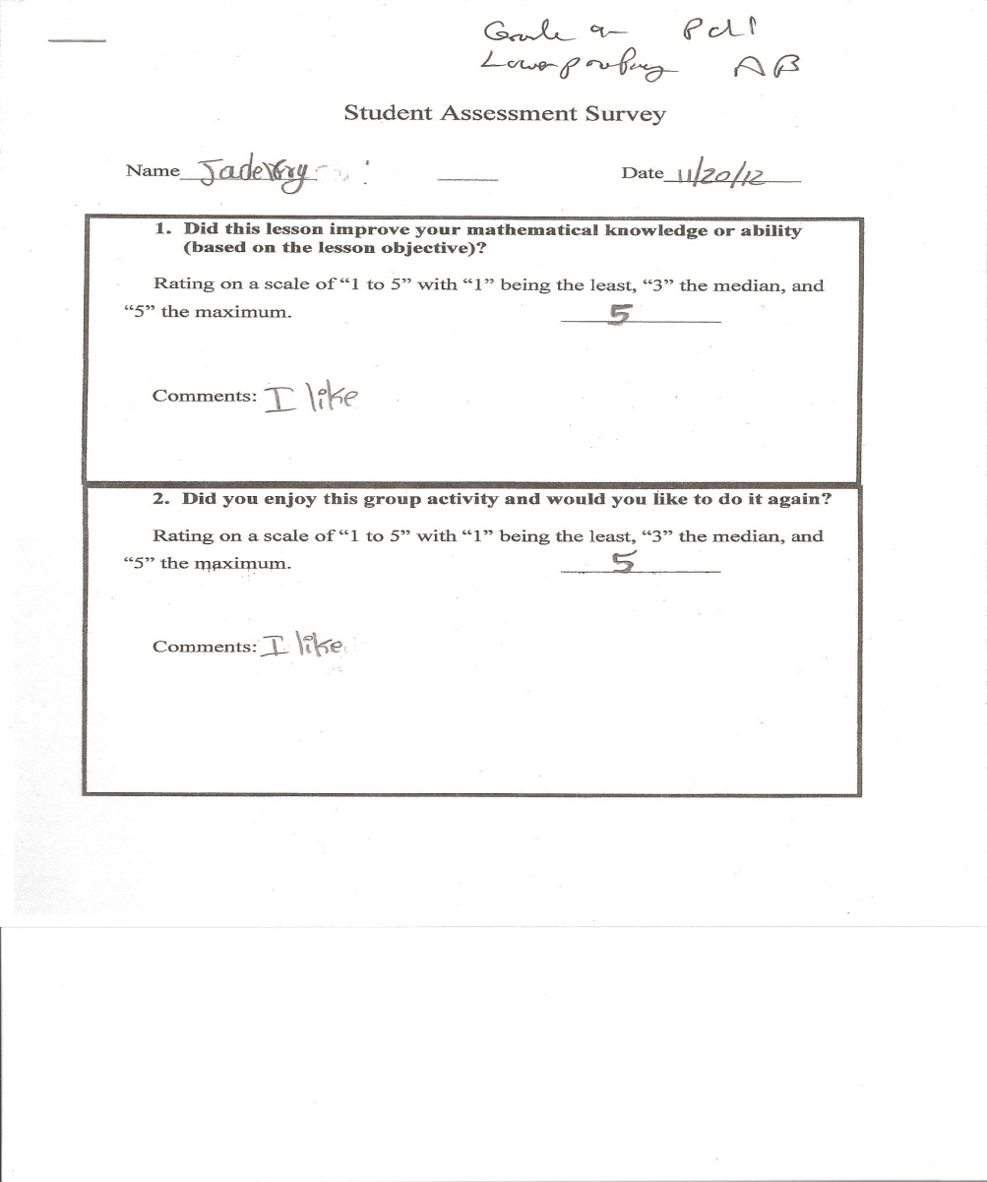

Lower Proficiency ESL

Slide 20
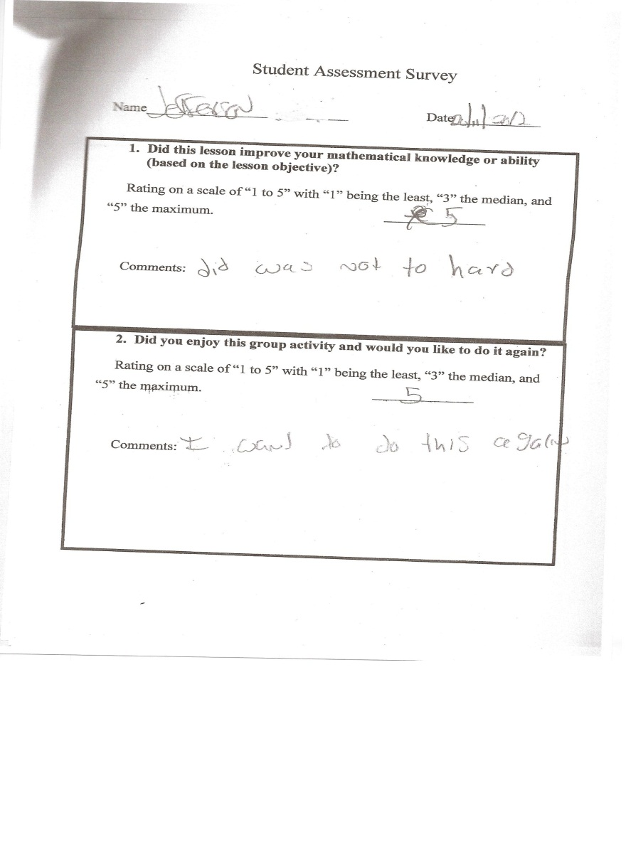
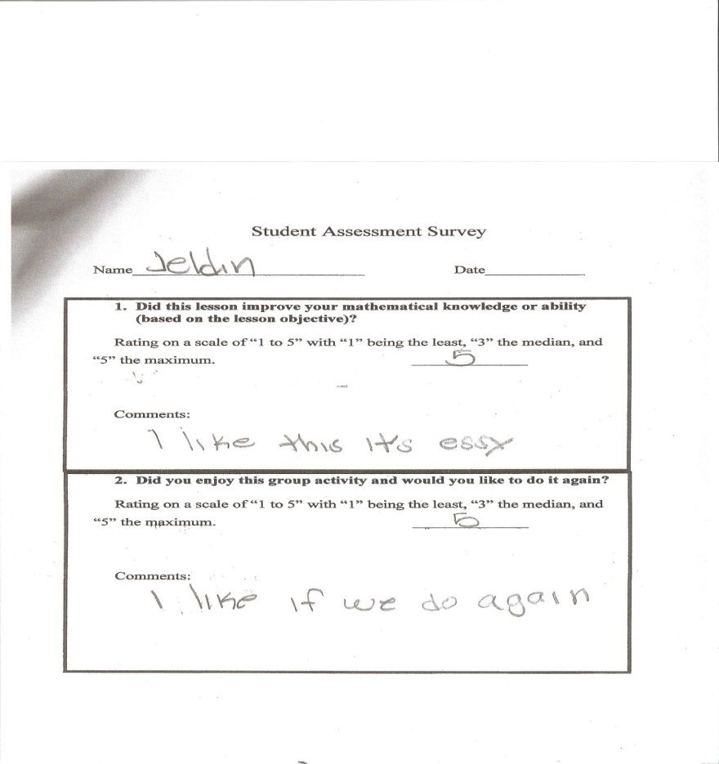
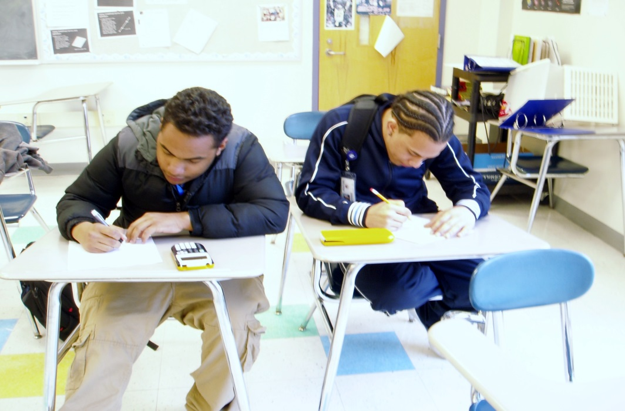


Slide 21
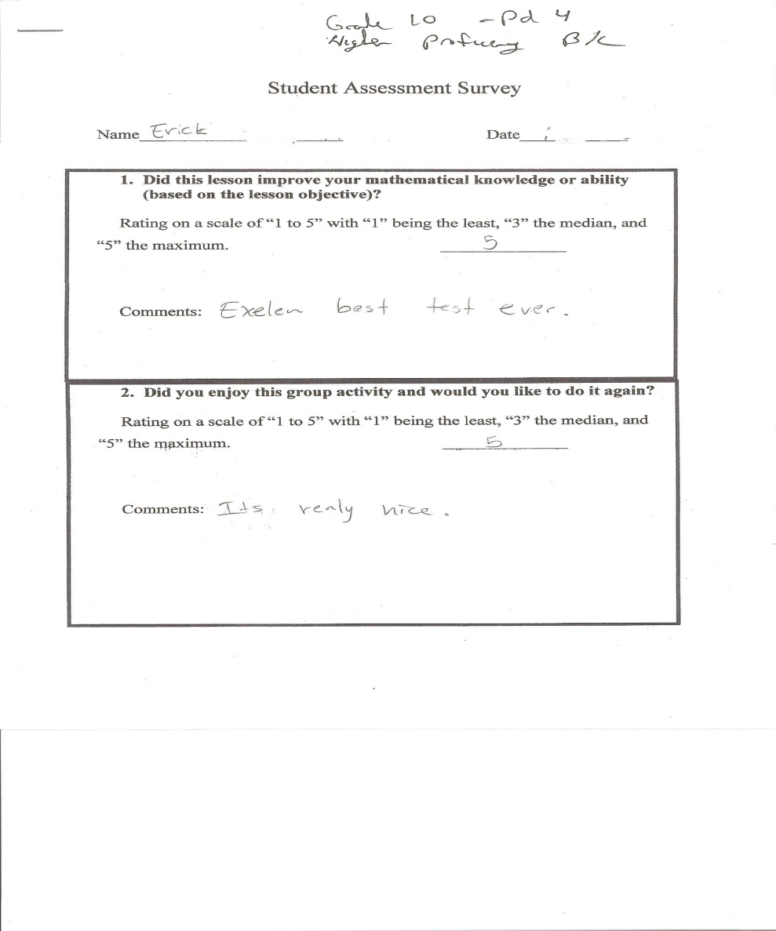
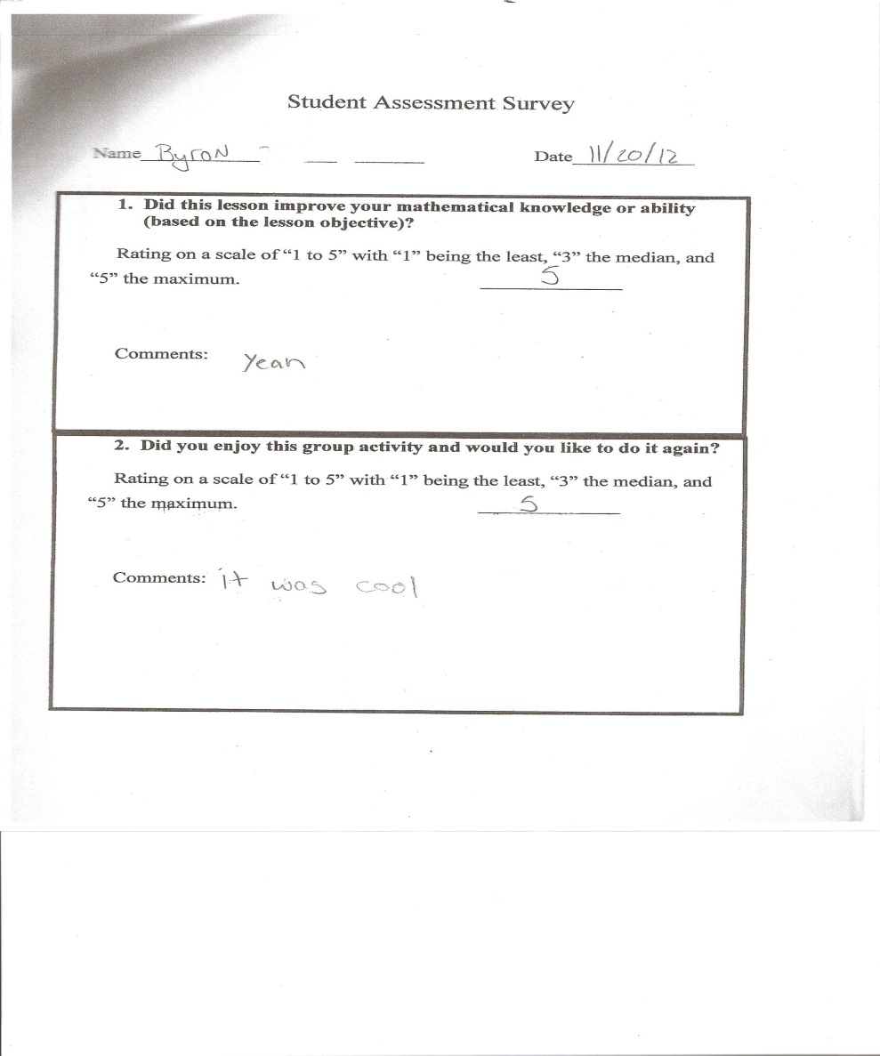


Higher Proficiency ESL Students

Slide 22
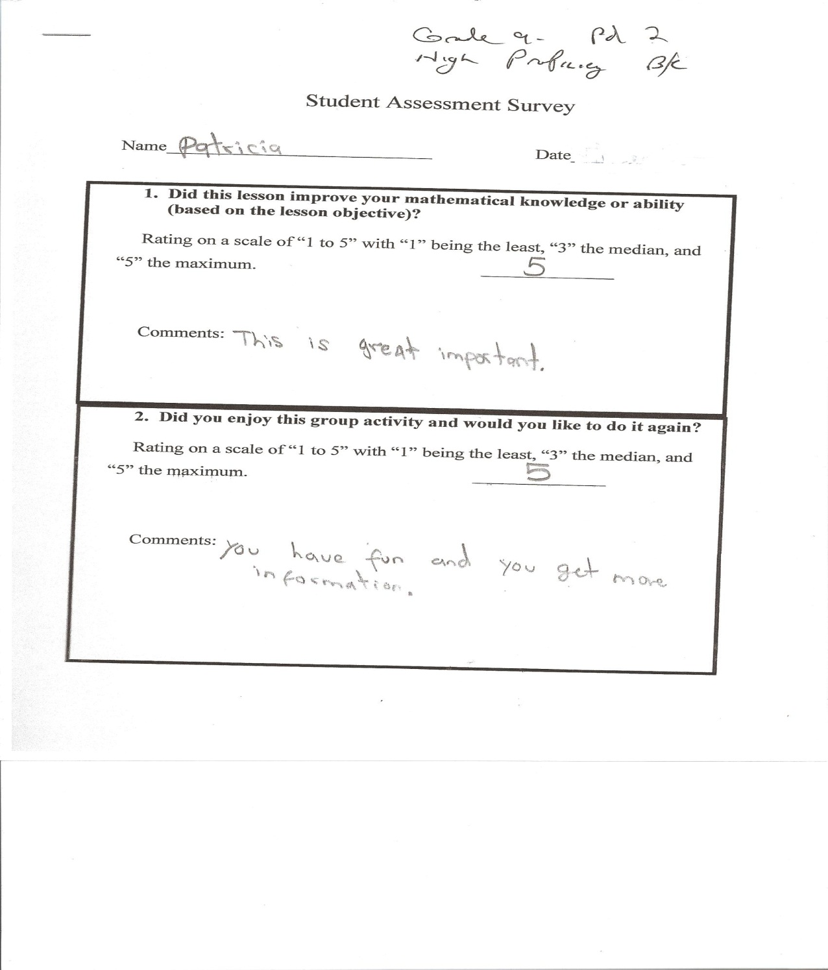
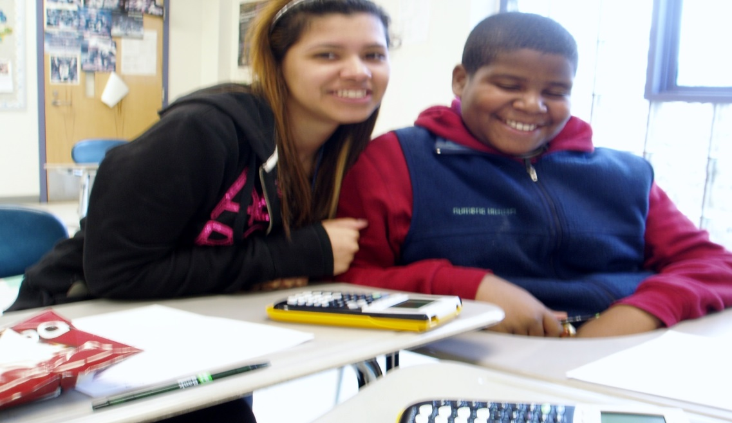


Slide 23
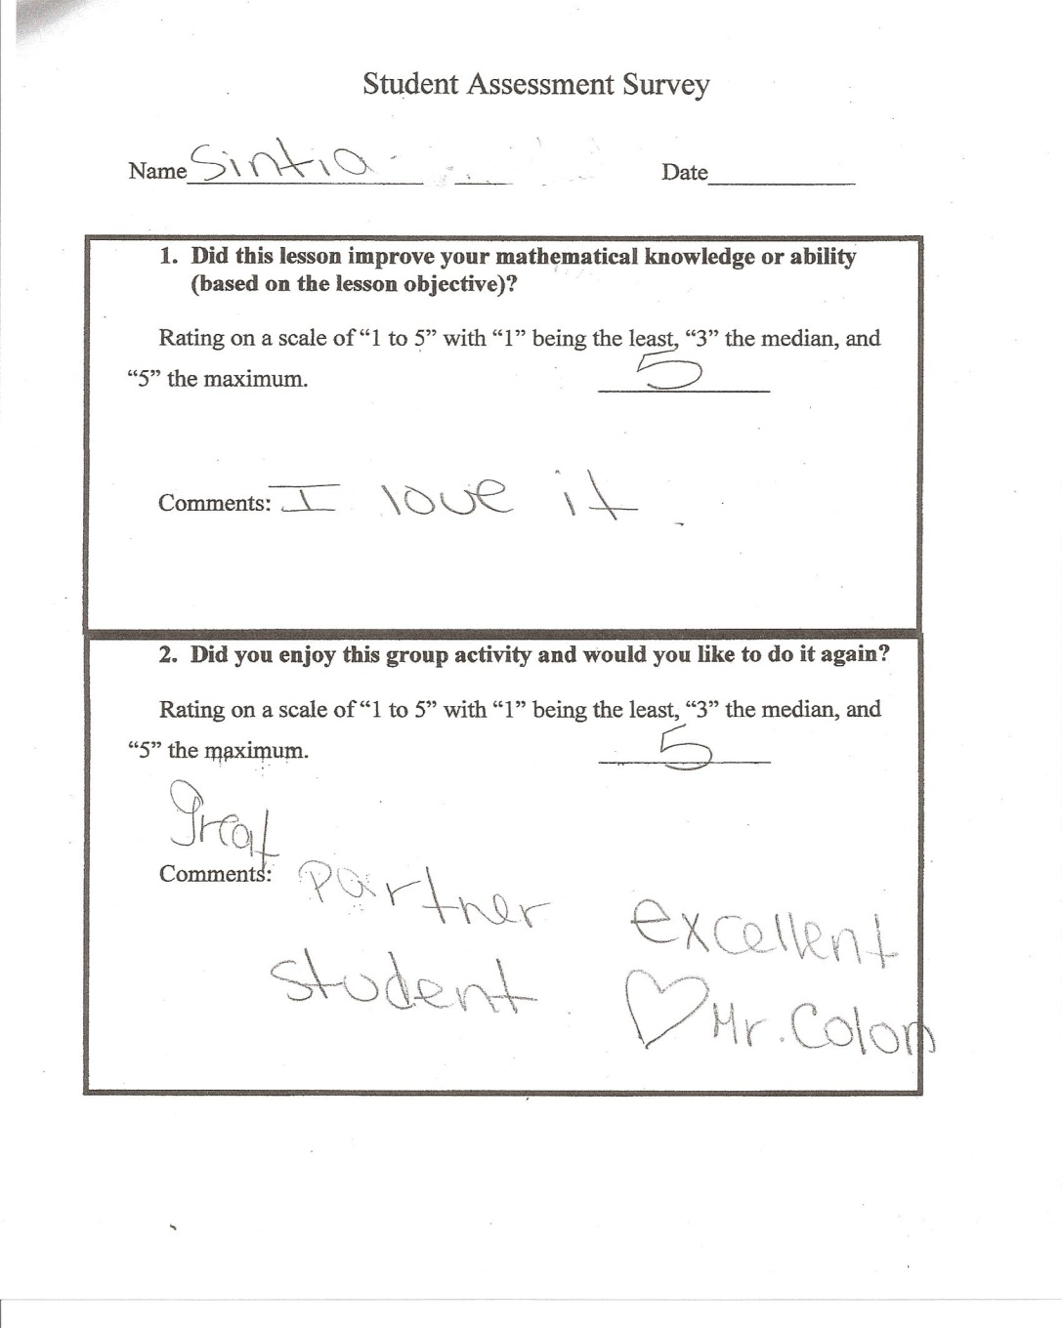
Notes:
Fabulous!

