Slide 1
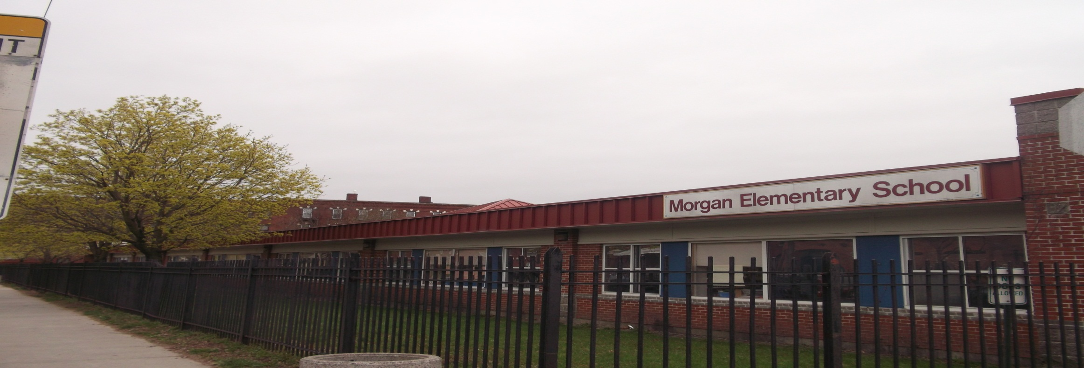
Morgan Full Service Community School
Family Literacy Program
Past the PTO: Family Literacy and Engagement at Morgan Full Service Community School

Slide 2
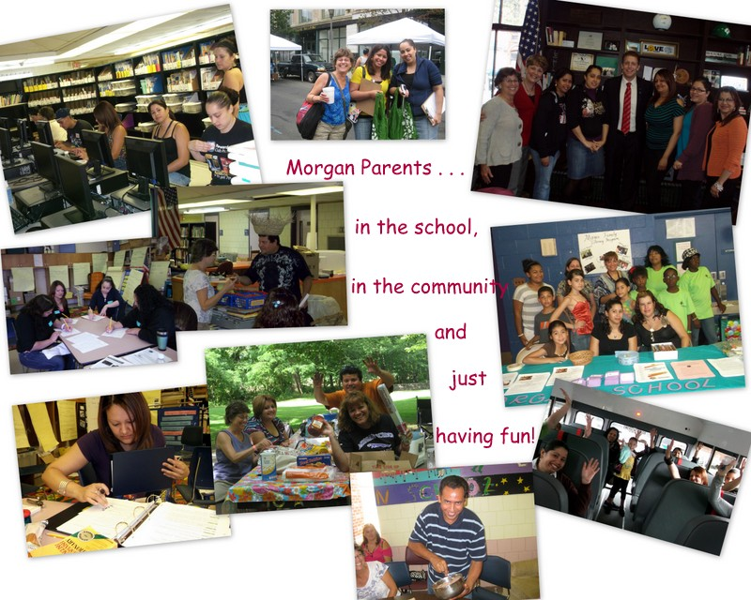

Slide 3
Morgan Full Service Community School
Family Literacy Program – OVERVIEW
Vision/ Values
Empowerment
Capacity
Ownership
Recruitment
Staffing
Planning
Curriculum

Slide 4
Morgan Full Service Community School
Family Literacy Program – VISION/VALUES
Our Family Engagement Vision:
To empower families to take an active role in the education achievement of their children by providing meaningful opportunities to be involved in the school.
Our CORE VALUES
Empowerment (strengths-based relationship building)
Building Capacity (sustainability)
Increasing ownership (of staff, of participants)

Slide 5
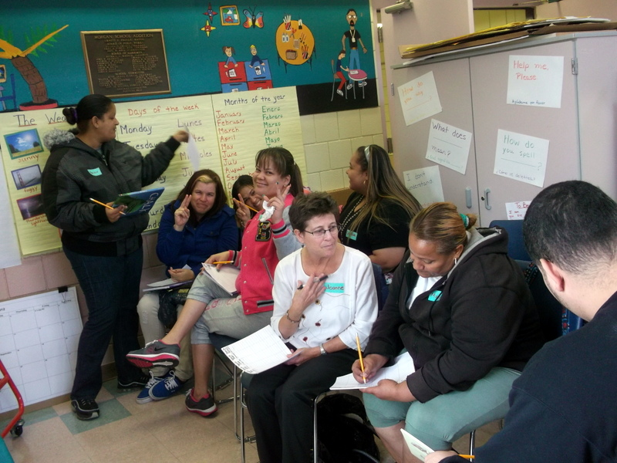
Morgan Full Service Community School
Family Literacy Program – VISION/ VALUES
Full Service Community School/Demographics
Program Development
  Professional Development
    Initial – K-3 Teachers/Summer School, Adult Basic Education Teachers
    Continued – All K-3 Teachers
  Curriculum
    Summer 2011
    School Year 2011 – 2012
Focus on Relationships
Family Orientation
Parental Involvement Choices

Slide 6
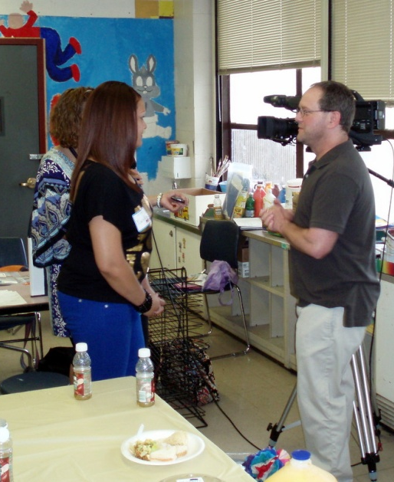
Morgan Full Service Community School
Family Literacy Program – RECRUITMENT
Opportunities for recruitment
  Events
  Welcoming /Orientation
  Designated enrollment windows
Systematic follow-up
Parent to parent recruitment
  Events
  Word of mouth
  Parent to parent letters

Slide 7
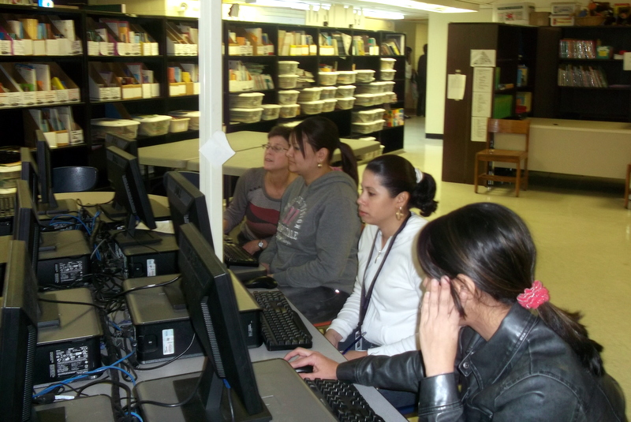
Morgan Full Service Community School
Family Literacy Program – CURRICULUM
Needs and interests assessment
Class structure
Continuity
Cycle of planning
Documentation

Slide 8
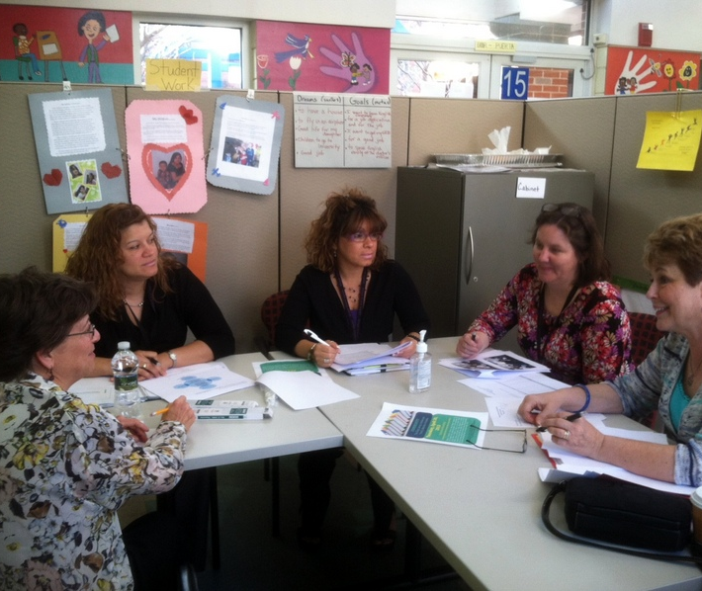
Morgan Full Service Community School
Family Literacy Program – STAFFING
Communication
Flexibility
Professional Development and Training
Support

Slide 9
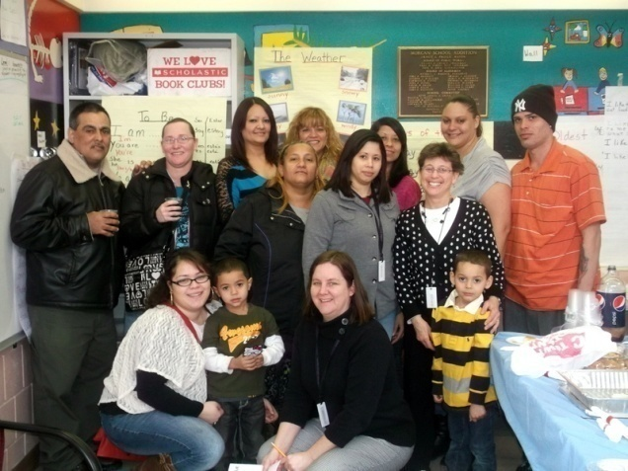
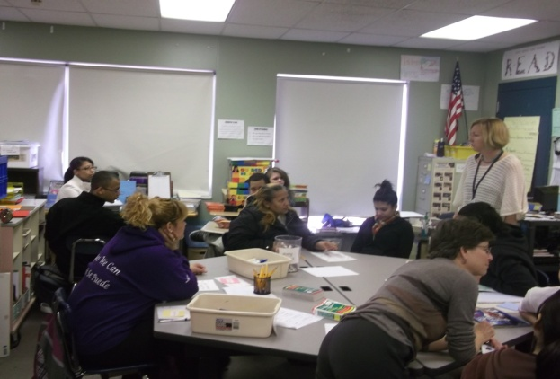
Morgan Full Service Community School
Family Literacy Program
Benefits & Impact - School
School Climate
Classroom/school volunteers
Positive interaction between teachers and parents
Student MEPA scores- above average growth
Beginning class collaborations: Parents with ESL class.
Benefits & Impact – Families
More comfortable in the school/classrooms
Know more about what their children are learning
Know who to ask for help with concerns
Family involvement in school activities and PMAD.

Slide 10
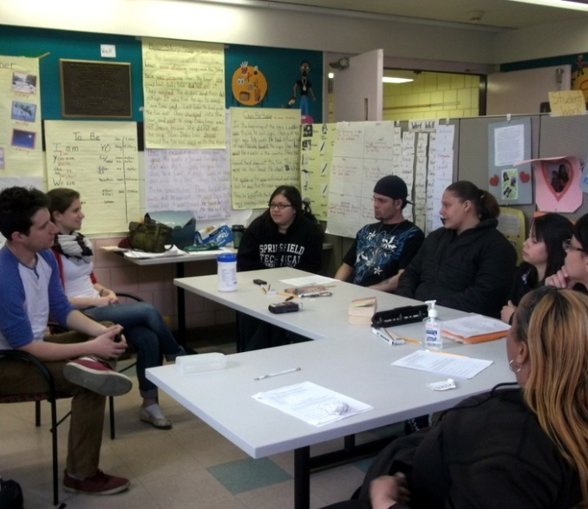
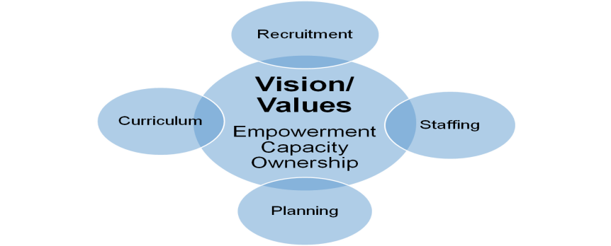
Morgan Full Service Community School
Family Literacy Program – PLANNING FOR THE FUTURE
Vision
  Empowerment
  Capacity/Sustainability
  Ownership
Recruitment/Staffing
Curriculum/Planning

Slide 11
Morgan Full Service Community School
Family Literacy Program Overview
MATSOL Conference
May 2, 2013
Reflections:
Define the goal
Recruit and build a team
Create empowerment and ownership in planning, curriculum, and recruitment
Plan to plan consistently and with flexibility
Redefine “Success”
Vision/ Values
Empowerment
Capacity
Ownership
Recruitment
Staffing
Planning
Curriculum

Slide 12
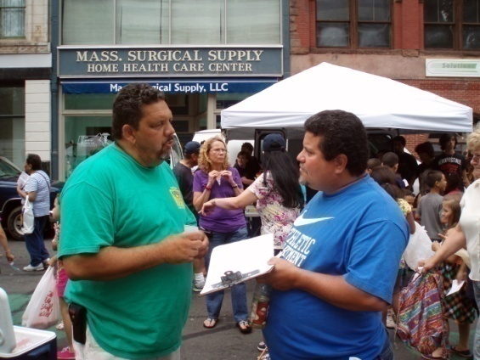
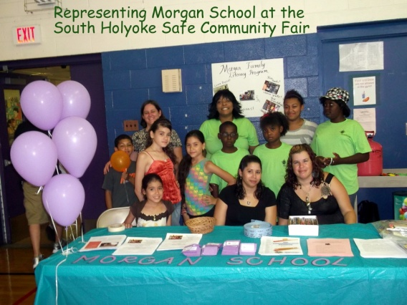
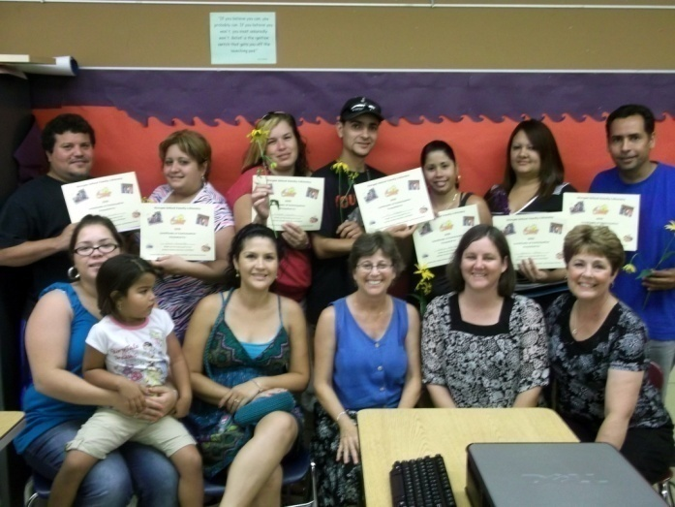
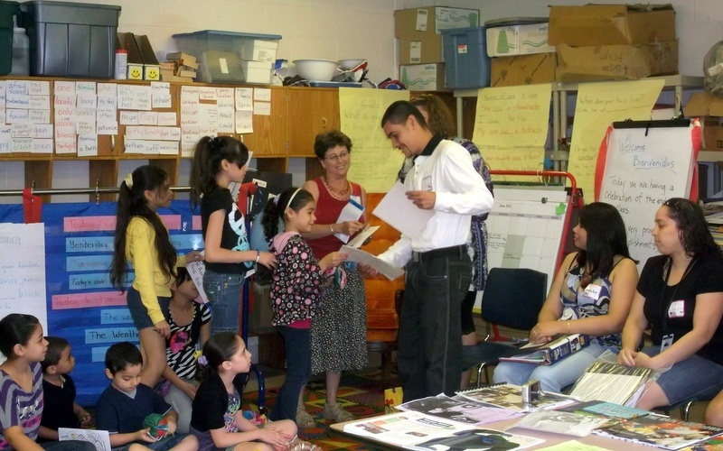
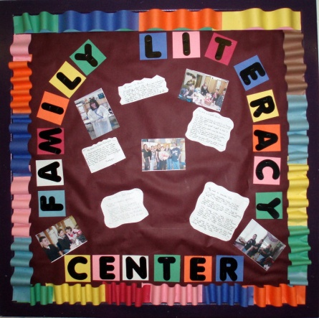
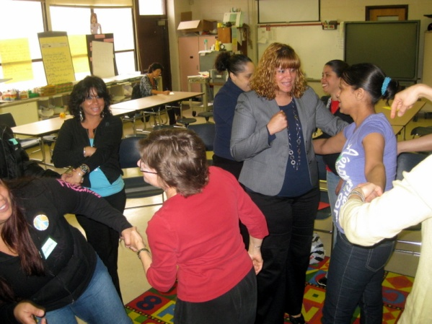
Morgan Full Service Community School Family Literacy and Engagement

