Slide 1

Infusing Linguistic Analysis into a Preservice Teacher Education Model
Stephanie Garrone-Shufran
Brian Herrmann
Doctoral Students
Lynch School of Education, Boston College
Notes:
Stephanie:

Slide 2
Presentation Outline
Discuss our experience working with pre-service and in-service teachers on linguistic analysis of text
Model and practice tracking participants in history texts
Model one strategy for using participants to determine the main idea of a text
Model one strategy for using participants to critically analyze text
Notes:
Stephanie:

Slide 3
Elements of Linguistically Responsive Pedagogy (Lucas and Villegas, 2011)
1. Sociolinguistic Consciousness ✔
2. Value for Linguistic Diversity ✔
3. Inclination to Advocate for ELL Students ✔
4. Learning about ELL Students’ Language Backgrounds, Experiences, and Proficiencies ✔
5. Identifying the Language Demands of Classroom Discourse and Tasks
6. Knowing and Applying Key Principals of Second Language Learning
7. Scaffolding Instruction to Promote ELL Student Learning
Notes:
Brian: Lets return to this slide. So, the teacher education program has been trying to build this holistic plan for preparing linguistically responsive teachers. How are we doing. Research conducted by a number of our teacher educators has helped us answer that question. Some of you may have heard Dr. Homza speak this morning and maybe others heard Kevin O'Conner this afternoon. Well they are two of the researchers that have helped us here. According to this research, we have found that the BC program has made progress in meeting the first four benchmarks. However, even given our efforts to focus on linguistically responsive teaching through coursework, by infussing instruction into methods courses, and by incorporating training as part of the pre-practicum program, we are not adequately helping our pre-practicum students achieve the final three benchmarks.

Slide 4
ED211: Secondary Curriculum and Instruction…An Opportunity Presents Itself
All secondary preservice teachers take ED211 at the beginning of their program.
Field-based course at a local high school where over 50% of the students are classified as “First Language not English”
Knowledgeable instructor interested in collaboration
History of strong school and university partnership
Notes:
Brian: Make All Complete Sentences

Slide 5
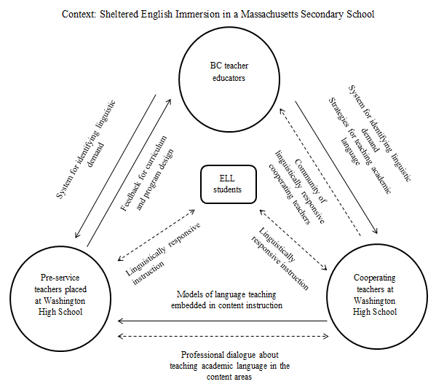
Notes:
Brian:

Slide 6

Intersections between the collaborative model and LRT Framework
Focus on “identifying the language demands of classroom discourse and tasks” in order to:
1) Make language visible.
2) Provide the foundation for infusing linguistic knowledge into lesson planning and instruction.
Notes:
Brian:

Slide 7
Linguistic Demand in Text
Academic Language
Academic grammar
Elements
Vocabulary
Long sentences/ embedded clauses
“Participants”
(noun groups)
Tiers
Multiple meanings
Passive Voice
Nominalization
Notes:
Stephanie: Now We Ask Everyone to Quickly Read Through the Muckrackers Paper. Maybe just ask them to read the first sentence. Instead of asking for their reactions, we can share Chris’s answer from last month’s training.

Slide 8
Identifying “participants”
(noun groups)
1) Identify the nouns/noun phrases (participants)
2) Identify every instance in which a “participant” is referenced (referents)
Notes:
Stephanie: (e.g., pronouns, nominalization)

Slide 9
First “participant”
Socially Conscious Journalists
Notes:
Stephanie

Slide 10
Muckrakers reveal the need for reform
Socially conscious journalists and other writers dramatized the need for reform. Their sensational investigative reports uncovered a wide range of ills afflicting America in the early 1900s. Even though Theodore Roosevelt agreed with much of what they said, he called these writers muckrakers because he thought them too fascinated with the ugliest side of things. (A muckrake is a tool used to clean manure and hay out of animals’ stables.) The writers were angry at first but in time took up Roosevelt’s taunting name as a badge of honor. The muckrakers’ articles appeared in magazines and newspapers that entered millions of Americans homes. People across the nation were horrified by the conditions that were revealed to them.

Slide 11
Muckrakers reveal the need for reform
Socially conscious journalists and other writers dramatized the need for reform. Their sensational investigative reports uncovered a wide range of ills afflicting America in the early 1900s. Even though Theodore Roosevelt agreed with much of what they said, he called these writers muckrakers because he thought them too fascinated with the ugliest side of things. (A muckrake is a tool used to clean manure and hay out of animals’ stables.) The writers were angry at first but in time took up Roosevelt’s taunting name as a badge of honor. The muckrakers’ articles appeared in magazines and newspapers that entered millions of Americans homes. People across the nation were horrified by the conditions that were revealed to them.

Slide 12
Muckrakers reveal the need for reform
Socially conscious journalists and other writers dramatized the need for reform. Their sensational investigative reports uncovered a wide range of ills afflicting America in the early 1900s. Even though Theodore Roosevelt agreed with much of what they said, he called these writers muckrakers because he thought them too fascinated with the ugliest side of things. (A muckrake is a tool used to clean manure and hay out of animals’ stables.) The writers were angry at first but in time took up Roosevelt’s taunting name as a badge of honor. The muckrakers’ articles appeared in magazines and newspapers that entered millions of Americans homes. People across the nation were horrified by the conditions that were revealed to them.

Slide 13
Muckrakers reveal the need for reform
Socially conscious journalists and other writers dramatized the need for reform. Their sensational investigative reports uncovered a wide range of ills afflicting America in the early 1900s. Even though Theodore Roosevelt agreed with much of what they said, he called these writers muckrakers because he thought them too fascinated with the ugliest side of things. (A muckrake is a tool used to clean manure and hay out of animals’ stables.) The writers were angry at first but in time took up Roosevelt’s taunting name as a badge of honor. The muckrakers’ articles appeared in magazines and newspapers that entered millions of Americans homes. People across the nation were horrified by the conditions that were revealed to them.

Slide 14
Muckrakers reveal the need for reform
Socially conscious journalists and other writers dramatized the need for reform. Their sensational investigative reports uncovered a wide range of ills afflicting America in the early 1900s. Even though Theodore Roosevelt agreed with much of what they said, he called these writers muckrakers because he thought them too fascinated with the ugliest side of things. (A muckrake is a tool used to clean manure and hay out of animals’ stables.) The writers were angry at first but in time took up Roosevelt’s taunting name as a badge of honor. The muckrakers’ articles appeared in magazines and newspapers that entered millions of Americans homes. People across the nation were horrified by the conditions that were revealed to them.

Slide 15
Muckrakers reveal the need for reform
Socially conscious journalists and other writers dramatized the need for reform. Their sensational investigative reports uncovered a wide range of ills afflicting America in the early 1900s. Even though Theodore Roosevelt agreed with much of what they said, he called these writers muckrakers because he thought them too fascinated with the ugliest side of things. (A muckrake is a tool used to clean manure and hay out of animals’ stables.) The writers were angry at first but in time took up Roosevelt’s taunting name as a badge of honor. The muckrakers’ articles appeared in magazines and newspapers that entered millions of Americans homes. People across the nation were horrified by the conditions that were revealed to them.

Slide 16
Muckrakers reveal the need for reform
Socially conscious journalists and other writers dramatized the need for reform. Their sensational investigative reports uncovered a wide range of ills afflicting America in the early 1900s. Even though Theodore Roosevelt agreed with much of what they said, he called these writers muckrakers because he thought them too fascinated with the ugliest side of things. (A muckrake is a tool used to clean manure and hay out of animals’ stables.) The writers were angry at first but in time took up Roosevelt’s taunting name as a badge of honor. The muckrakers’ articles appeared in magazines and newspapers that entered millions of Americans homes. People across the nation were horrified by the conditions that were revealed to them.

Slide 17
Second “participant”
One leading muckraker

Slide 18
Journalists uncover injustices
One leading muckraker was Lincoln Steffens, managing editor at McClure’s, a magazine known for uncovering social problems. In 1903, Steffens published The Shame of the Cities, a collection of articles on political corruption. His reports exposed how the government of Philadelphia let utility companies charge their customers excessively high fees. He showed how corrupt politicians won elections by bribing and threatening voters, and revealed how political corruption affected all aspects of life in a city.

Slide 19
Journalists uncover injustices
One leading muckraker was Lincoln Steffens, managing editor at McClure’s, a magazine known for uncovering social problems. In 1903, Steffens published The Shame of the Cities, a collection of articles on political corruption. His reports exposed how the government of Philadelphia let utility companies charge their customers excessively high fees. He showed how corrupt politicians won elections by bribing and threatening voters, and revealed how political corruption affected all aspects of life in a city.

Slide 20
Journalists uncover injustices
One leading muckraker was Lincoln Steffens, managing editor at McClure’s, a magazine known for uncovering social problems. In 1903, Steffens published The Shame of the Cities, a collection of articles on political corruption. His reports exposed how the government of Philadelphia let utility companies charge their customers excessively high fees. He showed how corrupt politicians won elections by bribing and threatening voters, and revealed how political corruption affected all aspects of life in a city.

Slide 21
Journalists uncover injustices
One leading muckraker was Lincoln Steffens, managing editor at McClure’s, a magazine known for uncovering social problems. In 1903, Steffens published The Shame of the Cities, a collection of articles on political corruption. His reports exposed how the government of Philadelphia let utility companies charge their customers excessively high fees. He showed how corrupt politicians won elections by bribing and threatening voters, and revealed how political corruption affected all aspects of life in a city.

Slide 22
Journalists uncover injustices
One leading muckraker was Lincoln Steffens, managing editor at McClure’s, a magazine known for uncovering social problems. In 1903, Steffens published The Shame of the Cities, a collection of articles on political corruption. His reports exposed how the government of Philadelphia let utility companies charge their customers excessively high fees. He showed how corrupt politicians won elections by bribing and threatening voters, and revealed how political corruption affected all aspects of life in a city.

Slide 23
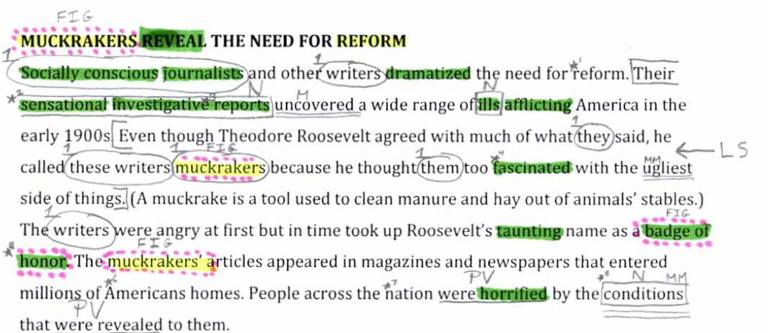
Multiple Linguistic Demands!
Notes:
BRIAN Very small sampling of linguistic features – make choices of what to focus on
Why participants?

Slide 24
Genre/Purpose
Purpose of the text shapes the language.
  Recount- to tell what happened (personal, factual, imaginative)
    Personal pronouns
    Past tense verbs
    Adverbs of time and place
  Narrative-to entertain (to embody the writer’s reflections on experience)
    Variety of verb tenses
    May include dialogue
    More complex noun phrases w/ adjectives
  Report-to document, organize and store factual information; classify and describe the phenomena of the world
    Passive voice, no personal pronouns
    Technical terms
    Conjunctions for purpose, not time
    Language for comparison, contrast
Notes:
BRIAN
Genres – some linguistic features more salient

Slide 25
Genre/Purpose (continued)
  Instructions- to tell someone how to do or make something
    Simple present tense
    Detailed information on how, where, when
    Linking words to do with time
  Explanation-to give an account of how something works or reasons for some phenomenon by explaining how or why
    Generalized, non-human participants
    Timeless present tense
    Mainly action verbs
  Argument-to take a position on some issue and justify it
    Passive voice
    Connectives associated with reasoning (therefore, so, etc.)
    Nominalization of verbs
    (Schleppegrell, 2003)

Slide 26
Linguistic Demand Varies by Genre
  Recount- to tell what happened (personal, factual, imaginative)
    Personal pronouns
    Past tense verbs (“doing” processes)
    Adverbs of time and place
Participants are important in a recount
  “Doing” processes need actors
  Therefore, tracking participants can help determine who or what acts in the text
Notes:
Traditional grammar – only people do things, broadening what participant can be allows students to see how main idea can be about participant who is not a person

Slide 27
Tracking Participants in a Recount
Purpose: Find main idea in a recount
Content Objective:
SWBAT demonstrate understanding of the events of the paragraph from the textbook.
Language Objective:
SWBAT identify all references to major participants in the paragraph by circling and numbering the referents of the participants “war” and “critics”.
SWBAT state the main idea of the paragraph by writing a complex sentence about the participants “war” and “critics”.
Notes:
BUT we’re going to stick with participants and show one way to use them in getting meaning from text

Slide 28
Use Participants to Determine the Main Idea:
Teacher locates important participants (2 or 3) and tracks the referents for each.
Students track each participant and its referents
Students identify the information that tells/describes each participant in the text.
Students write one sentence summarizing the information gathered about each participant (participant remains subject of the sentence).
Students combine the information about the participants into a more complex sentence that shows the relationship between the participants(main idea of paragraph)
Notes:
STEPHANIE

Slide 29
Graphic Organizer
Participant | Information |  | Participant | Information
Sentence about Participant 1
Sentence about Participant 2
Sentence showing relationship between participants
Main Idea
Notes:
STEPHANIE

Slide 30
Participants
Circle and number each participant and all the references to it in the text:
1. The war in Vietnam
2. Critics
Notes:
STEPHANIE

Slide 31
Antiwar Protests Increase
1
The war in Vietnam divided Americans more deeply than any conflict since the Civil War. Although most Americans initially supported President Johnson's bombings and troop deployments, by 1966 critics began speaking out. Senator Fulbright’s opposition to the war hurt Johnson in Congress, and the senator was soon joined by like-minded activists who believed that American soldiers were dying in a war that had little to do with American interests.
1
2
1
2
2
1
Notes:
STEPHANIE

Slide 32
Graphic Organizer
Participant | Information |  | Participant | Information
The war in Vietnam President Johnson’s bombings and troop deployment the war a war | divided America most Americans initially supported little to do with American interests |  | Critics The senator (Fulbright) like-minded activists | began speaking out opposition to the war
The war in Vietnam divided America, because the war had little to do with American interests.
Critics of the war, like Senator Fulbright, began speaking out in opposition to the war.
The war in Vietnam divided America because critics of the war spoke out in opposition to the war.
Main Idea
Notes:
STEPHANIE

Slide 33
Beyond the Main Idea
Consider the participants and the processes.
  Non-human participant linked to “doing” process
  “The war in Vietnam divided America…”
  Did the war actually “divide” America?
  Why did the textbook present it in this way?
  Why is the topic sentence not about critics (a human actor)?
Notes:
BRIAN

Slide 34
Critical Reading by Analyzing Participants
Identify non-human participants linked to “doing” processes
  Language is then figurative
  Ask the question: Why did the author make this choice?
  Choose a human participant that might make sense and rewrite the topic sentence.
  Critics who believed that American soldiers were dying in a war that had little to do with American interests protested the Vietnam War. Although most Americans initially supported President Johnson's bombings and troop deployments, by 1966 critics began speaking out. Senator Fulbright’s opposition to the war hurt Johnson in Congress, and the senator was soon joined by like-minded activists.
Notes:
BRIAN

Slide 35
Time for Questions

Slide 36

Thank you for your attention!

