Slide 1

Using an Interactive Excel Workbook and Alma Analytics for Inventory
Tom Lundstrom
Hunt Library, Embry-Riddle Aeronautical University

Slide 2
Limitations/Qualifications for this Inventory Tool
Not a one-size-fits-all product
Not real-time data retrieval
Scalability not tested
Single library, Institution Zone implementation
Physical inventory, barcoded items
Notes:
Presentation as implementation of an approach
Does require knowledge of VBA – used Web searches for coding ideas
To simplify security concerns, use of an Analytics Excel workbook data file
80k+ active item records in source file
Only Location Name data used as test, potential for use of Library
Object of inventory is to ensure cataloging information correct as well as presence in collection
Individual periodical issues not barcoded, will need different approach for inventory

Slide 3
Motivation for Physical Material Inventory
Move to new building (with interim, temporary location)
Weeding before some items put in temporary storage
Migration 2019 to Alma (from Voyager)
Review OCLC holdings, bibliographic record match
Ensure accurate status of available items

Slide 4
Inspiration
Alma Inventory Tool
Anna Striker (Project Manager) | (Team Leaders) | Terry Brady (Developer)
Washington Research Library Consortium (WRLC) GitHub
https://github.com/WRLC/AlmaInventory
Real-time API access to Alma data
Flagged problem alerts
Check item call number, title information
Record of inventoried items, including problems

Slide 5
Conceptual Approach to Inventory Process
Excel-based interface, intended for use with a laptop
Uses Analytics report as basis for collection item information: avoid security implications for networked drive & API access
Excel workbooks for the interface, standard Analytics report and inventoried item spreadsheet: flexibility of design
Physical flags to identify problems, placed in materials brought to TS: combination color coding and text caption
Use the inventoried list workbook to update item record ‘Inventory date’ as an Alma manual job and as record of problems (estimate investment of effort for corrections)
Notes:
Excel VBA help/ideas readily available on Web, advantage of run-time testing
Use of OneDrive/other shared data sheets might allow multi-location inventory as well as simply access
Inventory done in the shelving area
Minimize need for authenticated networking access by using Analytics report
One day lag using Analytics
Manual Alma job to update item record Inventory date

Slide 6
Design Parameters for Interface
Display Alma data associated with scanned barcode
Use of visual indications for problems based on Analytics report data
Ability to input select problems from physical item inspection
Error message displays
Add inventoried items to a list; manually batch process Alma item record inventory date
Notes:
Inventoried Items.xlsm workbook used to record problem statistics – helpful to indicate work needed for corrections by staff

Slide 7
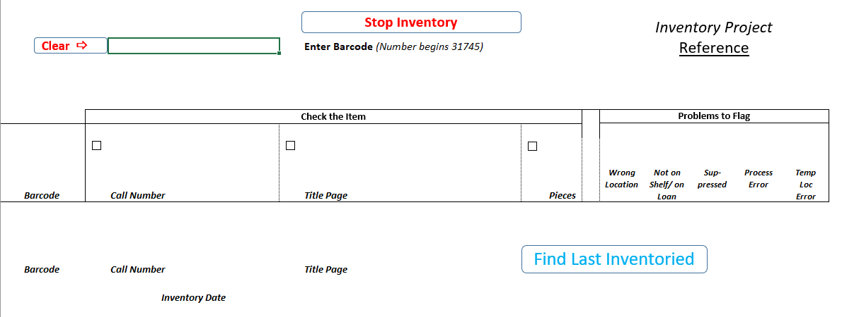
Interface – Opening Screen
Notes:
Default active cell near Clear Button
The collection location name is displayed, the location name used as basis for identifying Wrong Location
Last Inventoried is based on last row of Inventoried workbook
Stop Inventory insured Inventoried workbook is saved before closing
Stop Inventory Clears interface and saves workbook
Clear button returns active cell
Not all cells are protected, currently conditional formatting data and saved inventory data are unprotected for macro processing tasks

Slide 8
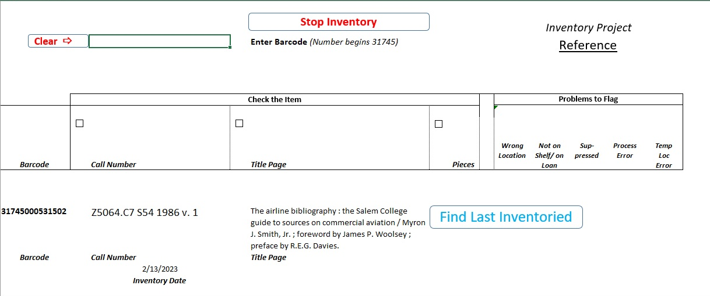
Interface – Last Inventoried
Notes:
Based on the separate Inventoried Items.xlsm workbook.
The last row with data, not necessarily the item with the next call number/shelf mark.
If there was an error indicated in the Call Number (yellow) or Title (orange), it will be indicated. This is a signal to the inventory taker that data may have changed and an inventory manager should be consulted.

Slide 9
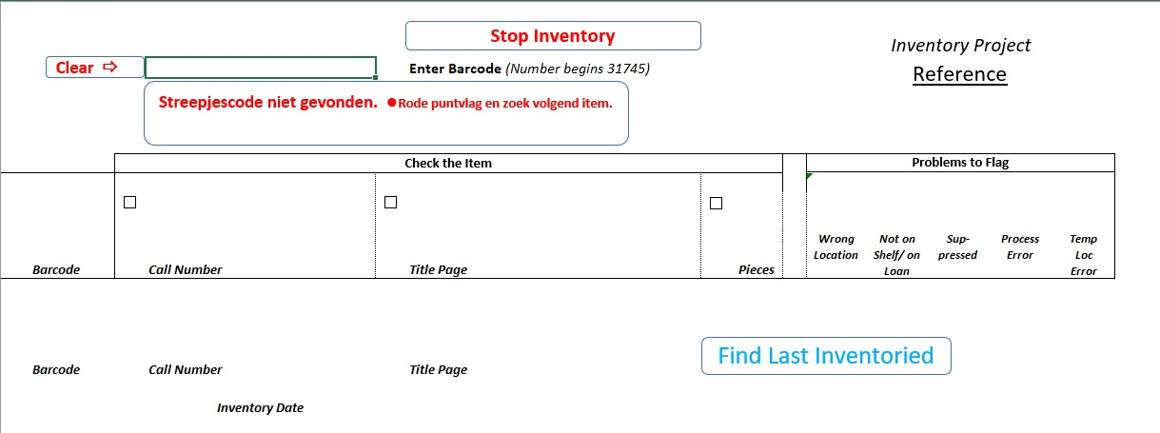

Interface – Localization
[Google Translation ]
Notes:
Most cells, and the buttons/message shapes, of the interface are protected. Editing requires unprotecting the worksheet.
Any of the text can be changed.
To expedite development, color-coded ‘Problems to Flag’ cells use conditional formatting, requiring data – not cell references. The data is camouflaged by using white font color.

Slide 10
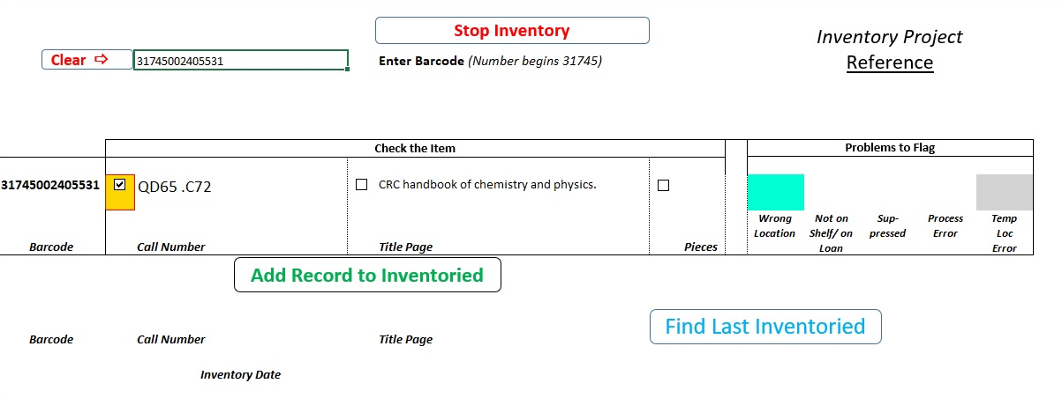
Interface – Scanned Item
Notes:
More than one problem to flag can be identified for shelved items
When physical item Call Number/Title Page/Pieces problems are found, the tick box is checked and flag color generated
Even with problems, items are recorded to the Inventoried workbook for statistical purposes and batch update to Alma item records
When item is added to Inventoried, the screen is automatically cleared
From the interface there is no facility to edit records (e.g., call number error identified and entry added to Inventory but tick box not checked)
Data, not color coding, added to the Inventoried workbook
Problem flagging by color based on Conditional Formatting in worksheet, would be better generated as a VBA routine

Slide 11
Organization of VBA Macros
Notes:
No orderly commenting in macros
Dead-end ideas commented out, left for future reference
Sheet2 was removed when separate Inventoried Items.xlsm workbook implemented for recorded inventoried items

Slide 12
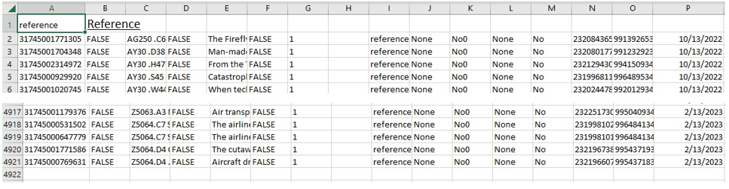
Alma Analytics Report and Inventoried Workbooks
‘Analytics Item Recs Full Lst’ – Report used for item data searching/retrieval
‘Inventoried Data’ – Replicates textual data transferred from ‘Search’ interface
Notes:
When ‘Exporting this analysis’, Data for Excel is based on Criteria column arrangement
‘Normal Call Number’ and ‘Description’ sorted ascending – for personal use, not required for searching
Can use ‘=COUNTIF( )’ formula for total of number of problems recorded in ‘Inventoried Data’ workbook for work statistics
Red Dot (‘no barcode found’) are tracked manually, not an option recorded

Slide 13
Processing Schematic
Notes:
Because VBA macro ideas came from several WWW resources, coding is patchwork and could be streamlined
Barcode Check Error is based on local barcode prefix, used for staff who may accidentally scan ISBN or other publisher barcodes
Search interface Problems to Flag errors use conditional formatting in the worksheet, not VBA generated
Already Inventoried Error checks retrieved data from Analytics Item Recs Full Lst.xlsx for Inventoried date as well as Inventoried Items.xlsm
Inventoried Items Data workbook saved every time data is added from the interface

Slide 14
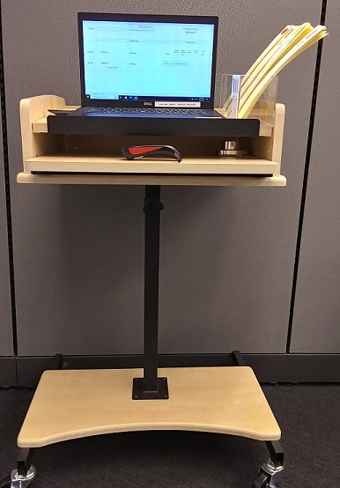

Inventory Equipment & Accessories
Notes:
Red dot used both for item records not found and items which have lost the barcode
Flags are color coded and have captions

Slide 15
Follow-up Processing of Problems
Red Dot Flags – ‘No barcode found’
Cataloger reviewed
Acquisitions consulted for possible replacement or confirmed withdrawal
Recorded call number/title problem flagged
Cataloger reviewed
Technician follow up
Automatically generated problem flags
Technician correcting process problems
Cataloger involved with more technical problems
For items on Loan, batch process item ‘Fulfillment note’ to pass materials to Technical Services when returned
Notes:
• Red Dot Flags
Possibly records deleted owing to Missing item, to be restored
Items previously weeded in batch process to delete records but missed from physical removal
Wrong barcode number entered previously or physically missing from item
• Recorded call number/title problems flagged
Slight differences in series titles may cause flagging, perhaps a nuisance – better safe than sorry?
Better choice of OCLC record now available
Completely incorrect bibliographic record associated with item
Spine label printed with incorrect information
May not catch edition differences, work on principle that call number publication year might correlate
• Automatically generated problem flags
Holdings collection location not updated in past
Item not scanned when returned after loan
Status such as Missing or Lost not updated from migration
Other status may indicate types of follow-up: e.g., if materials are in transit

Slide 16

Questions
Tom Lundstrom, Head of Cataloging and Metadata
Hunt Library, Embry-Riddle Aeronautical University
Contact information:
lundstrt@erau.edu
Thank You
Notes:
Graphic : https://huntlibrary.erau.edu/about/facilities

