Slide 1

Getting Started in Sinopia. A linked data editor for metadata creation and reuse
&
Margarita Perez Martinez
Metadata Librarian
University of Miami Law Library
Timothy Ryan Mendenhall
Metadata Librarian
Columbia University Libraries
September 14, 2023
3:05 PM CEST
9:05 AM EST
Developer’s day

Slide 2
Agenda
What is Sinopia?
  BIBFRAME and Sinopia
Creating a Sinopia Stage account
Navigating the Sinopia Stage interface
Sinopia templates
Demonstration (editing a resource description in Sinopia Stage)
  Marc export feature
Q&A
Getting Started in Sinopia

Slide 3
What is Sinopia?
Sinopia is linked data editor.
Sinopia was created to enable catalogers to
catalog in a linked data environment without having to set up and maintain tools locally. Sinopia tool is Web-Based.
explore cooperative cataloging in a linked data environment
catalog using the BIBFRAME data model.
Getting Started in Sinopia

Slide 4
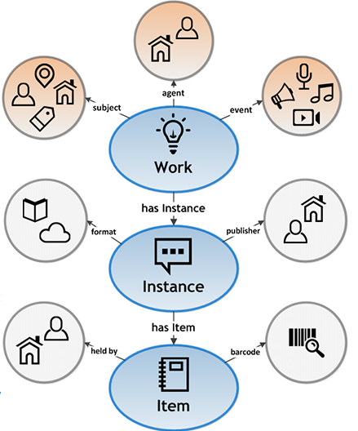
BIBFRAME and Sinopia
BIBFRAME model core levels of abstraction
Sinopia
Work: The highest level of abstraction, a Work, in the BIBFRAME context, reflects the conceptual essence of the cataloged resource: authors, languages, and what it is about (subjects).
Instance: A Work may have one or more individual, material embodiments, for example, a particular published form. These are Instances of the Work. An Instance reflects information such as its publisher, place and date of publication, and format
Item: An item is an actual copy (physical or electronic) of an Instance. It reflects information such as its location (physical or virtual), call number, shelf mark, and barcode.
Work Template
URI
Sinopia
URI
Instance
Template
URI
Sinopia
Item Template
Getting Started in Sinopia

Slide 5
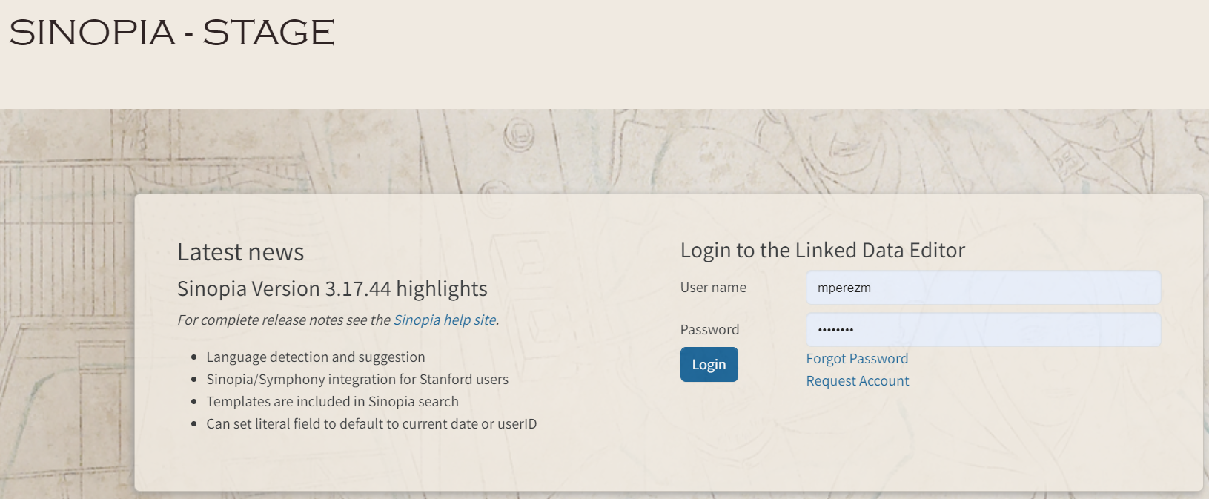
Sinopia Stage: stage.sinopia.io
Sinopia users’ test environment intended for practice
Users can create data while in training and not worry about the quality of the data
Descriptions (and templates) may be deleted from time to time
PCC Templates available
Getting Started in Sinopia

Slide 6
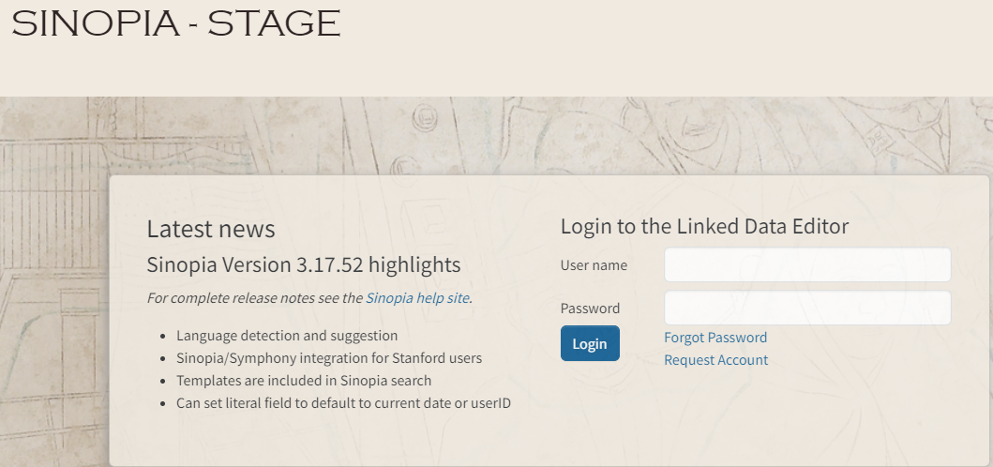
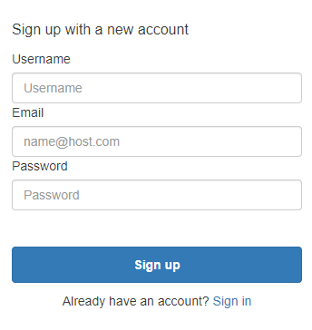
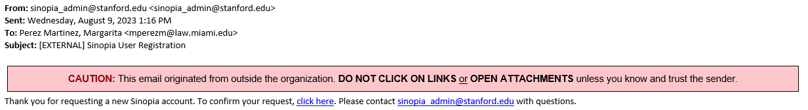
Creating an account in Sinopia Stage
Enter a username, email, and password.
Go to stage.sinopia.io Click on Request Account
You’ll receive an email asking you to confirm.
Getting Started in Sinopia

Slide 7
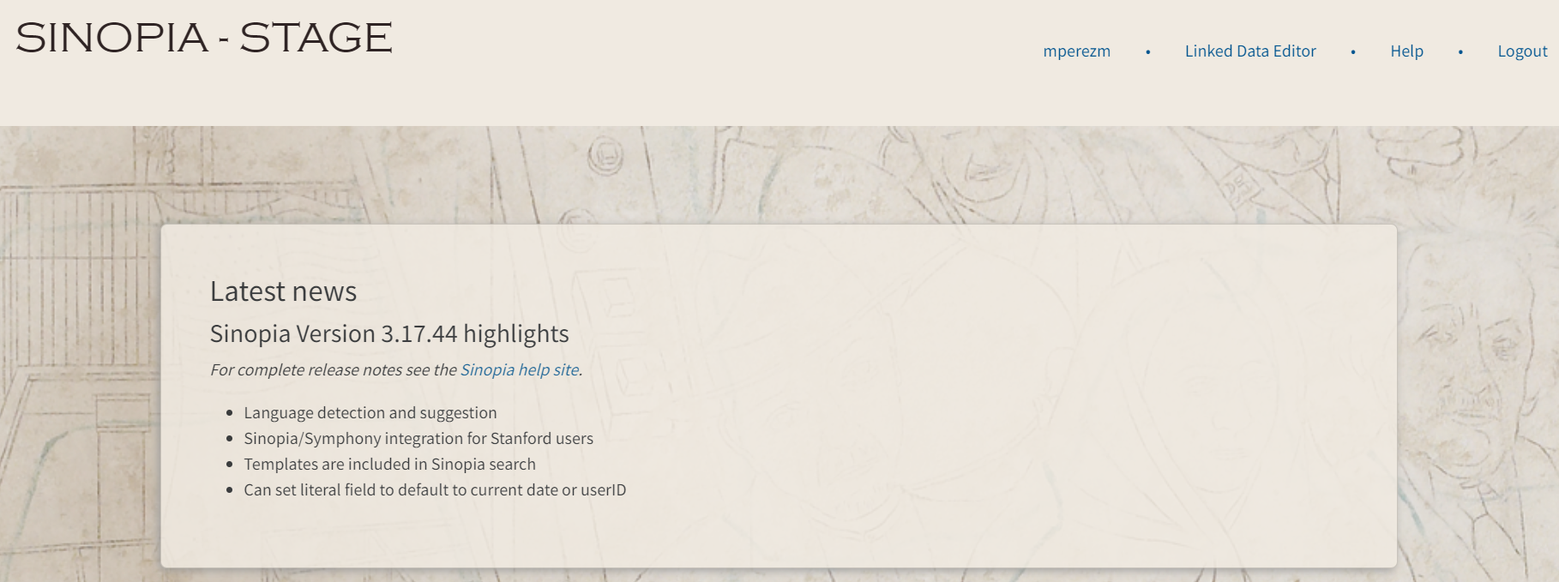
After logging in
Notice your username displays in the top right
Click the Linked Data Editor button to start using Sinopia.
Getting Started in Sinopia

Slide 8
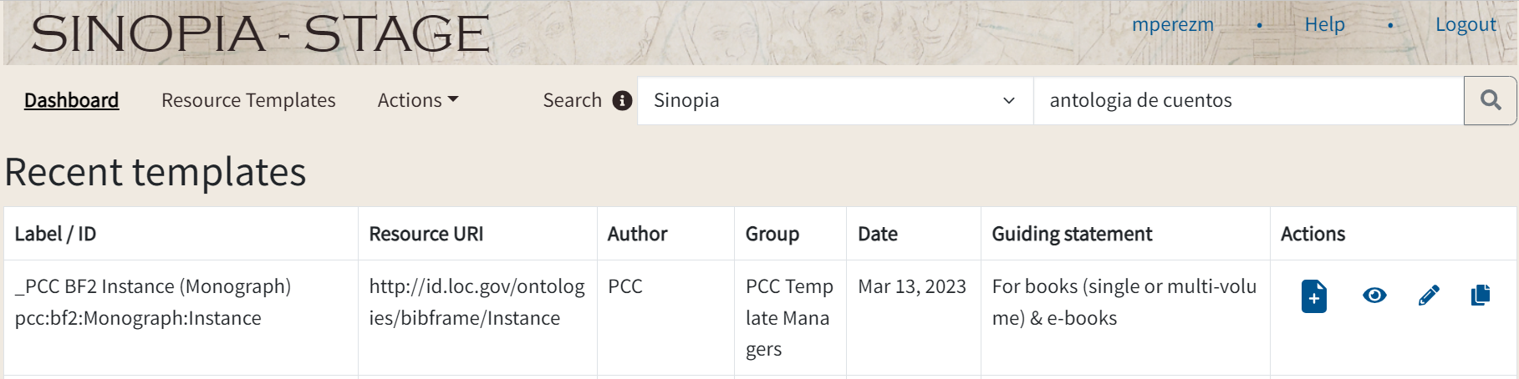
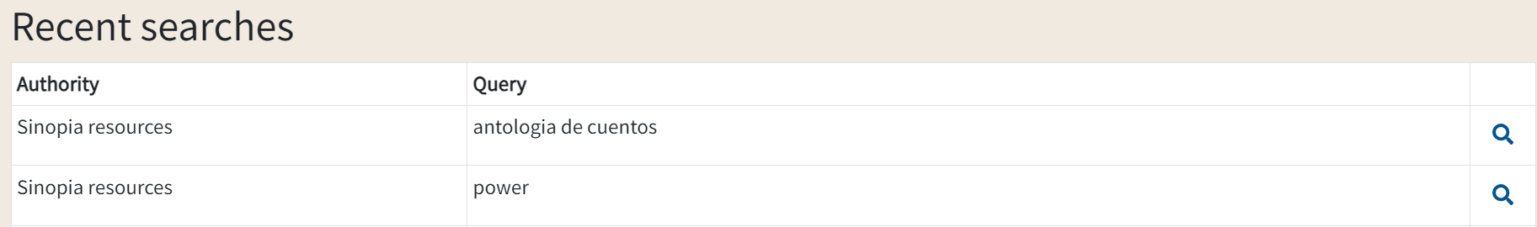
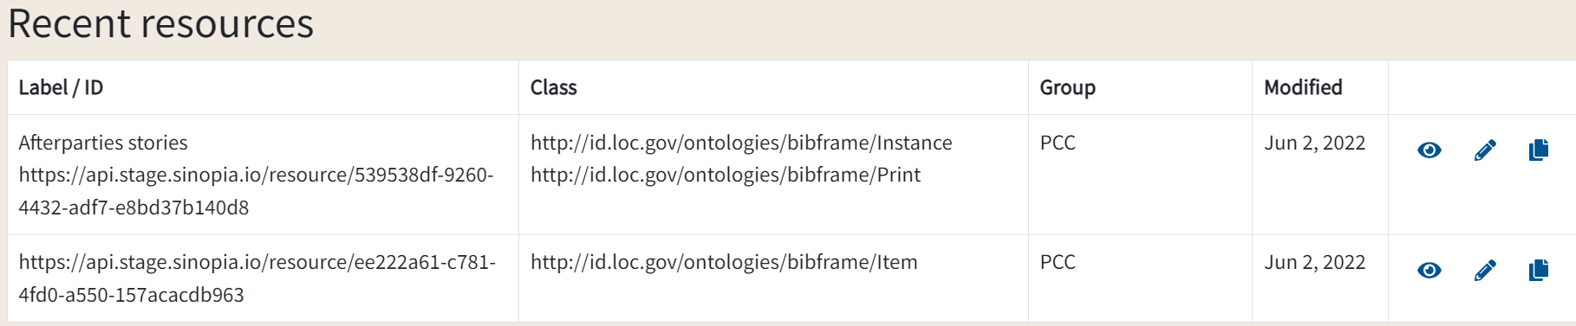
Navigating in Sinopia
After clicking Linked Data Editor
Dashboard tab: has links to your recent templates, searches, and descriptions
Create
View
Copy
Edit

Slide 9
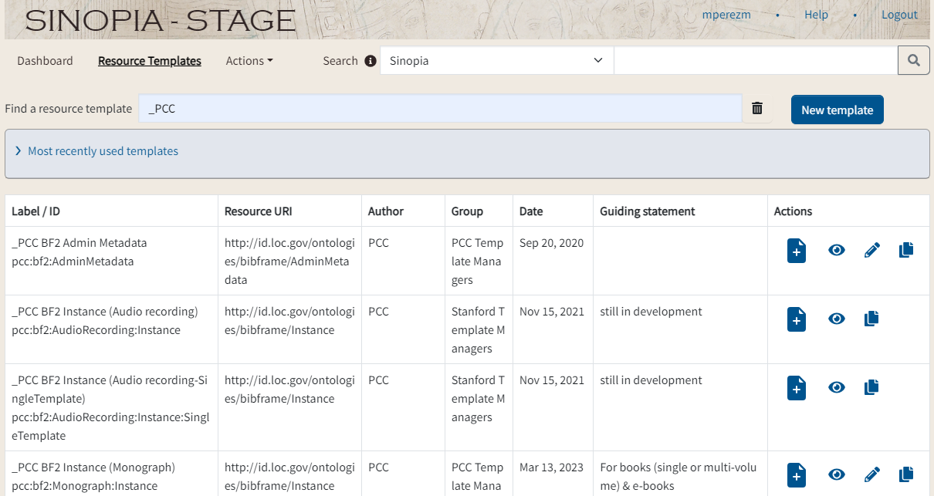
Sinopia Resource Templates
_PCC BF2
Getting Started in Sinopia

Slide 10
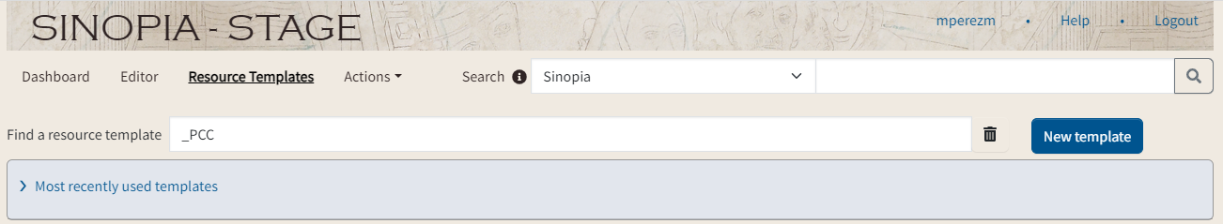
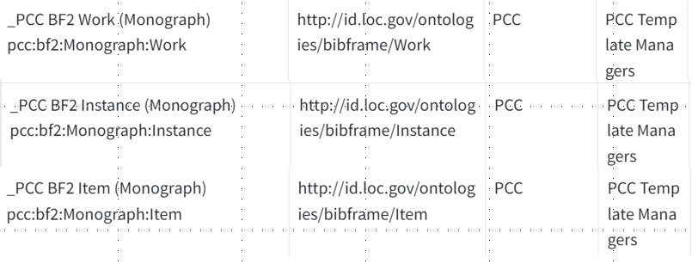
Most used Sinopia PCC Resource Templates
_PCC BF2
More PCC resource templates available to catalog:
Serials
Audio recording
Music recording
Notated music
Instance clases:
Archival
Print
Electronic
Getting Started in Sinopia

Slide 11
  Demonstration in Sinopia Stage
  By Timothy Ryan Mendenhall
  Edit a resource description
                _PCC BF2 Instance (Monograph)
                pcc:bf2:Monograph:Instance
                _PCC BF2 Work (Monograph)
                pcc:bf2:Monograph:Work
                _PCC BF2 Item (Monograph)
                pcc:bf2:Monograph:Item
  Show Sinopia-Marc export feature
Getting Started in Sinopia

Slide 12
Take away
Developer’s day
Q&A
PCC Sinopia Cataloging Affinity Group https://wiki.lyrasis.org/display/PFCCP/PCC+Sinopia+Cataloging+Affinity+Group
Thank you!
Margarita Perez Martinez
mxp1235@miami.edu
Timothy Ryan Mendenhall
trm2151@columbia.edu
Getting Started in Sinopia

