Slide 1


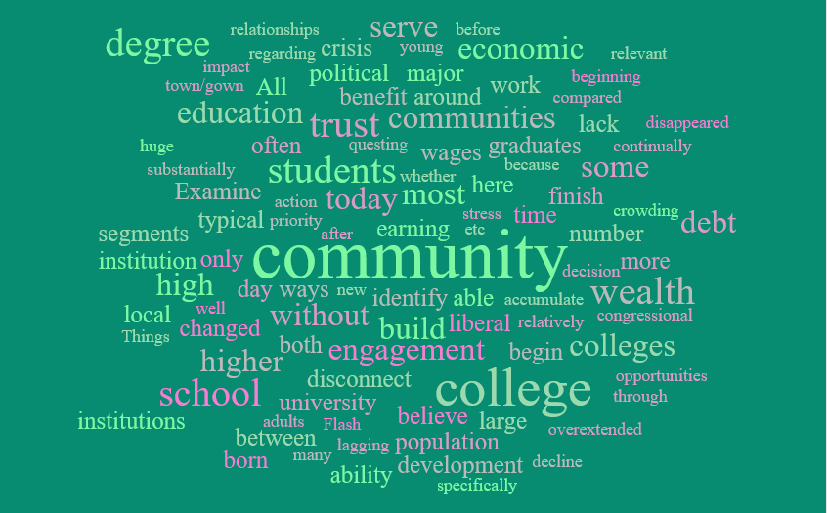

Community Engagement and Higher Education: Everyone’s Business
Mary Ettling, Southern Illinois University Edwardsville
Tammy Keylon, Tennessee Technological University

Slide 2
U.S. Higher Education Development
British Empire- invested little in college and only if they were a source of revenue. Story: The British Empire, for instance, responded to Virginia's request for a seminary to save their souls, with "Souls?!? Damn your souls! Make tobacco." But religion drives the founding of colleges during the colonial period
College Building Boom (1800-1850) areas hoped to gain culture and legitimacy by building and supporting local colleges. There was a high closure rate as the colleges were fully tuition dependent but some found success attracting young women and second born sons who didn’t inherit family land to programs
Morrill Act of 1862 created the Land Grant institution opportunity where states and territories would receive profits if they sold land to establish programs of agricultural, mechanical and military sciences.
1870- 1890 The Age of the University- by 1880 Ohio had more college than all of France; the land grants gain support and expand their scope to engineering and medicine and a second Morrill Act (Hatch Act of 1890) expands federal involvement in education by bringing in funding for more and expanded land grant colleges
Between the world wars- Great Depression- surge in enrollments and development of Junior College this is the beginning of the phenomenon where in times of economic downturn, college enrollments increase. There is also new programming in military sciences and development of war technologies and innovations
1944 Serviceman’s Readjustment Act (GI Bill) expanded opportunity and enrollments surged and continued on as Baby Boomers aged into college

Slide 3
U.S. Higher Education – The Shift
Things really begin to shift around 1970 – the university becomes “impersonal” due to crowding, lack of living space and large lecture halls as well as the civil unrest- there is a congressional and public loss of trust in HE. Inflation and an energy crisis add stress and by 1985 colleges are lowering admission standards without questing whether they are able to serve less prepared students and the tension between how to achieve both equality and excellence continues to loom large. The end of the 20th century ends with a financial roller coater for HE as a way to stimulate economic development or an overextended, administratively bloated albatross.
In 2008, economic crisis loomed again and most notably impacted the number of births and this decline in number of high school graduates is only beginning to be felt today as the enrollment cliff.
Comparing 2009 to today, 70% of high school grads went directly to college and this made sense because a typical American with a BS degree was earning 2/3 more than a typical high school graduate at the time. Flash forward to today, only 41 % of young adults believe a college degree is “very important”. And they are not entirely wrong.
The change is in the ability to build wealth. Those born before 1980 were able to accumulate substantially more wealth than those without the degree but for those born after 1980, the wage differential stayed relatively the same but the wealth benefit disappeared. The culprits are both the delay of earning potential (which has not changed) and the amount of college tuition and debt taken on by new graduates. Gains found with increased wages are wiped out by college debt and the ability to start building wealth early.
Now overlay this with choice of school, major, time to degree, remedial classes etc. and we find the most vulnerable to be harmed are poorer students who borrow money for college and never finish. Even for students who do finish, depending on major, they may still suffer from lagging wages and student debt.
Finally, consider the political environment- many who identify as republican have changed to believe that colleges are too liberal and that professors indoctrinate students by bringing their political and social views into the classroom. It is the case that the ratio of college faculty who identify as liberal has shifted to 2:1 as compared with 5:1 in the 2010’s. All of this without discussing the SCOTUS decision regarding affirmative action and university admissions. While it may not have a huge impact on publics and community colleges, the perception around inclusion is hard to miss.

Slide 4
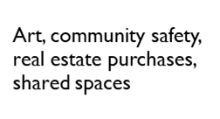
Mutually Beneficial Partnerships
Adult Students
Inform Programming and Community Needs
Buying Power
Locally owned businesses and funding to recoup tax dollars
Contribute to Livability
High Impact Practices, Real world experience civic engagement
Capstone Projects and Volunteers

Slide 5
Examplary Program Examples
Colorado State Science Education Campus: https://www.cns-eoc.colostate.edu/
Colorado State University Spur: https://csuspur.org/
University of Chicago Consortium on School Research: https://consortium.uchicago.edu/
Southwestern Illinois College Running Start: https://www.swic.edu/students/high-school-students/running-start/
Align programs to suit shifting workforce needs: SIUE Healthcare Informatics
Tennessee Tech Rural Reimagined: https://youtu.be/3jM_aZaX2HY

Slide 6

Thank you!
Further Reading
Fischer, K. (2023). College as a Public Good.
Thelin, J., Edwards, J., & Moyen, E. (2019). Higher Education in the United States - HISTORICAL DEVELOPMENT, SYSTEM. Stateuniversity.com. https://education.stateuniversity.com/pages/2044/Higher-Education-in-United-States.html.
Tough, Paul. “Americans Are Losing Faith in the Value of College. Whose Fault Is That?” The New York Times, 5 Sept. 2023, www.nytimes.com/2023/09/05/magazine/college-worth-price.html. Accessed 10 Oct. 2023.
‌
MAWALKE@SIUE.EDU AND TKEYLON@TNTECH.EDU

