Slide 1
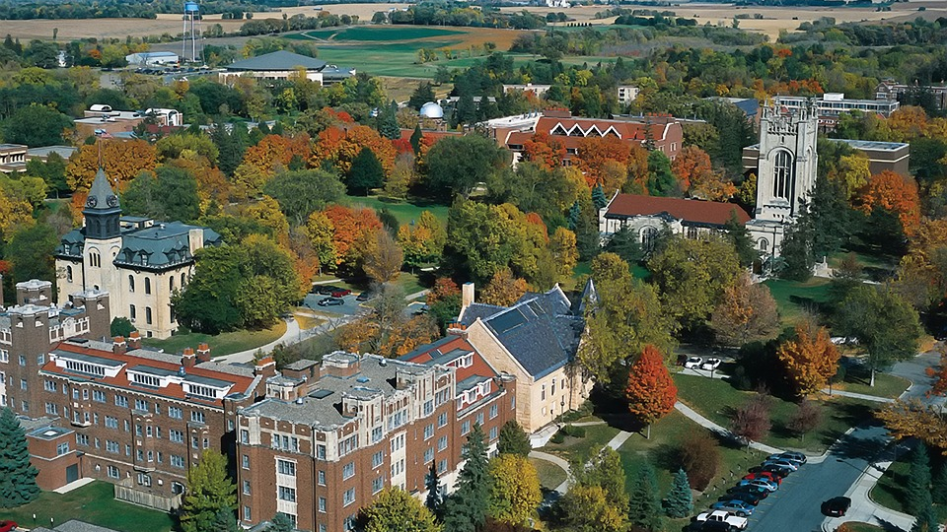

Fostering Student Success in Higher Education using Transition Theory Hope Norwood Guffey, MEd Leslie Cordie, PhD
Auburn University
Educational Foundations, Leadership, & Technology
Notes:
Introductions: Hope & Dr. C

Slide 2

Ice Breaker Activity
Notes:
Now that you all know a bit about us, let’s learn a little about each other
2 truths and a lie?
Rock paper scissors tournament?
Simply have everyone state their name, where they are from, and 1 unique thing about themselves?

Slide 3
Description of content
During this session, you will:
Explore the three types of transitions according to Schlossberg’s transition theory (1981)
Examine an individual case study from a non-traditional student
Assess the connection to Schlossberg’s transition theory and application from both the student and practitioner point of views
Brainstorm examples of transitions in education
Discuss how campus resources can contribute to student retention and successful degree completion
Notes:
This session will propose a more formal process in terms of transitional periods in higher education. Today’s student is confronted with a notable difference in the expectations of the learner in high school versus that same learner’s expectations in the college environment. In addition, higher ed sees a diverse group of students including first generation, non-traditional, transfer students who come to higher education lacking preparation for the complex learning environment. During this session, Hope will provide her individual case study and experiences as a non-traditional student who was unprepared for the college requirements. Although this learner had exceeded expectations as a high school student, she did not anticipate the level of difficulty in either academics or college life. Her plan to move from her rural location to the city was met with excitement about the new people and freedoms of college. Yet, once in school, she quickly realized that while she had planned for the many changes to living arrangements, she had failed to plan for the most important transition of the college experience – the educational transition. She will share how this created a crisis in her academic journey and almost ended her college plans. In addition to her story, we will frame the session using Schlossberg’s transition theory, and discuss the 4 Ss – situation, self, support, and strategies. Lastly, we will provide examples of best practices from the Academic Support office, where presenter one works as an Academic Coach. By disclosing her own experience from first entering higher education to current role, the audience will understand the connection to Schlossberg’s transition theory and application from both the student and practitioner point of views. Both presenters and participants will share collaboratively about how other campus resources can contribute to student retention and successful degree completion.

Slide 4
Schlossberg’s Transition Theory
The Four Ss
Situation – Characteristics of the transition
Self – The individual’s personal and psychological characteristics
Support – Social networks and environment
Strategy – Planned and implemented coping resources
Notes:
Situation: Place, timing, context, duration, impact
Self: (personal) Age, gender, health (psychological) Mindset/headspace, emotions
Support: Social network/environment, family, friends, community, institution, intimate relationships
Strategy: To cope—stress management, identifying controllable factors

Slide 5
Schlossberg’s Transition Theory
Three Types of Transitions
Anticipated: The expected transitions, often planned for in detail
Unanticipated: The unexpected transitions that are not planned for
Non-event: The anticipated transitions that one plans to experience, but these transitions do not happen
Notes:
Encourage the audience to think of their own examples of each type of transition using think-pair-share (next slide).

Slide 6
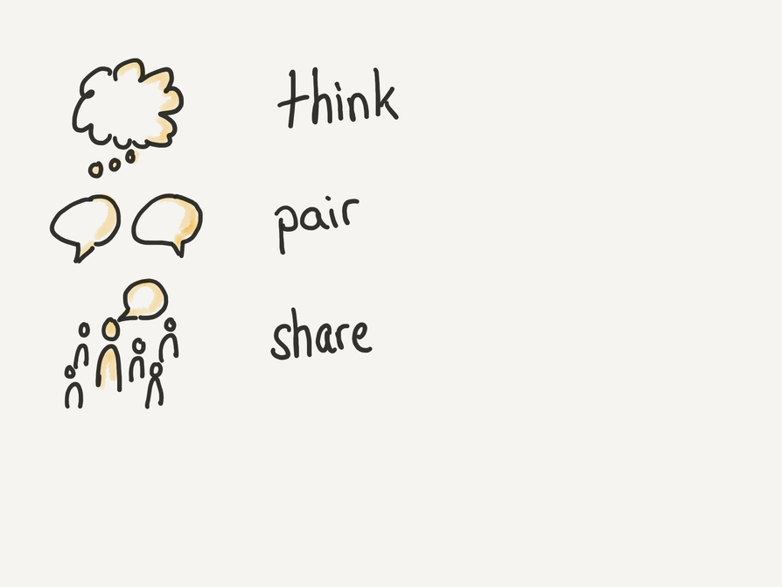
Discussion
Think-Pair-Share
What examples come to mind when you imagine an educational transition that is:
Anticipated?
Unanticipated?
Non-event?
This Photo by Unknown author is licensed under CC BY-SA.
Notes:
Take 3 minutes to think, 5 minutes to pair, and then we will go around the room to discuss and share our ideas.

Slide 7

Personal Case Study
This Photo by Unknown author is licensed under CC BY-SA.

Slide 8

Example Case
Difference in the expectations between high school and college
Difficult transition to higher education
Exceled in high school
No concerns about college learning
Planning - move to the city, meet new friends, gain new freedoms…
Failed to understand her educational transition
Created a crisis in the academic journey
Felt that college was not the right choice for her
Left the University after only one semester
This Photo by Unknown author is licensed under CC BY-NC-ND.
Notes:
These are my personal experiences as a non-traditional student who was unprepared for the college requirements. I exceeded expectations as a high school student. I was very active in clubs and organizations, I cheered and played softball, and I kept all As without ever having to study. So, as you can imagine, I did not anticipate the level of difficulty that I would face in the transition from high school level learning to college level learning. My plan to move from the one-stoplight rural location to the big college town was met with excitement about the new people and freedoms of being on my own. Yet, once in school, I quickly realized that while I had planned out exactly how to decorate my room, meticulously chose the cutest planner and matching notebook, and already scoped out the best late-night pizza joint, I had failed to plan for the most important transition of the college experience – the educational transition. This quickly created a crisis in my academic journey. After just one semester, I left Auburn University with a 1.7 GPA and a hurt ego. Thinking I was a failure and college was not right for me, I never planned to go back (but spoiler alert: thankfully, I did ☺).

Slide 9
Case Study
Discussion Questions
What were Hope’s transitions? Anticipated, unanticipated, or non-event?
Identify the 4 Ss (situation, self, support, strategy) for at least one transition.
What might be some campus resources that could have helped ease these transitions?

Slide 10

AU Campus Resources
Auburn University’s FREE Campus Resources
Academic Coaching
Peer Tutoring
Supplemental Instruction (SI)
Miller Writing Center
Student Counseling & Psychological Services
Notes:
Academic Coaching- A personalized partnership designed to support each student in meeting their academic goals. You and your coach work together to identify your academic habits, interests, skills, concerns and intentions. Through this interactive process, you will develop realistic and workable plans to achieve your vision of success in college.
Peer Tutoring- Free peer tutoring to undergraduate students at Auburn University through one-on-one appointments. Our goal is to promote academic excellence through peer-to-peer assistance by helping students develop the study skills necessary to succeed in their core courses and encourage them to grow as confident, self-directed learners.
SI- A free academic program designed to help students succeed in historically difficult courses at Auburn University. The program provides relaxed, peer-assisted study sessions led by students who have successfully completed the course in a previous semester and want to help other students excel. SI is a non-remedial approach that provides regularly scheduled sessions outside of class during which students work collaboratively to improve retention, discuss complex topics, and prepare for tests.
MWC- The Miller Writing Center offers free, one-on-one consultation for all writers at Auburn University. The staff is made up of undergraduate and graduate peer tutors who are highly trained to will help with any kind of writing, whether for class or otherwise, at any stage in the writing process
SCPS- Auburn students receive 3 free sessions per semester with SCPS.

Slide 11
Questions?

Slide 12
References
Lindstrom, D. D. (2019). From community college faculty to dean: Using Schlossberg’s Transition Theory to understand the transition experience [Doctoral thesis, St. Cloud State University]. Culminating Projects in Higher Education Administration, 31. https://repository.stcloudstate.edu/hied_etds/31/
Schlossberg, N. K., & And, O. (1981). Adult transitions. Counseling Psychologist, 9(2), 2-51.
Schlossberg, N. K., Lynch, A. Q., & Chickering, A. W. (1989). Improving higher education environments for adults: Responsive programs and services from entry to departure. Jossey-Bass.
Schlossberg, N. K. (2008). Overwhelmed: Coping with life's ups and downs (2nd ed.). Rowman & Littlefield Publishing Group.

