Slide 1
Creating an In-House Prior learning Assessment Program
Presented by:
Cara Nissen
Student Success and Retention Manager

Slide 2
Agenda
Background of Mount Saint Mary’s University, Los Angeles
Overview of our Weekend/Evening & Online College (WEOC)
Current Process
Walk through of Free Intro to Learning Portfolio Course
Next Steps
Recommendations
Brainstorming and Questions

Slide 3
Background of Mount Saint Mary’s University, LoS Angeles (MSMU)
We were founded by the The Sisters of St. Joseph of Carondelet (CSJs) in 1925!
Mount Saint Mary’s is the only women’s university in Los Angeles and one of the most diverse in the nation. The University is known nationally for its research on gender equality, its innovative health and science programs, and its commitment to community service.
As a leading liberal arts institution, Mount Saint Mary’s provides year-round, flexible, and online programs at the undergraduate and graduate level. Weekend, evening, and graduate programs are offered to all genders. Mount alums are engaged, active global citizens who use their knowledge and skills to better themselves, their communities and the world.
#1 For Student Social Mobility- U.S. News & World Report
#3 Most Transformative- Money magazine has ranked the Mount as a top university with the power to change life trajectory and earnings for its graduates.

Slide 4
About the WEOC
The Weekend College began in 1991 with 91 students and was located on the Chalon Campus. In 2006 we moved to Doheny Campus in historic West Adams area of Downtown LA. Evolved into Weekend/Evening and then Weekend/Evening & Online College.
196 million age 21 and older. 36 million before pandemic and now 39 million adults 25-64 have “some college/no degree”. 4 million of these in CA.
CA has about 400,000 high school grads each year.
Demographic cliff/long known changes in higher ed population across the U.S.

Slide 5
Student Population Overview
80% work 40 hours+ per week
Over 90% are first generation college students
51% pursue graduate coursework
Average age: 36
Average Transfer Units: 40-45
Average CUM GPA: 3.2
Average Transfer GPA: 2.4

Slide 6
Majority female – about 3-4 % male
Race & Ethnicity– Hispanic 84%, American Indian or Alaska Native 3.8% Asian 18%, Black/African American, 16% White 23%
Average age 36 on-campus, 30 online
96% female on-campus, 97% online identify as female
Top majors – on-campus Business, Applied Psychology, Liberal Arts. Online Liberal Arts and Business
90% Satisfied / very satisfied with academic advising
94% Likely/very likely to recommend to friends/family

Slide 7
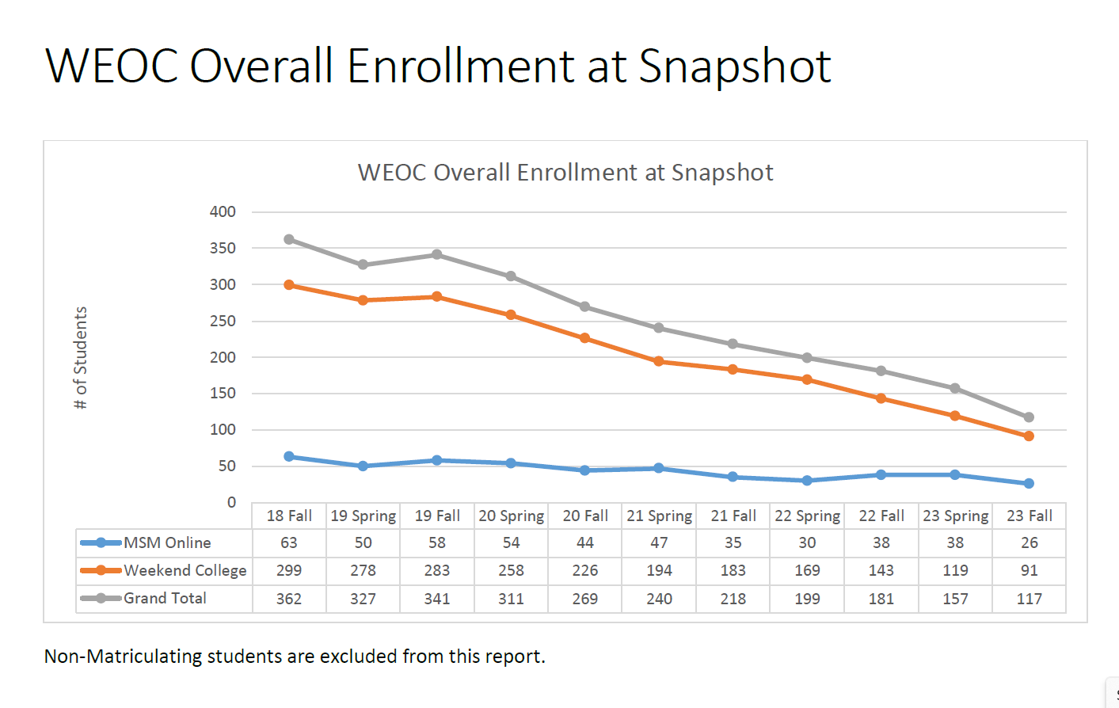
Enrollment in WEOC

Slide 8
Flexibility Matters
Weekends:
Evenings:
Online:
Classes meet on 6 non-consecutive weekends (BOTH SATURDAY & SUNDAY)
Approximately 1 to 2 weekends a month
Classes meet once a week, per class (for example: Every Monday of the semester from 6:00pm-9:00pm)
Classes take place in an virtual format

Slide 9
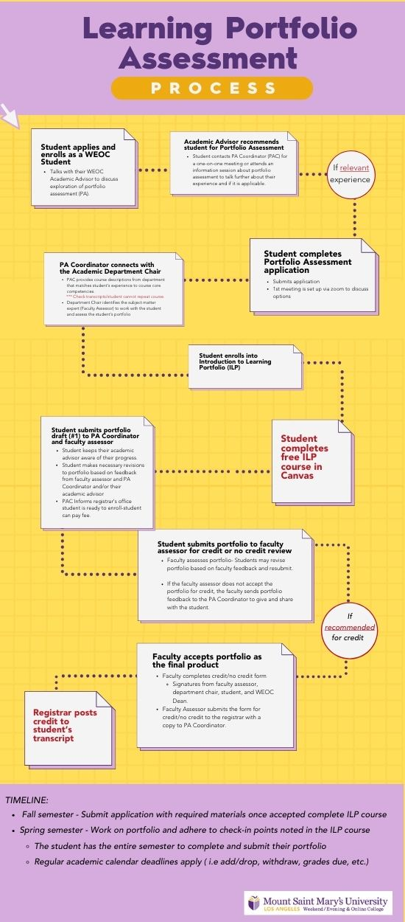

Slide 10
Current Process as of Sept 2023
Created a PA working group May 2021 to start the process of creating an in-house process for Portfolio Assessment previously done via LearningCounts. When LearningCounts closed we, along with other adult undergrad programs, had to create our in-house process. The working group met throughout summer 2021 and AY20-21. Two faculty created our Introduction to Learning Portfolio self-pace FREE online course.
Students complete the free ILP course in order to successfully complete a portfolio with regular check-ins with their Faculty Assessor who is a subject matter expert (SME), and PA Coordinator, Cara.
Our in-house process was created by faculty (Andree Leighton, Angela Benveniste, Ira Lovitch). OID Academic Director Christopher Tsang, former WEOC Admissions staff, WEOC Student Success/Retention Manager, Cara Nissen, Suzanne Williams, Dean, along with input from Rocio DeLeon, Registrar. La Royce Housley, Director of Financial Aid, Susanna Nelson, Director of Student Accounts, Michele Starkey, Associate Provost and Bob Perrins, Provost.
During the pilot year, AY2022-23, one Applied Psychology student, successfully completed PA working with Faculty Assessor/SME.

Slide 11
Walk through of Course

Slide 12
Next Steps
During end of 2022-2023 AY, President formed a taskforce to re-imagine the WEOC due to enrollment challenges, economic challenges, etc.
  Our charge: be bold, be creative… nothing is off the table
Taskforce is chaired by Interim Provost and Dean Suzanne Williams (ACHE lifetime member and Director at Large!)
Meetings started at end of Spring 2023 semester, continued through the summer, and are currently meeting
Recommendations from taskforce and Interim Provost to make the process less complicated, arduous, and discouraging

Slide 13
current process
Current process only allows for elective credit
Students enrolled in an undergraduate program at Mount Saint Mary’s University may receive academic credit through Prior Learning Assessment (PLA) for college-level learning gained from life or work experience prior to admission to Mount Saint Mary’s University. Students who wish to pursue credit for PLA portfolio assessment must meet with their Academic Advisor and work with a faculty subject matter expert who will serve as the faculty assessor for the portfolio. Students working with their Advisor and faculty assessor must identify the MSMU course that matches their learning and for which they would like to earn PLA credit. Students will complete an online module to assess readiness for portfolio assessment. After successfully completing the module, the student would be able to submit three portfolios for a cost of $500 per portfolio. Each successful portfolio may receive 3-units of elective credit. Each course credit will be noted based on the existing course at MSMU that the completed portfolio assessment matches. Credit obtained through PLA will be noted as such on the student's official MSMU transcript. The University may grant up to 12 lower or upper division elective units for Prior Learning Assessment portfolio assessment. PLA units may not be used to fulfill general education requirements. No letter grades will be awarded for this academic elective credit.

Slide 14
Proposed Changes
Expand policy to give major credit and general education credit
Clarify the process for students applying to CPL
Clarify the roles of Program Assessment (PA) coordinator and subject matter experts (SME)
Clarify terms!
Revise fee structure to make CPL a “free” process
  Currently, it is $500 for each potential course of credit/no credit (total could be $1,500).

Slide 15
Proposed Changes
Offer a free one unit for credit course after students are admitted and before classes start
  During this time, their portfolio would be accessed
  Currently, the process can take months and is confusing to students, staff, and faculty
  Our goal is for their portfolio to be accessed in weeks vs. months

Slide 16
Proposed New Policy- currently undergoing faculty governance review
Students enrolled in the post-traditional undergraduate program at Mount Saint Mary’s University (MSMU) may receive academic credit via Portfolio Assessment (PA) for college-level learning gained from life or work experience prior to admission to MSMU.
Students who wish to pursue credit for Portfolio Assessment (PA) must meet with the PA Coordinator and work with a faculty subject matter expert who will also assess the portfolio. Students working with the PA Coordinator and a faculty assessor must identify the MSMU course that matches the prior learning that may qualify to earn PA credit.
Students will complete a free self-paced online portfolio process to prepare and submit up to four portfolios for possible academic credit. Each successful portfolio may receive 3-units of elective, LACE or major course credit. Course credit will be awarded according to the MSMU course that the portfolio successfully matches and noted as obtained through PA on the student's official MSMU transcript. The University may grant academic credit for up to 12 lower or upper division elective units, LACE coursework, or major requirements through Portfolio Assessment (PA). No letter grades will be awarded for this academic credit.

Slide 17
Recommendations
Know who your allies are, and form a team/work group/etc.
Track your progress and pain points
Talk to others about the benefits for students
Delegate work out
Have weekly check ins

Slide 18

Brainstorming and Questions

Slide 19
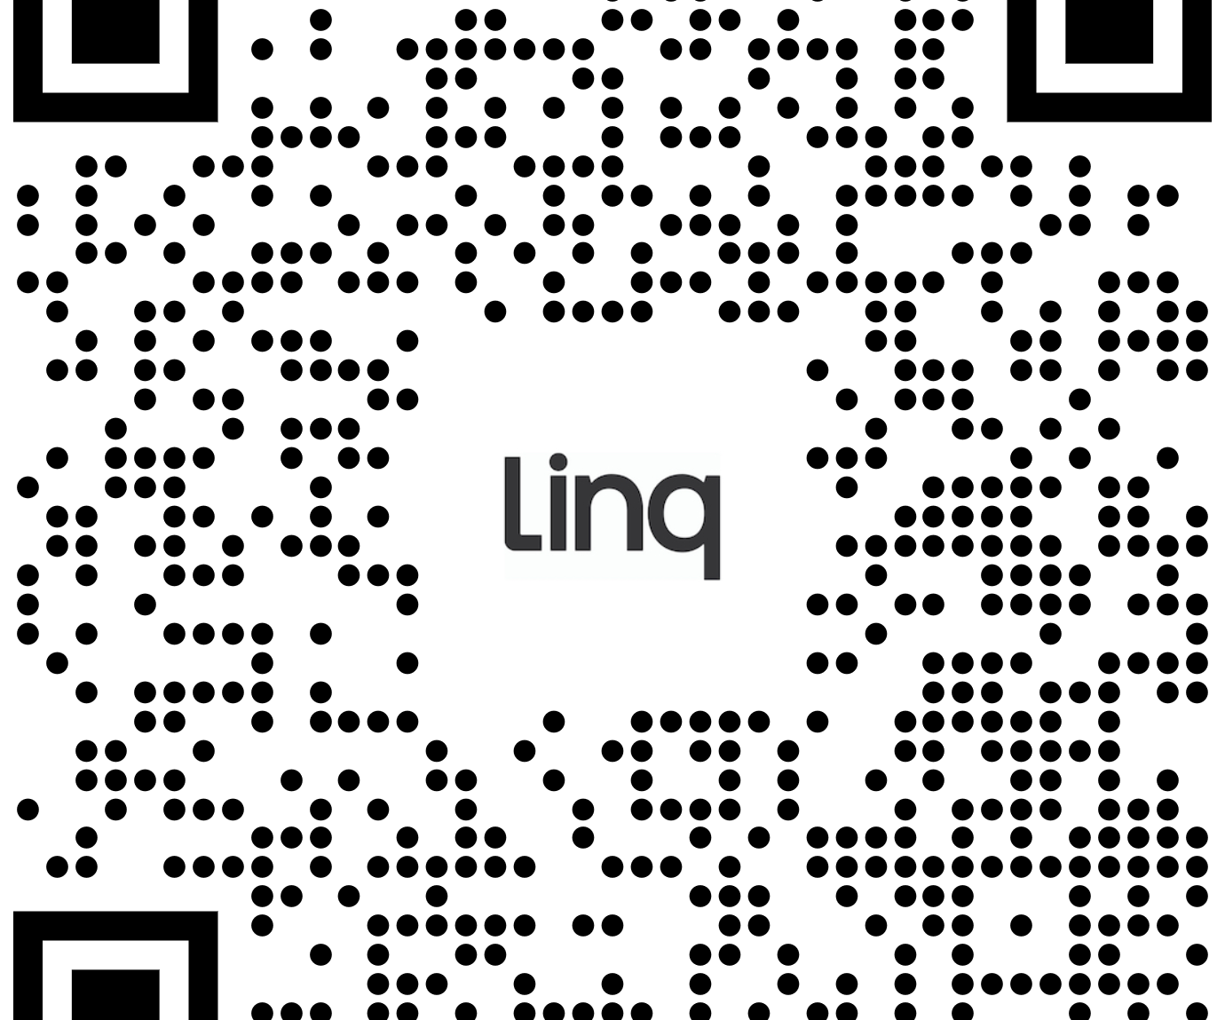
Thank you! Let’s Connect and support one another!
Cnissen@msmu.edu

