Slide 1
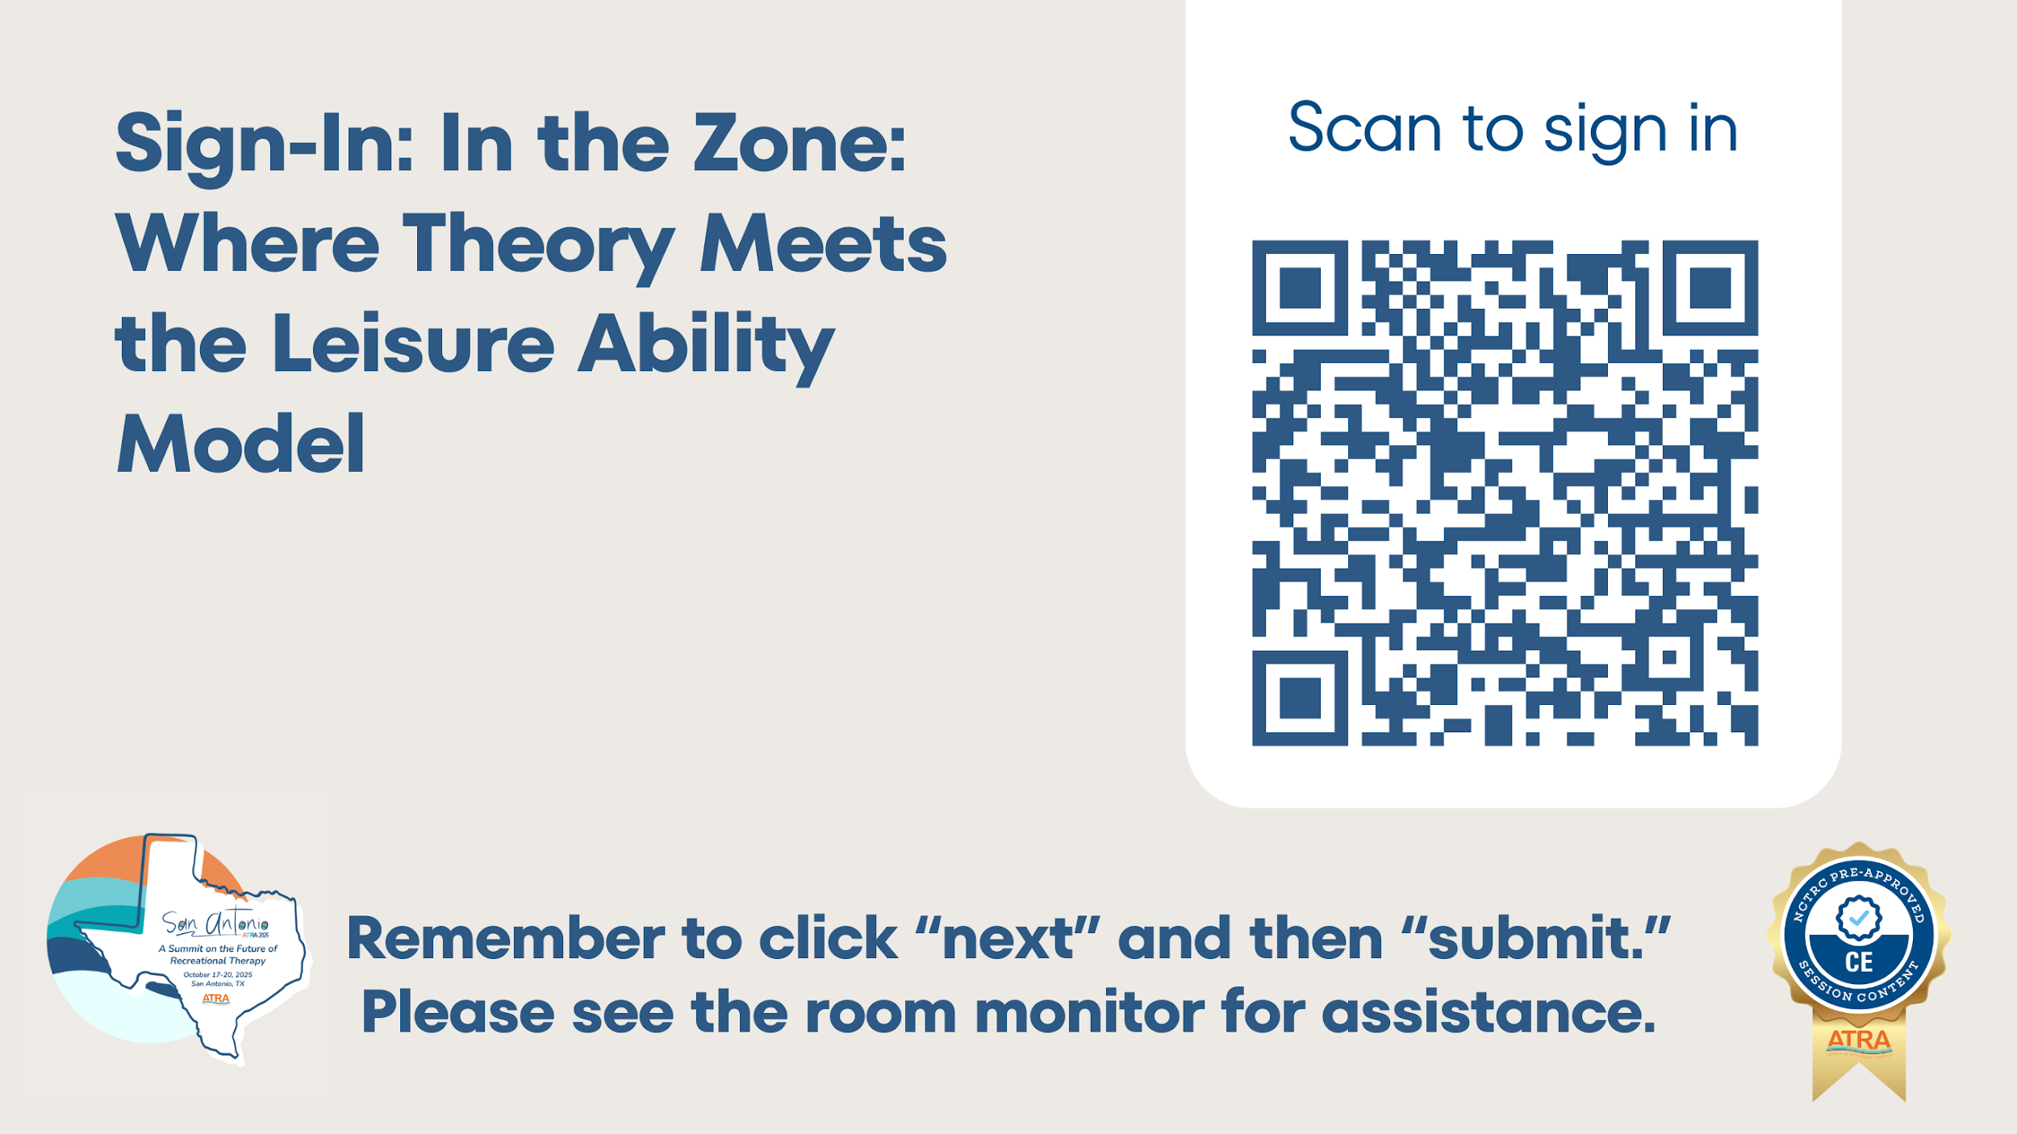

Slide 2

Welcome!
Session Overview
Learning Outcomes
Introducing the Speakers
Emily Higgins, MS, CTRS
Thomas W Means, PhD, CTRS
Shay Dawson, PhD, CTRS
After attending this session, participants will be able to:
Role of Evidence-Based Practice in Recreational Therapy
Use of Models and Theories to Inform Practice
Discuss Leisure Ability Model
Introduce Zones of Leisure Framework
Feedback and Reflections
Applications, Takeaways, Q&A
Analyze how the integration of the Leisure Ability Model (LAM) and the Zones of Leisure framework can enhance therapeutic recreation practice and promote client growth in skill development and independence.
Examine the influence of key theoretical foundations on evidence-based practice within recreational therapy, emphasizing how theory strengthens consistency, intentionality, and outcomes across diverse settings.
Evaluate the potential of the Zones of Leisure framework to inform the evolution of future models and guide continued innovation in therapeutic recreation.
Notes:
1. Introduction and Session Overview (5 minutes – 8%)
Welcome and brief introduction of presenters
Overview of session goals and learning objectives

Slide 3
Evidence-Based Practice in Recreational Therapy
The Need
The Relationship Between Theories and Models
Guides RT’s in making informed, client-centered decisions instead of relying on tradition or intuition
Helps justify services to stakeholders
Provides a scientific foundation for RT interventions
Theory
Models of Practice
Translates theory into structured, goal-directed action. Guides the selection, sequencing, and organization of interventions
Gaps on Consumer Outcome
Provides the foundation for understanding how and why change occurs
CTRSs acknowledge research is valuable, EBP is not used consistently in everyday planning
Specialized areas or interventions lack rigorous evidence or standardized protocols
Benefits of RT Service Delivery
When theory and model align, interventions become intentional, measurable, and evidence-based. This alignment ensures that every clinical decision supports meaningful client outcomes, strengthens professional credibility, and promotes growth that is truly client-centered
Enhances client outcomes
Supports continuity and generalization of service effects
Encourages accountability, program evaluation, and continuous improvement through measurable outcomes
NCTRC Job Task 3.01: Develop individualized plan of care
Notes:
2. Role of Evidence-Based Practice in Recreational Therapy (8 minutes – 13%)
NCTRC Job Task 3.01: Develop individualized plan of care
The need for evidence-based practice in recreational therapy
Current gaps in research and their impact on consumer outcomes
Benefits of EBP in RT service delivery
Role of models and frameworks in supporting EBP
Introduction to the Leisure Ability Model (LAM) as a widely used practice model

Slide 4
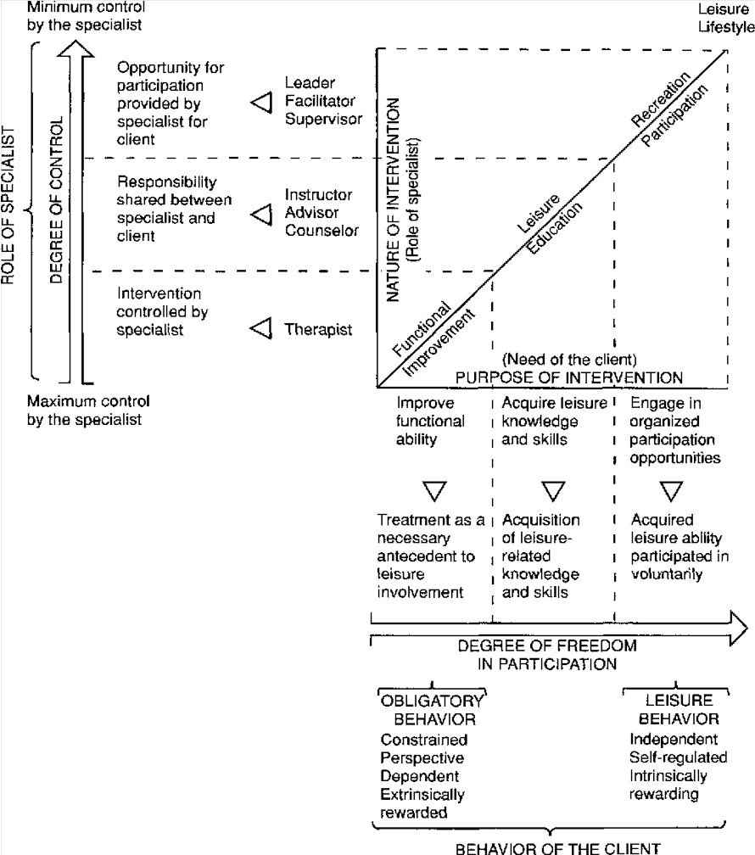
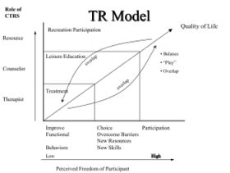
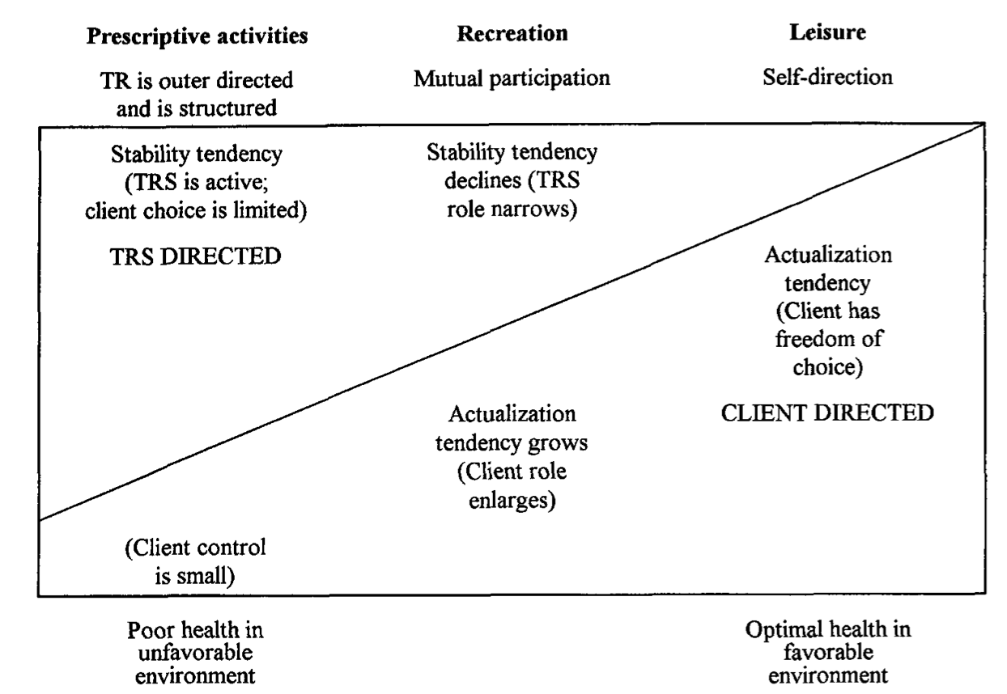
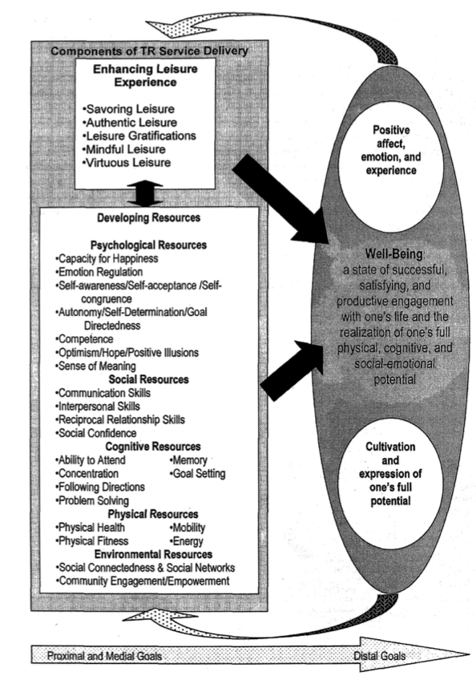
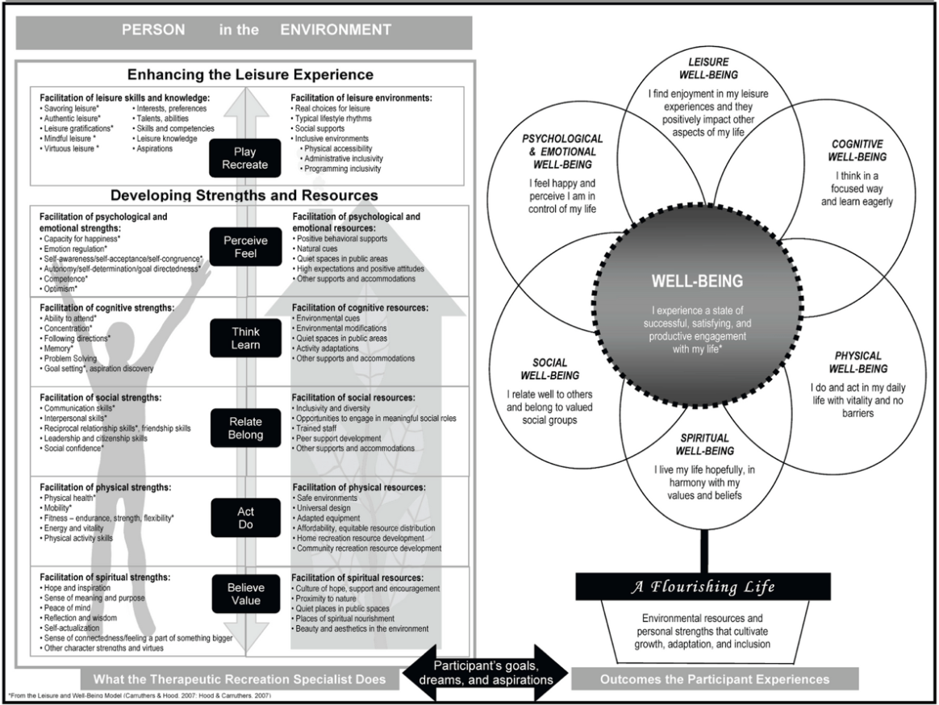
Models of Practice in the Field
Leisure Ability Model
(Pedersen & Gunn, 1984; Stumbo & Peterson, 1988)
Health Protection/Health Promotion Model
(Austin, 1998)
Leisure and Well-Being Model
(Hood & Carruthers, 2007)
Flourishing Through Leisure Model
(Anderson & Heyne, 2012)
NCTRC Job Task 3.02: Design program services
Notes:
4. Critique of LAM and Introduction to the Zones of Leisure (7 minutes – 12%)
NCTRC Job Task 3.02: Design program services
Critique of LAM’s limitations in today’s evidence-focused landscape
Introduction of the Zones of Leisure as a possible theoretical foundation for LAM
Integration possibilities: Should Zones of Leisure complement, extend, or reframe LAM?

Slide 5
Informing Practice: Leisure Ability Model
Origin and Development
Developed by Pedersen & Gunn (1984)
Designed to help individuals establish an independent leisure lifestyle
Integrates three service phases: Functional Intervention, Leisure Education, and Recreation Participation
Refined by Stumbo & Peterson (1988)
Promotes health, well-being, and quality of life through leisure engagement
Emphasizes client control, autonomy, and individualized approaches
Introduced concepts of learned helplessness vs. mastery or self-determination, intrinsic motivation, internal locus of control, causal attribution, choice, and flow
Use in Practice
Provides structure and continuity across treatment settings
Adaptable and flexible, meeting diverse client needs across populations and programs
Effectively guides program planning and consistent, client-centered service delivery
NCTRC Job Task 3.01: Develop individualized plan of care; NCTRC Job Task 3.02: Design program services
Notes:
3. Use of Models to Inform Practice: Leisure Ability Model (12 minutes – 20%)
NCTRC Job Task 3.01: Develop individualized plan of care
NCTRC Job Task 3.02: Design program services
Origin of LAM: Contributions by Pedersen, Gunn, and Stumbo
Overview of LAM’s structure and historical use in practice
LAM as a “living, breathing model” across RT generations, use in program planning
Strengths of the model and recognition of its lack of theoretical foundation

Slide 6
Critiques of LAM
Context Within EBP
Developed before the modern emphasis on evidence-based practice (EBP)
LAM is practical but limited in theoretical depth
Leisure orientation versus therapy orientation
Leisure Orientation: emphasizes a fulfilling leisure lifestyle as the end goal
Therapy Orientation: uses leisure as a tool to achieve broader functional improvements
Lacks explanation for how and why change occurs during progression
NCTRC Job Task 3.02: Design program services
Notes:
4. Critique of LAM and Introduction to the Zones of Leisure (7 minutes – 12%)
NCTRC Job Task 3.02: Design program services
Critique of LAM’s limitations in today’s evidence-focused landscape
Introduction of the Zones of Leisure as a possible theoretical foundation for LAM
Integration possibilities: Should Zones of Leisure complement, extend, or reframe LAM?

Slide 7
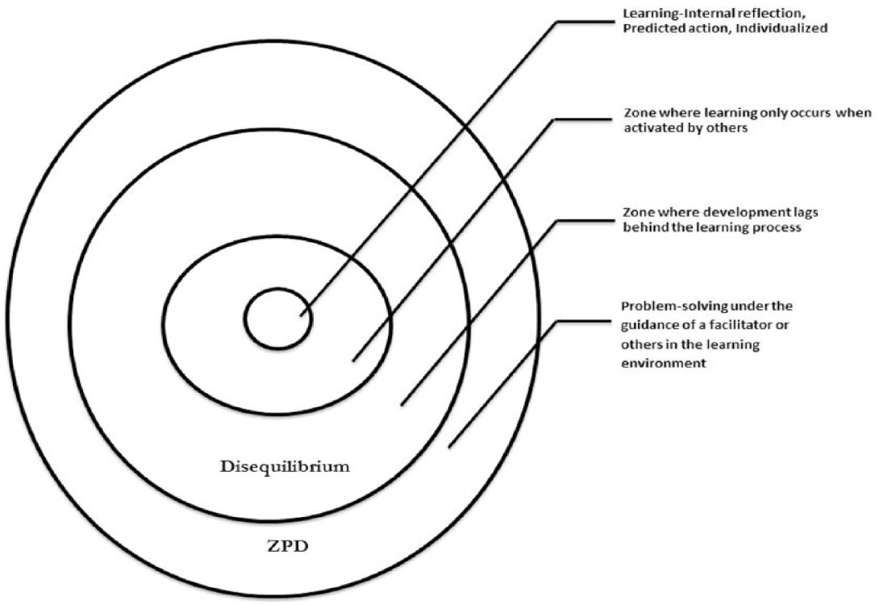
Adding Theory: The Zone of Proximal Development
Foundational Knowledge
Lev Vygotsky (1896–1934): Psychologist whose work laid the foundation for theories of learning and cognitive development
Zone of Proximal Development (ZPD): The gap between what a learner can do independently and what they can achieve with guidance
Combined social interaction and scaffolded learning, where growth occurs through collaboration and supported challenge.
More Knowledgeable Others (MKOs): Individuals with greater experience or expertise who provide structure, feedback, and support.
Effective facilitation within the ZPD ensures learners receive the right balance of challenge and support, promoting autonomy, skill mastery, and long-term engagement.
Key Zones: Structured, Mentorship, Independent
NCTRC Job Task 3.02: Design program services
Notes:
4. Critique of LAM and Introduction to the Zones of Leisure (7 minutes – 12%)
NCTRC Job Task 3.02: Design program services
Critique of LAM’s limitations in today’s evidence-focused landscape
Introduction of the Zones of Leisure as a possible theoretical foundation for LAM
Integration possibilities: Should Zones of Leisure complement, extend, or reframe LAM?

Slide 8
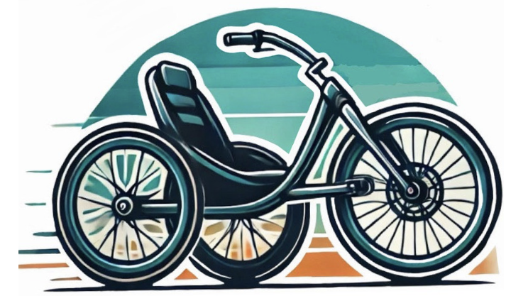

ZPD Through the Lens of the Leisure Ability Model
LAM Component | ZPD Alignment | LAM Related Concept | Example in Practice
Functional Intervention | Structured: Facilitator identifies where the participant’s skills currently are and provides structured, scaffolded support to promote success. | Learned Helplessness → Mastery or Self-Determination | Identify participant strengths and challenges, set achievable goals, and build mastery of skills through guided, scaffolded practice
Leisure Education | Mentorship and Coaching: Participants learn through guided discovery and structured support until skills become internalized | Motivation & Choice | Identify interests and readiness, create supportive learning opportunities, and empower self-directed choice and reflection.
Recreation Participation | Participants act within their independent zone, using learned skills autonomously while the facilitator steps back. | Flow, Personal Causality/Control | Identify environments that balance challenge and skill, design opportunities for self-directed participation, and observe sustained engagement and flow as indicators of independence
NCTRC Job Task 3.02: Design program services
Notes:
4. Critique of LAM and Introduction to the Zones of Leisure (7 minutes – 12%)
NCTRC Job Task 3.02: Design program services
Critique of LAM’s limitations in today’s evidence-focused landscape
Introduction of the Zones of Leisure as a possible theoretical foundation for LAM
Integration possibilities: Should Zones of Leisure complement, extend, or reframe LAM?

Slide 9
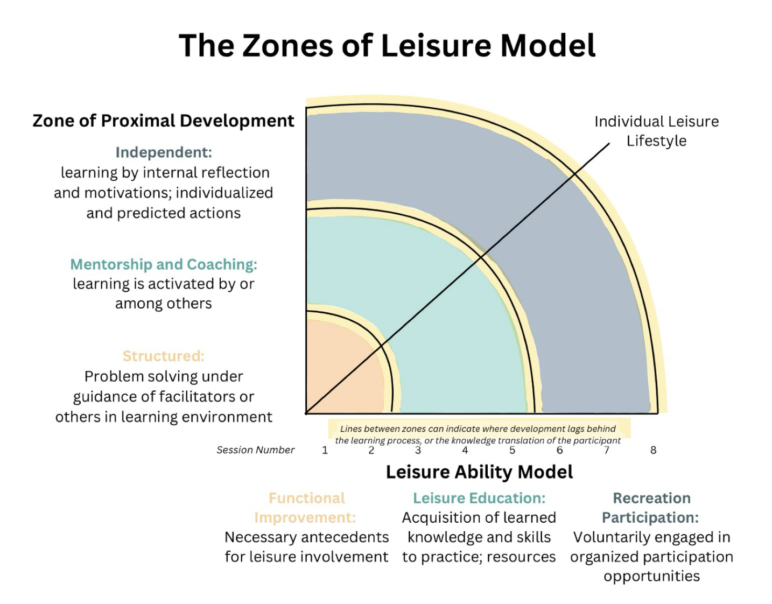
Zones of Leisure Framework
Theoretical Integration and Application
Foundations: Integrates the Leisure Ability Model (LAM) with Zone of Proximal Development (ZPD) to show how clients progress from supported to independent leisure participation throughout recreational therapy programs. The LAM structures programs by defining session categories and practitioner involvement. The ZPD guides skill progression, balancing support and autonomy.
Purpose: Explains the “how” and “why” behind skill development, motivation, and autonomy in leisure.
Addresses Gaps in LAM:
Adds focus on learning progression and therapeutic scaffolding
Highlights motivation, flow, and choice within each stage
Emphasizes client–therapist collaboration and growth
Strengthening RT Practice:
Encourages measurable progression and reflective facilitation
Connects evidence, theory, and person-centered outcomes
Integration Possibilities:
Complement: Use alongside the Leisure Ability Model to guide session design.
Extend: Integrate ZPD principles within LAM to deepen theoretical understanding and application.
Reframe: Establish the Zones of Leisure as a distinct, evolving model of practice.
NCTRC Job Task 3.01: Develop individualized plan of care; NCTRC Job Task 3.02: Design program services
Notes:
5. Introduction to the Zones of Leisure Framework (10 minutes – 17%)
NCTRC Job Task 3.01: Develop individualized plan of care
NCTRC Job Task 3.02: Design program services
Explanation of the Zones of Leisure and its theoretical foundations
How the framework addresses gaps in LAM
The potential for strengthening RT practice through integration
Integration possibilities: Should Zones of Leisure complement, extend, or reframe LAM?

Slide 10

Future Applications, Practical Takeaways
The Zones of Leisure Framework offers an evidence-informed structure for participant development, program design, and evaluation in adaptive sport and recreation.
By integrating the Leisure Ability Model (LAM) with the Zone of Proximal Development (ZPD), practitioners can intentionally align interventions with participants’ evolving skills, motivation, and level of support/challenge in recreational therapy programs
Enhance participant progression by identifying each individual’s optimal “zone” for growth, balancing support and challenge
Strengthen evidence-based practice by introducing measurable
outcomes and theoretical grounding for program design.
NCTRC Job Task 3.01: Develop individualized plan of care
Notes:
7. Future Applications and Practical Takeaways (5 minutes – 8%)
NCTRC Job Task 3.01: Develop individualized plan of care
Implications for early-career professionals and graduate students
Recommendations for integrating the Zones of Leisure in clinical and academic settings

Slide 11
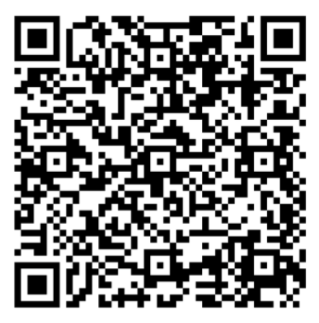
Framework Feedback and Reflection
What are your initial impressions of the Zones of Leisure Framework?
How well do you feel this framework captures the progression from guided
to independent leisure participation?
Which aspects of the framework seem most applicable or valuable in your
current practice or academic setting?
How do you see the Zones of Leisure supporting goal setting, progress tracking, or treatment planning?
What barriers or challenges might exist to implementing the Zones of Leisure Framework in your setting?
How do you see this framework interacting with key psychological concepts such as self-determination, intrinsic motivation, choice, locus of control, or flow?
In what ways could this framework contribute to advancing evidence-based and theory-informed practice within recreational therapy?
If you could modify or expand one part of the Zones of Leisure Framework to make it more applicable to your practice, what would it be and why?
How do you see the Zones of Leisure fitting within current practice — as a complement to the Leisure Ability Model, an integration that deepens it, or a new framework that stands on its own?
NCTRC Job Task 3.02: Design program services
Notes:
6. Zones of Leisure Framework Feedback and Reflection (8 minutes – 13%)
NCTRC Job Task 3.02: Design program services
Practitioners engage in providing first-time feedback on the Zones of Leisure
Encouraging critical reflection on the use of models and theories in RT practice
Promoting dialogue about the future direction of therapeutic recreation frameworks
Zones of Leisure Framework – Feedback & Reflection Questions
Section 1: Initial Impressions and Conceptual Understanding
What initial impressions do you have of the Zones of Leisure Framework?
How well do you feel this framework captures the progression from guided to independent leisure participation?
Which elements or concepts within the framework resonate most strongly with your understanding of client growth and development in recreational therapy?
Are there areas within the framework where you would like greater clarity or explanation?
How effectively do you think the framework integrates both theoretical depth and practical application?
Section 2: Application and Relevance to Practice
Which aspects of the framework seem most applicable or valuable in your current practice or educational setting?
How do you see the Zones of Leisure supporting goal setting, progress tracking, or treatment planning for clients?
In what ways could the framework enhance interdisciplinary collaboration or documentation of outcomes?
Section 3: Feasibility and Implementation
What barriers or challenges might exist to implementing a framework like the Zones of Leisure in your workplace or field setting?
What training, professional development, or educational preparation would be necessary to effectively use this framework in practice?
Are there specific client populations or service settings where you anticipate greater or lesser feasibility in applying this framework?
Section 4: Theoretical and Psychological Alignment
How do you see the Zones of Leisure Framework interacting with key psychological constructs such as:
Self-determination
Intrinsic motivation
Choice and autonomy
Locus of control and causal attribution
Flow or engagement
Do you feel the framework adequately supports progression from dependence to mastery in these areas? Please explain.
Section 5: Broader Impact
In what ways could this framework contribute to advancing evidence-based practice and theoretical consistencywithin recreational therapy?
How might you envision using or adapting the Zones of Leisure Framework in your own practice, research, or academic setting moving forward?

Slide 12
Questions?
Emily Higgins, MS, CTRS
Sport Program and Outreach Manager
Great Lakes Adaptive Sports Association
ehiggins@glasa.org
Thank You!
Notes:
8. Q&A and Discussion (5 minutes – 8%)
Open floor for participant questions and reflections
Group discussion on applying the session content to real-world RT practice

Slide 13
References
Means, W. T., Taylor, J., & Delong, T. (2024). RT Open Eagles: Answering the call for evidence-based practice. American Journal of Recreation Therapy, 23(1), 6-8.
Anderson, L. S., & Heyne, L. A. (2012). Flourishing through leisure: An ecological extension of the Leisure and Well-Being Model (Conceptual paper). Therapeutic Recreation Journal, 46(2), 129–152. Retrieved from https://bctra.org/wp-content/uploads/tr_journals/2675-10396-1-PB.pdf
Hood, C. D., & Carruthers, C. (2007). Enhancing leisure experience and developing resources: The Leisure and Well-Being Model, Part II. Therapeutic Recreation Journal, 41(4), 298–325. Retrieved from https://www.bctra.org/wp-content/uploads/tr_journals/932-3643-1-PB.pdf
Austin, D. R. (1998). The Health Protection / Health Promotion Model (Conceptual article). Therapeutic Recreation Journal, 32(2), 109-117. Retrieved from https://www.bctra.org/wp-content/uploads/tr_journals/1160-4544-1-PB.pdf
Ervin, A., & Litchke, L. G. (2023). Comparison Between Maslow’s Hierarchy of Needs and the Leisure Ability Model: Theory to Practice. Canadian Journal of Recreation Therapy, 2(1).
Bullock, C. C. (1998). The Leisure Ability Model: Implications for the Researcher. Therapeutic Recreation Journal, Second Quarter, 97–102.
Austin, PhD, D. R., McCormick, PhD, CTRS, B. P., & Van Puymbroeck, PhD, CTRS, M. (2010). Positive psychology: A theoretical foundation for recreation therapy practice. American Journal of Recreation Therapy, 9(3), 17–24. https://doi.org/10.5055/ajrt.2010.0020
Stumbo, N. J., & Pederson, C. A. (1998). The leisure ability model. British Columbia Therapeutic Recreation Association. https://www.bctra.org/wp-content/uploads/tr_journals/1157-4532-1-PB.pdf
Clapper, T. C. (2015). Cooperative-based learning and the zone of proximal development. Simulation &amp; Gaming, 46(2), 148–158. https://doi.org/10.1177/1046878115569044 https://doi.org/10.1016/s0959-4752(99)00025-0
Allal, L., & Pelgrims Ducrey, G. (2000). Assessment of—or in—the zone of proximal development. Learning and Instruction, 10(2), 137–152. https://doi.org/10.1016/s0959-4752(99)00025-0

Slide 14
