Slide 1


Slide 2
Philanthropy’s Albatross
Debunking Theories of Change
http://postcards.typepad.com/Philanthropy%20s%20Albatross.doc
albert@gnof.org

Slide 3
Four primary uses
Planning a program
Evaluating a program
Enriching consultants (like me)
Befuddling grantees

Slide 4


Slide 5

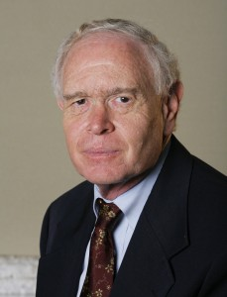
“The Power of Theories of Change” Spring 2010

Slide 6
What is a theory of change,
anyway?

Slide 7
“A theory of change describes a process of planned social change, from the assumptions that guide its design to the long-term goals it seeks to achieve.”

Slide 8
“Grant makers who use the term may be describing anything from a detailed map to a general storyline.”

Slide 9
A theory of change “defines all the building blocks required to bring about a given long-term goal.”

Slide 10
“A THEORY OF CHANGE is the empirical basis underlying any social intervention.”

Slide 11
“[T]he product of a series of critical-thinking exercises that provides a comprehensive picture of the early- and intermediate-term changes in a given community that are needed to reach a long-term goal articulated by the community.”

Slide 12


Slide 13
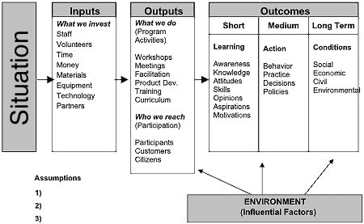
Theory of Change ≠ Logic Model …
… for most people

Slide 14


Slide 15
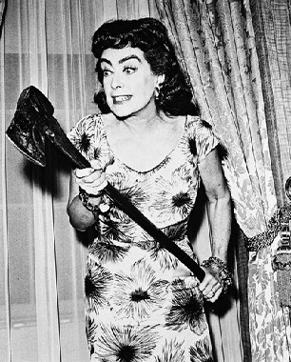

Slide 16
So what is a theory of change?

Slide 17


Slide 18
A program theory is a sequence of causes and effects, in which our interventions function as the instigating causes and certain hoped-for social benefits function as their ultimate effects.

Slide 19
A → B → C … → OUTCOME

Slide 20
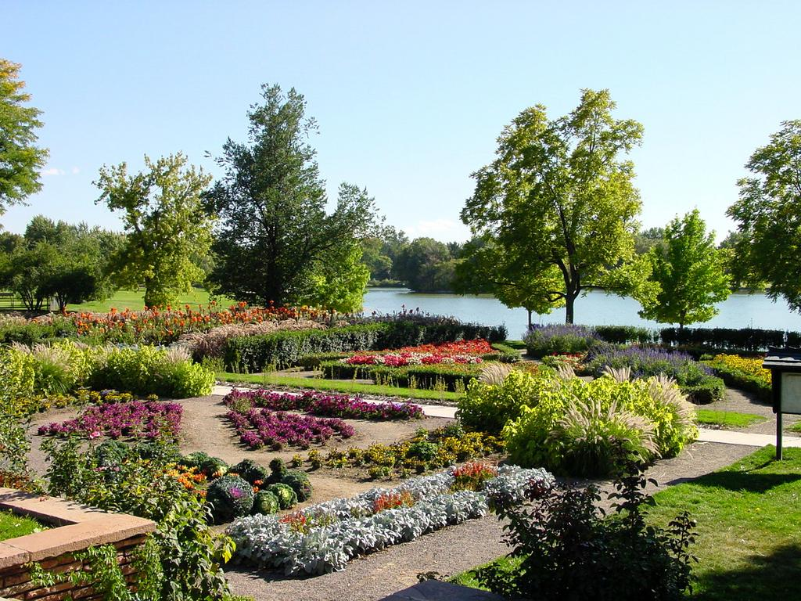
Parks, Inc.

Slide 21

We propose to create a park in Neighborhood X so residents can use and enjoy it … This will lead to better health outcomes for residents …

Slide 22

What’s your theory of change

Slide 23


Slide 24
If we create a park within walking distance of neighborhood homes, and residents participate in the design of the park, and the city commits to its upkeep → Residents will use the park

Slide 25
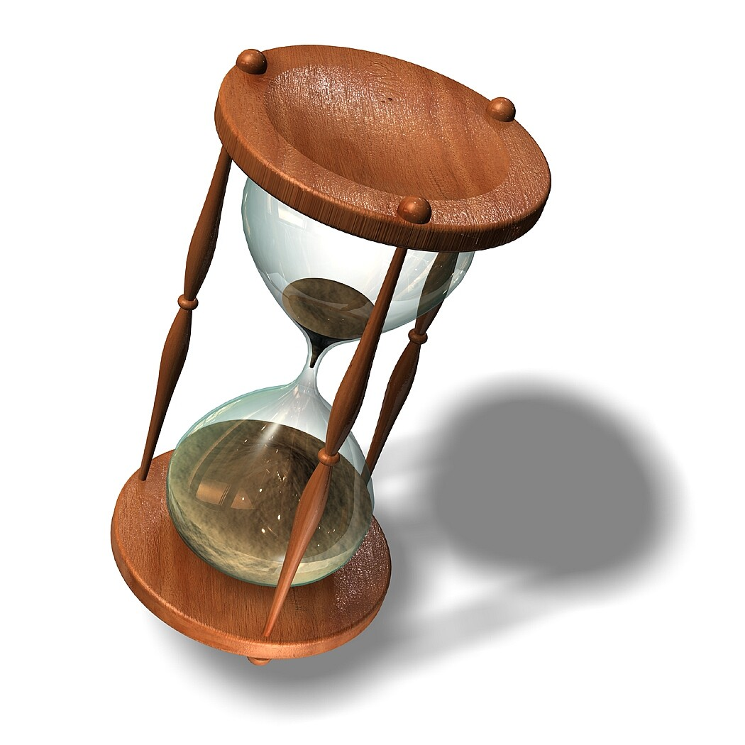

Slide 26
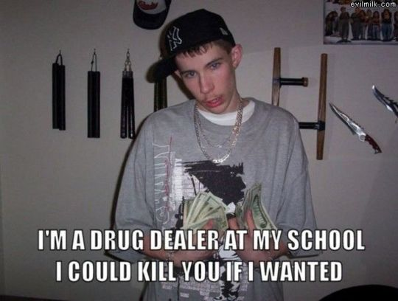

Slide 27


Slide 28
If we create a park within walking distance of neighborhood homes, and residents participate in the design of the park, and the city commits to its upkeep, and residents feel safe in the park → Residents will use the park

Slide 29


Slide 30


Slide 31


Slide 32
If we create a park within walking distance of neighborhood homes, and residents participate in the design of the park, and the city commits to its upkeep, and residents feel safe in the park, and residents feel safe walking from their homes to the park → Residents will use the park

Slide 33
Some Lessons
The most relevant parts of the theory of change were already implicit in the original grant proposal.
Articulating all the conditions necessary for the desired change to occur can get ridiculously complicated. In general, you cannot know ahead of time what the “relevant” conditions will be.

Slide 34
If we create a park within walking distance of neighborhood homes, and residents participate in the design of the park, and the city commits to its upkeep, and residents feel safe in the park, and residents feel safe walking from their homes to the park → Residents will use the park

Slide 35
Some Lessons, Cont.
Your theory of change is not helping you to plan your work.
Your theory of change is not helping you to evaluate your work.
Your theory of change is not working for you: you are working for it.

Slide 36

In order to improve conditions at Public Housing Project X, we propose to include tenants on the managing board.

Slide 37
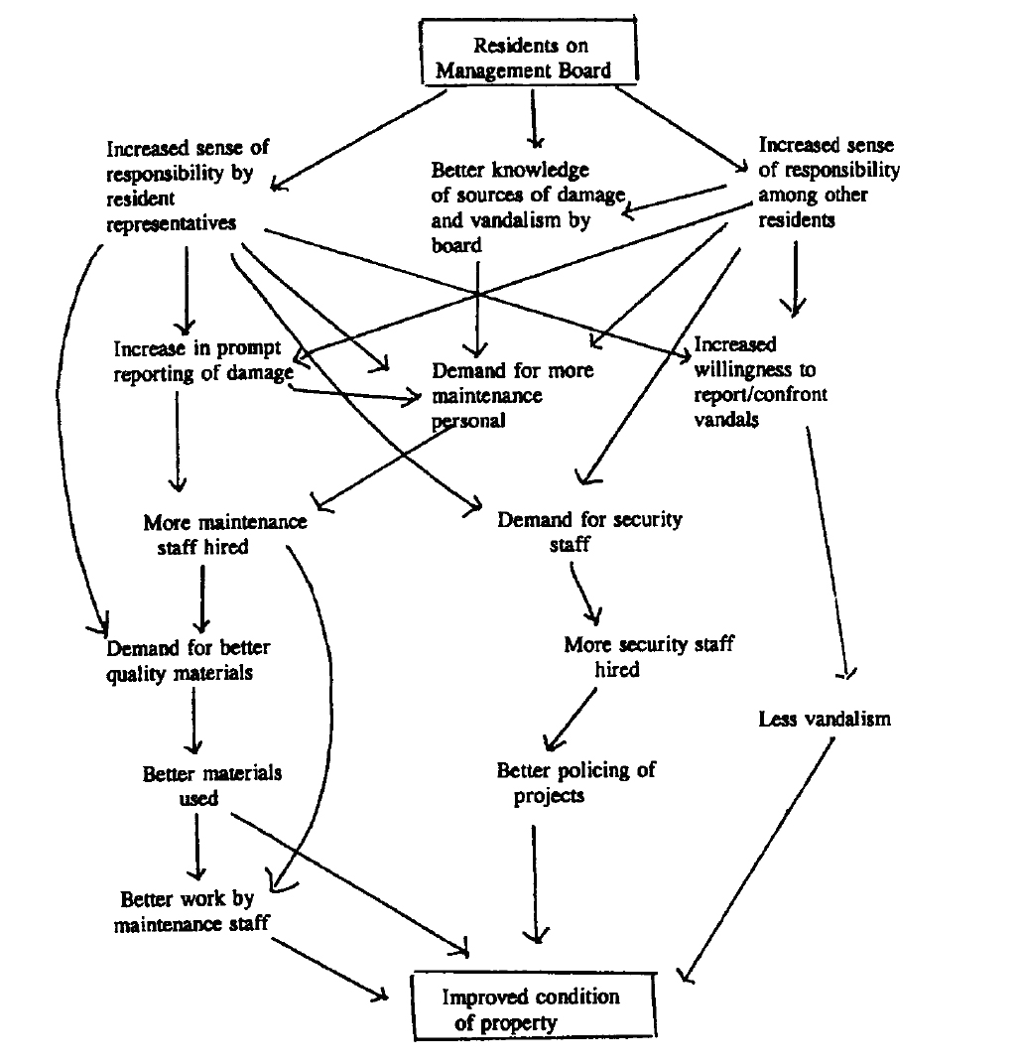

Slide 38


Slide 40
Keep in Mind
This TOC, as unwieldy as it is, doesn’t begin to articulate all the conditions that might be critical to the success of the project.
If, after a year, the property doesn’t improve, it’s unlikely the TOC will indicate how to fix the intervention.
We can imagine many scenarios in which the property improves but for none of the reasons outlined in the TOC!

Slide 41
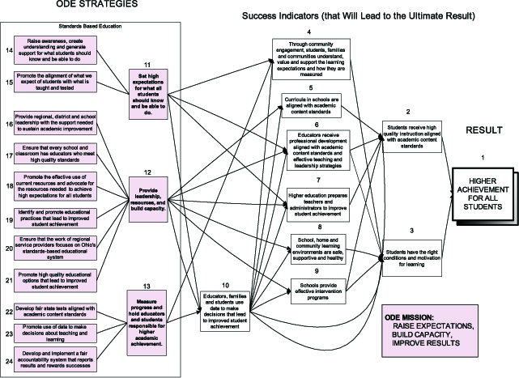

Slide 42


Slide 43
Plausibility Test

Slide 44
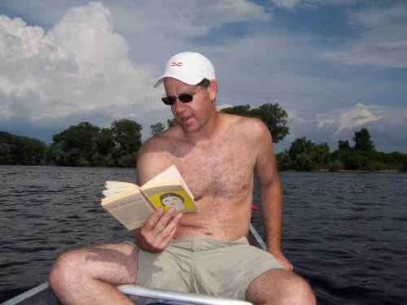


➔

Slide 45


Slide 46
Try This At Home
Don’t request a separate theory of change. Read the proposal carefully and/or ask appropriate questions during the site visit, then simply apply the Plausibility Test.
Ask yourself this question: What, beyond what’s stated in the proposal, do I believe a theory of change will buy me?
If you must ask applicants to articulate a theory of change, encourage them to keep it simple.

Slide 47
“The Power of Theories of Change” Spring 2010

Slide 48
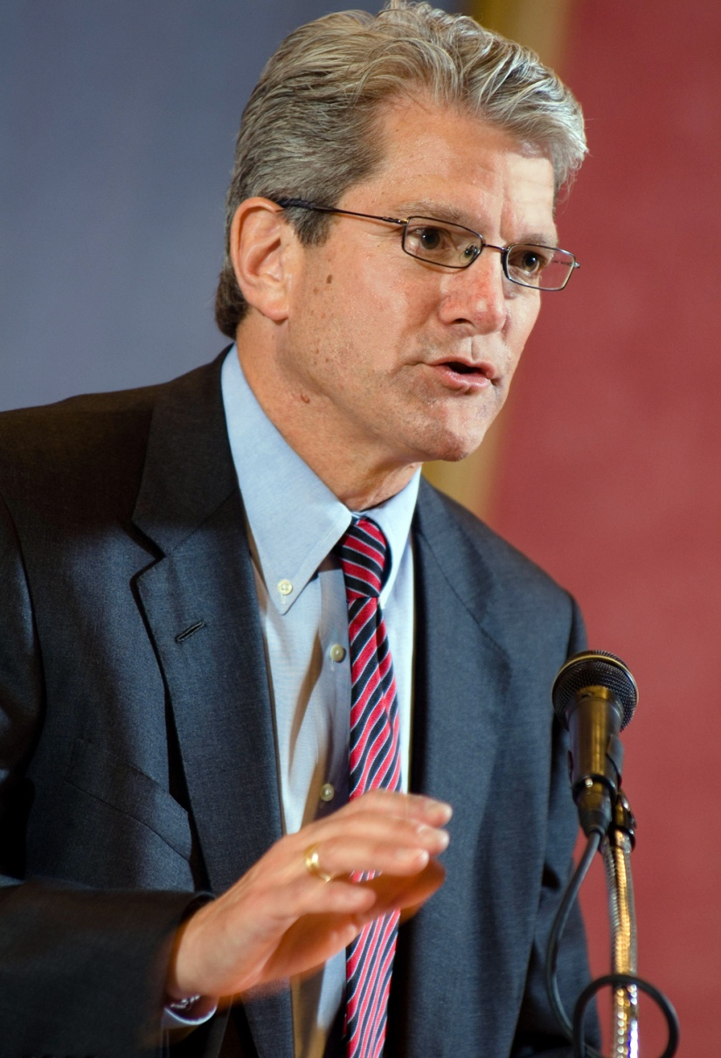
“Schambra … argue[s] that funders … should trust an organization’s leaders without requiring them to articulate theories of change …”
— Paul Brest
Bill Schambra, Hudson Institute

Slide 49
Funding a brilliant nonprofit leader who has produced spectacular results in the past →
Spectacular results from him/her in the future

Slide 50
Thank You!

Slide 51
Philanthropy’s Albatross
Debunking Theories of Change
http://postcards.typepad.com/Philanthropy%20s%20Albatross.doc
albert@gnof.org

Slide 53


Slide 54
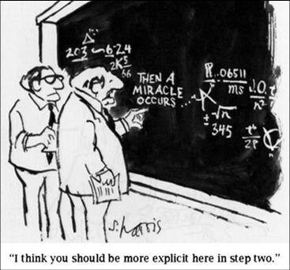

Slide 55
Creating a park within walking distance of neighborhood residents →
Residents’ use of the park →
Better health outcomes for residents

Slide 56
Creating a park within walking distance of neighborhood residents →
Residents’ use of the park →
Better health outcomes for residents

Slide 57
Every time I’ve given nonprofit leader X a grant and simply asked her to spend it wisely to make the world a better place, she has succeeded beyond my expectations.
I will give nonprofit leader X a grant and ask her to spend it wisely to make the world a better place.
____________________________________
Therefore, nonprofit leader X will likely succeed beyond my expectations.

Slide 58
Keep in Mind
This TOC, as unwieldy as it is, doesn’t begin to articulate all the underlying beliefs and conditions that might be critical to the success of the project.

Slide 60
A → B
1. If A, then B
2. A
3. Therefore B

Slide 61
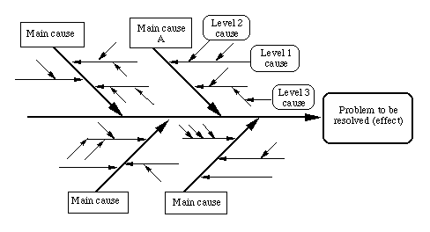
A → B → C … → OUTCOME

Slide 62
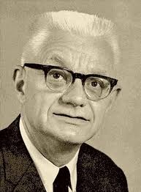
Carl Gustav Hempel
1905 – 1997

Slide 63
Giving a child a caring adult mentor →
An increase in that child’s sense of self-worth
If a child is given a caring adult mentor, then his/her sense of self-worth will increase.
My program will provide child A with a caring adult mentor.
_____________________________________
Therefore, child A’s sense of self-worth will likely increase.

Slide 64
If we create a park within walking distance of neighborhood homes, and residents participate in the design of the park, and the city commits to its upkeep, then residents will use the park.
Our organization will create a park within walking distance of neighborhood homes, residents will participate in the design of the park, and the city will commit to its upkeep.
__________________________________________
Therefore, residents will use the park.

Slide 65
If we create a park within walking distance of neighborhood homes, and residents participate in the design of the park, and the city commits to its upkeep, and residents feel safe in the park, then residents will use the park.
Our organization will create a park within walking distance of neighborhood homes , residents will participate in the design of the park, the city will commit to its upkeep, and we’ll take steps to ensure that residents feel safe in the park.
__________________________________________
Therefore, residents will use the park.

Slide 66
If we create a park within walking distance of neighborhood homes, and residents participate in the design of the park, and the city commits to its upkeep, and residents feel safe in the park, and residents feel safe walking from their homes to the park , then residents will use the park.
Our organization will create a park within walking distance of neighborhood homes , etc.
__________________________________________
Therefore, residents will use the park.

