Slide 1
Learning a common language
Humanity
How NDE loads our code, and how the LIBIS flavour of customModule makes it easier to speak.
LIBIS · KU Leuven
Taipei · October 2026
Notes:
Welcome. Before we talk about code, I want to tell you a story about language. We created our own flavour of the customModule. I'll explain in an hour how NDE boots, the different building blocks of our customModule. Ask questions any time. I am not a native English speaker I will be using simple English. If a word is unclear, raise your hand.

Slide 2

Understanding starts with a common language.
DENIS VILLENEUVE, 2016
https://www.scribd.com/document/781617351/Copia-de-An-Analysis-of-Heptapod-B
https://en.wikipedia.org/wiki/Arrival_(film)
Based on Story of Your Life, a short story by Ted Chiang.
NDE customModule · Taipei
Notes:
Who has seen Arrival? [Ask for hands] Twelve alien ships land on Earth. Nobody understands them. A linguist, Louise Banks, is asked to learn their language. The whole film is about one idea: before you can work together, you need a common language. That is also the idea of this talk.

Slide 3


Notes:
A small confession: I love science fiction from the 1940s to the 1960s. Although the special effects are simple they contain a form of not knowing or naivity that still exists today in this kind of movies.

Slide 4
When something new arrives
HUMAN NATURE
1
2
3
We are afraid
We fight it
We learn it
Everything alien or unknown feels like danger, even when it comes to help us.
We throw everything we have at it, until someone says: hold on.
"Let us get to know them first." Learning the language changes everything.
NDE customModule · Taipei
Notes:
In the film Arrival, the world reacts in three steps. First fear: the aliens are unknown, so they must be dangerous. Then force: armies get ready, countries stop talking to each other. And then one person says: wait, let us learn to know them first. I think we do the same with new technology. The perfect example is AI we have been talking about it for some time. First some of us were reluctant to use it then we saw its benefits and now you can not afford to ignore it. When NDE arrived, many of us were a bit afraid. Angular? Module Federation? We choose to fight it and I'm not an exception. For me personally the timing is wrong the technology stack wrong and yes it will always have issues but so does your favourite AI stack but you are still using it. Let us take some steps together.

Slide 5
Science fiction has told it before
AN OLD STORY
1951
2016
The Day the Earth Stood Still
Arrival
A visitor lands in peace, and is met with guns.
Visitors land with a gift, and we almost miss it.
Sixty-five years apart. The lesson is the same.
NDE customModule · Taipei
Notes:
In The Day the Earth Stood Still (1951), Klaatu lands in Washington with a message of peace, and the first thing that happens is a soldier shoots him. Sixty-five years later, Arrival tells the same story with better special effects. The lesson did not change: fear first, understanding later. Let us try to do it in the other order.

Slide 6
We want to know how the world works
BUT WE ARE ALSO CURIOUS
What?
Why?
Who?
Where?
What is NDE made of?
Why does it work this way?
Who controls each part?
Where does our code run?
Today we answer these four questions for NDE.
NDE customModule · Taipei
Notes:
Fear is only half of human nature. The other half is curiosity. We want to know what, why, who and where. In Arrival, Louise starts with the simplest words: her name, "human", "walk". We will do the same: start small and simple, and build up.

Slide 7
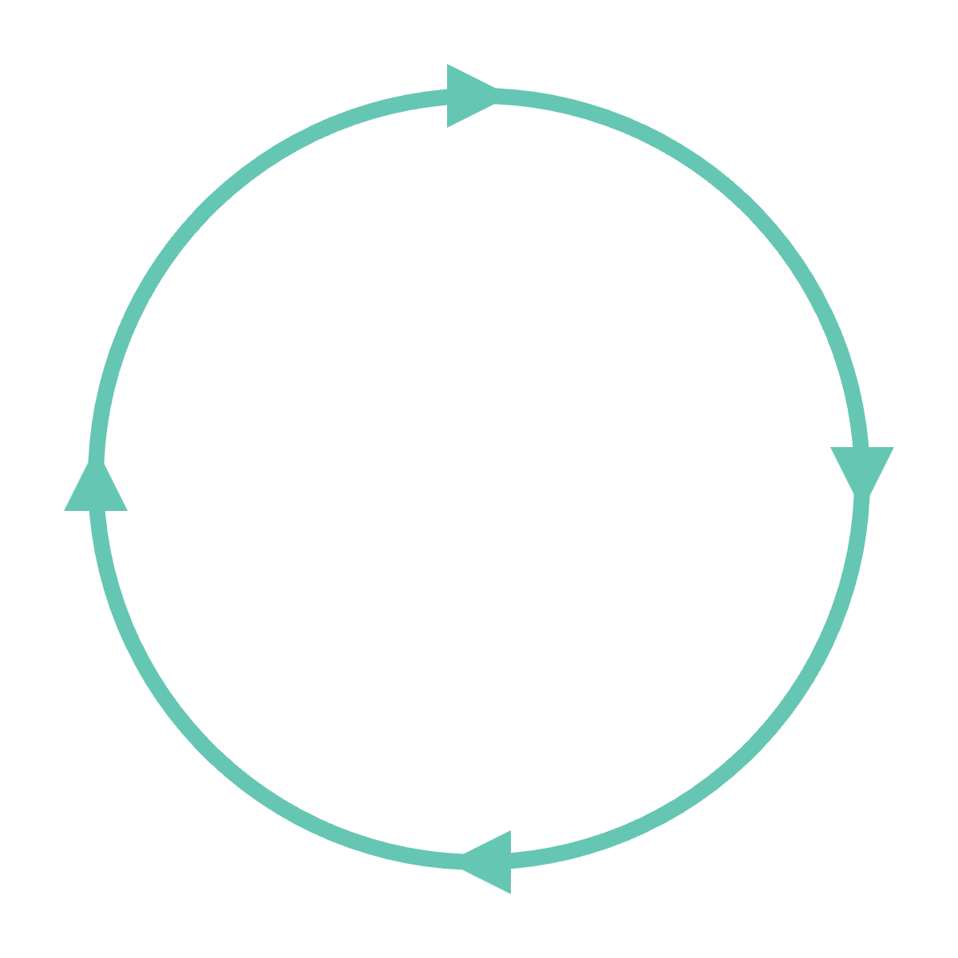
Software is a circle, not a line
A NON-LINEAR LANGUAGE
The heptapods write a whole sentence at once, as a circle. Building software is the same: we plan from start to end, but the world keeps moving around us.
Plan
Angular 18 → 19 → 20
Library upgrades
New NDE releases
World changes
Build
New user needs
Release
NDE customModule · Taipei
Notes:
The heptapod language is non-linear. They write a full sentence as one circle; they know the end when they start. We are not heptapods. We think we have everything planned, but then Angular has a new version, a library we use changes, Clarivate ships a new NDE release. Willing or unwilling, our software must move with the world. That made us think what can we do to ease the pain when problems are identified that need a more drastic fix. That is the goal of our flavour of the customModule.

Slide 8
Here we speak English. In code we speak NDE.
OUR COMMON LANGUAGE
TypeScript
Angular
Module Federation
JavaScript with types.
The framework NDE is built with.
Loads our code into NDE at runtime.
RxJS
NgRx
Webpack
Streams of data over time.
One shared store for app state.
Builds and packages it all.
A lot to ask from a newcomer. Like learning Mandarin in a week.
NDE customModule · Taipei
Notes:
At this conference we have a common language: English. Most of us are not native speakers, and that is fine. In code, NDE is the common language. It forces us to think and build in a certain way. And that language is built from many smaller languages: TypeScript, Angular, Module Federation, RxJS, NgRx, Webpack. For a newcomer, that is a lot. It is a bit like arriving in Taipei and being asked to read Mandarin in a week. Our customModule tries to be a phrase book.
Words:
TypeScript: JavaScript with types, so many mistakes show up before the code runs.
Angular: a framework from Google for building web applications out of components.
Module Federation: a Webpack feature to load code from another, separately built application while the page runs.
RxJS: a library for streams: values that arrive one after another over time.
NgRx: one central store that holds the state of the application (user, search results, filters).
Webpack: the tool that turns all our source files into a few files the browser can load.
runtime: the moment the code runs in the browser, not when we build it.

Slide 9
"Let us table this."
SAME WORD, DIFFERENT WEIGHT
IN BRITISH ENGLISH
IN AMERICAN ENGLISH
Discuss it now
Do not discuss it now
Our world has the same problem. A view in Alma is a Primo configuration. A view in Angular is a piece of the screen. Same word, different meaning.
NDE customModule · Taipei
Notes:
Even with one common language, words carry different weight. A simple example: "let us table this". In a British meeting it means: put it on the table, discuss it now. In an American meeting it means the opposite: put it aside for later. Same language, same words, opposite action. Translation is easy; context is hard. In our field it happens too: "view", "component", "module" all mean something different to a librarian, an Alma admin and an Angular developer. So today, when I use such a word, I will say which meaning I use.

Slide 10
One starter kit, two flavours
CUSTOMMODULE
THE ORIGINAL
OUR FLAVOUR
ExLibrisGroup / customModule
libis / NDE_customModule
The official starter kit from Clarivate. A clean, minimal base to build NDE components.
Same base, organised in the way we find more logical for a network of many views.
github.com/ExLibrisGroup/customModule
github.com/libis/NDE_customModule (branch LIBIS)
NDE customModule · Taipei
Notes:
There are two flavours. The original from Clarivate is a minimal starter: an Angular app with Module Federation, an empty component map and build scripts. Our flavour, on the LIBIS branch, starts from the same base. It is not "better", it is organised differently: in the way we find more logical for LIBISnet, where one network serves many institutions and views. Two examples on the next slides: one file for all configuration, and a proxy that tells you where every file comes from. The other choices, like the registry, interceptors and shared state, come later in the talk.

Slide 11
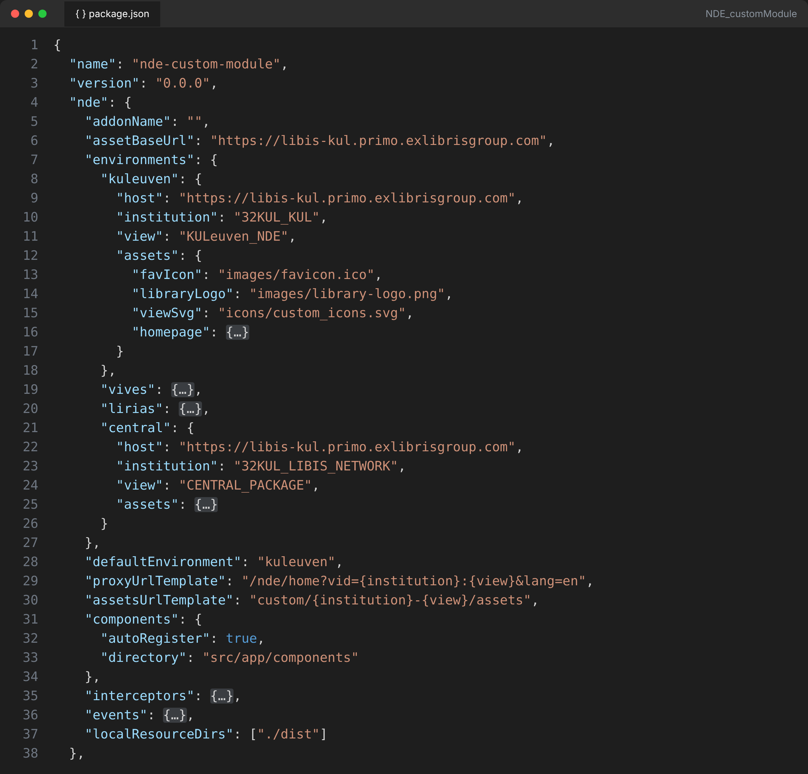
package.json holds all the configuration
OUR CHOICE 1 · CONFIGURATION
environments
Every view and the central package: host, institution, view, assets.
defaultEnvironment
What the proxy and build use when you name nothing.
components · interceptors · events
Which folders are scanned and auto-registered.
One file to read, one file to review. No .env files, no hidden settings.
NDE customModule · Taipei
Notes:
Our flavour is not "better". We organised it in the way that we find more logical. The first choice: one place for all configuration, the "nde" block in package.json. That is the first thing a curious developer opens anyway. Every environment is listed: each view of the network and the central package(we are a consortium), with host, institution, view and its assets. defaultEnvironment says what to use when you do not name one. The URL templates build the proxy URL and the asset path. And three blocks say which folders are scanned for components, interceptors and events. The build, the proxy, and even primo-alpine read this same file. When a new colleague asks "where is this configured?", the answer is always the same.
Words:
package.json: the standard file in every JavaScript project that lists its name, scripts and dependencies.
environment: one Primo view we work against, with its host, institution and view code.

Slide 12
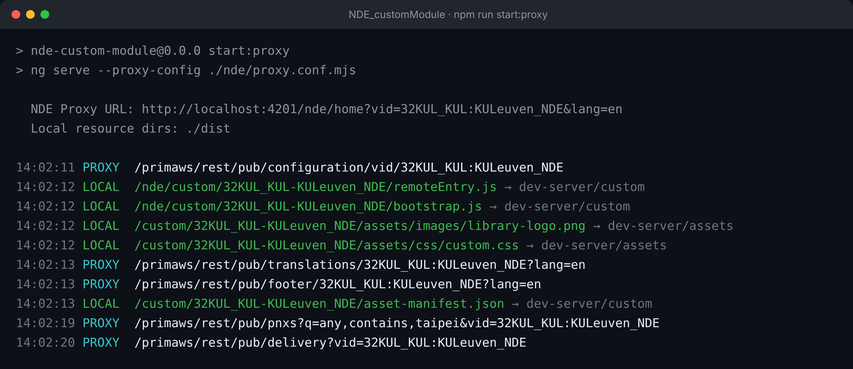
Every request, one line, one colour
OUR CHOICE 2 · THE PROXY TALKS
LOCAL
From your disk: our module, our assets.
PROXY
From Primo: config, search, delivery.
Is my logo coming from my laptop or from Alma? Read one line and you know.
NDE customModule · Taipei
Notes:
Second choice: the proxy tells you what it does. npm run start:proxy prints one line per request. Green LOCAL: the file came from your own machine, the dev server or src/assets, and the arrow says from where. Cyan PROXY: the request went to Primo, for example the view configuration, translations or a search. The most common question during development is "why do I not see my change?". With these logs you see at once if the browser got your file or the one on the server. The asset-manifest.json is also answered locally, merged from Primo, dist and src/assets.
Words:
proxy: a program in the middle: the browser asks it, and it answers from our disk or forwards the question to Primo.
dev server: a small local web server that rebuilds our code every time we save a file.

Slide 13
Seven words to learn today
OUR PHRASE BOOK
1
2
3
4
Boot process
Module Federation
Components
custom.js and manifest
How NDE starts
Host, remote, add-on
Angular and NDEComponent
The small files
5
6
7
Interceptors
Shared State
Primo Alpine
Change data on the fly
Read and change safely
No Angular needed
NDE customModule · Taipei
Notes:
This is our plan for the rest of the hour. Seven words of our phrase book. We start with the boot process, because everything else makes sense once you know when each piece is loaded. Number 7, Primo Alpine, is for people who want results without learning Angular first.

Slide 14

From one click to our component
BOOT PROCESS
1 Host starts
2 Config
3 Assets
4 Our module
5 Inject
Browser
NDE host (shell)
Alma configuration API
User opens Primo
Built by Clarivate
View settings and add-ons
Angular app
Owns the NgRx store
Customization package
Has slots like nde-search-bar
custom.css · custom.js · asset-manifest.json
The page
Slots where our components appear
Our custom module
remoteEntry.js · our components
Five phases. Watch the green dot: it shows where the work happens.
NDE customModule · Taipei
Notes:
Here are all the actors. On the left: the browser and the page. In the middle: the NDE host, the shell. Clarivate builds it and runs it. On the right: what the host reads. The Alma configuration, the customization package with custom.css, custom.js and the asset manifest, and our custom module. The green dot shows where the work happens in each phase. Let us follow it.
Words:
host: the main application that loads other code; here NDE itself.
remote: code that is built separately and loaded by the host; here our custom module.
slot: a named place in the NDE page where our component can appear.
asset: a static file like an image, a CSS file or an icon.

Slide 15

The host starts
BOOT PROCESS · PHASE 1
1 Host starts
2 Config
3 Assets
4 Our module
5 Inject
Browser
load
NDE host (shell)
Alma configuration API
User opens Primo
Built by Clarivate
View settings and add-ons
Angular app
Owns the NgRx store
Customization package
The page
Has slots like nde-search-bar
custom.css · custom.js · asset-manifest.json
Slots where our components appear
Our custom module
remoteEntry.js · our components
1. The browser loads NDE. The host starts Angular and creates the NgRx store.
NDE customModule · Taipei
Notes:
Phase 1. The browser loads index.html. main.ts does a dynamic import of bootstrap. The host reads a small config (CENTRAL_CODE.txt) and bootstraps its AppModule as the "shell". It creates the NgRx stores: search, user, view config, filters and more. Nothing of ours runs yet.
Words:
bootstrap: starting up an application, step by step.
dynamic import: loading a piece of code only when it is needed, not at the start.

Slide 16

The host asks Alma for the view
BOOT PROCESS · PHASE 2
1 Host starts
2 Config
3 Assets
4 Our module
5 Inject
Browser
NDE host (shell)
config
Alma configuration API
User opens Primo
Built by Clarivate
View settings and add-ons
Angular app
Owns the NgRx store
Customization package
Has slots like nde-search-bar
custom.css · custom.js · asset-manifest.json
The page
Slots where our components appear
Our custom module
remoteEntry.js · our components
2. GET /primaws/rest/pub/configuration/vid/{vid}: settings, add-ons, customization.
NDE customModule · Taipei
Notes:
Phase 2. AppInitService calls the Alma configuration API for this view. The answer contains everything the view needs: settings, the list of add-ons (ndeAddons), and the customization block. In proxy mode, our proxy merges the "customization" block from package.json into this answer, so you can test a new logo without changing Alma.
Words:
API: a fixed way for programs to ask each other for data, here over HTTP.
vid: the view id, for example 32KUL_KUL:KULeuven_NDE.

Slide 17
The host loads our assets
BOOT PROCESS · PHASE 3
1 Host starts
2 Config
3 Assets
4 Our module
5 Inject
Browser
NDE host (shell)
Alma configuration API
User opens Primo
Built by Clarivate
View settings and add-ons
Angular app
Owns the NgRx store
Customization package
Has slots like nde-search-bar
assets
The page
custom.css · custom.js · asset-manifest.json
Slots where our components appear
Our custom module
remoteEntry.js · our components
3. custom.css, custom.js, favicon. Fallback: our view, then the central package, then the default.
NDE customModule · Taipei
Notes:
Phase 3. The host loads custom.css, custom.js and the favicon. It looks in three places, in order: custom/{institution-view}/, then custom/{network}-CENTRAL_PACKAGE/, then the default. That is why a central package for a whole network works: a view only needs to override what is different. Remember this moment: custom.js runs here, before our Angular module exists.
Words:
fallback: the next place to look when a file is not found in the first place.

Slide 18
The host loads our module
BOOT PROCESS · PHASE 4
1 Host starts
2 Config
3 Assets
4 Our module
5 Inject
Browser
NDE host (shell)
Alma configuration API
User opens Primo
Built by Clarivate
View settings and add-ons
Angular app
Owns the NgRx store
Customization package
Has slots like nde-search-bar
custom.css · custom.js · asset-manifest.json
The page
Slots where our components appear
load
Our custom module
remoteEntry.js · our components
4. Fetch remoteEntry.js, share Angular, RxJS and NgRx, then call bootstrapRemoteApp.
NDE customModule · Taipei
Notes:
Phase 4: Module Federation. The LookupService finds remoteEntry.js. The host calls __webpack_init_sharing__, then container.init with the shared scope, so Angular, RxJS and NgRx are shared, not loaded twice. Then container.get('./custom-module') returns bootstrapRemoteApp. The host calls it and gives us its Store, TranslateService and router. Our bootstrap.ts runs here. In the LIBIS flavour its very first line installs the global HTTP interceptor.
Words:
remoteEntry.js: the small file a remote publishes; it tells the host what the remote offers.
shared scope: the list of libraries that host and remote agree to use together, only one copy.
interceptor: code that sits between the application and the server and can look at or change requests and responses.

Slide 19

Our components join the page
BOOT PROCESS · PHASE 5
1 Host starts
2 Config
3 Assets
4 Our module
5 Inject
Browser
NDE host (shell)
Alma configuration API
User opens Primo
Built by Clarivate
View settings and add-ons
Angular app
Owns the NgRx store
Customization package
Has slots like nde-search-bar
custom.css · custom.js · asset-manifest.json
The page
Slots where our components appear
inject
Our custom module
remoteEntry.js · our components
5. Our components become web components. The host places them in its slots.
NDE customModule · Taipei
Notes:
Phase 5. Our module bootstraps as a "microfrontend": it shares NgZone and the platform with the host. In ngDoBootstrap every component in the registry is turned into a web component with createCustomElement. The host's BaseCustomDirective scans each NDE slot, asks our module for a matching name, defines the custom element and puts it in the page. The name decides the place: nde-search-bar replaces, nde-search-bar-before and -after go next to it, -top and -bottom go inside.
Words:
web component: a custom HTML tag, a browser standard, that works in any page.
NgZone: the part of Angular that notices when something happened and the screen must update.

Slide 20
Zoom in on phase 4
MODULE FEDERATION
HOST
REMOTE
NDE shell
Our custom module
Decides when and where to load
remoteEntry.js
Exposes ./custom-module
Gives us Store, translations, router
Returns bootstrapRemoteApp
Owns the slots
Brings our components
Shared, one copy:
Angular · RxJS · NgRx store · ngx-translate
NDE customModule · Taipei
Notes:
Let us zoom in on phase 4. Two applications, built separately, by different teams, at different times. At runtime they meet in one page. The host loads our remoteEntry.js, we give back a function, and the host calls it. Below: the libraries both sides share as singletons. Because of this, the NgRx store we see is the same object as the host's store. That is the basis for Primo Shared State we created. Words: singleton: there is exactly one copy, used by everybody.

Slide 21
Load code built by someone else, while the page runs
MODULE FEDERATION · WHAT IS IT?
THINK OF THIS CONFERENCE
IN NDE
The organisers give the room, the stage and the microphone. Each speaker brings a talk. Nobody rebuilds the room for one talk.
Host = the room: NDE.
Remote = the talk: our module.
Shared = the microphone: Angular, RxJS, NgRx.
NDE customModule · Taipei
Notes:
Module Federation is a Webpack feature. It lets one application load code from another application at runtime, in the browser, even if they were built separately. Think of this conference. The organisers provide the room, the stage, the microphone and the schedule. Each speaker brings only a talk. NDE is the room. Our custom module is the talk. Angular, RxJS and NgRx are the microphone: shared, only one copy, so we do not each bring our own.

Slide 22
Our side of the contract
MODULE FEDERATION · HOW NDE USES IT
new ModuleFederationPlugin({
name: 'CustomModule',
filename: 'remoteEntry.js',
exposes: {
'./custom-module': './src/bootstrap.ts'
},
shared: share({
'@angular/core': { requiredVersion: 'auto' },
'rxjs': { requiredVersion: 'auto' },
'@ngrx/store': { singleton: true },
...
})
})
remoteEntry.js
The menu: what we offer.
exposes
The one door NDE knocks on. The central build exposes ./CustomModuleCentral.
shared
Use the host's copy. Singleton: one store for both.
NDE customModule · Taipei
Notes:
This is the real config from webpack.config.js, shortened. Three words to remember. remoteEntry.js is the menu: a small file that tells the host what we offer. exposes is the door: NDE always knocks on ./custom-module for a view package; our central build uses ./CustomModuleCentral. shared says: do not bring your own Angular, use the host's. For @ngrx/store and ngx-translate we say singleton: there must be exactly one. A host is the app that loads; a remote is the app that is loaded. NDE is the host, we are the remote.
Words:
exposes: the list of things a remote makes available to a host.
requiredVersion: which version of a shared library the remote expects.

Slide 23
Know where your power ends
MODULE FEDERATION · WHO CONTROLS WHAT
CLARIVATE CONTROLS
WE CONTROL
The host app and its release dates
The Angular version we must follow
Which slots exist (nde-*)
The shape of the NgRx state
Security rules (CSP) and the config API
Our components and where they go
custom.css, custom.js and assets
What we do with HTTP traffic
Which views get which features
Where our add-ons are hosted
NDE customModule · Taipei
Notes:
This slide saves a lot of frustration. Clarivate owns the host: its release schedule, the Angular version, the list of slots, the internal state shape, the Content Security Policy and the configuration API. When they upgrade Angular, we must follow. We own everything on the right. Good design means: depend as little as possible on the left column, and when you must, put that dependency in one place. That is exactly why primo-shared-state exists.
Words:
CSP: Content Security Policy: browser rules that say which scripts and servers a page may use.

Slide 24
The pitfalls of Module Federation
LESSONS FROM PRACTICE
1 · Primo does not wait
2 · Two remotes, two pipelines
3 · Tag names are a contract
NDE customModule · Taipei
Notes:
Module Federation is powerful, but you are a guest in someone else's house. We just saw who controls what. Here is what that means in practice: three things surprised us while building our own custom module. The first one is the most important: Primo does not wait for our code. Then two smaller ones: the central package has its own build pipeline, and the host's tag names are a contract we do not control.

Slide 25
Primo does not wait for remotes
PITFALL 1
Primo bootstraps first
Remotes load asynchronously
Primo starts its own API calls right away
Our code, including our HTTP interceptor, exists only after our bundle loads
CONSEQUENCE
The first request on a page load can never be intercepted.
NDE customModule · Taipei
Notes:
This is the main pitfall. Remember the boot animation: the host starts, gets its config, loads assets, and only then loads our module. But Primo does not stop and wait for us. As soon as it can, it starts its own API calls. In our flavour we have a global HTTP interceptor: it can change API responses, for example search results, before Primo reads them. We look at it in detail later. It is installed in the first line of our bootstrap.ts, but that file is only loaded in phase 4. So anything Primo asks before that moment, we never see. Words: asynchronous: started now, finished later; the program does not wait for it. bundle: one JavaScript file made by Webpack from many source files.

Slide 26
A race we lose by 60 ms
PITFALL 1 · MEASURED ON /NDE/SEARCH?QUERY=…
PRIMO (HOST)
GET /pnxs in flight
15.70 s
in the store
OUR REMOTE
remoteEntry.js and our bundle loading
15.76 s
interceptor ready
14.52 s first /pnxs request and remoteEntry.js start together
response first, interceptor 60 ms later
14.0 s
14.5 s
15.0 s
15.5 s
16.0 s
The first results are already in NgRx before our interceptor exists. They show unchanged.
NDE customModule · Taipei
Notes:
These are real numbers, measured on a direct search URL, times from the start of the page. At 14.52 seconds Primo fires its first /pnxs search request, and at exactly the same moment it starts loading our remoteEntry.js. At 15.70 seconds the search response is back and Primo puts it in its NgRx store. At 15.76 seconds our bundle with the interceptor has just finished loading. We lose the race by about 60 milliseconds. On a slower network or a bigger bundle we lose it by more. The orange band is the gap. Later searches, made from the search bar, are intercepted fine, because by then we are loaded.
Words:
race condition: two things run at the same time, and the result depends on which one finishes first.

Slide 27
Every first request of a page load
PITFALL 1 · WHO IS AFFECTED
NOT INTERCEPTED
INTERCEPTED FINE
Direct links to a search
Bookmarks
Page refresh
Anything Primo fetches during bootstrap
A new search from the search bar
Anything after our module loaded
NDE customModule · Taipei
Notes:
So who sees the problem? Everyone who arrives on a page with work already to do: a shared link to a search, a bookmark, a refresh. Also everything Primo fetches during its own bootstrap. Once the page is running, the user searches from the search bar, and from then on every request goes through our interceptor. That is why a test looks perfect if you start from the home page, and broken if you paste a search URL.

Slide 28
Workarounds, each with a price
PITFALL 1 · WHAT WE TRIED
Re-run the search
Rewrite the store
Full record view
Our interceptor logs every recordid it changes. Unseen records in the store? Call primo.search.search(currentParams).
Dispatch searchSuccessAction with modified docs. No extra request.
Opened directly, it loads one record, not a search.
Price: Primo's delivery effect runs again for every record. Documented as risky for remotes.
Price: neither workaround covers it.
Price: a second /pnxs request and a flash of unchanged results.
Everything a remote can do is a workaround. The timing is decided by the host.
NDE customModule · Taipei
Notes:
What did we try? Our test case was an interceptor that reverses every string in the search results, so you see at once whether a result was changed. First: detect and re-run. Our interceptor remembers every recordid it changed. When the module is loaded and the first results in the store were never seen, we call primo.search.search with the current parameters. It works, but it costs a second /pnxs request, and the user sees the unchanged results flash before the changed ones arrive. Second: rewrite the store directly by dispatching searchSuccessAction with modified docs. No extra request, but Primo's delivery effect listens to that action and runs again for every record, and primo-shared-state, the library we introduce later, documents this action as risky for remotes. Third: a full record view opened directly loads one record, not a search, so neither trick covers it. Conclusion: whatever a remote does here is a workaround. The host decides the timing.
Words:
dispatch: send an action to the store.
action: a message to the store that says what happened, for example 'search succeeded'.
effect: code that the store runs after an action, for example a call to the server.

Slide 29
Only the host can fix the timing
PITFALL 1 · THE REAL FIX
OPTION A
OPTION B
Wait for remotes
An official hook
Primo waits for custom-module remotes, or for an opt-in "blocking" remote, before its first API calls.
A request/response hook that is registered before Primo's first request.
NDE customModule · Taipei
Ex Libris side
Notes:
The real fix is on the Clarivate side, and there are two clean options. Option A: Primo waits for the custom-module remotes before it starts its first API calls. To keep Primo fast for everybody, this could be opt-in: a remote that declares itself "blocking". Option B: an official hook for requests and responses, which Primo registers before its first request, so our code can be plugged in even if our bundle is still loading. Either one would make interceptors like ours reliable, and would remove a whole class of workarounds. This is something we as a community can ask for, through IGeLU.

Slide 30
Two remotes, two build pipelines
PITFALL 2
View package
Dev server · recompiles on save
OUR ANSWER
"nde": {
"centralPackage": false
}
Central package
Static dist/ or production · no recompile
Separate remote, separate build
Named in the view's CENTRAL_CODE.txt
Edits to central components do not show up
It can silently fall back to the production version
Central components are built into the view. Everything comes from one dev server.
NDE customModule · Taipei
Notes:
Second pitfall, smaller but painful. A view can use two remotes: its own view package, and a shared central package named in CENTRAL_CODE.txt. They are separate remotes with separate builds. In local development the dev server only serves the view package. The proxy serves the central package from a static dist folder, or even from production. So you edit a central component, save, and nothing changes. Worse, it can quietly fall back to the production version, and you debug old code. Our answer is one setting in package.json, centralPackage false: the central package is switched off and central components are built into the view, so everything comes from one dev server and recompiles on save.

Slide 31

The host's tag names are your contract
PITFALL 3
BEFORE
AFTER A PRIMO RELEASE
nde-search-bar
nde-search-bar-container
nde-search-bar-after renders
nde-search-bar-after: no error, just gone
TIP · CHECK AFTER EVERY RELEASE
Is the slot in the current Primo release? Inspect the DOM for -from-remote- elements:
[...document.querySelectorAll('*')].filter(e => e.localName.includes('-from-remote-'))
NDE customModule · Taipei
Notes:
Third pitfall. Our components attach to the host's tag names, for example nde-search-bar-container-after. That name is the contract, and we do not own it. In one release the host renamed nde-search-bar to nde-search-bar-container. Every component registered for nde-search-bar-after simply stopped rendering. No error, no warning, nothing in the console: it just does not appear. So after every Primo release, check that your slots still exist. A quick way: in DevTools, look for elements whose tag name contains -from-remote-; those are the components the host injected from a remote. If yours is missing, the slot name probably changed.
Words:
DOM: the tree of HTML elements the browser builds from the page.
DevTools: the developer tools in the browser, opened with F12.

Slide 32
Module Federation lets you add to the host app, but the host still decides when and where your code runs.
THE PITFALLS OF MODULE FEDERATION
NDE customModule · Taipei
Notes:
One sentence to remember from this part: Module Federation lets you add to the host app, but the host still decides when and where your code runs. When: the load order, pitfall 1. Where: the slots and the tag names, pitfall 3. Knowing this is part of speaking the common language.

Slide 33
An add-on is a separate remote
MODULE FEDERATION · ADD-ONS
Component
Add-on
EXAMPLE · THIRD IRON LIBKEY
Lives inside our package
Built and deployed by us
One per slot position
Its own remoteEntry.js, on its own server
Built by a vendor or community
Switched on in Alma, per view
Settings as JSON (max 5 KB)
Name: LibKey
URL: discovery-adapters.thirdiron.com/ primo-nde/production/
JSON: apiKey, libraryId, viewOption, ...
The vendor updates it. We only configure it.
NDE customModule · Taipei
Notes:
An add-on is also a Module Federation remote, but a separate one. It is not part of our customization package. A vendor, a consortium or the community builds it, hosts it, and updates it. In Alma, under Configuration, Discovery, Other, Add-on Configuration, you add a row: the add-on name, its URL, the views, and a JSON file with parameters, at most 5 KB. Example: Third Iron LibKey. The name must be exactly "LibKey". The URL is discovery-adapters.thirdiron.com/primo-nde/production/. The JSON holds your apiKey, libraryId and options like viewOption. Inside the add-on code, these parameters arrive through the MODULE_PARAMETERS injection token. In our flavour you build an add-on by setting addonName and assetBaseUrl in package.json.
Words:
add-on: a separate remote from a vendor or the community, switched on in Alma.
njection token: a name that Angular uses to look up a value, here the add-on settings.
JSON: a simple text format for data, with names and values.

Slide 34
Angular component or web component?
COMPONENTS
 | Angular component | Web component
What | Class + template + styles | A browser standard: custom element
Works in | An Angular app | Any page, any framework
Gets services | Dependency injection | Only what you give it
Tag name | Inside Angular templates | Registered with customElements.define
The bridge:
We write Angular components. @angular/elements wraps each one as a web component, so NDE can place it by name.
NDE customModule · Taipei
Notes:
Two words that sound alike. An Angular component is a TypeScript class with a template and styles; it only lives inside an Angular application and gets its services through dependency injection. A web component is a browser standard: a custom HTML tag that works on any page. NDE needs to place our code by tag name, so in ngDoBootstrap we call createCustomElement from @angular/elements. Our Angular component goes in, a web component comes out, still connected to our injector. Best of both worlds. Words: component: a piece of the screen with its own code, HTML and style. template: the HTML part of a component.
dependency injection: Angular gives a component the services it needs, so it does not have to create them itself.
injector: the part of Angular that creates and hands out those services.
service: a class with shared logic or data, used by many components.

Slide 35
@NDEComponent: one extra line
COMPONENTS · OUR WRAPPER
@NDEComponent({
selector: NDE_SLOTS.SEARCH_BAR,
position: 'after',
viewPattern: /KULeuven/,
priority: 10
})
@Component({
selector: 'custom-hello-world',
standalone: true,
templateUrl: './hello-world.component.html'
})
export class HelloWorldComponent {}
Where
Slot and position
For whom
Views that match the regex
In which order
Lower number first (default 100)
NDE customModule · Taipei
Notes:
This is our wrapper. A normal Angular component, plus one decorator on top. @NDEComponent says where: the slot, from the NDE_SLOTS list, and the position. It says for whom: viewPattern is a regular expression on the view id; if it does not match, the component is simply not registered. And it says the order: priority, lower first, default 100. The decorator builds the full name, for example nde-search-bar-after, and puts the class in a registry. No mapping file to edit.
Words:
decorator: a label with @ above a class that adds extra information or behaviour.
regular expression: a short pattern to match text, for example /KULeuven/.
standalone: a component that does not need an Angular module around it.

Slide 36
One command, then write your HTML
COMPONENTS · HOW TO CREATE ONE
npm run nde -- generate component
hello-world
--target search-bar
--position after
--build_target kuleuven
POSITIONS
before → nde-search-bar-before
top → ...-top
nde-search-bar (replace)
No build_target? It goes to central: src/app/components/central/. A view name puts it in src/app/components/views/<view>/.
bottom → ...-bottom
after → nde-search-bar-after
NDE customModule · Taipei
Notes:
Creating a component is one command. Target is the slot, position is where, build_target is which package. Without build_target the component goes to central and is part of the network-wide package. With a view name it only goes into that view's package. On the right: the five positions. Replace takes the place of the original NDE element. Before and after are siblings. Top and bottom are inside, as first or last child. Live demo here if time allows.
Words:
CLI: command line interface: a program you use by typing commands in a terminal.
build target: which package we build: the central package or one view.

Slide 37

From a file on disk to a tag in NDE
COMPONENTS · HOW THE REGISTRY WORKS
1 · build time
2 · build time
3 · in the browser
4 · in the browser
5 · in the browser
Scan
Generate
Decorate
Collect
Wrap
A Webpack plugin walks the shared, central or view folder.
One import per *.component.ts in a generated mappings file.
Each import runs @NDEComponent. Wrong view? Not added.
Sorted by priority into selectorComponentMap.
Each entry becomes a web component. NDE asks by key.
THE KEY
SAME PATTERN EVERYWHERE
'nde-search-bar' + 'after'
→ nde-search-bar-after
@NDEEvent → events/_registry.ts
@NDEInterceptor → interceptors/_registry.ts
primo-alpine island → *.island.component.ts
NDE customModule · Taipei
Notes:
How does the registry work? Two halves. At build time: NdeComponentDiscoveryPlugin runs before every compilation. It walks src/app/components/shared, plus central for the central build or views/your-view for a view build. For every *.component.ts it writes one import line into a generated file, .nde/generated/.../customComponentMappings.ts, which webpack knows as @nde/component-mappings. In the browser: importing a file runs its decorators. @NDEComponent builds the key, slot plus position, for example nde-search-bar-after. It reads the vid from window.__BOOTSTRAP_CFG__ and checks viewPattern; if it does not match, the component is simply not added. Duplicate keys give a warning. getComponentRegistry() sorts by priority and returns the Map that app.module calls selectorComponentMap. In ngDoBootstrap each entry becomes a custom element, and when NDE finds a slot it asks getComponentRef(key). Events and interceptors use exactly the same idea with their own _registry.ts files, and primo-alpine generates one *.island.component.ts per island so the same plugin picks it up.
Words:
registry: a central list where every component writes its name and place.
import: a line that loads another file, so its code runs.
plugin: an extra piece that adds a feature to a tool, here to Webpack.

Slide 38
Less to remember, fewer mistakes
COMPONENTS · WHY A WRAPPER?
Automatic registry
One code base, many views
A Webpack plugin finds every *.component.ts. You never edit a mapping file.
viewPattern and build targets decide who gets what.
Safe names
Clear logs
NDE_SLOTS constants and a name check. A typo gives a warning, not silence.
Each registration prints name, slot, position and viewPattern.
NDE customModule · Taipei
Notes:
Why a wrapper? In the original, you add each component to customComponentMappings.ts by hand, with the exact selector string. Forget it, and nothing happens, no error. Our NdeComponentDiscoveryPlugin scans the component folder of the selected build target before each build and writes the imports for you. The decorator does the rest. viewPattern and build targets let one Git repository serve the central package and every view. NDE_SLOTS gives you names with autocomplete, and an invalid selector gives a warning in the console. The logs tell you exactly what was registered, which is the first thing you check when a component does not show up.

Slide 39
A plain script, loaded early
THE SMALL FILES · CUSTOM.JS
1 Host starts
2 Config
3 custom.js
4 Our module
5 Inject
What
Good for
Watch out
assets/js/custom.js. A classic script, not an ES module. No Angular.
Tracking snippets, third-party embeds, small global helpers, Primo Alpine.
It runs before our module and before the page is built. The element you want may not exist yet.
NDE customModule · Taipei
Notes:
custom.js is the oldest trick in the book. It lives in assets/js/custom.js and the host loads it in phase 3, with custom.css and the favicon, using the same fallback chain. It is a classic script, so no import statements and no Angular. Use it for small things: a tracking snippet, a chat widget, a global helper. Be careful with timing: it runs before our module and before NDE has drawn the page, so you often need a MutationObserver or an event to wait for elements. In our flavour, external scripts like Altmetric go through the Angular script loader instead, so we know when they are ready.
Words:
classic script: an old style script file; it cannot use import.
ES module: a modern JavaScript file that can import other files.
MutationObserver: a browser feature that tells you when the page changes.

Slide 40
The table of contents of our package
THE SMALL FILES · ASSET-MANIFEST.JSON
{
"files": [
"assets/custom.css",
"assets/images/logo.svg",
"remoteEntry.js",
...
],
"directories": [
"assets", "assets/images"
]
}
What
A list of every file and folder in the package, written at build time.
Why
The host reads it to know which custom files this package really has.
In proxy mode
Built on the fly: remote manifest + local dist + local src/assets.
NDE customModule · Taipei
Notes:
The manifest is the table of contents of our customization package: a JSON file with all files and folders. Postbuild writes it, sorted, every time we build. The host reads it to know which custom assets exist, for example whether this view has its own logo or should fall back to the central package. During development the proxy answers /custom/*/asset-manifest.json itself: it merges the remote manifest from Primo, our local dist folder and our src/assets folder, live on every request. So a new image in src/assets shows up without a rebuild. Tip: run a build once before start:proxy so dist exists.
Words:
manifest: a list of all files in a package.

Slide 41
Two houses, two sets of doors
INTERCEPTORS · THE PROBLEM
HOST INJECTOR
OUR INJECTOR
NDE HttpClient
Our HttpClient
Search /pnxs, login, delivery, config...
no view
Opening hours, Altmetric, our APIs...
Its interceptors see only host calls.
Our interceptors see only our calls.
Angular interceptors work per injector. Our module cannot see what NDE asks the server.
NDE customModule · Taipei
Notes:
Why do we need something special? In Module Federation, host and remote share the page but have separate Angular injector trees. Angular's HTTP_INTERCEPTORS are registered in an injector, so ours only see requests from our own HttpClient. They never see the host's calls: the search to /primaws/rest/pub/pnxs, the login, the delivery lookups. But that is exactly the data we often want to change.
Words:
HTTP request: a question from the browser to a server; the answer is the response.
HttpClient: Angular's tool to make HTTP requests.

Slide 42
Stand at the front door of the browser
INTERCEPTORS · OUR ANSWER
LAYER 1 · PLAIN TYPESCRIPT
LAYER 2 · ANGULAR
Patch XMLHttpRequest and fetch, the first line of bootstrap.ts.
GlobalHttpEventService turns them into RxJS streams.
Sees every call on the page. Buffers events until Angular is ready.
request$, response$, error$, all$
Decorator | Sees | Can
@NDEEvent | All traffic, host included | Observe, modify, block
@NDEInterceptor | Our own HttpClient calls | Classic Angular interceptor
NDE customModule · Taipei
Notes:
Our answer: do what Sentry and DataDog do. We patch XMLHttpRequest and window.fetch at the browser level, before Angular starts. It is the very first line of bootstrap.ts. All Angular HttpClient calls go through XHR in the end, so we see everything. Layer 1 has no Angular imports and keeps its state on window, so it is installed only once. It buffers events that happen before Angular is ready. Layer 2 is an Angular service that listens to those events and gives RxJS streams. On top we have two decorators. @NDEEvent for all traffic: observe, change requests and responses, or block. @NDEInterceptor for a classic Angular interceptor on our own calls. Both auto-register like components.
Words:
XMLHttpRequest and fetch: the two ways a browser can call a server from JavaScript.
patch: replace a built-in function with our own version that calls the original.
observable stream: values you can subscribe to; you get each new value when it arrives.

Slide 43

Change the data, and NDE does the rest
INTERCEPTORS · THE TRICK
@NDEEvent({
stream: 'response',
match: /delivery|pnxs/
})
export class SearchEvent extends NDEEventBase {
override onResponse(m, url, s, body) {
for (const doc of body.docs)
this.addHrefToIdentifiers(doc);
return body;
}
}
BEFORE
$$CDOI:$$V10.1000/xyz
AFTER
$$CDOI:$$V<a href="https://doi.org/...">
NDE shows a clickable DOI. No new component.
NDE customModule · Taipei
Notes:
Here is the trick I like most. A real example from our Lirias view. The search response contains identifiers like DOI, PMID and Scopus id as plain text. We want them as links. The normal way: replace the NDE component with our own. That is a lot of work and breaks on every NDE update. Instead, our SearchEvent listens to responses from /pnxs and /delivery, and changes the identifier text before the host reads it. The data enters the NgRx store already changed, and NDE renders the link itself. We make the UI think it must behave differently, and we save an extra component. The same file also rewrites creator fields with ORCID ids. Note the marker on each doc so we never process it twice.

Slide 44
One door to the host's memory
PRIMO SHARED STATE · WHAT IS IT?
Host and module share one NgRx store. @libis/primo-shared-state gives it typed, safe services.
search
filters
user
config
primo = inject(PrimoStateService);
docs = primo.search.allDocsSignal();
isLoggedIn$ = primo.user.selectIsLoggedIn$();
vid$ = primo.config.selectVid$();
primo.filters.clearAllFilters();
entity
account
Observable $
Signal
Promise
Safe dispatch
NDE customModule · Taipei
Notes:
Remember the singleton store from Module Federation? Host and module share exactly one NgRx store. That is the memory of NDE: the current user, the search results, the filters, the view config. @libis/primo-shared-state is our library on top of it. You inject one service, PrimoStateService, and reach six domains: search, filters, user, config, entity, account. Each read comes in three styles: an Observable ending in $, an Angular Signal, or a one-time Promise. For writing, there are typed dispatch helpers, only for actions that are safe.
Words:
Observable: a stream of values; the screen updates on each new value.
Signal: a value that Angular watches; when it changes, the screen updates.
Promise: a value you get one time, a little later.
selector: a small function that picks one piece out of the store.

Slide 45
Is the user logged in?
PRIMO SHARED STATE · WHY?
WITHOUT IT
WITH IT
createSelector(
createFeatureSelector('user'),
s => s.isLoggedIn)
primo.user
.isLoggedInSignal()
Typed, with autocomplete
Fixed in one place, for everybody
Only safe actions can be sent
You guess the state shape
It breaks quietly after an NDE release
Every component copies it
NDE customModule · Taipei
Notes:
A simple question: is the user logged in? Without the library you write raw NgRx selectors against a state shape you had to discover yourself. When Clarivate changes that shape in a release, your code does not crash, it just gets undefined, and you find out from a user. And every component has its own copy. With the library it is one call, typed. When NDE changes, we update the library once; all components follow. The library is regenerated from the host source for each NDE release, the version follows the release, for example 2026.10.1. And it is a safety gate: only 49 curated actions are exported, so you cannot dispatch something that corrupts the host state or triggers unwanted HTTP calls. That is the "who controls what" slide, put into code.

Slide 46
Not ready for the whole language? Start with a phrase book.
PRIMO ALPINE · WHAT IS IT?
jQuery style
Primo Alpine
Angular + NDEComponent
Find an element, change it
HTML islands, no Angular
Full power, steep curve
NDE customModule · Taipei
Notes:
Not everybody wants to learn TypeScript, Angular, RxJS and Module Federation to show a banner or a link. For them we have Primo Alpine. It is based on Alpine.js, a very small JavaScript framework where you write behaviour directly in HTML attributes. It feels a lot like jQuery: you stay close to the HTML. The bars show the learning curve: jQuery is easy but messy, Angular is powerful but steep, Alpine sits in between. Primo Alpine (github.com/libis/primo-alpine) builds on Alpine.js: you write "islands", small pieces of plain HTML, and they read host state through primo-shared-state, read-only. It works in the original customModule and in our flavour. Words: Alpine.js: a very small JavaScript framework where behaviour is written in HTML attributes. island: a small piece of HTML with Alpine behaviour, placed in an NDE slot.

Slide 47
Three commands to get started
PRIMO ALPINE · INSTALL
# not on npm yet: build the package once
git clone https://github.com/libis/primo-alpine
cd primo-alpine && npm install && npm run pack
cp dist/libis-primo-alpine-19.0.0.tgz ../NDE_customModule/nde/
# in NDE_customModule
npm install --save-exact ./nde/libis-primo-alpine-19.0.0.tgz alpinejs@3.17.3
npx primo-alpine init --registration nde-decorator
npx primo-alpine generate taipei-island --slot nde-search-results --position top --dir central
Version = Angular
init
Then once
19.x for Angular 19, 20.x for Angular 20.
Adds a "primoAlpine" block to package.json.
providePrimoAlpine() in app.module, codegen before builds.
NDE customModule · Taipei
Notes:
primo-alpine is not on npm yet, so we build it once from GitHub: clone, npm install, npm run pack. That gives a tgz, just like primo-shared-state, which we put in the nde folder. Then three commands in NDE_customModule. Install the tgz together with Alpine 3.17.3. Run init with registration nde-decorator: in our flavour every island becomes a normal @NDEComponent class, so the registry we just saw picks it up. init also writes a "primoAlpine" block into package.json, again our one place for configuration; islands live in src/app/components, and islands in central are CSP-safe by default. In our flavour two lines are added by hand, or by the demo script: providePrimoAlpine() in app.module, and "primo-alpine codegen" before build and start. The version follows Angular: 19.x for Angular 19.
Words:
npm: the package manager for JavaScript: it downloads and installs libraries. tgz: a packed library file that npm can install, like a zip.
codegen: code generation: a tool writes code for you from simple files.

Slide 48
Write HTML, add a few x- attributes
PRIMO ALPINE · HOW IT WORKS
central/taipei-island/
island.json where: slot, position
template.html what: Alpine HTML
logic.js how: optional
$primo = shared state
$primo.search.totalResults
calls primo.search.selectTotalResults$(). Read-only.
<div x-data="taipeiIsland"
x-show="visible">
<span x-text="summary"></span>
<button @click="hide">Hide</button>
</div>
$record
The current record, in record-level slots.
codegen
Turns each island into an @NDEComponent class.
NDE customModule · Taipei
Notes:
An island is just a folder. island.json says where: the slot and the position, optionally a viewPattern and a priority, the same words as @NDEComponent. template.html is plain HTML with Alpine attributes: x-data gives it data, x-show shows or hides, x-text fills in text, @click reacts to a click. logic.js is optional and holds the behaviour; islands in the central folder are CSP-safe, so expressions stay simple names and the logic goes there. The magic is $primo: it is primo-shared-state, read-only. $primo.search.totalResults calls primo.search.selectTotalResults$() for you, and only what the template reads is subscribed. $record gives the current record in record-level slots. primo-alpine codegen turns each island into an Angular component with @NDEComponent, so you never write Angular yourself. Good for banners, toggles, links. For HTTP interception or dispatching actions, move up to Angular.
Words:
x- attribute: an Alpine instruction in HTML, like x-show or x-text. magic ($primo, $record): a ready-made helper you can use inside Alpine expressions.
CSP-safe: works under strict browser security rules, because it does not build code from text.

Slide 49
Everything together, on primo-shared-state
LIVE DEMO · ./DEMO-TAIPEI.SH GOTO 1 … 5
1
New branch taipei, remove all existing components
2
@NDEComponent after the search bar: view, user, results
3
@NDEEvent captures every pnx record and reverses its strings
4
Install primo-alpine, add an island on top of the results
5
Built: ./demo-taipei.sh start, then search
NDE customModule · Taipei
Notes:
(Short on time? Skip this slide and go to the next one: the whole demo is on GitHub, step by step.) Now we put all the words together. Everything was prepared with one script; every step is a tag, so on stage I only jump: ./demo-taipei.sh goto 1, goto 2, and so on (or Run Task, "Taipei: go to step"), and show the changed files in Source Control. No installs, no waiting. Step 1: a new branch called taipei, and we remove every existing component, so we start from a clean page. Step 2: generate an @NDEComponent after the search bar; it shows the view, whether you are signed in and the number of results, all signals from PrimoStateService. Step 3: an @NDEEvent on /pnxs responses: it keeps a copy of each record on window.__taipeiPnx and reverses every string, except pnx.control, which NDE needs for ids. It reads the store back through primo-shared-state to prove the reversed titles arrived. Step 4: install primo-alpine and add an island on top of the search results, reading $primo. Step 5: the build is done; ./demo-taipei.sh start runs the proxy with live island regeneration. Search for "taipei" and read the titles backwards. Watch the console for the registration lines from the registry slide.

Slide 50

Every step is a tag: taipei-1 to taipei-5
TRY IT YOURSELF
git clone https://github.com/libis/NDE_customModule
cd NDE_customModule
git checkout taipei-1
npm install
# next step
./demo-taipei.sh goto 2
In VS Code
Run Task › "Taipei: go to step". Fell behind? Jump to the next tag.
github.com/libis/ NDE_customModule tree/taipei
NDE customModule · Taipei
Notes:
Everything we talked about today is in one branch, so you can try it yourself, now or at home. Scan the code, or clone the repository and check out tag taipei-1. Every step is a commit with a tag, taipei-1 to taipei-5: an empty start, an @NDEComponent, an @NDEEvent that reverses the search results, a primo-alpine island, and the build. To move on, or if you fall behind, just jump: ./demo-taipei.sh goto 3 checks out the tag and runs npm install when the packages changed. In VS Code you can do the same from the Command Palette: Run Task, "Taipei: go to step". To compare two steps, open Source Control and compare with the previous tag. Words: git branch: a separate line of work in a repository. commit: a saved snapshot of the code. tag: a fixed name for one commit, like taipei-3.

Slide 51
Learn the language, and it changes how you think.
BACK TO ARRIVAL
NDE asked us to think in a new way. Today we learned seven words. The rest comes with practice, together.
NDE customModule · Taipei
Notes:
In Arrival, learning the heptapod language changes how Louise thinks: she starts to see time as they do. Learning NDE does the same to us. At first it feels alien and we want to fight it. Once we speak the language, we start to think in components, slots, streams and shared state. Boot process, Module Federation, components, custom.js and the manifest, interceptors, shared state, Alpine: seven words. The rest comes with practice, and it is easier if we learn together, as a community.

Slide 52
Questions?
THANK YOU · 謝謝
Our flavour
The original
Shared state
github.com/libis/ NDE_customModule (branch LIBIS)
github.com/ExLibrisGroup/ customModule
github.com/libis/ primo-shared-state
LIBIS · KU Leuven
Notes:
Thank you, xiè xie. All code is on GitHub: our flavour on the LIBIS branch, the original from Ex Libris, and primo-shared-state. Questions are welcome, in simple English, and if you prefer, come and find me after the session.

