Slide 1
Teachers Role in Creating Rules
Create with students classroom rules on the first day of school. Help guide students to create appropriate rules.
Post up to five rules for students to be held accountable for.
Explain the rules to the students and adapt when needed for the classroom.
EXPLAIN, REHEARSE, REINFORCE!

Slide 2
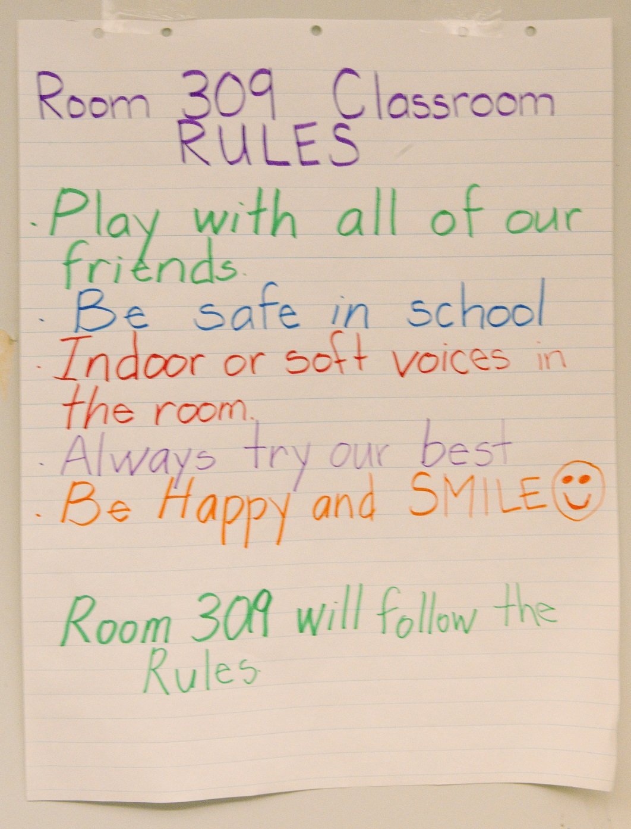
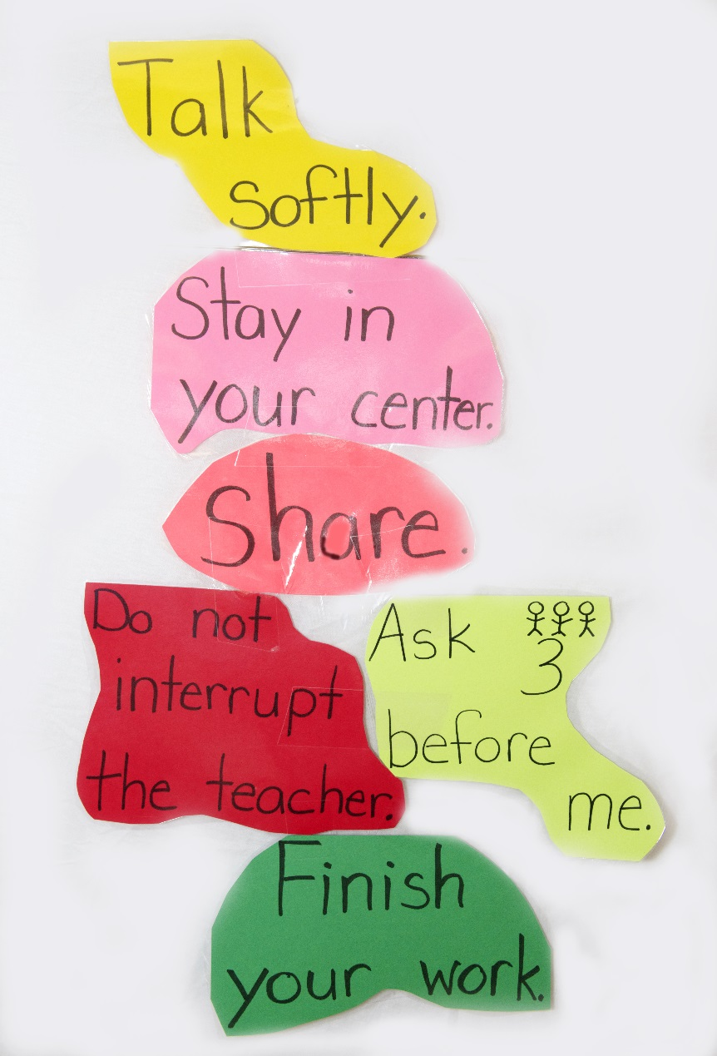

Slide 3
Consequences
Positive Consequence
Negative Consequence
Rewards
Pointing out the positive behaviors of a student
Penalties
Result of student not following classroom rules
A consequence should not be confused with discipline.
A consequence is the result of a behavior CHOSEN by the student.
Notes:
It is the students choice on the type of consequence that they will receive. They choose their behavior and need to be held accountable for it.

Slide 4
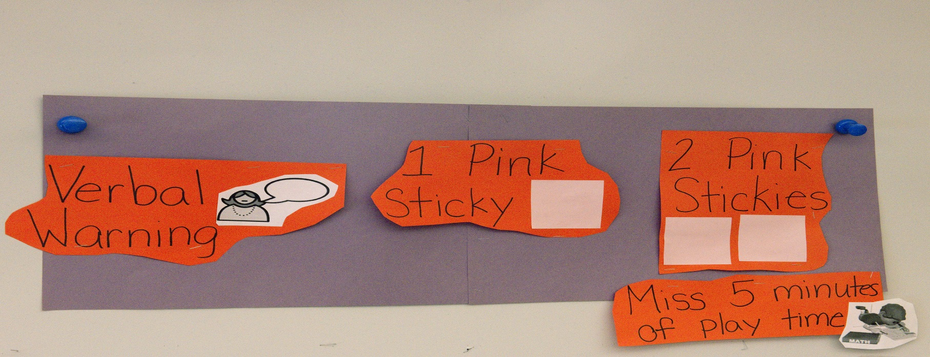
Teachers Role in Consequences
Act early, do not wait until the last minute before recognizing the behavior.
Be Consistent- Use same consequences for behavior. The students should know how you are going to react.
Make sure the consequence fits the behavior
Notes:
These rules are for a positive or negative behavior. A small adjustment to behavior or pointing out a positive behavior is easier than waiting for it to become a bigger distraction. Be consistent! The students should know what to expect from you. It should not be a mystery. You are not going to have a huge praisal or consequence for a student when recognizing a minor behavior.

Slide 5
Language vs. Behavior
Exception to the Rule!
- The teacher needs to be able to depict if the behavior was chosen or if language was a factor in the action.
Notes:
Defiant vs. lack of language – deliberately not listening vs. not clear/not comprehending what is expected

Slide 6
Classroom Management
The key to student success

Slide 7
What is classroom management?
“Classroom Management refers to all of the things that a teacher does to organize students, space, time and materials so that student learning can take place.”
(Wong & Wong, pg. 84)
Notes:
Before we go any further, we should explore what exactly classroom management means. Wong describes it above [read quote]. This includes how to line up, sit on the rug, do lunch count, buddy read, rotate in centers, and any other procedure or task that needs to get done in the classroom. Take note of how the description is so general and all encompassing. This is because classroom management is the core of a classroom.

Slide 8
Everything is good to go!
Classroom is READY…
All materials are in place.
Environment is SET…
The classroom atmosphere is constructive.
Teacher is ready to GO!!!
You're welcoming, positive & have high, clear student expectations
Notes:
All you need for the day is ready at your fingertips. You have prepped everything prior to the start of the day and you know where everything is. You are not wasting valuable instruction time on preparation. This includes room set up. Down time allows students to test the waters. It like dead air space on the radio. We don’t know what to do with the silence so we just switch the channel.
The atmosphere must be set before your students walk into the room EVERY DAY. The students must know that their atmosphere is calm, positive and centered around productive work.
You are the teacher, you set the tone. If you are positive about teaching, they will be positive about learning. If you are ready to teach in the morning, they will be ready to learn.
These three components need to be consistently practiced by the teacher in order to have an effectively run classroom. Consistancy is the key.

Slide 9
Effective Teacher
Classroom READY…
Environment SET…
Teacher is good to GO!
Notes:
When a teacher puts all those pieces together…he/she is an Effective Teacher!

Slide 10
You're an Effective Teacher if you:
Have a plan for all procedures in your class.
Explicitly Explain and teach all procedures.
Rehearse all procedures with your class Rules.
Reinforce all procedures

Slide 11
Explain
Rehearse
Reinforce
Notes:
It all comes back to Explain, Rehearse Reinforce! A quick story…when we were video taping my class….

Slide 12

Effective Teacher
=
Good Classroom Manage
“Effective teachers MANAGE their classrooms, ineffective teachers DISCIPLINE their classrooms.”
(Wong & Wong pg. 83)
Notes:
Managing and disciplining are two different practices. If your managing, you are maintaining an atmosphere that is basically running itself. The rules, routines and procedures are known, understood and upheld. Your students know these rules, routines and procedures because you explained, rehearsed and reinforce them. You are one step ahead. Your time is spent instructing and bringing your little ones to a higher level of learning. If you are disciplining all the time, you are one step behind. With our SEI population, we can not afford to be anything BUT an effective teacher.

Slide 13
An extremely good classroom manager…
Produces a calm climate with emphasis on work.
Time on task/little disruption.
Has a high level of student involvement with work.
Has clear student expectations.
Notes:
The book states that it’s the way you manage your classroom that will determine how well your students learn. This is the number one factor in classroom success.

Slide 14
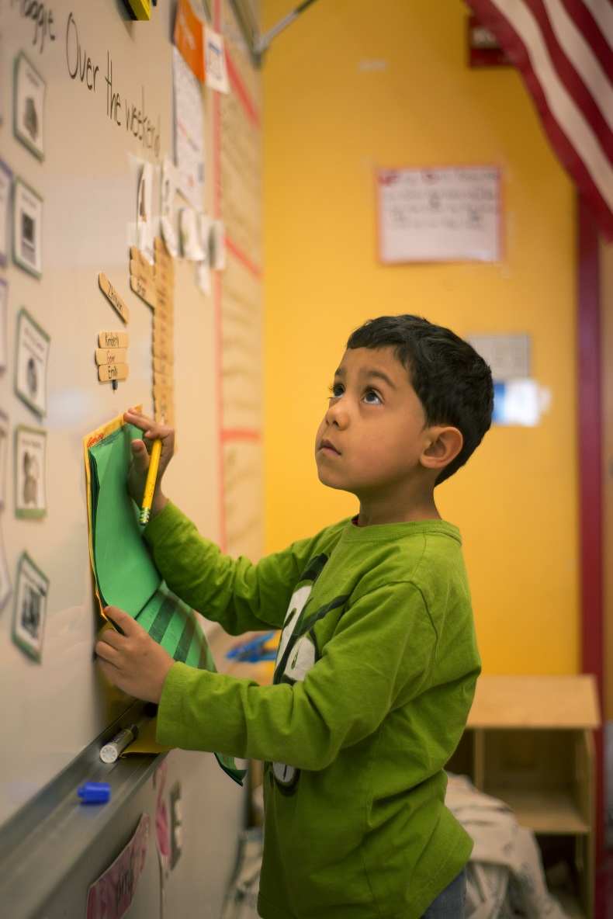
High level of student involvement with work
Students are working
Engaged Time
Academic learning time is provable.
Notes:
Engaged time = students on task. Teacher is facilitator of help only when needed.
Academic learning time is when students are demonstrating comprehension of a skill or content.

Slide 15
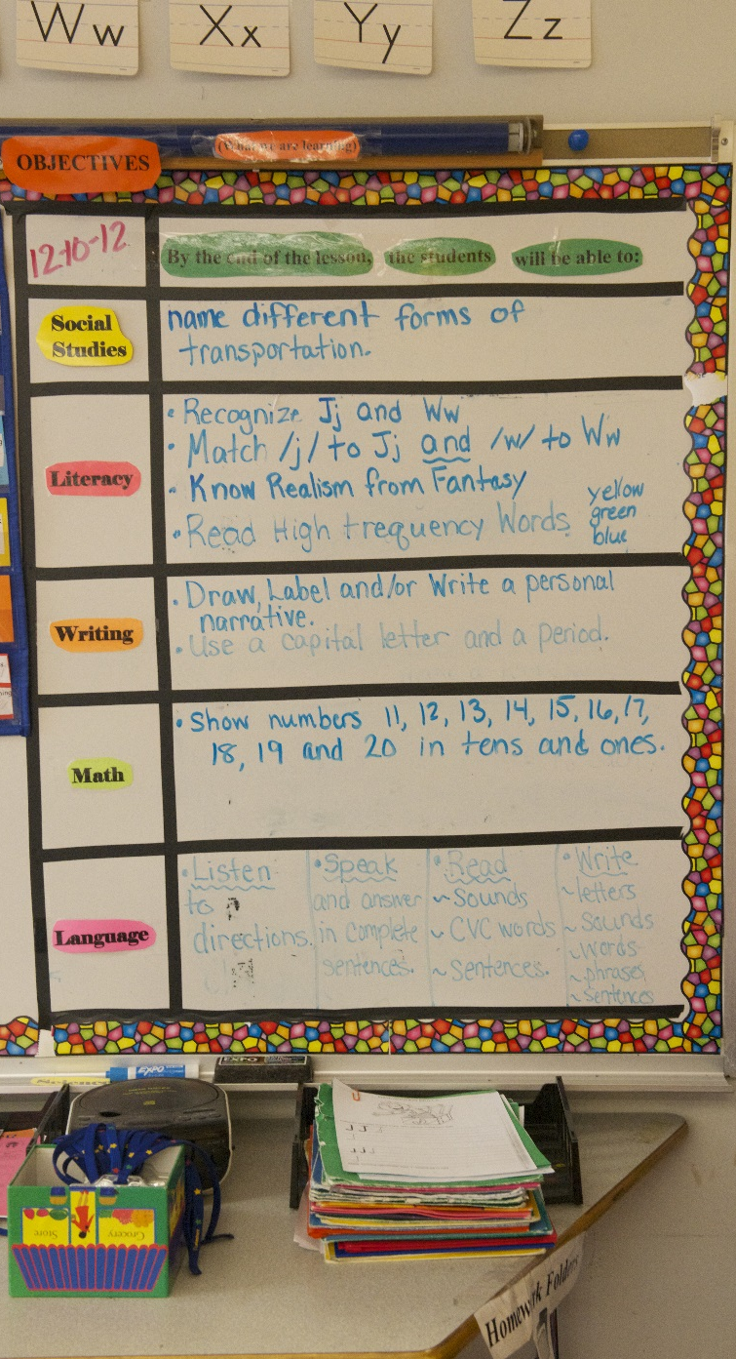
Has clear expectations
Students know what is expected of them behaviorally and academically.
Students know their consequences
Students know what they need to accomplish (Objectives)
Students know what they will be tested on accomplishment of objectives.
Notes:
This is what my objective board looks like…it is located right to the right of my front door…this way whoever comes into my room…an admin, students, another teacher and myself are informed or reminded of objectives. The students look at them now too.

Slide 16
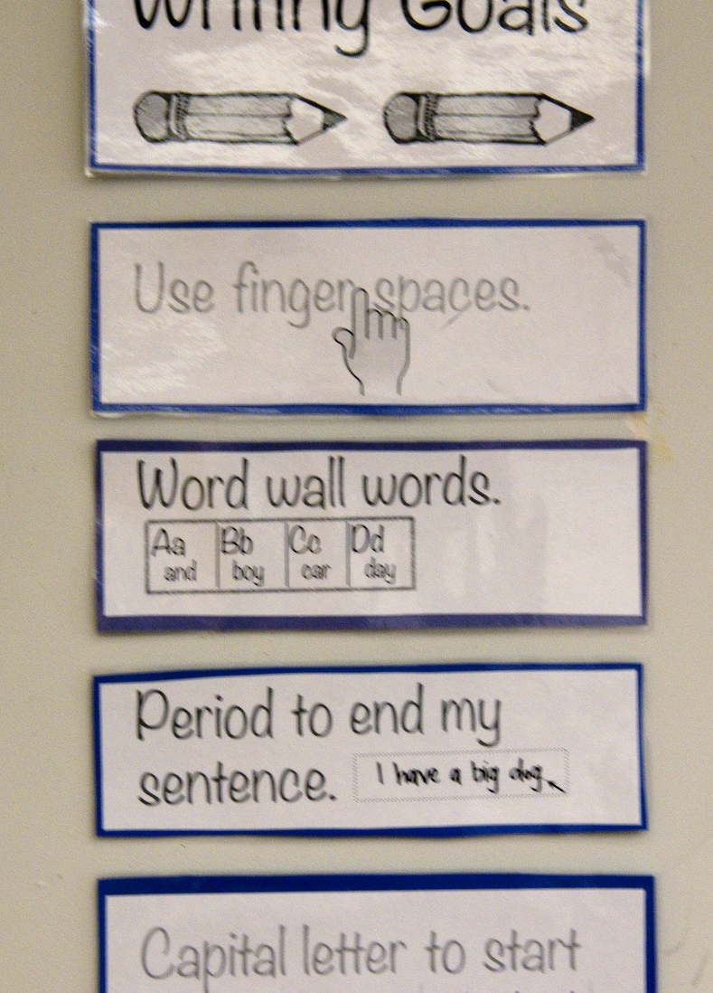
Little waste time, confusion or disruption
Teacher has procedures and routines in place and students understand them.
Teacher is consistent
Class is started immediately (no waste time)
Teacher posts assignments
Notes:
Routines and procedures…lunch count, attendance, tardy slips, bathroom, homework
Start class immediately…first priority is to get students to work…”do nows”, post assignments in the same spot. This is an anchor chart in Allison’s room on writing expectations.

Slide 17
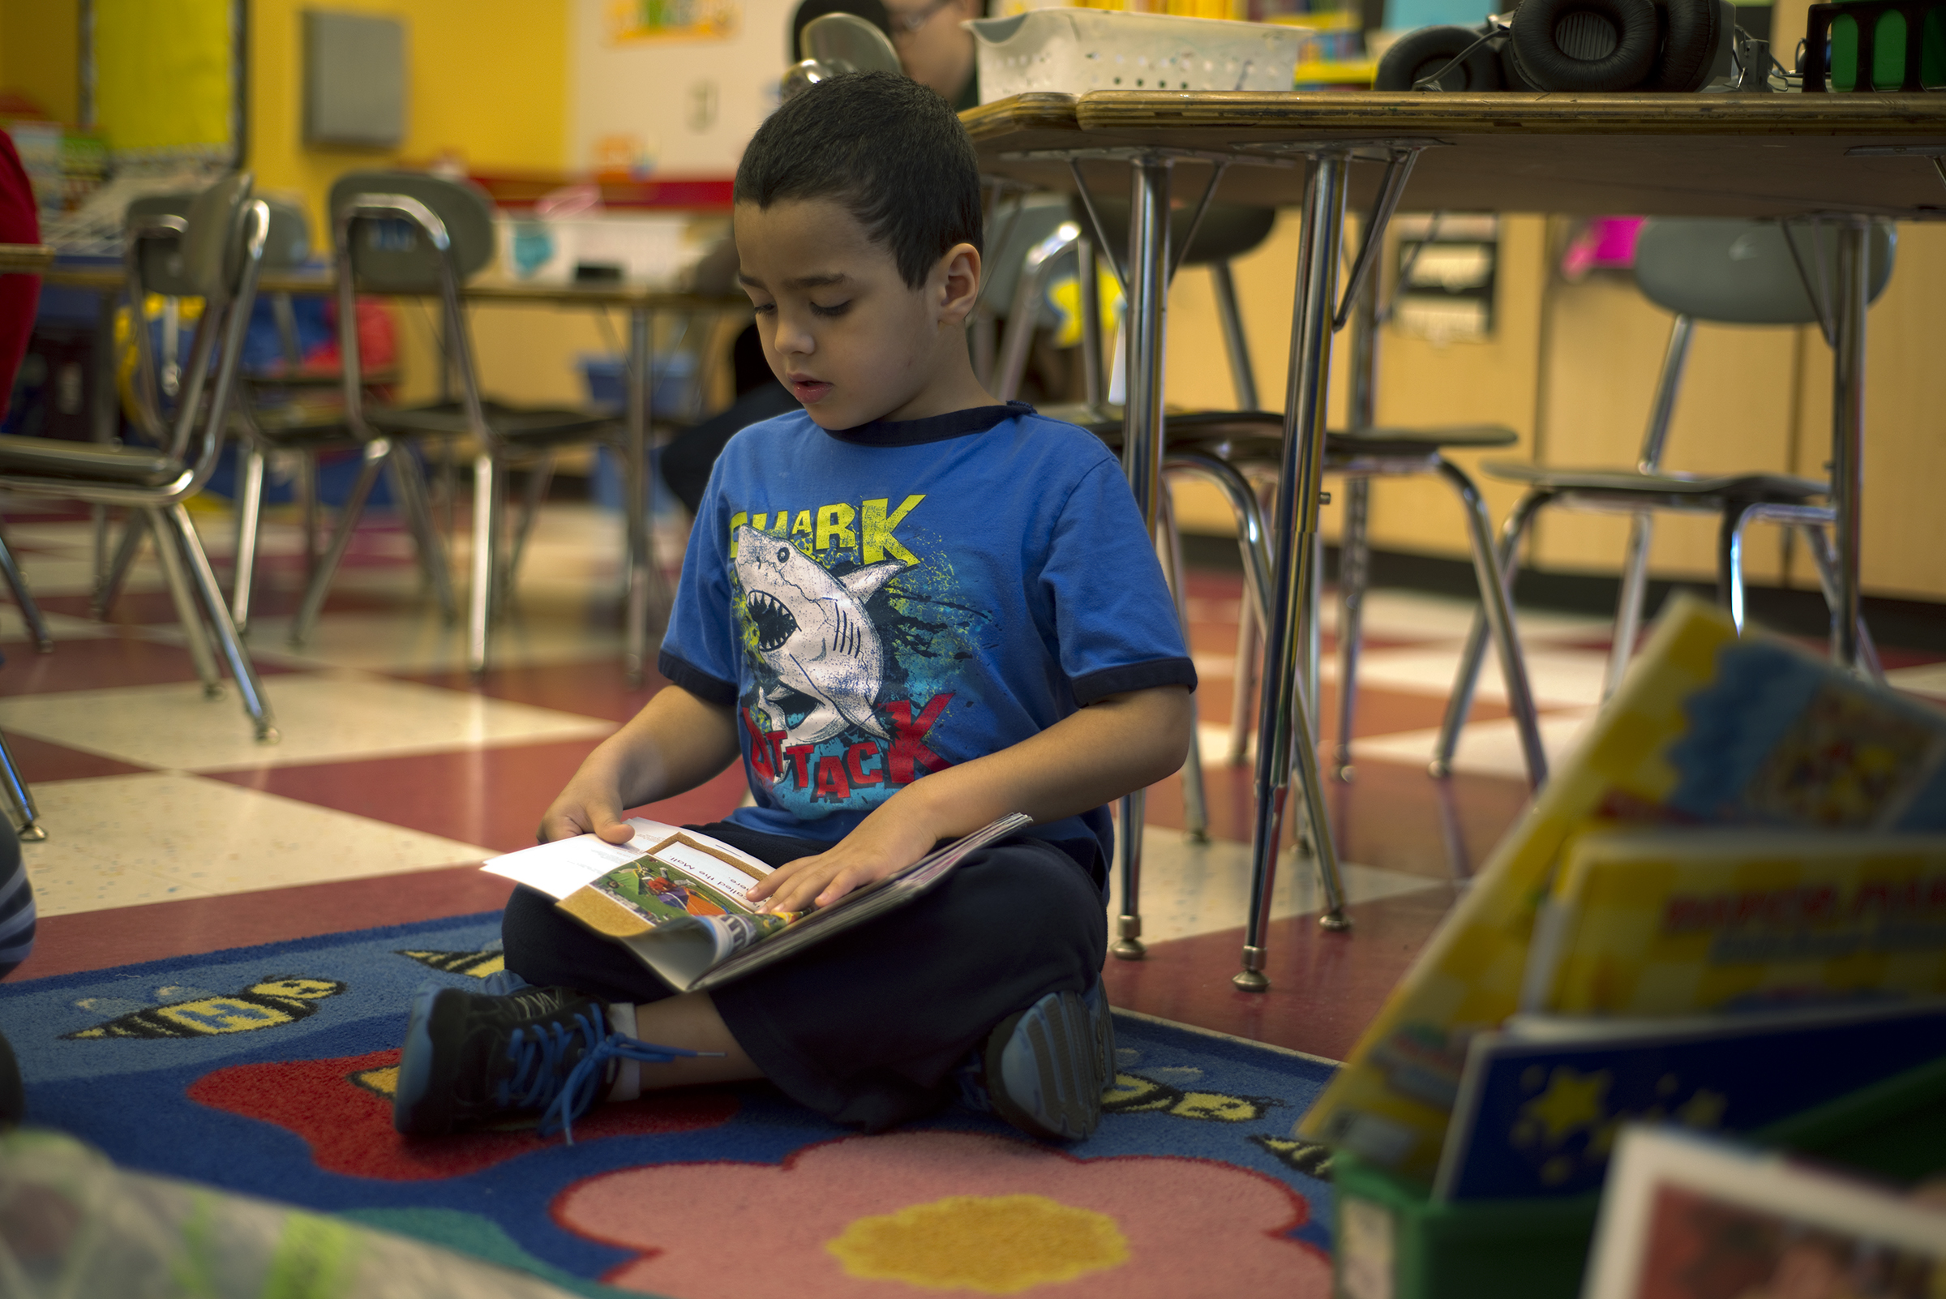
Produces a calm climate with an emphasis on WORK
Invest time in practicing procedures that become routines.
Explain, rehearse, reinforce
Can quiet class with a simple procedure
Praise and encourage the deed when correct.
Notes:
Procedures to routines…three steps…explain, rehearse, reinforce.
Quiet class…lights off, clap hands, hold hand in air, use of musical instrument…explain, reearse, reinforce
Praise the deed, encourage the student. Praise what the student did not the student in general then encourage them to do it again. William great job with your writing, you put your friend first when writing “Helen and I”…make sure you do it again when you want to talk about you and another friend.

Slide 18
Video Clip
Explain, Rehearse, Reinforce
Notes:
Greco…rug to table

Slide 19
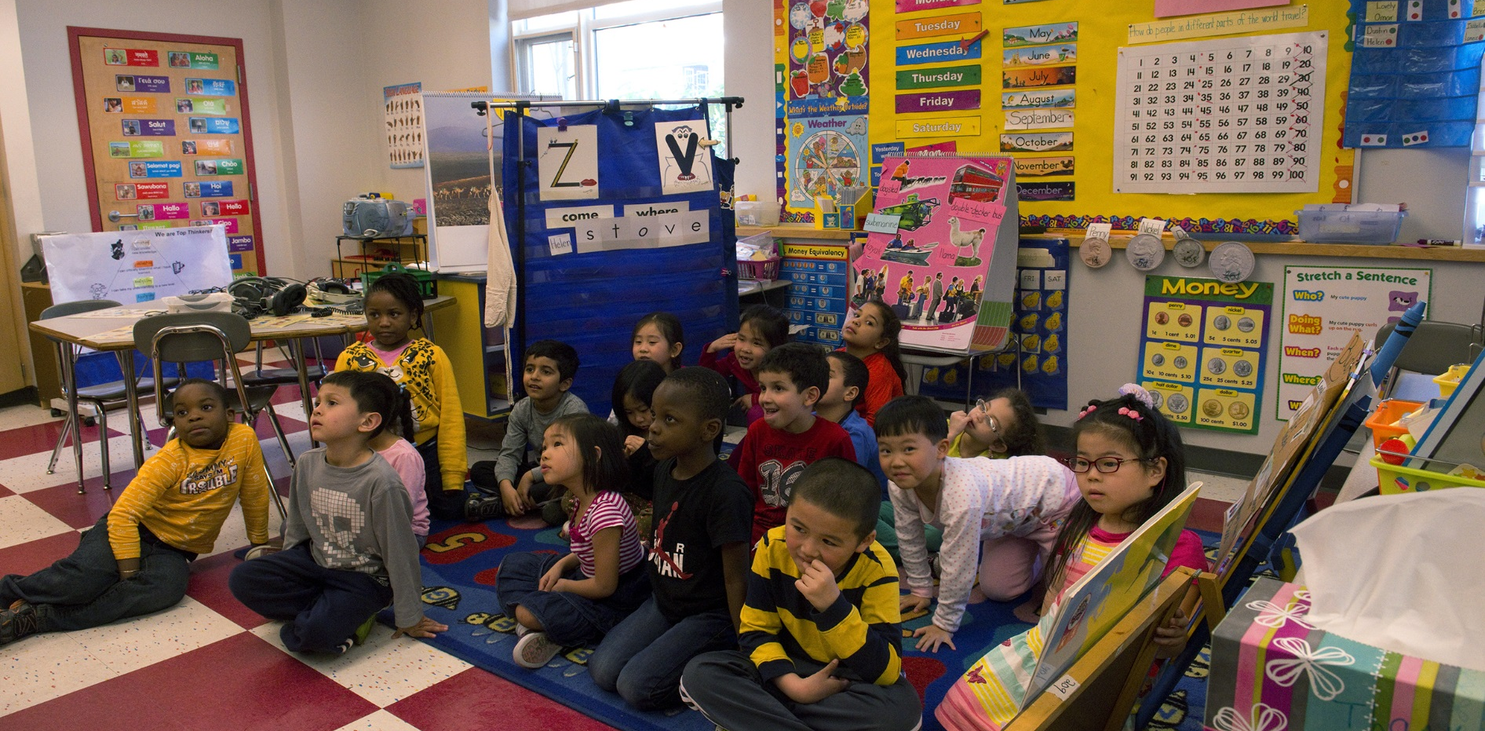
“If you do not structure your classroom, the students will structure it for you.”
(Wong & Wong, pg. 95)
Notes:
This basically sums it up.

