Slide 1
WIDA Social Instructional Language
How does this apply to the Kindergarten SEI Classroom?
Notes:
Now…how does all this fit in with WIDA?

Slide 2
WIDA’s 5 ELD Standards
Standard 1 | ELLs communicate for Social and Instructional purposes within the school setting. (SIL)
Standard 2 | ELLs communicate information, ideas and concepts necessary for academic success in the content area of Language Arts. (LoLA)
Standard 3 | ELLs communicate information, ideas and concepts necessary for academic success in the content area of Mathematics. (LoMA)
Standard 4 | ELLs communicate information, ideas and concepts necessary for academic success in the content area of Science. (LoSC)
Standard 5 | ELLs communicate information, ideas and concepts necessary for academic success in the content area of Social Studies. (LoSS)

Slide 3
WIDA’s ELD Standards
Social Instructional Language
Language of Mathematics
Language of Science
Language of Language Arts
Language of Social Studies
Academic Language
Notes:
Quickly go over the five standards and highlight that the five standards have NOT changed.

Slide 4

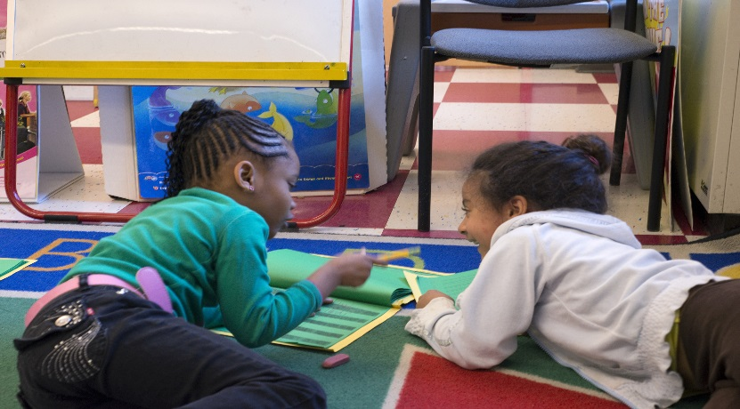
Social Instructional Language (SIL)
The Language of Social Instruction.
Includes social rather than academic discourse.
The use of every day language in your classroom
Emphasis on Listening and Speaking rather than Reading and Writing

Slide 5
Social Instructional Language
(SIL)
Listening
Following Directions
Speaking
Social conversations
Answering and asking questions

Slide 6
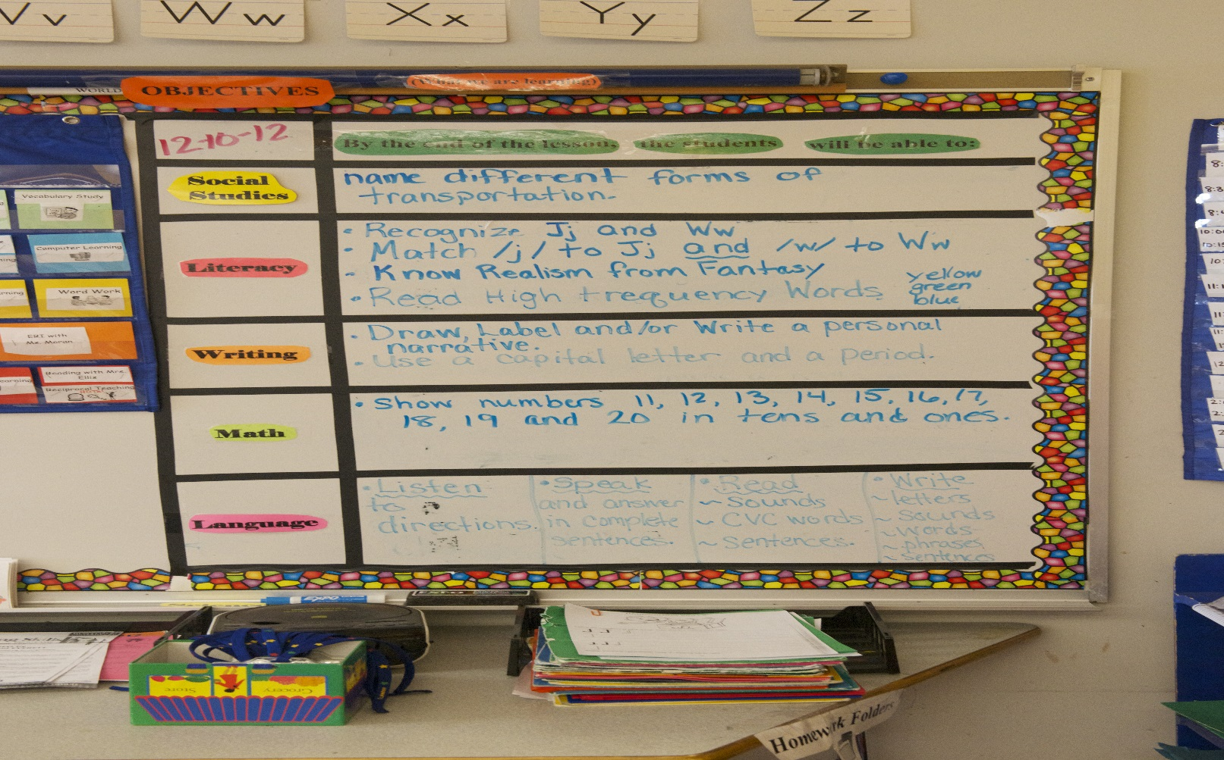
Post Language Objectives!

Slide 7
Lets practice making Language Objectives for SIL

Slide 8
Model Performance Indicator (MPIs) Formula Creating Language Objectives for SEI Kindergarten using WIDA 3 key components of language objectives
Language + Function | Topic + | Support
Verb or + Verbs | Topic from + state standards | Scaffolding
8

Slide 9
Academic Discourse: Kindergarten Language of Social Instruction
Language function
Students will transition from center to center using visual scaffolds like an anchor chart with pictures and their partners.
Content stem
Support
Notes:
Leave up for group activity as a reference

Slide 10
Language Functions
Listen Point Match Locate Select Sort Respond Identify Draw/illustrate Circle Name | Recall Retell Define Explain Summarize Role-play Compare/contrast Discuss Express Repeat Copy Trace Define | Analyze Interpret Justify/Defend Elaborate Critique Explain Narrate Conclude Convince Reflect Resolve Infer Compose Synthesize Hypothesize
Notes:
Note how the verbs climb higher in Higher Order Thinking Skills as their language level increases.

Slide 11
Examples of Sensory, Graphic and Interactive Supports
Sensory Supports | Graphic Supports | Interactive Supports
Real-life objects (realia) Manipulatives Pictures and Photographs Illustrations, diagrams, and drawings Magazine and Newspapers Physical activities Videos and Films Broadcasts Models and Figures | Charts Graphic Organizers Tables Graphs Timelines Number Lines | In pairs or partners In triads or small groups In a whole group Using cooperative group structures With the Internet (Websites) or software programs In the native language With mentors

Slide 12
Examples of SIL Objectives
The students will express the choice time activity they want to play by using real-life objects.
The students will identify what they choose for lunch by using illustrations or pictures.
Notes:
These are some examples of Language objectives we came up with.

Slide 13
Academic Discourse: Kindergarten Language of Social Instruction
Language function
Students will transition from center to center using visual scaffolds like an anchor chart with pictures and their partners.
Content stem
Support
Notes:
Leave up for group activity as a reference

Slide 14
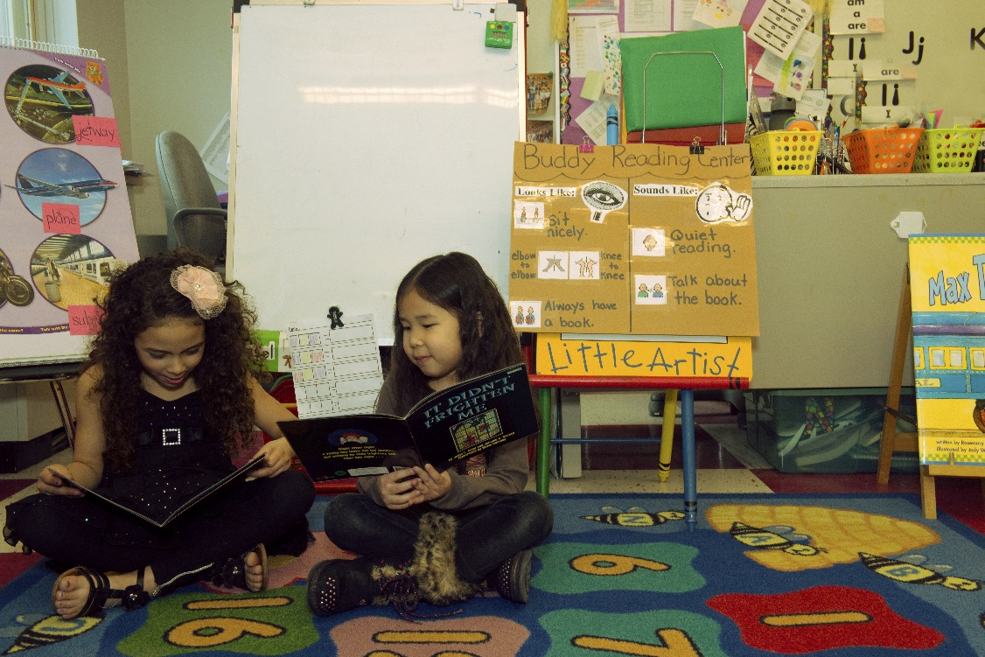
Anchor charts help!

Slide 15
Anchor charts help!

Slide 16


“EDUCATION IS NOT teaching people things they don’t currently know…EDUCATION IS teaching people behaviors they don't currently practice.” (Wong & Wong, pg. 7)
Notes:
We want to end with this thought…

Slide 17
Questions?
Comments?
Evaluation
Thank you!

Slide 18
References
"English Language Development (ELD) Standards." WIDA. N.p., n.d. Web. 29 Apr. 2013.
Karigianis, Michael. SEI Kindergarten. 2013. Photograph. Salemwood Elementary School, Malden, MA.
"Lemov, Doug. Teach like a Champion: 49 Techniques That Put Students on the Path to College. San Francisco: Jossey-Bass, 2010. Print
"MaldenELLs - Home." MaldenELLs - Home. N.p., n.d. Web. 29 Apr. 2013
Wong, Harry K., and Rosemary T. Wong. The First Days of School: How to Be an Effective Teacher. Mountainview, CA: Harry K. Wong Publications, 1998. Print.

