Slide 1
Extreme E-Resource Endeavors: from PDA to POOF! to Interface Management and more...
Jesse Koennecke, Head - Electronic Resources @ Cornell
Colleen Major, Electronic Resources Librarian @ Columbia
Boaz Nadav-Manes, Director - Acquisitions and Automated Technical Services @ Cornell
Notes:
Intro - We have been working on a lot of different projects. Some of these could have been a presentation on their own. Experiment. Series of lightning talks on a bunch of topics. These are not particularly interconnected. Approximate order from least to most collaborative. 2CUL brief?

Slide 2
E-Resource Renewal Calendar
what had we been using?
what we wanted:
  easy to use & implement
  push technology
  use existing efforts and strategies
how we did it
Notes:
This is a project from Columbia's E-Resources Assessment Working Group.
The Electronic Resource Assessment Working Group is charged with promoting the use of quantitative and qualitative measures to assess the effectiveness of Columbia’s licensed electronic resources. The Working Group will:
-Monitor and evaluate available sources of use data for electronic resources;Provide procedures, information and training for selectors on ways to employ use data in evaluating the importance, effectiveness, and cost/benefit of individual e-resource titles and packages;
-Identify, recommend and provide other types of measures and reports that can be helpful in making collection decisions and providing support for e-resources;
-Investigate and implement means of merging data from disparate sources and making the data readily available for generating standard and custom analyses;
-Examine longitudinal trends in Columbia’s provision of, and use of, e-resources.
The Working Group will consist of representatives from the Collection Development Office and the Continuing and Electronic Resources Management Division, and of 3-5 selectors involved in the purchase and assessment of e-resources. One member will be designated as a liaison to the Assessment Working Group. Members will serve for rotating terms of two years.
To access fund information a selector could use Voyager acquisitions (view only) or a local feed from Voyager - we called this feed our "fund activity reports", this data was pulled every two weeks and posted on a internal webpage. this export script had been developed locally to meet our information needs. This was strictly expenditure info, not organized in a way that could be easily used as a renewal.
Leveraging this feed, we constructed a program that feeds acquisitions data directly from our library management system into our shared cul domain Google Calendar. Each payment is represented as an event and it generates two subsequent notices, the first timed five months prior to the next renewal, and the second timed three months prior to the next renewal.
Why Google Calendar?
Integration with staff scheduling software
Already part of selectors' tool bag
Ability to subscribe to selected fund calendars-
Ability to search across all calendars by title or keyword
How we did it? Because we had already implemented Google Calendar and developed data exports from Voyager. Columbia's script, written in python and available online gathers its data from exports produced from the Voyager These exports, described previously, are produced by perl scripts that run independently of the python import script, and consist of one directory per fund code, containing comma-separated value (text) data for purchases made against that fund. (in the previous year.)
Using our Voyager export and Google API import (in optimal languages for each) and allowed the scripts to be independently scheduled

Slide 3
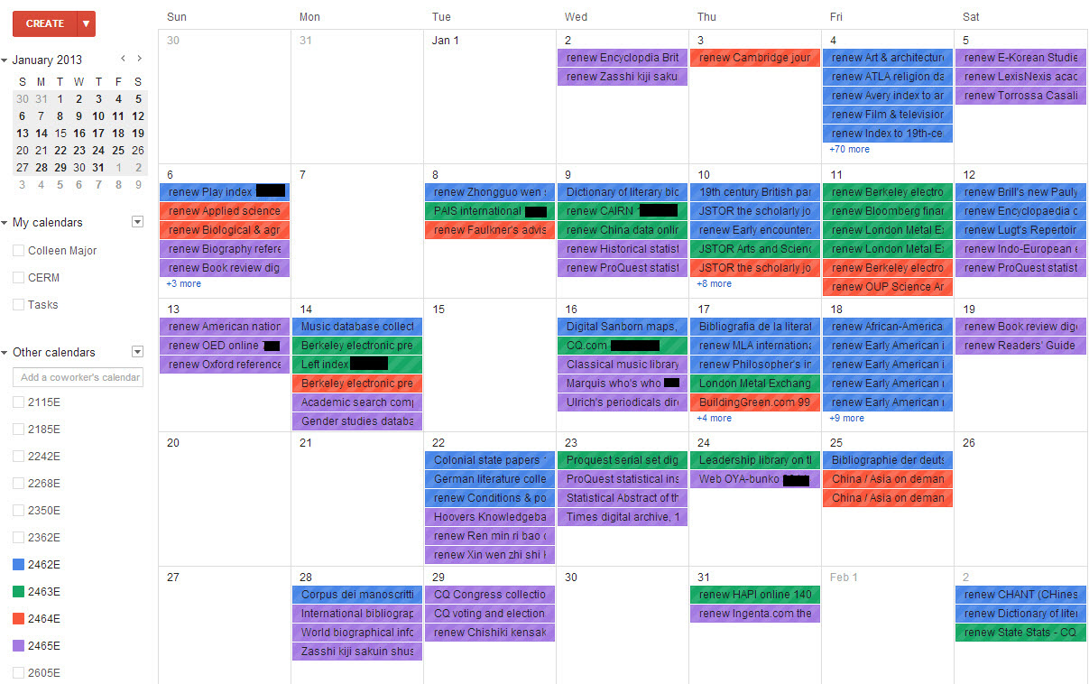
One month view
Notes:
This is a calendar view showing four e-funds: History and Humanities, Social Sciences, Sciences and the General Undergraduate.
Additional fund code calendars can be added as by searching in the box “add a coworker’s calendar”, you can then add that calendar to your view, or hide it from view and keep in your list.
A selector may want to subscribe to their own subject funds, as well as one of the larger shared funds – shown on the screen.
In total we currently have 126 funds for continuing e-resources, each on has its own calendar.
For each fund code that is used for recurring e-resource expenditures, a calendar is generated. In that calendar, each payment is represented as an event. We have two types of fund codes associated with ongoing e-resources – the end in e or eo.
Since each fund code was given its own calendar, so staff could subscribe to the fund codes they managed and set their preferred alerts. Each payment event generates two subsequent notices, the first timed five months prior to the next renewal, and the second timed three months prior to the next renewal..
Three examples of the 3 notices:
Expenditure notices always begin with name of resource. Reminder notices always begin with the word “renew.” Key acquisitions data is included in all notices.

Slide 4
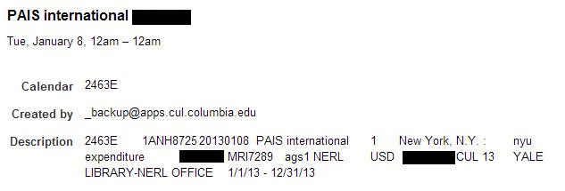
expenditure event view
Notes:
This is a view of what a e-resource expenditure event details look like in Google Calendar. Expenditure data is pulled from Voyager and pushed into Google Calendar every two weeks. The event information includes the resource name, fund code used (associated with fund code calendar), vendor that the invoice was paid to, invoice number and cost (blacked out.)

Slide 5
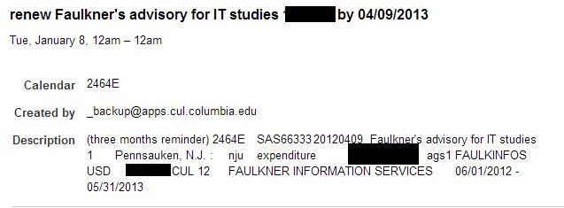
3 month event reminder
Notes:
This is an example of a 3 month reminder, it occurs three months before resource is due for renewal. Renewal events are listed on the calendar event by “renew” “resource name”. In this event detail screen the description indicates if the reminder is the 3 or 5 month reminder.

Slide 6
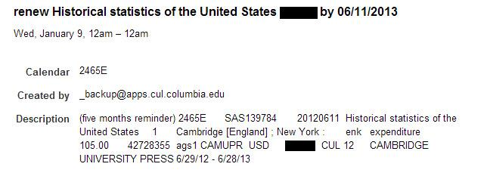
5 month event reminder
Notes:
Five-Month Reminder
Occurs five months before resource is due for renewal

Slide 7
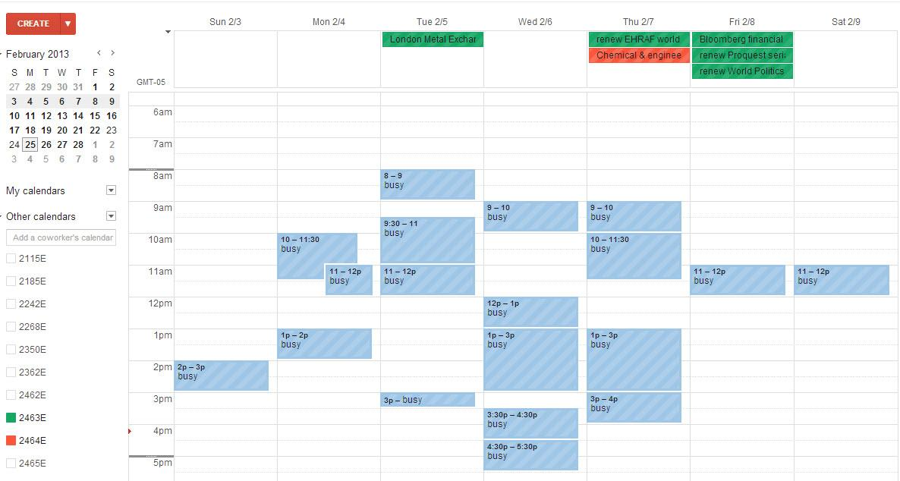
staff work view
Notes:
This is an example of what a staff user would see after logging in to their calendar.The reminders or events at the top of the screen are associated with the fund code calendars that this user has chosen to add to their Gcal. Green is for 2463E, red is for 2464E. If a user wanted to add additional calendars to their view they would just add the appropriate fund in the "add a coworker's calendar" on the left under "other calendars". The user could then choose to turn the view off and on (display or hide) by clicking on the calendars label in the "other calendar" view. The could change the color and set reminders per calendar (= per fund code).

Slide 8
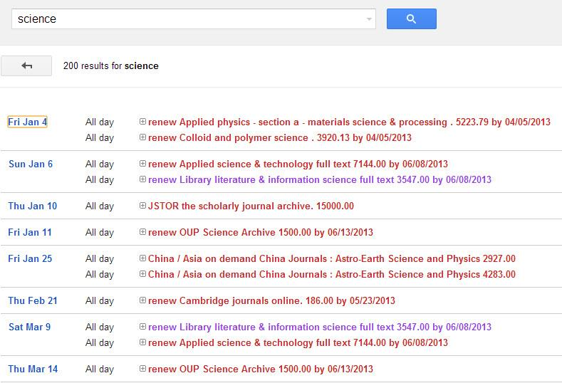
Searching across calendars
Notes:
A user can use the GCal search functional and search across multiple fund calendars that they may have added. This is particularly useful if a selector is unsure which funds paid for a resource, or when it was last paid.

Slide 9
For more information:
Jeffrey D. Carroll, Colleen Major, Nada O'Neal and John Tofanelli. Assessing Ongoing Electronic Resource Purchases: Linking Tools To Synchronize Staff Workflows. Journal of Electronic Resource Librarianship. 24.2 (2012):79-90.
http://dx.doi.org/10.1080/1941126X.2012.684330
Python code is available at: https://github.com/nadaoneal/gapps_python_whatever

Slide 10
PDA/DDA - Profiling
Modeled after print approval plan
Graduate level textbooks, no undergraduate textbooks
Scholarly books only
WorldCat Selection slips for practitioner books, foreign-language trade books
Price ceiling per title (raised the price ceiling to $350)
Excludes series that arrive on other eBook packages.
Notes:
Cornell University Library has shifted part of its former print approval plan profile and resources to begin a pilot for patron-driven acquisitions of both print and electronic monographs in the hard sciences. Designing the joint patron-driven plans posed unique challenges that required a significant amount of ingenuity on the vendor’s (Coutts and MyiLibrary) and Library’s side. Cornell’s Technical Services, via scripts and bulk loading rules, automatically deduplicates print and electronic formats of the same content yet still allows for review and selection of the identified duplicate formats by collection development staff should they wish to override the ‘no duplicates’ rule. In order to avoid purchasing of items not owned yet by patrons outside our institution, our loading scripts limit WorldCat Local from showing patron-driven items as available for Borrow Direct and Interlibrary Loan and remove the limitation once the item has been purchased. For out patron-driven print plan we developed together with Coutts an Inventory Query interface that allows seamless flow without technical services mitigation (according to certain parameters that check Coutts warehouse for availability) from the discovery of a patron driven title to the book arrival to Cornell’s LTS. We plan to completely integrate our patron-driven workflows with our more traditional acquisition’s guidelines and plan to increase our efficiencies by relying on previous experience with WorldCat Selection to automatically create purchase orders and locations in Voyager for those items.

Slide 11
Conrell’s PDA plan – current status:
7 Distinct Plans (Humanities, Social Sciences, Sciences, Med, Vet)
Unique Patron Driven print plan - inventory query
Current Stats: 4636 PDA titles not purchased - 588 purchased in 2 years
Optional shift of a segment of our plan to a Borrow Direct consortial PDA/DAA
Notes:
Cornell University Library has shifted part of its former print approval plan profile and resources to begin a pilot for patron-driven acquisitions of both print and electronic monographs in the hard sciences. Designing the joint patron-driven plans posed unique challenges that required a significant amount of ingenuity on the vendor’s (Coutts and MyiLibrary) and Library’s side. Cornell’s Technical Services, via scripts and bulk loading rules, automatically deduplicates print and electronic formats of the same content yet still allows for review and selection of the identified duplicate formats by collection development staff should they wish to override the ‘no duplicates’ rule. In order to avoid purchasing of items not owned yet by patrons outside our institution, our loading scripts limit WorldCat Local from showing patron-driven items as available for Borrow Direct and Interlibrary Loan and remove the limitation once the item has been purchased. For out patron-driven print plan we developed together with Coutts an Inventory Query interface that allows seamless flow without technical services mitigation (according to certain parameters that check Coutts warehouse for availability) from the discovery of a patron driven title to the book arrival to Cornell’s LTS. We plan to completely integrate our patron-driven workflows with our more traditional acquisition’s guidelines and plan to increase our efficiencies by relying on previous experience with WorldCat Selection to automatically create purchase orders and locations in Voyager for those items.
*

Slide 12
Cornell’s Patron Driven Print
Coutts deposits records weekly in FTP site (sends notification to ltsbulk-l)
PD E-batch loads dedups against 035 in PD P and generates a list to be deleted
Since electronic PDA versions appear sometimes many months after the print has been published (if at all), CUL instituted a maximized non-mediated patron driven print plan in which print records are loaded after 60 days waiting period. Patrons can ask the library to rush purchase the print version. When the electronic PDA version becomes available the print records which were not purchased are removed and the electronic versions are loaded instead.
WCL: “Click to ask Cornell University Library to RUSH purchase. We will contact you by email when it arrives (typically within a week) (Cornell affiliated users only)”
LTS batch loads: dedups + adds 899: couttspdbappr and other fields (008 field positions 20-21, 506,906) and WCL URL’S in 856
Webauth validates net id
WEB-BASED: “sorry your net id is not valid – return to browse?”
NO
YES
WEB-BASED: Hello [name] + Click "Confirm" to request Cornell to purchase the item below.
You will not be billed for this purchase (Items usually arrive in less than a week).
+ “Confirm”
WEB-BASED: We are ordering [title]/ [ISBN=] for you now.
We will let you know once the item arrives.
Thank you
Cornell University Library
Coutts automatic inventory query
Coutts locates and ships to library
YES (=<4 days)
NO (> 4 days)
Order confirmation email is sent to Ordering
Real time change: removal of the original record (for WCL) and loading of a new copy of that record
Real time change: removal of the original record (for WCL) and loading of a new copy of that record
LTS receives, Pink slip process- notifies Access Services
Ordering: rush orders the title using the dummy po
Automatic AMAZON PO’S created (using embedded id number) with req info (future loc’s are added according to call number table)
Automatic Coutts PO’S created (using embedded id number) with req info (future loc’s are added according to call number table)
Coutts: invoices LTS in the end of the month
LTS: chron job emails patron confirming order.
OPAC: “ON ORDER”
OPAC: “ON ORDER”
LTS pays and changes 899:couttspdbclo
LTS removes 899: couttspdbappr and other fields (008 field positions 20-21, 506,906) and WCL URL’S in 856
LTS: chron job emails patron confirming order.
LTS receives, Pink slip process -notifies Access Services
Notes:
Versioning (automatic decision making tools on the horizon).
ILL/BD exclusion (for non Cornell users).
Automatic creation of PO's and locations.
Effective non-mediation.
How to define and represent the PD plan titles in our New Titles feed.
Synchronization.
Collecting Statistics.

Slide 13
e-preferred reserves

Slide 14
The Problems
Student demand
Course related usage peaks
E-availability
  Course books
  Various subjects

Slide 15
Goals
Develop policy and workflow to maximize access to ebooks for course reserve
Faculty buy-in
  "Beginning Fall 2012 we will be offering the option of putting e books on reserve. If there is an available e book title, we will notify you and discuss what option is best for your class."

Slide 16
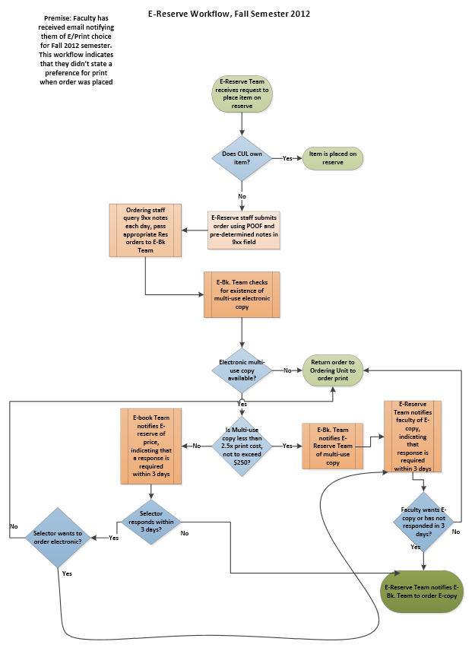

Slide 17
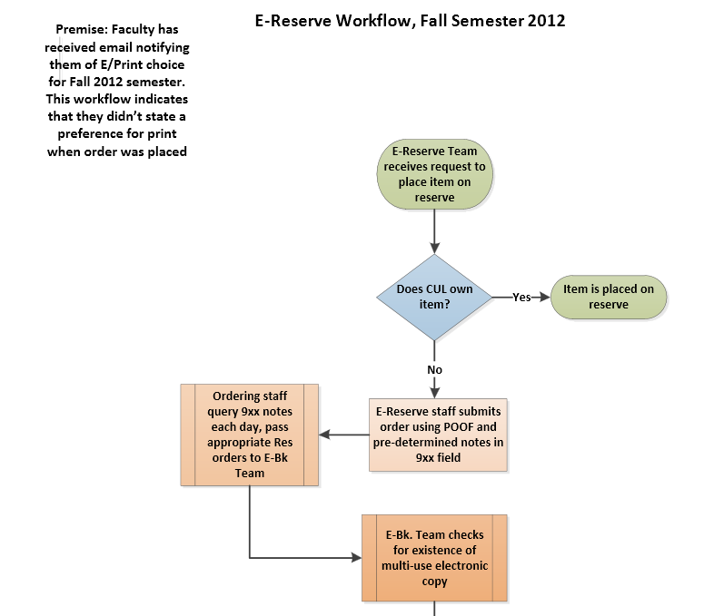

Slide 18
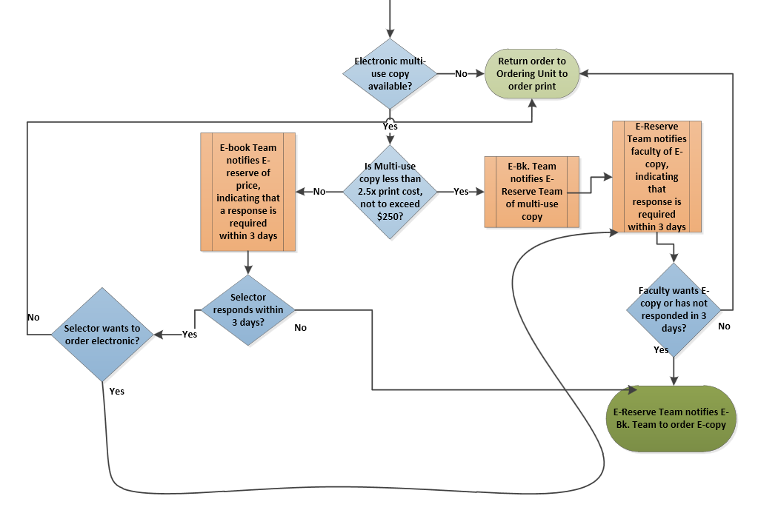

Slide 19
Futures
Historically on reserve? Owned in print?
Simplify and streamline workflow
  Official e-preferred policy
  Automated decision tree
Course use, not reserve
Streaming media

Slide 20
Cornell University Library - ebook strategic document
Goals:
Inform CUL selectors’ decisions and to map current standards for ebooks in light of the best interests of scholarly communication, broad access, and sustainability.
Help vendors, aggregators, scholars, and publishers further develop best features and practices
Guide CUL’s approach to ebook acquisitions in the context of the Library’s collaborations with partner institutions (e.g., 2CUL, Borrow Direct).
Provide a framework that CUL will use in evaluating various features of publisher/vendor ebook offerings, according to three categories: desired features, minimum expectations, and undesirable features.

Slide 21
Structure:
Introduction
General Considerations
Licensing Considerations
Vendor and Business model – Publisher or Aggregator?
Perpetual Access, Subscription, or Short-Term Rental?
Usability
Acquisition Options
Demand/Patron-Driven Acquisitions (DDA/PDA)
Technical Services
Ongoing Review
"As with other collection development decision-making, decisions to invest in particular ebooks or ebook packages for CUL will need to be weighed on a case-by-case basis. Although a blanket prescription for assessing ebooks is unrealistic, CUL weighs several factors beyond content and price. These include: vendor and business models, long-term preservation and access, ease and conditions of access and use, and technical services efficiencies. An evaluation matrix based on these facets allows CUL to complete a “scorecard” for ebook vendors and offers under consideration. This scorecard serves as a basis for decision-making".

Slide 22
Highlights:
"CUL supports the model of the university as publisher. The Library seeks to support a transition to ebooks for North American university presses and other not-for-profit academic publishers that bolsters — not erodes — their position in the marketplace. CUL expects that third-party vendors of ebooks from these publishers will provide fair and favorable returns to the publishers, and the Library’s ebook acquisition decision-making will reflect this expectation."
"Non-disclosure or confidentiality clauses. It is CUL policy not to enter into agreements that include any non-disclosure or confidentiality clause relating to pricing or license terms."
"Until and unless an equitable substitute for interlibrary lending is developed, CUL advocates licensing that allows libraries to share ebooks via existing ILL networks; however, the Library recognizes that interlibrary lending was developed for the print environment and that the properties of physical books have traditionally afforded publishers an assurance against undue loss of potential sales that ebooks draw into question. CUL supports exploration of alternative models that might benefit publishers and libraries (e.g., via micropayments for short-term, demand-driven lending) as long as:
1) Libraries are on equal footing with publishers in the development of new models;
2) Any new model presents libraries with less expensive or cost-neutral options compared to traditional ILL; and
3) Alternative models do not disenfranchise ILL’s traditional beneficiaries."
"CUL considers DDA/PDA models an important tool to provide access to certain collections in a cost effective fashion"
"API (Application Programming Interface) support that allows query of inventory for availability and price, the ability to place an order, and tracking of shipment or activation"

Slide 23
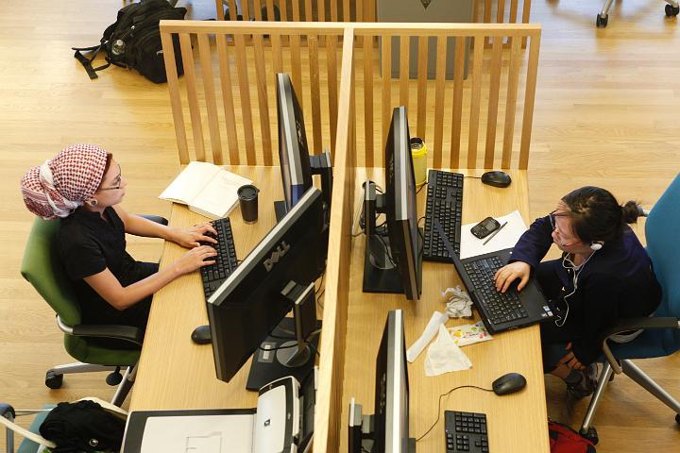
E-Resource Interface Working Group
Notes:
Colleen :
Who serves on this group?
E-Resources
Technology Services
Web services
ILL
Public Services (Science, Social Sciences, Humanities, HSL)
The E-Resources Interface Working Group was established to help determine what content to expose and what services to implements, make decisions regarding the look and feel of e-resources interfaces, recommend policies effecting e-resources interfaces, coordinate the scheduling of significant changes to interfaces, and to communicate to staff about changes. The group is comprised of selectors from various disciplines, e-resources librarians, and the web services librarian, so the responsibilities of the group's participants are quite varied.
Projects: seamless mobile access to e-resources - local auto-detect for e-resource mobile interfaces
Future: Combined 2CUL group (LERIWG)

Slide 24
Brief:
Columbia group
Cornell group
2CUL group

Slide 25
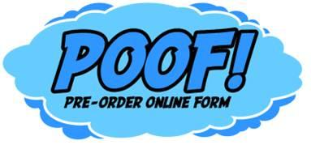
http://poof.library.cornell.edu/content/about

Slide 26
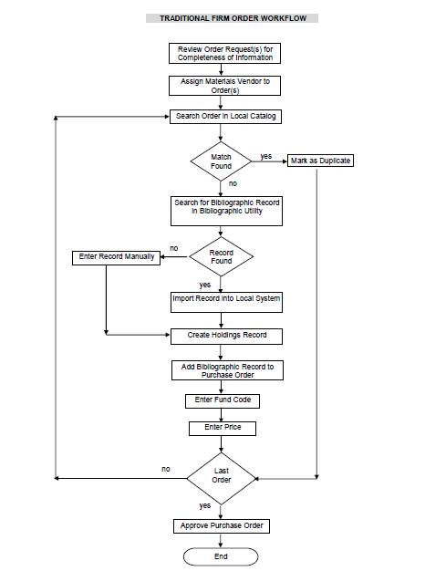

How have we dealt with firm orders? SLOWLY…
Notes:
Much of the cost incurred to acquire new materials for libraries happens as a result of the number of hand-offs of data between the person first deciding what to buy and the system used to execute the purchase order request. The diagram below illustrates the complexities and number of steps involved in the title-level acquisitions activity.
*

Slide 27
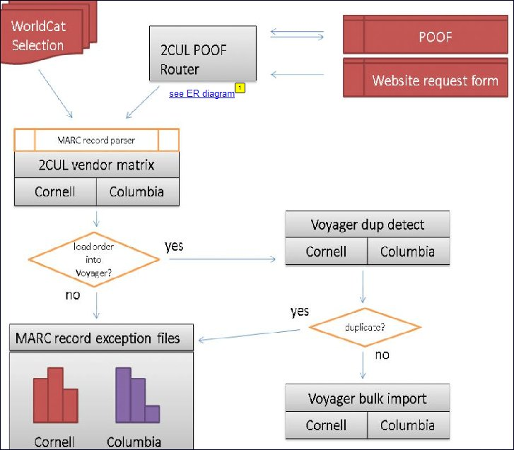
POOF! broad outline
Notes:
POOF! is an online tool built with Drupal
Uses queries that acquire bibliographic metadata from OCLC's WorldCat
Presents the data in a user friendly fashion.
Subject specialists in both Columbia and Cornell can review the bibliographical information and discover if an item is already held by the other 2CUL partner
The specialist are also able to reject or defer an item for additional review.
A preset matrix determines where the purchase will be made from (based on variables within the metadata associated with the material to be purchased.)
Various scripts would enact the decisions in the appropriate system that will create the acquisitions record and purchase order in Voyager.
The tool provides avenues for subject specialists to interact across institutions with each other (and with contributing vendors) regarding the value of the items reviewed, ranking them in terms of their usefulness, and adding comments.

Slide 28
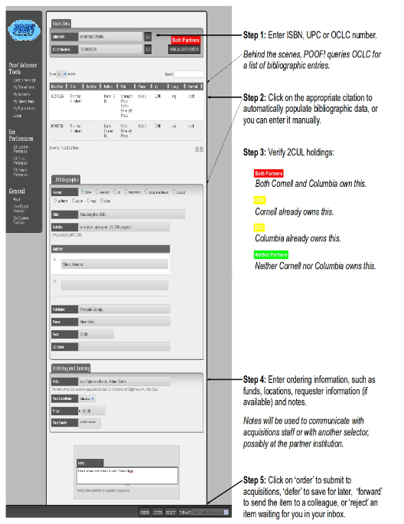
So how does it work?

Slide 29
Some numbers and facts:
8288 unit orders at Cornell since launch at December 2011
1776 unit orders at Columbia since launch at November 2012
POOF! is used to order items in all formats and to converge different workflows
2CUL is currently working with Harvard to see whether POOF! would be a good solution for them to adopt/adapt.

Slide 30
2CUL TSI E-Resources Troubleshooting Team

Slide 31

Team Charge
The E-Resources Troubleshooting Team is charged with developing consolidated, sensible workflows for addressing e-resource access problems at both institutions by July 2013. Work will progress in two phases: Investigation and Planning.
Reports to the 2CUL Technical Services Integration Steering Committee

Slide 32
Phase 1: Investigation
Create an inventory of policies, practices, tools, and workflows
Identify dependencies and limitations
Review policies, practices, and workflows to identify points of harmony and points of discord
Establish baseline productivity and staffing to allow for future assessment of changes and development

Slide 33
Phase 2: Planning
Examine points of discord, which are crucial, which can be better harmonized
Plan ways to best utilize staff at each institution
Recommend and implement tools: Incident ticketing/tracking, remote access testing
Propose, develop, and test consolidated workflows

Slide 34
More on this topic
Tuesday - 3:45
You Got a Problem with That? We’re Working on a Solution: The Future of E-Resource Management and Troubleshooting in a Unified 2CUL Context

Slide 35
END

