Slide 1

Red Flags of Failure
Courtney Bourns

Slide 2
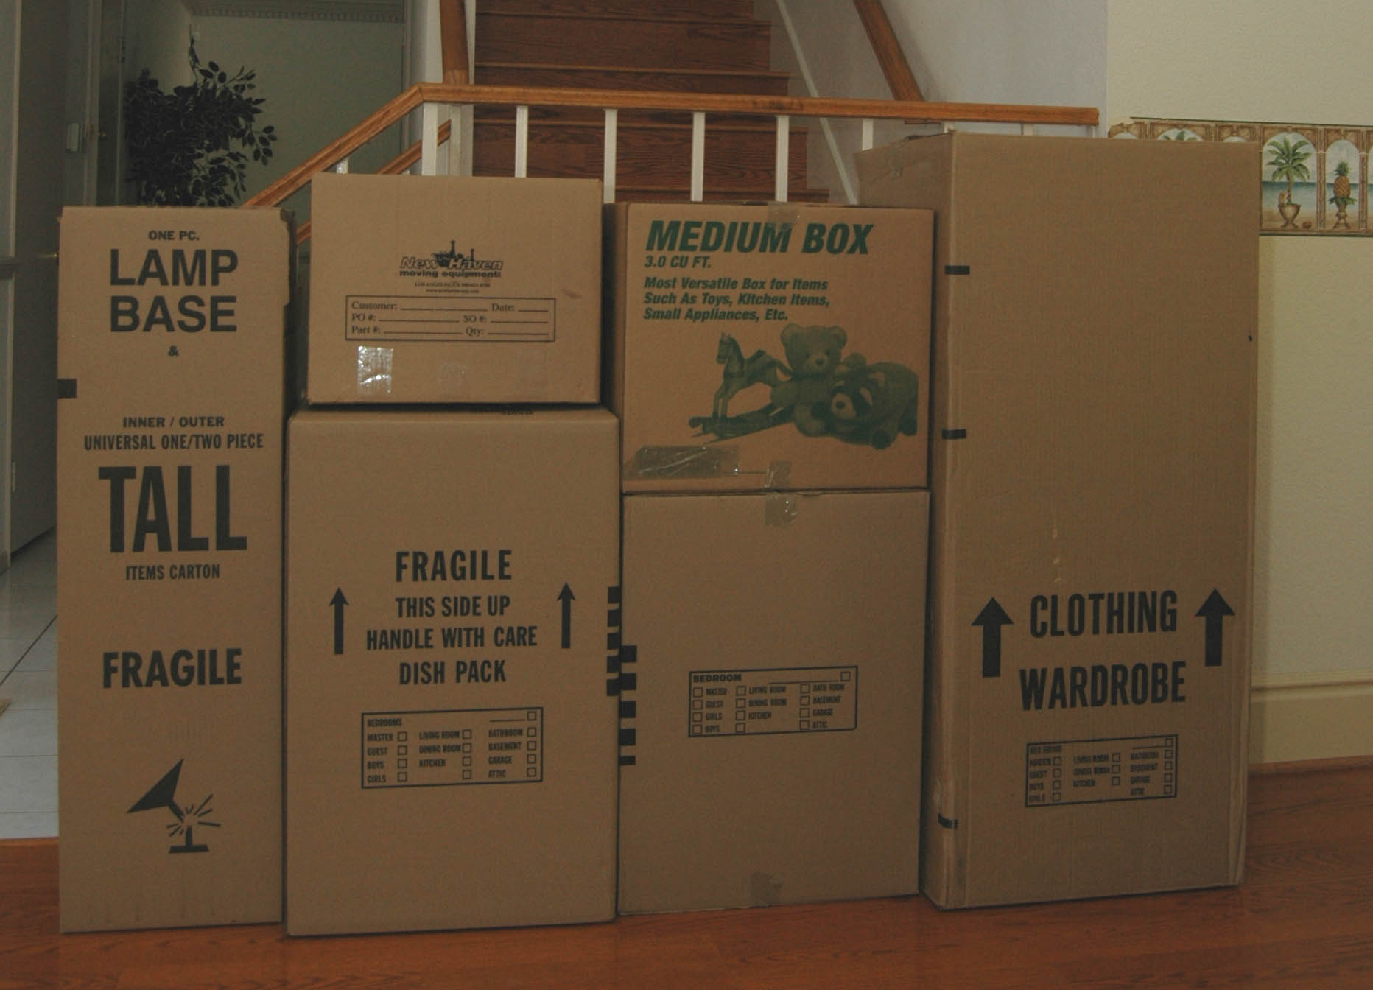

Slide 4


Slide 6


