Slide 1



Creating
Communities of Practice
to Accelerate Learning
Katherine Daniel
Green For All
Horacio Trujillo
Innovations for Scaling Impact
Tanya Beer
Center for Evaluation Innovation

Slide 2
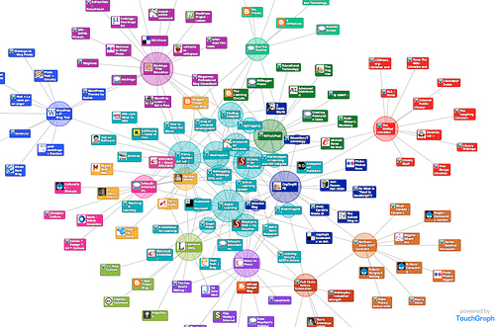
Communities of Practice
Community
Network
Notes:
Rather than thinking about CoPs as distinct from networks, consider a CoP as balance of the “community” and “network” qualities of social learning
The network aspect refers to the set of relationships, personal interactions, and connections among participants who have personal reasons to connect. It is viewed as a set of nodes and links with affordances for learning, such as information flows, helpful linkages, joint problem solving, and knowledge creation.
The community aspect refers to the development of a shared identity around a topic or set of challenges. It represents a collective intention – however tacit and distributed – to steward a domain of knowledge and to sustain learning about it.

Slide 3

Layers of Value in Learning
Immediate value: Activities and interactions
Potential value: Knowledge Capital
Applied value: Changes in Practice
Realized value: Performance improvement
Reframing value: Redefining success
From Wenger, Trayner, de Laat (2011)
Notes:
Immediate value: Activities and interactions
What happened and what was my experience of it?
Potential value: Knowledge Capital
How has my participation changed me? What access to resources has my participation given me?
Applied value: Changes in Practice
What difference has it made to my practice/life/context?
Realized value: Performance improvement
What difference has it made to my ability to achieve what matters to me or other stakeholders?
Reframing value: Redefining success
Has it changed my or other stakeholders’ understanding and definition of what matters?

Slide 4
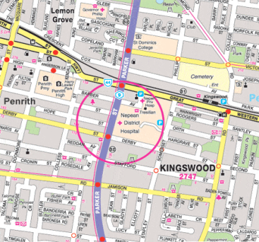


Community of Practice
Structural Elements
Domain
What’s it about?
of knowledge
Who’s in it and how will they participate?
Community
of people
shared
What capabilities does it produce ?
Practice
Notes:
Domain: What topics and issues do we really care about? How is this domain connected to our strategy? What’s in it for us?
What are the open questions and the leading edge of our domain?
Community: What roles are people going to play? How will newcomers be introduced into the community? How often will the community meet and how will members connect in the interim? What kind of activities will generate energy and develop trust? How can the community balance the needs of various members? How will we deal with conflict?
Practice: What do we want to do better and talk about? What knowledge do we want to share, develop, and document? What kind of learning activities and development projects should we engage in?

Slide 5
Design Dimensions
Narrow, invited membership
Broad, open membership
Low expectations for member participation
High expectation for member participation
Unstructured information sharing
Structured group learning
Diffusely managed
Centrally managed
In-person
Virtual

Slide 6

Pointers from the field
Notes:
Design for evolution.
Open a dialogue between inside and outside perspectives.
Invite different levels of participation.
Develop both public and private community spaces.
Focus on value.
Combine familiarity and excitement.
Create a rhythm for the community.

