Slide 1

Rosanna Tran Allison Metz Fatima Angeles June 2013
Breakthrough Strategies to Create a Meaningful Learning Environment

Slide 2
Panelists
Fatima Angeles
The California Wellness Foundation
Allison Metz
on behalf of the Kate B. Reynolds Charitable Trust
Rosanna Tran
California HealthCare Foundation

Slide 3
Who’s in the audience?
Organization Type
Grantmaker
Nonprofit/grantee
Other – consultant, infrastructure/affinity group, government, etc.
Position
Evaluation or knowledge management
Program
Executive
Administrative and other – grants management, trustee, etc.

Slide 4
Session Overview
The Set-Up: Introducing the learning challenges
Hearing from you
The Story: Panel discussion
Questions
Wrap-up and closing

Slide 5


Slide 6



Slide 7
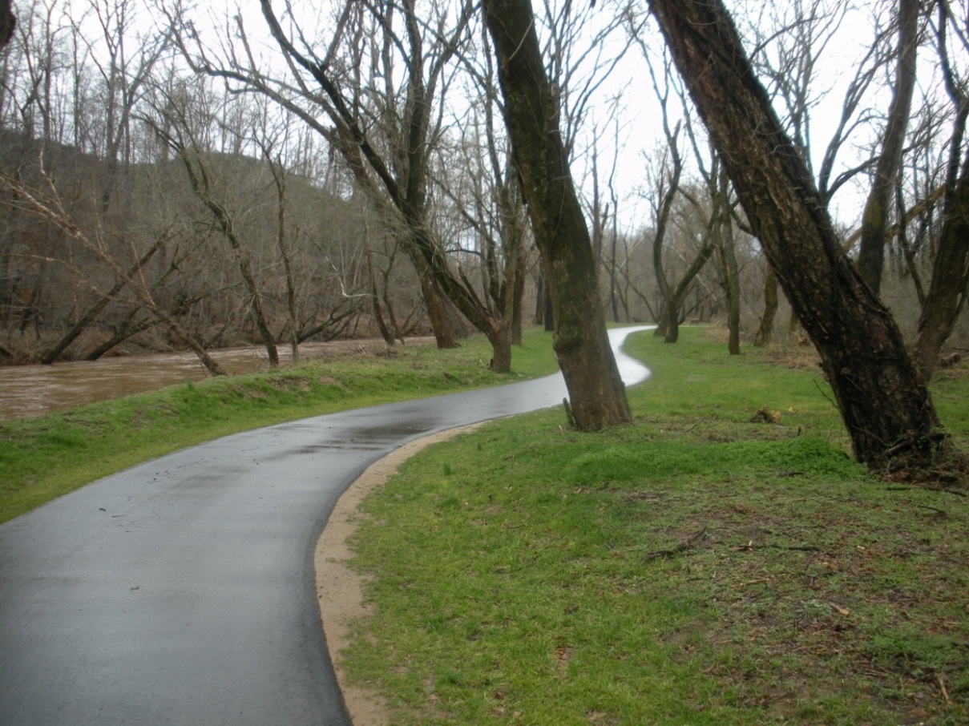
Healthy Places North Carolina
A new Trust initiative supporting community-wide health improvements in rural North Carolina counties.
Greenway, McDowell County
Notes:
Also a new way of doing business for the Trust (discuss why we need a new way), natural transition. We are not stopping traditional responsive grantmaking. There is a still a need for that, and we will continue that work. That said, we are investing a great deal in this new strategy in an effort to make lasting change in some of North Carolina’s neediest rural communities.

Slide 8

Starting Points for Healthy Places NC
Underlying theory:
Tier 1 counties have poor health status.
These problems stem in large part from structural factors.
Progress requires that the Trust do more than simply provide grant funding for disease-specific programming.
Beaufort County waterfront
Notes:
Underlying theory:
Tier 1 counties have poor health status (e.g., diabetes, heart disease, poor nutrition, lack of physical activity, high rates of injury, untreated mental illness and substance abuse)
These problems stem in large part from structural factors that relate to the local history, economy, culture and political structures.
Progress requires that KBR do more than simply provide grant funding for disease-specific programming.
Intent of HPNC
Activate local actors to take more initiative, to think more strategically, to move to action, to work together in ways that go against convention, and to learn from their experience in ways that deepen and broaden the work.
Over the long run, increase the capacity of local actors to identify and solve health problems, and to design and implement programs and policies that advance community health.
Set in motion new thinking and behaviors that ultimately translate into a more health-promoting community culture.

Slide 9
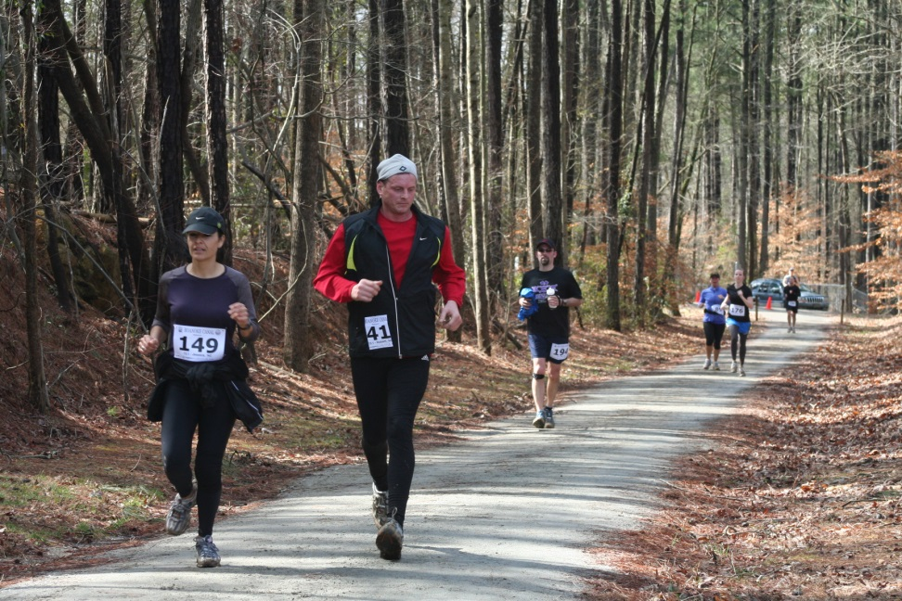
Starting Points for Healthy Places NC
Intent of Healthy Places:
Activate local actors.
Increase the capacity of local actors.
Set in motion new thinking and behaviors that ultimately translate into a more health-promoting community culture.
Halifax County

Slide 10
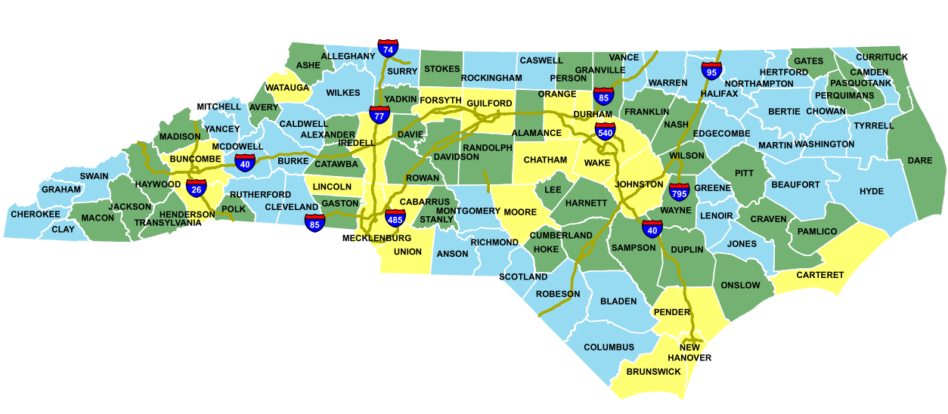
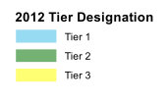
Healthy Places NC
$100 million over 10 years in
10-15 rural, Tier 1 NC counties
Notes:
10

Slide 11
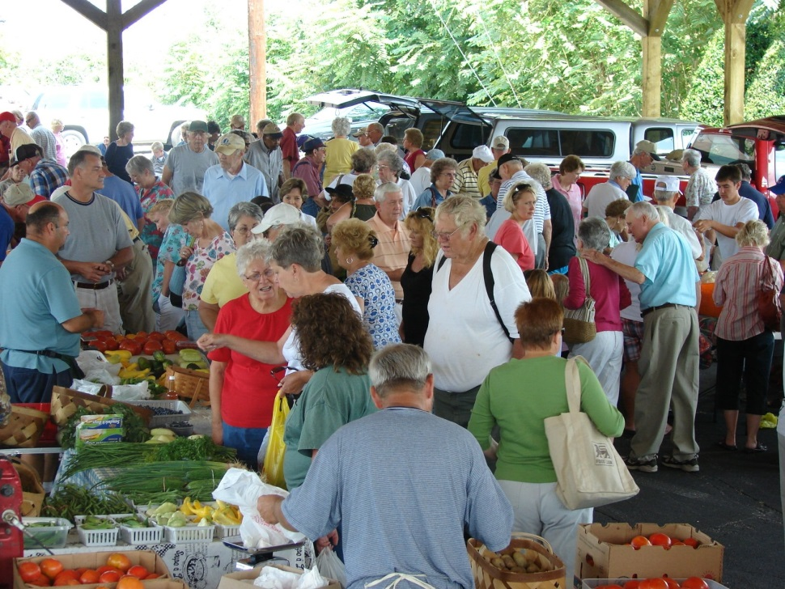
Program Officer Role
Program officer an active agent in the change process.
Overarching activity: Cultivating
Interest and initiative
Relationships and networks
New, bigger, more systems-level thinking
New projects
Farmers market, McDowell County
Notes:
Phase 1: Researchers focused on forming relationships, gathering information, analyzing data, and diagnosing the situation.
Phase 2: Interventionists who prompt local actors to think differently, facilitating networks and cross-sector collaboration, and problem solving.
Phase 3: Colleagues who work closely and openly with local actors to develop more effective and comprehensive projects and strategies.

Slide 12
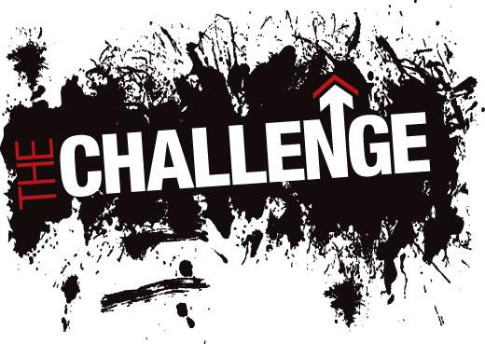
To develop a fully operationalized
Program Officer Practice Model
for engaging and supporting communities
Notes:
Practice profiles have several benefits for HPNC program officers:
Provide a fully operationalized practice model for engaging and supporting HPNC counties
Facilitate the development of effective training protocols, coaching strategies, and staff performance assessments for HPNC program officers
Refine the organizational and systems supports the Trust will need to install to facilitate consistent and effective practice across the HPNC program officers
Promote the use continuous improvement strategies and data-driven decision making as essential functions and activities of the HPNC practice model are tested in interactions with county stakeholders
Increase the replicability of the HPNC practice model in across a range of settings and contexts
Inform ongoing strategic planning efforts to inform next steps and leverage resources that can advance what POs are trying to accomplish with counties
Ensure that outputs and outcomes as they related to expected county milestones can be accurately interpreted

Slide 13

Who We Are and What We Do
Health conversion foundation based in Oakland, CA
Focus on improving health care delivery, policy, and financing in California
$40 million per year in grants
50 staff
Notes:
Private, nonprofit foundation, created when Blue Cross of CA converted from nonprofit to for-profit in 1996
Ideas and innovations that improve quality, increase efficiency, and lower the cost of care.
Improving clinical outcomes and quality of life for Californians with chronic disease.
Reducing barriers to efficient, affordable health care for the underserved.
Promoting greater transparency and accountability in California's health care system.
Supporting the implementation of health reform and advancing the effectiveness of California's public coverage programs.

Slide 14
Organizational Learning at CHCF
Advisory Group on Organizational Learning & Evaluation (OLÉ)
Grants: Closeout Forms
Projects: Results Reports
Topic: Organizational Learning sessions
Orientation: Grantmaking 101 for new staff
What’s Next?
Notes:
The function of organizational learning at CHCF falls under the Research & Evaluation department, which was established at CHCF in 2007. Since then, CHCF has developed a number of ways to capture lessons from our grantmaking. These efforts are guided by an advisory group on organizational learning and evaluation (OLE for short).
Closeout forms: After a grant is closed, program officers complete a brief survey that captures grant processes and lessons learned from individual grants. The quantitative data and comments from these forms are summarized two times a year in a Closeout Report and discussed at regular staff meetings.
Results reports: a practice borrowed and adapted from the Robert Wood Johnson Foundation, Results Reports are written for an internal audience and summarize accomplishments, impact, challenges, and lessons learned from CHCF’s larger initiatives. These are also discussed at regular staff meetings, and a summary is provided to the board every quarter.
Learning sessions: these focused sessions allow program staff to drill down on topics that cut across CHCF projects and program areas. Topics have included working with consumer partners, informing policy, and spreading ideas and best practices, and are typically based on recurring themes in Results Report or Closeout Reports.
New staff orientation: with an influx of new staff hired in 2011 and 2012, Research & Evaluation staff partnered with senior staff to develop a formal orientation process for new staff. A series of interactive “Grantmaking 101” sessions that promote exchanges and discussions across programs and between newer staff and more experienced staff comprise the centerpiece of this orientation program. Between November 2011 and June 2013, we’ve held 11 sessions on topics ranging from an overview of philanthropy to developing your first project to managing relationships with grantees.

Slide 15
How can we learn better?
Notes:
While CHCF had successfully been documenting lessons from its grantmaking via the efforts I just described, it was not always clear how the Foundation could apply those lessons in a tangible way. In 2012 at the urging of its leadership, we started thinking about with what to do next? And we began to explore how we could more effectively use learning to become better a grantmaker.
Recognizing that the goal is not to gather as many lessons as possible but to use those lessons to improve how we do our grantmaking, so how could we take our efforts one step further to institutionalize organizational learning?

Slide 16

Who We Are and What We Do
Independent, private foundation; assets came from the conversion of HealthNet from nonprofit to for profit.
HQ in Woodland Hills, CA, branch office in San Francisco, CA
$40 million in grants each year
42 staff

Slide 17
Evaluation and Organizational Learning
Evaluation – internal and external; goal is to learn from our grantees, our strategies, our approach so that we can improve our work
Knowledge Management – goal is to collect, manage and use relevant and accurate data to inform and improve our work
Organizational Learning – goal is to support the continual learning and growth of the grantmaking team.
Peer learning and sharing
Reflective practice
Annual learning theme

Slide 18
How do you make room for learning?

Slide 19
Hearing from You
Clarifying questions?
Turn to your neighbor and discuss:
What are the learning challenges at your organization?
How do you identify the learning needs of your colleagues?
Report-back

Slide 20


Slide 21

What were your first steps in addressing your learning challenge?

Slide 22
Role of NIRN
Operationalizing and testing the Healthy Places Program Officer Practice Model.
Coaching for competence through a Learning Collaborative.
Managing the process by which POs track their behavior and experiences with Healthy Places.
Promoting ongoing improvement and refinement of the model over time.
Notes:
Initially proposed work at the county level to support implementation of strategies and initiatives

Slide 23
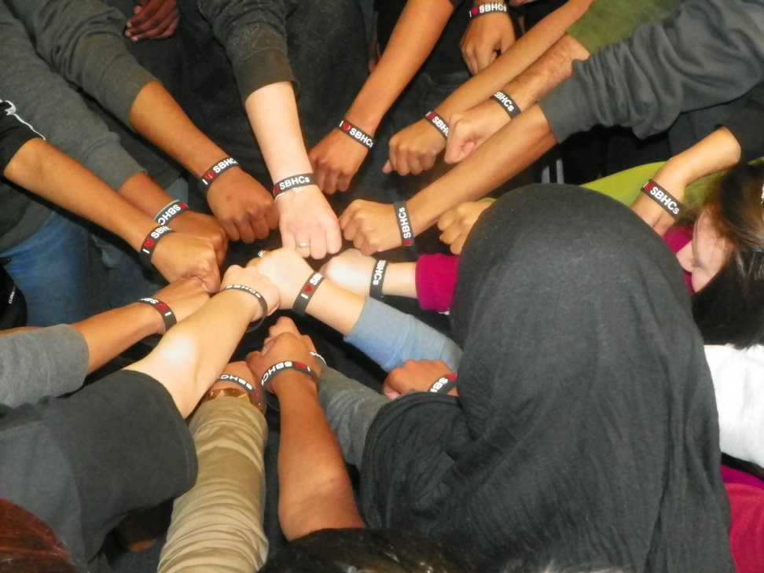
Learning Strategy
Learning Strategy
Learning Collaborative + One-on-One support
Engaging leadership and staff
Consistent support and feedback
Notes:
Learning Collaborative is monthly with one on one meetings in between

Slide 24
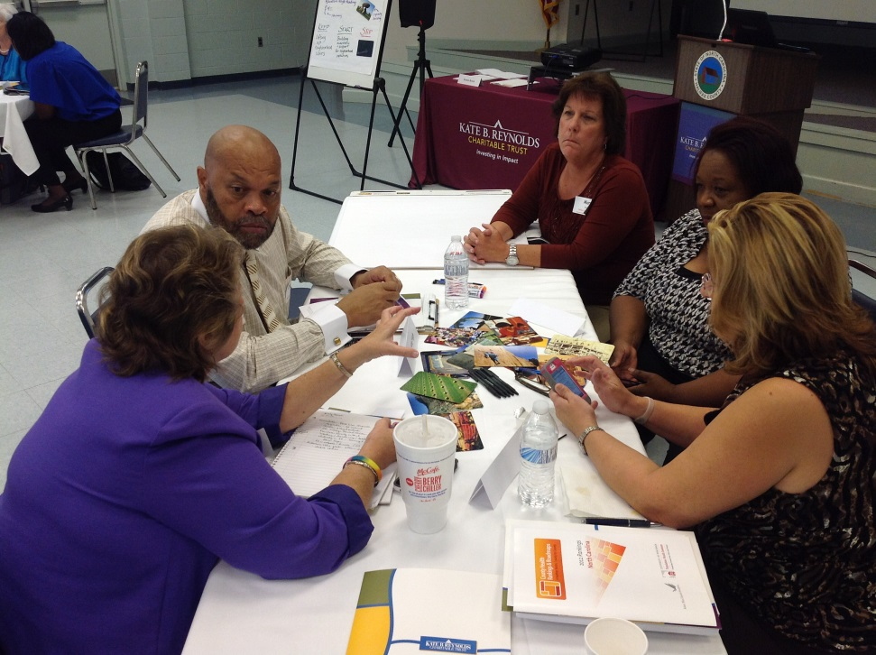
Program Officer Role
Key tasks:
Reach out to wide range of organizations and residents (even if ineligible for Trust grant).
Encourage local actors to take initiative, to develop their ideas, and to move their ideas into actionable strategies.
Connect actors with complementary interests.
Distinct phases to the work:
Phase 1: Researchers
Phase 2: Interventionists
Phase 3: Colleagues
Collaborative meeting, Halifax County

Slide 25

Program Officers’Guided by Practice Model
PHASES | 1 – RESEARCHER ROLE |  | 2 – INTERVENTIONIST ROLE |  |  | 3 – COLLEAGUE ROLE
 | Forming relationships with people and organizations; gathering information, analyzing data, and diagnosing the situation |  | Prompting and facilitating local actors to think and act differently together; facilitating networks and cross-sector collaboration; and problem-solving |  |  | Working closely and openly with local actors to develop more effective and comprehensive projects and strategies
MILESTONES | PO Visibility and Interactions Relationships Small Grants and Wins |  | Relationships Deliberations and Planning Small Grants and Wins |  |  | Relationships New projects, initiatives, campaigns
FUNCTIONS | Active Listening Building & Managing Relationships Communication Power Analysis Brokering Connections |  | Facilitating Networks & Collaboration Strategic Analysis & Problem Solving |  |  | Strategic Analysis & Problem Solving Questioning & Advising
 | Critical Thinking (in phase) | Critical Thinking (between phases) |  | Critical Thinking (in phase) | Critical Thinking (between phases) |  | Critical Thinking (in phase)
Range of grantmaking, monitoring, and management
Notes:
Program officer an active agent in the change process.
Overarching activity: Cultivating
Interest and initiative
Relationships and networks
New, bigger, more systems-level thinking
New projects
Key Tasks
Reach out to wide range of organizations and residents (even if ineligible for KBR grant)
Encourage local actors to take initiative, to develop their ideas, and to move their ideas into actionable strategies.
Connect actors with complementary interests.
Distinct phases to the work
Phase 1: Researchers focused on forming relationships, gathering information, analyzing data, and diagnosing the situation.
Phase 2: Interventionists who prompt local actors to think differently, facilitating networks and cross-sector collaboration, and problem solving.
Phase 3: Colleagues who work closely and openly with local actors to develop more effective and comprehensive projects and strategies.

Slide 26

How can we learn better?
How can we
maximize CHCF’s impact?

Slide 27
Capturing Lessons
Creating Change
?

Slide 28
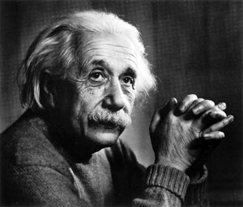
If I had an hour to solve a problem and my life depended on the solution, I would spend the first 55 minutes determining the proper question to ask, for once I know the proper question, I could solve the problem in less than five minutes.

Slide 29
Challenge: Making room for learning
Tried a range of things – still trying!
Maximize learning at staff meetings
Creating opportunities to document learning
Role: Facilitator and coach
Organizational buy-in
Developing an annual learning agenda

Slide 30
What challenges did you face?

Slide 31
Challenges
Defining the “it” and capturing key information for usability testing
Stabilizing the model “enough” to move to coaching
Notes:
Learning Collaborative is monthly with one on one meetings in between

Slide 32
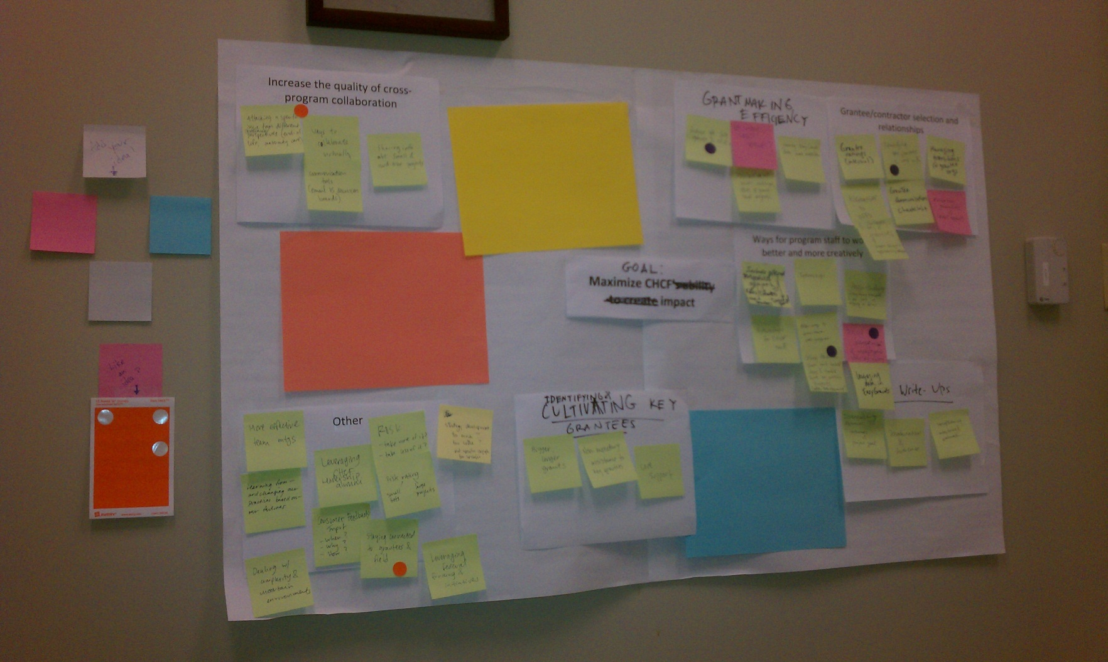
Notes:
April 16

Slide 33
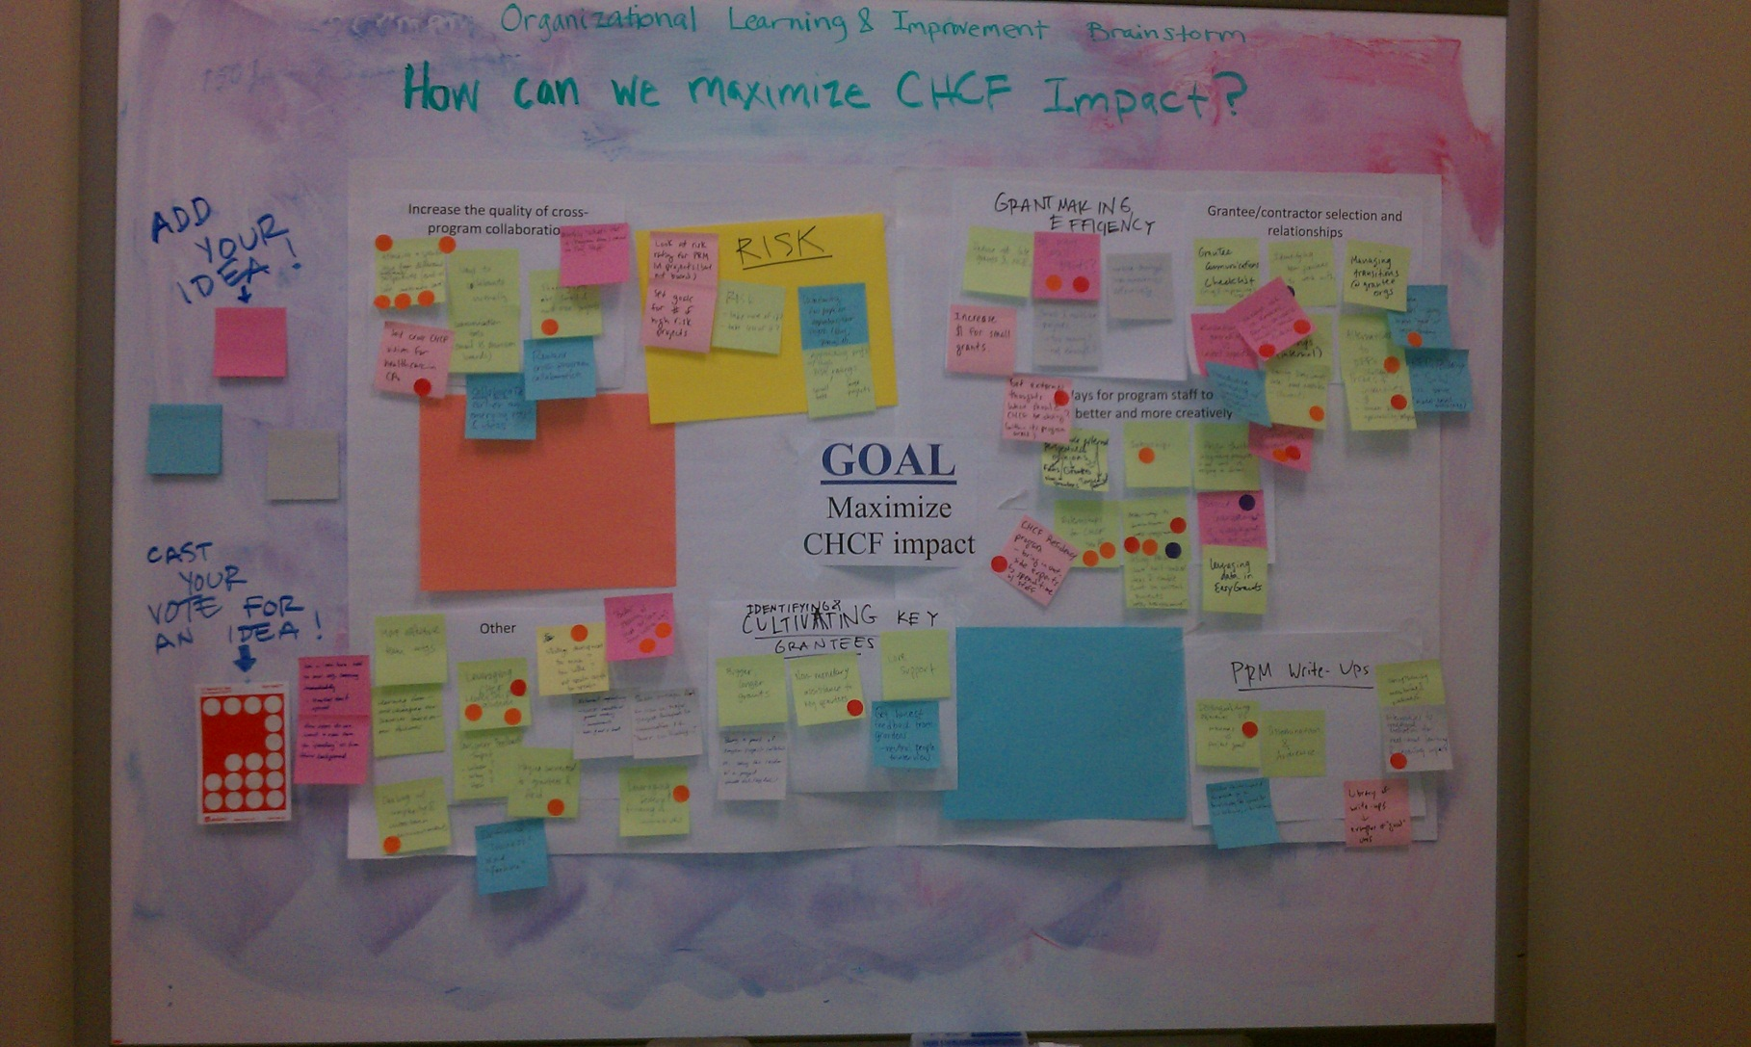
Notes:
May 2

Slide 34
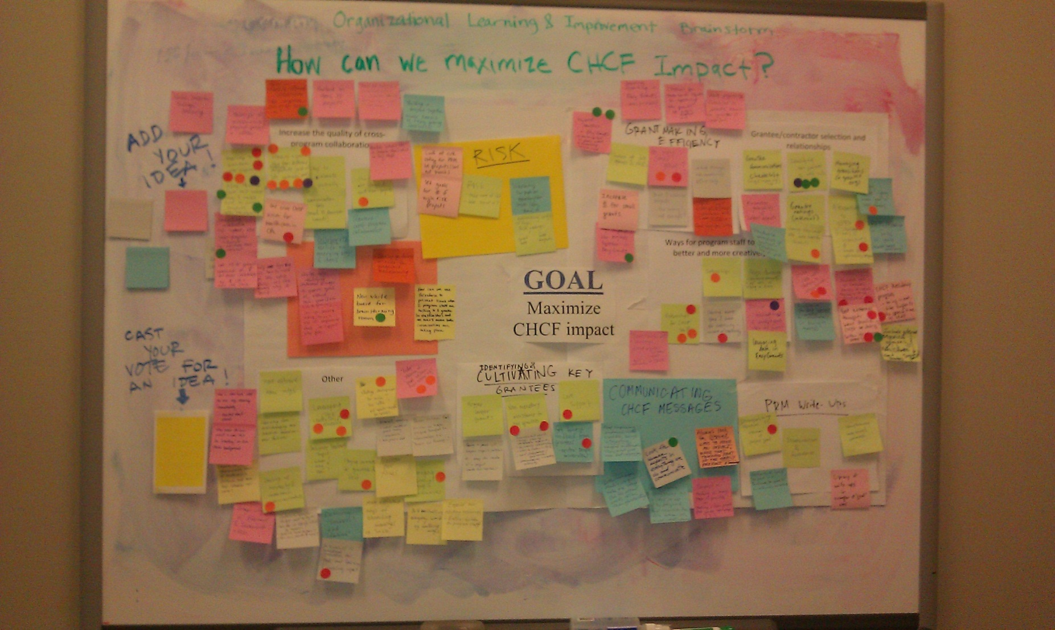
Notes:
May 11

Slide 35
Challenge: How do we make room for learning?
Everyone is really busy
While learning is an organizational value, there aren’t performance metrics that tie to this
Everything we wrote was geared towards the board and leadership; none for documenting thoughts, musings, observations
Influence without authority

Slide 36
How did you create an environment conducive to learning?

Slide 37

Learning Environment
Creating a “safe space” for facilitated reflection and peer to peer learning
One-on-one coaching for competence with POs
Bridging leadership and practice
Notes:
Learning Collaborative is monthly with one on one meetings in between

Slide 38
Five Key Learning Opportunities
Improve cross-program exchanges of ideas
Increase engagement with external stakeholders
Widen pool of potential grantees
Expand our toolbox
Discern when to double down versus cut our losses

Slide 39
Vote

Slide 40


Let’s build our toolbox!

Slide 41
Reinforce that LEARNING is an organizational value
Craft, curate, facilitate meetings and discussions to maximize learning
Encourage peer dialogue = share experiences, lessons learned
Seek input and develop activities in partnership with colleagues
Seek opportunities to incentivize learning efforts

Slide 42
What have been the fruits of your learning efforts?

Slide 43
Fruits of our Learning Efforts
Identifying key areas for building competency and confidence
Facilitating refinement of initiative-level logic model
Notes:
Learning Collaborative is monthly with one on one meetings in between

Slide 44
PO Practice Model that has promoted:
Coaching for competency on essential functions
Conducting usability testing to identify, refine and stabilize the phases and functions of the model
Engaging in formative evaluation
Promoting continuous improvement of the model
Refining organizational and systems supports at the Trust
Ensuring that outputs and outcomes related to expected county milestones can be accurately interpreted

Slide 45
23 Tools in the Box
Advisory Groups
California Healthcare Leaders Network
California Improvement Network Challenges and Prizes
Contract Language
Core support grant
Data Analysis Tools (DIY)
Demonstration
Grantee site visits
Innovation Learning Network
Intermediary
Mapping
Memorandum of Understanding
Micro-documentaries
Online Surveys (DIY)
Public Service
Request for Information (RFI)
Sacramento Briefings
Showcase
Survey (commissioned)
Technical assistance for grantees and partners
Truth on Call (ToC)
Webinar

Slide 46
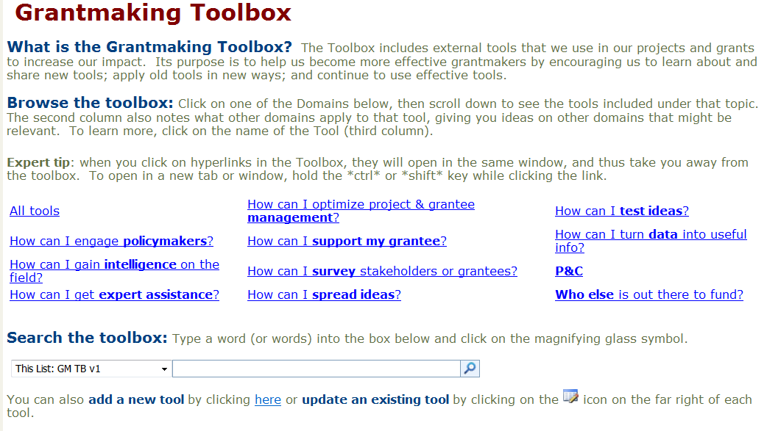

Slide 47
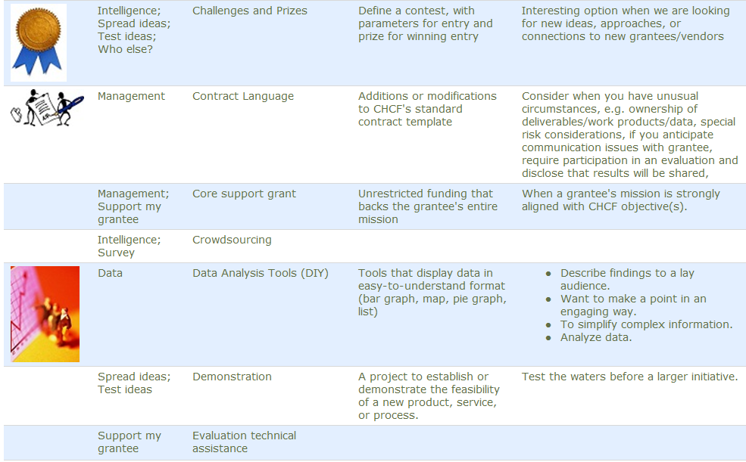

Slide 48
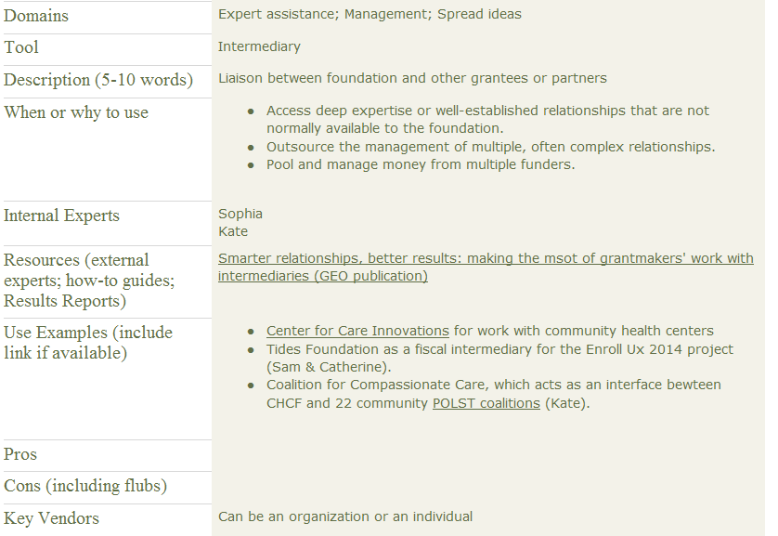
Intermediary
(example of a tool)

Slide 49
Other benefits
Institutionalizing knowledge
Orienting new staff
Facilitating cross-program collaboration

Slide 50
What surprised you?

Slide 51
Surprises
Challenges in integrating learning so it did not feel like an “add on” or extra burden
Extension of learning to entire foundation is critical for success
Notes:
Learning Collaborative is monthly with one on one meetings in between

