Slide 1

Shared library services: where there's a value in numbers
A tale of two services
Ross MacIntyre, Mimas, The University of Manchester
ER&L Conference, March 2014

Slide 2


Slide 3
What does JUSP offer?
a single gateway for libraries to access e-journal usage statistics from participating publishers
accurate usage statistics to help in analysing the value of impact of e-journal collections.
  Saving time and duplicated effort
  Providing better data and more reliable data for decision-making

Slide 4




The JUSP team

Slide 5
A single gateway
Access to COUNTER journal level reports, normally from 2009 to date.
  JR1 reports
  JR1a (backfile) reports
  JR1 GOA (Gold Open Access)

Slide 6
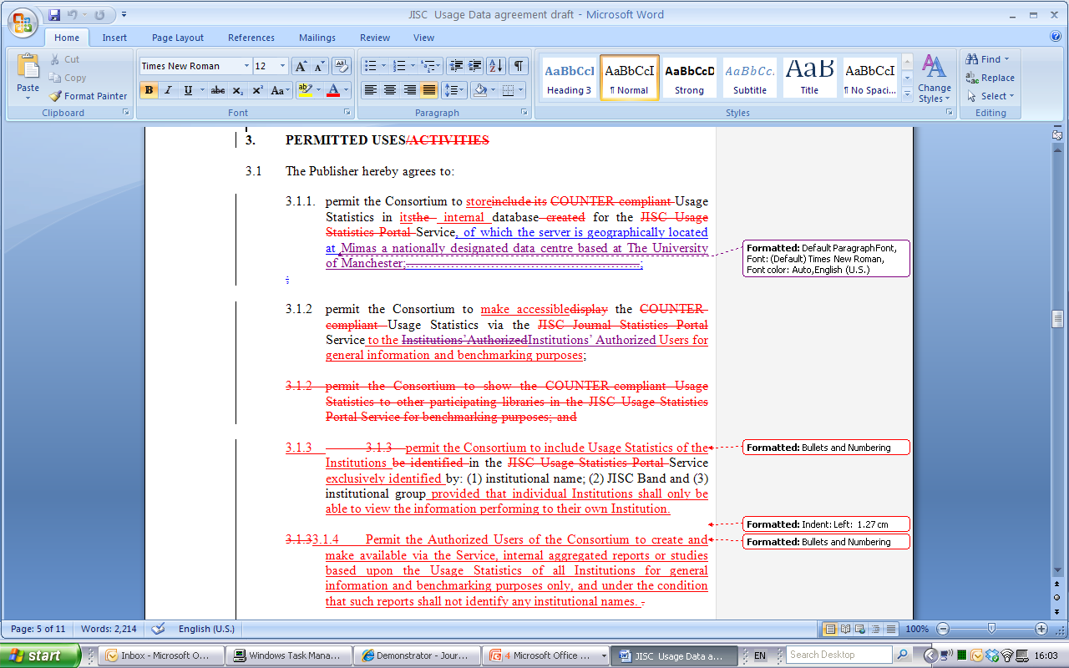

Some slight modifications…

Slide 7

How do we collect data?
Standardized Usage Statistics Harvesting Initiative (NISO Z39.93 )
M2M way of gathering statistics
Replaces the user-mediated collection of usage reports
SUSHI server to gather data from JUSP

Slide 8
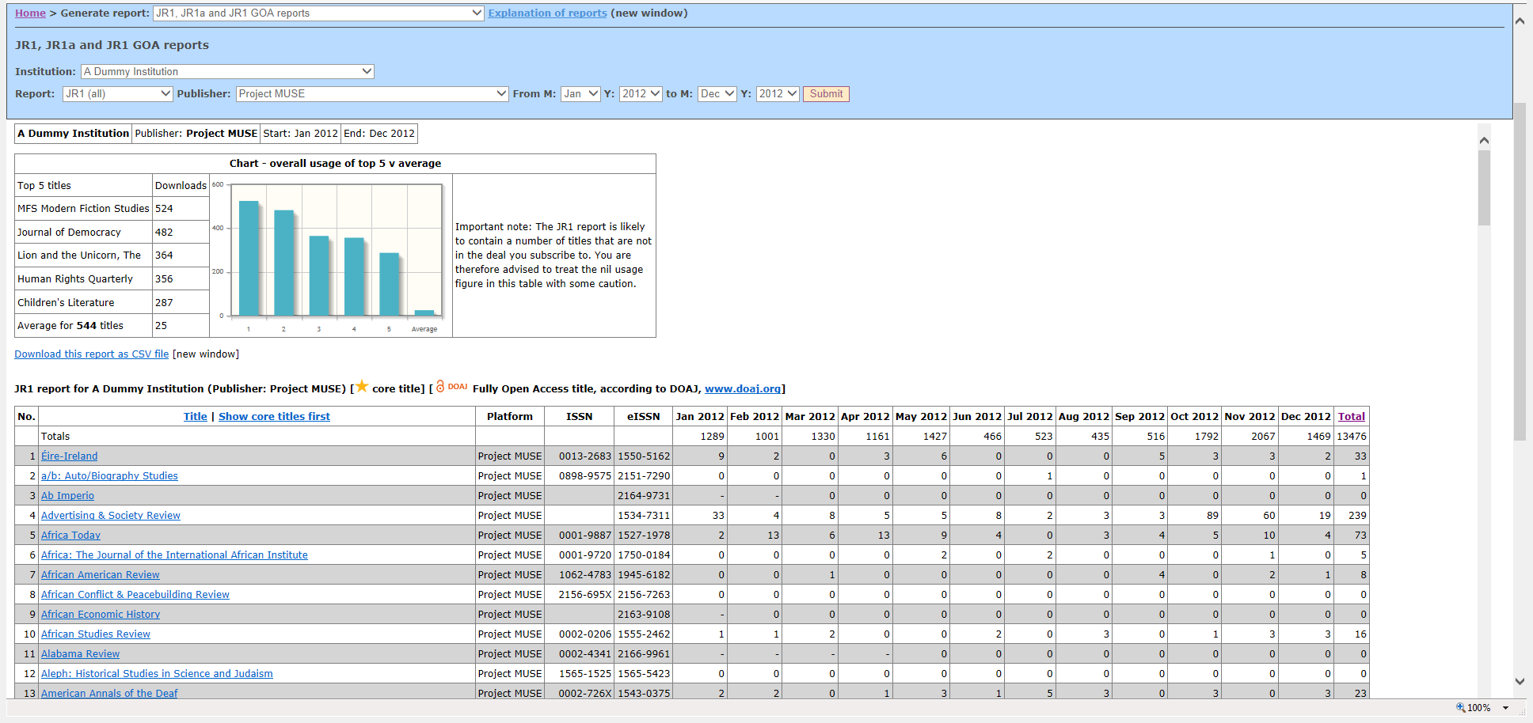
JR1 – Project Muse

Slide 9
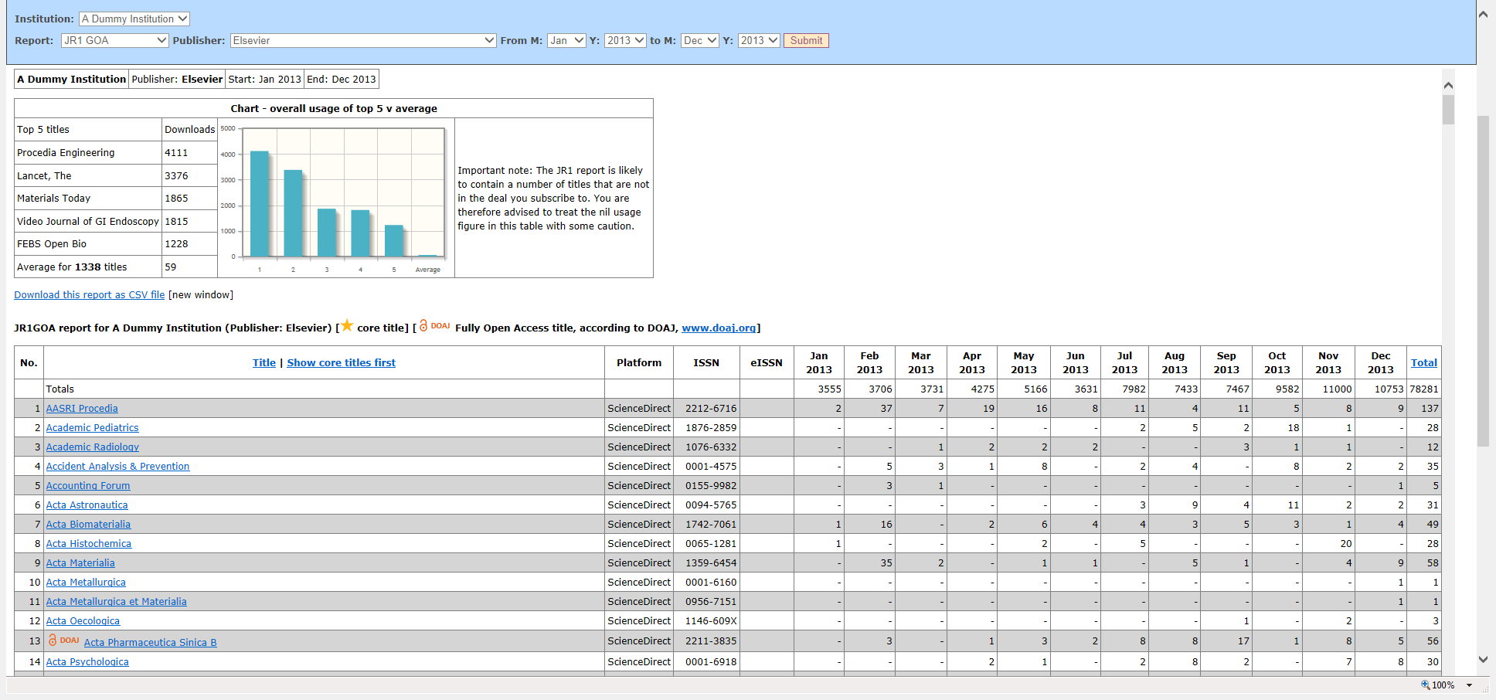
JR1 GOA report

Slide 10
Added value
Summary reports include:
  SCONUL return
  Titles with highest use
  Number of titles and requests in various usage ranges
  Trends over time
  Usage through gateways and host intermediaries

Slide 11
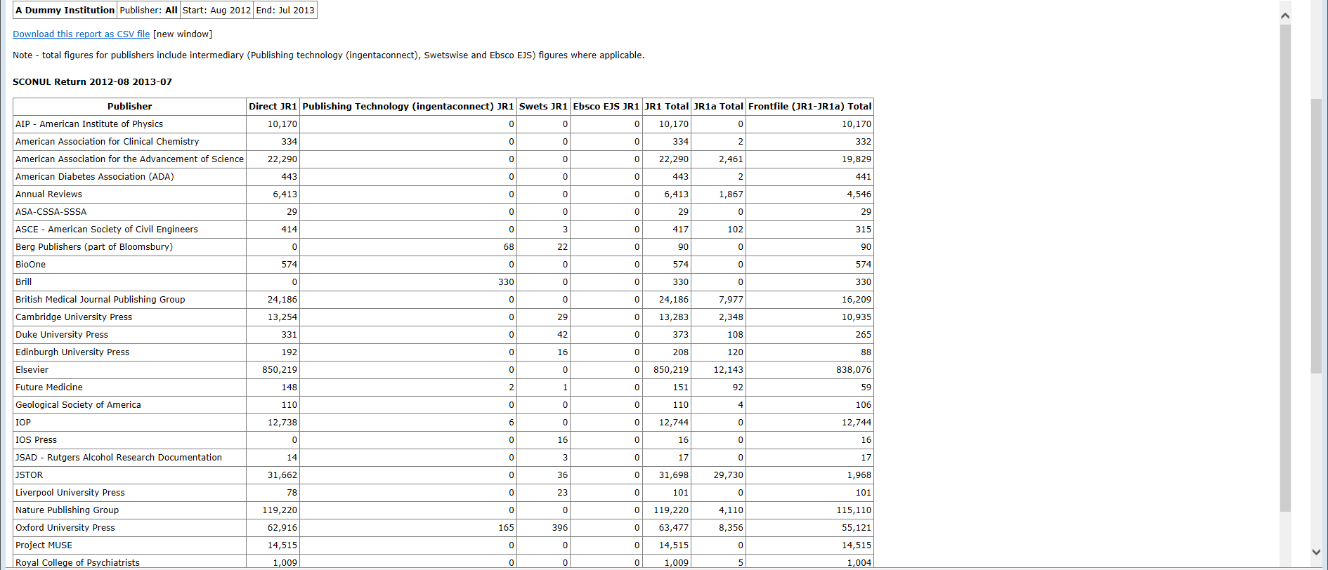
SCONUL return: total usage for an academic year

Slide 12
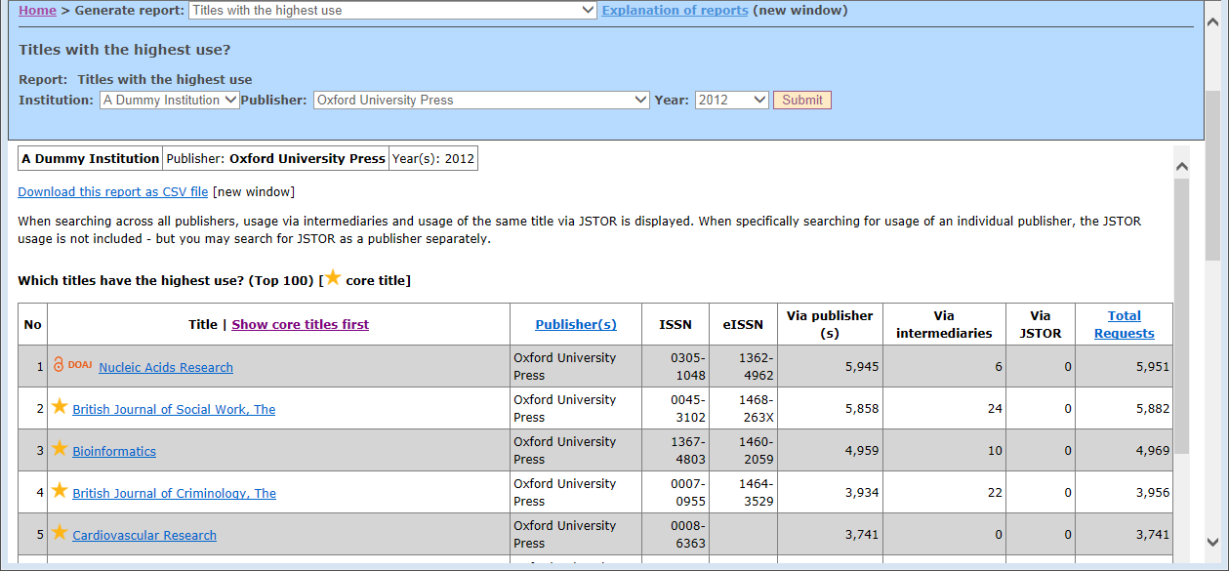
Titles with the highest use

Slide 13
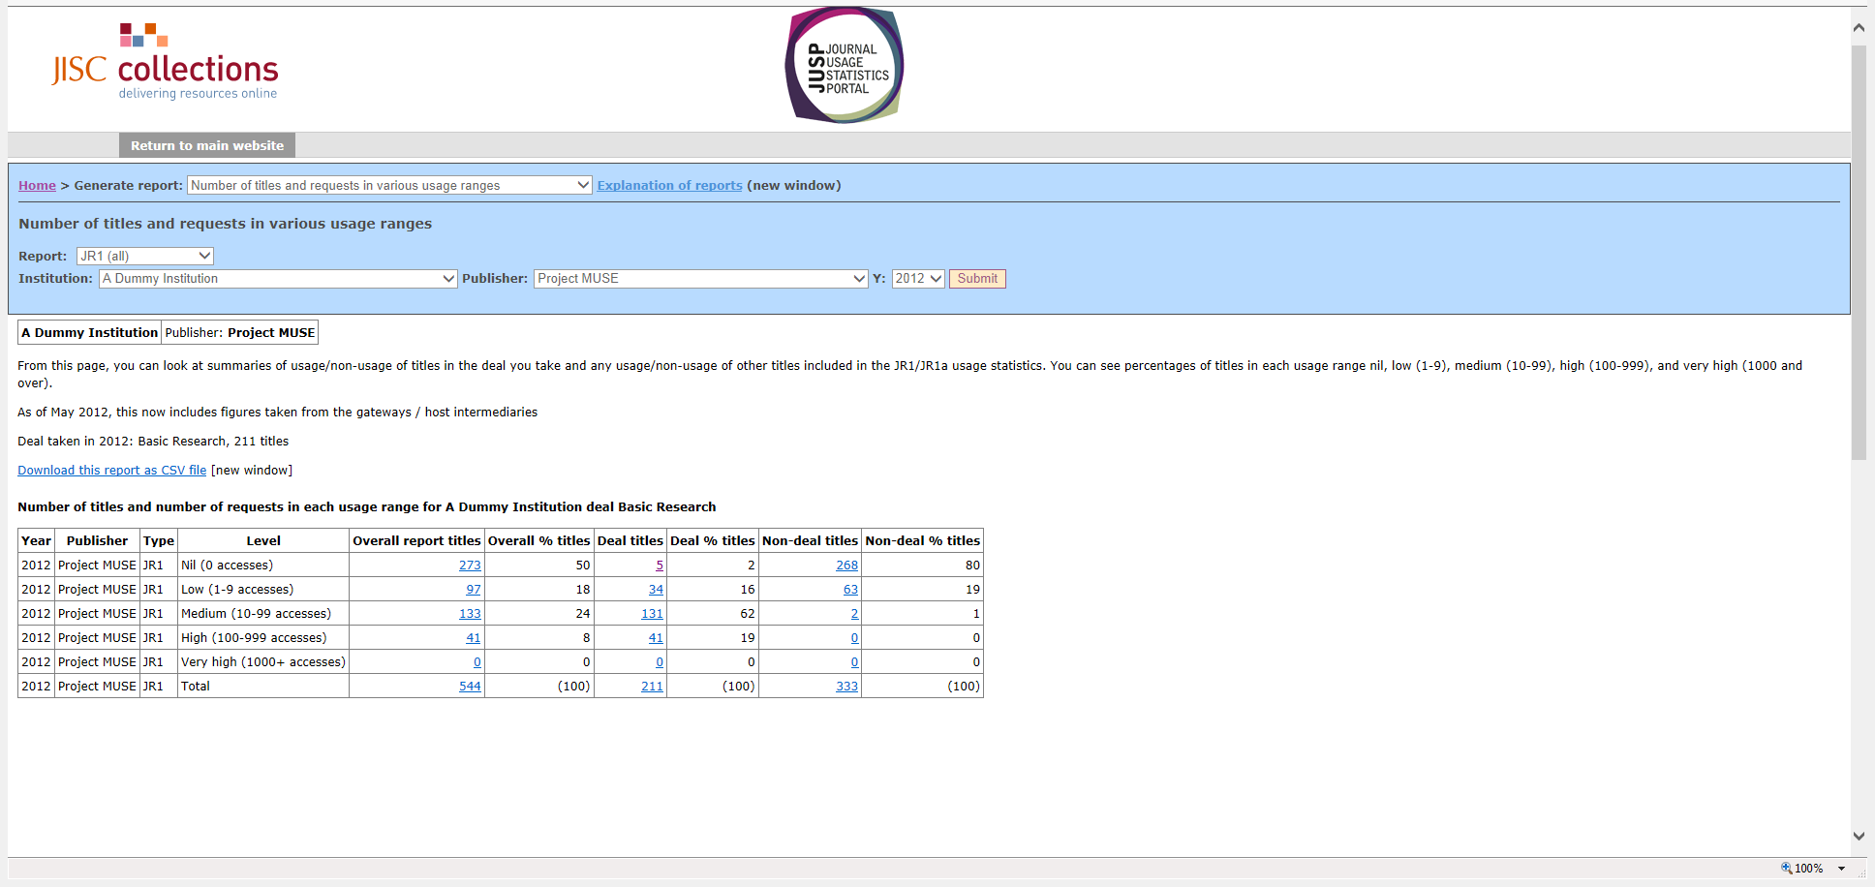
Number of titles and requests in various usage ranges

Slide 14
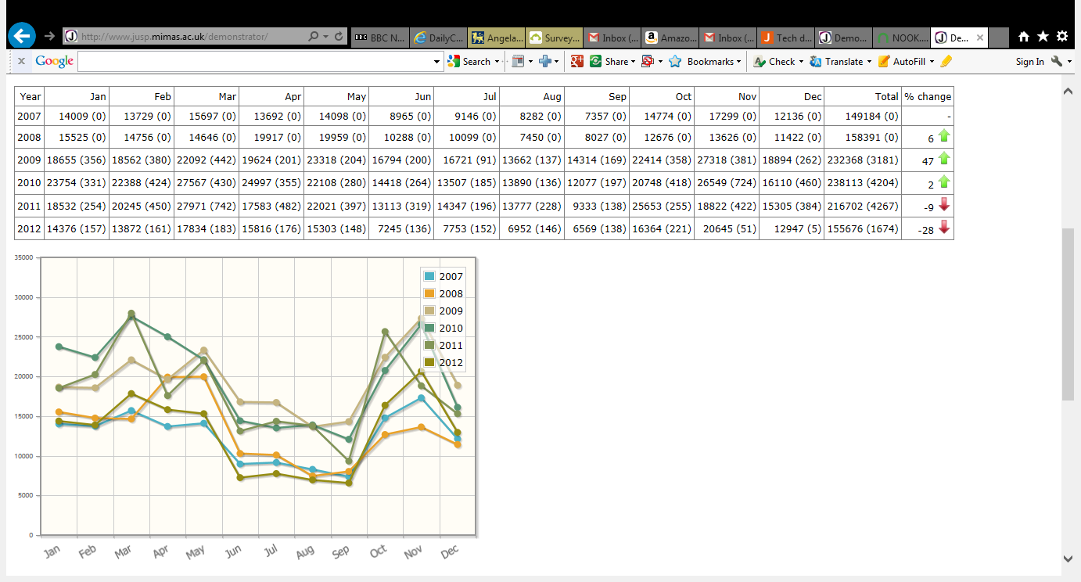
Trends over time – tables and graphs

Slide 15
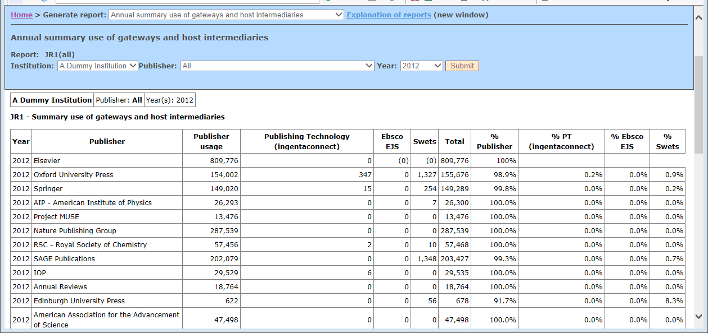
Annual summary use of gateways and host intermediaries

Slide 16
Special features
  Adding core/subscribed titles
  Title lists
  Reviewing titles within different deals
  Usage of titles and deals
  Usage profiling

Slide 17
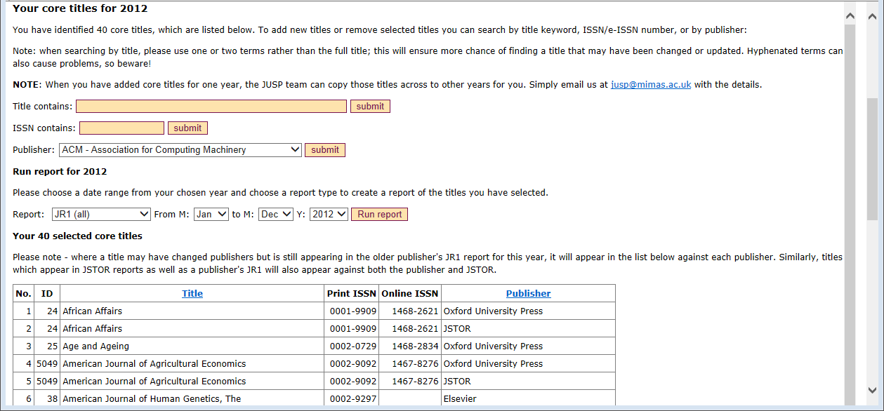
Core titles

Slide 18
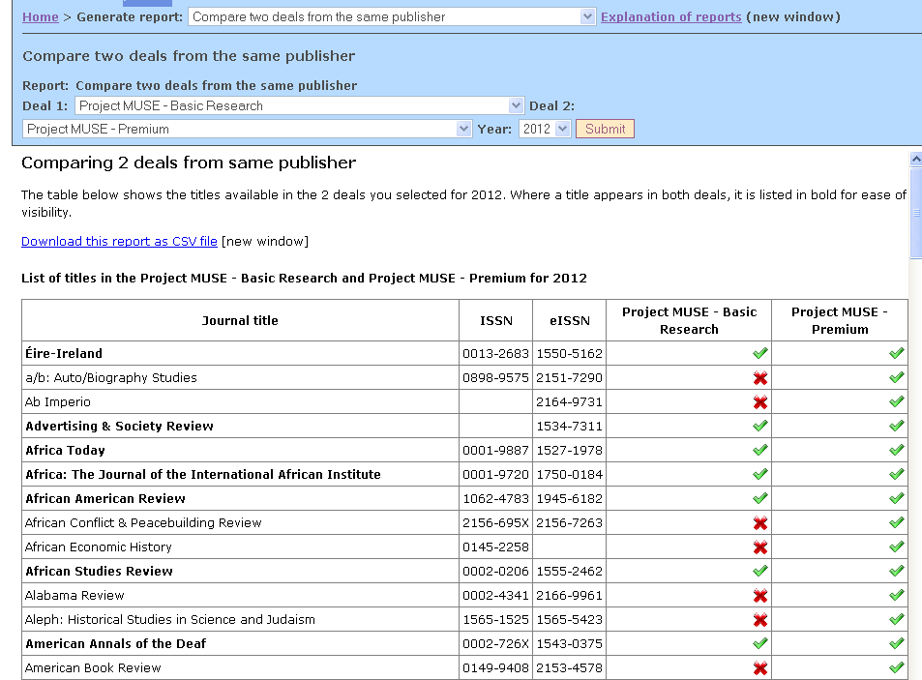
Compare two deals from the same publisher

Slide 19
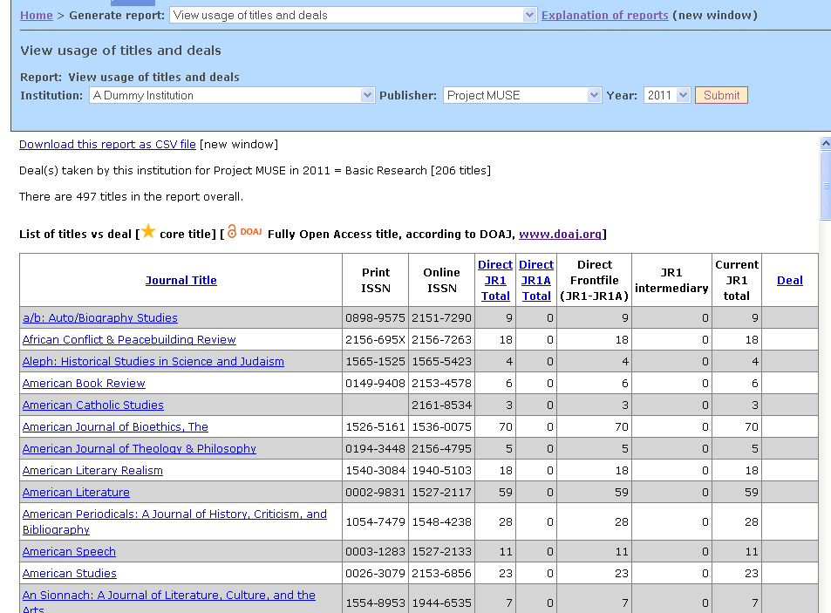
View usage of titles and deals

Slide 20
Usage profiling
Enables libraries to see how their usage compares with the average for others in the same Jisc band, group and region.
Useful for:
Marketing and promotion
Seeking reasons for use which is higher or lower than average
Decisions on renewal/change of deal

Slide 21
Supporting the JUSP community
JUSP Community Advisory Group (CAG)
Workshops & exercises
Webinars
Use cases
Support materials:
  guides to individual reports & features
  ‘getting started’ guides for new users
  FAQ
Community area

Slide 22
Future/on-going developments
Extending range of publishers in JUSP
Support for institutions (workshops, webinars)
e-books pilot
Counter 4 (accommodating R4, JR5)
Interoperability with KB+ (& GOKB)
Ensuring JUSP aligns with user workflows and responds to emerging requirements
JUSPConsult

Slide 23
JUSP Community Survey 2013
The best thing about JUSP is:
“I can see a whole range of publisher statistics with one login.”
“It saves me time and gives me confidence that errors in usage data can be picked up and addressed collaboratively.”
“The range of different reports can help with different aspects of ejournal collection management”
“Very customer focused and develops in response to customer needs”
“Wouldn't be without it”

Slide 24
Where to find out more
JUSP website: www.jusp.mimas.ac.uk
JUSP helpdesk: jusp@mimas.ac.uk

Slide 25

Institutional Repository Usage Statistics - UK

Slide 26
IRUS-UK
Funded by Jisc
Project Team Members:
  Mimas, The University of Manchester – Project & Service Management & Host
  Cranfield University - Development
  EvidenceBase, Birmingham City University – User Engagement & Evaluation
Outcome of PIRUS2 (Publisher and Institution Repository Usage Statistics)
  http://www.cranfieldlibrary.cranfield.ac.uk/pirus2/
  Aimed to develop a global standard to enable the recording, reporting and consolidation of online usage statistics for individual journal articles hosted by IRs, Publishers and others
  Proved it was *technically feasible*, but (initially) easier without ‘P’
IRUS-UK: Institutional Repository Usage Statistics – UK
  Enable UK IRs to share/expose usage statistics based on a global standard – COUNTER

Slide 27
IRUS-UK: aims & objectives
Collect raw usage data from UK IRs for *all item types* within repositories
  Downloads not record views
  Not just articles
Process those raw data into COUNTER-compliant statistics
Return those statistics(+) back to the originating repositories for their own use
Give Jisc (and others) a wider picture of the overall use of UK repositories
  demonstrate their value and place in the dissemination of scholarly outputs
Offer opportunities for benchmarking/profiling/reporting/
Act as an intermediary between UK repositories and other agencies
  e.g. global central clearinghouse, national shared services, OpenAIRE

Slide 28
IRUS-UK: gathering data
Considered 2 scenarios for gathering data
  Push: ‘Tracker’ code
    Whenever a download occurs the repository ‘pings’ the IRUS-UK server with details about the download
  Pull: OAI-PMH harvesting
    When a download occurs the details of the event are stored on the local repository server
    IRUS-UK periodically harvests the download data (using the OAI-PMH protocol)
Opted for the Push method – ‘Tracker’
  Just easier - but minimise data pushed
  Patches for Dspace (1.8.x and 3.x) and Plug-in for Eprints (3.3.x)
  Implementation guidelines for Fedora
  Same method used in other contexts too, eg Book downloads from OAPEN

Slide 29
IRUS-UK: Tracker strings ‘pinged’
The OpenURL key/value pairs
  url_ver=Z39.88-2004
  url_tim=2012-07-05T22%3A59%3A59Z
  req_id=urn%3Aip%3A86.15.47.114
  req_dat=Mozilla%2F5.0+(iPhone%3B+U%3B+CPU+iPhone+OS+5_1_1+like+Mac+OS+X%3B+en-us)+AppleWebKit%2F534.46.0+(KHTML%2C+like+Gecko)+CriOS%2F19.0.1084.60+Mobile%2F9B208+Safari%2F7534.48.3
  rft.artnum=oai%3Aeprints.hud.ac.uk%3A8795
  svc_format=application%2Fpdf
  rfr_id=eprints.hud.ac.uk

Slide 30
IRUS-UK: processing data
Logs are processed daily
Step 1: Perl script parses the logs
  Processes entries from recognised IRs
  Sorts and filters entries following COUNTER rules
  Consolidates daily accesses for each item
  Outputs to intermediate file
Step 2: Perl script parses intermediate file
  Looks up each item in the IRUS DB
    If item is unknown to the system add item with (most) metadata “unknown”
  Updates DB with new statistics (for both ‘known’ & ‘known unknowns’)
Step 3: Obtain “unknown” metadata
  For the ‘known unknowns’ retrieve metadata from Source IR (using OAI GetRecord)
  Updates the metadata to DB

Slide 31
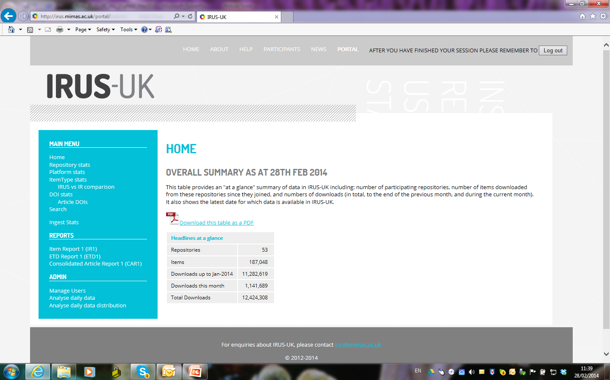
IRUS-UK: Overall Summary
SKIP

Slide 32
IRUS-UK: the ingest process
The existing ingest process has been described in detail previously, see : http://www.irus.mimas.ac.uk/news/
The key point is to apply the COUNTER Code of Practice to filter out robots and double clicks
However the COUNTER Robot Exclusion list is specified only as a *minimum requirement* – more can be done
We’ve added additional filters to
  Remove more user agents
  Apply a simple threshold for ‘overactive’ IP addresses
  Substantially better, but we’re still not satisfied - we need a more sophisticated filtering system!

Slide 33
IRUS-UK: the new ingest process
‘Information Power‘ investigation & report:
  Analysed raw data collected since July 2012
  Tested the feasibility of devising algorithms to ‘dynamically’ identify unusual usage/robot activity
  Suspicious behaviour can’t necessarily be judged on the basis of one day’s usage
  Can be almost impossible to distinguish between genuine and non-genuine activity
In each calendar month we will process logs daily
  Eliminate as much as we can with a quick, minimalist approach
  Insert statistics into a ‘Provisional Daily Stats’ table
At the end of each month reprocess those provisional stats
  Apply more comprehensive, sophisticated filtering
  Load the restated stats into the permanent daily stats table
  Empty the provisional table ready for the next month

Slide 34
IRUS-UK: “What’s the value proposition?”
Facilitates comparable, standards-based measurements
Provides consistent and comprehensive statistics conforming to a well-recognised, global standard (COUNTER)
Provides statistics on the same basis as those from other conformant supplier including scholarly publishers
Presents opportunities for benchmarking at a national level
Provides an evidence base for repositories to develop policies and initiatives to help support their objectives
Helps develop a user community that will ensure that the service is responsive to user requirements

Slide 35
IRUS-UK: User survey
Used for: Regular reporting to management (86%) & Identifying trends and patterns in usage (73%).
  Eg “Evidence provides case for continued Repository support”
Value: Saves time collecting statistics (65%) & Enables reporting I was previously unable to do (65%)
  Best thing?: “COUNTER compliant reports”; “Fast and easy to use” & “General reporting tool outside of repository platform”
Would you hope to use IRUS-UK for benchmarking: Yes (84%)
  What types of benchmarks?: Previous year (95%) & peer institutions (95%)
Support: Case studies (78%) & Use cases (74%)
“Already a great service, but so much potential with this data”

Slide 36
Contacts & Information
If you wish to contact IRUS-UK:
  irus@mimas.ac.uk
Project web site:
  http://irus.mimas.ac.uk/
IRUS-UK webinars scheduled throughout 2014
Thank you!
  “The set up was quick and painless, which is always a delight!”
  “Consistent collection of statistics without me having to do it!”

