Slide 1

Collection Budget Management and Individual Article Purchase
Doug Bates
Tennessee Tech University

Slide 2
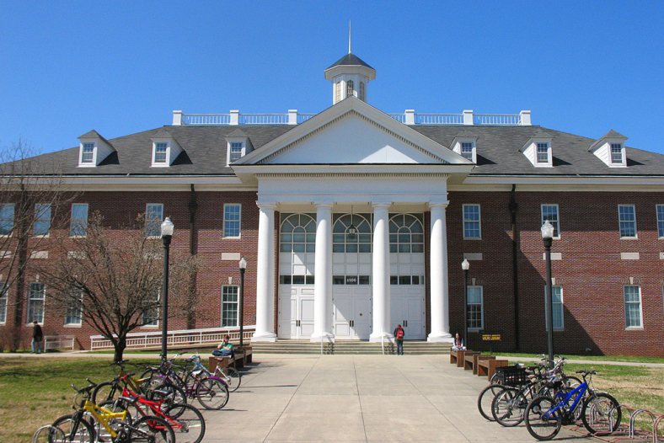
About Tennessee Tech
Comprehensive Masters Large University
11,000 Students
Largest College – Engineering

Slide 3
We Will Discuss…
Development Process
The Plan
Implementation
Current Results

Slide 4
Development Process
Why did we do it?
The Issues
Important Conclusions
Developing the Plan

Slide 5
Why did we do it?
What are we getting for our $449,000?
Chemical Engineering would like 69 new titles
$100,000 Budget Shortfall

Slide 6
What are we getting for our $449,000?
234 Titles for $449,000
Over 3 years an average of 6,324 FT downloads/Yr
2012 we “bought” 30,909 articles and used 6,454
2012 Average cost of $70.00 per article used
Issue 1- We spend a lot for material we don’t use

Slide 7
We Pay for Materials That Are Not Used

Slide 8
Chemical Engineering wants 69 new titles
Biology wants 33 new titles
“We need the information to stay relevant”
Issue 2-We can’t supply all of the journals the faculty need or want

Slide 9
$100,000 Budget Shortfall
History of Journal Cuts
Issue 3-We can’t afford what we have
Year | Dollars | Titles
1992 | $76,000 | 201
1997 | $177,634 | 361
1999 | $63,653 | 157
2006 | $129,412 | 335
2009 | $218,575 | 230
2012 ? | $215,000 ? | ?

Slide 10
Important Conclusions
More efficient use of resources needed
We can’t afford to pay for material that is not used
Flexibility
Faculty not getting what they need
Current system unsustainable

Slide 11
Developing the Plan
Situation Presented to the Deans Council
Create a team of Faculty and Librarians to study the issue and find a new way to provide article information to faculty and grad students

Slide 12
Materials Team -Colleges
Chris Brown Arts & Sciences –Biology
Mark Groundland Arts & Sciences –For. Lang.
Tammy Howard Ag and Human Ecology –Nursing
Beth Howard Business – Accounting
Julie Stepp Education –Curr. and Inst.
Holly Stretz Engineering -Chemical Engineering

Slide 13
Materials Team – Library/Purchasing
Susan LaFever Acquisitions
Sharon Buckner Administration
David Hadjik Public Services
Sharon Holderman Public Services
Regina Lee Public Services
Ann Manginelli Public Services
Nancy Mielke Public Services
April Crockett Web Development
Judy Hull Purchasing
Donna Wallis Purchasing

Slide 14
The Goal
The goal of the committee is to find an efficient, effective method of spending the library materials budget to get the most information needed for faculty and students

Slide 15
The Team Considered…
Faculty needs
Student needs
What we already have and how we get it?
Budget
Purchasing options
Use patterns
Accrediting bodies and reports
Other libraries best practices

Slide 16
Faculty Survey –Concerns
How do I know if it is an article I want or has something I want without reading the entire article?
Not being able to browse an entire journal is too restrictive and won’t allow the faculty to be as thorough as needed.
A potential black hole for funding, if researchers are allowed to download (purchase) articles without limit. If researchers are given a limit, how is that limit decided?
Turn-around time for getting the articles.

Slide 17
Faculty Survey –Advantages
If the cost would be similar then individual articles would probably benefit better than buying whole journal subscription that only benefit a few.
I am usually looking for individual articles, not the contents of an entire journal.
As long as we have access to a wide selections of journals and not just one publisher.

Slide 18
Intriguing Comment
TTU's limited resources have never been an impediment to instruction and research with the internet around (which has leveled the playing field) in my opinion. Engineering

Slide 19
Materials Acquisitions Recommendations
Cancel low use journals and products
Begin transition greater reliance on single article purchase using the Get it Now service

Slide 20
Why Get it Now?
Covered 4 of the 5 publishers of journals we were planning to cut
Cost per article compared favorably with single article cost from publishers
Dealing with one source and invoice
Reasonable turnaround time

Slide 21
Materials Acquisitions Recommendations
Cancel low use journals and products
Product | Number | Cost
Print Titles in Databases | 183 | $29,320
Switch to online only | 108 | $21,746
Index Databases | 5 | $40,570
Journal Titles | 182 | $382,408
Total |  | $474,044

Slide 22
Single Article Acquisitions
Discovery
Summon-Discovery Product
Google Scholar
Delivery
Illiad - Interlibrary Loan System
Get it Now – Article Purchase Product.

Slide 23
Issues to Consider
Cost per use threshold for cutting titles
How much to allocate for article purchase
To charge or not to charge
Mediated or direct access
Limit the service to graduate students and faculty only
Marketing/education plan
Patron feedback mechanism

Slide 24
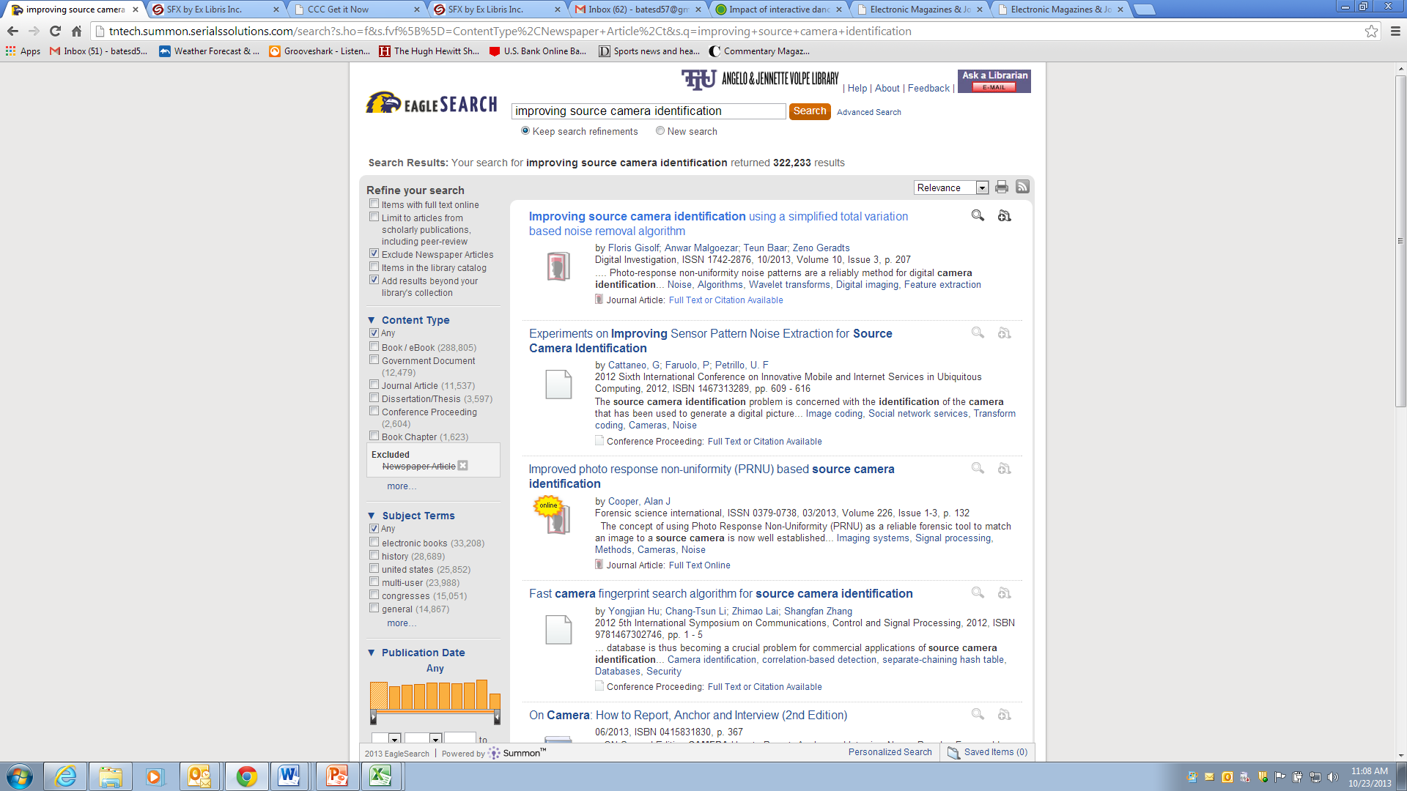

Slide 25
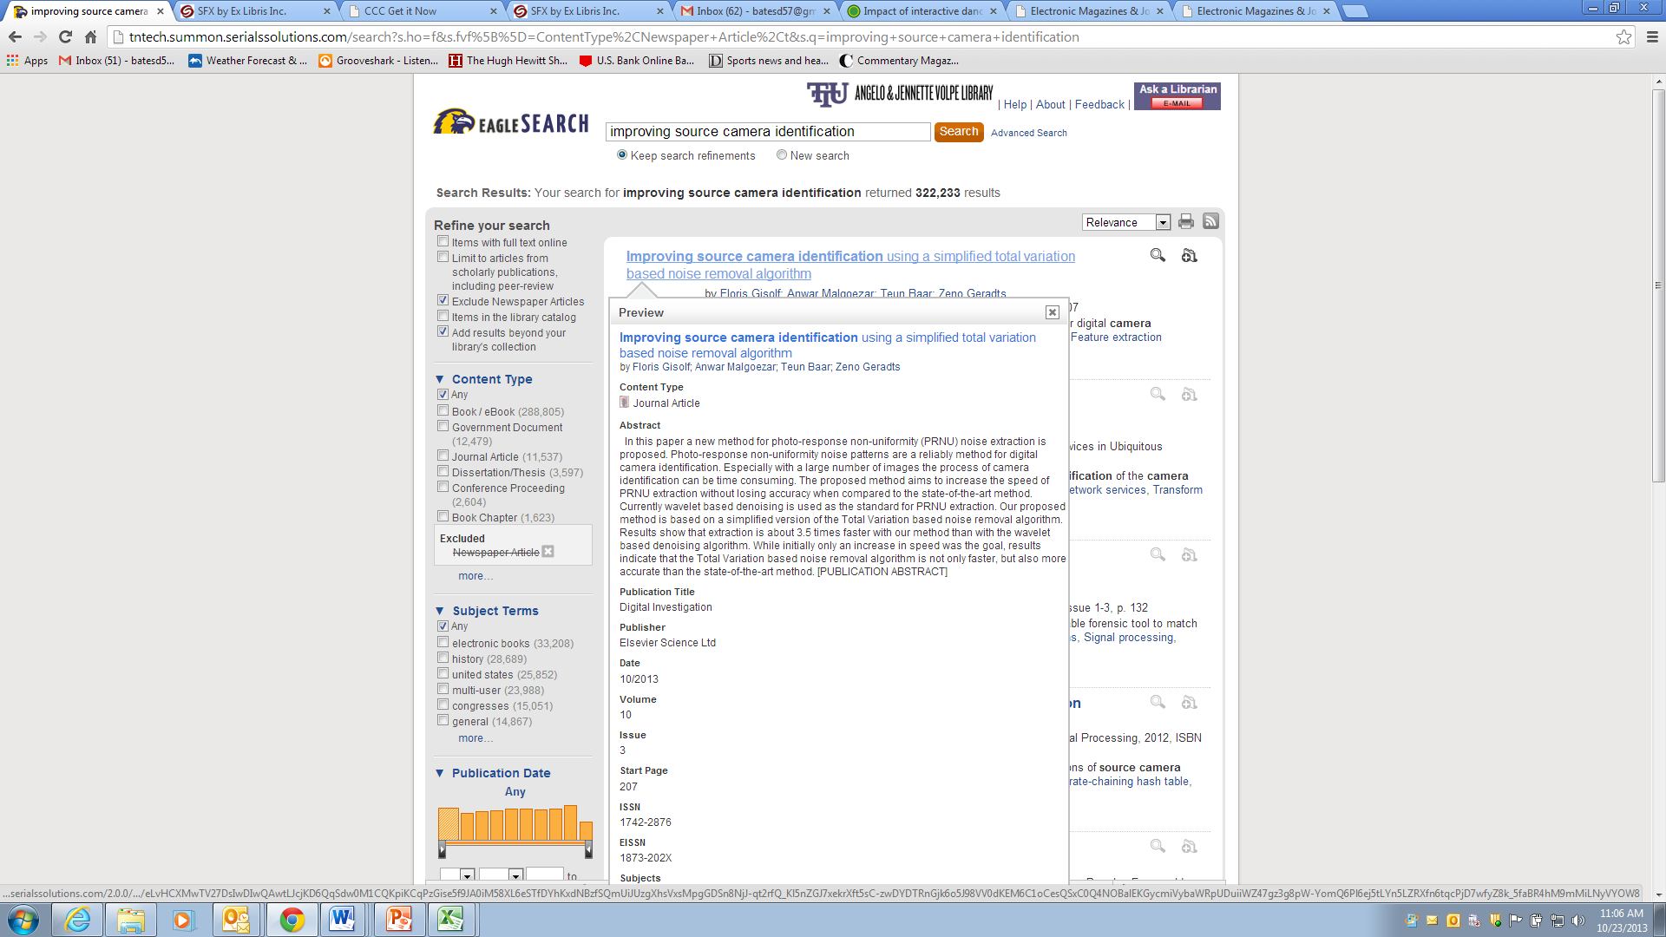

Slide 26


Slide 27
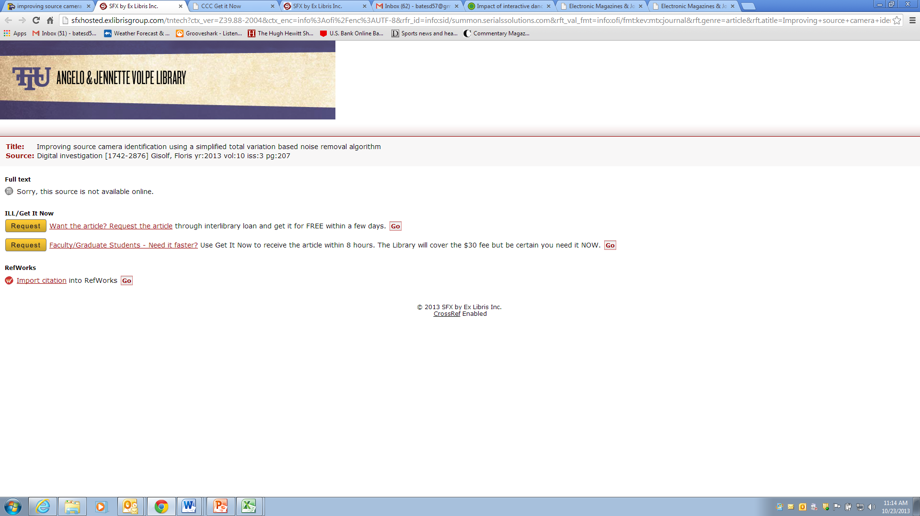

Slide 28
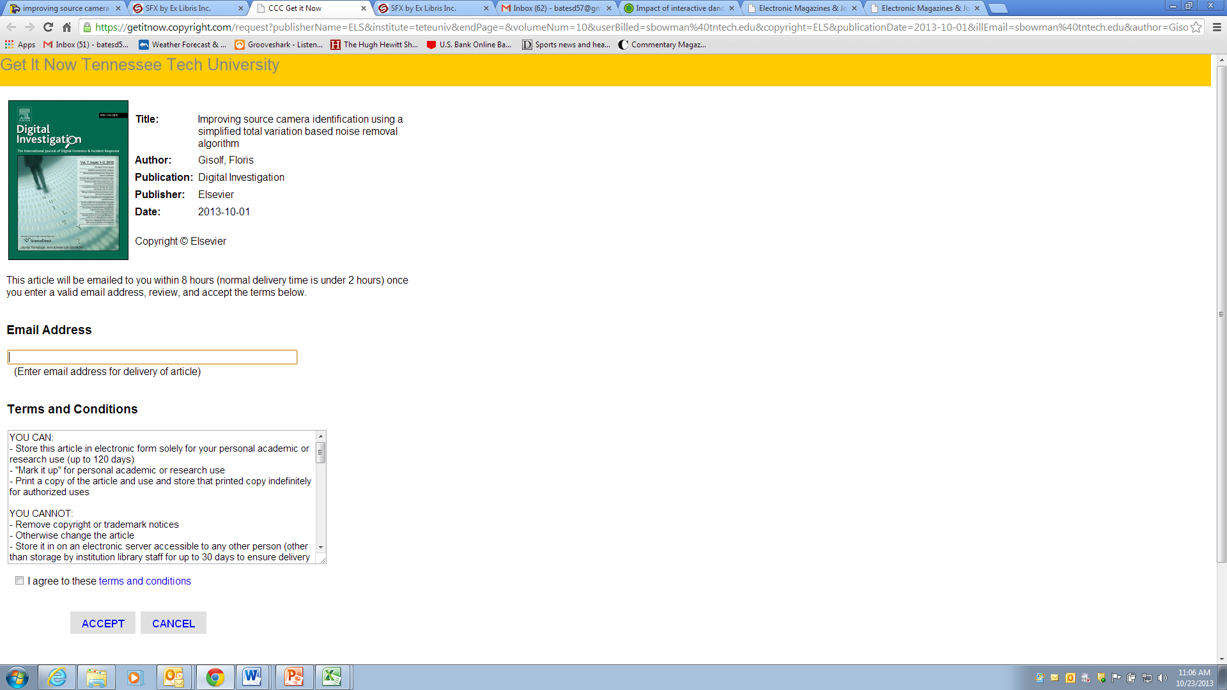

Slide 29
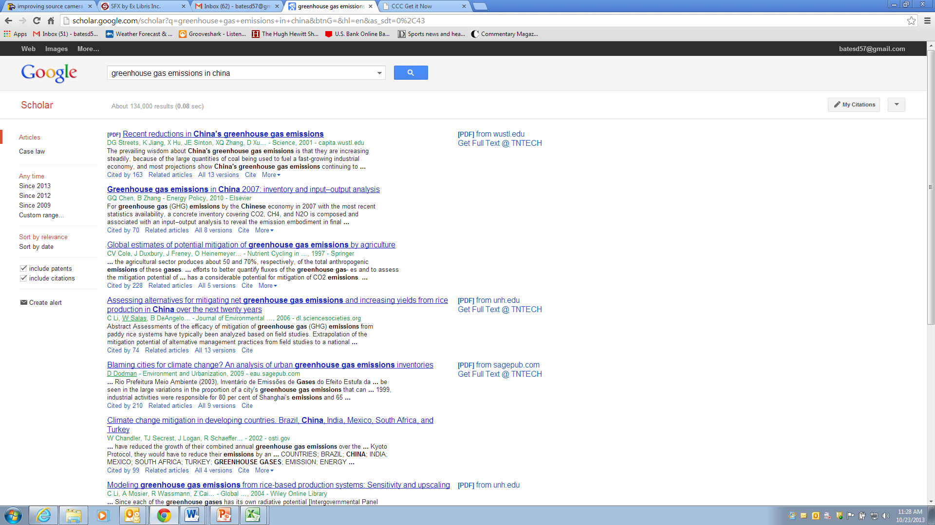

Slide 30
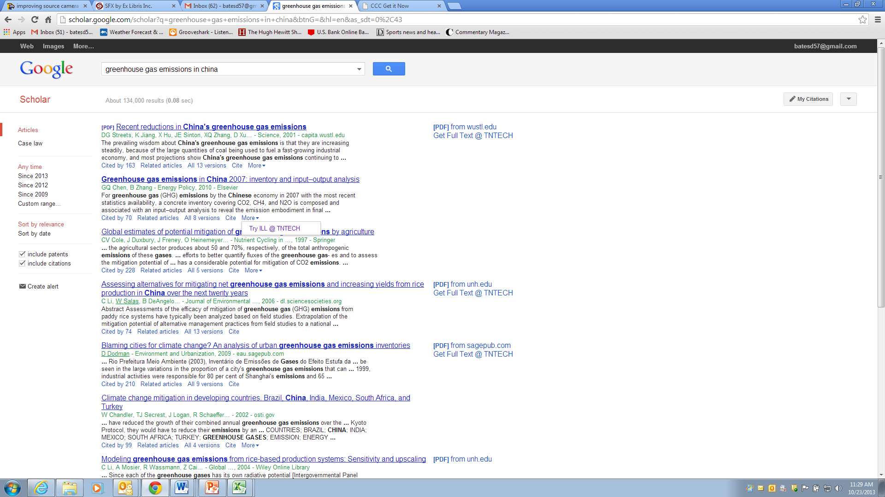

Slide 31
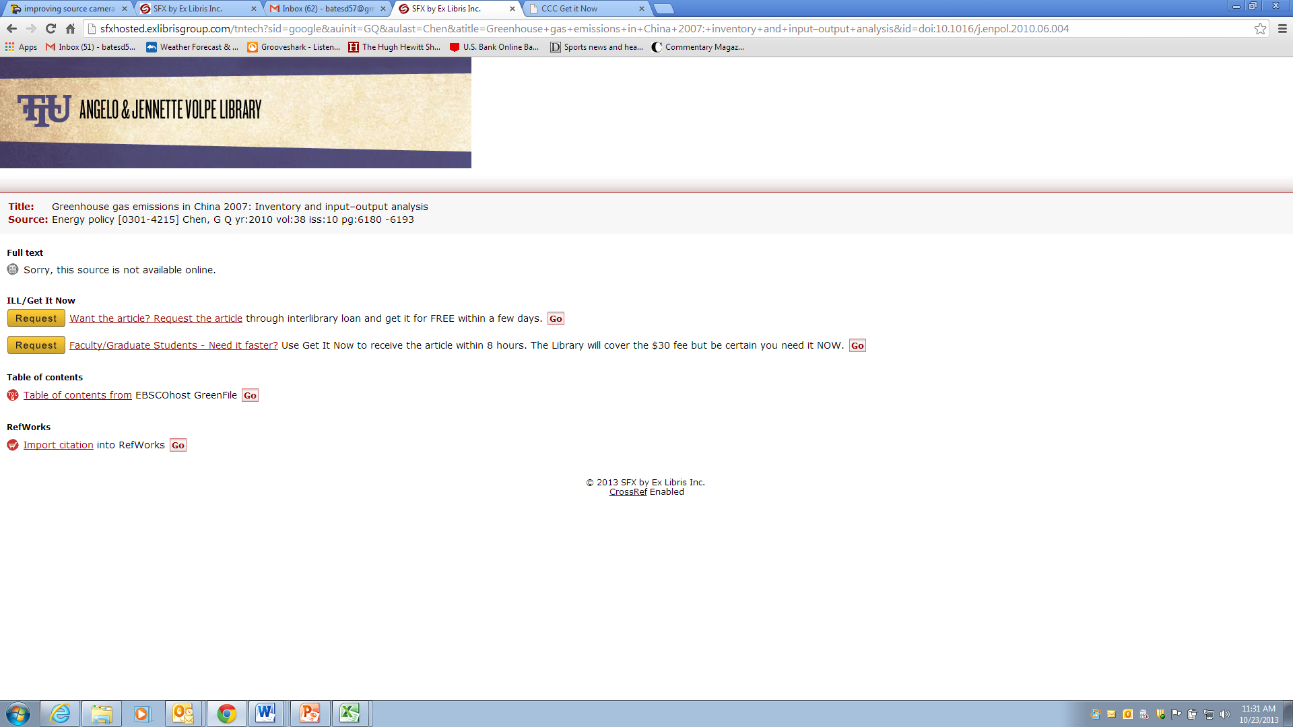

Slide 32


Slide 33
What We Expect
Flexibility
Lower overall costs
Increased interactions with the faculty

Slide 34
What We Have Seen 5 Months (8/26/13-1/22/14)
1,064 Total Article Requests
353 Articles available Through ILL and GIN
214 Choices between ILL/Get it Now
181 Chose ILL
33 Chose Get it Now

Slide 35
What We Have Seen
Those who chose ILL over Get it Now:
71 Faculty Requests
37 Different Faculty
18 Different Departments
84 Graduate Student Requests
47 Different Students
10 Different Departments
22 Undergraduate
4 Staff
Requests came from 134 different titles

Slide 36
What We Have Seen 6 Months (9/3/13-3/4/14)
53 Get it Now Requests
25 Graduate Student requests - 15 Different Students
28 Faculty requests - 10 Different Faculty
Requests came from 44 different journal titles
Delivery Time
Shortest 0 minute
Longest 9 hours
Average 2 hours
Amount Spent - $1,338

Slide 37
Thank You
Doug Bates
dbates@tntech.edu

