Slide 1

ERM, Party of One?
Managing Electronic Resources from Start to Finish with a One-Person Department
Ashley Krenelka Chase, J.D., M.L.I.S.
Library Administrator (Reference & Emerging Technologies)
Hand Law Library, Stetson University College of Law

Slide 2
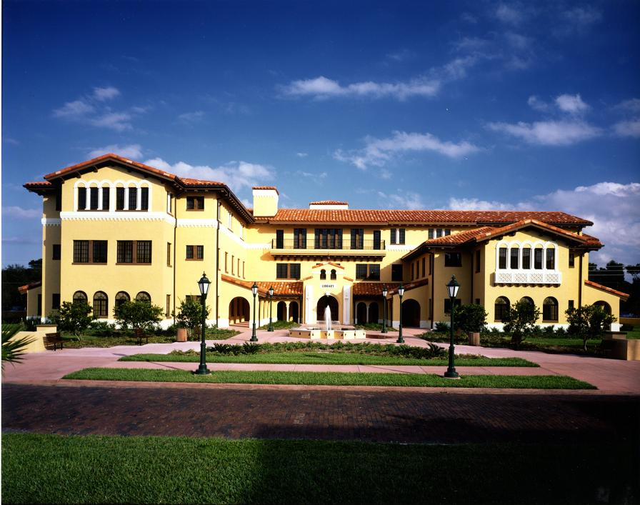

Slide 3


Slide 4



Slide 5








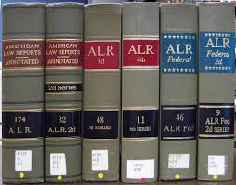

What do we buy?

Slide 6
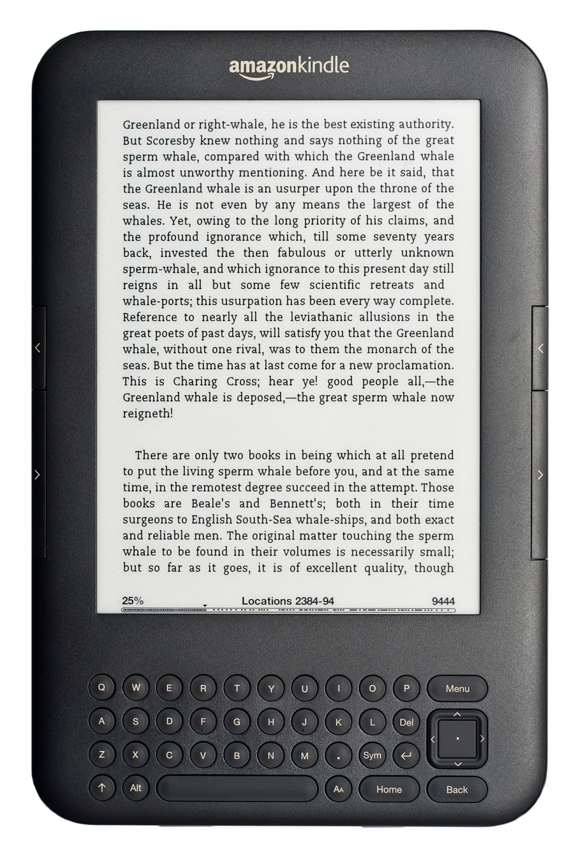


Slide 7
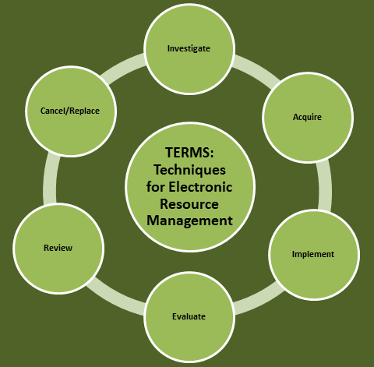
http://6terms.tumblr.com/post/9997650918/what-is-terms

Slide 8
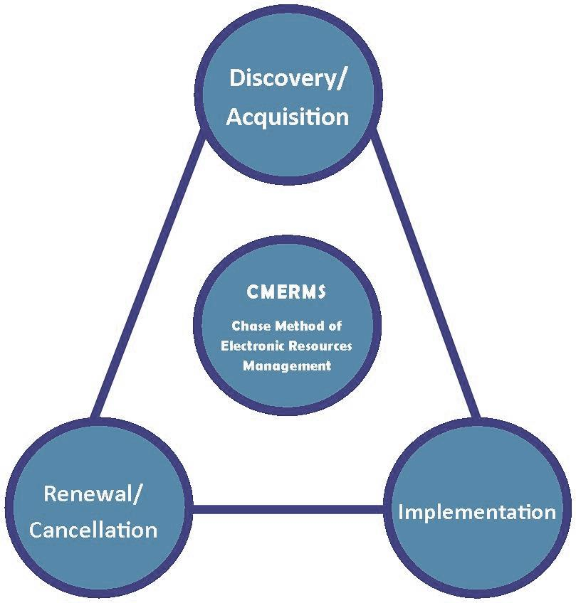

Slide 9
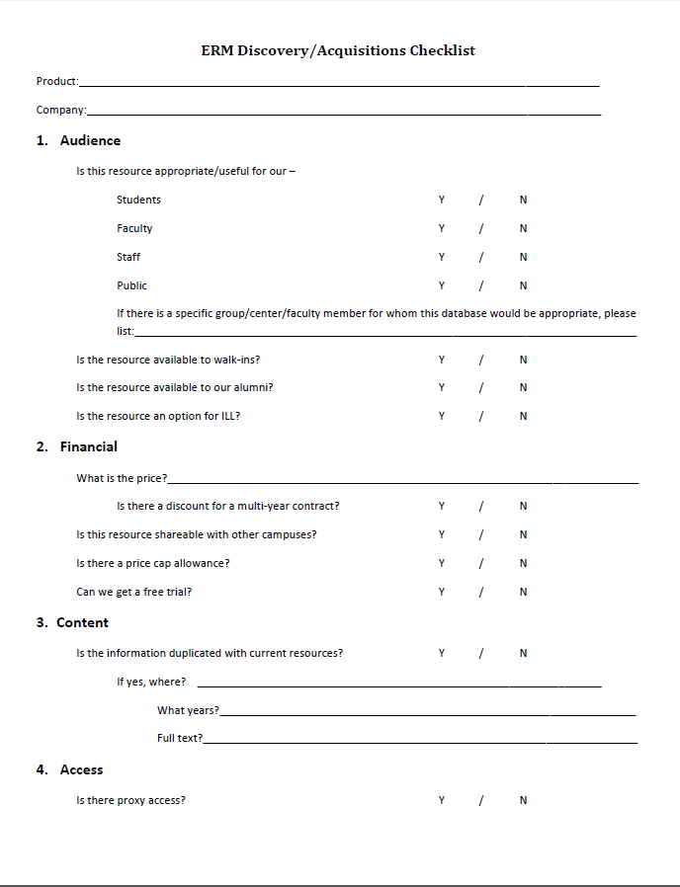
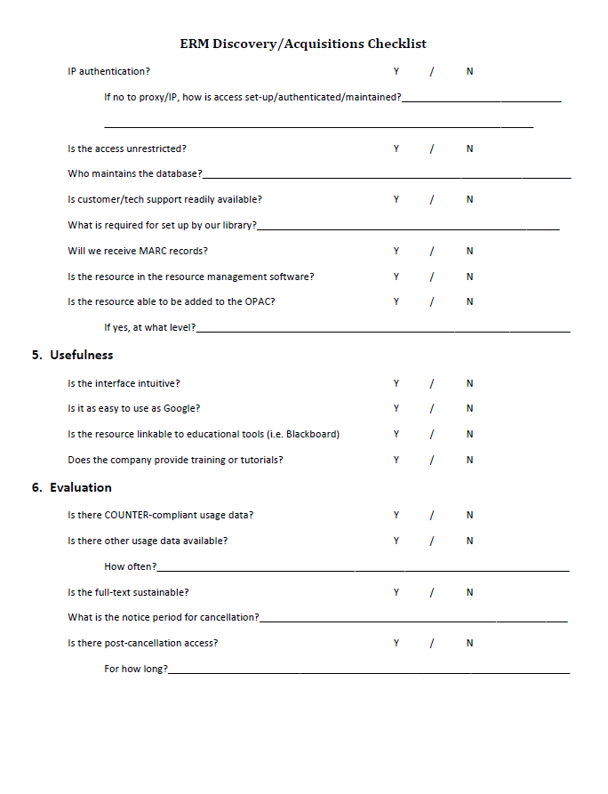

Slide 10
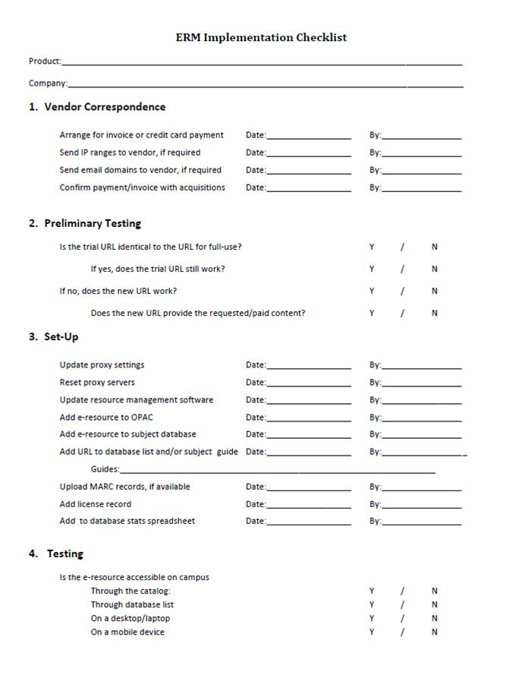
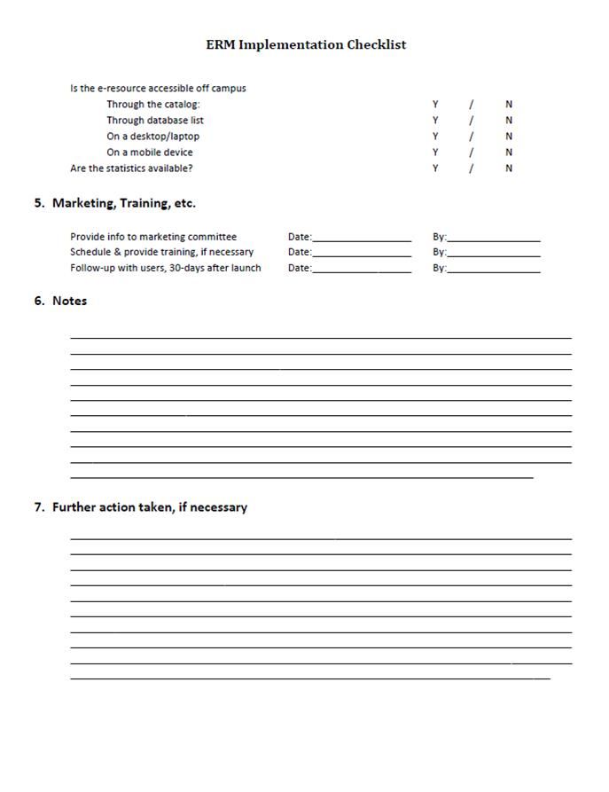

Slide 11
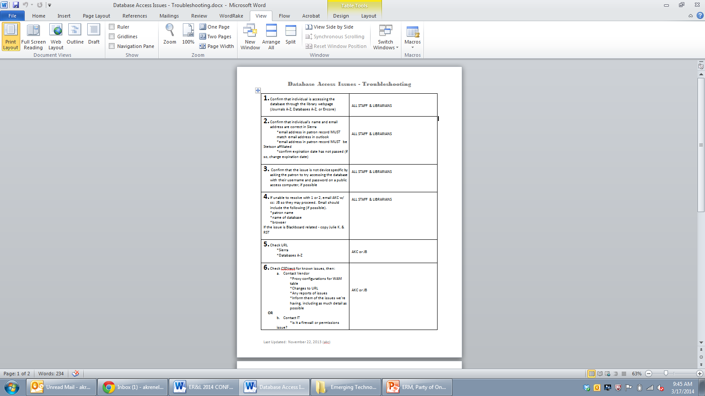
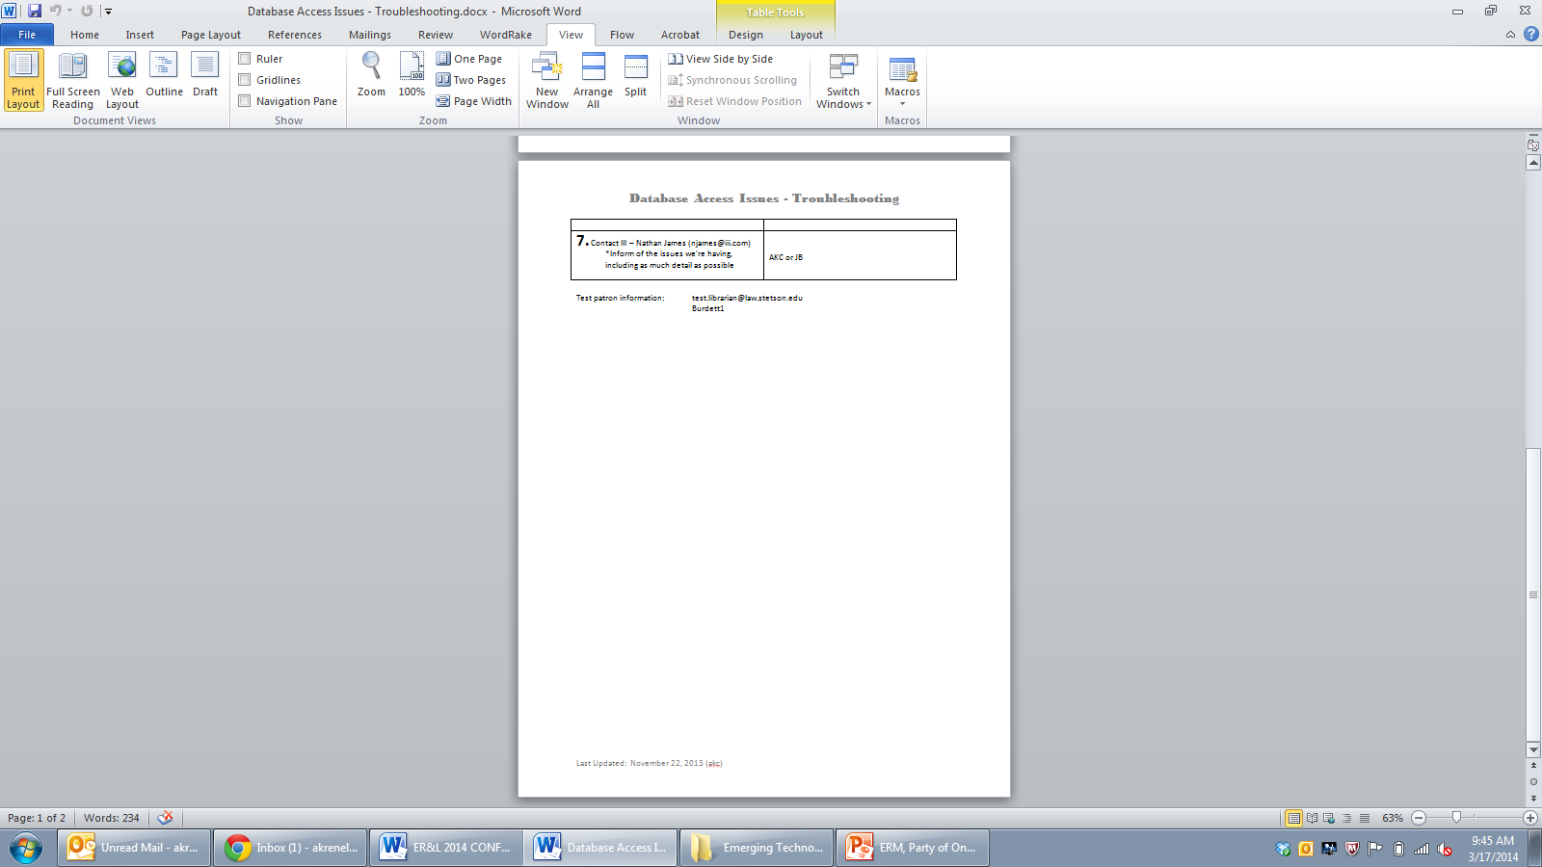

Slide 13
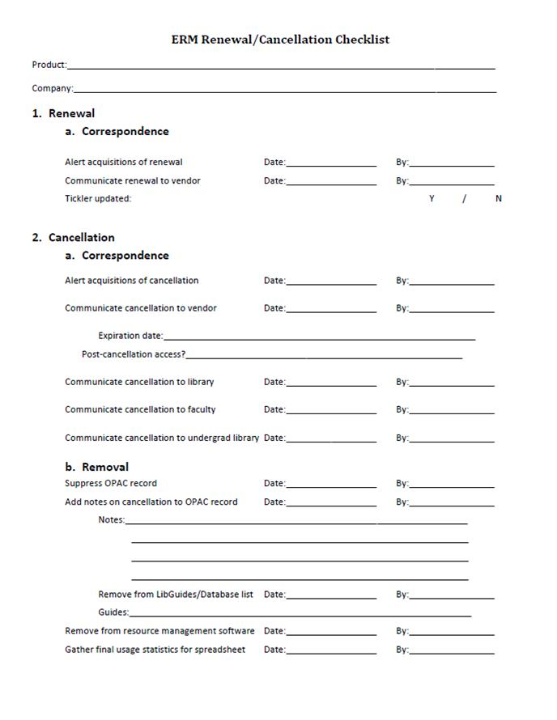

Slide 14
QUESTIONS?
akrenelk@law.stetson.edu
http://LibGuides.law.stetson.edu/AshleyKChase
(727) 562-7311

