Slide 1
INQUIRY FOCUSED ON EQUITY FOR ELLs
Center for Collaborative Education
Worcester Public Schools
MATSOL Conference
MAY 8, 2014
Notes:
Introduce all presenters and whip around to hear who participants are

Slide 2
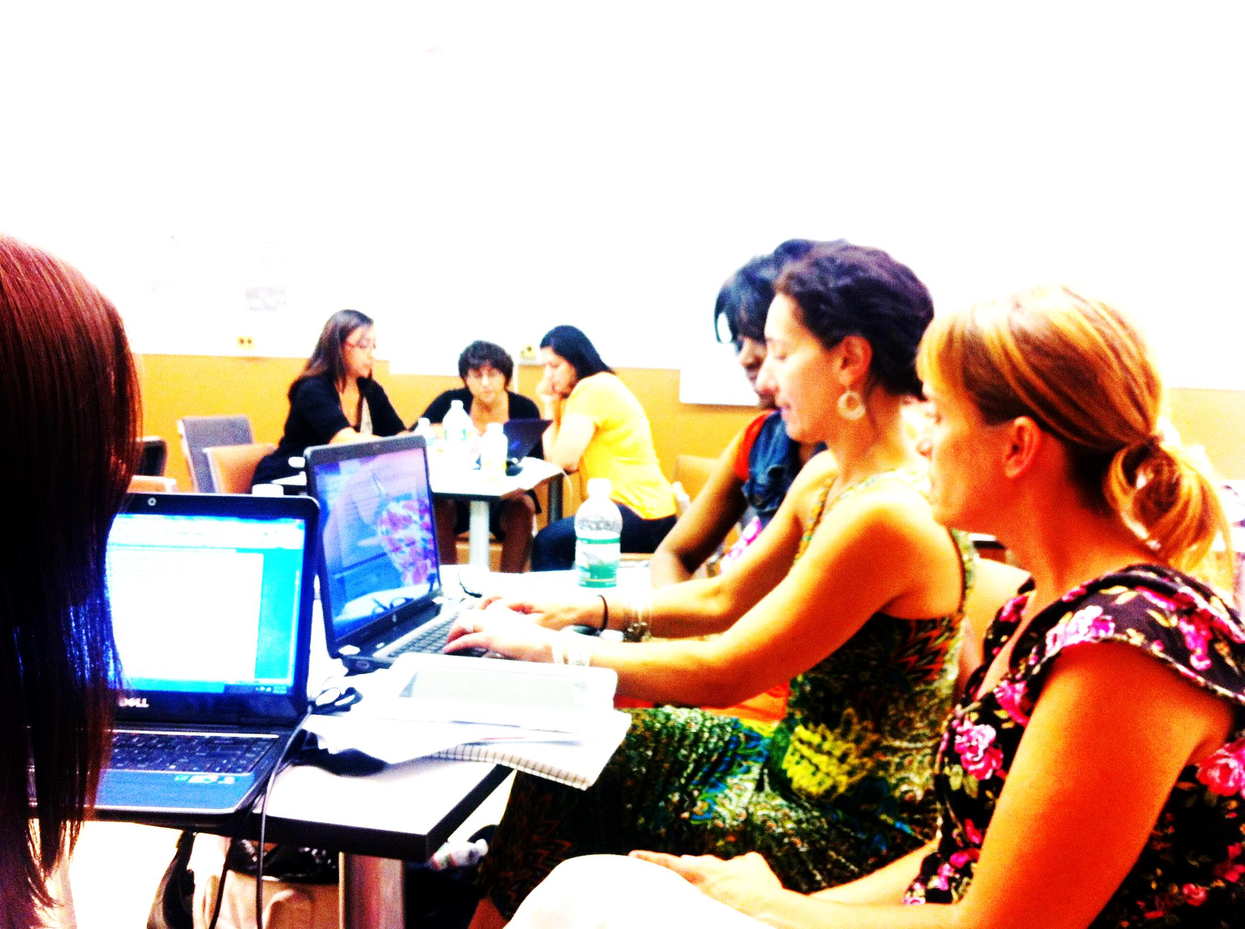
Worcester
English Language Learner
Teacher Residency
Notes:
Hope or Sarah

Slide 3
Connecting activity
How can teachers be change agents….
For students?
For the system?
For themselves?

Slide 4
“In contexts of cultural, linguistic, or economic diversity, where social inequity inevitably exists, these interactions are never neutral; they either challenge the operation of coercive relations of power in the wider society or they reinforce those power relations.” --Jim Cummins

Slide 5

Pipeline of high quality teachers of ELL students in the Worcester Public Schools working to transform schools for equitable and high achievement of ELL students

Slide 6



Notes:
Hope or Sarah

Slide 7

Delivering on High Expectations and Outstanding Results for All Students
Third largest district in MA
30% ELLs
Top languages: Spanish, Twi, Vietnamese, Arabic, Nepali, Swahili, Portuguese
Alliance for Excellent Education www.all4ed.org
Worcester Public Schools www.wpsweb.com
Notes:
Hope

Slide 8

For Working Adults
Connecting coursework to life and work
Master’s in ESL
Certification in ESL
Notes:
Hope or Sarah

Slide 9

Transforming Schools for Student Success
Research and Evaluation School Redesign
Autonomous Schools Residency Programs
Quality Performance Assessment
Notes:
Sarah

Slide 10

Voices from the residents
Why WELLTR?
Notes:
Sarah

Slide 11
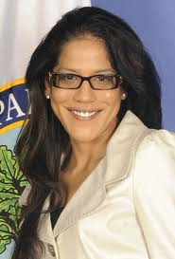
“Despite the best efforts of America's educators to bring greater equity to our schools, too many children- especially low-income and minority children- are still denied the educational opportunities they need to succeed.”
Russlynn Ali
Assistant, Secretory for Civil Rights
U.S. Department of Education
As cited in National Opportunity to Learn Campaign, www.otlcampaign.org
Notes:
We have to recognize that the underachievement—or achievement gap—of our English learners, is largely a result of educators not being fully prepared to serve them. This discrepancy of our learning—as teachers--resulting in the underachievement of students is what we mean when we talk about “the opportunity gap.” Effectively, ELLs are experiencing an opportunity gap in the knowledge base of the teachers that serve them. We don’t often know how to make content accessible to this subgroup. Therefore, it is up to us to increase our efforts to become better prepared to teach ELLs, a culturally and linguistically diverse student body. Which is why we are here today!

Slide 12

THE NEED
Fastest growing subgroup
30%+ in WPS
RETELL initiative
WIDA Tools
ACCESS Test
More effectively prepared teachers
More effectively prepared administrators
Notes:
Sarah

Slide 13
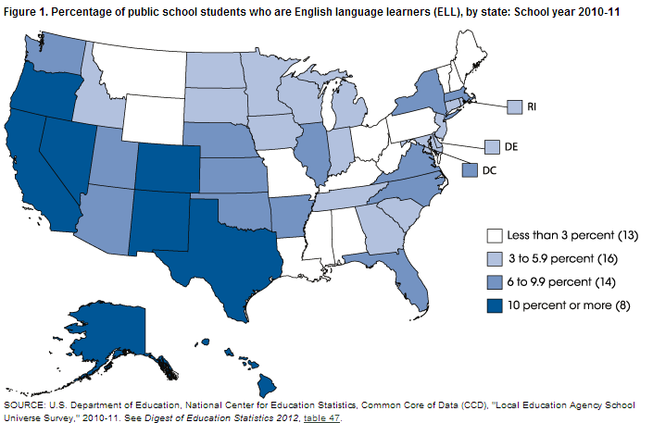
The National Context
As cited in The National Center for Education Statistics, https://nces.ed.gov/programs/coe/indicator_cgf.asp
Notes:
Let’s start with the WHY—why do we need to focus our own learning as teachers on the achievement of English learners?
Fastest growing subgroup in the USA
Implications for educators—
We are all language teachers
ELLs are not a homogenous group
“long-term” versus “short-term” ELLs
ELLs are doing “double-duty”
content + language
Second language acquisition can take years

Slide 14

What the Research Says
Notes:
Deltas---In 2011, CCE partnered with U-Mass and the Gaston Institute to review the academic and linguistic achievement of ELLs in the Boston Public Schools

Slide 15

The Reality for ELLs
High level of drop outs
High level of suspensions
High level of being retained
Issues with Special Education services
A “culture of failure”
Uriarte, Tung, Karp, et al. (2011)
Notes:
This is what we’ve found; Effectively underserved; in MA, we’ve had massive policy change based on the fact that the US DOJ found schools here out of compliance in serving ELLs’ civil rights; we are focusing on how to better prepare teachers and leaders to fully serve ELLs, as well as implementing standards and assessment from the WIDA Consortium

Slide 16

What the Research Says
Notes:
CCE also partnered with U-Mass and the Gaston Institute to conduct a set of case studies of schools in Boston that we found to have high performance levels for ELLs; we have learned a great deal from these stories…

Slide 17

What We Can Do
Coherent, standards-based curriculum
Explicit teaching of all aspects of English
Opportunities to use English authentically
Multiple forms of assessment
Tung, Uriarte, Diez, et al. (2011)
Notes:
Case study schools in BPS that showed these four ways to focus on curriculum, instruction and assessment
Schools with the highest performing ELLs had high standards, key ways of providing access to curriculum through instructional scaffolding and teaching of English

Slide 18
INNOVATIVE PROFESSIONAL DEVELOPMENT
Theory Practice
Building Teacher Leaders

Slide 19
Habits of Mind
Asset-based thinking
Commitment to partnerships
Persistence
Advocacy
Inquiry
Personal responsibility
Takes ownership for student learning
Notes:
Sarah

Slide 20
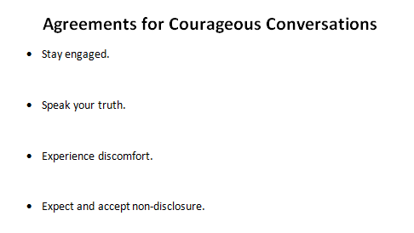

Notes:
Sarah--We use this to guide our work in equity

Slide 21
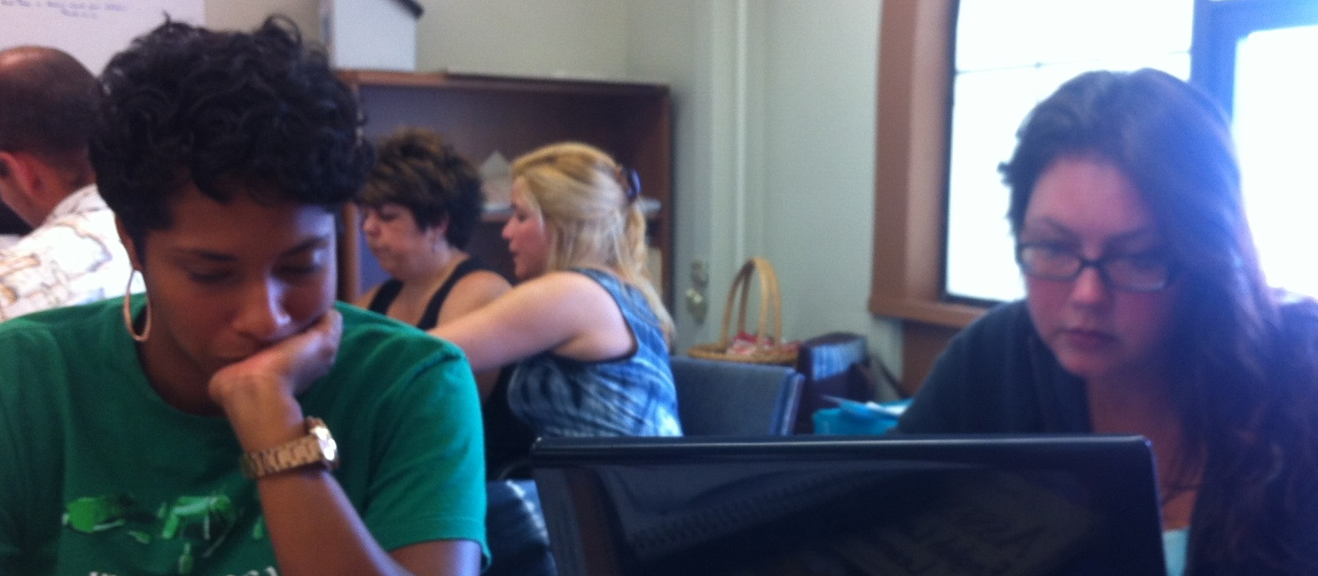
Action Research Project
-application of new learning
-addressing an area of equity
-process = collaborative
-product = independent

Slide 22
Action Research
"Action research is the process through which teachers collaborate in evaluating their practice jointly; raise awareness of their personal theory; articulate a shared conception of values; try out new strategies to render the values expressed in their practice more consistent with the educational values they espouse; record their work in a form which is readily available to and understandable by other teachers; and thus develop a shared theory of teaching by researching practice."
- John Elliott

Slide 23
Inquiry
Define the Problem
Hypothesize the cause(s)
Identify Solutions
Action Plan
Evaluate and Reassess

Slide 24
Exploring a project in depth
Ashley:
Rubric for Behavioral Expectations
Chavani
Modifying Complex Text
Allison
Systemic Best Practices

Slide 25
Listen for…
What issue(s) of equity do/does this project address?
What does this remind you of in your practice, if anything?
Do you have any feedback for the teacher?

Slide 26
To Consider for Your Practice:
What are some ways that you already engage in inquiry as an educator?
How do you know if you have successfully targeted your issue of focus? (What evidence do you use?)
What impact does inquiry have on your identity as an educator?
How do you share this kind of work or how might you share it?

Slide 27
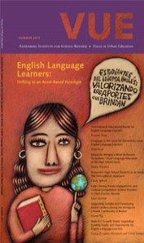
Download the issue at:
vue.annenberginstitute.org
Download the CCE studies
at:
ccebos.org/ell_success.html

Slide 28

Thank you!

Slide 29
Notes:
questions

