Slide 1
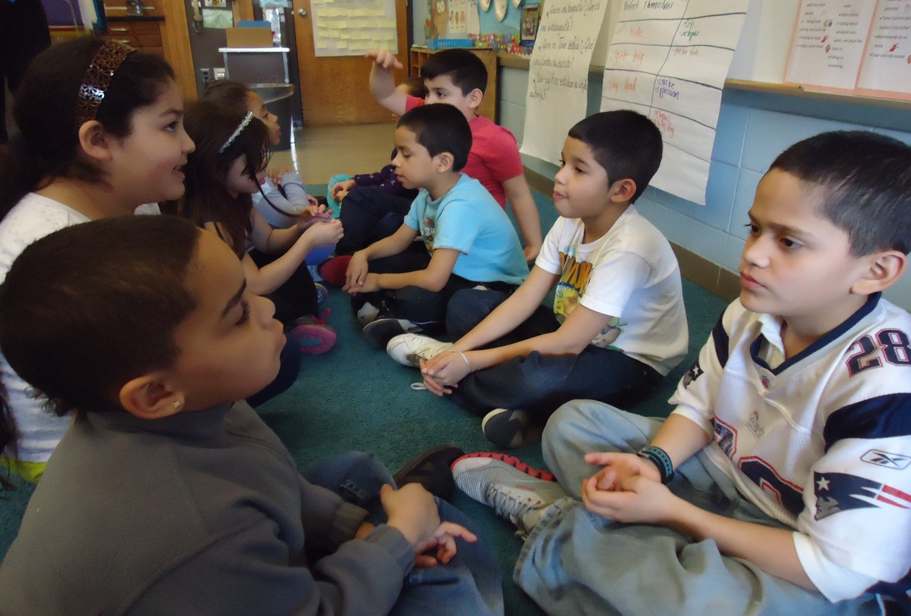
Academic Conversations:
Engaging students and promoting achievement

Slide 2
A Glimpse into a bilingual classroom
Jennifer Johnson, English Language Development (ELD)
jjohnson@framingham.k12.ma.us
Gabriella Tagliaferro, Second Grade Bilingual Teacher
gtagliaferro@framingham.k12.ma.us
Sara Hamerla, English Language Learner Coach
shamerla@framingham.k12.ma.us
Framingham Public Schools
Notes:
Jennifer, Gabriella, and Sara introduce themselves

Slide 3
Objectives
PWBAT:
Justify the importance of conversations to develop language and content knowledge.
Discuss the socioemotional context of a second grade bilingual classroom and consider your own students.
Brainstorm lesson ideas for paraphrasing, elaborating, supporting ideas with examples.
Analyze speaking and writing of second language learners for evidence of communication skills.
Design a conversation prompt that integrates language and content and allows students to draw on their funds of knowledge.
Notes:
Jennifer

Slide 4
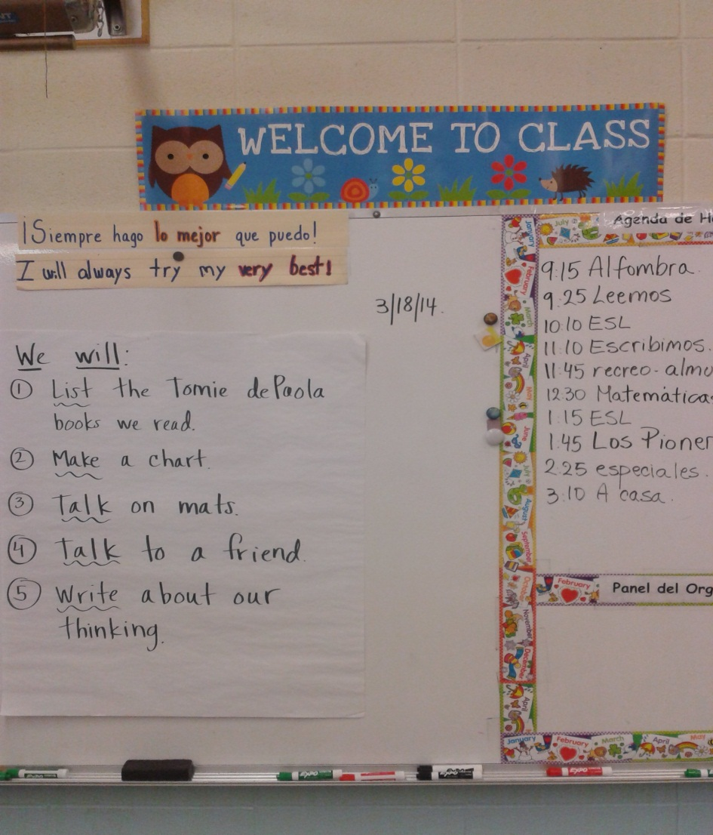
¡Bienvenidos a la
Clase 208!
Notes:
Gabriella- Structure of day: TBE classroom
Characteristics of students: WIDA levels
Jennifer teaches English language development

Slide 5
Introducing AC to Students
Model conversations (smile, nod and make eye contact)
Explain why it is important
Anchor charts (what it is, what it isn’t)
List norms
Topic Tuesdays
Introduced with icons and gestures
Notes:
Sara- data team initiative

Slide 6
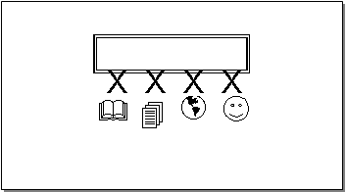
Five core communication skills
Paraphrase/Retell
Elaborate
Supporting Ideas
with Examples
Building on or challenging others’ ideas
Synthesizing
Notes:
Jennifer

Slide 7
Challenges
Differentiating for second graders with WIDA levels 1, 2, 3
Supporting students as they form a community and learn to follow routines
Focusing on the language through the content areas (Tomie DePaola)
Building on their strengths (understanding their cultural background as an asset)
Notes:
Jennifer and Gabriella

Slide 8
successes
Collaborating- Jennifer and Gabriella- transfer across languages
Co-teaching partnership
Using “stop and jot” strategy during RW can apply to ELD
Writing a book using “supporting ideas with examples” Thanksgiving Unit
Notes:
Gabriella and Jennifer

Slide 9
Reflect on Academic conversation
What did you notice?
What WIDA levels for speaking are these students?
Where could you take these students next?
Write an academic conversation prompt for your students.
Notes:
Sara

Slide 10
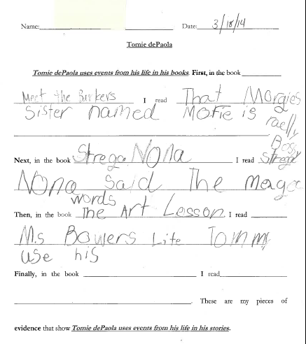
Writing Samples
Notes:
Jennifer- this is how we scaffold

Slide 11
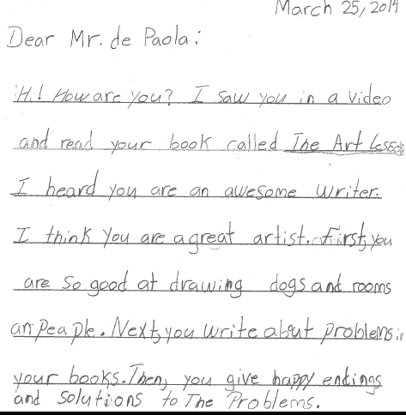
Notes:
Gabriella- a final product

Slide 12
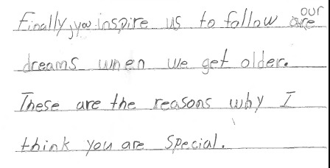
Notes:
Gabriella and Jennifer- example of how students need support at the word, sentence, and discourse (message level)

Slide 13
Reflect on Writing sample
What did you notice?
What WIDA levels for writing is this student?
Where could you take this student next?
Talk to a partner about a lesson you could implement in your classroom.
Notes:
Jennifer and Gabriella

Slide 14
Next Steps
Practice building on/challenging others’ ideas
Use building blocks as tangible representation of ideas
Promote enthusiasm about writing in response to big questions (e.g. Do you think exercise is important?)
Use sentence starters and sequence words (first, next, finally) across content areas and languages (Spanish and English)
Measure progress toward ELD teachers’ goal- students will improve based on academic conversations rubric
Introduce academic conversations to families
  At parent nights
  Through children explaining to parents
  Modeling
Notes:
Jennifer and Gabriella

Slide 15
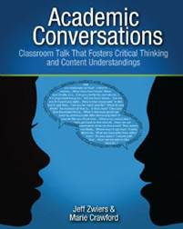
Academic conversations
By Jeff Zwiers and Marie Crawford
http://www.stenhouse.com/emags/0884/index.html
Notes:
Thank you for coming!

