Slide 1
Scaffolding Argumentative Writing for High School English Learners
Zachary Shufran
Somerville Public Schools

Slide 2
Agenda
Context and Definitions
Examples, Scaffolds, Work Samples
Arguments of Fact
Arguments of Judgment
Arguments of Policy
Discussion/Questions

Slide 3
Context and Definitions

Slide 4
Context - Somerville High School
2 classes of 15-20 students each - WIDA Level 2
L1s: Spanish, Bengali, Portuguese, Haitian Creole, Mandarin, Somali, Albanian, French, Punjabi
Argumentative writing unit lasted 12 weeks
Goal for the unit: Students write argumentative essays of 3 paragraphs about a policy issue
Overarching Scaffolds for the Unit:
Repeated engagement with reading and writing the 3 types of arguments
Graphic organizers

Slide 5
Aristotle and Hillocks, Jr.
Aristotle
Types of Argument
forensic
epideictic
deliberative
Hillocks, Jr.
Types of Argument
fact
judgment
policy

Slide 6
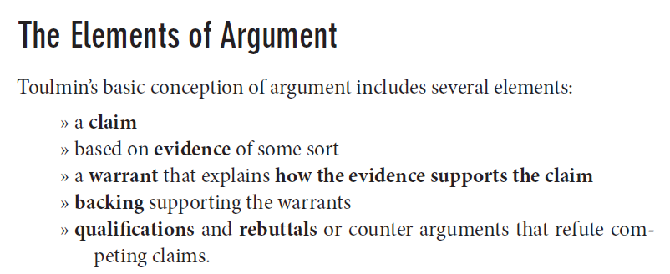
Toulmin in Hillocks Hillocks, Jr., G. (2011). Teaching Argument Writing: Grades 6-12. Portsmouth, NH: Heinemann.

Slide 7
My terms
Argument – the entire piece of writing
Claim – an opinion or idea, often an oppositional claim exists
Evidence/Reason – a reason why the claim is a “good idea”
Rule (abandoned)
Support – an explanation of how the writer know the evidence is “good evidence” or a “good reason”

Slide 8
Arguments of Fact

Slide 9
Arguments of Fact
Students use things they know about the world to support evidence they see
Examples:
Picture Mysteries
Slip or Trip (Hillocks)
Cookie Jar

Slide 10
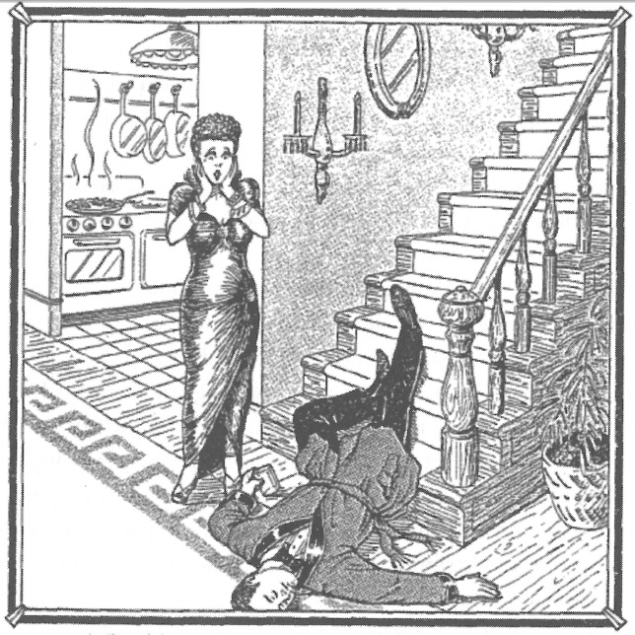
Slip or Trip
Hillocks’suggestion

Slide 11
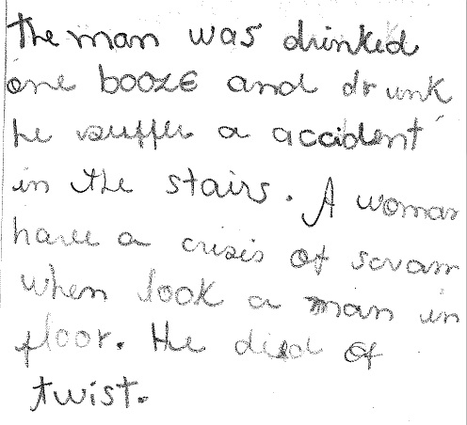
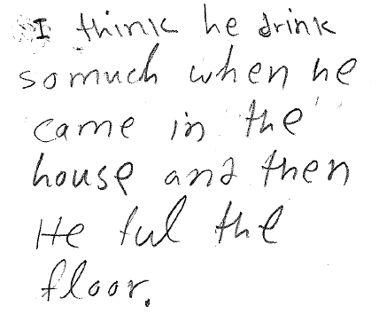
Initial Responses

Slide 12
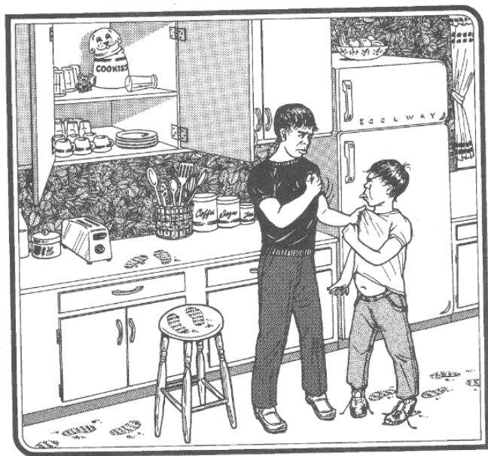
Cookie Jar Scaffolds
Read adapted text from Treat
Tier 2 vocabulary preview
Leading questions with highlighting
Fill in the blanks with measure estimates
Yes/No leading questions with does and can
Act out the scene

Slide 13
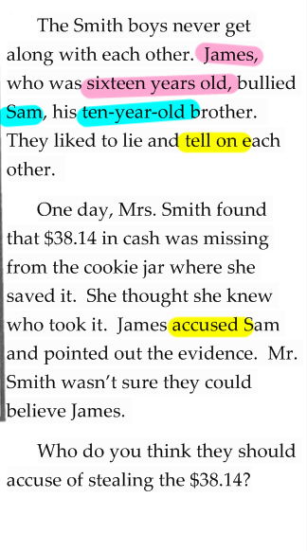
Scaffold: Adapted Text
The Bicker boys never got along with each other. Bonehead, who was sixteen years old bullied Thickhead, his ten-year-old brother. They delighted in snitching on each other, with the result that their parents believed neither of them.

Slide 14
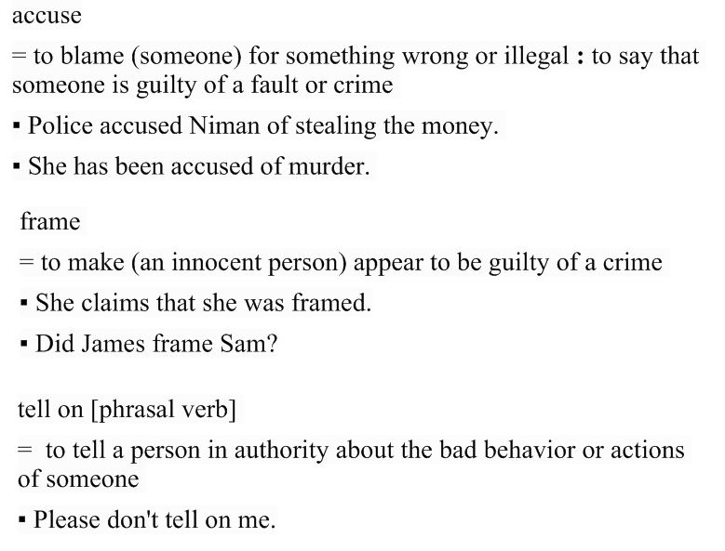
Scaffold: Tier 2 Vocabulary Preview

Slide 15
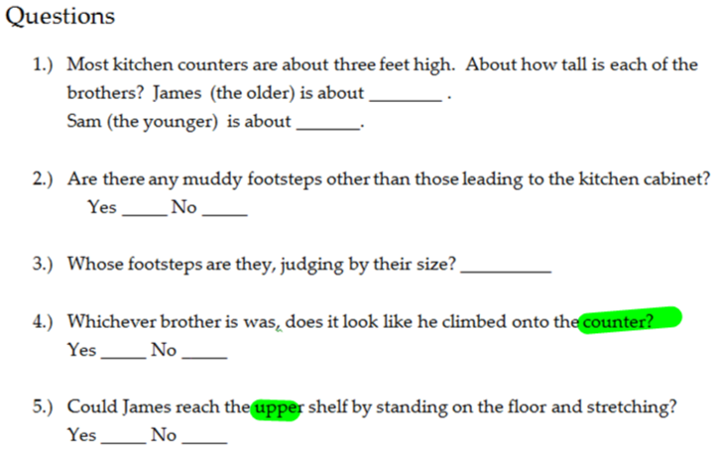
Scaffold: Leading Questions with Highlighting

Slide 16
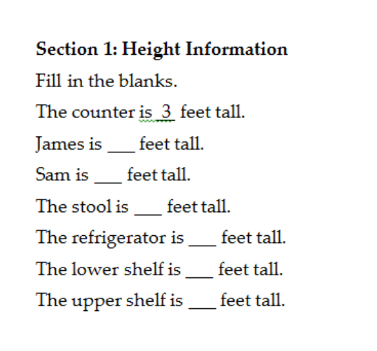
Scaffold: 2nd attempt at leading questions Fill in the Blanks with measure estimates

Slide 17
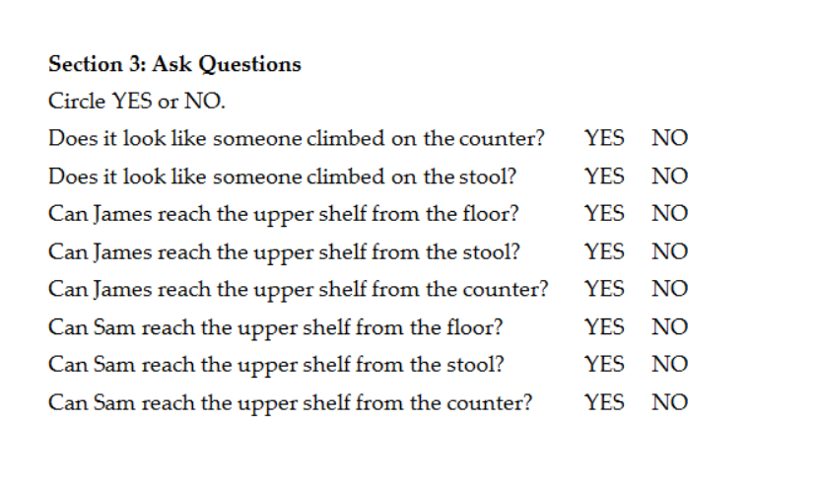
Scaffold: Yes/No Leading Questions with Does and Can

Slide 18
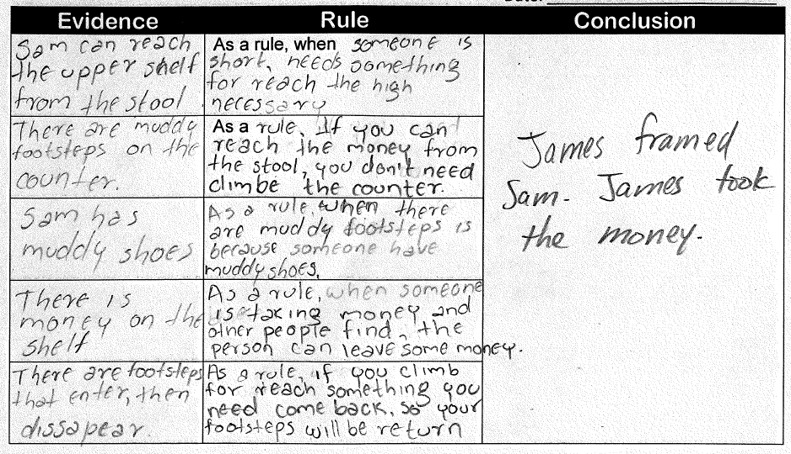
Scaffold: Guided Practice

Slide 19
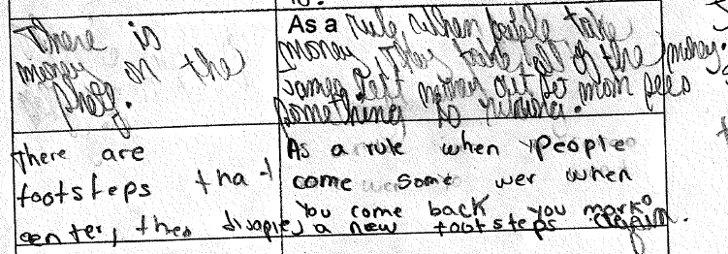
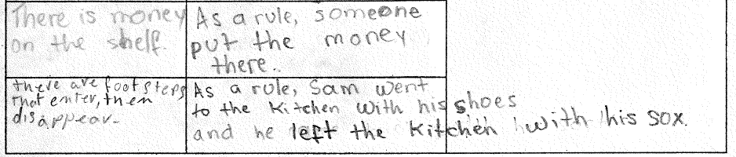
Cookie Jar: Student Work

Slide 20
Arguments of Judgment

Slide 21
Arguments of Judgment
Students support opinions about the quality of a subject by defining an abstract quality that the subject
Examples:
Composition “X is a good Y”
In class writing assessment: “X is the best restaurant”

Slide 22
Composition: X is a Good Y Scaffolds
X is a good restaurant delicious affordable _____________p(___) Topic Sentence: __________________________________________________ | X is a good teacher helpful intelligent _____________p(___) Topic Sentence: __________________________________________________
Graphic organizer
Supplied reasons (judgment) to increase focus on supports
Repetition of topic sentences
Review part of speech using dictionary
Element of student choice

Slide 23
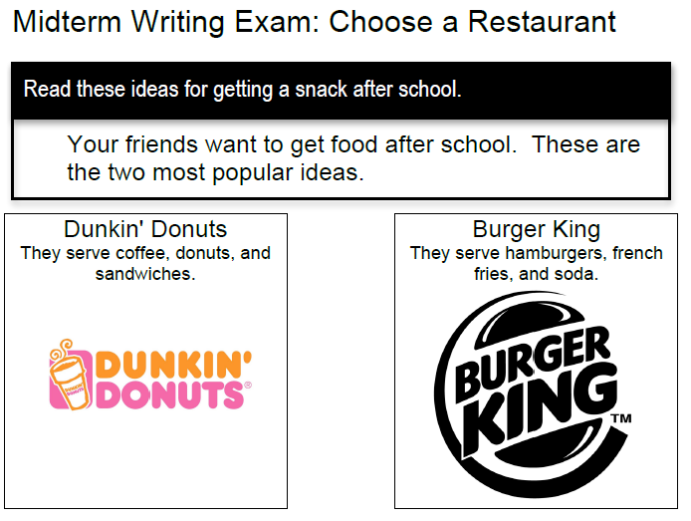
In Class Writing Assessment: X is a Good Restaurant What scaffolds do you see?

Slide 24
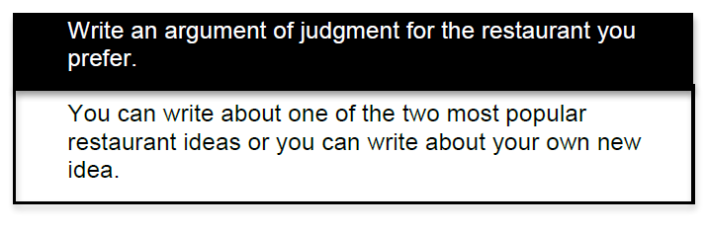
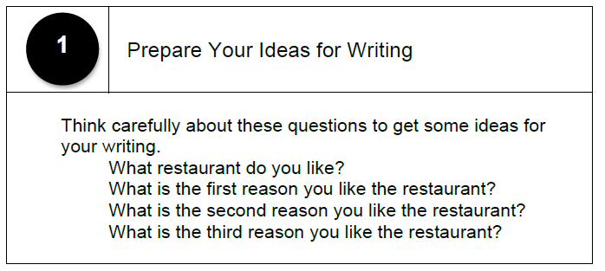
In Class Writing Assessment: X is a Good Restaurant What scaffolds do you see?

Slide 25
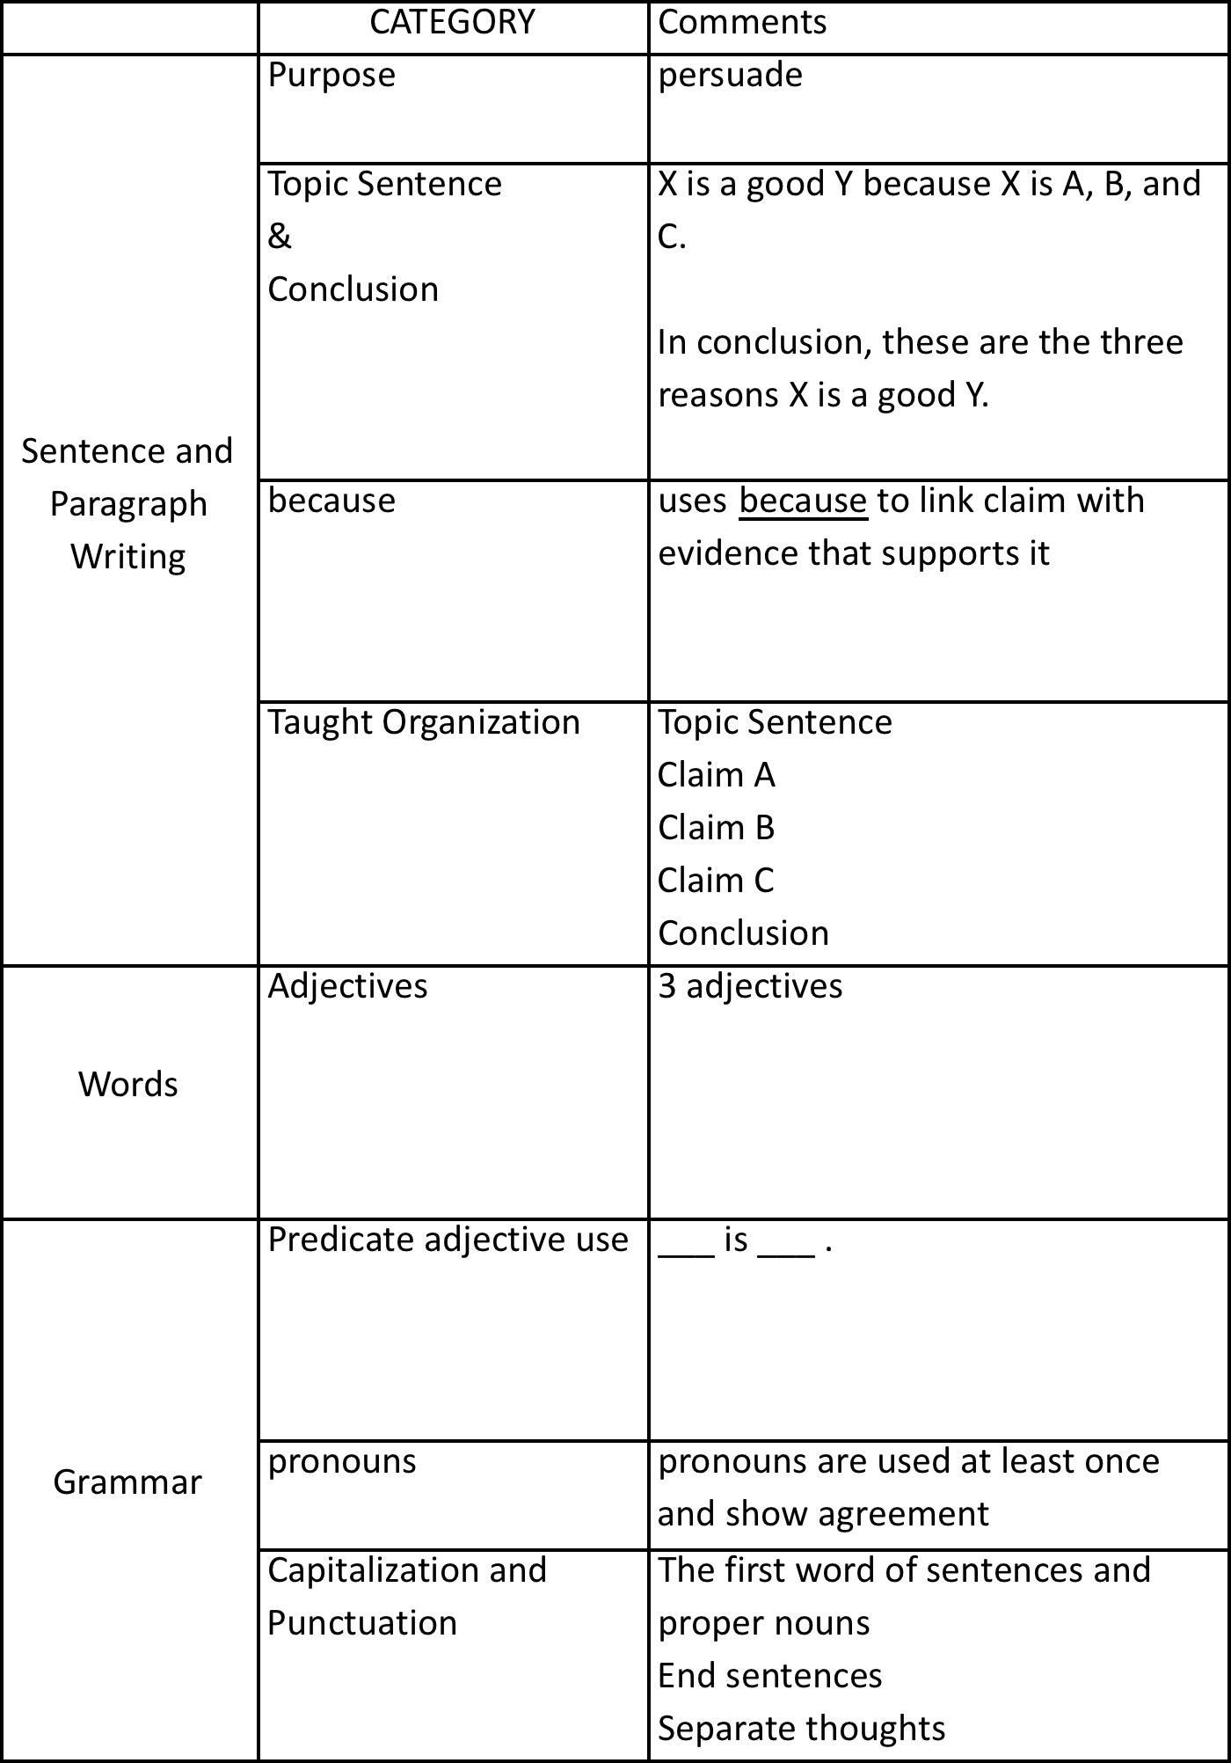
In Class Writing Assessment: X is a Good Restaurant What scaffolds do you see?

Slide 26
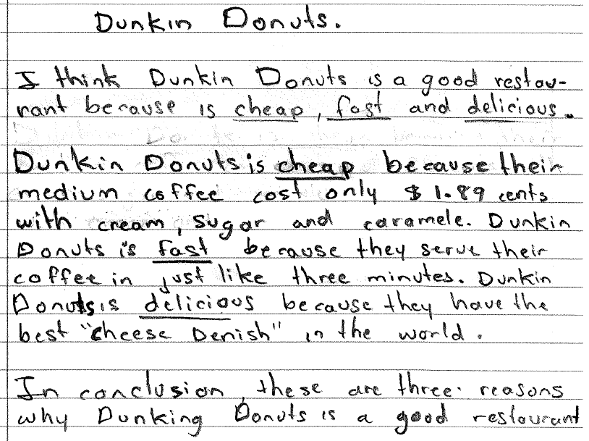
Student Work

Slide 27
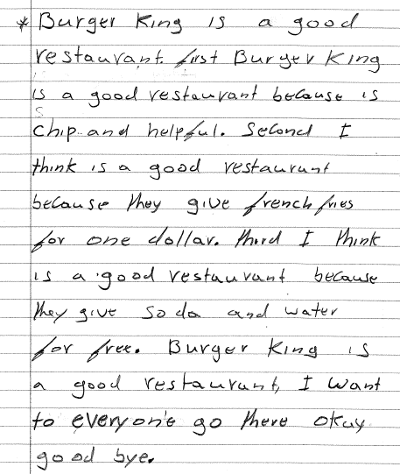
Student Work

Slide 28
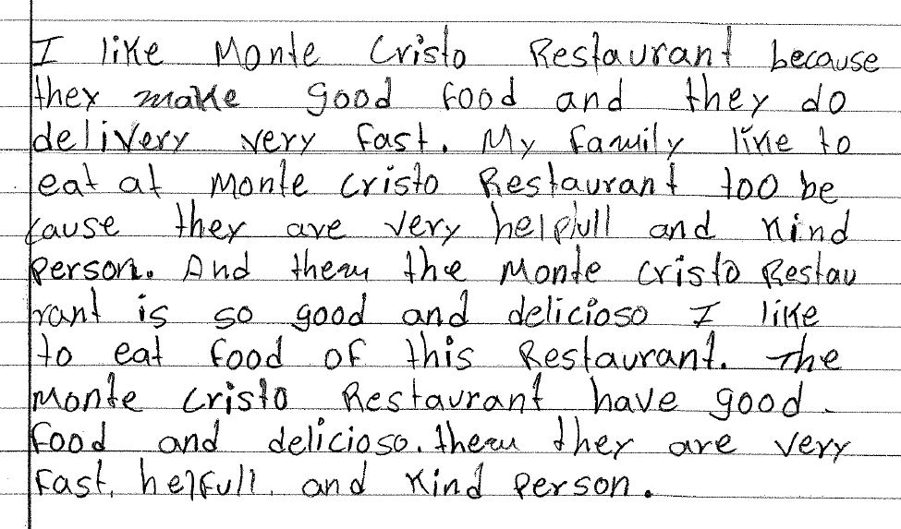
Student Work

Slide 29
Arguments of Policy

Slide 30
Arguments of Policy
Students support their idea to change a policy with evidence from their experience.
Examples:
3 paragraph essay

Slide 31
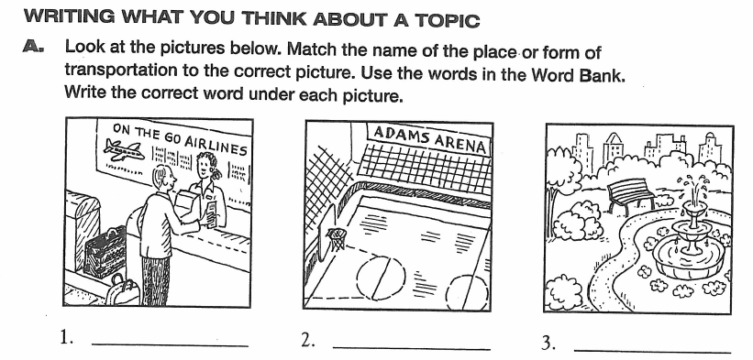
3 paragraph essay Scaffolds
Pictures
Turn and talks
Co-writing

Slide 32
3 paragraph essay Scaffolds
Graphic organizers

Slide 33
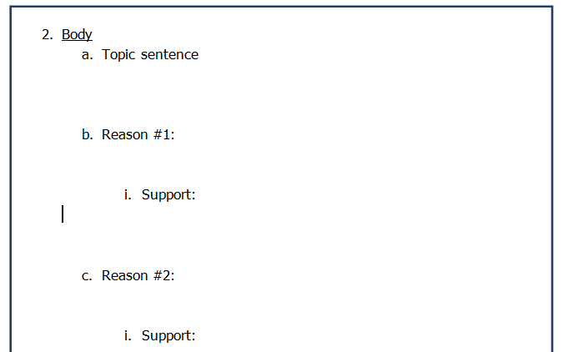
3 paragraph essay Scaffolds
Graphic organizers

Slide 34
Student Work packet

Slide 35
Discussion

