Slide 1
Write on: Strategies for helping ElLs write Common Core
Cathy Fox, M.Ed., NBCT
Peg Schembre, CAGS., NBCT

Slide 2
Content Objective
Participants will be able to sequence the ACES strategy for writing a constructed response.
Participants will be able to develop strategies for teaching each component of ACES so our ELLs “can do.”

Slide 3
Language Objective
Participants will be able to explain three components of writing that teachers have to address in order for our ELLs to write effectively.
Participants will be able to write various types of questions that their students can use to sort to the appropriate graphic organizer.

Slide 4

Creating a Context: Thematic Unit: Civil Rights

Slide 5
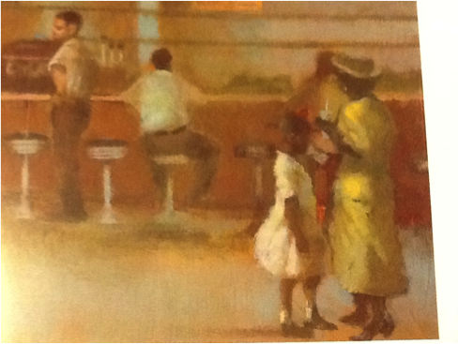

Slide 6


Slide 7


Slide 8


Slide 9


Slide 10


Slide 11
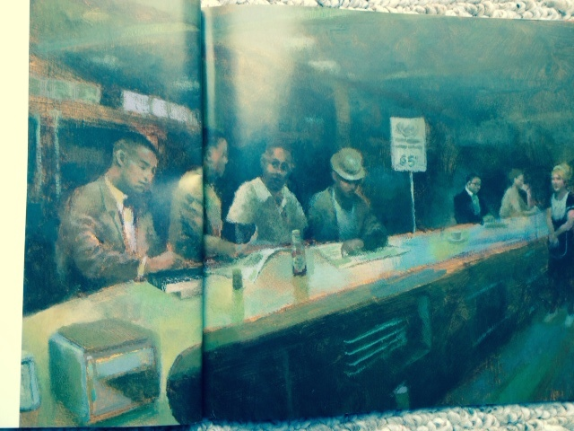

Slide 12


Slide 13

In order for our ELLs to write they need…

Slide 14
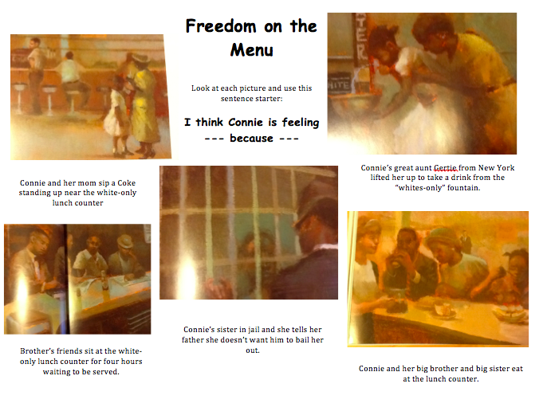
Build and Strengthen Background
Notes:
Provides opportunity for students to share the read-aloud with families; picture support is present; sentence stem for language support; Extra + They love doing their homework on sticky notes --- provides written support for student discussion the next day

Slide 15
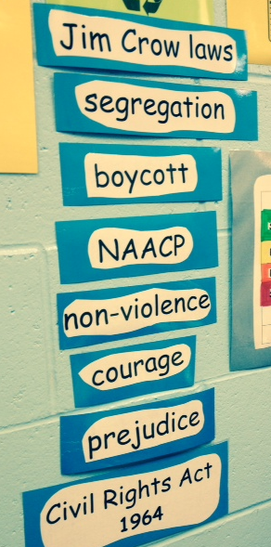
Teach Vocabulary
Vocabulary is introduced at beginning of the unit.
Each read-aloud reinforces vocabulary.
Students are expected to use vocabulary in their writing during the unit.

Slide 16
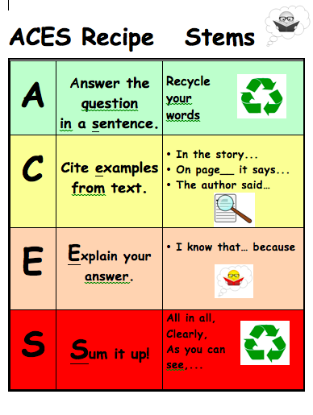

Provide Organization

Slide 17

ACES*: Let’s beat the high stakes test!
You shuffle the cards,
You deal them out,
You beat them once,
You beat them twice,
Aces are high,
Deuces are low,
Come on writers!
Here we go!

Slide 18
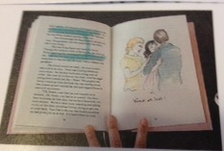



Analyzing the Question
The answer is in the text.
The answer is in my head.
The answer is right in the book.
I need to search in the book to find the answer.
Only ideas in my brain (schema) will answer the question.
I need ideas from my brain and information from the book.

Slide 19
Six Types of Questions
Sequencing
Compare and Contrast
Cause and Effect
Main Idea and Details
Opinion
Inferencing
When visual support in the form of graphic organizers are used, students are more easily able to ”see" what type of question they have.

Slide 20
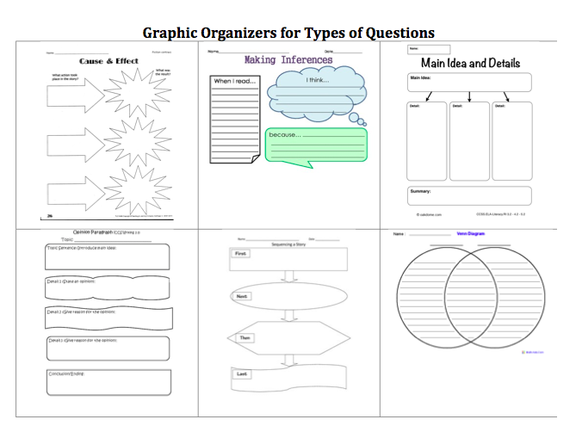

Slide 21

A
Common Core Standard:
SL.3.6
Answer the question completely by recycling words.

Slide 22
Teaching A
What do I have to teach?
What are the question words?
What words do I recycle?
Does it sound right?
Did I answer the question completely?
How can I teach it?

Slide 23
S
W.3.2
Sum
it up.

Slide 24
Teaching S
What do I have to teach?
Choose a stem or create your own.
Restate your opening sentence but make it a little stronger.
How can I teach it?
Practice changing these opening sentences into strong closing statements.

Slide 25
C
RL.3.1
RI.3.1
W.3.1
W.3.2
W.3.4
Cite
examples from the
text

Slide 26
Teaching C
What do I have to teach?
Choose a stem or create your own.
Relevant and irrelevant evidence
How can I teach it?

Slide 27
Let’s Practice citing evidence
1. How do you know that the waitress was ignoring the students at the lunch counter?
2. How did Connie feel when she was not able to get a banana split?
3. What does the old white woman say to show her support of the boys?
4. Can you describe Aunt Gertie?

Slide 28

Citing evidence using the listening domain

Slide 29

E
RL.3.3
RL.3.7
W.3.1
SL.3.1
Explain

Slide 30
Teaching E
What do I have to teach?
I know… because…
Connecting…
my schema
with the evidence
How can I teach it?

Slide 31

Deconstructing the Constructed Response

Slide 32
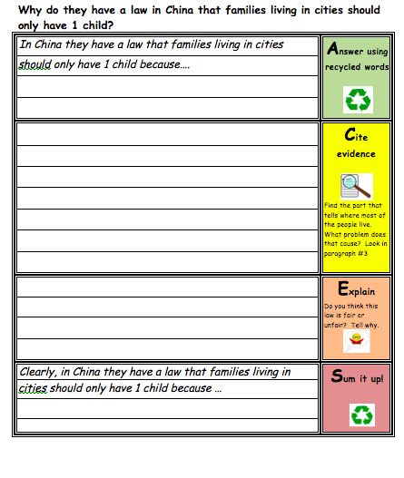
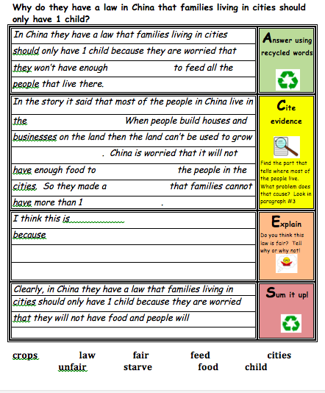
Differentiating for ELD Levels

Slide 33
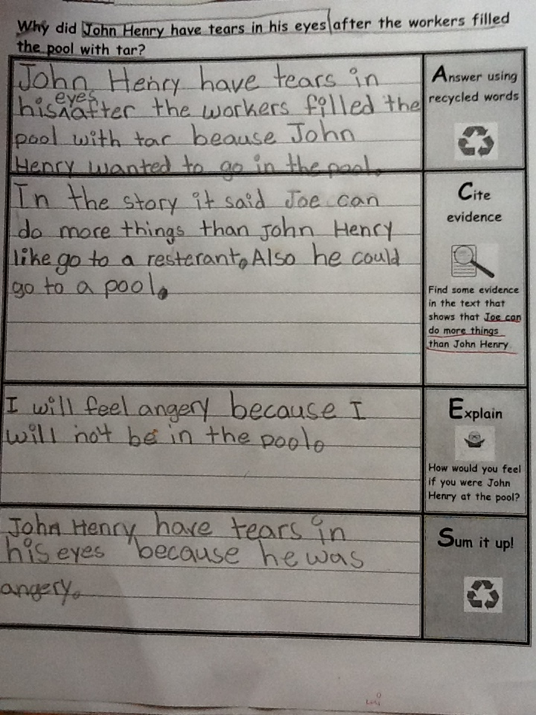
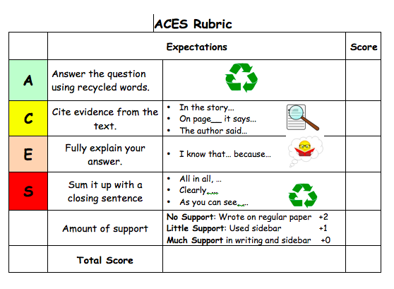
Assessing…
Notes:
This rubric assess for the use of ACES strategy. Common Core and PARCC will include assessing student writing: conventions, grammar, etc. It is important for educators to be mindful of this, however, as teachers of ELLs we need to keep in mind the student’s ELD level and be developmentally appropriate.

Slide 34
Content Objective
Participants will be able to sequence the ACES strategy for writing a constructed response.
Participants will be able to develop strategies for teaching each component of ACES so our ELLs “can do.”

Slide 35
Language Objective
Participants will be able to explain three components of writing that teachers have to address in order for our ELLs to write effectively.
Participants will be able to write various types of questions that their students can use to sort to the appropriate graphic organizer.

Slide 36

Thank you…
Contact us:
cathyfox10@gmail.com
pegschembre6@gmail.com

Slide 37
Websites for ACES
http://aceswritingstrategy.com
http://www.writingfix.com/rica/constructed_response.htm#top

Slide 38
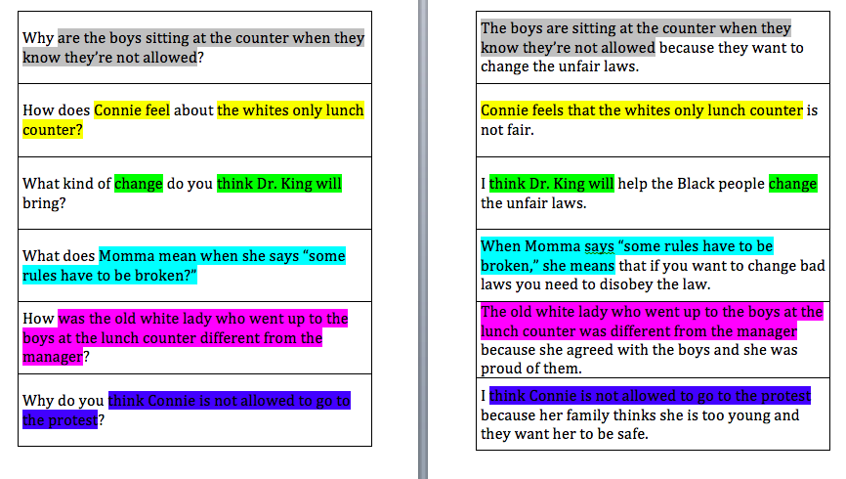

Slide 39
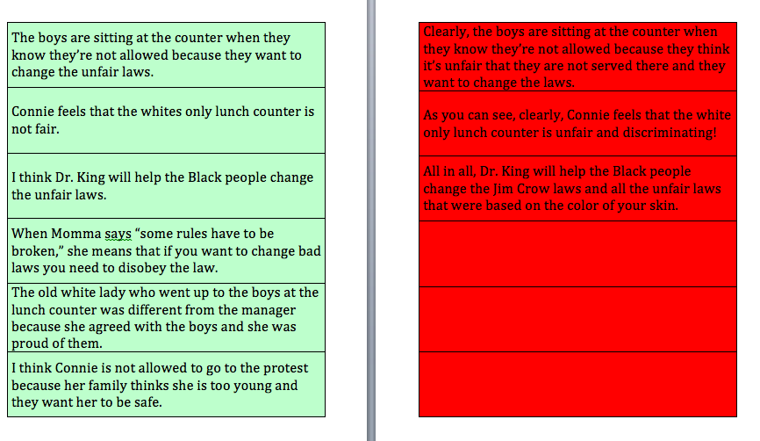

Slide 40

Additional Sentence Stems for Evidence

Slide 41
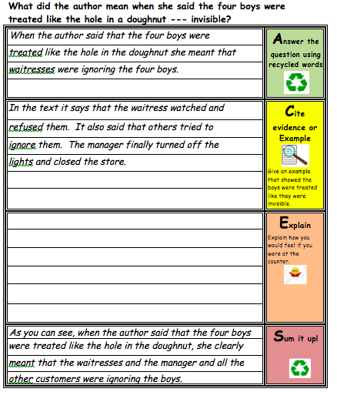
Zeroing in on Explaining

Slide 42
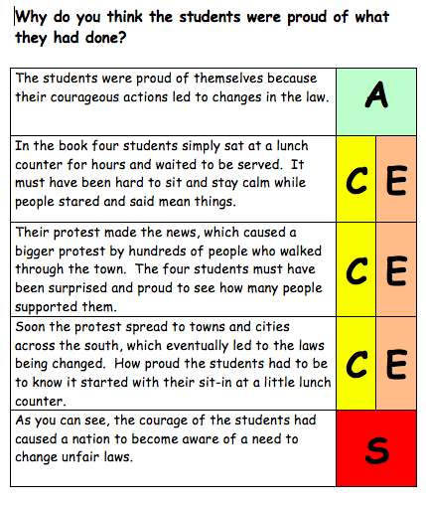
Knocking it up a level…
Notes:
Some people don’t like to use structures such as ACES because they feels student’s writing sounds formulaic and contrived; We believe it provides a scaffold, which when internalized can easily be taken away and expanded upon

Slide 43
