Slide 1
Writing with Colors:
Enhancing Writing for ELLS
Matsol Conference
May 9, 2014

Slide 2
Types of Writing
Narrative—tell a story
Expository—explain, give information
Descriptive—describe the steps in a process
Persuasive—convince, state a point of view

Slide 3
Narrative

Slide 4
detail detail
Writer’s Workshop Graphic Organizer
Main Idea
Topic idea
Topic idea
Topic idea
detail
detail
detail
detail
detail
detail
Clincher

Slide 5
Topic Sentence
Hook—remember to hook your reader with a great topic sentence!
Scene—set the scene with a description so that readers can re-create it in their minds as they read!

Slide 6
Transitional Words and Phrases
Sequencing:
First, Second, Third, Next, Then, Afterwards
Before, After, As soon as
Yesterday, Today, Tomorrow
In the winter/spring/summer/fall
In the beginning/middle/end
In the morning/afternoon/evening
Once upon a time/Long ago

Slide 7
Transitional Words and Phrases
Time:
about now
after soon
afterward suddenly
as soon as then
at today
before tomorrow
during until
finally when
later while
meanwhile yesterday
Location:
above beneath inside
across beside into
against between near
along beyond off
among by onto
around down on top of
behind in back of over
below in front of through

Slide 8
Specific/Relevant
Ideas are specific to the main idea and supporting paragraphs of the story
Ideas are relevant to the topic and can be expanded with details
Ideas should be prefaced by transitional words and phrases to make your story more interesting and flow better

Slide 9
Explanation/Clear/Complete/Accurate
Details explain the Who? What? When? Where?
Details create a clear and complete image for the reader to understand what is happening
Details provide an accurate representation of the events of the story
Details are in sequential order—don’t confuse your reader!
Details should be prefaced by transitional words and phrases to make your story more interesting and flow better

Slide 10
Craft/Voice/Creativity
Story shows the author’s voice:
I…me We…us
Story shows author’s thoughts or opinions:
I think that…I believe that…it was my opinion that…
Story shows author’s creativity:
This was something that I had never expected…How could I have known? I was so surprised that….

Slide 11
Clincher
The story has a logical ending and answers all the questions raised
The ending neatly ties together all the ideas and details
The clincher is usually the last sentence and is as exciting as the topic sentence
The story never ends with “The End”

Slide 12
Turtle Adventure
When I woke up, my brother and I were excited. We were so excited that we couldn’t eat our breakfast. Then, my family was going to the pet store to buy a five-foot tank for the turtle. There were lots of different animals at the pet store. I wished I could take home lots of pets. We chose our tank and the materials to go inside. After paying for everything, we headed to Joe’s house.
When we arrived at Joe’s house, we went to choose a turtle. We chose Honey Bun because we knew him and had taken care of him in the past. Honey Bun was in the back yard walking around. Mom and dad picked up the turtle and put him in his tank in the car. Honey Bun was so scared that he pooped in the tank. While this was happening, my brother and I were watching the other turtles.
Afterwards, we decided to go eat lunch with Joe, the turtle’s owner. We went to eat tacos. Honey Bun stayed in his tank in the car while we were eating. After lunch, Joe explained how to care for our new turtle. He also gave us a mister which helps Honey Bun to breathe.
Then we took our turtle home and put him outside to walk around. And we love him.
I can’t wait for my sister’s birthday. I am so exited! We invited Grandma Grampa, uncle, aunt and my 3 cousins to the party. I hope they all come. We picked a Mickey Mouse theme for the party.
So my mom and I spent all morning decorating with balloons and streamers and my mom made fake presents out of empty boxes. The food was amazing too! I still remember how the food tasted. We ate meat, rice and beans. After we ate cake. The cake was pink and purple and a big Minnie Mouse bow. After she blew out the 3 candles, we got to eat it. The cake was chocolate and it was so yummy!
After we ate, there was music and dancing. Everyone was having fun. My mom said that my sister should wait until tomorrow to open the presents because my sister was going to be playing all night.
So then everyone went home. The party was so fun and I will always remember that fun party that my mom and I made for my sister!!

Slide 13
Expository

Slide 14
Topic Sentence
In this selection…
In this text…
In this passage…
In this story…

Slide 15
MCAS Topic Sentences George Washington Carver ________________________________________________________________________________________________________________________________________________________________________________________________________________________________________________________________________________________________________________________________________________________________________________________________________________________ A Picture Book of Benjamin Franklin ________________________________________________________________________________________________________________________________________________________________________________________________________________________________________________________________________________________________________________________________________________________________________________________________________________________ 3. Ludwig van Beethoven: Master of a Silent World ________________________________________________________________________________________________________________________________________________________________________________________________________________________________________________________________________________________________________________________________________________________________________________________________________________________ 4. Bicycle Rider . ________________________________________________________________________________________________________________________________________________________________________________________________________________________________________________________________________________________________________________________________________________________________________________________________________________________
Based on the article, explain why George Washington Carver is famous. Support your answer with important information from the article.
Explain why Benjamin Franklin was famous. Use information from the story to support your answer.
In your own words , describe what happened at the first playing of Beethoven’s Ninth Symphony. Include at least FOUR important details from the selection in your answer.
According to the selection, Mr. Hay helped Marshall become a bicycle racer. List FOUR things that Mr. Hay did to help Marshall. Use important details from the selection in your answer

Slide 16
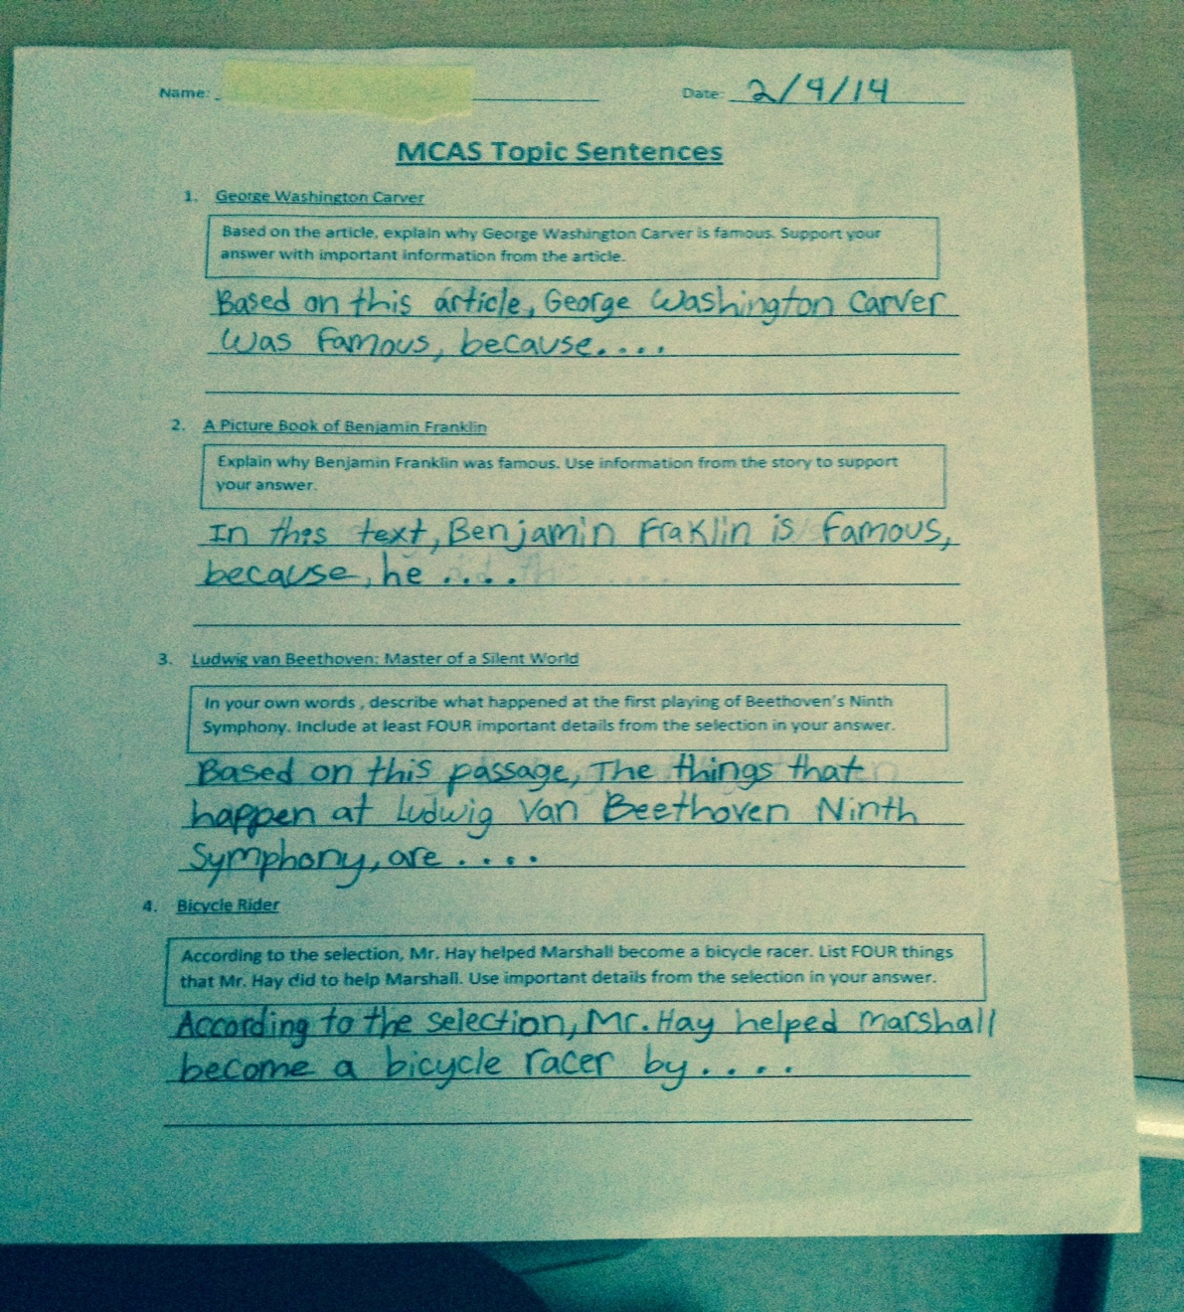
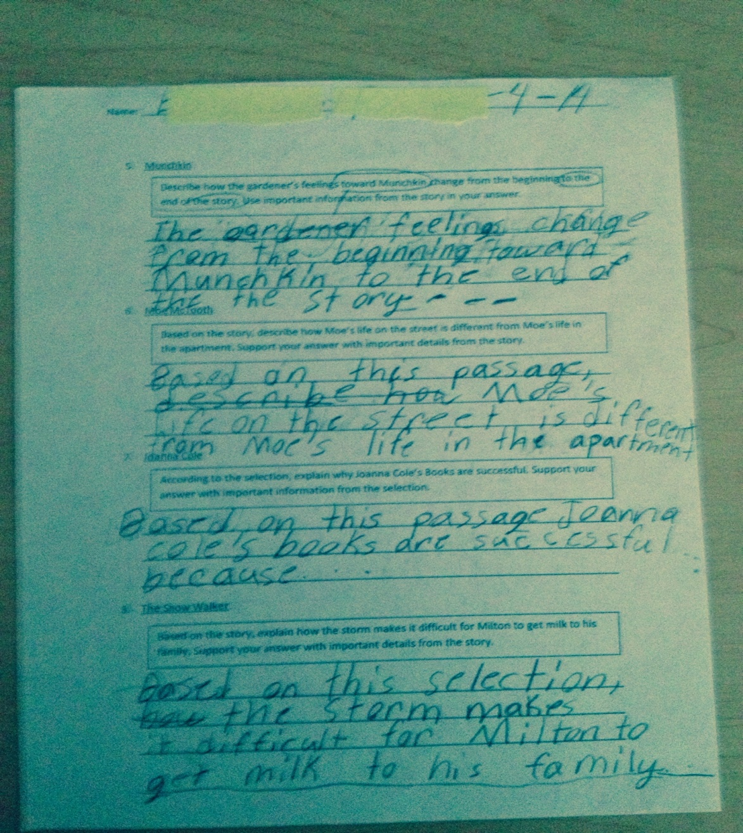

Slide 17
Transitional Words and Phrases
Sequencing:
First, Second, Third, Next, Then, Afterwards
Before, After As soon as, Earlier, Later
Yesterday, Today, Tomorrow
In the winter/spring/summer/fall
In the beginning/middle/end
In the morning/afternoon/evening
Once upon a time/Long ago

Slide 18
Transitional Words and Phrases
Conclude/Summarize:
Add Information:
all in all
as a result
because
finally
in conclusion
lastly
therefore
to sum it up
additionally besides
again finally
along with for instance
also for example
and in addition
another moreover
as well other

Slide 19
Quotes/Specific/Relevant
In paragraph (number), it says…
On line (paragraph), it says…
In the middle…
Towards the end…
In the end…
The author tells us…

Slide 20
Explanation/Clear/Complete/Accurate
This means that…
The author is telling me that…
This is important because…
The reason this is important is…
I know that…
It’s possible that…

Slide 21
Craft/Voice/Creativity
I believe that…
I think that…
In my opinion…
My opinion is…
I feel that…

Slide 22
Clincher
These are the reasons…
This is the reason…
This is why…
In conclusion…

Slide 23
Descriptive

Slide 24
Topic Sentence
Hook—remember to hook your reader with a great topic sentence!
Examples:
Baking a cake is so much fun!
Have you ever taught a dog a new trick?

Slide 25
Transitional Words and Phrases
Sequencing:
First, Second, Third, Next, Then, Afterwards
The first step…the next step…the final step
Initially…during the process…finally
In the beginning…after that…in the end
At the beginning…in the middle…at the end
To begin with…while you’re waiting…to end with

Slide 26
Specific/Relevant
Ideas are specific to the main idea and supporting paragraphs of the story
Ideas are relevant to the topic and can be expanded with details—add some hints about how you think the process can be done easier, better
Ideas are in sequential order—don’t confuse your reader!
Ideas can be prefaced by transitional words and phrases to make your story more interesting and flow better

Slide 27
Explanation/Clear/Complete/Accurate
Details explain the steps of a process of doing or making something
Details create a clear and complete image of each step for the reader—remember: the reader reads your work, not your mind…don’t leave out important information!
Details are an accurate representation of the steps involved using words that are descriptive: the thesaurus is your friend!

Slide 28
Clincher
The story logically explains the process being described
The ending neatly ties together all the ideas and details—make sure you haven’t left out a step!
The clincher is usually the last sentence and is as exciting as the topic sentence

Slide 29
One of my favorite things I like to draw is a picture of people. It’s not hard to draw a person. First, you take a piece of paper and a pencil. Next, you start drawing an oval head. Then comes the body with the legs and arms and shoulders.
The next step is to draw the face. You can make the eyes a circle or oval. It’s your choice. Don’t forget the eyelashes! You need to draw a nose and lips too.
The last step is to draw the clothes. I like to draw dresses and bows for the hair. You don’t need shoes but you can if you want. When you color the clothes you are done with your picture.
How to take care of a puppy
The first thing to do is you have to train your puppy tricks. Second of all you have to give your puppy plenty of water and food. The third reason is that your puppy has to rest its paws and feet.
Now your puppy is ready to go to the park. Then when you get home give your puppy a bath. Then you take your puppy outside and get a big bucket and put your puppy in the bucket.
When your finished play with your puppy and be happy.

Slide 30
Persuasive

Slide 31
Topic Sentence
Hook—remember to hook your reader with a great topic sentence!
Examples:
I really need a new bike!
It’s time for another trip to Disney!

Slide 32
Transitional Words and Phrases
Compare:
Contrast:
also
as
in the same way
like
likewise
similarly
while
although
but
even though
however
on the other hand
otherwise
still
yet

Slide 33
Transitional Words and Phrases
Emphasize a point:
Clarify:
again
as previously stated
especially
in fact
for this reason
to emphasize
to repeat
truly
as a matter of fact
besides
for instance
furthermore
in addition
in other words
that is
that is to say

Slide 34
Specific/Relevant
Ideas are specific and relevant and support your arguments
Ideas are in sequential order—focus on one argument at a time!
Ideas can be prefaced by transitional words and phrases to clarify, contrast, or enhance your argument

Slide 35
Explanation/Clear/Complete/Accurate
Details explain the how and why of your argument
Details create a clear and complete image of each argument for the reader—remember: the reader reads your work, not your mind…don’t leave out important information!
Details are an accurate representation of your argument involved using words that are descriptive: the thesaurus is your friend!

Slide 36
Clincher
The story logically explains your argument
The ending neatly ties together all the ideas and details—make sure you summarize your arguments
The clincher is usually the last sentence and is as exciting as the topic sentence

Slide 37
Why do students have to wear designer clothes? I believe students need to wear uniforms. Here are some reasons that students should wear uniforms.
Every now and then families need to save money for more important things. Some families don’t have lots of extra money to buy expensive clothing for their children. Uniforms could help parents because they aren’t as expensive as designer clothing.
Also, if we go on a field trip, we could wear uniforms so we don’t get lost. Some schools send students on field trips wearing a school t-shirt. If we have school uniforms and someone gets lost, we could easily find them.
Another reason is all students may not be listening to the teacher because they are distracted by other students’ clothing. Students may be focused on other students’ clothing and not on the lesson. So this is a good way to convince the principal to choose school uniforms.
In conclusion, I believe the principal should decide that all students should wear uniforms instead of designer clothing. Anyways, who needs designer clothes because we’re here to learn not show off our clothes!

Slide 38
Mrs. Nunes why do we have to read? I don’t have enough time to do all my other homework every day and read too. Besides, my sister keeps bothering me because she wants to play. Another problem is I get very sleepy when I read.
Every day I need 30-50 minutes to do my homework. Especially the math homework is hard and this makes me think a lot. It uses a lot of brain energy so I don’t have enough left over to read.
All day my sister Ainara waits for me to come home from school. So, when it’s time for me to do my homework, she wants to play. She knocks loudly until I open the door. Then she jumps on my bed. I can’t read when she is in my room.
When it’s time for me to do my daily reading for 30 minutes, I start to get sleepy after reading only 10 minutes. I have to put my books away for a while and lay down and rest for a little bit.
In conclusion, these are the reasons that I think that I should have less reading for homework. I read a lot at school and really need to do my math homework at home. If I don’t spend time with my sister, she will cry. If I read I will get sleepy but my mom doesn’t let me sleep during the day. I think it’s time to stop with the reading homework.

