Slide 1
Whittemore School
2013-2014

Slide 2
It All Started in January 2013
Intervention Block
Collaboration
Analysis of Student Work
Outcomes

Slide 3
WRITING with COLORS
Topic Sentence
TOPIC
Transitional Words and Phrases
TRANSITIONS
Explanation
Clear
Complete
Accurate
EXPLANATION
Supporting Details
Relevant (Important)
Specific (Direct Quotation)
DETAILS
© 2003, Writing With Colors, Daly, Renna, O’Toole

Slide 4
In the folktale "The Guest" Mullah Nasreddin's actions are both wise and foolish when he feeds his food to his clothes to teach the rich man a lesson. The first thing that the Mullah does to teach the rich man a lesson is to put on ragged clothes that make him look like a poor man. For example, in paragraph 4, it says "the Mullah threw on his shabbiest and most comfortable clothes." This is important because the Mullah has to test the rich man first by coming to his house as a beggar before he feeds his food to his clothes. The next important thing that happens for the Mullah to teach his lesson to the rich man is when the rich man does not see that it is the Mullah who has come to his house. In paragraph 10, the rich man "Seeing the old man in his ragged clothes, he waved a hand to the servant, then went back to join his elegant guests." This shows that the rich man cannot see who the Mullah really is because of the clothes the Mullah has on. The last step in the Mullah's lesson for the rich man happens when the Mullah rubs food all over his fine clothes and the rich man understands his mistake. After seeing what the Mullah has done, the rich man in paragraph 29 says, "I saw only your clothes and could not recognize the wearer." This means that the Mullah did something that was both foolish and wise to teach the rich man that it is who you are and not how you look that is most important. In conclusion, Mullah teaches the rich man a lesson when he feeds his food to his clothes at the rich man's feast. Sometimes what looks foolish at first ends up being wise in the end.
“The Guest”
12-Sentence
Open Response Model

Slide 5
In the folktale "Mr. Lucky Straw," Shobei shows kindness towards the others in the story. The first way Shobei shows kindness toward others in the story is when he gives the little boy the dragon fly. The author writes in paragraph 9, "To express her appreciation, the boy's mother gave Shobei three of the oranges she was carrying." This shows that Shobei received a better gift of oranges for being kind to the little boy. A second way that Shobei shows kindness toward others is when he gives the thirsty peddler his oranges. In paragraph 11, the author writes that "The peddler was very grateful, and in exchange he gave Shobei three pieces of cloth." This is important because Shobei now has cloth which is even more valuable than the oranges. A final way that Shobei is kind toward others is when he gives the princess the pretty cloth. In paragraph 14, the princess gives Shobei "a large sum of money" to thank him for the cloth that he has given to her. This means that Shobei ends up with lots of money that is even more valuable than the cloth. In conclusion, in the folktale "Mr. Lucky Straw," Shobei shows kindness towards everyone he meets. The more Shobei gives away to others the more he gets in return.
“Mr. Lucky Straw”
12-Sentence
Open Response Model

Slide 6
In the folktale, "The Seed" the emperor uses a clever trick to choose the next emperor. The first thing the emperor does to choose the next emperor is to announce that he wants to pick someone who is not a family member. In paragraph 1, the emperor says that he "felt that the power and wealth had made his heirs lazy." This shows that the emperor is a fair man interested in finding the best person who will work hard as the next emperor. The second way that the emperor is clever about how he finds the next emperor is by giving each of the young men in the town a seed that he tells them to grow for one year. When the young men returned to the temple with their plants a year later, in paragraph 29 one young man named Chun said to the emperor, "My seed didn't grow," Chun replied. "I failed." This is important because even though Chun was not able to grow a plant, he still came to show the emperor what had happened. The final way that the emperor is clever about how he will choose the next emperor is when he tells everyone that he has boiled all the seeds so that none of the seeds could grow. In paragraph 22, the emperor says, "Only one person had enough honesty and courage to bring me the original seed," and "that is why Chun will be the next emperor." This means that the emperor was very clever because he knew that many of the young men would try to fool him by substituting other seeds rather than show up without a plant. In conclusion, the emperor has a very clever way to choose the next emperor. The next person to be the best emperor is the honest one.
“The Seed”
12-Sentence
Open Response
Model

Slide 7
Explanation
Sentence Starters
This shows that the emperor is a fair man interested in finding the best person who will work hard as the next emperor.
This is important because even though Chun was not able to grow a plant, he still came to show the emperor what had happened.
This means that the emperor was very clever because he knew that many of the young men would try to fool him by substituting other seeds rather than show up without a plant.

Slide 8
Student Sentence Starters for Explanation Sentence
This is important because....
The reason why this is important is because...
In this example, the author is showing that...
This shows that....
This means that...
Here, the author is saying that...
This proves that...

Slide 9
In the folktale "Mr. Lucky Straw," Shobei shows kindness towards the others in the story. When Shobei gives the little boy the dragon fly, the author writes in paragraph 9, "To express her appreciation, the boy's mother gave Shobei three of the oranges she was carrying." This shows that Shobei received a better gift of oranges for being kind to the little boy. When Shobei gives the thirsty peddler the oranges, in paragraph 11, the author writes that "The peddler was very grateful, and in exchange he gave Shobei three pieces of cloth." This is important because Shobei now has cloth which is even more valuable than the oranges. When Shobei gives the princess the pretty cloth, in paragraph 14, the princess gives Shobei "a large sum of money" to thank him for the cloth that he has given to her. This means that Shobei ends up with lots of money for being kind because he was willing to share what he had with others. In conclusion, Shobei shows kindness towards others that he meets and the more he gives away the more he gets in return.
8-Sentence
Open Response
Model

Slide 10
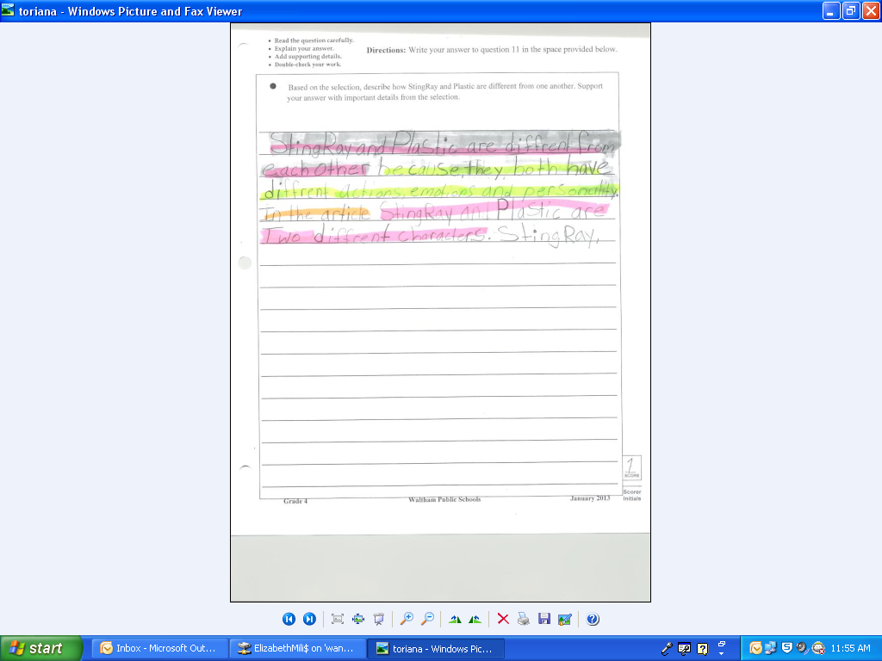
Sample Work: Student 1 (before)

Slide 11
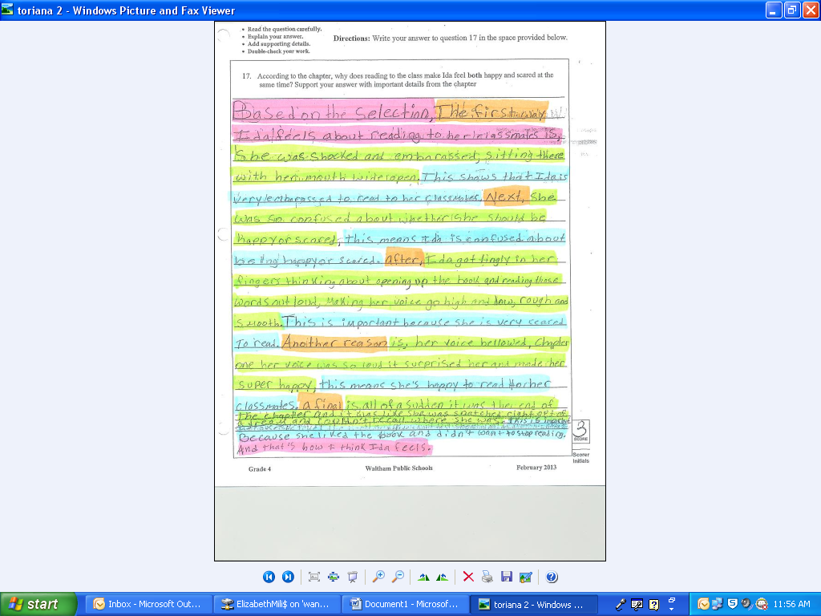
Sample Work: Student 1 (after)

Slide 12
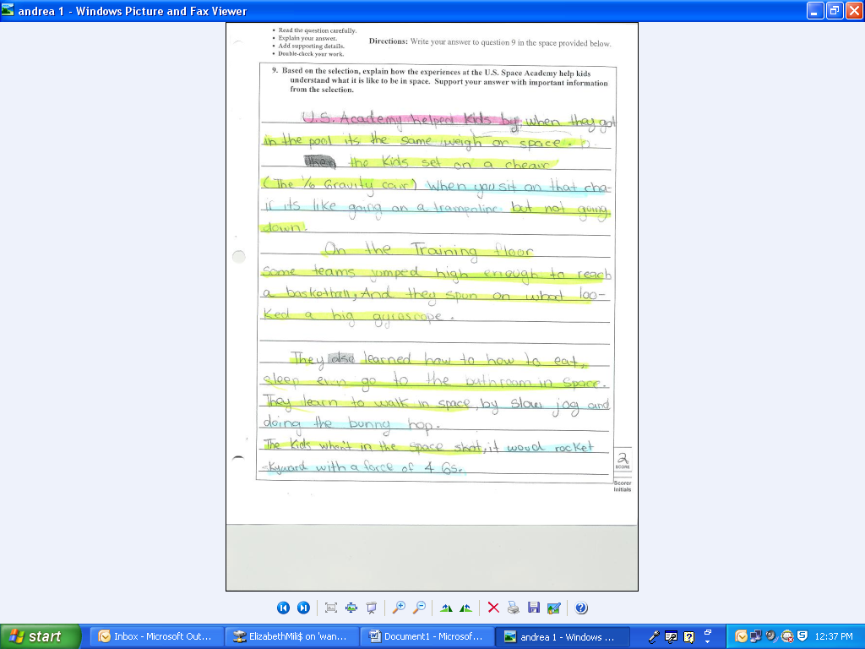
Sample Work: Student 2 (before)

Slide 13
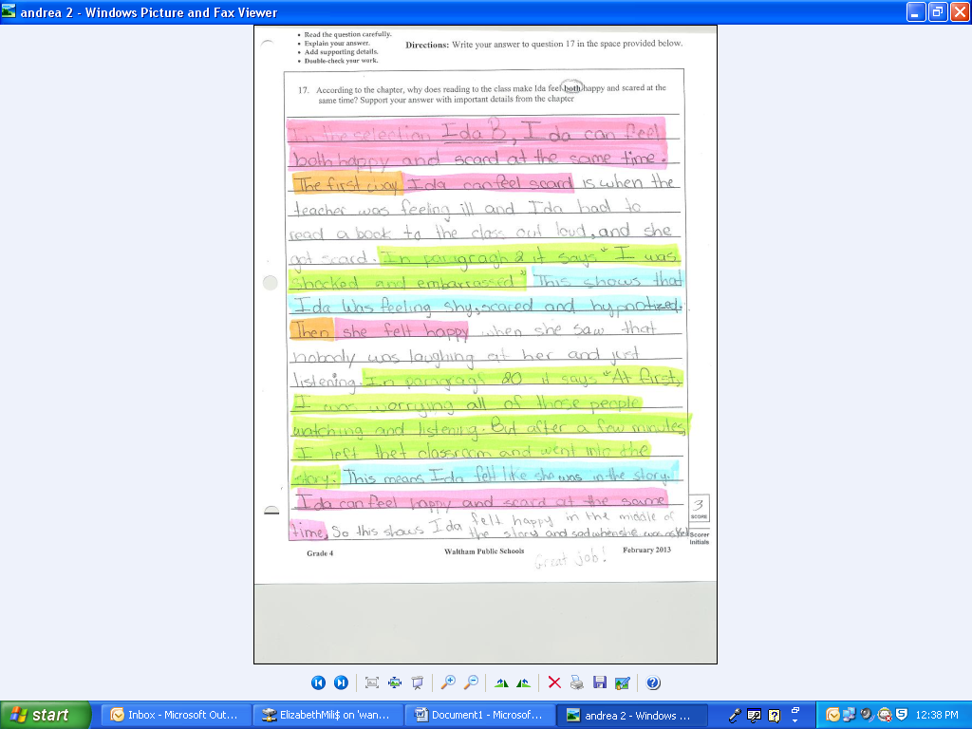
Sample Work: Student 2 (after)

Slide 14
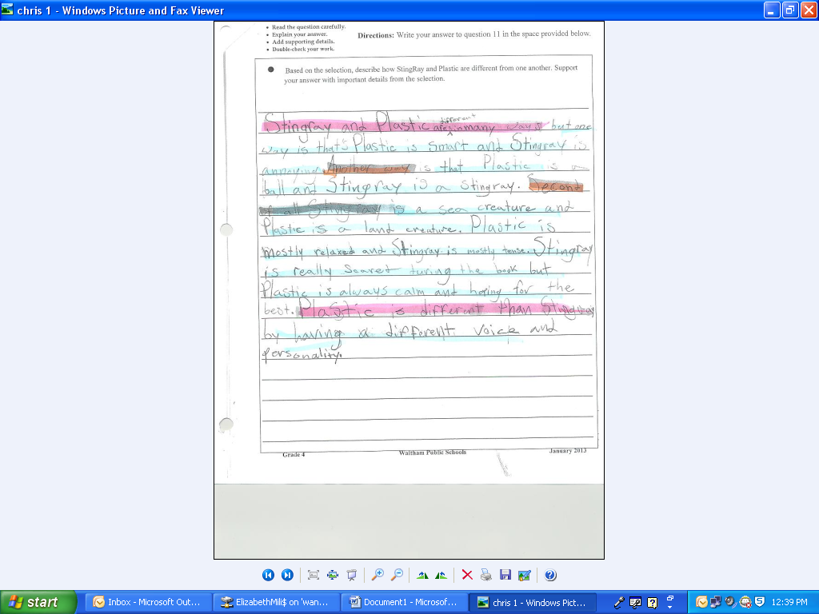
Sample Work: Student 3 (before)

Slide 15
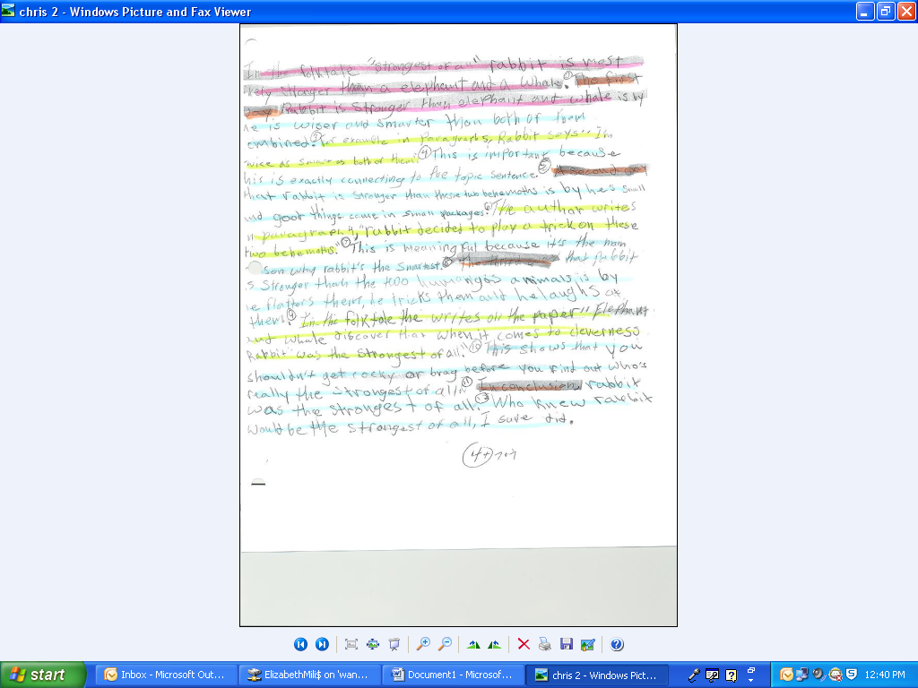
Sample Work: Student 3 (after)

Slide 16
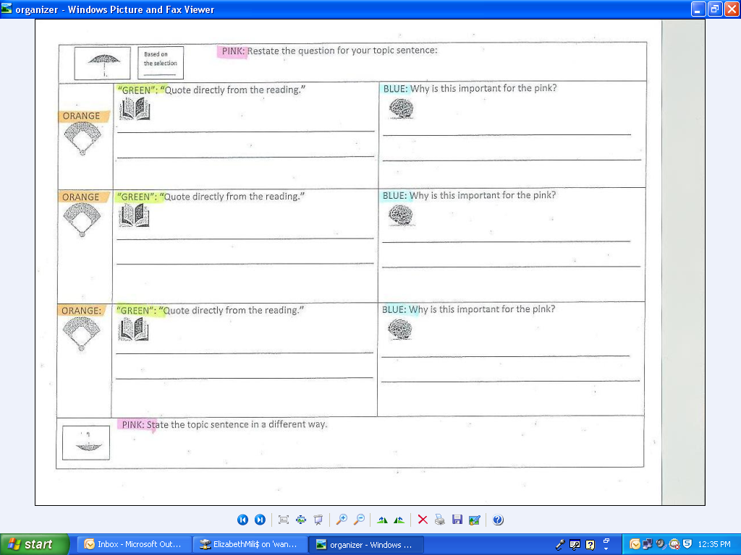
Open Response Organizer Example

Slide 17


Slide 18
Summary
Lessons Learned:
Personalization
Transparency
Instructional Modifications/Adjustments to Practice
Student Reflections Video

Slide 19
