Slide 1
Web-scale Discovery Tools and the Backgrounding of Government Information
Christopher C. Brown, University of Denver, main Library
Electronic Resources & Libraries, Austin, TX, Feb. 23, 2015

Slide 2
The Days of Broadcast Search
Often referred to as “federated search”, but not
It was disintegrated search, and maybe you could say federated results
Characterized by long waits (connection wait times, handshakes, mapping of search terms, merging and “deduping” of results, messy results)
Searching across metadata. No FT searching.

Slide 3
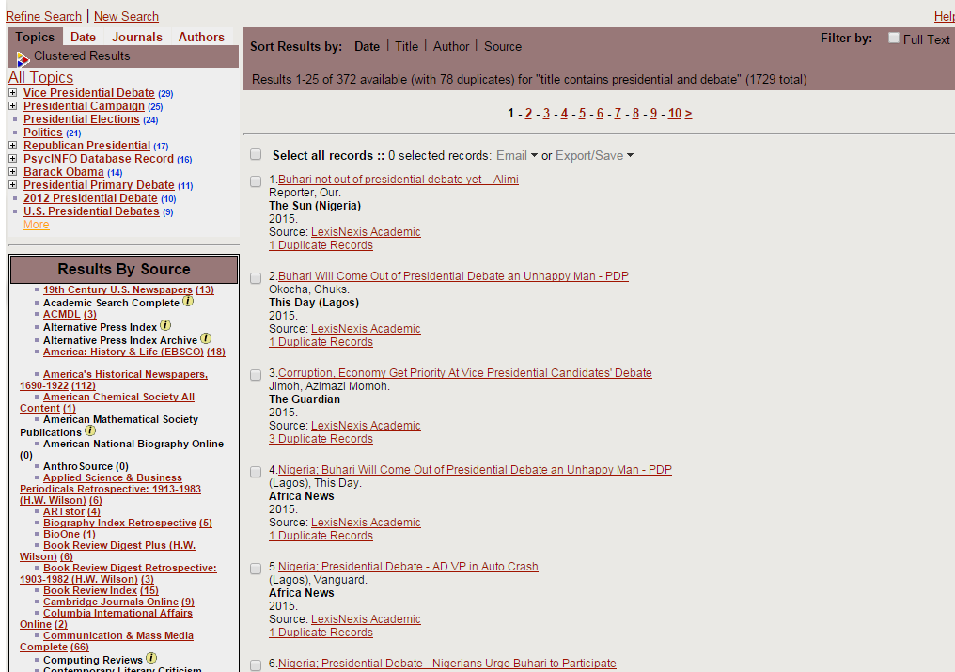
Metasearch or broadcast search was a fail
Inordinate delays
Missing results
Messy “on the fly” merging
No FT searching
Sloppy clustering

Slide 4






Metasearch or Broadcast Search Innovative technology, but never lived up to expectations
Web Metasearch Examples: Metasearch, Dogpile
Library Metasearch Examples: MetaLib, Research Pro, ENCompass, Central Search/360 Search, WebFeat, AGent, iBistro

Slide 5


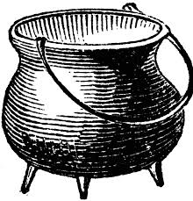
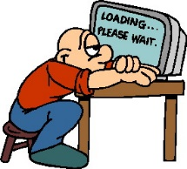
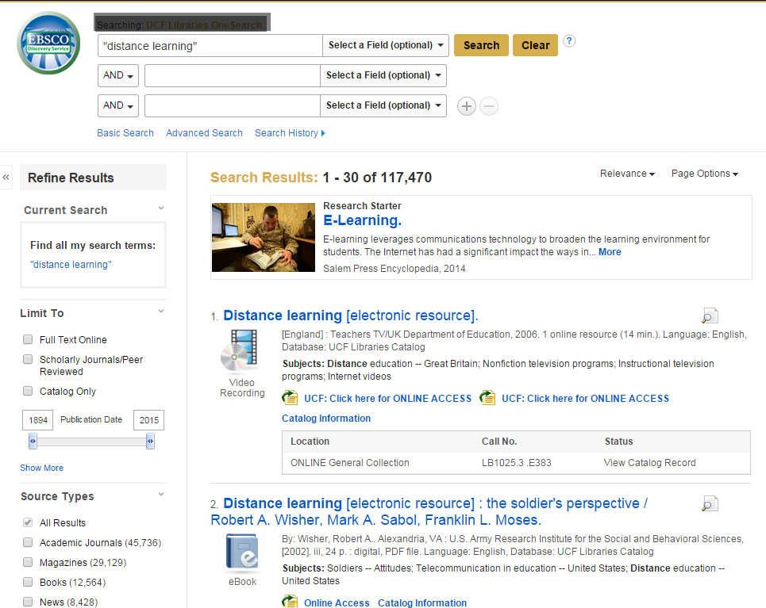
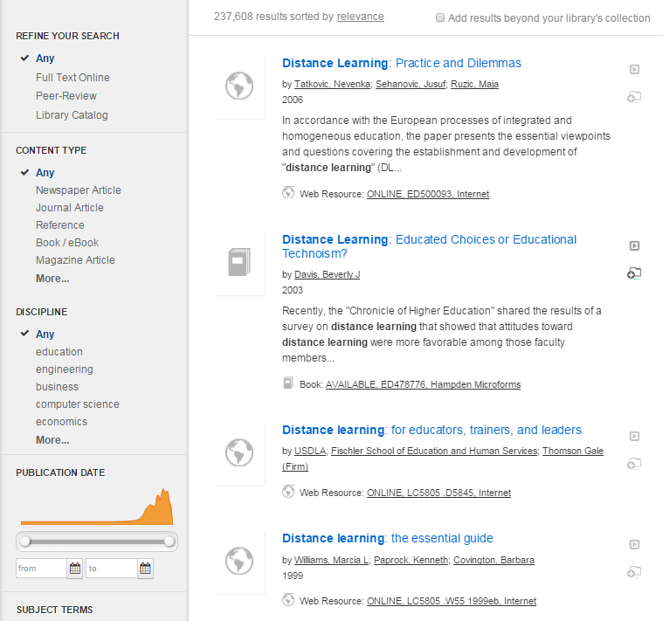
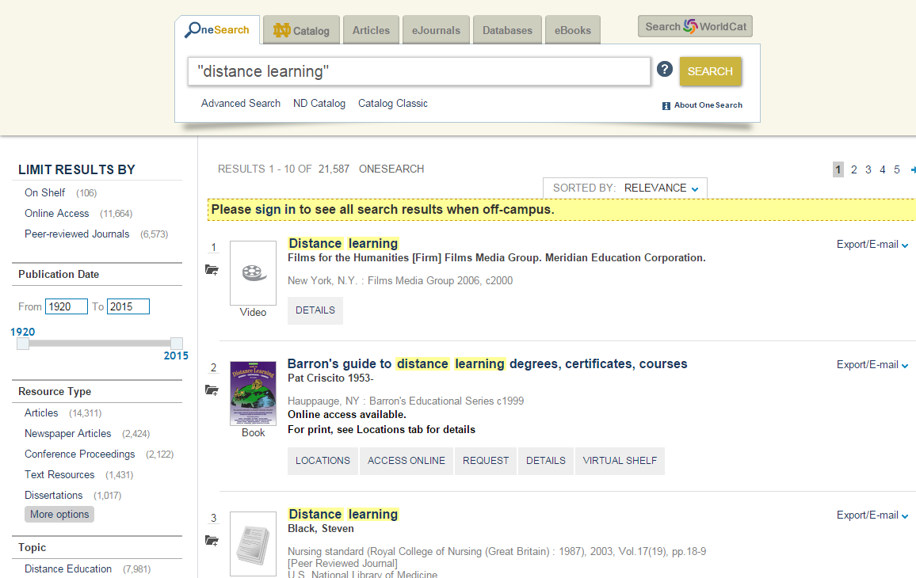
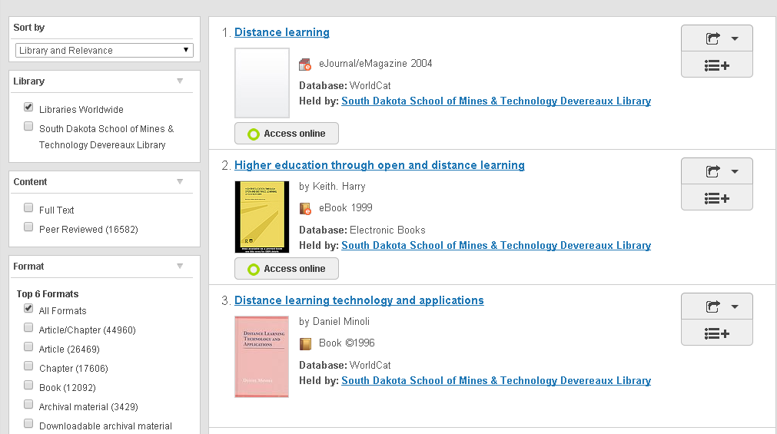
Broadcast Search
Webscale Discovery
Metasearch or Broadcast Search
Was often referred to as “federated search” but it was not; at best it was federated results.
Web-scale discovery tools are the real “federated search”. But since vendors already used that term, they had to invent “discovery”.
Information Silos
Metadata only
Metadata and sometimes FT
Query
Merging and de-duping on-the-fly
Query
Federated Results
Federated Search and Federated Results

Slide 6
Breadth and Depth
Breadth refers to the number and kinds of resources covered. Google Scholar is rather narrow in breadth, covering scholarly articles, selected technical reports, and Google Books “bleadthrough”. Discovery tools are much broader in scope, covering books and ebooks, magazine articles, scholarly articles, trade publications, newsletters, newspapers, dissertations, technical reports, maps, audio-visual materials, institutional repositories, and many other sources.
Depth refers to how deeply a search tool goes down into the resource. Google (Google Web, Google Scholar, and Google Books) usually indexes full text of nearly everything. Discovery tools vary greatly in their full text search reach. Sometimes they don’t have access to the full text, only metadata. Other times they have access but choose not to provide full text search access.

Slide 7
Metasearch tools were weak, but they searched rather evenly
eBooks
Print Books
Dissertations
Newspapers
Magazines
Gov Info
Scholarly Journals
Surface Searching

Slide 8

Let’s Face It: Google Scholar Does It Better: There is Room for Improvement
Discovery Tools
Google Scholar
eBooks
Print Books
Dissertations
Magazines
Scholarly Journals
Gov Info
Scholarly Journals
Google
Books “bleedthrough”
Misc:
tech rpts,
other
Newspapers
Indexing: title, author, keywords, abstract
Surface Searching
Deep Searching
Full text of content – Every last word
Full text of content – Every last word

Slide 9
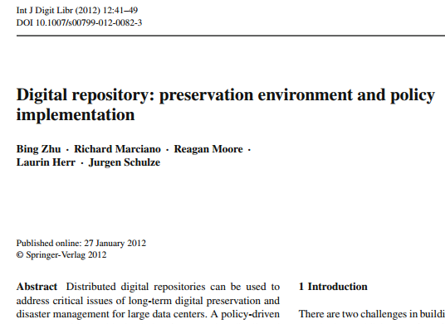
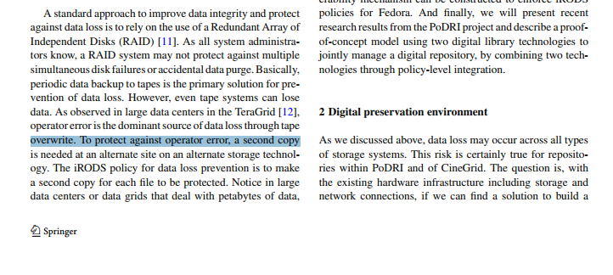
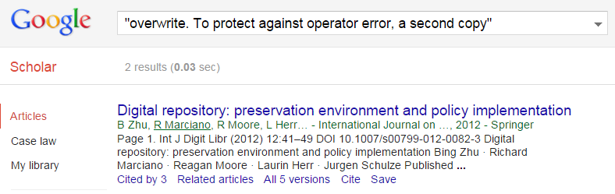
Google Scholar: Setting the Bar

Slide 10
Discovery Tools are not very good at exposing primary sources
Not all primary sources are created equal
Archival resources: unique and interesting
Government information: arguably one of most important primary sources – public policy affects us all.
Primary Sources Include:
Vendor primary sources (archival collections)
Institutional repositories or Digital repositories
Government primary sources

Slide 11
Why do Discovery Tools succeed more than metasearch tools? The Information Access Anomaly
 | Book (average) | Journal Article (average) | Google (Scholar/Books)
Typical Length - full text (FT) | 200 pages x 400 = 80,000 words | 15 pages x 400 = 6,000 words
Surrogate Record (SR) | 50-100 words (75 ave.) | 300-500 words (400 ave. ¹)
SR to FT ratio | 1 to 10,666 | 1 to 15 | 1 to 1
¹ http://www.writersservices.com/wps/p_word_count.htm
What this chart means: Very often at the Reference Desk, student will say “Why doesn’t the library have any books on my topic?” Actually, we do; it’s just that our discovery tools are weak.

Slide 12
Relevance vs. Discovery
Higher Relevance
Higher Discovery
Metadata
Full Text
Full text indexing within Discovery Tools is uneven, maybe even erratic. Efforts should be made to increase full text presence within their indexing.

Slide 13
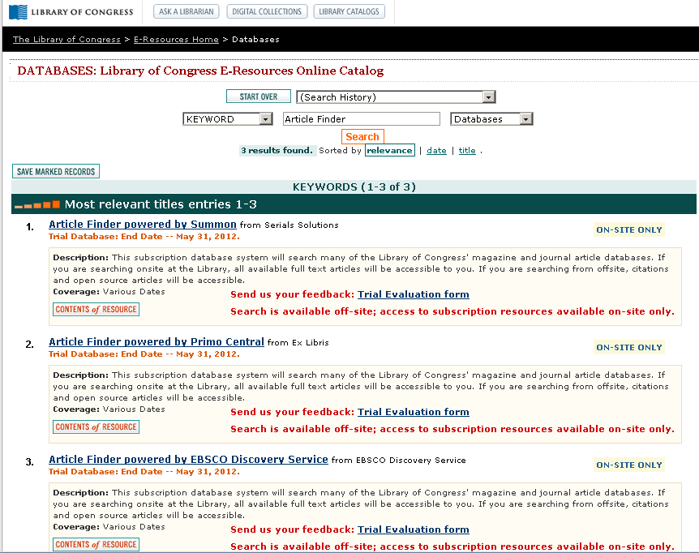
Unique Library of Congress Trials A unique opportunity in 2012

Slide 14

Testing Discovery Systems
Select item to be tested (scholarly article, ebook, government publication etc.)
Test each of the four discovery tools to ensure metadata is present
Test each of the four to see if they can retrieve full text (test both with and without quotes around text)
Text should not contain gremlin characters or cross lines (line breaks)
Use Google as a control (Google Web, Google Scholar, Google Books)

Slide 15
Test 1
Wood, Phillip K., Kenneth J. Sher, and Patricia C. Rutledge. "College student alcohol consumption, day of the week, and class schedule." Alcoholism: Clinical and Experimental Research 31, no. 7 (2007): 1195-1207.
Text 1: drinking but based instead on the sum of the number of
Text 2: night of drinking. In this case, it is not the time spent
Test | G. Scholar | Summon | EDS | Primo | WC Disc.
Citation | Yes | Yes | Yes | Yes | Yes
Text1 | Yes | Yes | No | No | No
Text2 | Yes | Yes | No | No | No

Slide 16
Test 2
Citation: Garcia, Sònia, Teresa Garnatje, and Aleš Kovařík. "Plant rDNA database: ribosomal DNA loci information goes online." Chromosoma 121, no. 4 (2012): 389-394.
Text 1: "FISH data is stored prior to its publication, without being"
Text 2: "outline of how to work with the database. The Simple"
Test | G. Scholar | Summon | EDS | Primo | WC Disc.
Citation | Yes | Yes | Yes | Yes | Yes
Text1 | Yes | Yes | No | No | No
Text2 | Yes | Yes | No | No | No

Slide 17
Test 3
Pound, Pandora, Shah Ebrahim, Peter Sandercock, Michael B. Bracken, and Ian Roberts. "Where is the evidence that animal research benefits humans?." BMJ 328, no. 7438 (2004): 514-517.
Text 1: An unpublished study by Ciccone and Candelise
Text 2: Moreover, if animal experiments fail to inform medical
Text 3: single consultations. PP and SE applied (unsuccessfully) to the
Test | G. Scholar | Summon | EDS | Primo | WC Disc.
Citation | Yes | Yes | Yes | Yes | Yes
Text1 | Yes | Yes | No | Yes | No
Text2 | Yes | Yes | No | Yes | No

Slide 18
Test 4
Tartter, Molly A., and Lara A. Ray. "A prospective study of stress and alcohol craving in heavy drinkers." Pharmacology Biochemistry and Behavior 101, no. 4 (2012): 625-631.
Text 1: "Participants were contacted for an on-line follow-up at 6 and 12 months after evaluation in the laboratory"
Text 2: "The ACQ was modified to encompass the four quantitative indices of alcohol use recommended"
Test | G. Scholar | Summon | EDS | Primo | WC Disc.
Citation | Yes | Yes | Yes | Yes | Yes
Text1 | Yes | Yes | No | Yes | No
Text2 | Yes | Yes | No | Yes | No

Slide 19
Test 5
Muggah, Robert, and Keith Krause. "Closing the gap between peace operations and post-conflict insecurity: towards a violence reduction agenda." International Peacekeeping 16, no. 1 (2009): 136-150.
Text 1: "armed violence prevention and reduction programmes that draw upon"
Text 2: "before, during, and after wars come to a close. Armed violence does"
Test | G. Scholar | Summon | EDS | Primo | WC Disc.
Citation | Yes | Yes | Yes | Yes | Yes
Text1 | Yes | Yes | Yes | Yes | No
Text2 | Yes | Yes | No | Yes | No

Slide 20
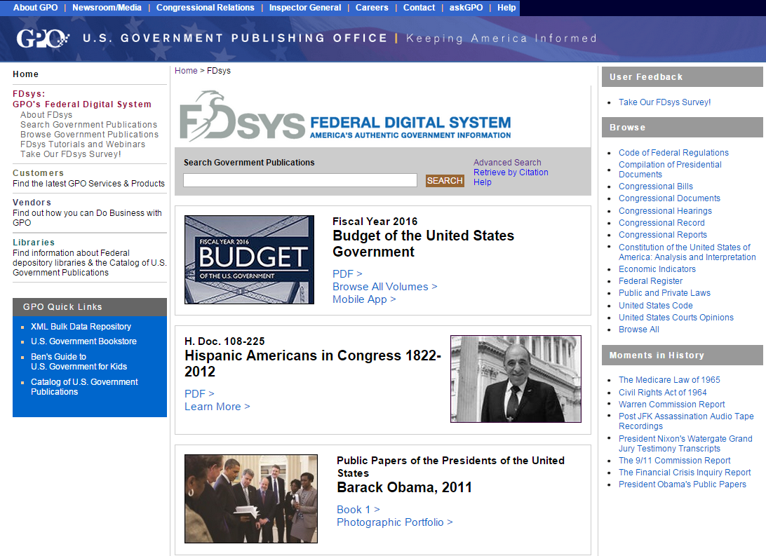
Testing for Government Information
Choice of benchmark: Fdsys - http://www.gpo.gov/fdsys/

Slide 21
Sources for Government Information
The Government Publishing Office has these freely available tools:
Catalog of Government Publications (CGP) – library catalog, metadata only - http://catalog.gpo.gov/
Metalib – metasearch tools, searches metadata only - http://metalib.gpo.gov/
FDsys – Repository, searches metadata and full text - http://www.gpo.gov/fdsys/
FDsys searches full text by default.
In 2011 FDsys officially replaced GPO Access as the official repository for Legislative, Executive, and Judicial Branch documents that GPO hosts.
FDsys was engineered from the ground up to bring quick, faceted searching for discovery of government information.
FDsys content is available for anyone to download and for third-party vendors to utilize.

Slide 22
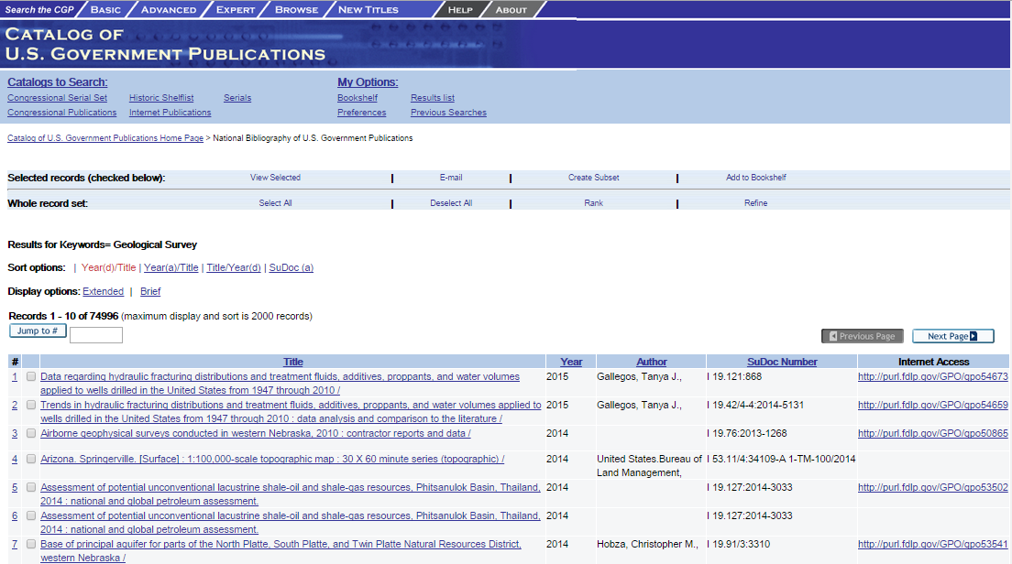
Catalog of Government Publications: GPO’s Online Catalog
http://catalog.gpo.gov/

Slide 23
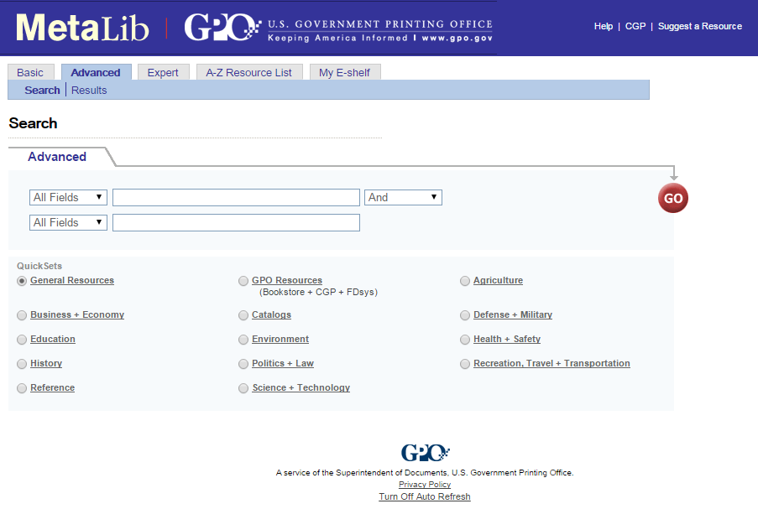
MetaLib: the GPO Metasearch Platform
Metalib is a broadcast search for government information. No FT searching, only metadata.
Access to Archival Databases (AAD) System - NARA | DONE | 99 | 30
AGRICOLA Books | DONE | 1 | 1
AUL Index to Military Periodicals | DONE | 0
Catalog of U.S. Government Publications (CGP) | DONE | 8 | 8
Education Resources Information Center (ERIC) | FETCHING | 10000
EPA Publications and Newsletters | DONE | 10 | 10
Federal Digital System (FDsys) | DONE | 1352 | 30
Library of Congress (LOC) | DONE | 128 | 30
PubMed | DONE | 1 | 1
http://metalib.gpo.gov/

Slide 24
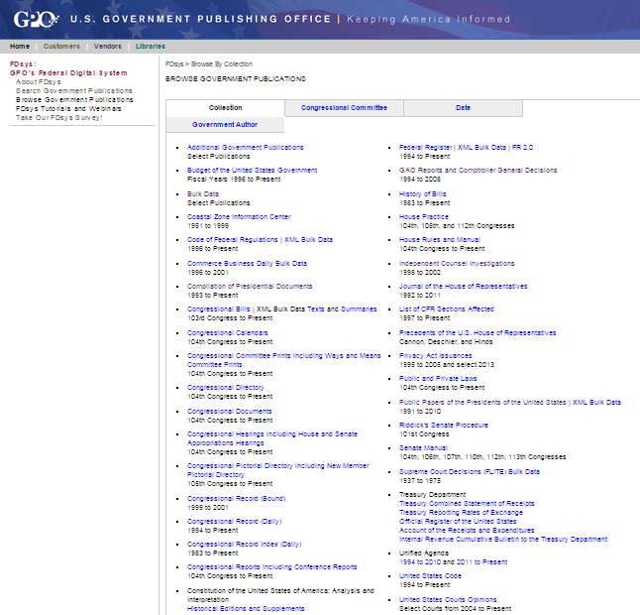
FDsys – Default FT Searching of Official Content
Although some of this content does not lend itself to inclusion in Discovery Tools, some of these subsets are essential for students to work with public policy, legislative research, and history.
http://www.gpo.gov/fdsys/

Slide 25
Priorities of what Full text Government Information to Include in Discovery Tools
Congressional Reports – legislative intent (1995-present)
Congressional Hearings – social history and policy making (1995-present)
Congressional Documents – budget, treaties, special reports, and legislation-related (1995-present)
Public and Private Laws (1995-present)
Compilation of Presidential Documents (1993-present)
Public Papers of the Presidents (1991-2010)
Economic Report of the President (1995-present)

Slide 26
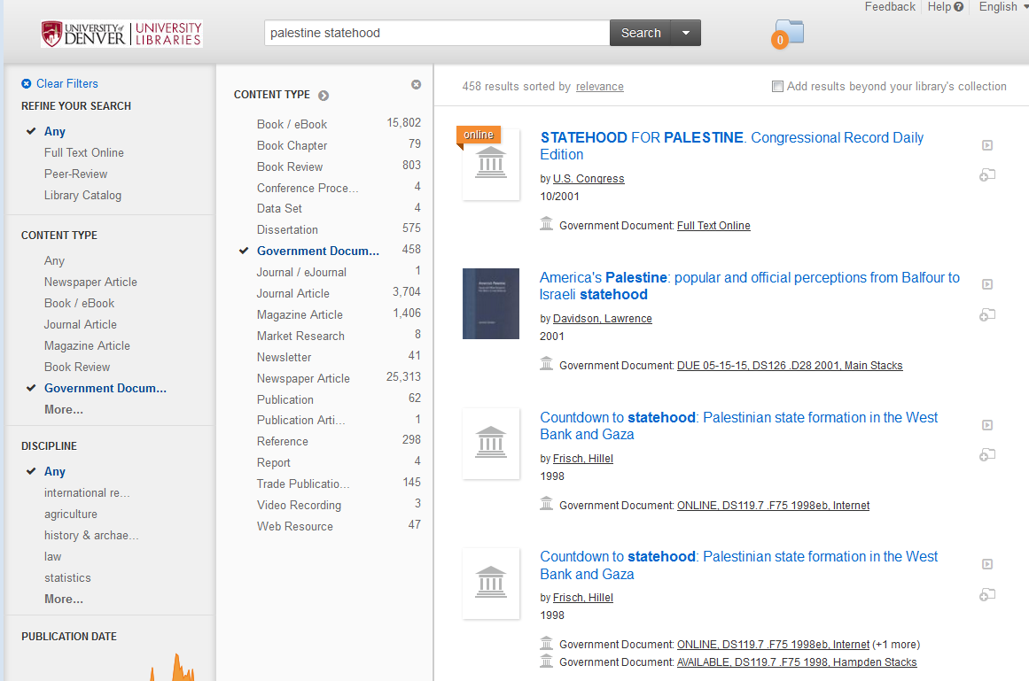
Summon has govdocs – but their own PQ Congressional content, not FDsys

Slide 27
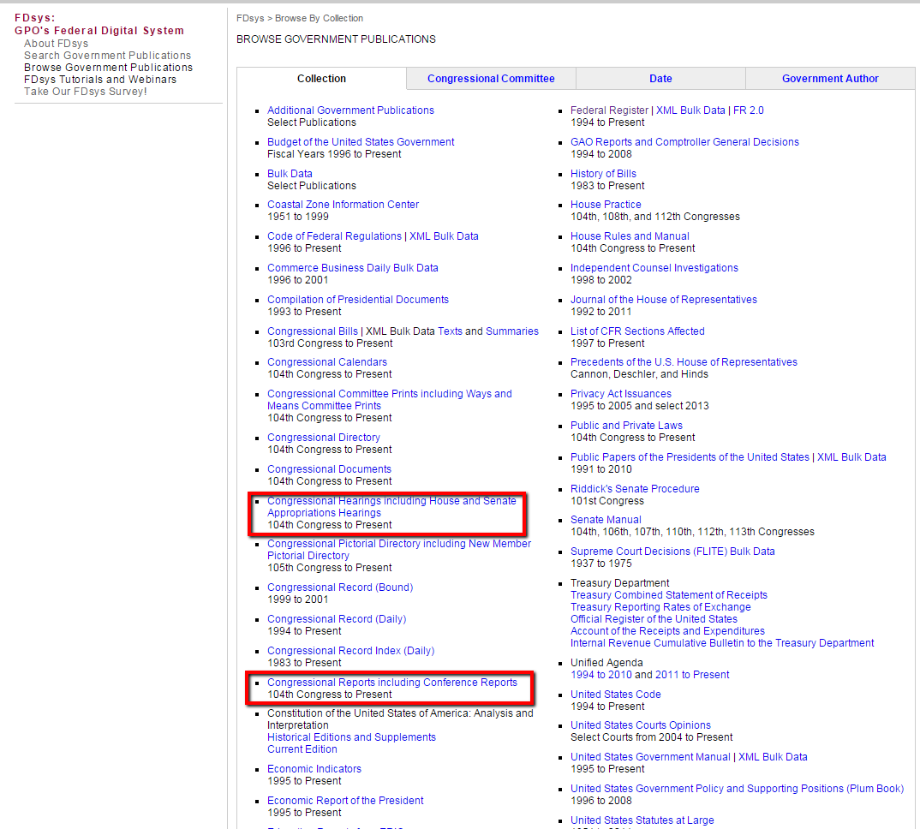
Congressional Hearings and Congressional Reports
Hearings are important because they can provide valuable background information including statistics, scientific research, social implications, and stakeholder perspectives.
Reports are even more important that hearings in that they can show legislative intent – why a bill is needed. They can provide majority and minority perspectives and section-by-section explication on bills.

Slide 28
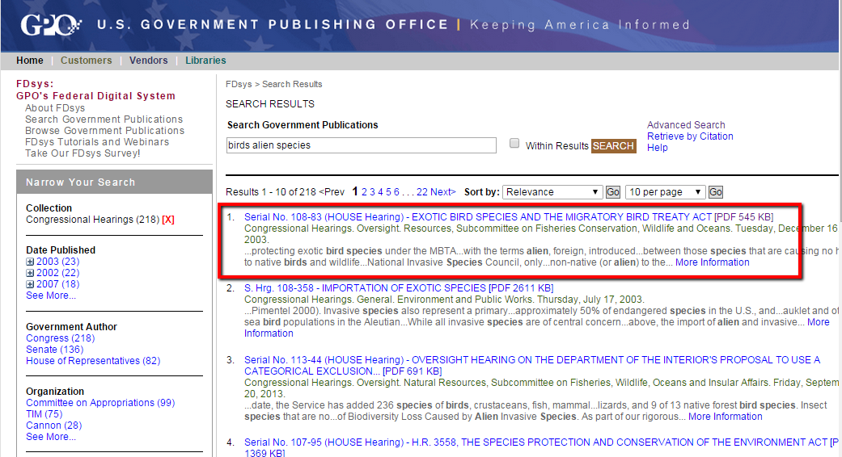
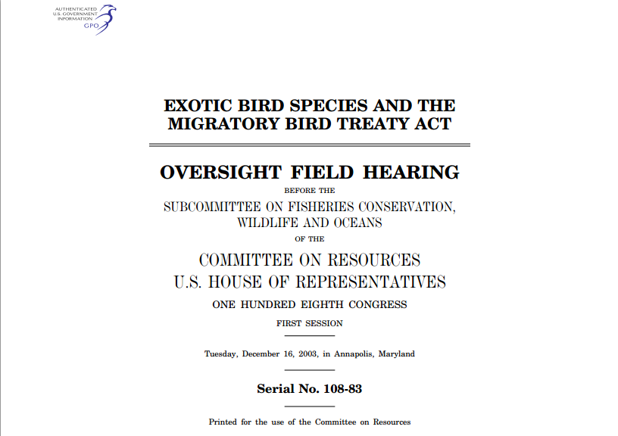
Test cases – Congressional Hearings
Hearings are important because they can provide valuable background information including statistics, scientific research, social implications, and stakeholder perspectives.

Slide 29
Gov Test 1 – Congressional Hearings
Citation: United States. 2004. Exotic bird species and the Migratory Bird Treaty Act: oversight field hearing before the Subcommittee on Fisheries Conservation, Wildlife and Oceans of the Committee on Resources, U.S. House of Representatives, One Hundred Eighth Congress, first session, Tuesday, December 16, 2003, in Annapolis, Maryland. Washington: U.S. G.P.O.
Text1: "change to the MBTA that would make clear that invasive birds are not protected"
Text2: "it is going into the Everglades system, in and around the"
Test | Google | FDsys | Summon | EDS | Primo | WC Disc.
Citation | Yes | Yes | Cat rec only | Cat rec only | Cat rec only | Cat rec only
Text1 | Yes | Yes | No | No | No | No
Text2 | Yes | Yes | No | No | No | No

Slide 30
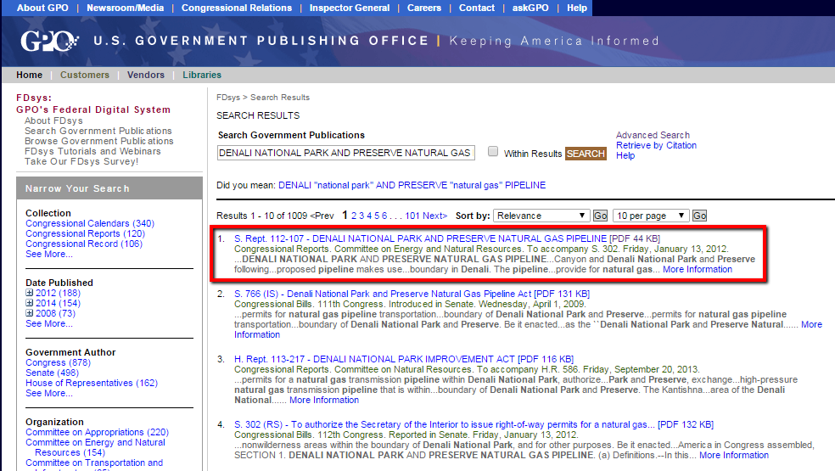
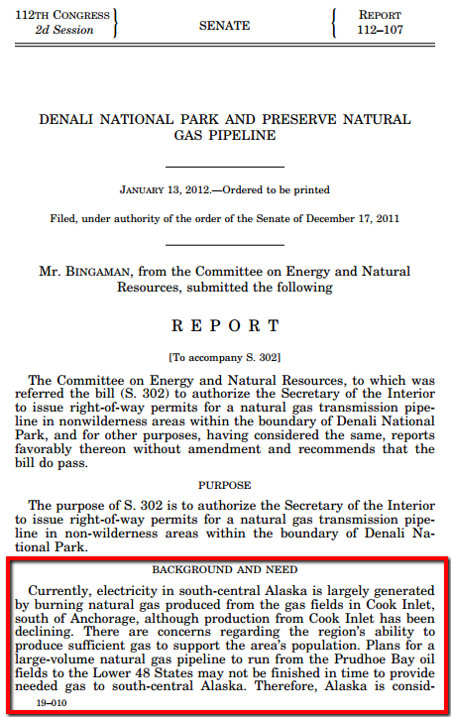
Test cases – Congressional Reports
Reports are even more important that hearings in that they can show legislative intent – why a bill is needed. They can provide majority and minority perspectives and section-by-section explication on bills.

Slide 31
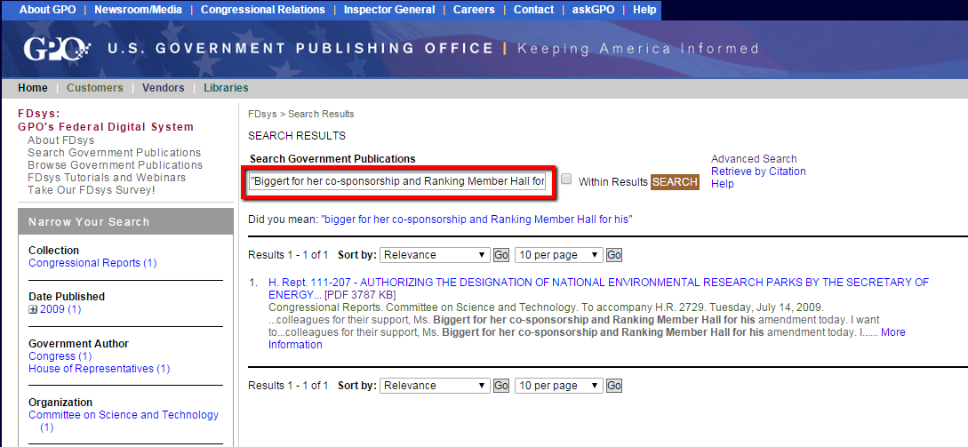
Gov Test 2 – Congressional Report
United States. 2009. Authorizing the designation of national environmental research parks by the Secretary of Energy, and for other purposes report (to accompany H.R. 2729) (including cost estimate of the Congressional Budget Office). Washington, D.C.: U.S. G.P.O. http://purl.access.gpo.gov/GPO/LPS115815.
Text1: "Biggert for her co-sponsorship and Ranking Member Hall for his"
Text2: "Chair GORDON. Let me again in closing say that just because we"
Test | Google | FDsys | Summon | EDS | Primo | WC Disc.
Citation | Yes | Yes | Cat rec only | Cat rec only | Cat rec only | Cat rec only
Text1 | Yes | Yes | No | No | No | No
Text2 | Yes | Yes | No | No | No | No

Slide 32
Gov Test 3: Compilation of Presidential Documents
Remarks on the Patient Protection and Affordable Care Act, April 1, 2014. Compilation of Presidential Documents. http://www.gpo.gov/fdsys/pkg/DCPD-201400224/pdf/DCPD-201400224.pdf.
Text 1: "health insurance who didn't just a few years ago, and that's something to be proud of"
Text 2: "understand. I've got to admit, I don't get it. Why are folks working so hard for people not"
Test | Google | FDsys | Summon | EDS | Primo | WC Disc.
Citation | Yes | Yes | Cat rec only | Cat rec only | No | No
Text1 | Yes | Yes | Yes* | No | No | No
Text2 | Yes | Yes | Yes* | No | No | No
*Not the freely available FDsys content.

Slide 33
Conclusions
Government information, when it is available through a Discovery Tool, is available through licensed content, not freely available sources.
Government information should not be backgrounded, buried with the many other content types.
Since GPO will hand over FDsys content to any vendor that wants it, vendors need to figure out how to acquire it, even if it means developing a new ingest method.

Slide 34




What can be done?
Ask your vendor
Ask GPO

Slide 35
A Charge to Vendors
Keep working on relevance ranking
All more full text into your index (include all types of content, scholarly articles, magazine articles, books and ebooks)
Work with GPO to acquire FDsys metadata and full text
The vendor that figures this out first will have a competitive edge.

Slide 36
Questions?
Christopher C. Brown, Reference Technology Integration Librarian; Government Documents Librarian
University of Denver, Main Library - http://library.du.edu/
cbrown@du.edu
(303) 871-3404

