Slide 1
Undergraduates’ Academic Reading Format Preferences: Electronic or Print?
Diane Mizrachi, PhD.
UCLA
Los Angeles, California
2015

Slide 2

“There would appear to be several types of reading: for information, for entertainment, for understanding.”
Mortimer Adler, 1940

Slide 3
Expectations, assumptions, discoveries…
We expect students to read for understanding.
We assume college students love technology.
We’re finding that format impacts comprehension.
Let’s ask: What do undergraduates really feel about reading formats?

Slide 4
This presentation
Results of online survey at UCLA
Research questions:
What are undergraduates’ format preferences when engaging with their academic readings?
What factors impact their preferences & behaviors?
How do these factors impact their behaviors?
Notes:
390 undergraduates Spring 2014

Slide 5
Academic readings
Readings of any origin (monograph, textbook, course reader, journal article) required, needed, or used to fulfill coursework.

Slide 6
Selected literature review
Previous studies of academic format preferences and usage
UC Libraries (2011)
U of Maryland (2014)
Mizrachi (2010)
Cognitive Studies on reading
Eshet-Alkalai & Geri (2007)
Magnen, et.al. (2013)
Popular press reports (2014)
Notes:
UC Libraries: Springer E-Book U of Maryland
Both studies specifically of e-book usage and preferences; all university groups: staff, faculty; researchers, students of all levels including undergrads
Both post very similar results: Most undergrads prefer print over electronic for monographs; UM E for reference, conference proceedings…
Eshet-Alkalai & Geri: summarizing several studies state:
“online reading creates a higher cognitive load on the reader compared to reading from print”
Results in:
readers remembering information more from print
More disorientation and difficulties with knowledge construction; lower sense of ownership, engagement, willingness to learn with electronic.
Magnen: 72 Norwegian 10th graders
Wells: Dissertation Liberty U., study of 140 HS & JHS students @independent school found no significant differences in either reading comprehension or motivation levels based on book format.
Popular press: Washington Post (April 2014); Wired Magazine (May 2014), Publishers Weekly (2014), New Yorker (2014)

Slide 7
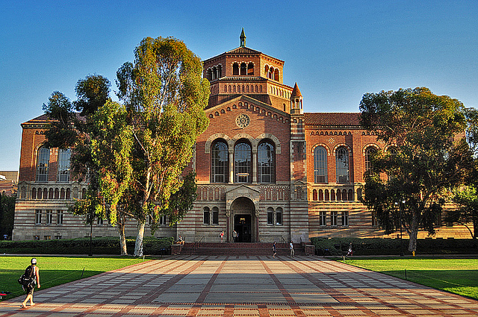
University of California, Los Angeles (UCLA)
Approximately 28,000 undergraduates
Most freshman applications in the US
Highly selective
Notes:
Institutional context
Over 100,000 applicants this year for next year’s freshman class

Slide 8
Methodology
Academic Reading Questionnaire (ARQ)
Online using Survey Monkey
22 questions
14 regarding format (Likert style)
Pilot test & IRB
Distribution
Email to 5,000 undergrads through Office of Registrar
April & May 2014
390 complete responses
Notes:
Likert-style – 5 response possibilities
1 question regarding electronic devices the students use
6 demographic questions
1 prompt for an open ended response
All questions provided space for optional comments
While the response rate is relatively low, only about 8%, the demographics of the participants align very closely to the general undergraduate population at UCLA

Slide 9
Population
Age: range 18-60 years, average 20.5
Year of Study:
1st 30% 2nd 22% 3rd 28% 4th 19%
GPA: 80% > 3.0 (‘B’ grade)
Strongest Language: English 90%
Majors:
53% sciences
46% arts, humanities, social sciences
Visual/other limitations: ~10%
Notes:
Did not ask for native language, first language, heritage language etc, because that may be different than their strongest language.

Slide 10
Devices used for course readings
Notes:
Question 16 – “I read my electronic course readings on a ___ (please check all that apply).”
n=
Desktop: 61 Laptop: 350 iPad/Tablet: 103
E-reader: 23 Phone: 109 W/Audio: 6
Never: 14

Slide 11
Analysis
14 Format Questions
9 – students’ preferences or behaviors that reflect those preferences
5 – learning factors and behaviors that reflect learning engagement
Notes:
Go to study: http://www.surveymonkey.com ARQ
Of 14 questions, 9 investigate students’ format preferences & their behaviors that reflect those preferences;
Skip to slide #14
Q1 L – 82% Agree/SA Q2P – 41% Agree; slightly less than 41% Disagree
Q3P – 67.69% Agree Q4P – most agree Q5P – majority agree
Q6P – most don’t Q7LB – Most agree Q8P – almost split: 47.69 agree; 38.72 da
Q9LB - agree Q10P – most agree Q11P - Definite da 77.95%
Q12LB - no Q13L –Agree Q14P – Definite DA

Slide 12
Format preference
Notes:
Q3= I prefer to have all my course materials in print format (e.g. book, course reader, handouts) [light blue]
Q14=I prefer to read my course readings electronically [dark blue]
67.7 percent of the respondents agree or strongly agree with Question 3, showing a preference for all course material in print format. Only about 18 percent agreed or strongly agreed with a preference for reading electronically while 69 percent disagreed/strongly disagreed.

Slide 13
Comments
Depends on which is more and least expensive.
If the reading is complex, I prefer to read it in print.
I don’t mind them being sent electronically, but I won’t view it from that medium.
If it is a book then I prefer reading it in print, but if it is a long article then I prefer reading it electronically.
If I need to flip through multiple pages or [it] requires lots of annotations then print is better.
I always prefer to read print, but when the cost of downloading articles or entire textbook pdfs is free or almost free, this benefit outweighs the former.
Notes:
Over 100 comments for these two questions expand on these answers including:

Slide 14
Electronic format more convenient
Notes:
Q2 – It is more convenient to read my assigned readings electronically than to read them in print.
Students appear split on whether reading their assignments is more convenient electronically; 41 percent agree or strongly agree that it is, and 40.8 disagree or strongly disagree.
Library’s hours of operation may affect convenience

Slide 15
Comments
It is more convenient economically-wise, but not as helpful for remembering and highlighting/annotating.
Convenient yes, but less effective.
It’s especially easier to read assignments on the bus, since I’m a commuter this makes a big difference.
Formats such as PDF make e-books more portable.
Notes:
85 comments recorded

Slide 16
Print material Digitize material
Notes:
Q5 – I prefer to print out my course readings rather than read them electronically [light blue]
Q6 – I like to make digital copies of my printed course materials [dark blue]
Question 5 inquires about a behavior which demonstrates a preference for print format, and nearly 57 percent of the respondents agreed or strongly agreed. Question 6 does not specify that the purpose of digitizing material is for reading so it cannot be compared to Question 5, but it does indicate a small behavioral trend.

Slide 17
Comments
If I need to write a paper on the material that I am reading, I will print it out.
Printing is expensive, if printing was free somewhere I would print out all of my course readings.
[Depends] on the length of the course reading. If it costs too much to print, I’ll suffer through reading it electronically.
Only [print out] the longer or more important readings.
[Digitization] makes searching through materials more efficient, and organization is easier.
When I want to study outside of my room, it is easier to have a digital copy of my books so that I don’t have to carry them around.

Slide 18
Prefer print by length
Notes:
Depends on length.
Q 4 – If an assigned reading is more than 5 pages long, I prefer to read it in print [light blue]
Q 10 – If an assigned reading is longer than 10 pages, I prefer to read it in print [dark blue]
In earlier studies students often stated that their format preference could depend on the length of the reading. Questions 4, 8, and 10 – tried to establish an approximate length at which point their format preference was impacted, less than five pages, more than five or more than ten pages. Nearly 75 percent of the respondents agreed/strongly agreed that they prefer to read material in print when it is longer than ten pages, which is comparable to the 72.3 percent who agreed/strongly agreed that they prefer print when the text is over five pages.

Slide 19
Preference for e-format when less than 5 pages
Notes:
Question 8: If an assigned reading is less than 5 pages long, I prefer to read it electronically

Slide 20
Prefer e-textbook over print
Notes:
Q 11 – I prefer electronic textbooks over print textbooks.
This was the only inquiry about a specific source of academic reading.
Nearly 68 percent of the respondents disagreed/strongly disagreed with this statement on preference for electronic textbooks

Slide 21
Comments
Print is easier to learn, but electronic is cheaper.
I only agree because electronic textbooks means I do not have to carry it. For that purpose, I prefer electronic textbooks.
[Depends on the] importance of textbook. Print textbooks are more preferred if it’s a history/reading intensive class. For math or science, e-book is fine.
Electronic textbooks provide easier access for looking up something, but print textbooks are easier for understanding.
Notes:
62 comments, including:

Slide 22
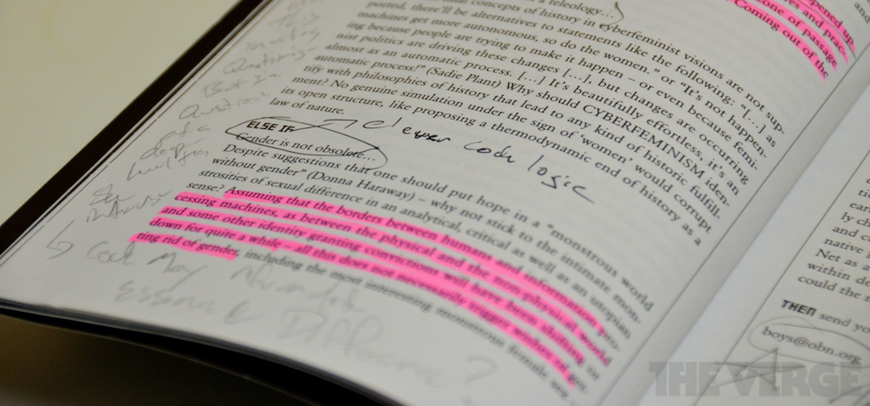
Learning engagement and behaviors
Notes:
5 questions refer to learning factors and behaviors that reflect learning engagement

Slide 23
Remember best Focus best with print
Notes:
Q1 - I remember information from my course readings best when I read them from printed pages.
Q13 - I can focus on the material better when I read it in print.
Look at the abilities to focus and remember material. Results show that over 80 percent of the students in this study either agree or strongly agree with these statements, indicating that students’ recognition of their optimal learning environment is consistent with most studies of the cognitive process of reading and learning.

Slide 24
Comments
Scientific articles I find more beneficial to print out so I can take notes and highlight easier on them. Printed textbooks are much harder for me to find specific information to match with lectures than if I were using an e-textbook.
It really depends on how interested I am in the content. If I am equally interested in each, my memory on each type will stay consistent.
I feel that writing notes on them physically with a pencil is better for me than typing them up on the same document. Plus my eyes start hurting if I am on the computer for too long.
Books are significantly less distracting than a computer and offer less opportunity to goof off.
Too many distractions easily available when I read electronically.
Not much of a difference; distractions happen either way.
Notes:
These two questions generated a total of 78 comments by the participants. Here is a selection of these comments.

Slide 25
Highlight & notate course readings
Notes:
Highlighting and annotating are behaviors that reflect active engagement with a text in an effort to learn and retain information. Over 80 percent (n=316) of the students agree or strongly agree that they highlight and annotate their print readings (Question 7), but only about a third of them (33.6 percent, n=131) agree or strongly agree that they annotate and highlight their electronic texts (Question 12). Comments indicate that more would do so if they knew how or if the particular format allowed them. Many pdfs for example, do not enable such engagement. Some students state that they do not have access to technologies for electronic highlighting and annotating. This circumstance may change as technologies improve and become more common.

Slide 26
More likely to re-read material in print
Notes:
Re-reading and reviewing a text is another learning engagement behavior (Question 9). Over 75 percent (n=295) agree or strongly agree that they are more likely to do so when the reading is in print.

Slide 27
Summary of results
Most undergrads prefer print for learning
Like the cost and convenience of electronic
Quandary: Better learning experience or better convenience?
Safe to assume no association with age, major, GPA or year of study
Notes:
Statistical analysis:
I used the Pearson’s Chi-Square and Fisher’s Exact Chi-Square tests to check possible associations between 4 independent variables (age, major, gpa, & year of study) and responses to the 14 questions.

Slide 28
“Depends…”
Format preference often ‘Depends’
Importance of reading to course
More important – greater print preference
Complexity of reading
More complex – greater print preference
Length of reading
Prefer longer readings in print
Shorter readings okay electronically

Slide 29
Benefits
Benefits of Electronic Format
Cost, weight, accessibility, no difference in learning efficiency (for some), environmental considerations, ‘Find’ feature, archival efficiency
Benefits of Print
Learn better – especially complex readings
More efficient engagement –tactile & kinetic learning benefits, less distractions
Less eyestrain
Notes:
Benefits of both formats as described by students.

Slide 30
Future
Commencing international study using ARQ for comparison among 23 countries.
Use every 4-5 years for longitudinal studies
Open invitation to use ARQ in home institutions.
Notes:
Australia - Gaby Haddow (Curtin University)
Bulgaria - Tania Todorova (SULSIT)
China - Pan Yantao (Sun Yat-Sen University) & Jiuzhen Zhang (Peking University)
Croatia - Darija Pesut & Daniela Zivkovic (University of Zagreb)
Czeck Republic – Michal Lorenz (University of Masaryk)
Finland
France - Joumana Boustany (University of Paris Descartes)
Hungary - Laszlo Karvalics (University of Szged)
India – Ghouse Modin (??)
Israel - Judit Bar-Ilan & Noa Aharony (Bar-Ilan University)
Italy - Elena Collina (University of Bologna)
Latvia - Liga Krumina (University of Latvia)
Lithuvania - Jurgita Rudzioniene (Vilnius University)
Moldova – Silvia Ghinculov (Academy of Economic studies of Moldova)
Norway - Ane Landoy (Bergen University)
Peru - Aurora de la Vega (Catholic University of Peru)
Poland - Monika Krakowska (Jagiellonian University)
Portugal - Ana Terra (Oporto Polytechnic Institute)
Romania - Angela Repanovici (Transilvania University)
Singapor - Shaheen Majid (Nanyang Technological University)
Slovenia - Polona Vilar (University of Ljubliana)
Switzerland - Rene Schneider (Haute Ecole de Gestion)
Turkey - Serap Kurbanoglu (Hacettepe University)
UK - David Bawden (City University)
USA - Diane Mizrachi (University of California)​

Slide 31

Questions about study?

Slide 32
Questions for discussion
How do we follow usage and preference trends?
Is the human brain in transition from linear/print information mode to electronic?
What, if anything, might we lose during this transition?
Can/should both modes be developed?
How do we balance institutional factors – space limitations, shrinking budgets, long term collection goals – with learning effectiveness?
Others?
Notes:
Audience engagement in a discussion on the broader topic of balancing electronic and print sources in education and collection development.
Show these questions to start but take more from audience

