Slide 1

The Future of Library Resource Discovery
http://www.niso.org/publications/white_papers/discovery/
Marshall Breeding
Independent Consultant,
Founder and Publisher, Library Technology Guides
http://www.librarytechnology.org/
http://twitter.com/mbreeding
February 18, 2015
Electronic Resources & Libraries

Slide 2
Description
In 2014, NISO commissioned a trends and strategy white paper, "The Future of Library Resource Discovery." The paper, covering an area of significant interest for libraries, provides an overview of the current research discovery environment and investigates technologies and practices which may present growth opportunities to support and improve user experience.

Slide 3

Update on the NISO
Open Discovery Initiative

Slide 4
Balance of Constituents
Libraries
Publishers
Service Providers
Marshall Breeding, Vanderbilt University
Jamene Brooks-Kieffer, Kansas State University
Laura Morse, Harvard University
Ken Varnum, University of Michigan
Sara Brownmiller, University of Oregon
Lucy Harrison, College Center for Library Automation (D2D liaison/observer)
Michele Newberry
Lettie Conrad, SAGE Publications
Roger Schonfeld, ITHAKA/JSTOR/Portico
Jeff Lang, Thomson Reuters
Linda Beebe, American Psychological Assoc
Aaron Wood, Alexander Street Press
Jenny Walker, Ex Libris Group
John Law, Serials Solutions
Michael Gorrell, EBSCO Information Services
David Lindahl, University of Rochester (XC)
Jeff Penka, OCLC (D2D liaison/observer)

Slide 5
ODI deliverables
Standard vocabulary
NISO Recommended Practice:
  Data format & transfer
  Communicating content rights
  Levels of indexing, content availability
  Linking to content
  Usage statistics
  Evaluate compliance
Inform and Promote Adoption

Slide 6

ODI Timeline
Milestone | Target Date | Status
Appointment of working group | Dec 2011
Approval of charge and initial work plan | Mar 2012
Completion of information gathering | Jan 2013
Completion of initial draft | Jun 2013
Completion of final draft | Sep 2013
Public Review Period commences | Sep 2013
NISO Publishes Recommended Practice | June 2014

Slide 7
ODI Recommended Practices
NISO RP-19-2014
  http://www.niso.org/workrooms/odi/
  http://www.niso.org/workrooms/odi/publications/rp/rp-19-2014
Metadata elements for content providers to contribute to discovery service providers
Content providers disclose extent to which they participate with each discovery service
Discovery Service providers disclose what content is represented in index
Discovery services disclose any bias in search results or relevancy relative to business relationships
Discovery services provide use statistics

Slide 8
ODI Standing Committee
Fulfilling recommendation of the ODI that NISO charge an ongoing committee to promote ODI best practices and related issues.
Discussions may include but are not limited to:
  brainstorming on ways to publicize and educate the community on ODI
  answering any support questions
  checking on status of vendor support
  liaising with other standards efforts as applicable
  determining when is an appropriate time to consider updating ODI

Slide 9
ODI Standing Committee Roster
Laura Morse – Harvard University
Lettie Conrad – SAGE
Aaron Wood – Ingram Content
Elise Sassone – Springer
Jason Price – SCELC
Jill O’Neill – NFAIS
Julie Zhu – IEEE
Marshall Breeding – Independent Consultant
John McCullough – OCLC
Michael McFarland – Credo
Rachel Kessler – Ex Libris
Scott Bernier – EBSCO
Steven Guttman – ProQuest
Ken Varnum – University of Michigan Library

Slide 10
NISO Discovery White Paper
Commissioned by NISO Discovery to Delivery Topic Committee
First Draft Nov 2014
Revised draft submitted in Feb 2015 with expected publication Feb 20, 2015

Slide 11
NISO Discovery Paper Outline
General Background
Integration between Discovery Services and Management Systems
Linked Data
Gap Analysis
Opportunities for Future Enhancements in discovery
Discovery Beyond Library-provided Interfaces
Open Discovery Initiative: recommendations for Phase II
Longer term prospects

Slide 12
General Background
Discovery interfaces
Index-based discovery services
Non-library discovery
Public library discovery products
Comprehensive library portals

Slide 13
Bento Box Discovery Model
Aggregated Content packages
Search:
Open Access
ILS Data
VuFind / Blacklight
E-Journals
Search Results
Consolidated Index
Web Site Content
Digital Collections
Institutional Repositories
Pre-built harvesting and indexing

Slide 14




Web-scale Index-based Discovery
ILS Data
Digital Collections
Search:
Web Site Content
Institutional Repositories
Search Results
Aggregated Content packages
Consolidated Index
Open Access
…
E-Journals
Usage-generated
Data
Customer
Profile
Reference Sources
Pre-built harvesting and indexing

Slide 15
State of Discovery indexes
Very strong coverage of primary publishers of scholarly materials
  Especially English and other Western Languages
Weaker coverage of scholarly content in other international regions
  Asian languages, Arabic, etc.
Mixed coverage of A&I resources
Mixed converge of non-textual resources

Slide 16


Comprehensive Library Portal
Public Interfaces:
Presentation Layer
Integrated Library
System
Library
Web site
Subject
Guides
Article, Databases,
E-Book collections

Slide 17
Discovery Service Installations
Product | 2007 | 2008 | 2009 | 2010 | 2011 | 2012 | 2013 | 2014 | Installed
EBSCO EDS |  |  |  |  |  |  | 1774 | 2634 | 8246
Primo | 12 | 37 | 53 | 506 | 111 | 101 | 98 | 88 | 1528
AquaBrowser | 55 | 339 | 64 | 69 | 74 | 58 | 81 | 6 | 89
Encore | 72 | 72 | 109 | 56 | 72 |  | 36 |  | 346
BiblioCommons |  |  |  |  |  |  | 41 |  | ~200
Summon |  |  | 50 | 164 | 214 | 158 | 238 | 195 | 697
Enterprise |  | 16 |  | 75 | 100 | 102 | 123 | 150 | 538
Infor Iguana |  |  |  |  |  |  |  | 18 | 74
Axiell Arena |  |  | 61 | 57 | 33 |  | 35 | 95 | 404

Slide 18
Multi-Role Stakeholders
Content provider / Discovery Service
  EBSCO Information Service
  ProQuest
Resource Management / Discovery Provider
  OCLC
  Ex Libris

Slide 19
Possibilities for Open Access discovery index
Open source tools exist for discovery Interfaces:
  VuFind
  Blacklight
No open access discovery indexes
  High threshold of expense and difficulty to build index
  Platform costs
  Software development
  Publisher relations
  Billions of content items to index and maintain

Slide 20
Current model requires massive resources
Threshold of resources required currently too high for open access central discovery index
Assessment might change if options narrowed
Opportunities to lower barriers to entry?
More open model more likely to come through linked data discovery model

Slide 21
Interoperability of Discovery Services and Management Platforms
Discovery and Management solutions offered as matched sets
  Ex Libris: Primo / Alma
  ProQuest: Summon / Intota
  OCLC: WorldCat Discovery Service / WorldShare Platform
Independent Discovery and Management
  Kuali OLE: no discovery component
  EBSCO Discovery Service: Works with any Resource management system
Both product categories depend on an ecosystem of interrelated knowledge bases
API’s exposed to mix and match, but are efficiencies and synergies are lost?
Recommendation to explore expectation regarding interoperability between these two product categories

Slide 22
Linked Data
Major trend toward information systems based on linked data
  Many projects now based on linked data
  Area of peak interest for Library of Congress, OCLC, etc
  BIBFRAME
Potential to transform how libraries approach discovery
Likely interim hybrid models: central indexes + Linked Data
Current opportunities in making library content more discoverable

Slide 23
Linked data
Not yet a fully operational method for library-oriented content
  Increasing representation of bibliographic resources
  BIBFRAME stands to make great impact
Universe of scholarly resources not well represented
Will current expectations for content providers to make metadata or full text available for discovery expand to exposure as open linked data?

Slide 24
Hybrid models
Can index-based search tools be improved through Linked Data
  Browse to related resources
  Add additional hierarchies of structure to search results

Slide 25
Gap Analysis
Many resources still not addressed in central indexes
  Especially A&I products
Better coverage of open access materials
Better support for internationalization and multilingual search and retrieval
Improved capabilities for precise search, known items, browsing
Improved and more transparent relevancy rankings
Non-textual content and retrieval mechanisms
Better integration with learning management systems

Slide 26
Opportunities for Future Enhancements in discovery
Improved delivery of APIs
More coherent ecosystem of APIs among discovery services and with resource management systems
Social features and scholarly collaboration
Address research data
Special Collections and archival materials: hierarchical discovery and browsing
Expanded Analytics and Altmetrics

Slide 27
Discovery Beyond Library-provided Interfaces
Reality that most discovery happens external to library
Improve discoverability of library resources
  Locally: through incorporation of SEO and semantic encoding
    Especially schema.org
  Globally: OCLC, Google Scholar and other services

Slide 28
Discovery beyond Library Interfaces
Improved performance of library content through Google Scholar
  Same expectations for transparency?
Better exposure of library-oriented content
  Schema.org or other microdata formats
Better exposure of scholarly resources
  Open access & Proprietary
Embedded tools in other campus interfaces

Slide 29
Schema.org encoding
<div itemscope="itemscope" itemtype="http://schema.org/Article">
<h2>
<span itemprop="headline">
Library Technology Forecast for 2015 and Beyond
</span>
</h2>
</div> <!-- End microdata itemscope div -->

Slide 30
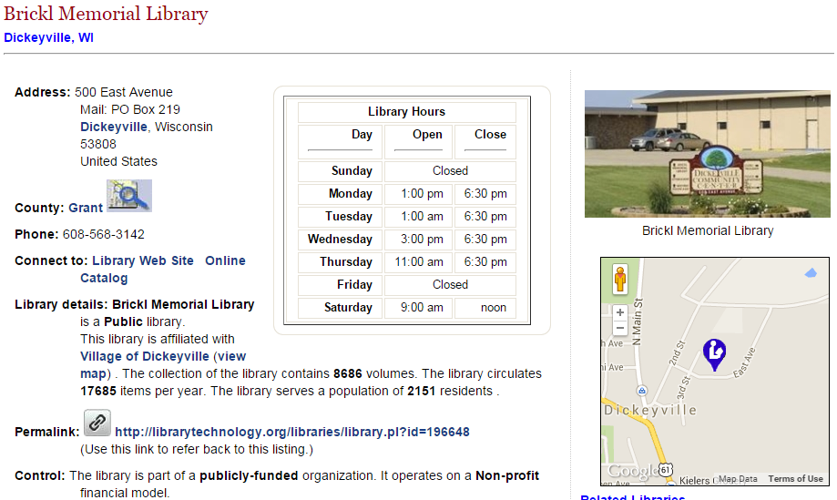
Sample Resource page

Slide 31
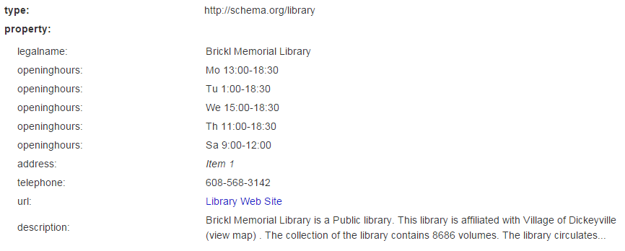
Interpreted by Google Rich Snippets
http://www.google.com/webmasters/tools/richsnippets

Slide 32
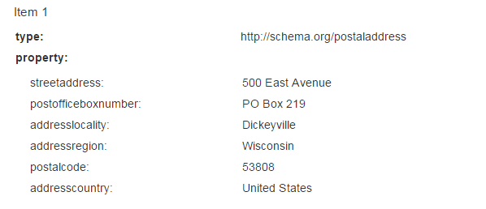
Interpreted by Google Rich Snippets

Slide 33
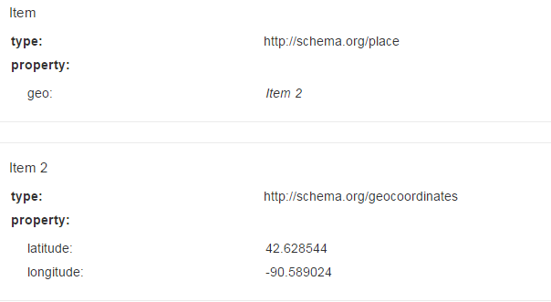
Interpreted by Google Rich Snippets

Slide 34
Open Discovery Initiative: recommendations for Phase II
Address A&I concerns to improve participation
Data exchange mechanisms: metadata + content
  Lower threshold of participation
Interoperability with resource management systems

Slide 35
Participation of A&I in Discovery
Libraries expect participation
A&I providers have concerns:
  Fear that inclusion in discovery will devalue A&I subscriptions
  If content not positioned well, libraries may not see evidence of value and drop subscriptions
How is the brand of A&I presented to users when accessed through discovery interface
Statistical validation of contributions of A&I to resource selection in discovery services

Slide 36
A&I Content in Discovery Services
What is the place for A&I services in the discovery ecosystem
Are there technology solutions capable of substituting for A&I content?
  Specialized and scoped search methodologies
  Clustering, term extraction, etc.?
Specialized vocabulary and other metadata make positive contributions to the discovery process
Researchers value A&I tools

Slide 37
Potential Opportunities for NISO
Convene a second phase of the Open Discovery Initiative
Launch research project on open linked data in scholarly publishing sector to facilitate new models of discovery and access
Expand scope of Altmetrics group to address their integration in discovery service ecosystem
Possible new workgroup to explore recommended practices for improving discoverability of resources via open linked data, schema.org, and other mechanisms.

Slide 38
Longer term prospects
Opportunities for discovery directly tied to realities in scholarly publishing
Dominance of proprietary publishing requires index-based discovery
Future to open access and exposure as open linked data will enable additional models of discovery

Slide 39
Questions and discussion

