Slide 2
Blogging: Process Writing, Developing Literacies, and Creating a Community
Liz Ging
MATSOL 2015
Framingham, MA
Notes:
Open with story about “is this going to be on the real internet?”
Hand out cards for questions while people are coming in? Open with show of hands questions

Slide 3
Why blogging?
Writing online can have different benefits for students with different motivations and priorities
Working online can also increase engagement with the writing process for students who already live their lives online
Working with technology can help students develop technological literacy, for academic and career goals
Creating a shared website can help create a sense of community
It also has the potential to foster ownership and investment in the writing process
Spurs students to critically reflect on their world, using their L2
Notes:
TWO MAJOR AREAS OF FOCUS
Using the same platform for different goals

Slide 4
Agenda
Two examples of using blogging as a platform for writing instruction in the ESOL classroom
Context and student body
Objectives
Challenges
Observations and Strategies
Outcomes
Recommendations, questions, discussion

Slide 5
Blog Project #1 Writing Workshop Boston The Context
Private language school, intensive English program
Writing Workshop class offered five days a week, 45 minute class, 12:30-1:15pm
Intermediate 1
Rolling admissions, intake every week
Class size of 8-12
No available computer lab (used for another course)
One instructor computer in each classroom, digital projector, WiFi
Additional computers were available in the student lounge

Slide 6
Student body
Mostly younger, 15-30
Some high school, college students, students preparing for advanced degrees in the US, few working professionals
Variety of nationalities, large percentage of Saudi, Turkish, Brazilian
In the summer, groups of European high school students, Italy, Spain, Russia
Extensive formal education and high technological literacy
Short-term stays in the US or preparation for university work

Slide 7
Objectives and Challenges
Creating a sense of class community
Engaging students with writing as a process
Writing for a purpose
Using the digital world as a bridge between the students’ lives outside of class and their English learning
Rolling admissions
Some students only enrolled in class to fulfill scholarship requirements, to satisfy parents, etc., low motivation
45 minute class
No computer lab available
Notes:
→little sense of community or ownership
→no investment in writing process
→not a problem, ss brought their laptops, used instructor computer, used tablets, phones, WiFi

Slide 8
Process
Pre-writing activities, pair work, small groups, survey
Wordpress.com
Universal username and password
Prepared worksheets with the login information and screenshots of the different steps of making a post
Walked students through login, posting, uploading media
Students worked at their own pace during class with pre, drafting activities
Some online work done in class, much done after class
Revising, peer-editing, adding media, commenting
Checklist
Notes:
PRE: survey about reading online, questions about how they use the internet, blogging, looking at models, brainstorms, outlines, mind-mapping, surveys, interviews

Slide 9
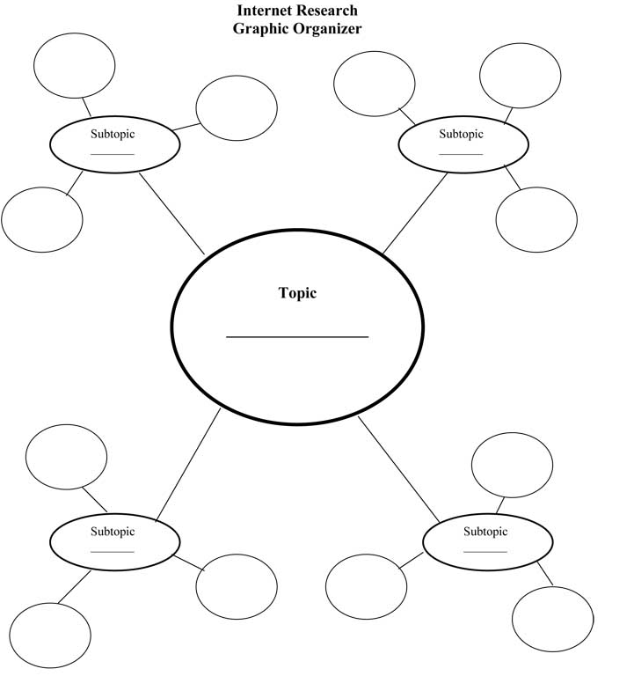
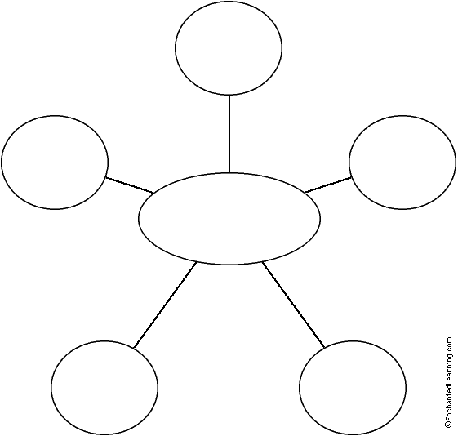
Observations and Strategies
name
food
service
Favorite
sport
address
IDENTIFY
Experience
neighborhood
price
Best
memory
Favorite athlete
Restaurant Review
Exercise and health
Recommendations
Healthy eating tips
?
Unfamiliarity with the writing process
Plagiarism
Pre-writing in class, mind maps, outlines, writing questions for partners

Slide 10
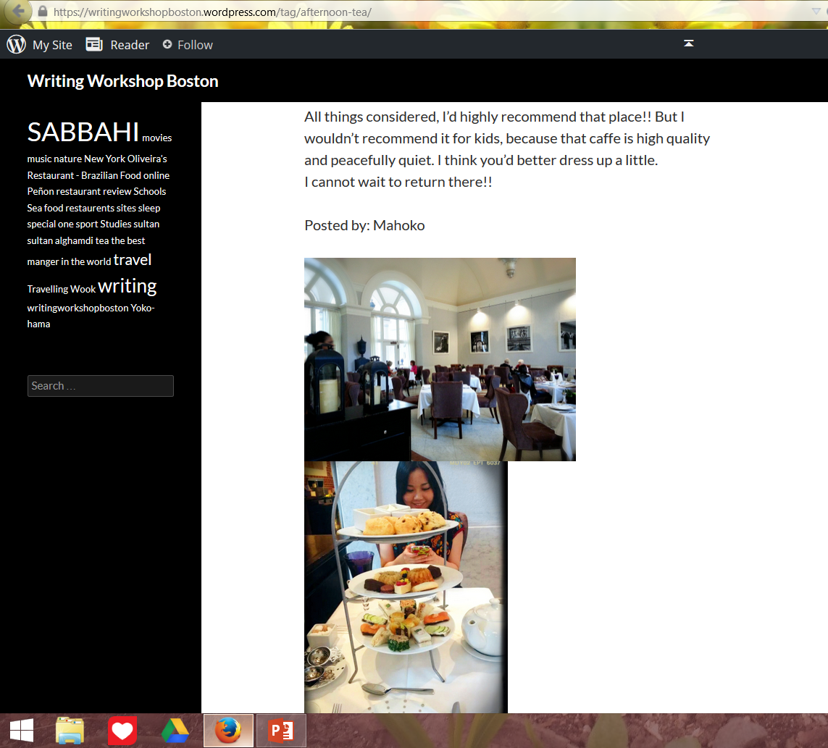
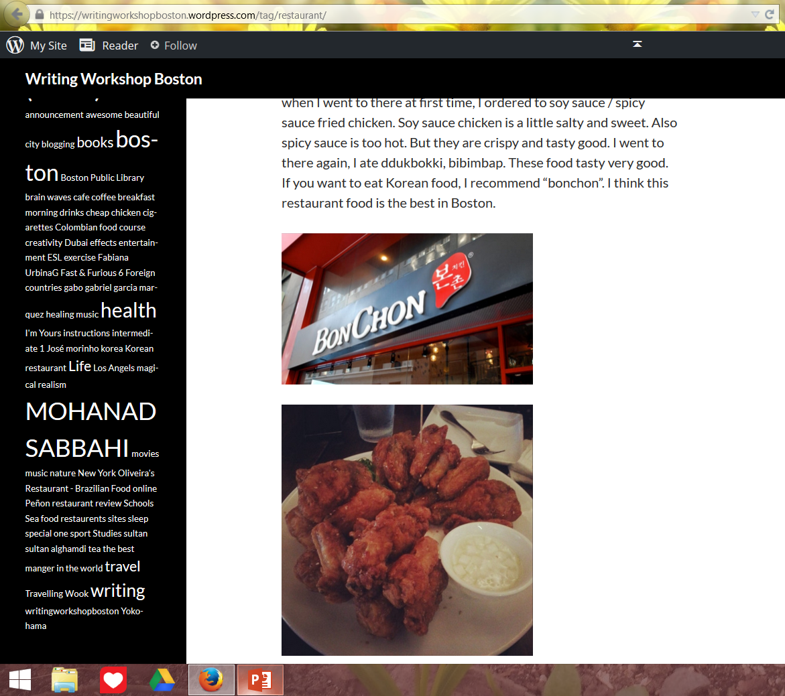
Many students had laptops, tablets, smartphones
Students brought those devices to class, use of cameraphones to document
Notes:
Ex: Uncle’s pics
Ex: Yuma, guitar, Uncle NGO’s
EX: Salem, writing review of American English File
Ex. Copy and paste from Wikipedia

Slide 11
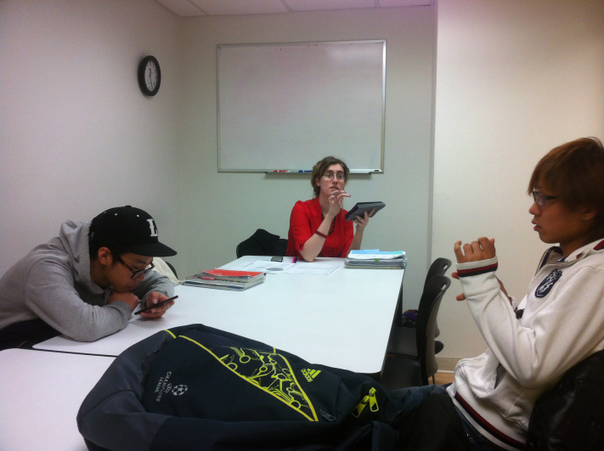
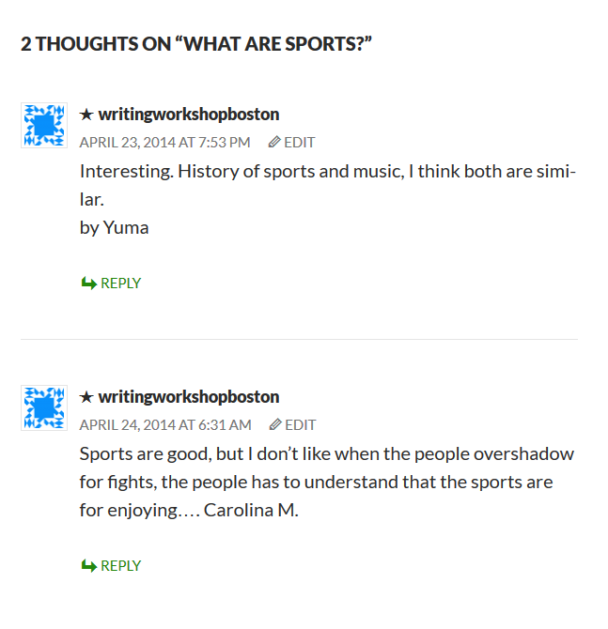
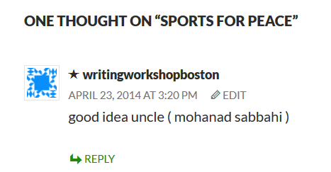

Slide 12
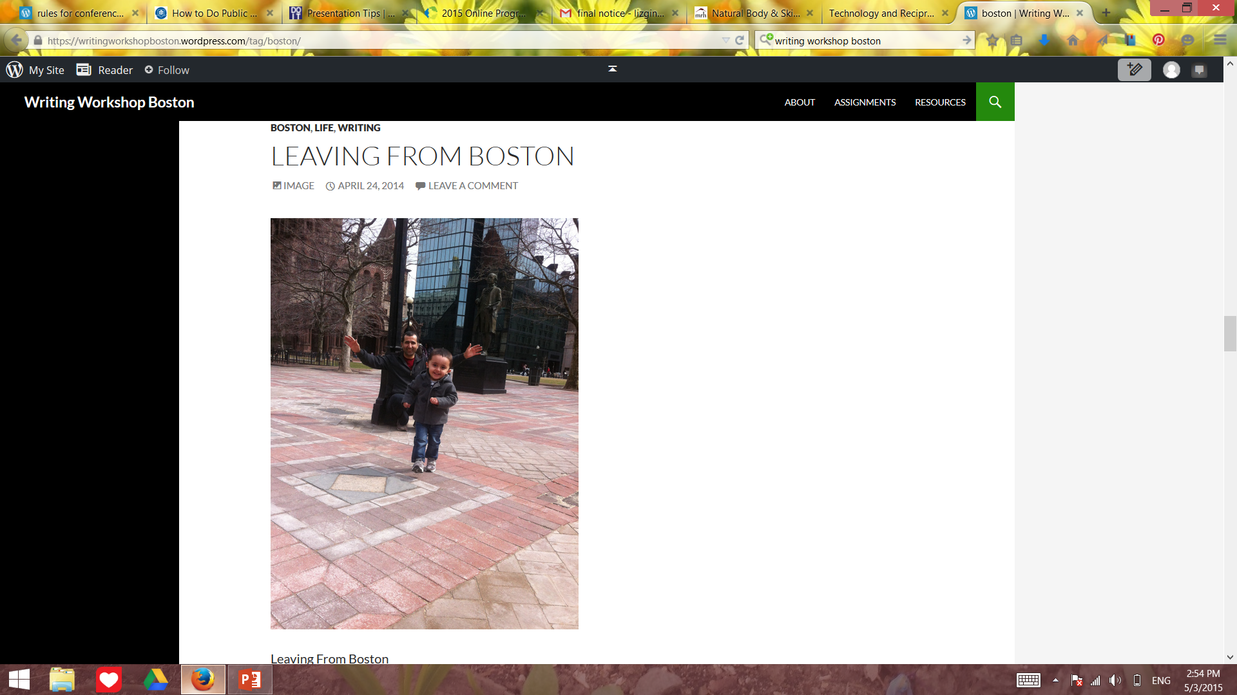
Spontaneous sharing of personal photos and ideas
Encouragement to share on social media

Slide 13
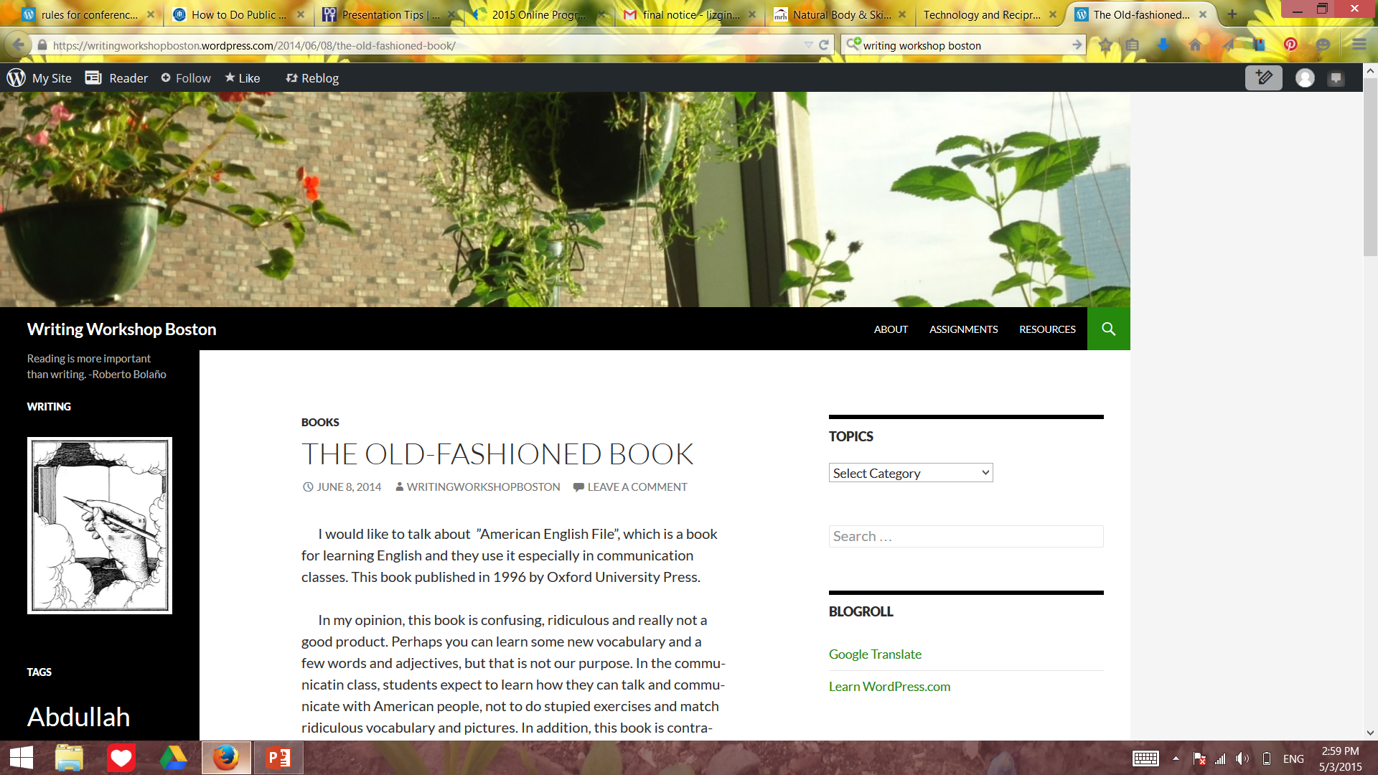
Expressing opinions about their own language learning process
Sharing writing with others in the school community

Slide 14
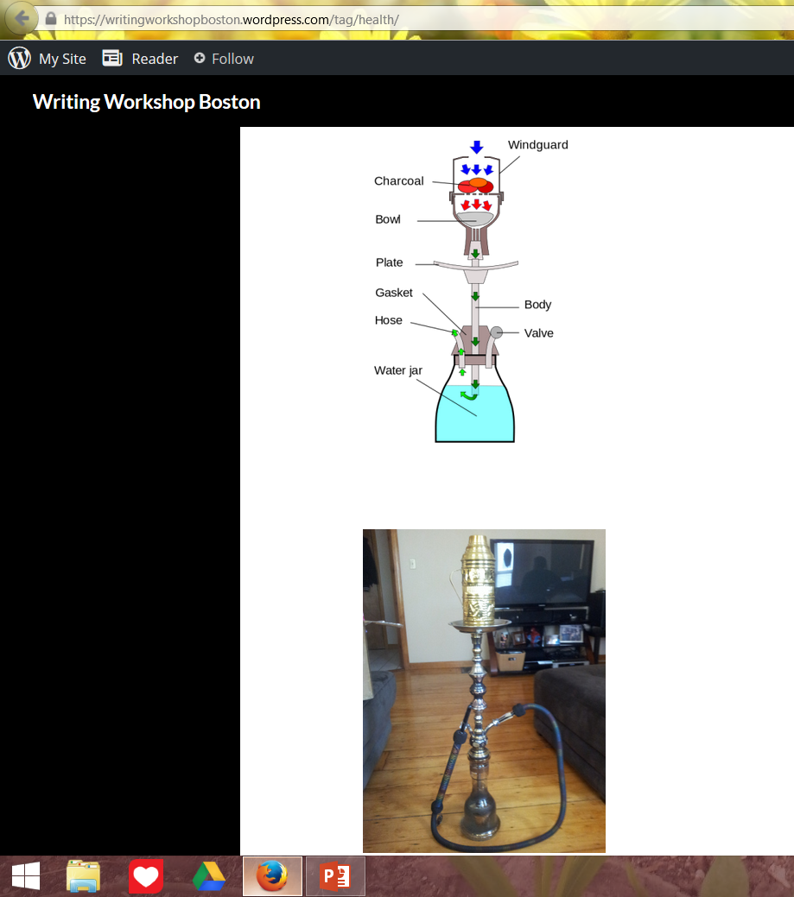
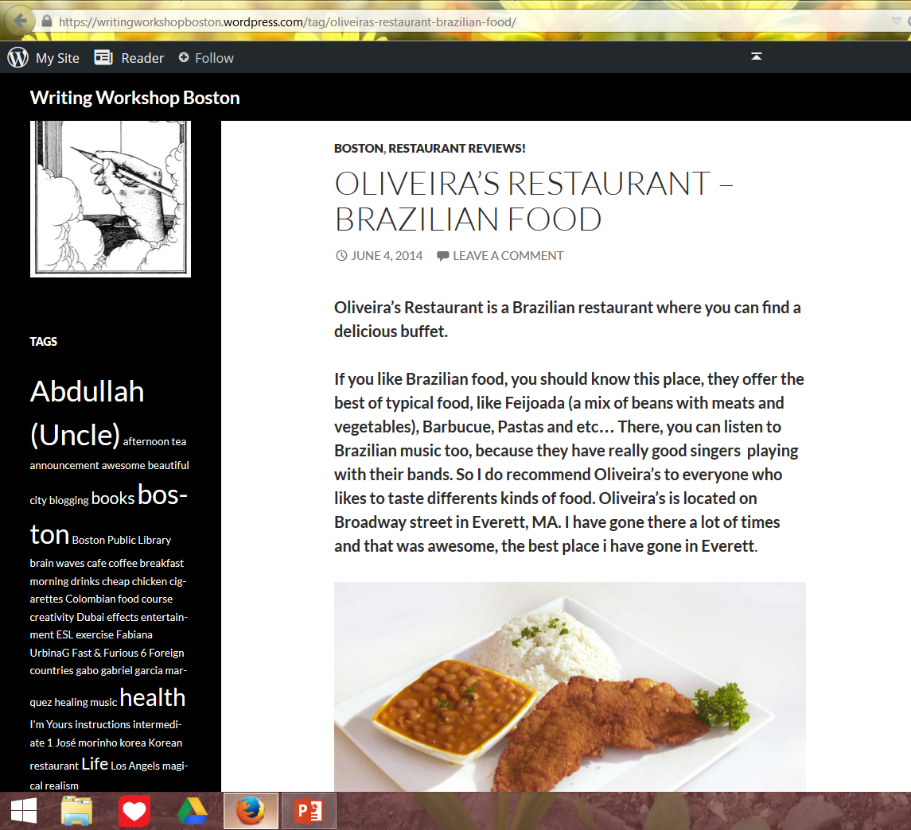
Writing about personal interests
Voting on topics as a class

Slide 15
Abdullah (Uncle) afternoon tea announcement awesome beautiful city blogging books boston Boston Public Library brain waves cafe coffee breakfast morning drinks cheap chicken cigarettes Colombian food course creativity Dubai effects entertainment ESL exercise Fabiana UrbinaG Fast & Furious 6 Foreign countries gabo gabriel garcia marquez healing music health I'm Yours instructions intermediate 1 José morinho korea Korean restaurant Life Los Angels magical realism MOHANAD SABBAHI movies music nature New York Oliveira's Restaurant - Brazilian Food online Peñon restaurant review Schools Sea food restaurents sites sleep special one sport Studies sultan sultan alghamdi tea the best manger in the world travel Travelling Wook writing writingworkshopboston Yokohama

Slide 16
Outcomes, “We have a website…”
Connections between school and life outside
Role reversal, learners as teachers, teacher as a learner
Higher rate of completed assignments from short-term students
More ownership and investment, in writing, the process, and giving feedback to peers
Sense of class identity, co-creation

