Slide 2
Blog Project #2 Jamaica Plain Writing Workshop, The Context
DESE-funded community education program
Free, long waitlist
Located in a local high school
Class offered three days a week, three hours per day, 6-9pm
Beginner 1 (SPL 2)
Class size of 18-24
Curriculum follows DESE ESOL Curriculum Frameworks and CCR Standards
Particular emphasis on using technology in the classroom
Computer lab available

Slide 3
Student body
Mixed age range, most students 20-40, youngest 17, oldest 62
Working immigrants
Newly-arrived and long term residents
Majority of Spanish-speakers
Students from the Dominican Republic, Haiti, Guatemala, Mexico, Albania, Honduras
Limited or interrupted formal education
Generally low technological literacy

Slide 4
Objectives
Improving written communication skills
Working with the writing process, in the classroom and in the lab
DESE ESOL Curriculum Frameworks
Increasing technological literacy
College and Career Readiness Standards, ex. CCR Writing Standards, Anchor 6
Self-expression, developing ownership, critical literacy
Building on the various skills and strengths of the students
Community building, creation of a shared project
Notes:
CCR Anchor 6: Use technology, including the Internet, to produce and publish writing and to interact and collaborate with others
With guidance and support, use technology to produce and publish writing (using keyboarding skills) as well as to interact and collaborate with others . (W.3.6)

Slide 5
ABE ESOL Curriculum Framework Objectives
W1.2a Write several original statements on a familiar topic
W2.3c Connect several related sentences (ex. Using transition words, conjunctions, and pronouns
W 2.2c Use capitalization and end punctuation
W3.4c Attempt to self-correct writing when location of errors has been pointed out
W3.3d Use graphic organizers
Notes:
SPELL CHECK

Slide 6
Challenges
Mixed level group
Setup of computer lab
Attendance and homework, impact on the project
Email challenges (Universal username vs. individual usernames)
Basic typing, how to use the keyboard, mouse
Teaching multiple objectives at the same time (language, writing, basic computer skills)
Notes:
--intake, new ss, JPA → we needed to bring the group together
--no instructor computer, no board
--how to use delete, backspace, shift, CAPS Lock,

Slide 7
Process
Entry into project with a focus on technology use as a job skill
Pre-writing activities, pair work, small groups
Working with models for each activity
Wordpress.com
Universal username and password
Prepared worksheets with the login information and screenshots of the different steps of making a post
Walked students through login, posting, uploading media
Students worked at their own pace in class, assisting others
Revising, peer-editing, adding media, commenting
Checklist
Notes:
PRE: discussion focused on job skills, is it important to be able to use a computer for work, community college, etc? survey about student computer skills, experiences, and current use

Slide 8
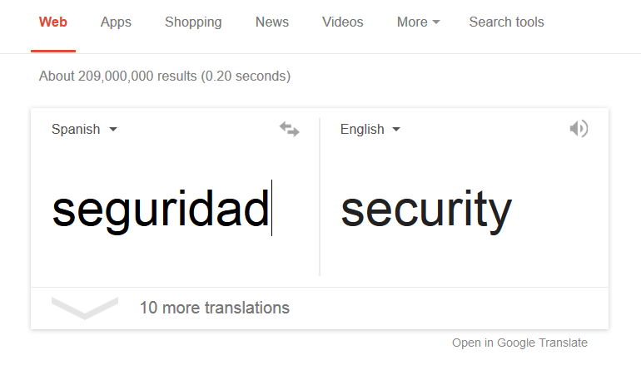
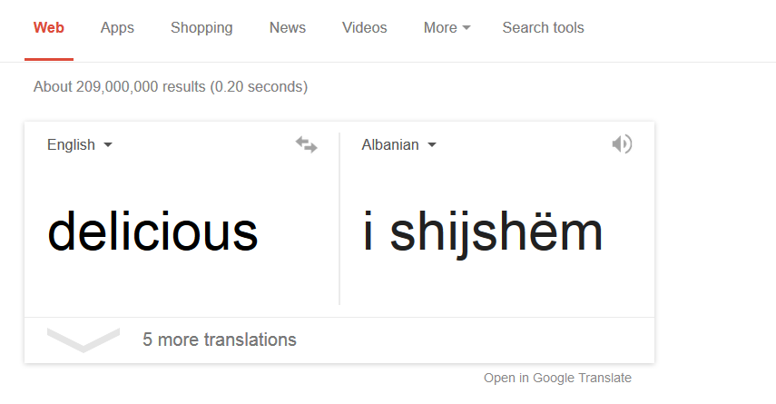
Observations and Strategies
More independence in vocabulary acquisition
Developing understanding of structural differences between L1 and L2
Use of Google Translate as online dictionary while writing, learning how to copy and paste text
Attempts to translate texts using translators, learning effective ways to use translators
Notes:
** PRE ** brainstorming tags, list of keywords, writing questions for their partners
How to use a web browser
Keyboard shortcuts, Control Z
Google translate: why you can’t translate word for word? Learning how to copy and paste text

Slide 9
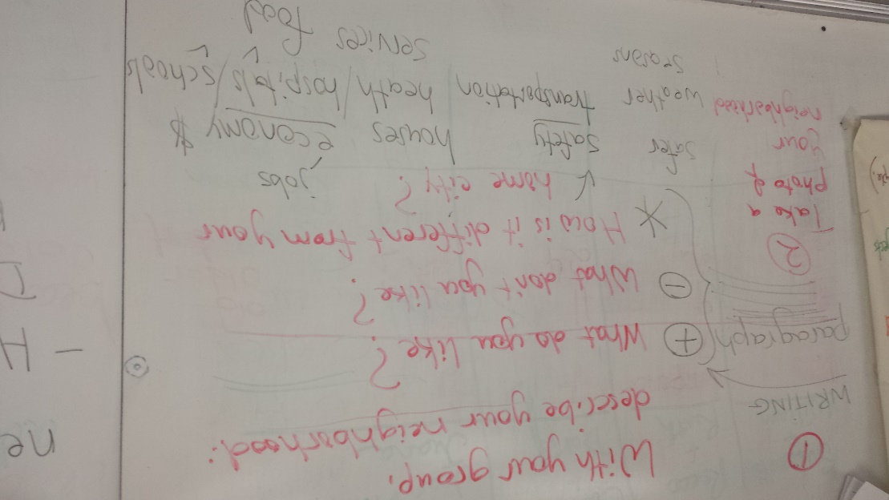
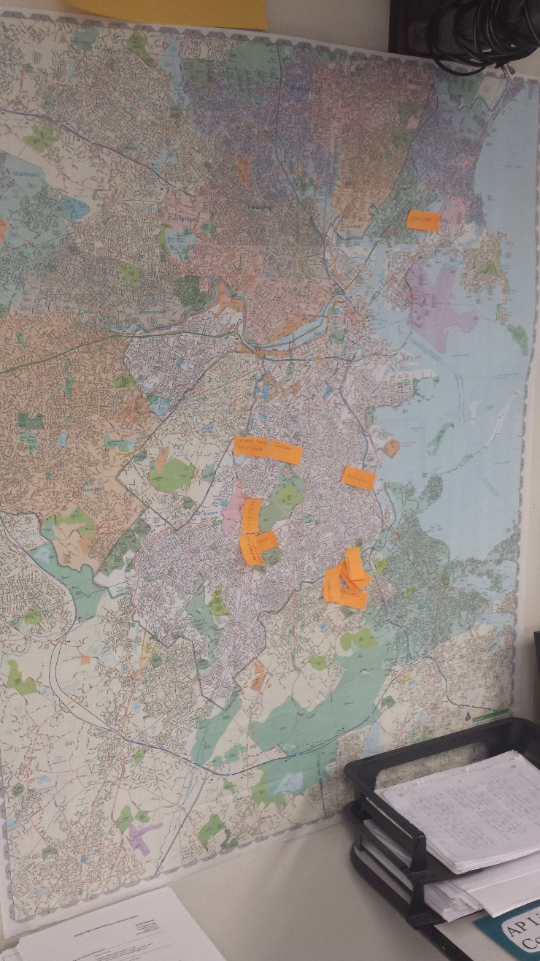
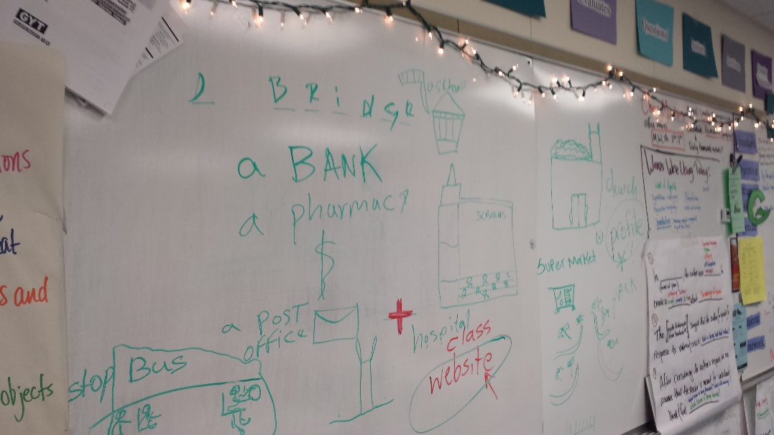
Unfamiliarity with the writing process
Variety of pre, during, post activities

Slide 10
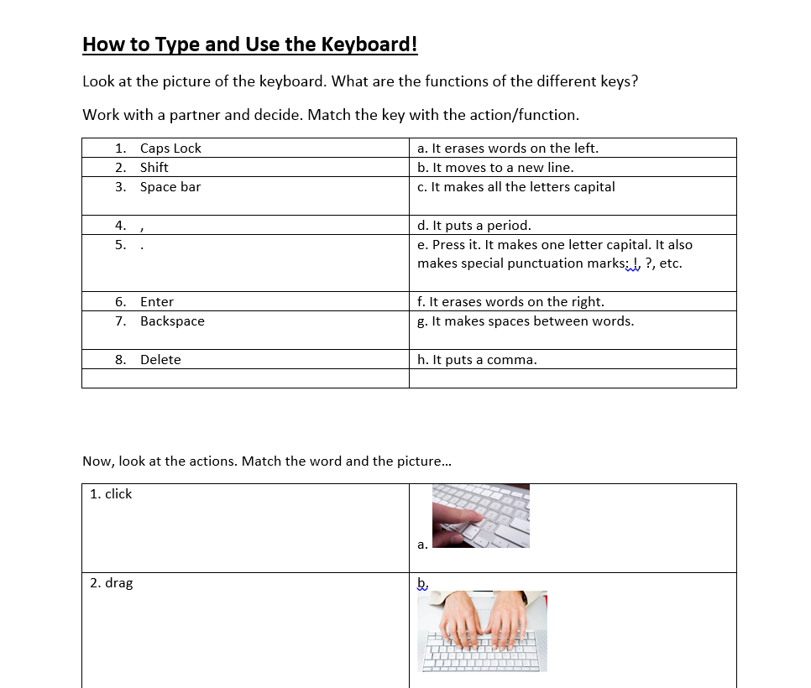
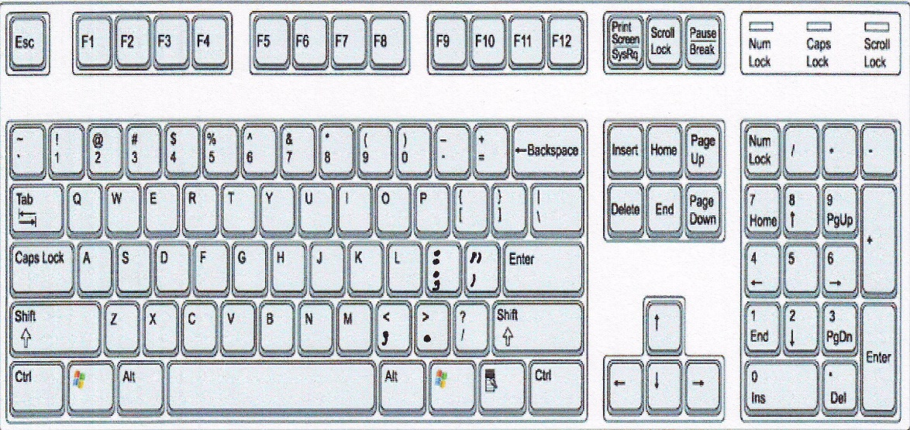
Typing challenges, using the equipment
Lack of vocabulary about technology in L1, L2
Workshop about using the keyboard, labeling parts
Peer-teaching arose, use of vocabulary throughout project

Slide 11
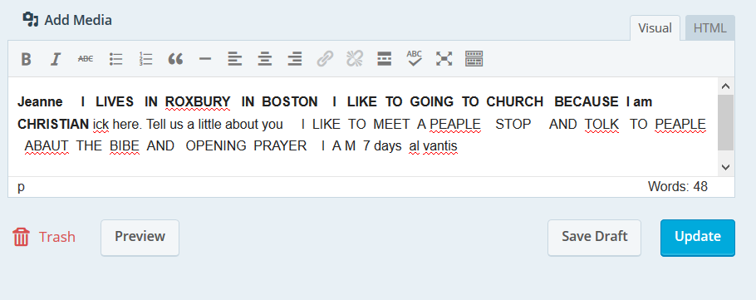
Use of spell check in the editing window was very helpful
Students asked questions about why words were underlined
Self-correction increased

Slide 12
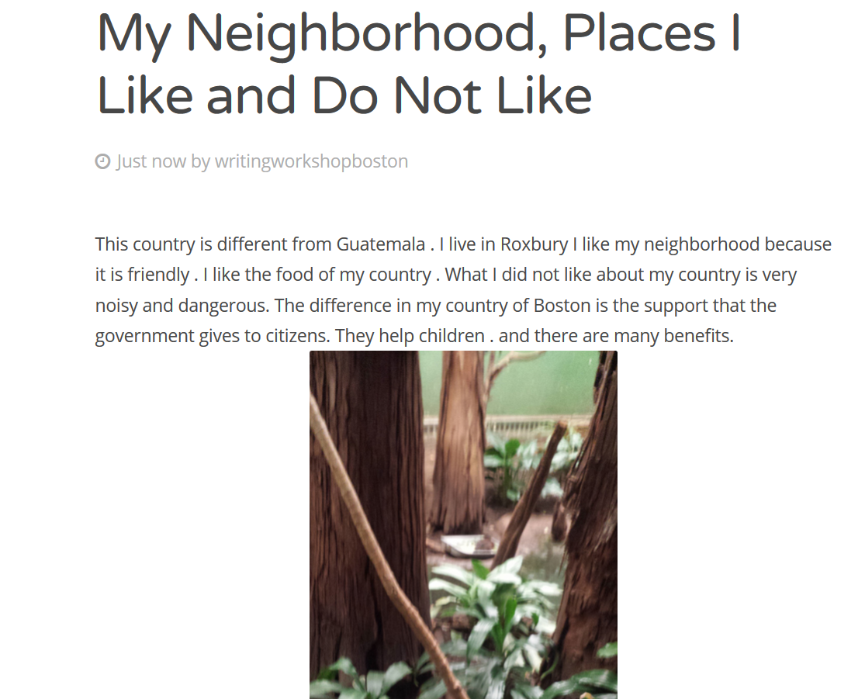
Some students wrote more freely while typing in the lab
Incorporation of freewriting activities at the computer

Slide 13
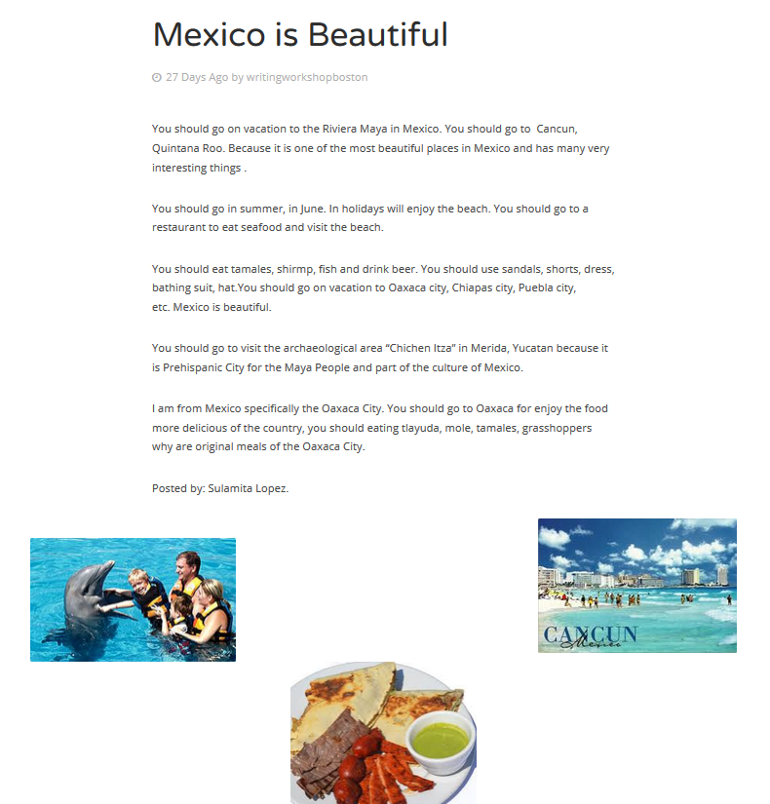
Some students didn’t know how to use Google Image Search
We experimented with using different keywords, search tools
Discussion about citing images

Slide 14
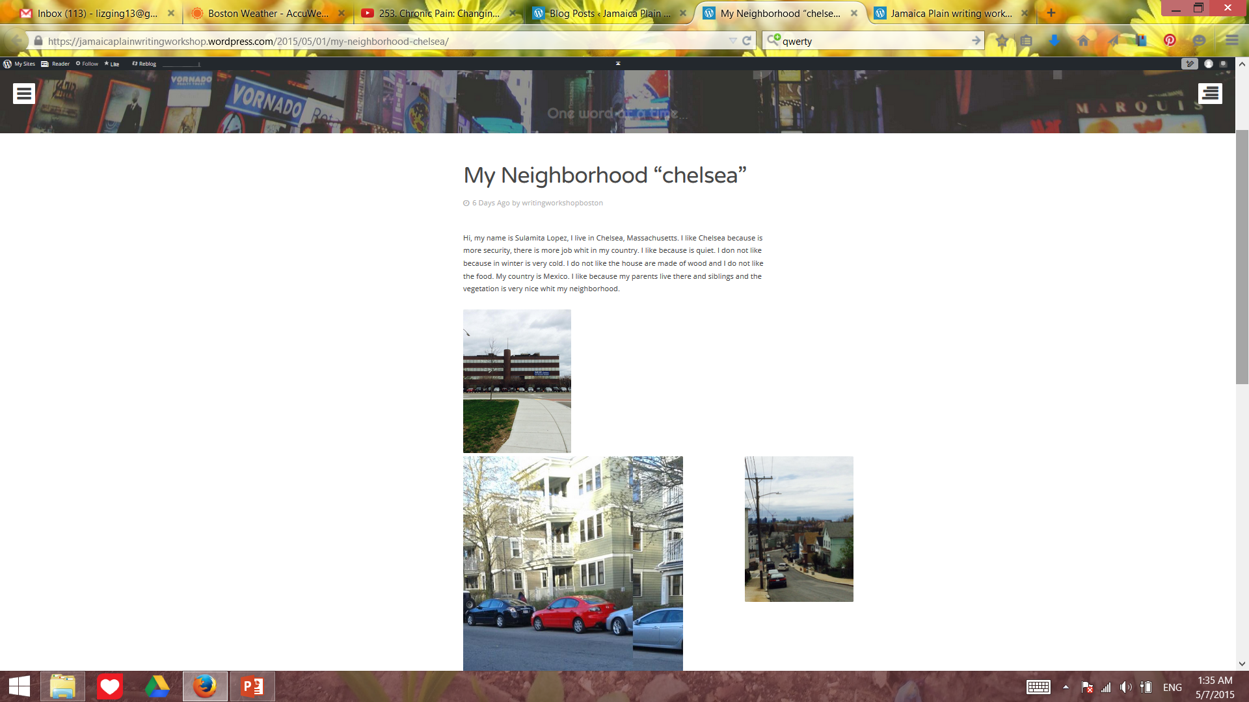
Students were eager to learn how to download photos from their phones
Taking and uploading personal photos was part of the checklist of assignments

Slide 15
Outcomes
Peer-teaching, peer-editing arose organically
New leaders emerged in the class
More independence
Self-correction
Meta-linguistic knowledge, students began to describe their own writing process
Increased technological literacy using both L1 and L2
Critical literacy, writing used as a platform for discussion
Strengthened group identity and class unity
Notes:
Reading the World…

Slide 16
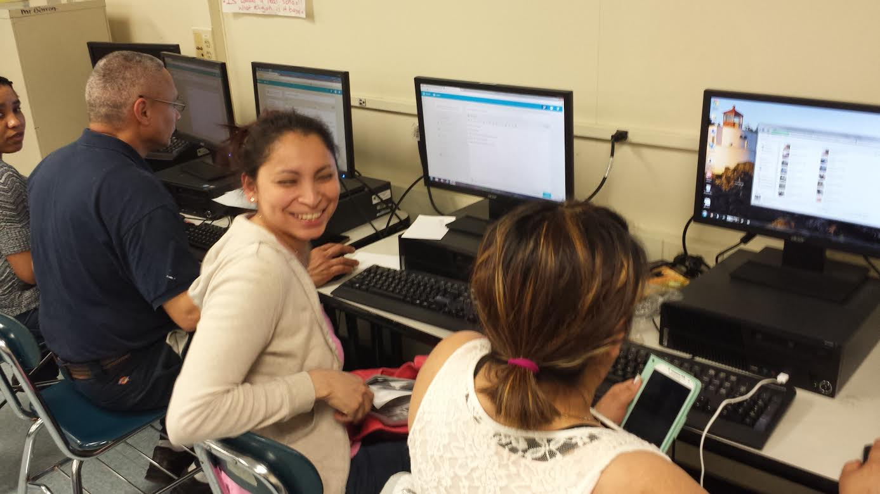
Recommendations
Experiment with a personal blog
Know your priorities and plan accordingly
Usernames/accounts
Prepare additional support materials
How will you walk students through the process? Screenshots, instructions…
Incorporate other forms of media, photos, videos, polls, etc.
Error correction: what is the best approach for your situation?
Publishing immediately vs. saving drafts
Encourage creativity
Be patient…wait for the spark to catch fire!

Slide 17
Thank you!
Liz Ging
Roxbury Community College and Jamaica Plain Community Centers Adult Learning Program
lizging13@gmail.com
www.writingworkshopboston.wordpress.com
www.jamaicaplainwritingworkshop.wordpress.com

