Slide 1

Photo by simonbooth - Creative Commons Attribution-NonCommercial License https://www.flickr.com/photos/35237092808@N01
Created with Haiku Deck

Slide 2
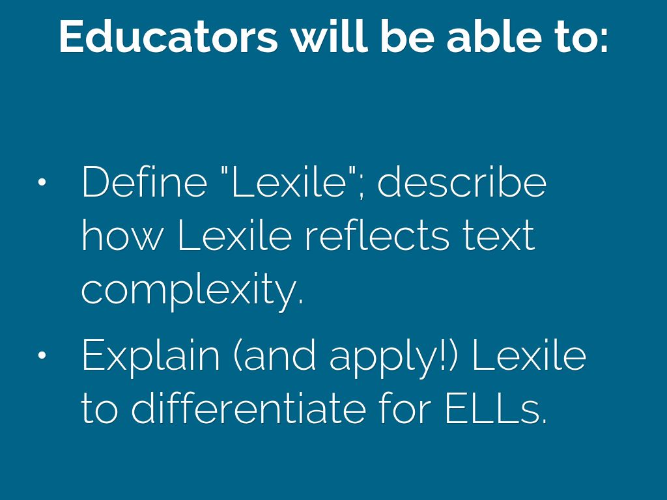

Slide 3

Photo by t3rmin4t0r - Creative Commons Attribution License https://www.flickr.com/photos/46888841@N00
Created with Haiku Deck

Slide 4


Slide 5
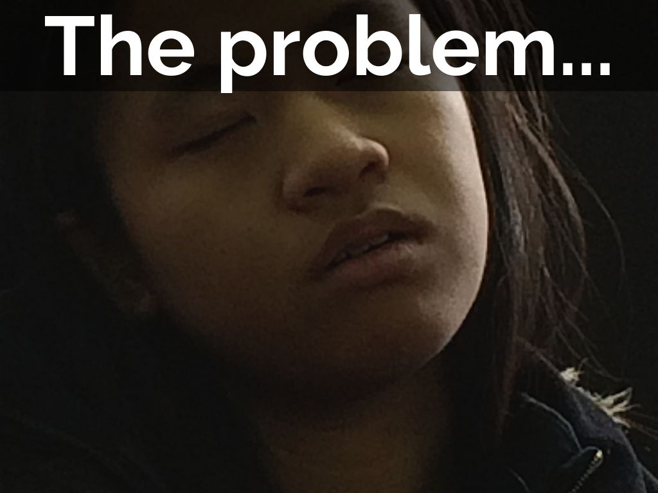
Photo by Ed Yourdon - Creative Commons Attribution-NonCommercial-ShareAlike License https://www.flickr.com/photos/72098626@N00
Created with Haiku Deck

Slide 6
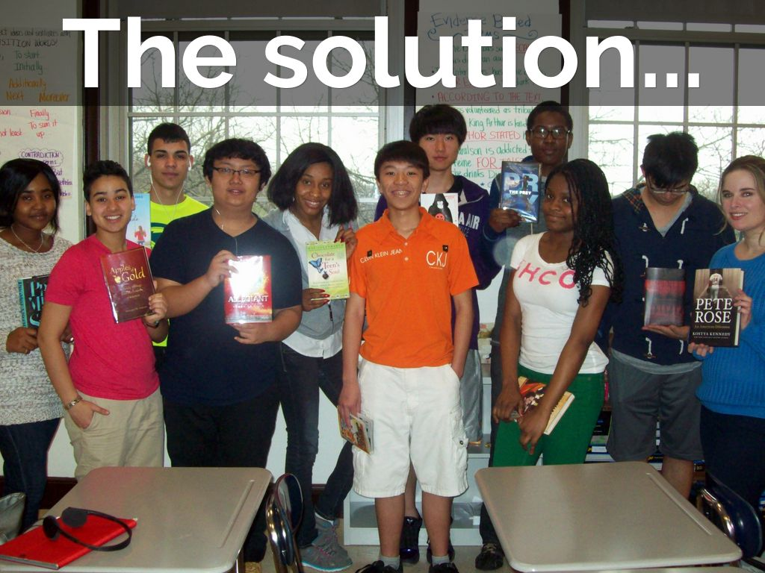

Slide 7
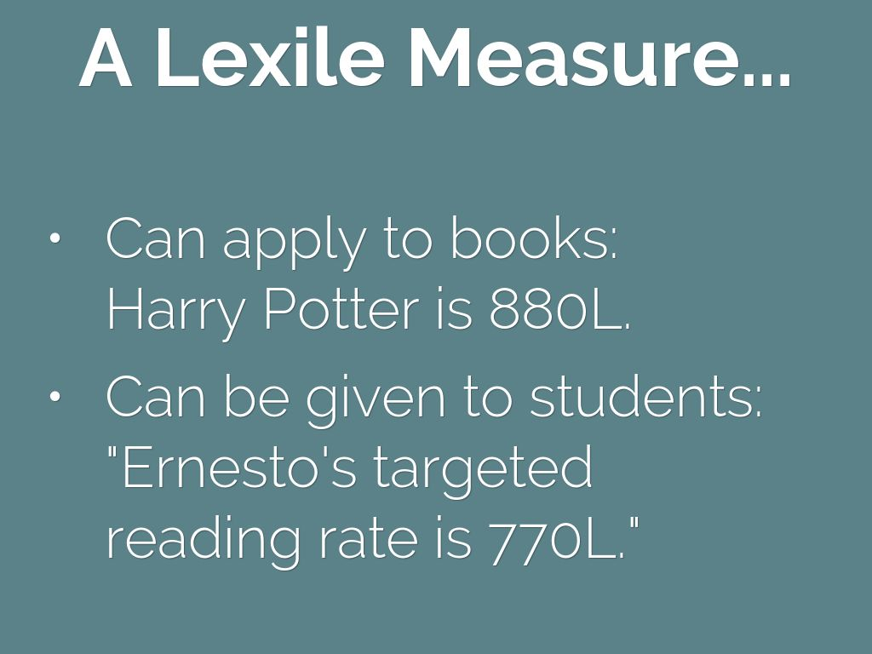

Slide 8


Slide 9
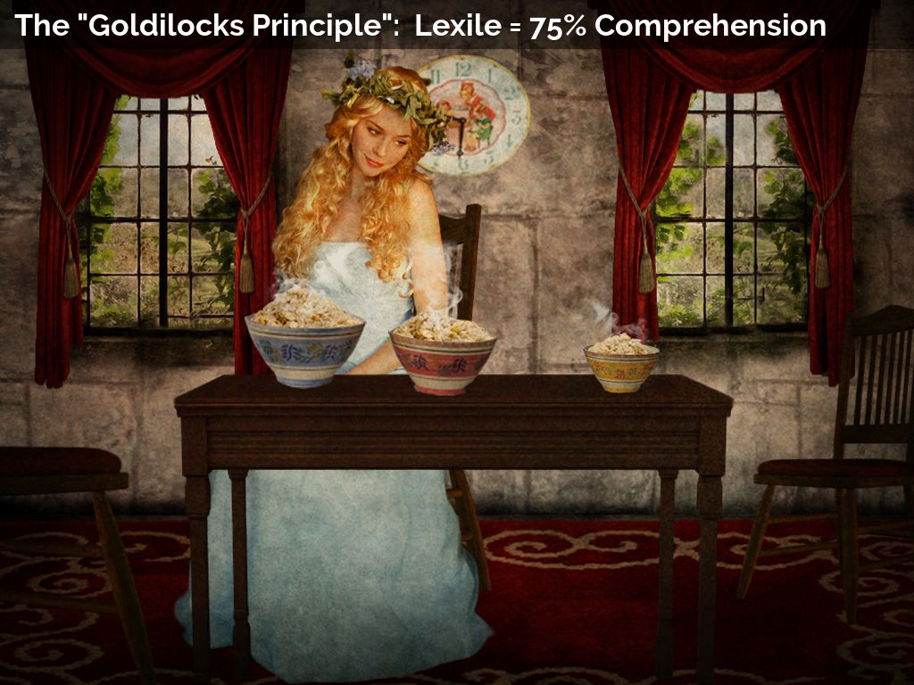
Photo by violscraper - Creative Commons Attribution-NonCommercial License https://www.flickr.com/photos/25297401@N08
Created with Haiku Deck

Slide 10
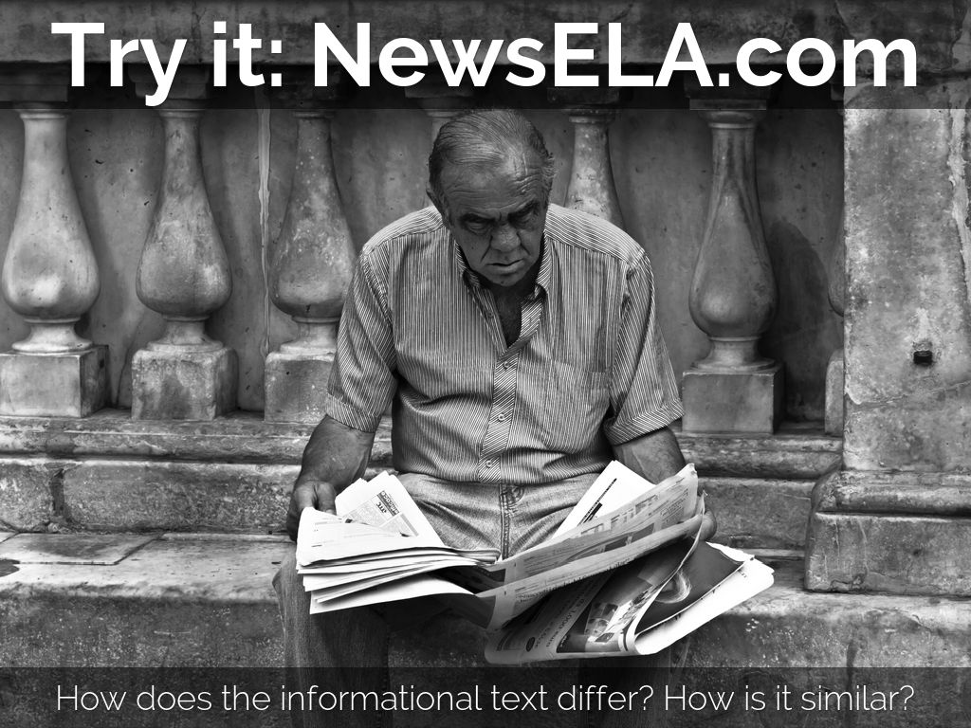
Photo by zilverbat. - Creative Commons Attribution-NonCommercial License https://www.flickr.com/photos/25228175@N08
Created with Haiku Deck

Slide 11
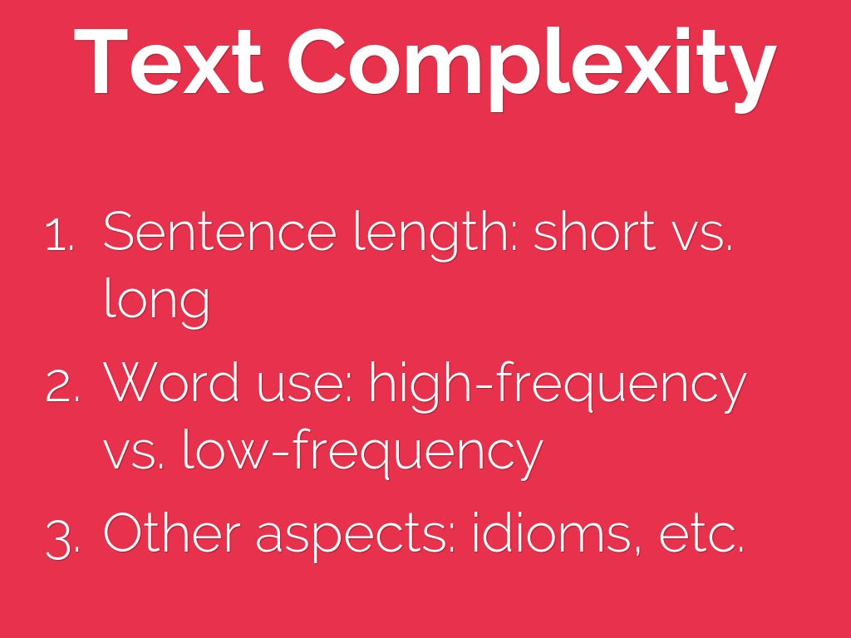

Slide 12
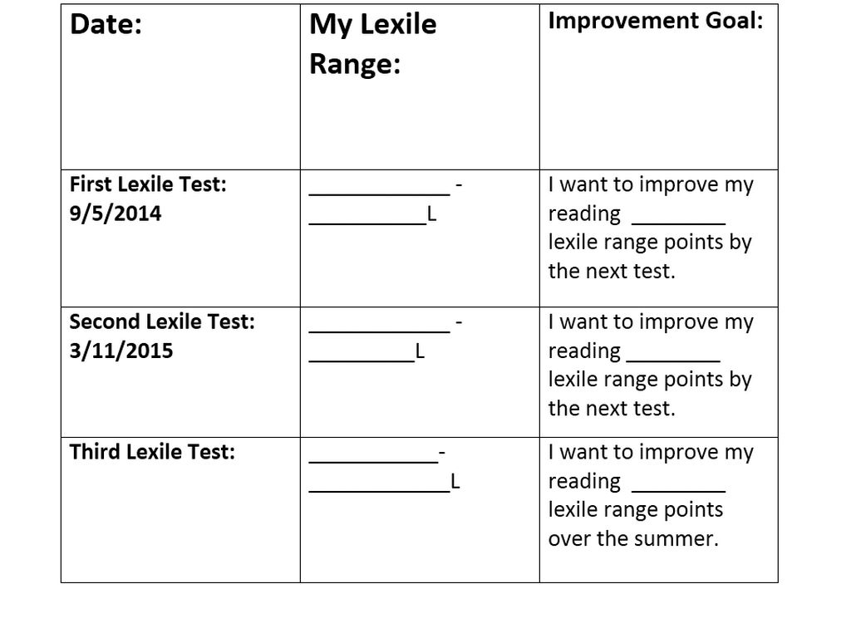

Slide 13
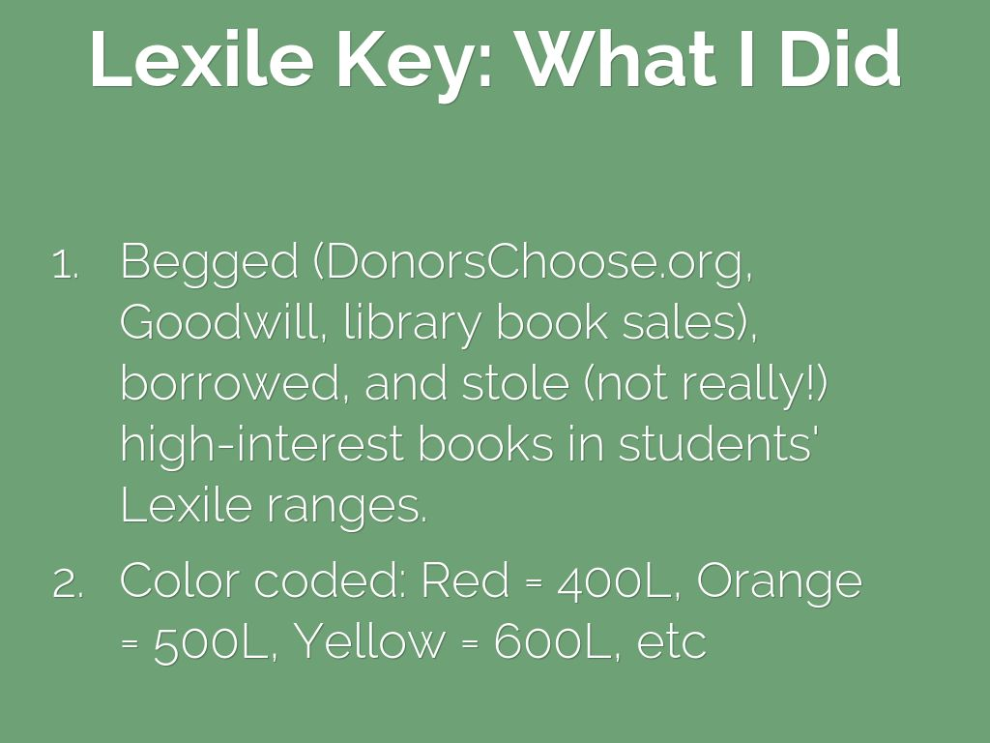

Slide 14
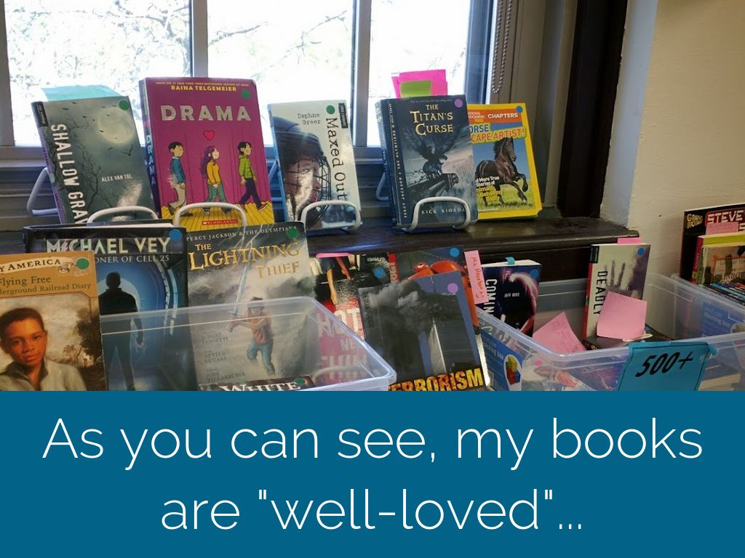

Slide 15
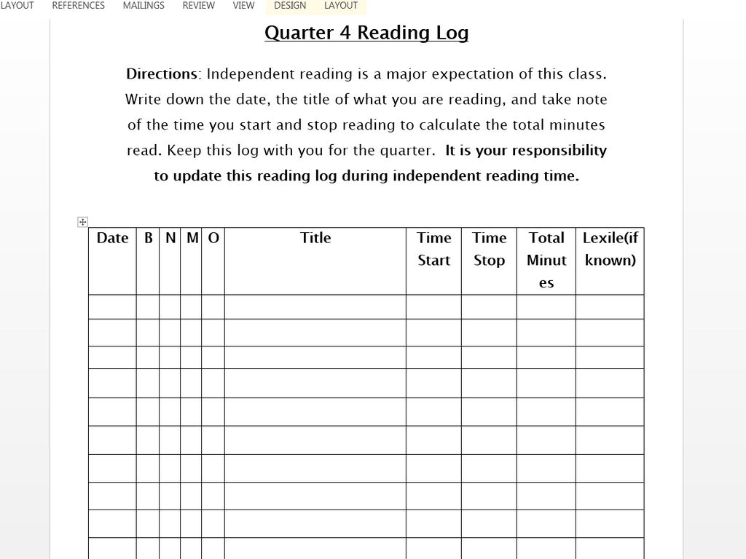

Slide 16
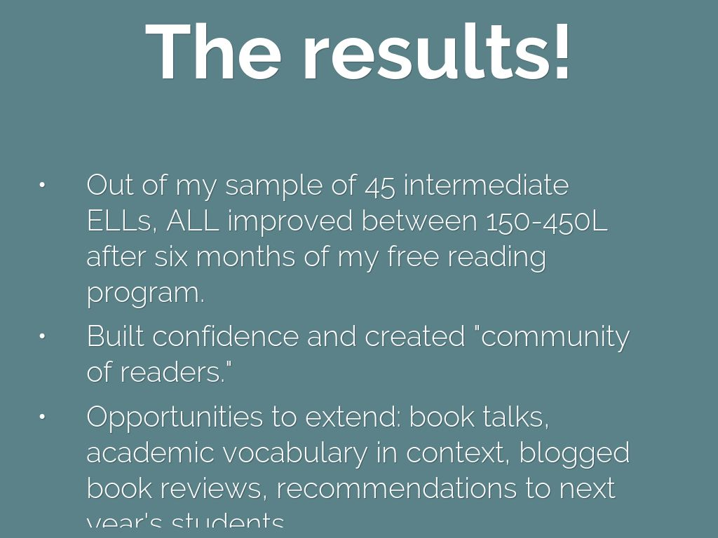

Slide 17


Slide 18


Slide 19

Photo by psd - Creative Commons Attribution License https://www.flickr.com/photos/45581782@N00
Created with Haiku Deck

