Slide 1

Developing Teacher Leadership for Teachers of English Language Learners
Andrea Mercado
Somnath Sinha, Ph. D.
University of Maine
MATSOL
May 7, 2015

Slide 2

Over the past three decades, almost 30 million immigrants have settled in the
U. S.
Retrieved from the Migration Policy Institute, ELL Information Center.
Notes:
http://www.cal.org/resource-center/factoids

Slide 3

By 2030, immigrants will make up over 20% of the U. S. workforce.
Retrieved from National Council of State of Directors of Adult Education.
Notes:
Estimated that by 2030, 40% of school age children in public schools will be classified as English language learners.
http://www.cal.org/resource-center/factoids

Slide 4

English learners represent over 10% of the PreK-12 U.S. student population.
Retrieved from Migration Policy Institute, States and Districts with the Highest Number and Share of English Language Learners.
Notes:
http://www.cal.org/resource-center/factoids

Slide 5

Over one million English learners take the ACCESS for ELLs test annually.
Provided by CAL WIDA team.
Notes:
http://www.cal.org/resource-center/factoids

Slide 6
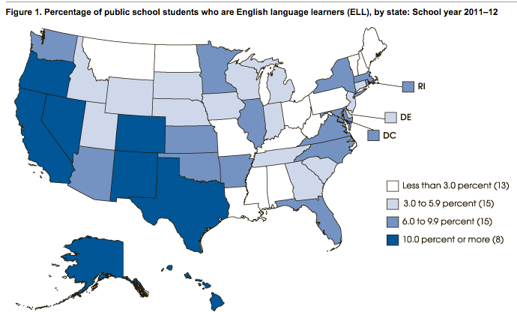

Slide 7
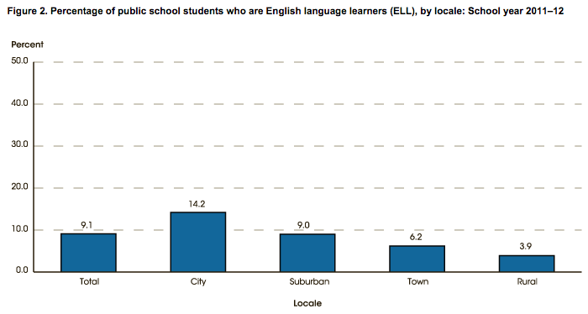
U.S. Department of Education, National Center for Education Statistics, Common Core of
Data (CCD), "Public Elementary/Secondary School Universe Survey," 2011–12

Slide 8
Number and Percentage of School School Students Participating
in ELL Programs
State | 2011-2012 # Students | Percentage
California | 1,415,623 | 23.2
Texas | 722,043 | 14.9
Florida | 234,347 | 8.8
New York | 204,898 | 7.8
Illinois | 170,626 | 8.2
Massachusetts | 62,354* | 7.9
Notes:
From 52,610, 2010-2011 increase 1.2%
Massachusetts Department Elementary and Secondary Education
2014-15 8.5% ELL, 81,246 students (based on 955,844)
First Language not English 18.5%
Teachers in ELL Program Area 1,590 (1/54) in 2013-2014

Slide 9
Why Teacher Leadership?
Teacher leaders are more likely to be trusted by peers
Experienced teachers have mastered shared practices for student success
Resurgence of teacher leadership
(Coggins & McGovern, 2014)
Notes:
“As baby boomers retire and those with less than 10 years experience teaching have become the majority of the teaching force, teacher leadership is experiencing a resurgence in popularity” (NCES, 2008).

Slide 10
And…
Teacher leadership has long been recognized as a crucial ingredient for improvement of school education (York-Barr & Duke, 2004).
Presently, teacher leadership has re-emerged with much greater importance due to various educational reforms and accountability (Harrison and Birky, 2011)

Slide 11
Research and Teacher Leadership
teacher leadership as seen through the eyes of practitioners and administrators
(Angelle & DeHart, 2011; Collay, 2006; Emira, 2010)
characteristics and influences of various teacher leadership degree courses
(Leonard, Petta, & Porter, 2012)
the influence and relation of school principals and teacher leadership
(Carver, 2010; Ghamrawi, 2011)
what factors influence leadership growth and construction of leadership identities
(Howe & Stubbs, 2003; Lewthwaite, 2006; and Kenreich, 2002)
Notes:
Much of previously research in the area of teacher leadership looks at these factors

Slide 12

  Very little is known about the process by which teachers become leaders.
  (Harris & Muijs, 2002; Komives, Owen, Longerbeam, Mainella, & Osteen, 2005; Lewthwaite, 2006; Martinez, 2004; York-Barr & Duke, 2004).

Slide 13
Research Questions
  How do teachers with various years of teaching experience develop as ‘teacher leaders’?
    Through what processes and pathways do teachers develop their identity as teacher leaders?
    What differences or commonalities with regard to their leadership practices, if any, are evident for teachers with varying years of teaching experience?

Slide 14
Theoretical Framework: Identity
An individual’s identity, besides her/his self-perception is the amalgam of unique personal features – the way those are presented and comprehended by others. This self-perception is also informed by the view others hold about that particular person. Moreover identity is not something static; rather it is dynamic in nature and grows/ changes with passage of time and also depending upon situational factors.

Slide 15
Brandon
“How do I see myself as a leader? I just try to lead by example”
  Charting new territories
    Applying experiences from business world to teacher leadership
      “The leadership aspect of the program was actually something I had already done in different fields of my life. I had owned and operated a successful business, managed a successful business for another individual, and worked for state government.”
  Leading within the classroom→ Colleagues
    Raising the bar of expectations for students
    Promoting use of technological tools

Slide 16
Brandon
Identity
I was a leader in the business world
I don’t have much experience as a teacher
I am not confident
in my ability to lead other experienced teachers
I don’t hold a leadership position
Practices
Taking part in professional development and school reform efforts
Views
Leadership requires a formal position
Leaders in schools are principals, school board members, etc.
What I’m doing isn’t ‘leadership’
Notes:
Exmple of Martin of empowering others as leaders
Example of Brandon of communication

Slide 17
Elisa
“I see myself as a more capable person and I think that’s both in being a teacher and being a colleague of a group of teachers and also a leader of a group of teachers”
  Leading from ground Up
    Leadership followed by classroom success
      “How can I be a leader if everyone else seems to have kids who are doing so well and mine are in academic support so often?”
  Leading within the class and school
    Science Crew program.
    Mentoring colleagues.

Slide 18
Elisa
Identity
I was uncomfortable as an army leader.
I am a teacher and don’t want to go out and lead formally.
I am not confident
in leading until my students are doing their best and others find me credible
I am a teacher and leadership is not part of my daily work; I don’t have a position of authority
Practices
Made professional presentations and collaborating with colleagues.
Views
Leadership requires a formal position
Leaders only give direction and always lead from front
I am not leading a group or taking charge, so I am not practicing ‘leadership’
Notes:
Exmple of Martin of empowering others as leaders
Example of Brandon of communication

Slide 19
Martin
“I saw that I could be a leader, I saw those opportunities and then I think may be more than anything just confidence-- that my confidence as a teacher leader grew”
  Leading by re-envisioning opportunities
    Change in leadership views helped identify opportunities for leadership for himself and others
      “I did not recognize in the past working with other teachers …collaborating with peers, presenting ideas at faculty meeting… [as] opportunities to be a leader”
  Leading outside the school
    Serve on district planning committee.
    Member of district-wide Assessment for Learning leadership team.
    Empowering others to lead.

Slide 20
Martin
Identity
I am just a teacher and football coach
I am a ‘position filler’
Teachers don’t have many opportunities to lead except formal positions
I am teaching, not ‘leading’
Practices
Conducted staff training on the use of smart boards.
Views
Leadership is hierarchical in nature.
Leaders expect others to follow them blindly with out any question.
I carry out my roles in various positions as mere ‘jobs’; there are not opportunities to lead
Notes:
Exmple of Martin of empowering others as leaders
Example of Brandon of communication

Slide 21
Cross Case Analysis
Similarities
Expansion of Teacher Leadership Views
Expansion of Dimensions of Teacher Leadership Practices
Collaborating with Colleagues
Modeling Oneself After Another Leader
Appreciation and Encouragement
Differences
Leading within and outside the classroom
Building content knowledge/competency
Leadership development priorities
Notes:
Priority of Elisa was to become confident by voicing her opinion, whereas Martin wanted to give PD to his colleagues and he formed a team of peers for observing each other class.

Slide 22
Teacher Leadership Process
Identity
Views
Practices
Teacher leadership taking place
Notes:
Exmple of Martin of empowering others as leaders
Example of Brandon of communication

Slide 23
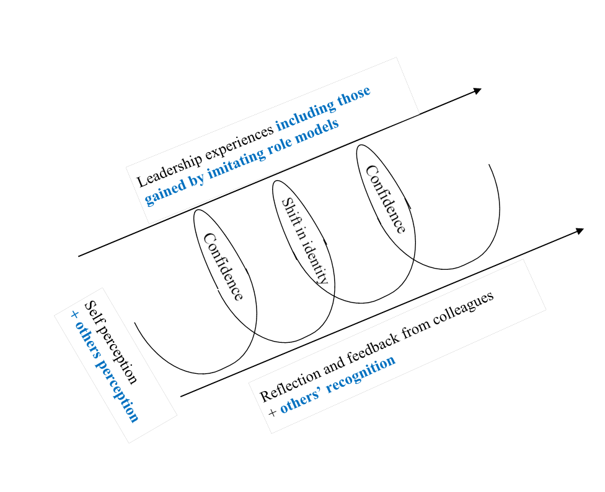
Gonzales & Lambert’s (2001) Model of Identity Development in Teacher Leaders

Slide 24
Implications
Professional Developers
  Broaden teacher leadership views
  Expand awareness of leadership opportunities
  Support them in forging identities as teacher leaders
School Administrators
  Create conducive environment to promote teacher leadership
  Pair up novice teachers with established teacher leaders
Educational Researchers
  Future research to validate process model & examine differences in teachers at various career stages
  Examine how teacher leadership identity is sustained
  Explore extent to which leadership role models are necessary
Notes:
PD program should attend broaden teachers’ leadership views, expand teachers’ awareness of leadership opportunities, and supporting them in forging identities as teacher leaders

Slide 25
SEVEN DIMENSTIONS OF TEACHER LEADERSHIP (YORK-BARR & DUKE, 2004)
Coordination & Management
School or district curriculum work
*PD of colleagues
Participation in School Change and improvement initiatives
*Parent and community involvement
Contributions to the profession of teachers
Pre-Service teacher education

Slide 26
Ten Roles for Teacher Leaders
Resource provider
Instructional Specialist
Curriculum Specialist
Classroom Supporter
Learning Facilitator
6. Mentor
7. School Leader
8. Data Coach
9. Catalyst for change
10. Learner
(Harrison and Killion, 2007)
Notes:
Harrison, C. and J. Killion. (2007). Ten Roles for Teacher Leaders. Educational Leadership. 65 (1), 74-77.

Slide 27
What do Teacher Leaders do?
Build trust and develop rapport
Diagnose organizational conditions
Deal with processes
Manage the work
Build skills and confidence in others
http://www.sedl.org/
Notes:
http://www.sedl.org/change/issues/issues44.html

Slide 28
NEA TEACHER LEADER STANDARDS | Teacher Leader for ELLs
Domain I: Fostering a collaborative culture to support educator development and student learning | Domain I: Fostering a collaborative culture to support educator development and student learning
Domain II: Accessing and using research to improve practice and student learning | Domain II: Accessing and using research to improve practice and student learning
Domain III: Promoting professional learning for continuous improvement | Domain III: Promoting professional learning for continuous improvement
Domain IV: Facilitating improvement in instruction and student learning. | Domain IV: Facilitating improvement in instruction and student learning.
Domain V: Promoting the use of assessments and data for school and district improvement | Domain V: Promoting the use of assessments and data for school and district improvement
Domain VI: Improving outreach and collaboration with families and community | Domain VI: Improving outreach and collaboration with families and community
Domain VII: Advocating for student learning and the profession | Domain VII: Advocating for student learning and the profession

Slide 29
Domains of Teacher Leader
1- Understands adults as learners to support professional learning communities
Facilitates group processes for problems solving, decision making and promoting change
Creates shared resources and builds trust among colleagues
(Baecher, 2012)

Slide 30
Domai
3. Promoting professional
learning for continuous improvement
Identifies and promotes professional learning based on colleagues needs
Provide colleagues with feedback for improved teaching practice and student learning
(Baecher, 2012)

Slide 31
Domai
4. Facilitates improvements in instruction and student learning
Leads teams to harness colleagues skills, expertise and knowledge
Supports colleagues growth by mentoring, coaching content facilitator, peer evaluator
(Baecher, 2012)

Slide 32
Domai
5. Using assessment and data for school and district improvement
Works with colleagues to use assessment and data findings to for potential changes in organization or practice
Facilitates teams of teachers in scoring and interpreting student performance
(Baecher, 2012)

Slide 33
Dom
6. Improving outreach and collaboration with families and communities
Facilitates colleagues’ self examination of their own understandings of community culture and diversity
Uses knowledge of different backgrounds, ethnicities, cultures and languages to promote effective interactions with families
(Baecher, 2012)

Slide 34
Domai
7. Advocating for student learning and the profession
Represents the profession in contexts outside of the classroom
Advocates for the rights and needs of students, to secure additional resources for learning
(Baecher, 2012)

Slide 35
Key Areas for ELL Teacher Leaders
Sociocultural context and bilingual foundations of education
Second language acquisition process
Instructional methods of teaching ELLs
Assessment modifications of ELLs
(Baecher, Knoll & Patti, 2013)

Slide 36
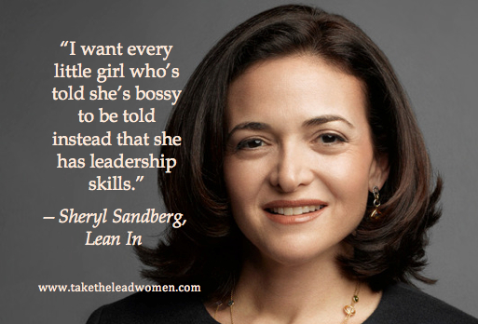
Notes:
I want to tell every teacher working in our schools, he/she has leadership skills.
With these statistics as a former ELL and current teacher, I want to find ways to encourage and “recruit” teachers of ELLs who are willing to take charge and lead in their organizations and communities as well, upper level administration and decision making and in policy development.
https://cdn.evbuc.com/eventlogos/78458493/sherylgraphic.jpg

Slide 37


Andrea Mercado
Andrea.mercado@maine.edu
Somnath Sinha, Ph. D.
somnath.sinha@maine.edu

